Slide 1
Leveraging Canvas for Program Assessment Across Modalities
Samantha Earley and Karri Hamlett-Bedan
INDIANA UNIVERSITY

Slide 2
Introduction

Slide 3
Comparable Features in Other Learning Management Systems
Introduction
Moodle
Blackboard
D2L Brightspace

Slide 4
Presentation Outcomes
Leveraging “Outcomes” Assessment Rubrics
PO #1: Strategize aligning programmatic outcomes
PO #2: Describe how to use LMS tools to assess programmatic outcomes in real time
PO #3: List ways to engage faculty/administrative buy-in

Slide 5
Strategize Aligning Programmatic Assessment
Presentation Outcome #1:

Slide 6
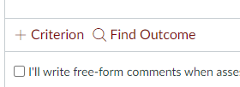
Alignment Steps
Strategize Aligning Programmatic Assessment
Program Outcomes, module outcomes, assignments, outcome assessment rubrics
Shared rubrics vs. shared assignments
Placement of assessments

Slide 7
Rationale
Strategize Aligning Programmatic Assessment
Optimize retrieval practices for direct evidence of student learning across program—in multiple modalities
“Ready to use” system for associate faculty
Easy lead-in to feedback loop for program improvement
Transparency and ease of reporting data

Slide 8

What Program at Your University is Ready to Use “Outcomes”?
Major/Collaborative Programs
First Year Seminar
General Education
Capstone Courses (across majors)
Other—please list

Slide 9
Use Canvas “Outcomes” Tool to Assess in Real Time
Presentation Outcome #2:

Slide 10
Canvas “Outcomes”
LMS Tools
Direct evidence of student learning
Shared assignments or shared outcomes rubrics
Data for feedback loop for program improvement
Transparency in reports for faculty, administration, accrediting bodies

Slide 11
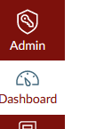
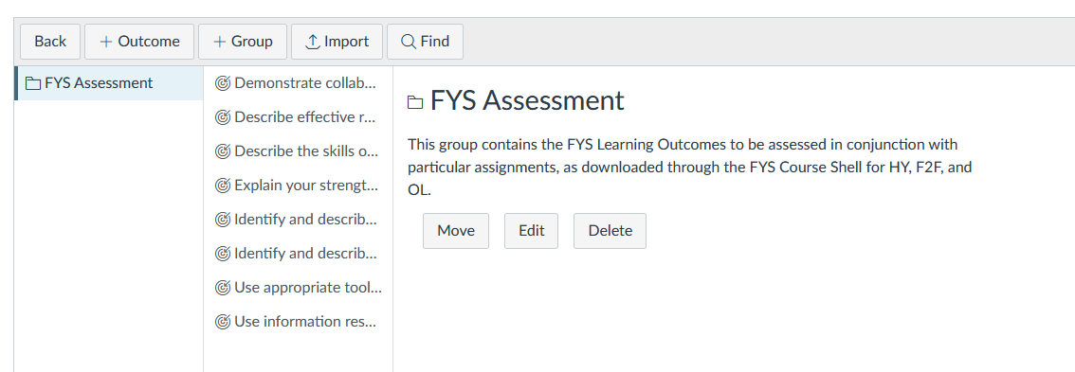
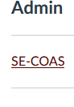

Administrative Person Inputs Outcomes in Canvas

Slide 12
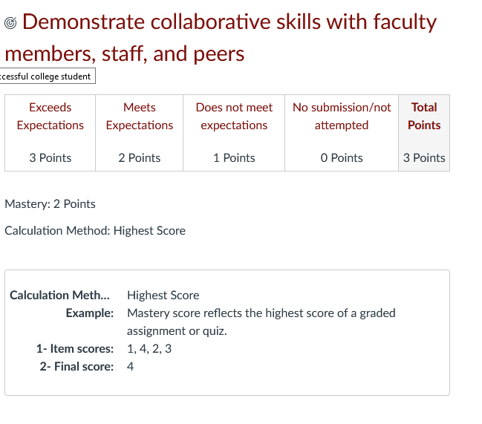
And Inputs or Builds Rubrics

Slide 13
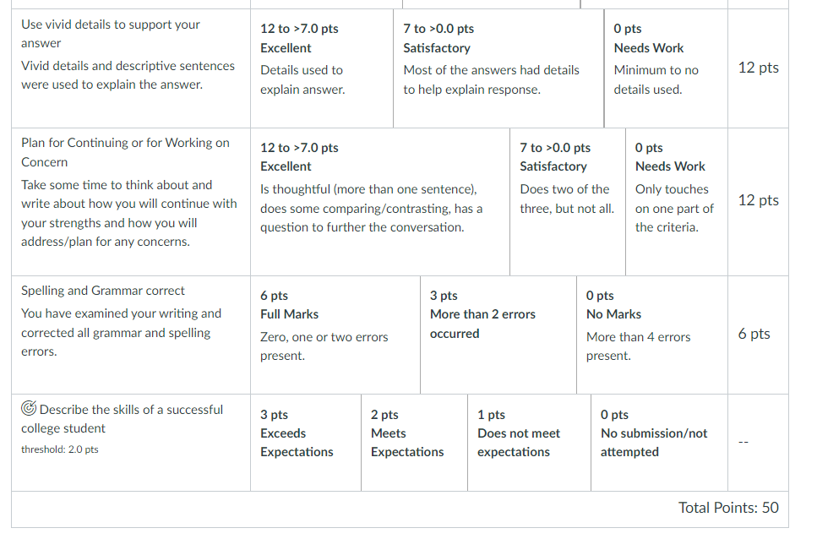
Instructors Attach Rubric to Assignment Where Outcome Is Measured

Slide 14
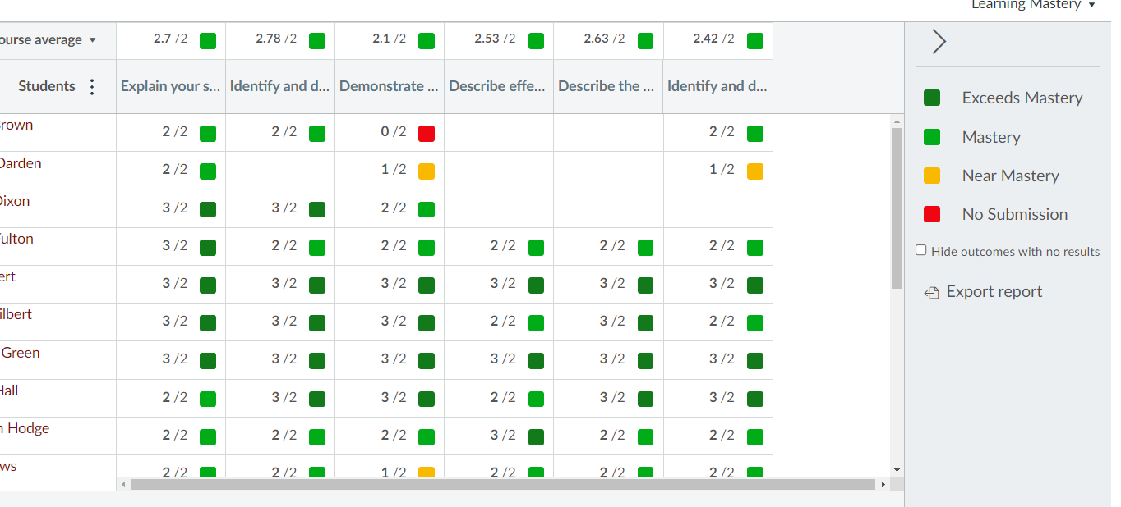
Instructor Can Run Report for Their Own Section

Slide 15
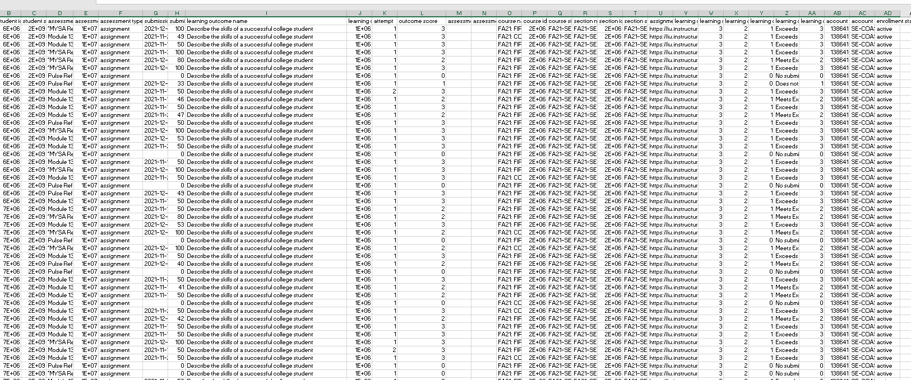
Admin Can Run Report for the Whole Program

Slide 16
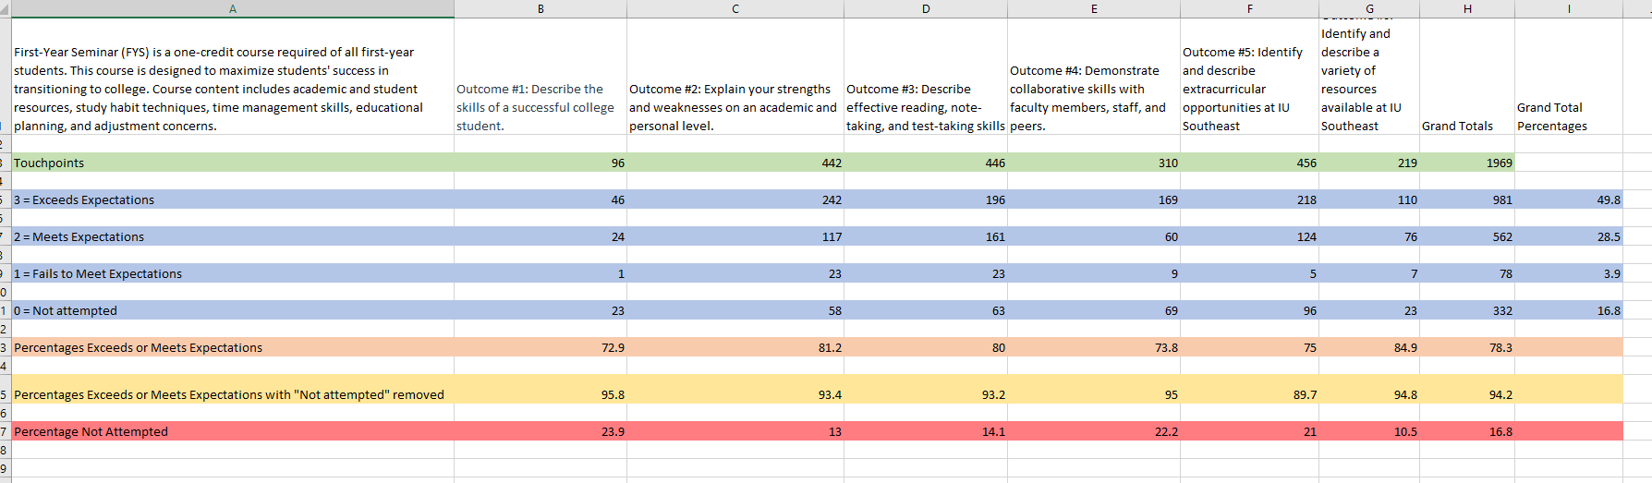
Program Assessment Data for FYS—Direct Evidence of Student Learning

Slide 17
In Your Program: Shared Assignments or Shared Rubrics?
Shared assignments
Shared rubrics
Both shared assignments and shared rubrics
Still working on shared Outcomes
Not quite there yet/Didn’t know this feature existed

Slide 18
List Ways to Engage Faculty Buy-In
Presentation Outcome #3:

Slide 19
Selling Points
Faculty and Administrative Buy-In
Set up system, then retrieve across platforms and semesters
Faculty collaboration—common assignments, common rubrics, or both
Maximum use of data—individual section reports and larger program reports
Creates an easily transferable “package” of data that can be shared with Office of Institutional Research for further analysis
Doesn’t require any software purchase to collect assessment data!

Slide 20
Best Faculty Buy-In Strategy?
Look at all this great direct evidence of student learning! (Faculty Annual Reports)
Wow! An easy way to do program assessment! (Program Assessment Reports)
Look at these amazing graphs! (Easy visualization)
The data! The data! The data! (Excel tables galore)
Other—please list

Slide 21
Q & A

Slide 22
Potential Questions
Q & A: Discussion
How long did it take to get buy-in to do program assessment this way? What were the sticking points?
How hard is it to get faculty to use the Outcomes rubrics, if all of them don’t use the same assignments?
How do I input Outcomes data for an assessment/activity that takes place outside of the LMS (hybrid, face-to-face, etc.)?

Slide 23
We would love to hear from you about the process at your school!
Samantha Earley searley@iu.edu
Karri Hamlett-Bedan khamlett@iu.edu

