Slide 1
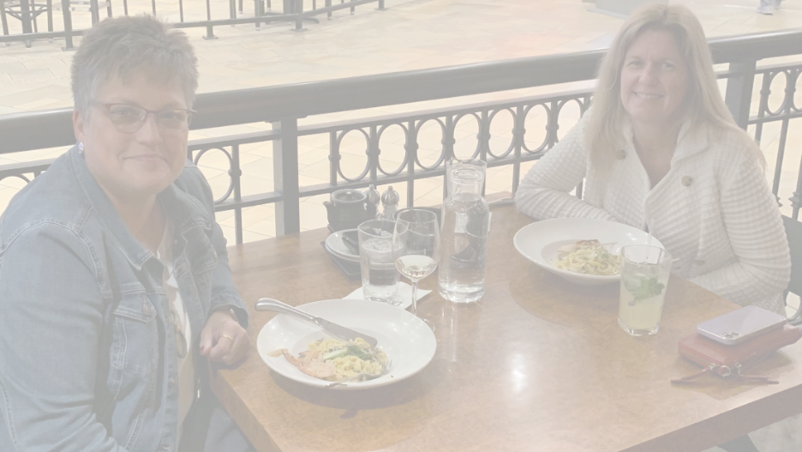
Cooking up Quality Feedback in Online Instruction
Amy E. Lyn, PhD
Executive Director
Teaching, Learning, and Distance Education
Grand Rapids Community College
Part-Time Associate Professor
National University
Katie Buvoltz, PhD
Associate Director
Faculty Support and Development
Associate Professor SCOE
National University

Slide 2
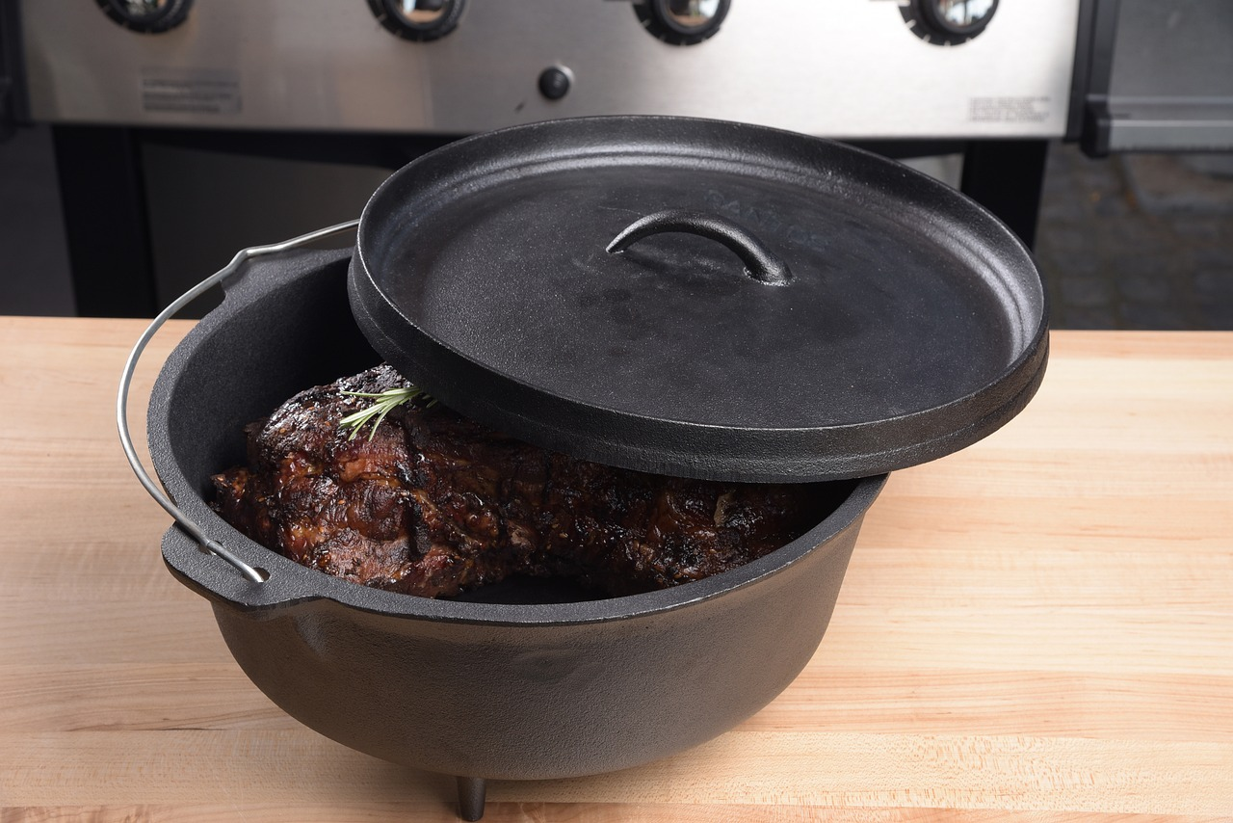


Why do we do what we do?

Slide 3
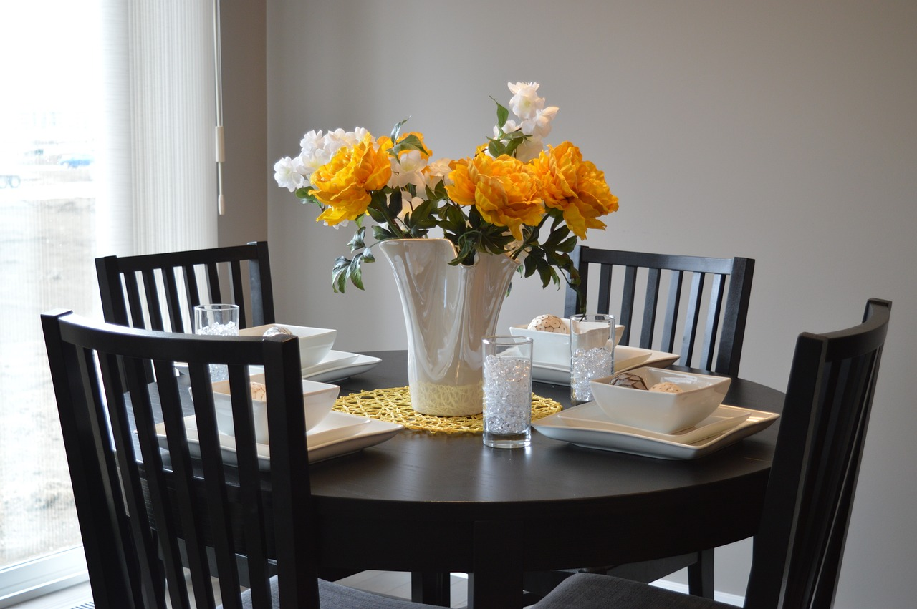
Cultivate relational trust and motivation through empathic feedback.
Explore options for multimodal feedback.
Provide quality feedback for an online assignment.

Slide 4
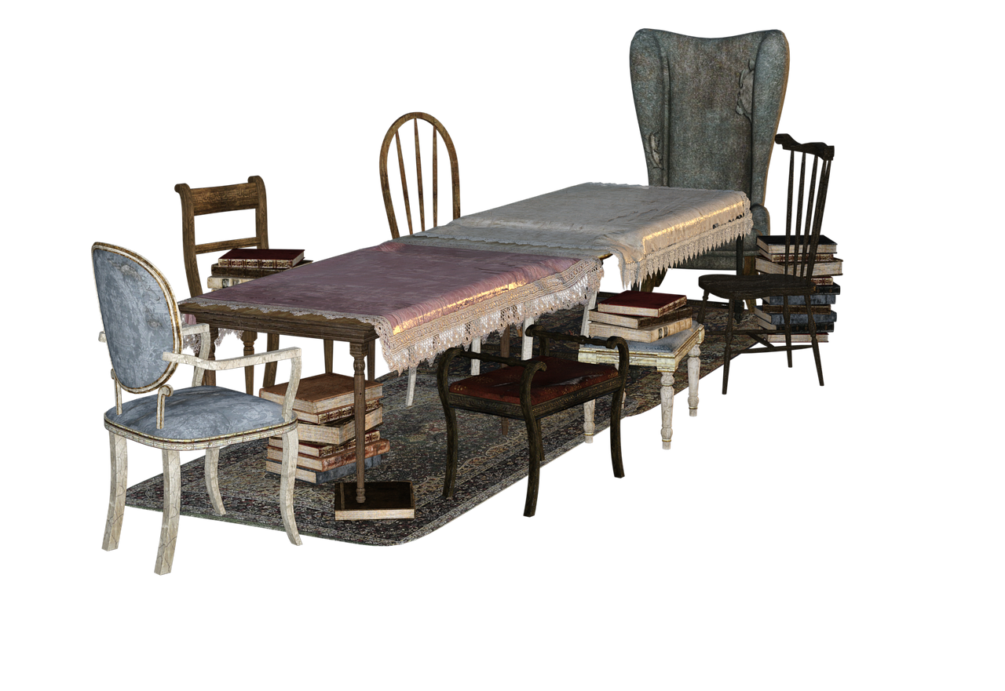

Slide 5
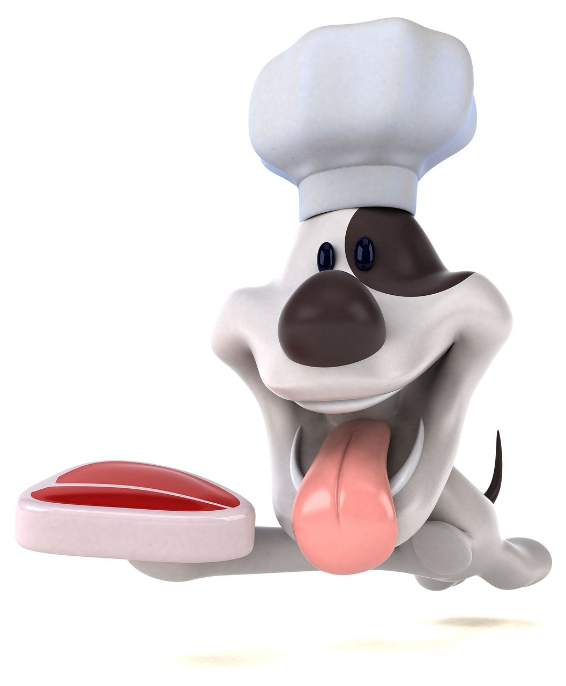
Feedback that Makes you Hungry for More!
Critique Protocol
Critical Friends
Wise Criticism
(Cohen, 2022; Costa & Kallick, 1993; Senge, 1990; Vaughn et al., 2024)

Slide 6

Wise Criticism
  Builds trust in educators
  Increases motivation to incorporate feedback
  More likely to persist
  Decreases conduct issues
  Can change life trajectory!
(Cohen, 2022; Cohen, Steele, & Ross, 1999; Yeager et al., 2014)

Slide 7
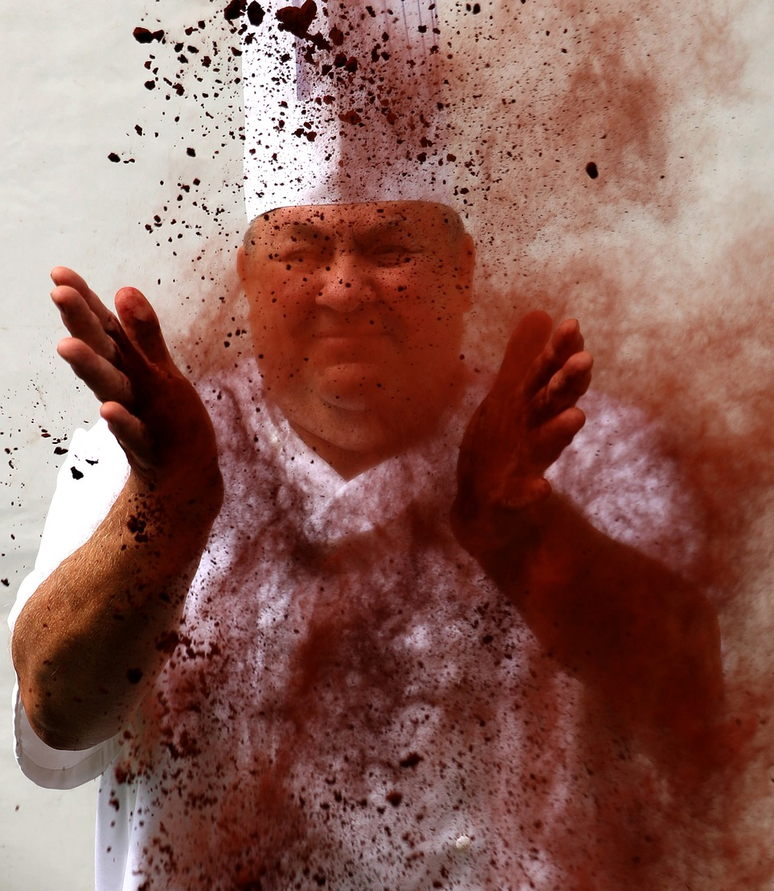
Wise Criticism
I can see you took this assignment seriously.
(I know this is important to you.)
I'm giving you this feedback because I have high expectations.
I know you can do it.
(Cohen, 2022)

Slide 8

Layering Feedback for Enhanced Flavor and Satisfaction!
Feedback = Teaching
Multimodal feedback enhances learning
Multimodal feedback aids application
Multimodal feedback enhances instructor-learner relationship

Slide 9
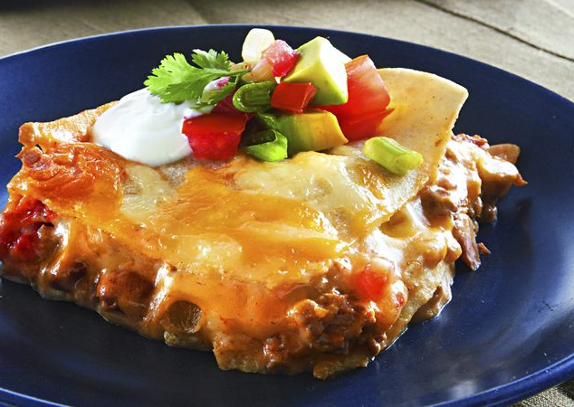
Feedback Examples
Goal: Layered feedback with wise criticism and varied modalities.

Slide 10
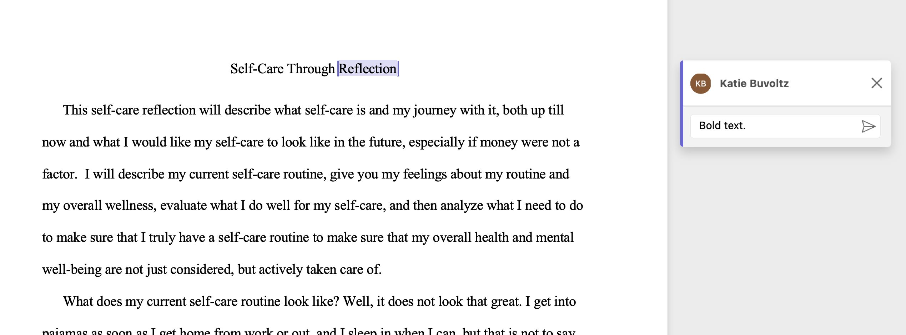

Slide 11
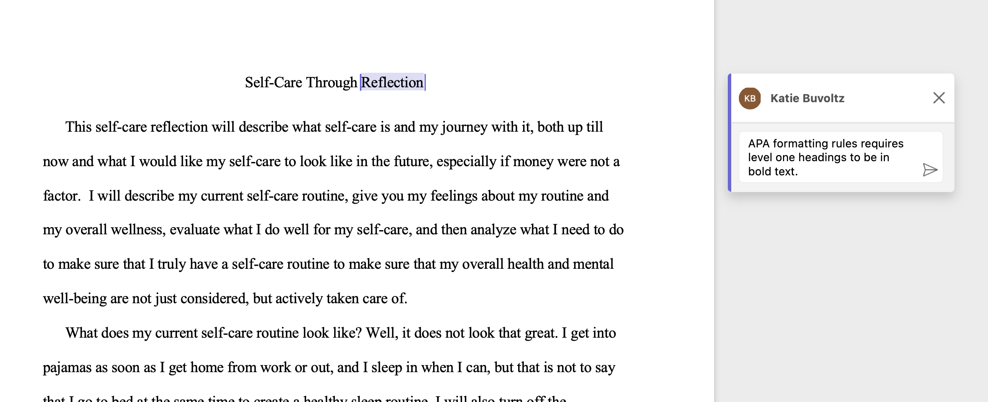

Slide 12
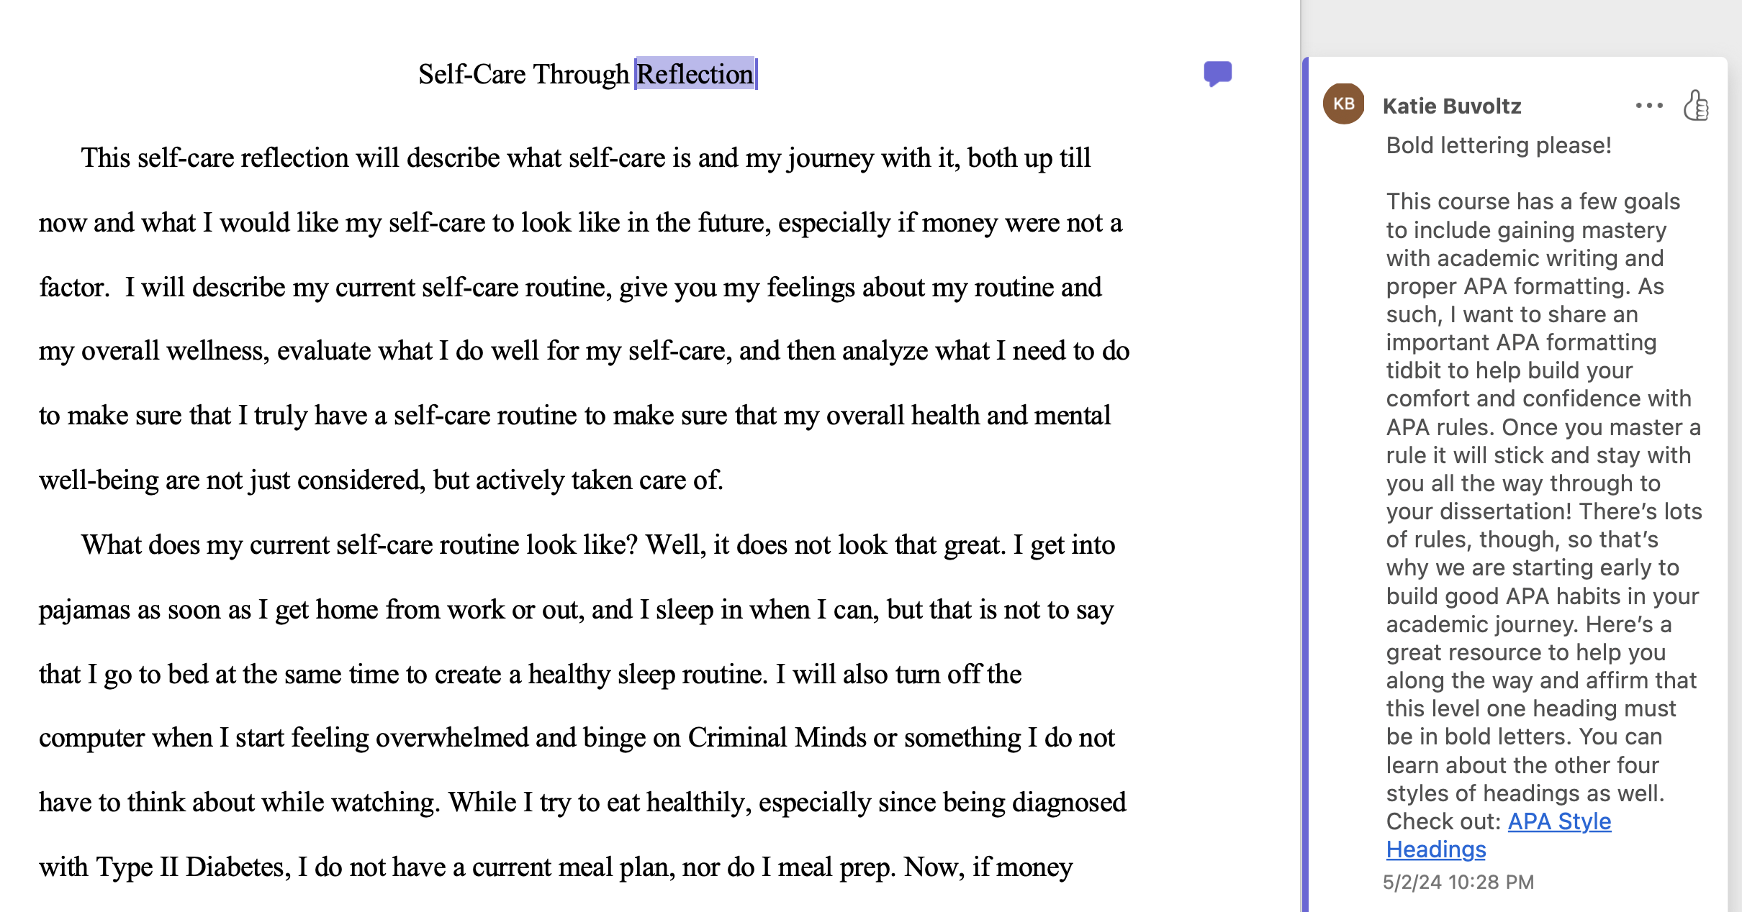

Slide 13
Multimedia and Wise Criticism Feedback
Check out more HERE.

Slide 14
Feedback Example
Multimodal feedback allows learners to pause and revise and play again or revisit the feedback later.
Multimodal feedback layered with wise criticism is encouraging and motivating for learners.

Slide 15

Now It’s Your Turn To Cook!
Assignment: Write a discussion post reflecting on the qualities of an effective leader.
Submission: My teacher was a great leader who made me feel like I belonged. I enjoyed our class and participated more often than usual. I think she was a great leader because everyone had fun in class, and we learned a lot.
Please draft one piece of feedback using the wise criticism protocol and share either in chat or verbally.
I can see you took this assignment seriously. (I know this is important to you.)
I'm giving you this feedback because I have high expectations.
I know you can do it!

Slide 16

Thank You!

