Slide 1
Active/Applied Research on Online Learning and
Quality Assurance
February 16, 2023| Online

Slide 2
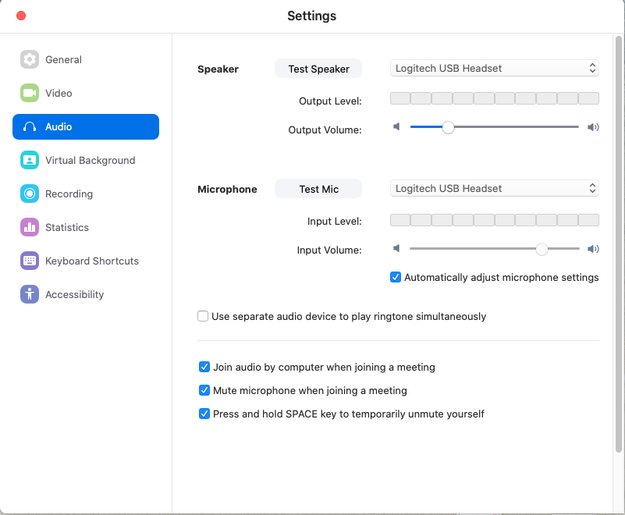

Please Check Your Audio Setup
You will be muted during this session, but please test your speaker.

Slide 3
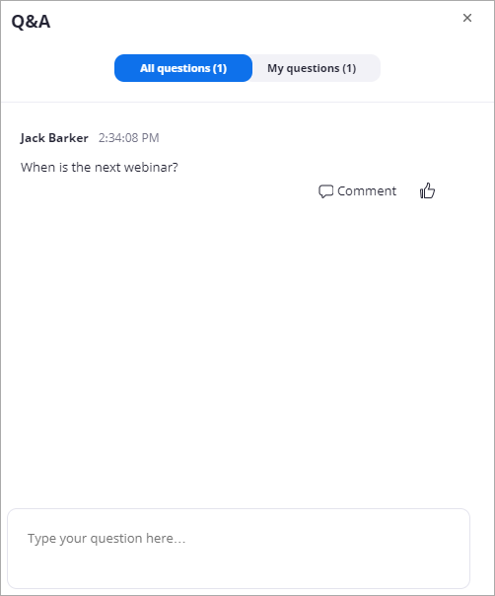
Asking Questions Using the Q&A
Only the host and panelists will see your questions. This is the best way to have your question seen and answered.
Notes:
the session.

Slide 4
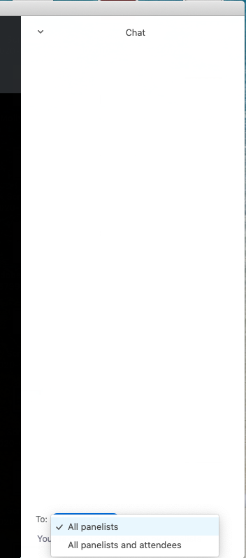
Let’s chat…
Select “All panelists and attendees” so everyone sees your comment.
Notes:
Barbra
To talk with the other attendees, type in the Chat.

Slide 5

@QMProgram
#highered
Share how you’ll
use something
you learned today!

Slide 6
Research Webinar
The Impact of Quality Matters Professional Development on Teaching Across Delivery Formats
Dr. Rae Mancilla, University of Pittsburgh

Slide 7
Session Goals
Recognize transferability of QM Professional Development to various instructional modalities.
Discuss common changes to F2F, online, and blended teaching related to participation in QM workshops.
Identify next steps for research on QM impact.

Slide 8
Background

Slide 9
Research Goals
Do QM professional development workshops have an impact on pedagogical practice in f2f and blended/online teaching modes?
What types of pedagogical changes in their f2f and blended/online teaching practices do instructors report as a result of developing expertise with the QM approach?

Slide 10
What We Know
Developing and teaching an online course gives instructors an opportunity to reflect on f2f teaching.
Participating in a faculty development program for online teaching influenced assumptions about teaching.
Some instructors transfer strategies they use online to their f2f classrooms – “reverse benefits.”

Slide 11
Online Learning in Higher Education
Continued growth for past 14 years
At least 32% of all students taking an online course
Student interest 51% higher post covid
Institutions increasing online staff to meet demand
Allen and Seaman,
2013 & 2014

Slide 12
Methods

Slide 13
Research Goals
Do QM professional development workshops have an impact on pedagogical practice in f2f and blended/online teaching modes?
What types of pedagogical changes in their f2f and blended/online teaching practices do instructors report as a result of developing expertise with the QM approach?

Slide 14
Procedure
Survey to 22,859 individuals
  Must have participated in QM workshop in past 3 years (<2015)
Qualitative and quantitative questions

Slide 15
Sample Questions
Which of the following Quality Matters workshops have you completed? For each workshop you have taken, please rate the extent to which it has influenced your professional/pedagogical practice. (Use this Likert scale: 1–not at all influential, 2–slightly influential, 3–somewhat influential, 4–very influential, 5–extremely influential, NA)
Please identify which of the following impacts you have experienced in your face-to-face teaching practice as a result of learning about the Quality Matters standards.
Please provide a brief description of a specific example or critical moment in your online or blended teaching when you implemented a new teaching strategy, learning activity, or practice as a result of learning about the Quality Matters standards.

Slide 16
Analysis
Descriptive statistics
Inductive and deductive coding
  QM Course Design Rubric Standards
  Multiple coders

Slide 17
Results

Slide 18
Demographics: Response Rate
Response rate: 9.4%
F2F | Online/Blended | Both
87.5% | 88.5% | 80%
n=1878 | n=1900 | n=1720

Slide 19
Demographics: Teaching Experience

Slide 20
Demographics: QM Peer Reviewers

Slide 21
RQ 1: Do QM professional development workshops have an impact on pedagogical practice in f2f and blended/online teaching modes?

Slide 22
Impact on Online/Blended Instruction
 | %
Standard 1: Course Overview and Introduction | 71.3
Standard 2: Learning Objectives (Competencies) | 66.9
Standard 5: Course Activities and Learner Interaction | 63.1
Standard 3: Assessment and Measurement | 58.0
Standard 8: Accessibility and Usability | 57.1
Standard 4: Instructional Materials | 55.1
Standard 7: Learner Support | 46.8
Standard 6: Course Technology | 42.3
None of the Above | 6.3

Slide 23
Impact on F2F Instruction
 | %
Reflected on my teaching goals and objectives | 70.3
Redesigned a learning activity or assessment | 60.0
Became more aware of how I communicate with my students | 50.6
Added and/or eliminated course elements | 47.5
Added between-class activities such as videos, quizzes, and online discussion | 44.3
Restructured the sequencing of course elements | 39.7
Questioned my assumptions about how students learn | 35.1
Changed the way I conduct class sessions | 27.4
Added more group activities | 27.3

Slide 24
RQ 2: What types of pedagogical changes in their f2f and blended/online teaching practice do instructors report as a result of developing expertise with the QM approach?

Slide 25
Impact on Online/Blended Instruction
Standard 1: Course Overview and Introduction
Standard 2: Learning Objectives
Standard 5: Course Activities and Interaction

Slide 26
Critical Moments: Online/Blended
Adopting a Learner-Centric Orientation
“Taking the QM courses have really helped me evaluate my courses from the student's viewpoint. I routinely try to view the course from a student's point of view and determine if the instructions are clear, links are valid, and other important information I find easy to access.”
Awareness of Accessibility Compliance
“I am now more careful about making sure that my material is accessible to students and that the organization of the material makes sense as is user-friendly. I have had several visually-impaired students over the years and accessibility is critical.”

Slide 27
Impact on F2F Instruction
Reflection on goals and objectives
Redesign of learning activities or assessments
Awareness of communication with students

Slide 28
Critical Moments: F2F
Re-purposing Instructional Materials
“I augment my face to face class with online resources, the same that my online students have access to. We use Blackboard at our institution and now I have a Blackboard site for my face to face classes that mirrors my online section(s).”
Aligning Course Materials and Outcomes
“In making the course objectives align more closely with the unit/module objectives, my course alignment has improved greatly. Makes more sense to students when they can see how each activity/assignment is linked to a unit/module objective, and then to a course objective.”

Slide 29
Cross-Cutting Themes
Paying attention to alignment
Sharing learning objectives with students
Appreciating the student point of view
Clarifying communication and instructions

Slide 30
Implications

Slide 31
Discussion
What has your experience been with the phenomenon of “reverse benefits?”
What faculty development opportunities does it present at your institution?
How can these findings be leveraged to promote faculty participation in online teaching at your institution?

Slide 32
Conclusion

Slide 33
Future Directions
Replication study with current data
Thematic analysis

Slide 34
Questions?
Please type your questions in the chat box.

Slide 35
References
Kearns, L. R., & Mancilla, R. (2017). The impact of Quality Matters professional development on teaching across delivery formats. American Journal of Distance Education, 31(3), 185-197.
McQuiggan, C. A. (2011). Preparing to teach online as transformative faculty development. (Doctoral dissertation). Retrieved from ProQuest Dissertations and Theses. (Accession Order No. AAT 3471829).
Moore, M. G. (1989). Three types of interaction. American Journal of Distance Education, 3(2), 1-7.
Pennington, J. P. (2005). Reverse benefits: How online teaching benefits face-to-face teaching for higher education faculty. Retrieved from ProQuest Dissertations and Theses database. (UMI No. 3176722).
Seaman, J. E., Allen, I. E., & Seaman, J. (2018). Grade increase: Tracking distance education in the United States. Babson Survey Research Group.
Shea, P. J., Pelz, W., Fredericksen, E. E., and Pickett, A. (2002). Online teaching as a catalyst for classroom-based instructional transformation. In J. Bourne and J.C. Moore (Eds.) Elements of quality online education (p. 103-126). Needham, MA: SCOLE.

Slide 36
Contact
Rae Mancilla, ram199@pitt.edu

