Slide 1
Apply UDL Checkpoints to the Design of Engaging
Online Learning Environments
Presented by Karen Harris and Natalia Kouraeva, Instructional Designers
Teaching and Learning with Technology (TLT)
Rutgers University

Slide 2


Today’s Overarching Goal
Inspire students to find purpose in their
learning and to sustain and internalize
their motivation to learn.
Icon made by iconic bestiary on freepik
Notes:
Talk about current situation – How do we know that students are engaged? We strive to design online courses that maximize engagement, but how do we do this for diverse population?

Slide 3


We Need Your Participation!
Please…
Have your Mobile Device available.
Have a Web Browser window open.
Contribute your ideas and your expertise.
Icon made by cornecoba and
vectors market on freepik

Slide 4
Today’s Learning Objectives
Describe how the brain’s affective network is responsible for student engagement, which is critical for success in online learning environments.
Map the UDL affective networks checkpoints to their appropriate QM rubric standards.
Apply UDL affective networks checkpoints as a strategy for designing and delivering engaging online learning experiences that meet QM specific review standards.

Slide 5
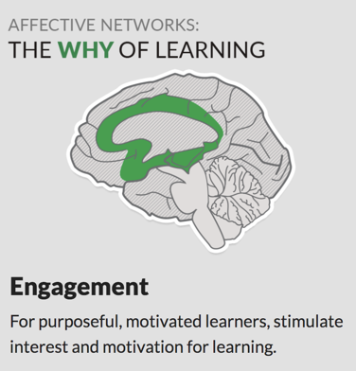
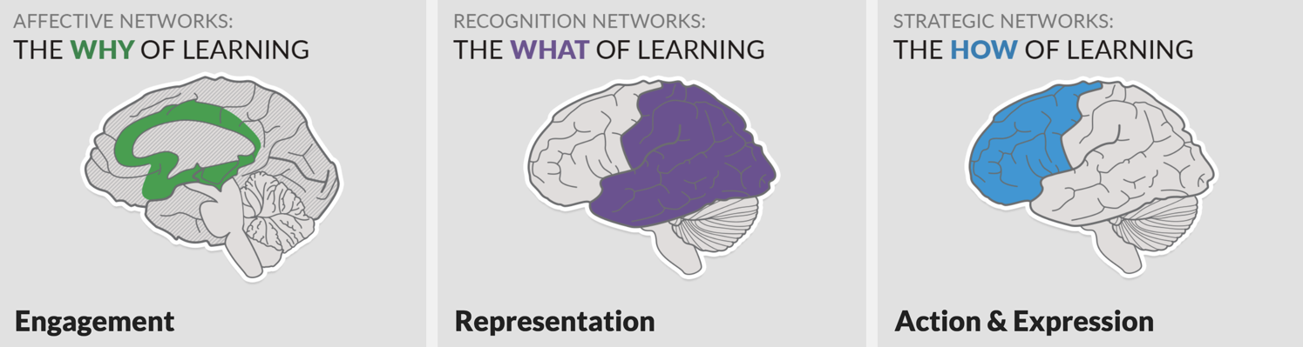
What is UDL? http://udlguidelines.cast.org/
“Universal Design for Learning (UDL) is a framework to improve and optimize teaching and learning for all people based on scientific insights into how humans learn.”
Notes:
NK talks about UDL big picture. Direct people to CAST website.
Universal Design for Learning is based on a framework rooted in neuroscientific insights into how we learn. UDL offers 3 principles based directly on 3 networks in our brains. Today we will focus on Affective Networks that support the design and development of strategies to engage learners. Animation Here

Slide 6

Affective Networks: The WHY of Learning
Why do I need
to learn this?
If there is not one means of engagement that will be optimal
for all learners, what strategies can we implement to effectively
design multiple options for engagement?
Notes:
The brain’s affective network is responsible for student engagement, and engagement is especially critical for success in online learning environments, hence the goal of designing for student engagement.
Can you think of how the affective network is expressed in young children?
There is not one means of engagement that will be optimal for all learners at all times in the learning process and in all contexts; some learners may have intrinsic motivation, and it may be most comfortable to teach only to these learners, but the learning outcomes, overall, for all students will suffer, unless we provide multiple options for engagement of a diverse group of learners. To design for multiple means of engagement, let’s start by answering the eternal question, “Why do I need to learn this?” If most students ask this question, and in some way each finds an answer or more than one answer for themselves, what do you think impacts how they answer this question? (INTERACTION - PollEverywhere WordCloud)

Slide 7
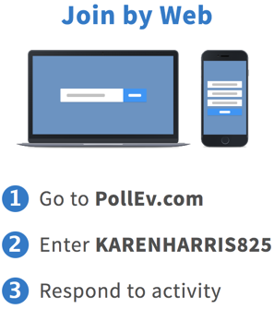
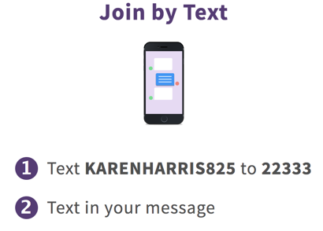
POLL Prompt: Why do I need to learn this?
Name some sources that may influence individual variation in engagement. (Affective Networks).

Slide 8
WHY?
Culture
Social Status
Personal Relevance
Proclivity
Economic Status
Gender

Slide 9
Guidelines for Multiple Means of Engagement
Recruit Interest
Sustain Effort
Self-Regulate
Notes:
NK - Here are the UDL Guidelines That Address WHY
UDL offers guidelines for promoting and establishing multiple means engagement.
How do we recruiting the learner’s interest? We may start by making instruction accessible.
How to we move forward to sustaining effort and persistence? We may start by building upon the student’s motivations.
How do we promote options for self-regulation? We may start by affording students opportunities to internalize motivation.
And consider that these guidelines are not linear, and rather are all implemented as longitudinal threads in our courses.

Slide 10

Checkpoints to Recruit Interest
7.1 Optimize individual choice and autonomy
7.2 Optimize relevance, value, and authenticity
7.3 Minimize threats and distractions
Notes:
Empower learners to take charge of their own learning.
Connect learning to experiences that are meaningful and valuable.
Foster a safe space to learn and take risks.

Slide 11
Checkpoints to Sustain Effort and Persistence
8.1 Heighten salience of goals and objectives
8.2 Vary demands and resources to optimize challenge
8.3 Foster collaboration and community
8.4 Increase mastery-oriented feedback
Notes:
Set a vision for the goal and why it matters.
Rise to high expectations using flexible tools and supports.
Cultivate a community of learners.
Guide learning by emphasizing the role of effort and process.

Slide 12
Checkpoints to Self-Regulate
9.1 Promote expectations and beliefs that optimize motivation
9.2 Facilitate personal coping skills and strategies
9.3 Develop self-assessment and reflection
Notes:
Set personal goals that inspire confidence and ownership of learning.
Develop and manage healthy emotional responses and interactions.
Increase awareness around progress toward goals and how to learn from mistakes.

Slide 13
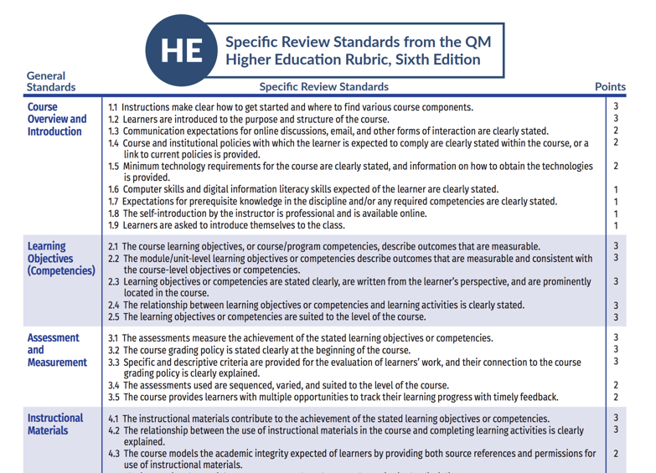
QM Framework of Standards
Notes:
Diagram – How can QM Framework be supported by UDL?

Slide 14
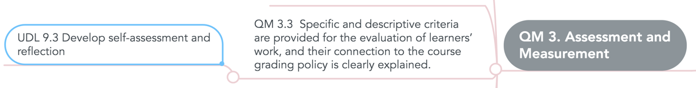
UDL Guidelines Mapped to QM Framework
Implementing UDL checkpoints that are aligned within the QM framework can foster a strategic learning environment that offers opportunities to engage diverse learners.

Slide 15
Time to Test Your Learning with a Mind Map!
Map the 10 UDL Checkpoints that promote Student Engagement to the QM Review Standards.
Propose UDL-inspired examples of course design and delivery practices that both support student engagement and align with QM standards.
Post to my Mindmeister WIKI Mind Map!!!
https://go.rutgers.edu/lmy4f5gj

Slide 16

Contact Information
Karen Harris
karen.harris@rutgers.edu
Natalia Kouraeva
kouraeva@rutgers.edu
Notes:
Questions?
Here’s our contact information!
Thank you!

