Slide 1

Meeting QM Standards through Hybrid Blended Learning
Yuliya Lef
Joanne Yantz
April 13, 2018

Slide 2

Standard 2
Learning Objectives or competencies describe what learners will be able to do upon completion of the course
This Photo by Unknown Author is licensed under CC BY

Slide 3


Business Writing Objectives
Differentiate between formal and informal writing skills
Use correctly, direct and indirect persuasive messages
Research a topic and gather sufficient data for a formal report
This Photo by Unknown Author is licensed under CC BY-NC-SA

Slide 4

Information Literacy Learning Outcomes
Preparation: Online Tutorials
Assessment: Quiz
Reflection: Peer Discussion
Assignment: Research Report
Assessment: Rubric
Vector cartoon programmer. Clip Art. Britannica ImageQuest, Encyclopædia Britannica, 25 May 2016. quest.eb.com/search/186_1622671/1/186_1622671/cite. Accessed 21 Mar 2018.

Slide 5
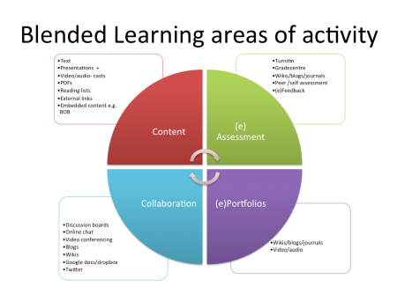
Standard 5
Course Activities facilitate and Support Learner interaction and engagement
This Photo by Unknown Author is licensed under CC BY

Slide 6
Writing Assignments
Scenarios are assigned to the students and they have to decide if they should use the direct or the indirect approach to writing
Students are given messages that they have to analyze the strengths and weaknesses of each sentence and revise the document to follow the chapter guidelines for persuasive messages
Students have to research a business topic of their choice and write a one page paper that includes a works cited with 6 sources from our library

Slide 7
Reflection Discussions: Active Learning
Business Writing
  Questions discussion (ungraded)
  learner – librarian interaction (little activity)
  Videos reflection discussion (graded)
  learner – learner – librarian interaction (active interaction)
English Composition I
  Research strategy reflection discussion (graded)
  learner – learner – librarian – instructor interaction (active interaction)
  Peer review assignment (graded)
  learner – learner interaction (active interaction)

Slide 8
Works Cited
Linder, Kathryn E. "Fundamentals of Hybrid Teaching and Learning." New Directions for Teaching and Learning, no. 149, 01 Jan. 2017, pp. 11-18
Masson, A.1, aj.masson@ulster.ac.uk, et al. "The Hybrid Learning Model - a Framework for Teaching and Learning Practice." International Journal of Emerging Technologies in Learning, vol. 3, no. S1, July 2008, pp. 12-17
Potter, Jodi. "Applying a Hybrid Model: Can It Enhance Student Learning Outcomes?." Journal of Instructional Pedagogies, vol. 17, 01 Nov. 2015

