Slide 1
Meeting Quality Matters Standards:
Developing a Syllabus Template
Office of Collaborative Academic Programs
INDIANA UNIVERSITY

Slide 2



Mr. David Becker,
Quality Matters Lead Coordinator
Office of Collaborative Academic Programs
Dr. Hitesh Kathuria,
Assistant Vice President for University Academic Affairs and Director
Office of Collaborative Academic Programs

Slide 3
Session Learning Outcomes
Identify QM standards that can be met in the design of a course syllabus
Identify resources needed to create a syllabus template
Import and personalize our syllabus template into your own course

Slide 4
A little about us…

Slide 5
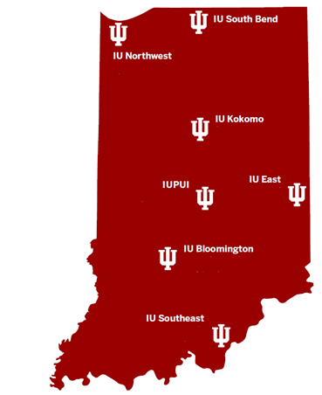
IU Online
Collaborative Degrees
140+ online programs
32,000+ students taking at least 1 online class (37% of all IU students)
8,000+ students - 100% online schedules (9% of all IU students)

Slide 6
QM Trained
Faculty at IU
To Date
8 Master Reviewers
90 Peer Reviewers
800+ APPQMR
Notes:
Across all of IU, 831 faculty have completed the QM @ IU Workshop or the QM APPQMR. We have 69 Peer Reviewers and 7 Master Reviewers. We are always interested in adding faculty as Peer Reviewers and Master Reviewers. If you are interested, please contact your campus's CTL, and a staff person there will help you enroll in the course. Remember, there is no charge to you or to your campus for these trainings! And the benefits to you and to your campus and students are significant.

Slide 8
Benefits to Students & Faculty

Slide 9

Think-Pair-Share
http://go.iu.edu/2q1K
How can course design templates help faculty?
How can course design templates help students?

Slide 10

Templates
SUBTITLE GOES HERE IF NECESSARY
Provides options
Simplifies design
Focus on content
Consistency

Slide 11
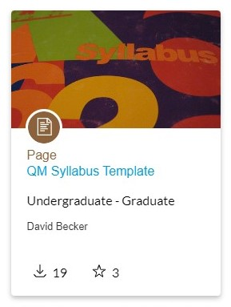
QM Syllabus Template
Helps faculty meet 10 out of 42 QM Standards
Easy to navigate
Fully accessible for all students
Customizable to fit your course

Slide 12
QM Standards Met
1.2 – Students are introduced to the purpose & structure of the course.
1.3 – Netiquette expectations for students.
1.4 – Links/statements to course & university policies.
1.5 – Minimum technology requirements & access information.
1.6 – Technology & digital information literacy skills needed for the course.
6.4 – Information to help students protect their privacy while using course tools.
7.1 – Tech support information for students.
7.2 – Links/statements about university accessibility services.
7.3 – Links/statements to academic support services.
8.6 – Accessibility statements for all technologies required for the course.

Slide 13
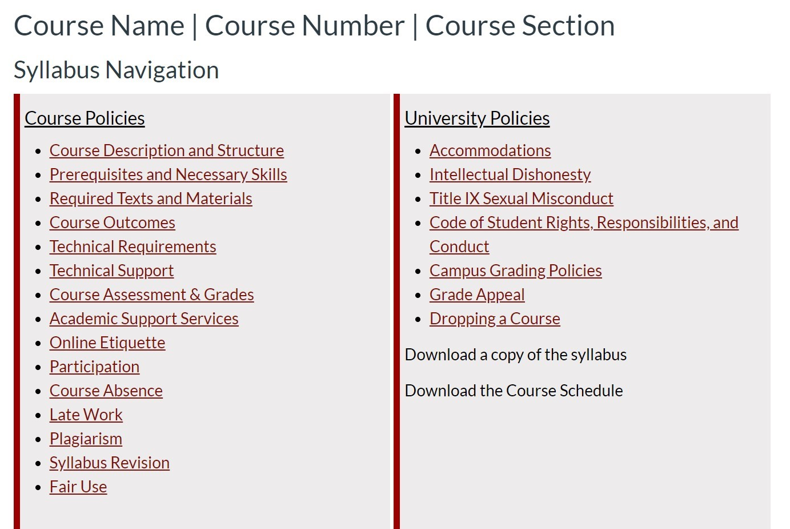

Slide 14
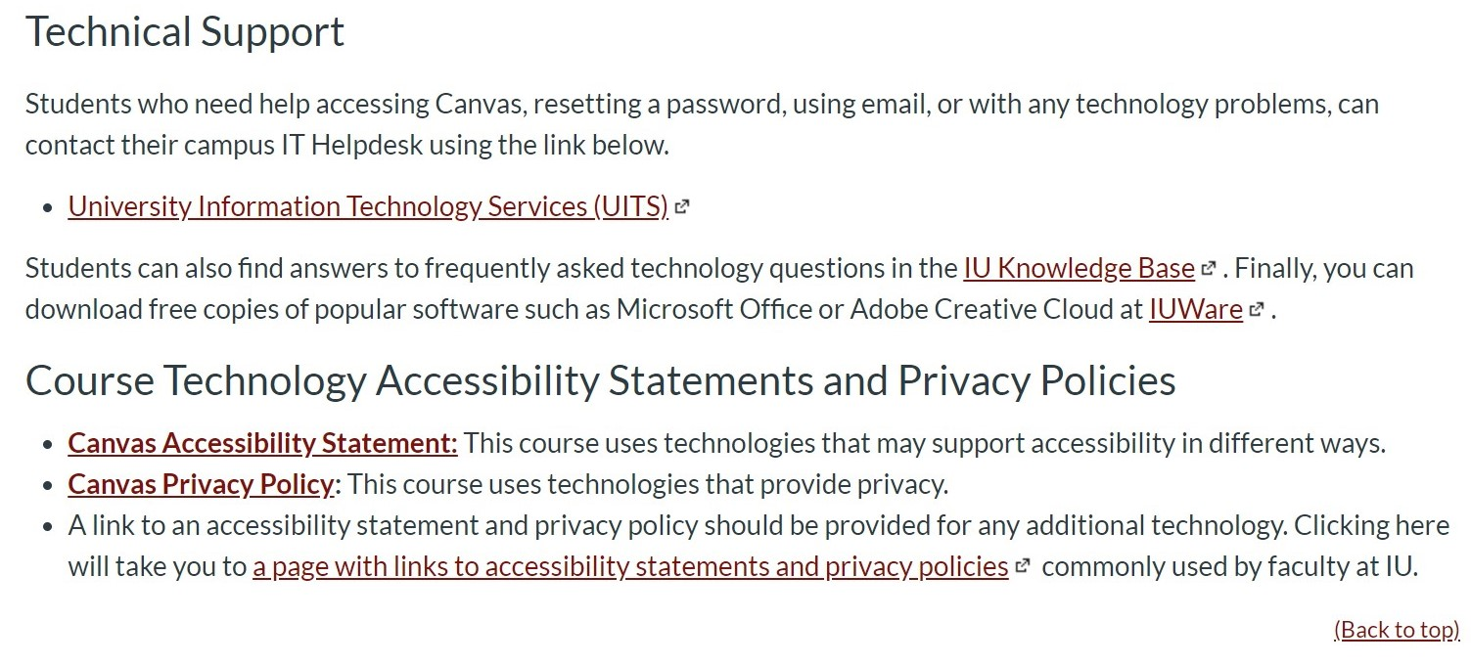

Slide 15
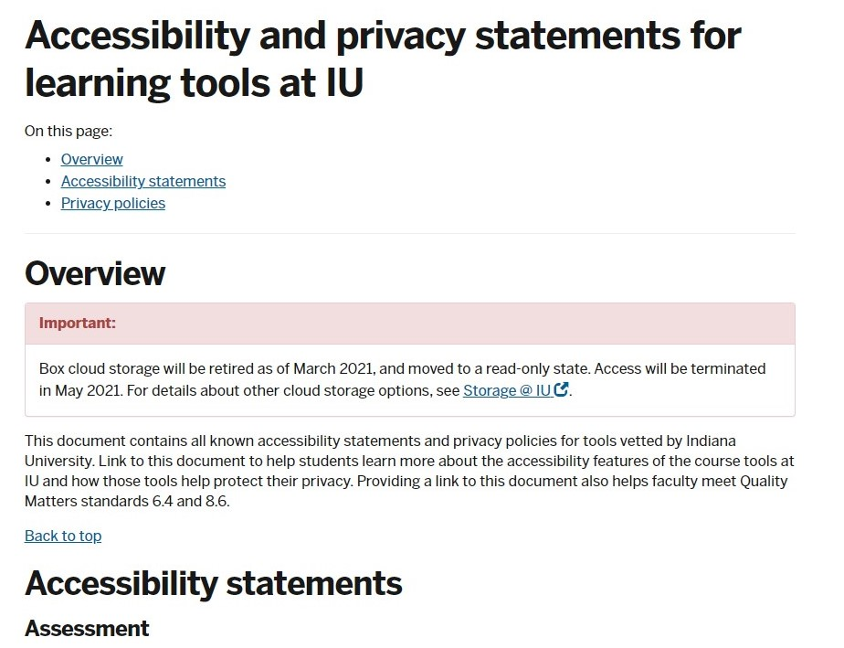
Tools Needed

Slide 16
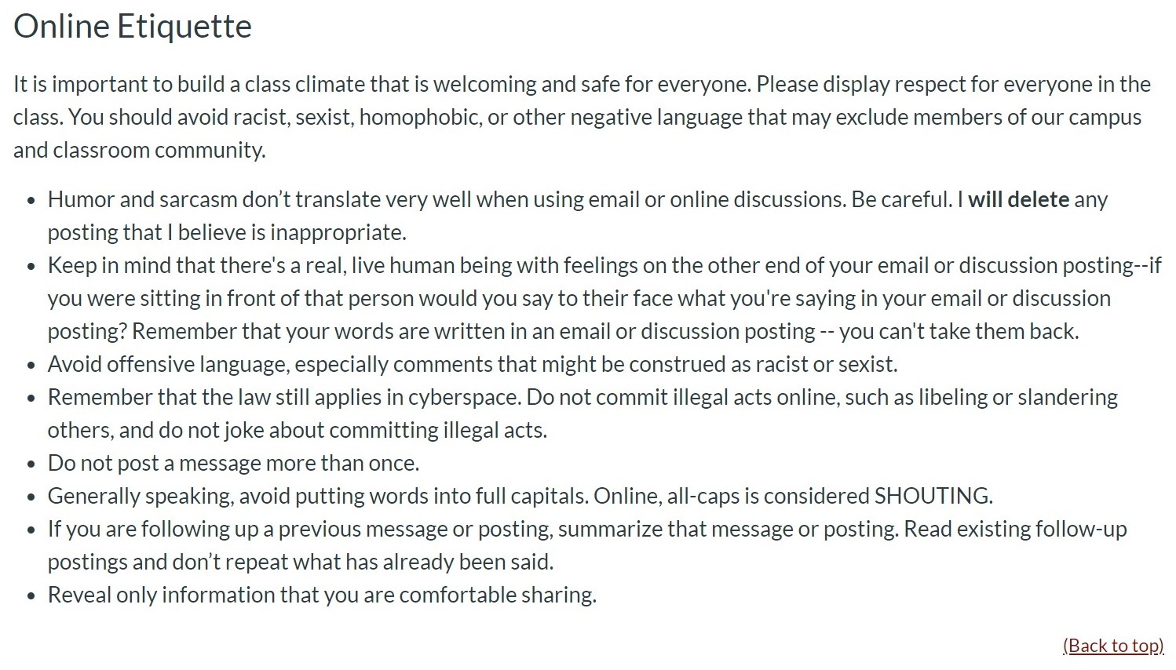

Slide 17
Importing the syllabus template
Download or import from Canvas Commons: http://go.iu.edu/2pZ0
Download the HTML code and paste it into your LMS: http://go.iu.edu/2pZ5
Download the Word doc version: http://go.iu.edu/2pZ6

Slide 18
Further Questions? Please Contact:
David Becker, M.A.
Quality Matters Lead Coordinator
Office of Collaborative Academic Programs
dabecker@ius.edu
812-941-2010
Hitesh Kathuria, Ph.D.
Assistant Vice President for University Academic Affairs and Director
Office of Collaborative Academic Programs
hikathur@indiana.edu
765-973-8247

