Slide 1

Title
Aligning QM Standards with
Higher Education Accreditation Hallmarks
A Juxtaposition for Distance Education Gap Analysis
and Action Plan Development
Mindi Miller, Bloomsburg University
Mary Nicholson, Bloomsburg University

Slide 2
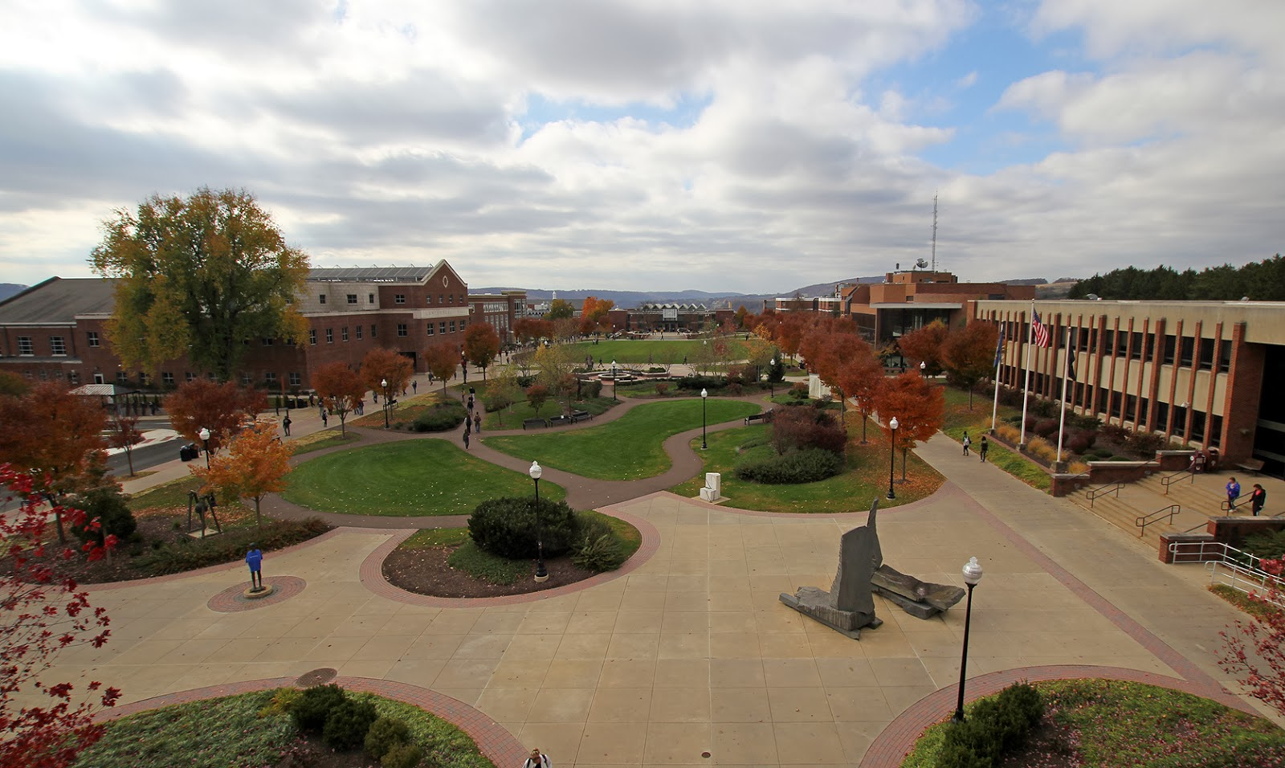
Case Study
Case Study
State System University
Taming the “Wild West” of DE
Notes:
Bloomsburg University

Slide 3
Overview
Overview
Gap analysis based on standards
Alignment of standards
Recommendations from the findings
Action plans fostering DE quality

Slide 4
Gap Analysis Template
Gap Analysis Template
Hallmark Standard | Gap Analysis | Evidence – driven Initiatives
Hallmark Standard 1: Mission and purposes | Unclear DE mission and vision | DE committee formed
Hallmark Standard 2: Sustainability Hallmark Standard 3: Governance | No formalized organizational structure | Proposed Center for Online Learning
Hallmark Standard 4: Academic Rigor Hallmark Standard 5: Evaluation | Master course syllabi with a methods section exists | Specific wording proposed to show equivalent rigor and evaluation of both online and F2F courses
Hallmark Standard 6: Qualified Faculty | No consistent faculty training for teaching online | Professional development opportunities expanded
Hallmark Standard 7: Student Support | Online orientation tutorials required for freshman students | Expand online assistance for all students
Hallmark Standard 8: Resources Hallmark Standard 9: Academic Integrity | Resources available through the LMS and support services Policies do not explicitly reference DE | Policies will be revised to include DE
Notes:
For screen-reader:
Gap Analysis Template Table – The columns align the Hallmark Standards with the Gap Analysis and Evidence-driven Initiatives
Hallmark Standard 1 Mission and purposes - Gap: Unclear DE mission and vision; Initiative: DE committee formed
Hallmark Standard 2 Sustainability and 3 Governance - Gap: No formalized organizational structure; Initiative: Proposed Center for Online Learning
Hallmark Standard 4 Academic Rigor and 5 Evaluation – Gap Analysis: Master course syllabi does include methods section; Initiative: Specific wording proposed to show equivalent rigor and evaluation of both online and F2F courses
Hallmark Standard 6 Qualified Faculty - Gap: No consistent faculty training for teaching online; Initiative: Professional development opportunities expanded
Hallmark Standard 7 Student Support - Analysis: Online orientation tutorial exists and is required for freshman students; Initiative: Expand online assistance for all students
Hallmark Standard 8: Resources and 9 Academic Integrity – Analysis: Resources available through the LMS and support services; Gap: Policies do not explicitly reference DE; Initiative: Policies will be revised to include DE

Slide 5


Standards Intro
Standards for Distance Education
Focused on
the Institution
Centered on
the Learner

Slide 6

Hallmark Standard 1
Hallmark Standard 1
Online learning is appropriate to the institution’s mission and purpose.
General Standard 2
Learning Objectives (Competencies)
Learning objectives or competencies describe what learners will be able to do upon completion of the course.

Slide 7
Hallmark Standard 2
Hallmark Standard 2
The institution's plans for developing, sustaining, and, if appropriate, expanding online learning offerings are integrated into its regular planning and evaluation processes.
General Standard 8
Accessibility and Usability
The course design reflects a commitment to accessibility and usability for all learners.

Slide 8
Hallmark 3
Hallmark Standard 3
Online learning is incorporated into the institution’s system of governance and academic oversight.
General Standard 7
Learner Support
The course facilitates learner access to institutional support services essential to learner success.

Slide 9
Hallmark Standard 4
Hallmark Standard 4
Curricula for the institution’s online learning offerings are coherent, cohesive, and comparable in academic rigor to programs offered in traditional instructional formats.
General Standard 1
Course Overview and Introduction
The overall design of the course is made clear to the learner at the beginning of the course.

Slide 10
Hallmark Standard 5
Hallmark Standard 5
The institution evaluates the effectiveness of its online learning offerings, including the extent to which the online learning goals are achieved, and uses the results of its evaluations to enhance the attainment of the goals.
General Standard 3
Assessment and Measurement
Assessments are integral to the learning process and are designed to evaluate learner progress in achieving the state learning objectives or mastering the competencies.

Slide 11
Hallmark Standard 6
General Standard 4
Instructional Materials
Instructional materials enable learners to achieve state learning objectives or competencies.
Hallmark Standard 6
Faculty responsible for delivering the online learning curricula and evaluating the students’ success in achieving the online learning goals are appropriately qualified and effectively supported.
General Standard 5
Learning Activities and Learner Interaction
Learning activities facilitate and support learners interaction and engagement.

Slide 12
Hallmark Standard 7
Hallmark Standard 7
The institution provides effective student and academic services to support students enrolled in online learning offerings.
General Standard 7
Learner Support
The course facilitates learner access to institutional support services essential to learner success.

Slide 13
Hallmark Standard 8
Hallmark Standard 8
The institution provides sufficient resources to support and, if appropriate, expand its online learning offerings.
General Standard 6
Course Technology
Course technologies support learner’s achievement of course objectives or competencies.

Slide 14
Hallmark Standard 9
Hallmark Standard 9
The institution assures the integrity of its online offerings.
General Standard 8
Accessibility and Usability
The course design reflects a commitment to accessibility and usability for all learners.

Slide 15
Recommendations and action plans
Gap analysis based on standards
Alignment of standards
Recommendations from the findings
Action plans fostering DE quality

Slide 16
Standard 1
Hallmark Standard 1: Mission and purposes
Mission:
Distance Education contributes to our mission for student success through an inclusive online community that meets diverse learning needs.
Vision:
Distance Education will provide seamless access to high-quality education (effective, affordable, accessible) and safe environments for learning by:
Incorporating new and emerging technologies
Delivering high quality courses and programs
Supporting students and faculty with resources and training

Slide 17
Standard 2 and 3
Hallmark Standard 2: Sustainability
Hallmark Standard 3: Governance
Student Support Services
Director
Center for Distance Learning
Distance Education Committee
Instructional Design
Technology Support
Student Support
Faculty Support
Instructional Media Support
Compliance
SARA, Middle States, DE
Instructional Designer
College of Science
LMS Administrator
Video/Audio Support
Instructional Designer
College of Liberal Arts
Help Desk
Video/Audio Production
Instructional Designer
College of Education
Hardware/Software Support
Instructional Designer
College of Business
Notes:
Bloomsburg University

Slide 18
Standard 4 and 5
Hallmark Standard 4: Academic Rigor
Hallmark Standard 5: Evaluation
Excerpts from Master Course Syllabus
“The objectives, content, resources, activities, and assignments are the same for both the Distance Education and on site versions of the course.”
“Teaching methods for this course (F2F or DE) can include presentations, demonstrations, and guided practice.”
“Learning activities and assignments (F2F or DE) can include discussions, assigned readings, written assignments, case studies, research, small group activities, team-based projects, student presentations, practice exercises, projects, quizzes, and a final exam.”

Slide 19



Standard 6
Hallmark Standard 6: Qualified Faculty
Professional Development
APPQMR
Brown Bag
Sessions
Teaching Online
Certification Course
Notes:
https://pixabay.com/vectors/brown-paperbags-lunch-bags-309963/
https://pixabay.com/vectors/certificate-diploma-document-seal-24960/

Slide 20

Standard 7
Hallmark Standard 7: Student Support
Orientation course and tutorials
Student Help Desk
Technology Support Services
24/7 D2L and Zoom support
Notes:
https://pixabay.com/photos/button-buttons-computer-design-key-2076/

Slide 21


Standard 8 and 9
Hallmark Standard 8: Resources
Hallmark Standard 9: Academic Integrity
Instructional Media Design Center
Notes:
https://pixabay.com/photos/team-team-building-success-computer-3373638/

Slide 22
Summary
Summary
Gap analysis
Standards
Recommendations
Action plans

Slide 23

Questions
Notes:
https://pixabay.com/illustrations/banner-header-question-mark-1090827/

