Slide 1
QM, Quality Assurance, & Course Templates
Angel Mootispaw, M.Ed., MIS, ABD
Notes:
Good afternoon and thank you for joining me. My name is Angel Mootispaw and I serve as the Director of Instructional Technology at Southern State Community College.
My role at SSCC includes all things distance learning and then some. I serve as the QM Coordinator and am in the final phase of completing my doctorate in Instructional Design Leadership.

Slide 2
ClassPoint
Please open a Browser window on your device and go to:
classpoint.app
Enter the Class Code on the top right
Enter your initials to join
Notes:
Before we get started I would like to ask everyone to open a browser window on your phone or other device to join the activities today.
To join add the class code number on the top right of the slide
Enter your initials, first name, or your favorite flavor of coffee…more about coffee on the next slide.

Slide 3


Reflection
Notes:
For those of you who do not know me, you will learn quickly, that my life is guided by coffee, QM, and QA sometimes in this order sometimes I switch it up…but coffee us usually first. So, I hope you have fresh coffee and are ready to begin this journey with me.
I want to start the conversation today through REFLECTION.
I am going to launch a word cloud activity, and ask you to submit two or three words that come to mind when you hear Distance Learning Quality Assurance.
While you are submitting your words, I will provide a little background to my research.
Community colleges across the U.S. have seen a steady decline in enrollment since around 2002
But online programs and course continue to increase.
In fact, the National Student Clearinghouse reported there has been a 15% enrollment decline since 2019 in community colleges
But IPEDS reported that 44.3% of Midwestern associate degree-seeking students were enrolled in some distance education and 21.1% were exclusively online.
Let’s look at the word cloud….give a couple minutes and insert the word cloud in as a slide.

Slide 4
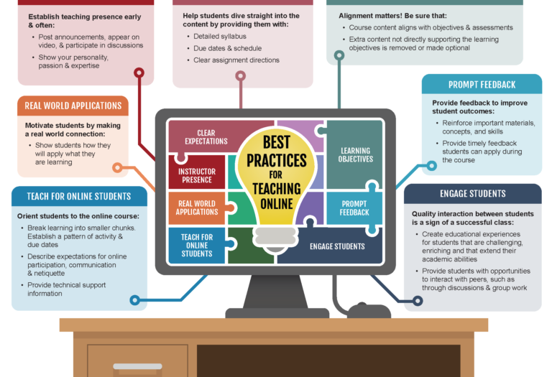
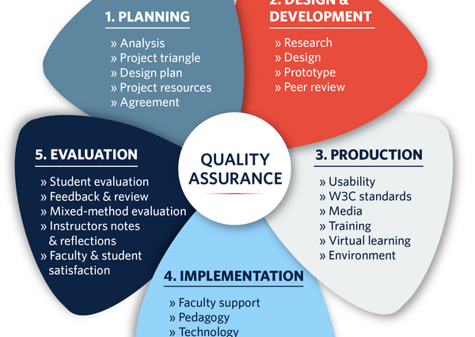
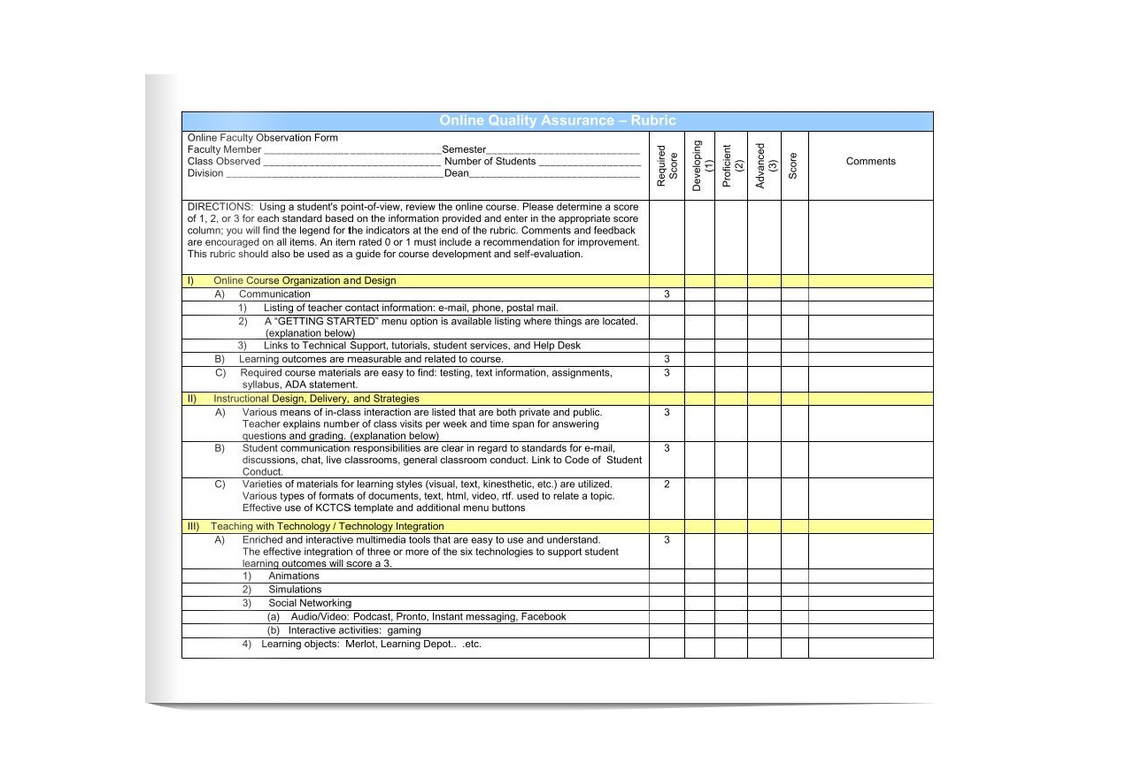
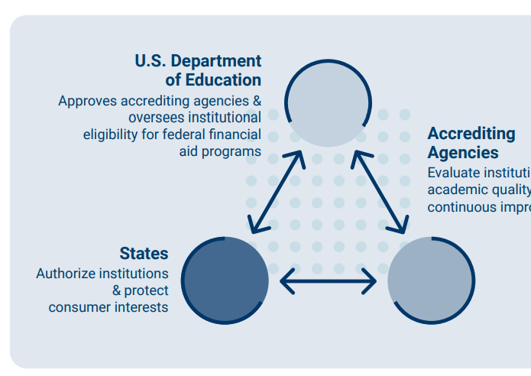
Distance Learning Quality Assurance
Notes:
Each of us think about Quality Assurance from our perspective, right?
Instructional designers start thinking about the process and planning, design and development, production, implementation, evaluation,
some of us are thinking about the QA checklist and rubrics, professional development, pedagogy – instructor presence, objectives, prompt feedback,
What about compliance, which makes me think of the Triad of governing bodies (Federal, State, and Accrediting bodies)….right?
Now we are starting to think holistically, looking at the bigger picture and of course all of this is for what….our STUDENTS…let’s keep our students in the center and not lose sight of them.
My next question to you is how do we manage QA or are we?
Many of us in Community Colleges and Universities are serving multiple roles? We are instructional designers, faculty and adjunct faculty members, QM Coordinators, Librarians, LMS administrators, and much more.
So how does your institution handle Online QA?

Slide 5
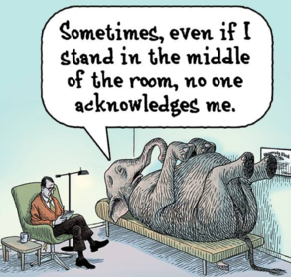

The Elephant in the Room
Notes:
With the onset of Covid at the beginning of 2020, we all have felt the reality of where are gaps are, right.
Because, now ALL of our faculty members and students have been forced to use some form of distance learning.
Which brings me to think about an article that recognized the demand for online learning courses is coming faster than faculty can keep up with the necessary training to develop and delivery quality online courses.
But, to meet demands the pandemic placed us in a situation where many traditional course materials were altered to an online version with little account for the pedological differences in the learning environment.
What we have seen and experienced with Covid, is what many of us have known, and that is Quality Assurance is essential to student success, completion, and sustainability in community colleges.
Community Colleges are no longer the only choice in their respective communities, students have choices and higher education is seen as a commodity, so how do we help our faculty members build quality online courses and remain mindful of academic freedom?

Slide 6

How does your institution handle Quality Assurance?
Did it change during Covid?
Notes:
Do you have a department, committee, is it like the Wild, Wild, West on steroids? Some days I find that we are ahead of the game and other days I think we are still in the Wild, Wild West. The reality is that we are doing our best and we work everyday to make progress.
7-minute breakout session.

Slide 7
Addressing QA through QM Course Templates
2019 | 2020 added | 2021 added
1.1. 1.8 | 1.4 | 1.2, 1.3, 1.5, 1.6, 1.9
3.2 | 1.7 | 5.3, 5.4
7.2, 7.3, 7.4 | 7.1 | 8.1, 8.2, 8.5, 8.6
Notes:
SSCC started addressing quality assurance before the pandemic through course templates. However, Covid pushed us to accelerate the work
In 2019 SSCC started with a basic online course template that included 6 QM specific review standards
In 2020 SSCC added three more specific standards to the template with the onset of Covid and offered the option for a Covid template.
In 2021 through a joint effort between our seasoned online Faculty members and our Instructional Technology team the template added 11 more QM Standards, for a total of 20 and it received a new look, by using a new tool called DesignPLUS.

Slide 8
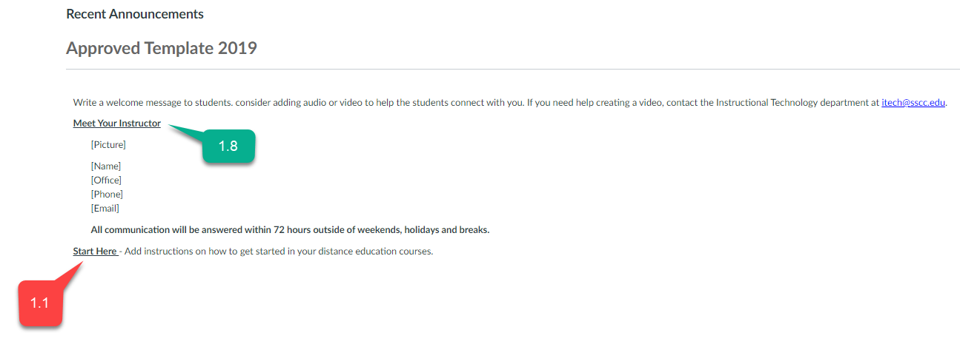
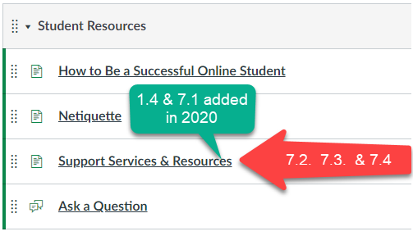
Onward we marched…
Notes:
First, let’s look at the 2019 and 2020 template. the basic format of the template was to use the Homepage to Introducing the Instructor (1.8), providing a welcome message, and to add clear instructions to get Started and find various course components (1.1).
Both 2019 and 2020 templates included a Student Resource Module that included Support Services and Resources, Netiquette, Tips to be a successful online student, and a place for students to ask a question. The Support Services & Resource page satisfied standards 7.2, 7.3, and 7.4 in 2019. In 2020 standards 1.4 and 7.1 were added to the resources, prior to this they were in the course syllabus.

Slide 9

Building templates, one cup of coffee at a time…
Notes:
What did we learn during the pandemic? We can do anything one cup of coffee at time…wait, that is my motto. We learned that it took experienced Faculty members to use the current template and we needed to implement something quickly and efficiently to assist all our instructors build the best distance learning courses with the limited resources our small team of three was able to provide.
I would be remiss if I did not mention that SSCC has a great team spirit, and we quickly developed a team of seasoned online faculty members that were willing to assist the Instructional Technology team with faculty members who were not familiar with distance learning.
We moved forward in 2021 with a new LMS template.

Slide 10
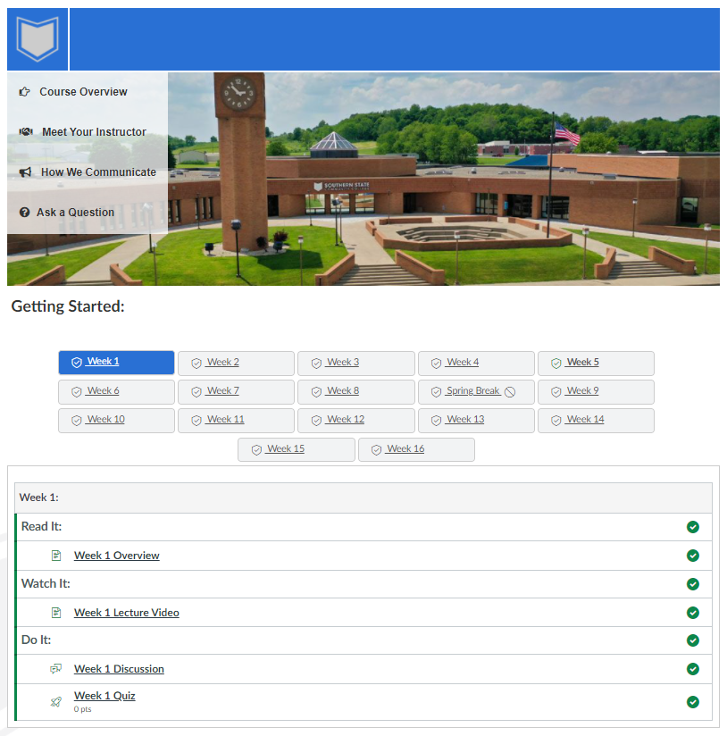
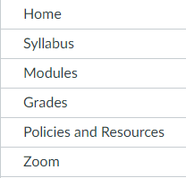
2021 + Covid + DesignPLUS = CHANGE
Notes:
2021 provided the tools for a team of seasoned online faculty and the instructional technology staff to envision and create a robust template that has an aesthetically pleasing look, minimize the navigation menu, and standardizes how course content is delivered.
What you are seeing is the new Home Page – The template is basically 4 pages, a discussion question, and a standard navigation menu.
Home Page: 1.1 – getting started,
Course Overview: 1.2 purpose and structure of course,
Meet Your Instructor: 1.8 self introduction
How We Communicate: 1.3 communication expectation for online discussions, email, and other forms of interaction; 5.3 instructor’s plan for interacting; 5.4 learner interaction
Ask a Question:
Policies & Resources: 1.4 institutional policies; 1.5 technology requirements; 1.6 computer skills; 7.1 link to technical support; 7.2 link to accessibility policies and services; 7.3 link to academic support services and resources; 7.4 link to student services resources; 8.6 vendor accessibility statements
Course Syllabus: 1.7 prerequisite knowledge; 3.2 course grading policy; 5.3, 5.4,
Introduction Discussion: 1.9 learners are asked to introduce themselves
Standard Navigation: 8.1 navigation facilitates ease of use; 8.2 readability
Delivery of Content via Modules: 8.2 facilitates readability
Specific review standard 8.2 is satisfied by using Canvas to embed multimedia and standardizing Zoom and Kaltura as the official multimedia tools.
All course syllabi are now located in the Syllabus Navigation link, and the standard navigation allows students to focus on course content over course navigation, limiting cognitive overload and the need to learn to navigate each course.

Slide 11
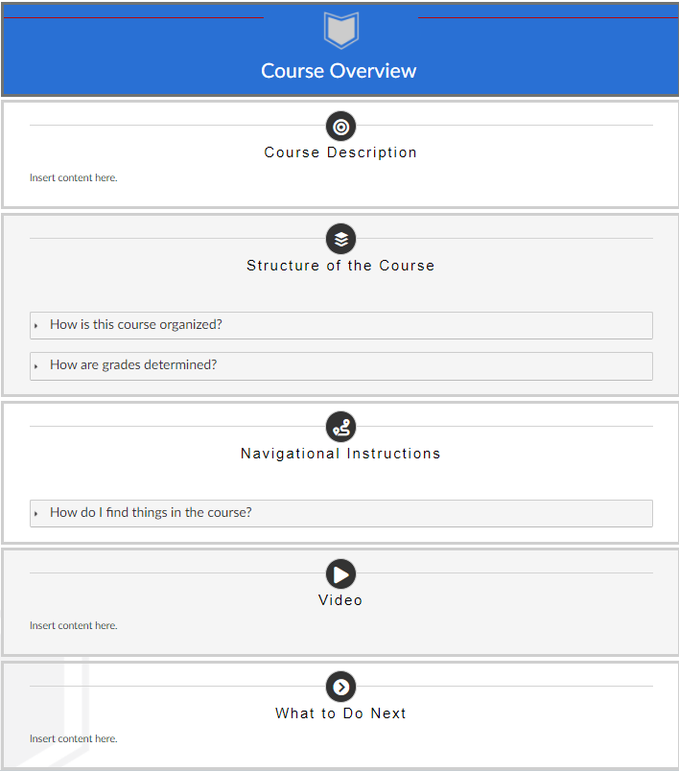
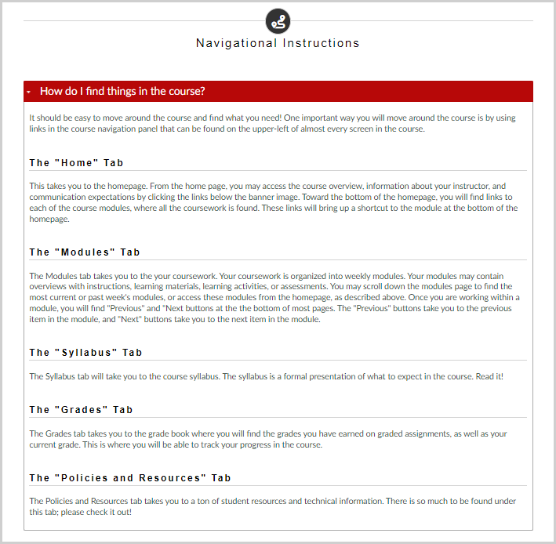
Course Overview Examples
Notes:
The two examples above are what we consider our Enhanced template. We offer templates for all the required pages and are starting to build a repository with pre-canned terminology and direction.
Both of these examples were designed by Samuel Ginn, our Distance Learning Support Specialist

Slide 12
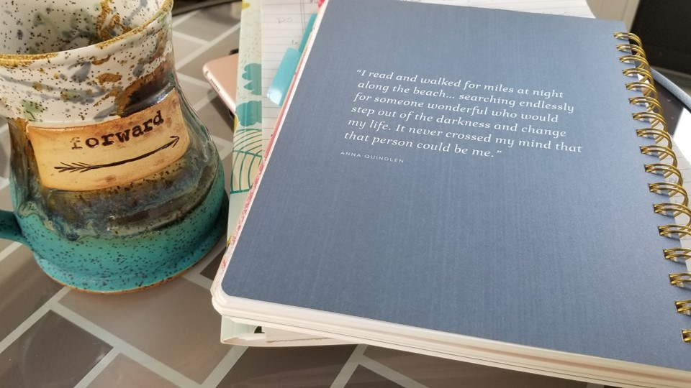
What did we Learn…
Notes:
The only way to move forward is with a great cup of coffee and determination
Wait, let’s talk about what we learned from our students…

Slide 13

Student Template Survey
Over 65% of our students found it easier to locate the Course Syllabus
Over 74% were able to locate their Instructor information with ease
Notes:
We had a 55% response rate from the survey and found overall that our students found it easy to locate the Syllabus and Instructor information.

Slide 14

Student Template Survey
Over 47% of students were able to easily locate the course communication and grading policy.
Over 54% of students were pleased with the streamlined course navigation.
Notes:
But we need to continue to work on Course Communication, Grading Policy, and Course Navigation

Slide 15

Notes:
I would like to close my presentation with asking you to reflect over the past 30-45 minutes and tell me in one or two words what you have taken away from the conversation…..something besides good coffee that is…
While you are providing me your final thoughts, I would like to thank some of my team members for being her to support me today. I do not work alone and what you have seen today is a joint effort, so Thank you Cathy Zile, my LMS Admin, Sam Ginn, my Distance Learning Support Specialist, and Dr. Gayle Mackay Full time Business Faculty member and online learning mentor to many. Your support is appreciated.
If anyone has questions, I am happy to answer what I can.

Slide 16
Thank you
Angel Mootispaw
amootispaw@sscc.edu

