Slide 1
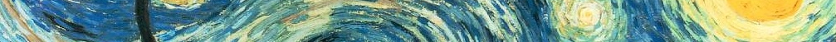
More than Citations: Understanding Copyright and Fair Use
Stephanie Korslund and Ashley Seibert

Slide 2
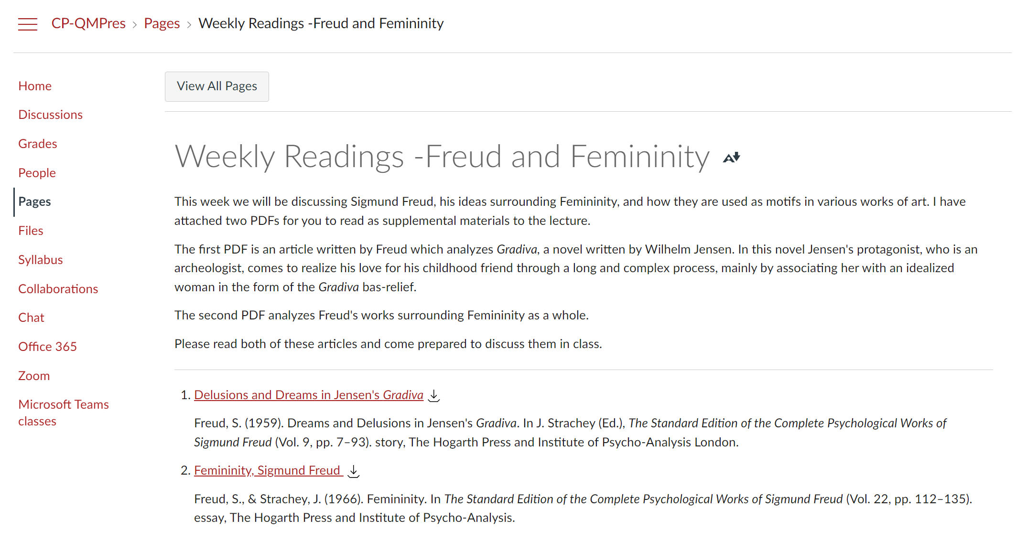
Scenario One
Downloaded PDFS with accompanying references
Notes:
Ashley
Direct link – citations not enough for Fair Use.

Slide 3
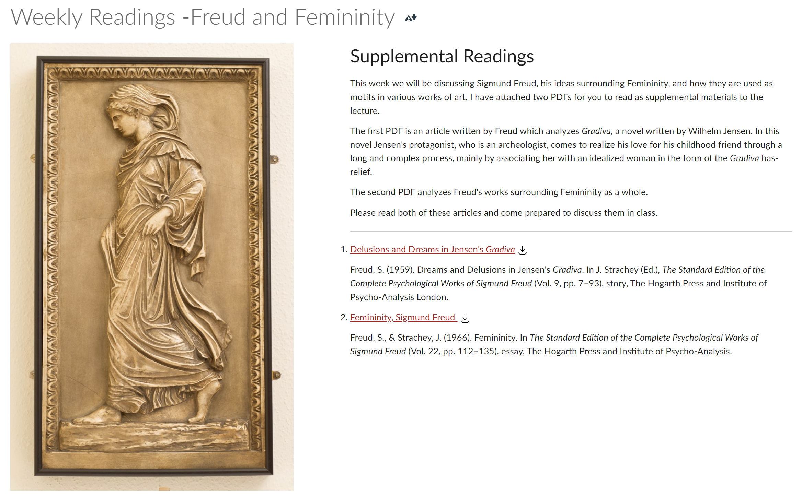
Scenario Two
Image from Google or another online search
Notes:
AShley

Slide 4
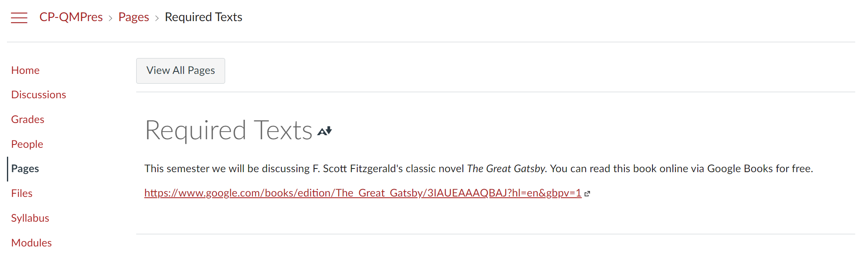
Scenario Three
A resource that is in the Public Domain
Notes:
Ashley
Great Gatsby PDF

Slide 5
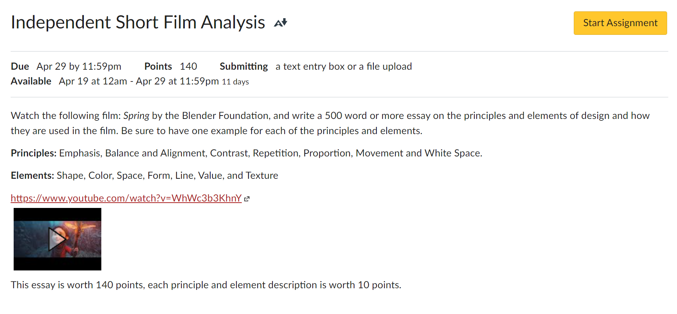
Scenario Four
Videos such as Youtube, Vimeo, TED, and Kanopy
Notes:
Ashley
Links to TED.com or TED Official YT channel
Up to the creator, license in description. Be cautious of reposts. Track down original creator
https://www.ted.com/about/our-organization/our-policies-terms/ted-talks-usage-policy

Slide 6
Objectives
Explain the difference between attribution and citation
Determine when to seek permission to use instructional materials in an online course
Identify strategies to more effectively apply SRS 4.3 in your online course

Slide 7
QM Standard 4.3
“The course models the academic integrity expected of learners by providing both source references and permissions for use of instructional materials.”
(Standards from the Quality Matters Higher Education Rubric, Sixth Edition)
Notes:
Stephanie
-Most faculty have confusion and misinterpret rubric. Even on annotated version.
-focuses on citation AND Attribution.

Slide 8
What Needs a Citation under SRS 4.3?
Journal articles
Textbooks
Images
Videos
Websites
Basically EVERYTHING
(Quality Matters Higher Education Rubric, Sixth Edition)
Notes:
Stephanie

Slide 9
Examples of SRS 4.3 Attributions
A scanned article uploaded to your LMS
A publisher slide deck uploaded to your course
A comic strip that you found on Google that you’ve now embedded into a course page
A video that you’ve linked into your course from TED.com
(Quality Matters Higher Education Rubric, Sixth Edition)
Notes:
Stephanie
the action of CREDITING a work or remark to a particular author, artist, or person
BEST PRACTICE: contact copyright holder for permission to use materials
To really understand attribution you need to first understand copyright and fair use because having an understanding of these things will help you to determine when attribution is needed

Slide 10
What is Copyright?
A form of protection grounded in the U.S. Constitution and granted by law for original works of authorship fixed in a tangible medium of expression. Copyright covers both published and unpublished works.
Includes: Literary works, dance, physical art, film, and audio
Excludes: ideas that have not be written down/recorded/ captured digitally, lists of facts that are public knowledge, US Government works, and works in public domain
(United States Code: Copyright Office, 2021)
Notes:
Ashley

Slide 11
This table outlines concepts on a spectrum from the most to least open
Public Domain | Open License | All Rights Reserved Copyright
Copyright ownership is waived or has expired | Copyright ownership is retained. | Copyright ownership is retained.
Author gives away rights to the public | Author grants rights in advanced | Author does NOT grant rights to the public
“It is not mine. I give up my right as an author. You don’t have to cite me, but I would appreciate it.” | “It is mine, but I do allow you to take my material. You don’t need to ask permission to use it because it is already granted. Just be sure to make proper attribution to me.” | “It is mine. I do not allow you to take this material and repurpose it. You definitely need to ask for my permission to use it.”
Most open |  | Most closed
Difference between open license, public domain, and all rights reserved copyright by Boyoung Chae, CC BY 4.0
Notes:
Ashley

Slide 12
Factors of Fair Use
The PURPOSE and character of the use, including whether such use is of a commercial nature or is for nonprofit educational purposes.
The NATURE of the copyrighted work.
The AMOUNT and substantiality of the portion used in relation to the copyrighted work as a whole.
The EFFECT of the use upon potential market for or value of the copyrighted work.
(United States Code: Copyright Office, 2021)
Notes:
Stephanie
The fair use doctrine is a set of guidelines outlined in section 107 of title 17 of the United States code that allows for the use of copyrighted works in limited contexts without needing to seek the permission of the copyright holder for their use.

Slide 13
Myths of Fair Use
As long as I use __% of a work and no more, then my use is considered Fair Use
Since I am hosting the material in my institution’s LMS, my use is considered Fair Use
I am using it for educational purposes therefore my use falls under Fair Use
If I cite the resource, then my use is considered Fair Use.
Notes:
Stephanie
“As long as I use % of a work and no more than my use is considered fair use.”
This is one of the most common myths associated with fair use. The problem with this myth is that in some cases, this belief restricts an educator’s ability to use a resource more than the fair use guidelines would. Because fair use is determined on a case by case basis, there is no way to say across the board that x amount of a work falls within the guidelines of fair use. Like many myths though, this myth is based in some truth. The third factor in determining fair use focuses on the amount of the work being used. Generally speaking, educators have a better case for fair use when they use a smaller portion of a work as compared to an entire work. The important factor here, is whether what is being used is considered to be the “heart of the work.” Even using a small portion of a work can be considered infringement if that part is central to the work itself.
The subsection "What about those educational guideline posters? (Links to an external site.)" in the section on Fair Use from Copyright and Fair Use for Teachers explores this idea more and why this myth persists.
“Since I am hosting the material in my LMS my use is considered fair use.”
While secure transmission can help support your case in determining fair use as it limits who has access to the resource, just because the resource is being hosted in a password protected system does not mean that the use of the resource is fair. Remember that when the court of law is determining fair use, there are four key factors that they are looking when determining whether a use is considered to be fair. Even if the use of a resource would be considered fair because of how it is being shared, the use may not be considered fair under the other factors.
“As long as I attribute the resource my use is considered fair use.”
Fair use and attribution are two different entities. Fair use is a legal application of US Copyright law where as attribution is an ethical decision. Just because an educator attributes a resource does not mean their use of the resource falls within the guidelines of fair use. By the same token, not attributing a resource is considered to be ethically immoral and in some instances may be classified as plagiarism, but may the use of the resource may fall within fair use.
The following pair of articles from Jonathan Bailey discuss plagiarism and fair use more, including how attribution differs from fair use, but can play a key role in help to make a case for fair use:
Copyright Infringement, Plagiarism, and Fair Use (Links to an external site.)
Plagiarism, Attribution, and Fair Use (Links to an external site.)
“I am using it for educational purposes therefore my use falls under fair use.”
Just because an educator is using a resource within an educational context does not mean that their use falls within the guidelines of fair use. As we have seen, while fair use guidelines do support the use of copyrighted materials in educational contexts, the fact that it is being used in an educational context is only one aspect of one factor of fair use, purpose. There are still three other factors that need to be considered when determining fair use.

Slide 14
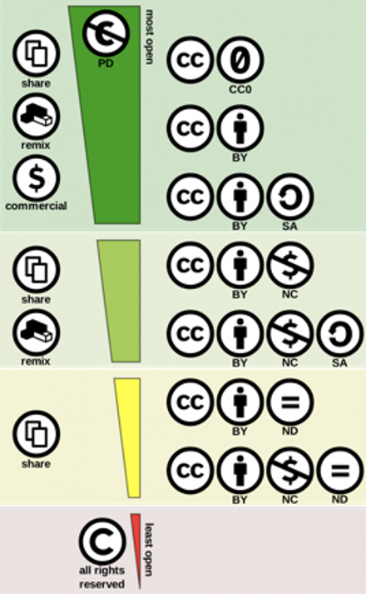
Creative Commons Licensing
“Creative Commons License Spectrum” by Shaddim (CC BY)
Notes:
Stephanie

Slide 15
Attribution
The act of giving credit to a content owner for their intellectual property when that content has an open license. It is best practice for an attribution statement to accompany the resource on the same page (Aesoph, 2018). An ideal attribution statement is written with the acronym “TASL” in mind.
T – Title
A – Author/Creator
S – Source
L - License
How to Give Attribution by Creative Commons CC BY 4.0, International
Notes:
Ashley
OERs and things in PD.
Be sure to still provide reference
Attribution = legal
Citation = moral/ethical

Slide 16
REDACTED DUE TO LICENSING
Notes:
Ashley
There is no need to request permission if you wish to use a comic for educational or classroom usage. Classroom use refers to public and private schools (grade K-12), home schooling (grade K-12), college dissertations, college thesis papers and other restricted college usage only. Comics MAY NOT be used in presentations outside of the classroom, such as employee training, as handouts for non-student use, or in any manner that is not a classroom setting at the K to college level. All other uses will be charged a licensing fee. If your use falls under the classroom use as stated above, you may use up to seven (7) comics per year at no cost as part of our fair-use policy. If you wish to use more than seven, please contact us at universalreprints@amuniversal.com. There will be a fee of $25.00 (USD) per comic over seven comics.
PLEASE NOTE: Calvin and Hobbes comics cannot be used on web pages, online, email or intranet – no exceptions.
For Better or For Worse: Only five comics per year may be used within the context of educational fair use.
Images may be used in the classroom for the following uses:
Overheads
Syllabi
Reprinted on tests or assignment papers
Distributed for sharing during lectures
Posted on a classroom bulletin board
Other uses within the classroom only
They MAY NOT be used in presentations outside of the classroom, as handouts for non-student use, or in any manner that is not a classroom usage.
We ask that no changes, deletions or additions be made to the comic or text. You must reprint or post the comic in its entirety. Please include the cartoonist’s name and the Andrews McMeel Syndication name in the credit line.
As long as you do not abuse the permission or the creator’s work, we are glad to offer comics free of charge.
All materials remain the property of Andrews McMeel Syndication. All Rights Reserved.
https://licensing.andrewsmcmeel.com/classroom-usage

Slide 17
Managing SRS 4.3
To determine whether or not your resource falls under fair use, or needs attribution follow these steps:
Identify License - does the resource have a copyright license listed? Is it in the public domain, or an OER (Open Educational Resource)?
Determine Usage Rights - Review terms of use for resource, ask the creator for permission, or claim fair use.*
  Remember, only a court of law can truly determine fair use.
  Avoid hosting resource directly when possible (use linking or embedding).
  If an item is an OER, determine the license.
Attribution and Citation - once you have identified the proper license, decide how to properly attribute and be sure to include a citation.
  If copyrighted and claiming fair use, if there is an attribution statement available, use it.
  If Public Domain, attribution is not needed.
  If OER, attribution is required based on license.
Notes:
Stephanie

Slide 18
Scenario One
Downloaded PDFs with accompanying references
Notes:
Ashley
Permission to use, permalink if possible
Don’t house resources in course
Reach out to copyright holder for permission and original document

Slide 19
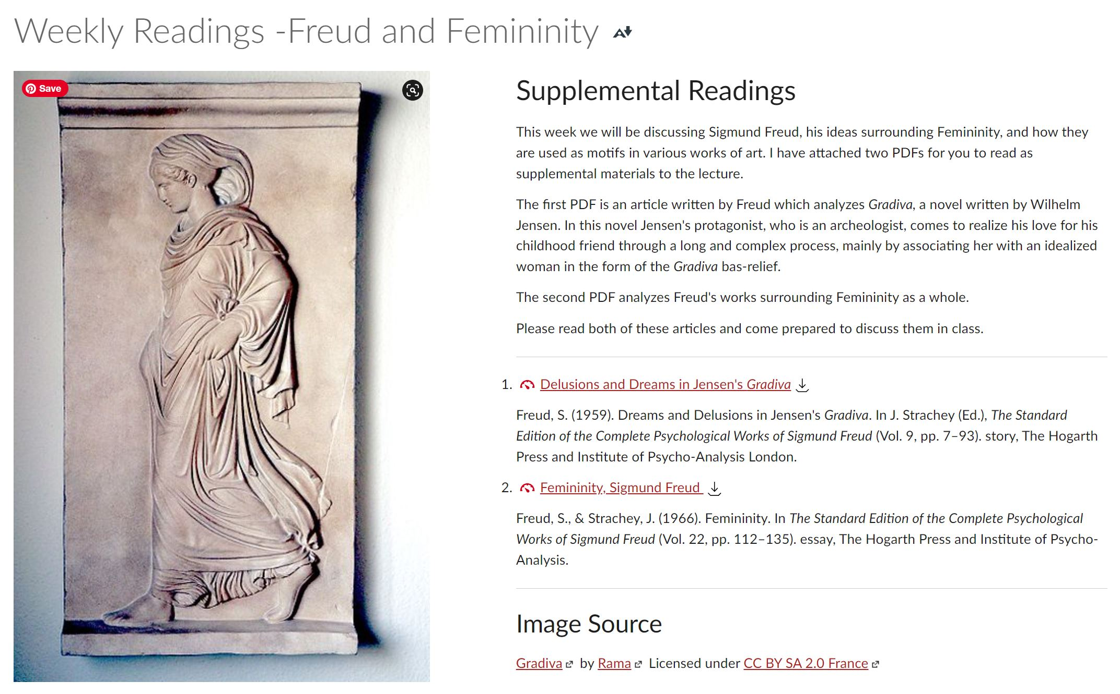
Scenario Two
Image from Google or another online search
Notes:
Ashley
Swap image
Creative commons version of image.
If you want to use original once again reach out to copyright holder and ask permission.
This copyright holder required a fee to use it.
Be sure to check copyright clauses from all resources and do not pull directly from google or other image database.

Slide 20
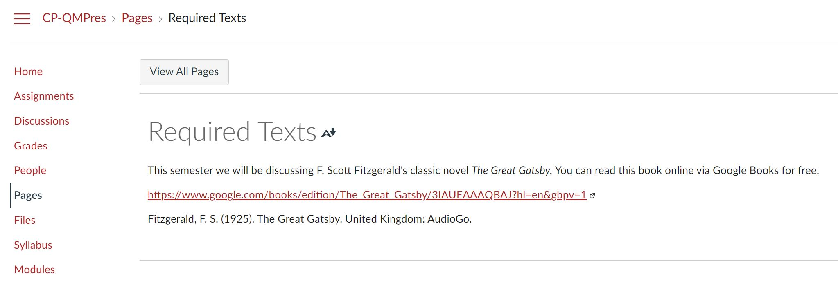
Scenario Three
A resource that is in the Public Domain
Notes:
Ashley
Great Gatsby PDF in PD. Do not need attribution, nice to provide citation
If it weren’t in PD, would need permission to use.

Slide 21
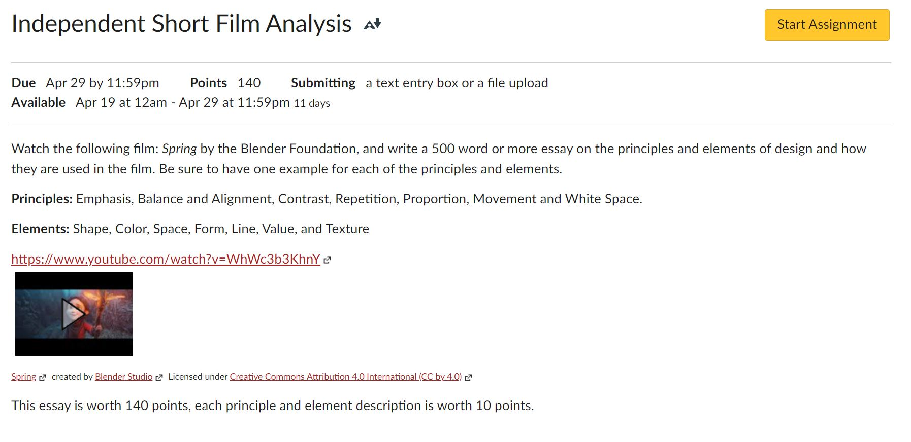
Scenario Four
Videos such as Youtube, Vimeo, TED, and Kanopy
Notes:
Ashley
Links to TED.com or TED Official YT channel
Up to the creator, license in description. Be cautious of reposts. Track down original creator
https://www.ted.com/about/our-organization/our-policies-terms/ted-talks-usage-policy

Slide 22
Resources
Adams, S. (1989, September 25). Dilbert [Cartoon]. Andrews McMeel Syndication. https://dilbert.com/strip/1989-09-25
Aesoph, L. (2018). Self-publishing guide. BCcampus. www.opentextbc.ca/selfpublishguide/chapter/citation-vs-attribution/
Chae, B. (2014). Difference between open license, public domain and all rights reserved copyright [Digital Graphic]. Wikimedia. https://commons.wikimedia.org/wiki/File:Difference_between_open_license,_public_domain_and_all_rights_reserved_copyright.png
Creative Commons. (2021). How to give attribution. https://creativecommons.org/use-remix/attribution/
QM Higher Education Rubric, Sixth Edition, 2018. Quality Matters. Used under license. All rights reserved. Retrieved from MyQM.
Shaddim. (2016). Creative commons license spectrum [Digital Graphic]. Wikimedia. https://commons.wikimedia.org/wiki/File:Creative_commons_license_spectrum.svg
Standards from the Quality Matters Higher Education Rubric, Sixth Edition. Quality Matters. Retrieved from Specific Review Standards from the QM Higher Education Rubric, Sixth Edition
United States Code: Copyright Office, 17 U.S.C. 101-110 (2021).
van Gogh, V. (1889). The starry night [Painting]. Museum of Modern Art, New York City, NY, United States.
Notes:
Fair use checker https://librarycopyright.net/resources/fairuse/index.php

