Slide 1
























NSQ
Online Course Standards Refresh

Slide 2


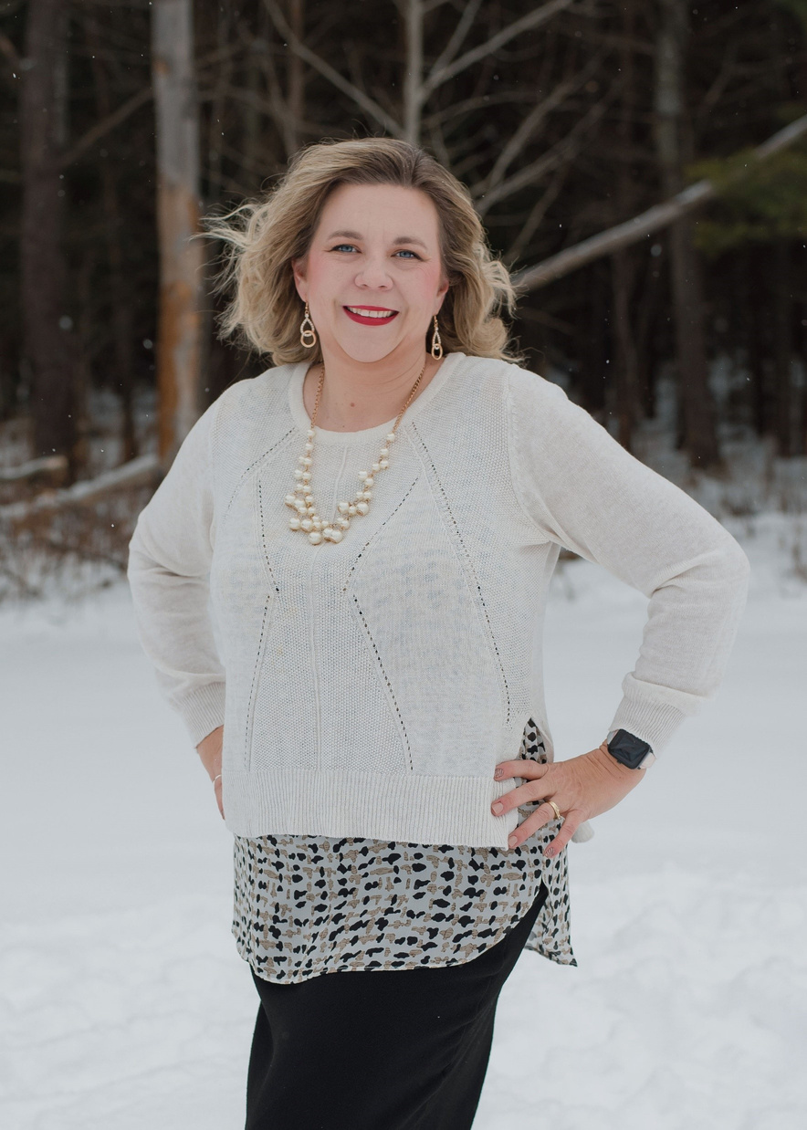
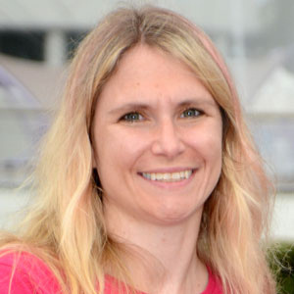
Introductions
Jason Neiffer
Betsy Spring
Suzie Scheffler

Slide 3





NSQ Oversight
Oversight of the National Standards for Quality Online Learning is led by the Virtual Learning Leadership Alliance (VLLA), Quality Matters (QM), and (DLAC), the Community Advancing Digital Learning. Together these organizations provide oversight and lead a broad-based community effort to keep the standards current and relevant.

Slide 4





Standard Sets
Online Course Standards
Online Program Standards
Refreshed in 2025
Refreshed in 2025
Online Teaching Standards
Online Leadership Standards
Revised in 2025
Coming Soon!

Slide 5


Contributers to the Refresh
Co-Chairs
Additional Contributions
Jason Neiffer
Betsy Springer
Contributors to the 2025 refresh include online learning leaders and practitioners from 20 organizations and two countries.

Slide 6





Focus Groups
  Virtual & In Person @ DLAC 2024
  Feedback on what works and what’s challenging
  Themes were:
    More exemplars for diverse learning environments.
    Hot Button Language
    Clarify Jargon

Slide 7



Standards
Standard A: Course Overview and Support
Standard B: Content
Standard C: Instructional Design
Standard D: Learner Assessment
Standard E: Accessibility and Usability
Standard F: Course Technology
Standard G: Course Evaluation

Slide 8



Standard Updates
Update to Standard B
Update to Standard F
Revise to more accurately focus on the course content.
Course Technology: Revised indicators to emphasize the technology used to deliver the course rather than focusing solely on the course.

Slide 9






Additional Changes
Expanded Explanations
and Examples
NEW Designer Notes
Provides additional insight into the indicators and tangible examples to illustrate implementation strategies
Notes were added to select indicators, providing course design suggestions.

Slide 10
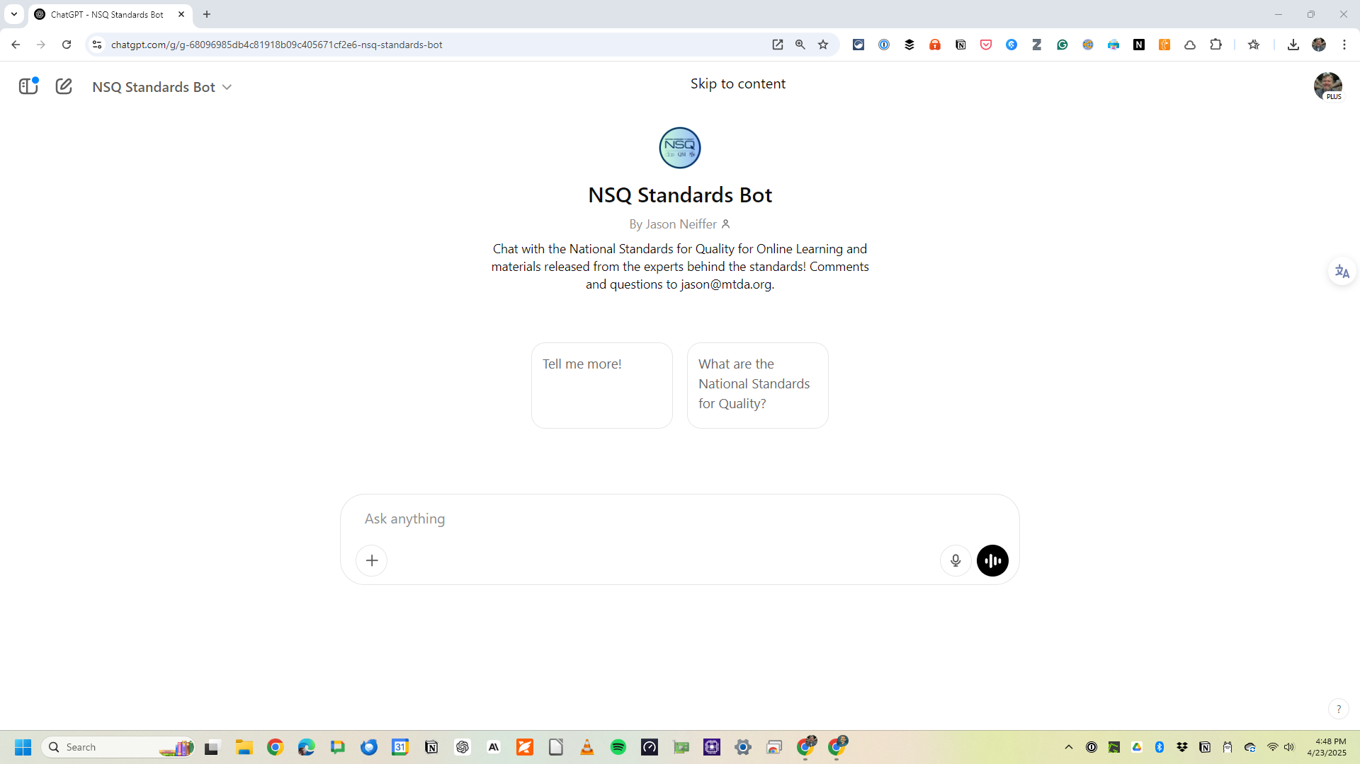
https://halfpint.link/nsq

Slide 11

Thank you

