Slide 1
Supporting Executive Functioning Skills in College Courses with QM Standards
Presented by: Natalia Kouraeva, Ed. D
Instructional Designer
Teaching and Learning with Technology

Slide 2
Objectives:
Review and discuss the design and instructional strategies aligned with general QM standards
View demonstration of a few LMS features and technology tools that can be used to support EFS
Analyze and reflect on the current EFS support in our design and teaching practice
Collaborate with peers to brainstorm possible modifications to their own courses to provide greater EFS support

Slide 3
What are Executive Functioning Skills (EFS)?
Executive function and self-regulation skills are the mental processes that enable us to plan, focus attention, remember instructions, and juggle multiple tasks successfully. (https://developingchild.harvard.edu/)
The Three (3) Areas of Executive Function
  Working Memory - The ability to keep information in mind and then use it in some way
  Cognitive Flexibility - The ability to think about something in more than one way
  Inhibitory Control - The ability to ignore distractions and resist temptation (exercise self-control) (https://www.understood.org/)

Slide 4
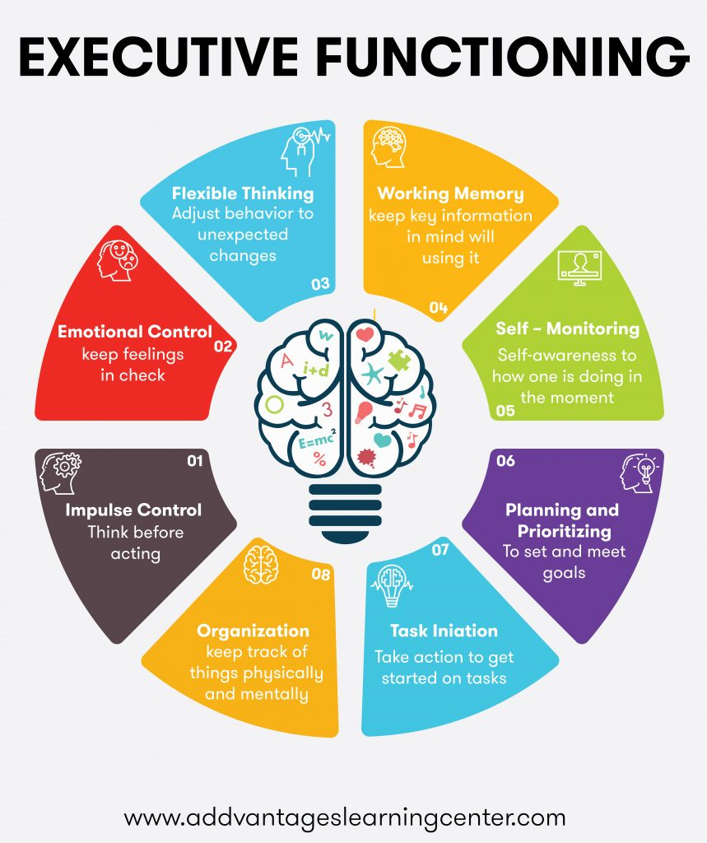
Executive functioning skills help you get things done. These skills are controlled by an area of the brain called the frontal lobe.
(https://www.webmd.com/)
Executive Functioning Skills are a Set of Skills Needed to be Independent in ALL areas of Life
(https://addvantageslearningcenter.com/)

Slide 5


EF in a College Classroom
What is your experience with students
who are struggling with EF skills?
  Manage time
  Pay attention
  Switch focus
  Plan and organize
  Remember details
  Avoid saying or doing the wrong thing
  Do things based on your experience
  Multitask
Why should we care about EF?

Slide 6

Design Courses with Supporting EFS in Mind?
Quality Matters (QM) Standards were created to help course developers, teachers, faculty, entire organizations, and — most importantly — students. ...
Using QM Standards helps educators to Integrate EFS support into many areas of college courses.

Slide 7

Applying QM Standards to support EFS
GS1 & GS2
General Standard 1: Course Overview and Introduction: The overall design of the course is made clear to the learner at the beginning of the course.
  Overview Statement: The course overview and introduction set the tone for the course, let learners know what to expect, and provide other guidance to help learners succeed from the outset.
General Standard 2: Learning Objectives (Competencies): Learning objectives or competencies describe what learners will be able to do upon completion of the course.
  Overview Statement: The learning objectives or competencies establish a foundation upon which the rest of the course is based.
Example

Slide 8

Applying QM Standards to support EFS – GS3
General Standard 3: Assessment and Measurement: Assessments are integral to the learning process and are designed to evaluate learner progress in achieving the stated learning objectives or mastering the competencies.
  Overview Statement: Assessment is implemented in a manner that corresponds to the course learning objectives or competencies and not only allows the instructor a broad perspective on the learners’ mastery of content, but also allows learners to track their learning progress throughout the course.

Slide 9

GS3 - Assessment and Measurement Strategies
Flexible Thinking
Working Memory
Self-Monitoring
Planning & Prioritizing
Task Initiation
Organization
Impulse Control
Emotional Control

Slide 10
GS3 - Assessment and Measurement Strategies
Flexible Thinking | Create differentiated projects and choices based on students experiences
Working Memory | Provide definitions, formulas, allow using resources, open notebook exams
Self-Monitoring | Offer forum for questions, checklists, rubrics, reflections, ask to self-grade
Planning & Prioritizing | Develop timeline, issue reminders, post announcements
Task Initiation | Ask to submit projects in stages, provide opportunities to brainstorm and discuss projects in groups or with a partner
Organization | Use graphical organizers, provide feedback on outline, organized resources.
Impulse Control | Review exam taking strategies, offer second chance or alternative ways to assess
Emotional Control | Offer choices, keep in mind relevance to students’ life and passion for topic, help to make connections
Example
Example
Example
Example

Slide 11

Assessments:
What changes can you make in your course(s) or teaching practice to support EF skills?
Flexible Thinking
Working Memory
Self-Monitoring
Planning & Prioritizing
Task Initiation
Organization
Impulse Control
Emotional Control

Slide 12
Applying QM Standards to support EFS – GS4
General Standard 4: Instructional Materials: Instructional materials enable learners to achieve stated learning objectives or competencies.
  Overview Statement: The focus of this Standard is on supporting the course objectives and competencies, rather than on qualitative judgments about the instructional materials.
Connecting materials to the learning objectives – provide explanation
Chunk materials into manageable parts
Insert opportunities to self-check
Provide a variety of resources / points of view / different ways of doing things
Add ways to work with the content, not just read or watch (experience (simulations), write summaries, create an infographics, annotations, etc.)
Example

Slide 13

Applying QM Standards to support EFS – GS5
General Standard 5: Learning Activities and Learner Interaction: Learning activities facilitate and support learner interaction and engagement.
  Overview Statement: Course components that promote active learning contribute to the learning process and to learner persistence.
Flexible Thinking
Working Memory
Self-Monitoring
Planning & Prioritizing
Task Initiation
Organization
Impulse Control
Emotional Control
Please provide examples of how your learning activities support students EF

Slide 14
GS5: Learning Activities and Learner Interaction: Learning activities facilitate and support learner interaction and engagement.
Offer a variety of active ways to work with the content
(not just read or watch videos, ask students to write summaries, create an infographics, add annotations, produce outline or timeline, develop test questions, etc.)
Offer a variety of ways to work with peers (pairs, small groups, do peer-reviews, discussions, collaborative projects, etc.)
Example

Slide 15
Applying QM Standards to support EFS – GS6
General Standard 6: Course Technology: Course technologies support learners’ achievement of course objectives or competencies
  Overview Statement: The technologies enabling the various tools used in the course facilitate rather than impede the learning process.
Example
apps integrated in LMS
Playposit, Kaltura, Scorm (Spring Presenter, Lectora, Adobe Captivate or Articulate Storyline)
How do you use technology to support EF?

Slide 16

Applying QM Standards to support EFS – GS7
General Standard 7: Learner Support: The course facilitates learner access to institutional support services essential to learner success.
  Overview Statement: It is important to ensure online learners know they have access to and are encouraged to use the services that support learners at the institution. In the Learner Support Standard, four different kinds of support services are addressed: technical support, accessibility support, academic services support, and student services support.
Online Courses - always include statement with all the resources
Example

Slide 17
Applying QM Standards to support EFS – GS8
General Standard 8: Accessibility and Usability: The course design reflects a commitment to accessibility and usability for all learners.
  Overview Statement: The course design utilizes the principles of Universal Design for Learning (UDL) and reflects a commitment to accessibility, ensuring all learners can access all course content and activities, and to usability, ensuring all learners can easily navigate and interact with course components.
Principles of Universal Design for Learning (UDL):
Multiple means of representation
Multiple means of action and expression
Multiple means of engagement
Universal Design and Accessibility in Online Education is a 5 week course, which is a part of our non-credit Online Teaching Certificate program available to faculty, staff, and graduate students
Example

Slide 18
What changes can you make in your course(s) or teaching practice to support EF skills?
Flexible Thinking
Working Memory
Self-Monitoring
Planning & Prioritizing
Task Initiation
Organization
Impulse Control
Emotional Control

Slide 19
Conclusion
Reviewed and discuss the design and instructional strategies aligned with general QM standards
Viewed demonstration of a few LMS features and technology tools that can be used to support EFS
Analyzed and reflected on the current EFS support in our design and teaching practice
Collaborated with peers to brainstorm possible modifications to their own courses to provide greater EFS support

Slide 20

What are questions or comments?

Slide 21
Contact:
Natalia Kouraeva, Ed. D
TLT Instructional Designer
kouraeva@docs.rutgers.edu
Tel: 848-932-8801

Slide 22
References
CAST (2018). Universal Design for Learning Guidelines version 2.2. Retrieved from http://udlguidelines.cast.org
Quality Matters. (2020) Course Design Rubric Standards, 6th edition. Retrieved form
https://www.qualitymatters.org/qa-resources/rubric-standards/higher-ed-rubric

