Slide 1



Navigating Institutional Improvement and Accreditation
Notes:
Can use one of these three slides or I can come up with something different

Slide 2
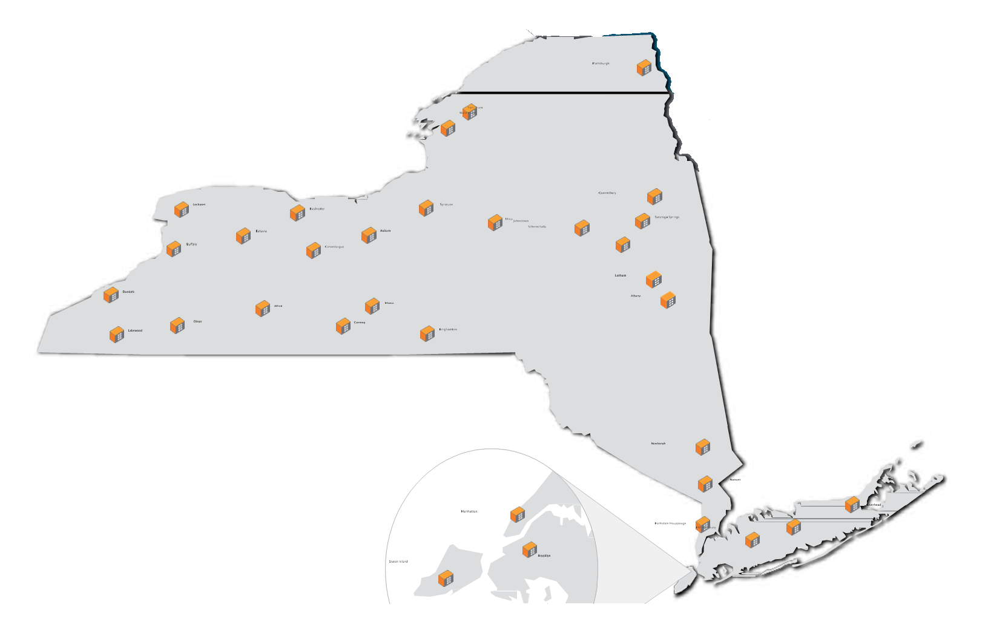
SUNY Empire State College’s
34 New York State Locations

Slide 3

Mission
Vision
Notes:
Vision
SUNY Empire State College will be the leading public college for students across New York State and around the world seeking affordable and flexible, quality degrees. We will be distinguished by our outstanding faculty and staff, our record of student success, our innovative programs and personalized learning opportunities, our rich continuum of student support services, our social and economic impact, and our commitment to a diverse and engaged academic community.

Slide 4
Empire State College
The College’s Mission:
…Connects motivated adult learners with access to innovative, flexible and quality academic programs that empower people and strengthen communities. We build on the diversity of our students, their work and life experiences and their individual personal and professional goals as the cornerstone for each academic program.
The College’s Vision is:
…to be the leading public college for students across New York State, and around the world, seeking affordable and flexible, quality degrees. We will be distinguished by our outstanding faculty and staff, our record of student success, our innovative programs and personalized learning opportunities, our rich continuum of student support services, our social and economic impact, and our commitment to a diverse and engaged academic community.

Slide 5
Navigating Empire State College Translation for QM or other assessment measures
The College’s Mission:
…Connects motivated adult learners with access to innovative, flexible and quality academic programs that empower people and strengthen communities. We build on the diversity of our students, their work and life experiences and their individual personal and professional goals as the cornerstone for each academic program.
Faculty – we hate anything standardized, ESC is special.
Administrators – those instruments are built for traditional colleges, how will they help us?
All- if we do all this work, how will know if it helps for “our” faculty and students?

Slide 6
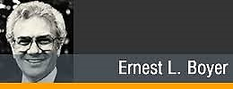
Navigating Empire State College Translation for QM or other assessment measures
The College’s Mission:
…Connects motivated adult learners with access to innovative, flexible and quality academic programs that empower people and strengthen communities. We build on the diversity of our students, their work and life experiences and their individual personal and professional goals as the cornerstone for each academic program.
Explain that QM and other instruments were built ground up by faculty like them.
Adapt the instruments to local challenges
Adapt the discussions to current problems in the institution
What would Boyer do today faculty and instructional design group

Slide 7
Trio talk – Your Institution Mission State and Future State
What is your institution’s mission?
How do you connect your work in Quality Improvement to that mission?
How do you translate the uniqueness of your institution in convincing faculty or others to do this work?
Administrators to support this work?

Slide 8
A little bit about me…
Served in a variety of leadership positions such as dean of online, vice provost, provost and acting president
1991
2007
Most Outstanding Achievement in Online Learning by an Individual
Inaugural class of Fellows, Online Learning Consortium and served as president of the OLC board of directors for six years
Part of Leading Efforts Related to State Authorization
2010
2011-15
Served as ESC Professor Learning and Ed Technology for five years.
Fulbright Research Scholar at the Waterford Institute of Technology in Ireland
2015
Completed my six year term as a commissioner for the Middle States Association for Higher Education.
2018
Notes:
2015 – Fulbright Research Scholar at the Waterford Institute of Technology in Ireland where my research focused on examining ways to further utilize educational technology to reduce barriers in adult learning.
Talking points – all this to say “online learning for adult students has been my life’s work….” and I am honored to be recognized for it through the years.

Slide 9
Current member of New York State's Regents Advisory Council. Interim Provost
Now
Provost, Current member of New York State's Regents Advisory Council.
Helped my institution in getting 3 million to develop online.
Initiated a proposal called Open SUNY to reinvigorate online
Currently serving on Chancellor’s Advisory – proposing a large change in Online at SUNY
Three Generations of Translating Online in SUNY and State Education Department

Slide 10




Trio talk – Conversations at your institution and elsewhere. How do you get a seat at the table?
What are the current conversations at your institution that are engaging faculty?
Are there grants and or other projects that you can use to improve quality through assessment?
Are there state-wide or other conversations that you need to join?
Examples?

Slide 11





Institutional Effectiveness
Notes:
To improve institutional effectiveness

Slide 12
Be Deliberate -- Beyond Course Assessment
Program effectiveness
Institutional effectiveness
Analytics
Resource Allocation
Accreditation
Frame at the start where and how you will share the results beyond the course.
Link to accreditation.
Partner with faculty development.
Partner for research, publish results.

Slide 13

Analytics
Notes:
effectiveness and ways in which to measure analytics and identify critical resource issues.

Slide 14
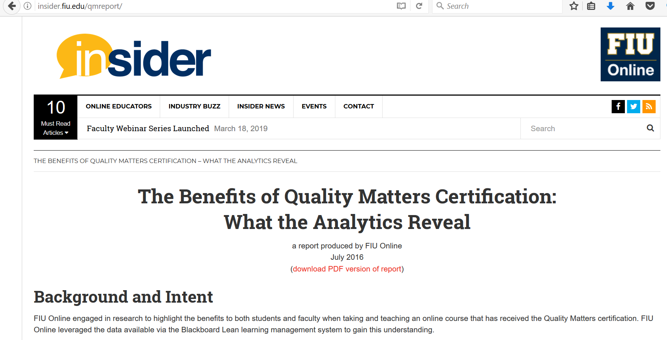

Slide 15

Institutional Support
Support
Notes:
We will discuss how to negotiate for internal institutional support

Slide 16
Getting the Investment and Support
From the VP Academic Affairs
Share specific improvement stories, in faculty voice
Very short report of five to ten results, greater data available, focus on results not activities
Link to other performance indicators (student retention, satisfaction)
Show how you have gotten on other agendas
From the VP Admin
Share efficiencies
Link to other performance indicators (student retention, satisfaction)
Present data in tabular format
Link to risk reduction

Slide 17
Trio Talk – Using Data and Performance to Inform and Change
Institutional effectiveness
Analytics
Resource Allocation
What examples do you have of using data to improve performance?
How have you used this to communicate needs or need for change at the institution?

Slide 18

Resources
Notes:
and resource development.

Slide 19

Accountability for the delivery and quality of online courses
Institutional effectiveness
Curriculum and instruction
Faculty involvement in curricula development
Technological delivery modes
Academic resources
Accessibility assessments
Course evaluation
Notes:
We will address the accreditation process and include how information ascertained from the QM process can tie into several important areas within accreditation standards including:
accountability for the delivery and quality of online courses;
institutional effectiveness;
curriculum and instruction;
faculty involvement in curricula development;
technological delivery modes;
academic resources;
accessibility assessments
and course evaluation.

Slide 20
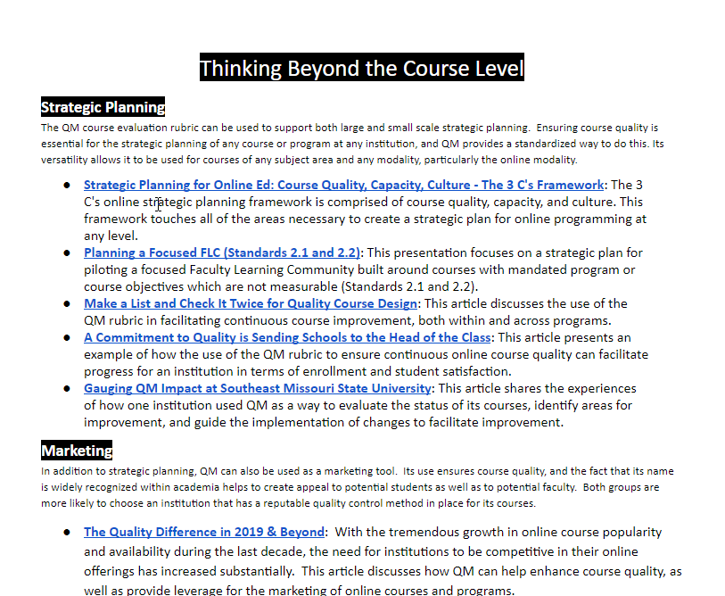
http://bit.ly/QMR19
QM Resources

Slide 21
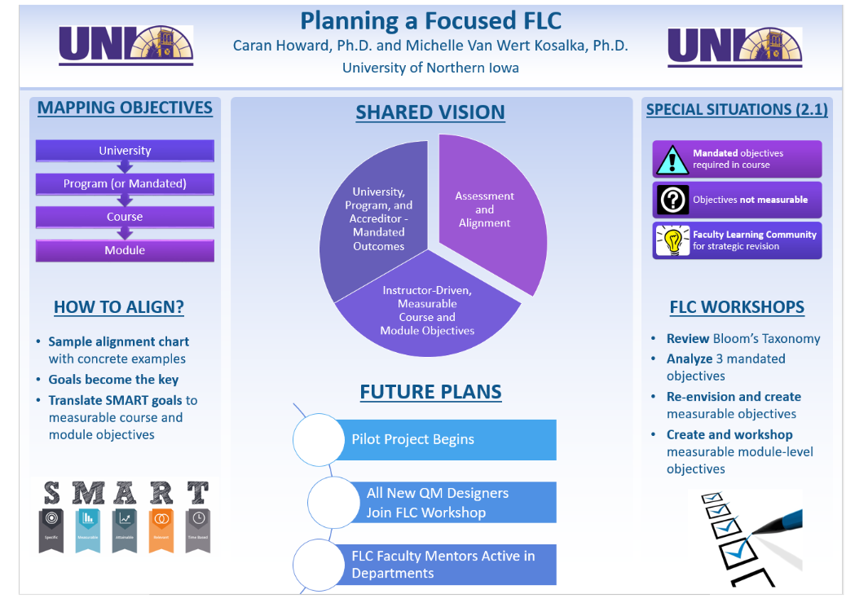

Slide 22
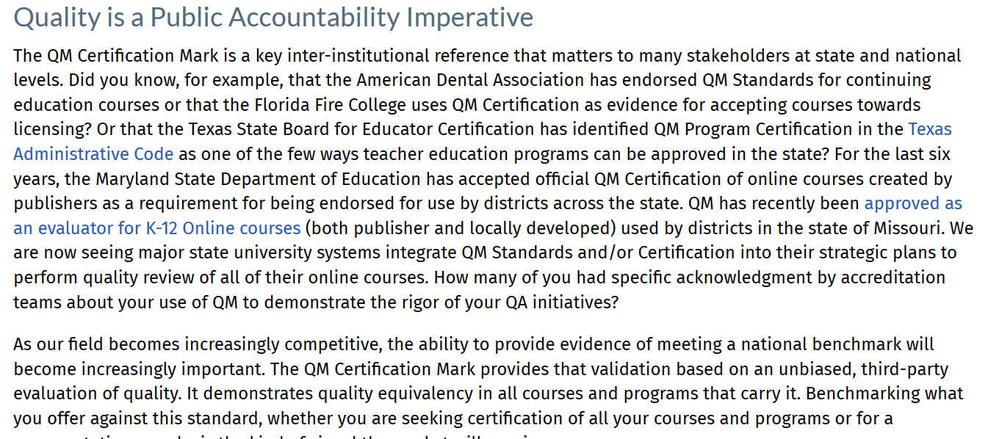

Slide 23

Emergency Review Process Example
Students who need accommodations for their currently enrolled courses are identified by Accessibility Resources and Services (ARS)
ARS sends emails to the Reviewers* and teaching faculty outlining identified students’ with disability needs
Identified courses are reviewed to identify challenges for specific types of functional limitation due to disability
Minor issues are fixed by the reviewers, while larger issues are addressed with the ARS office and the faculty member as needed
Facilitating Student
Success via
Emergency Accessibility
*Reviewers:
• Instructional Designers • Educational Technologists
Notes:
https://onlinelearningconsortium.org/about/2017-olc-effective-practice-award-winners/

Slide 24
2017 OLC Effective Practice Award
Students who need accommodations for their currently enrolled courses are identified by Accessibility Resources and Services (ARS)
ARS sends emails to the Reviewers* and teaching faculty outlining identified students’ with disability needs
Identified courses are reviewed to identify challenges for specific types of functional limitation due to disability
Minor issues are fixed by the reviewers, while larger issues are addressed with the ARS office and the faculty member as needed
Facilitating Student
Success via
Emergency Accessibility
*Reviewers:
• Instructional Designers • Educational Technologists
Notes:
https://onlinelearningconsortium.org/about/2017-olc-effective-practice-award-winners/

Slide 25
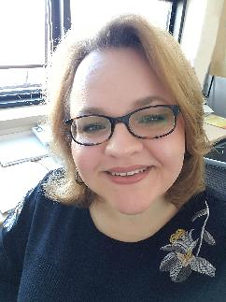
Emergency Review Process
Facilitating Student
Success via
Emergency Accessibility
Students who need accommodations for their currently enrolled courses are identified by Accessibility Resources and Services (ARS)
ARS sends emails to the Reviewers* and teaching faculty outlining identified students’ with disability needs
Identified courses are reviewed to identify challenges for specific types of functional limitation due to disability
Minor issues are fixed by the reviewers, while larger issues are addressed with the ARS office and the faculty member as needed
Antonia “Tonka” Jokelova, Ph. D.
Instructional Designer
and
Coordinator of Course Development Training
*Reviewers:
• Instructional Designers • Educational Technologists
Notes:
https://onlinelearningconsortium.org/about/2017-olc-effective-practice-award-winners/

Slide 26
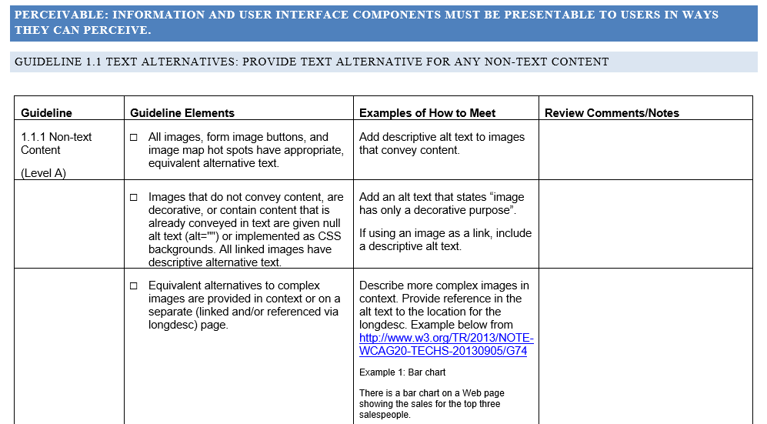
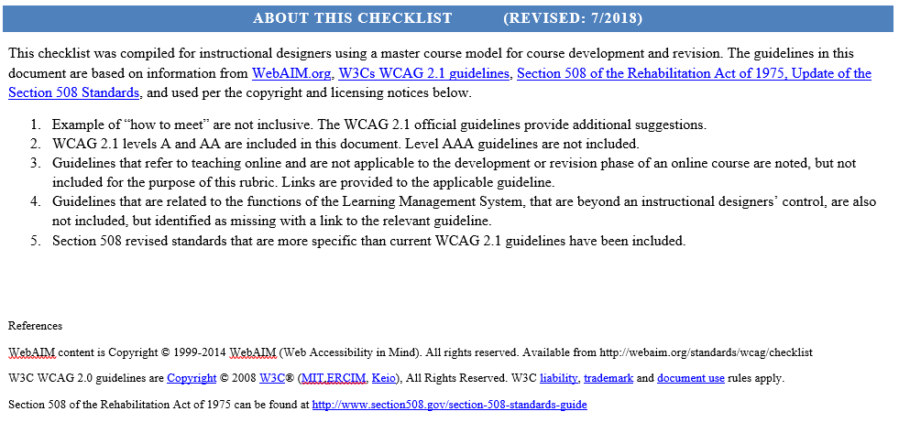
Accessibility Review

Slide 27


https://www.esc.edu/lit
Notes:
In an effort to share and collaborate with educators of all learning levels, the School for Graduate School and the Saratoga Springs School District has partnered for a free Learning with Innovative Technology conference in Saratoga Springs. This July will be the 4th annual.

