Slide 1
Faculty Perspectives on the Gold Review
A QM-Based Faculty Professional Development Model

Slide 2
Session Objectives
Share how the Gold Review process has progressed since its inception in 2015
Hear faculty perspectives as
  Peer certified reviewers
  Review Team members
Brainstorm ways to scale up and sustain the model in order to keep faculty learning at the forefront

Slide 3
Thought Question
What is the biggest challenge to SCALING UP faculty participation in the review process?

Slide 4
Background
VIDEO
Towson University, a master’s comprehensive state university within the University System of Maryland

Slide 5
Gold Review Process
A comprehensive course review and instructional design support system based on QM standards
Teams of QM-certified faculty reviewers and Office of Academic Innovation instructional designers use an abridged version of the QM Rubric to review courses
Formative, not evaluative
Not a teaching evaluation

Slide 6

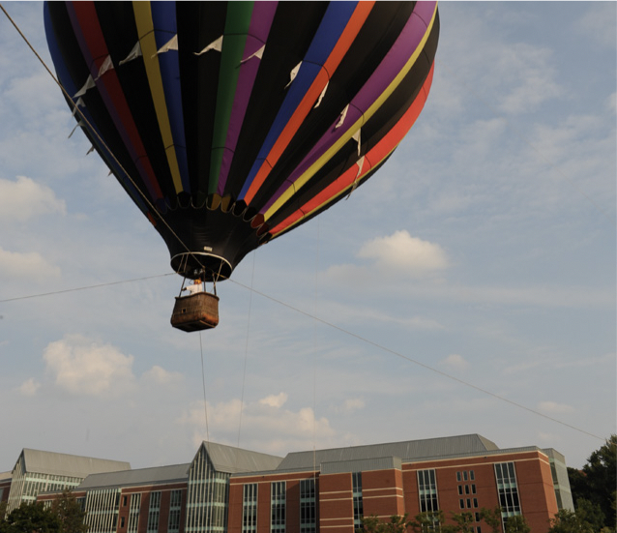
Accomplishments to Date
Faculty Participants (n = 21)
Courses Reviewed (n = 19)

Slide 7
Undergraduate Courses (n = 10)
AHLT 310
AHLT 320
AHLT 450
MUSC 116
MUSC 355
HLTH 207
HLTH 220
KNES 315
KNES 460
HCMN 441

Slide 8
Graduate Courses (n = 9)
ILPD 603
ILPD 668
ILPD 675
ILPD 716
ILPD 740
ILPD 742
ILPD 745
ILPD 781
ILPD 797

Slide 9
Bethany Willis Hepp, Ph.D.
Assistant Professor
Family Studies and Community Development
Motivation to Participate
Improvements Made
As a Reviewer:
  Desire to increase my knowledge base about online learning
  Wanted inter-disciplinary perspectives on distance learning
  Looking for best-practices
As a Participant:
  Desire for constructive peer-feedback on a course were I was feeling “too comfortable”
  Desire to increase student ownership of the learning experience while supporting their process with quality supports in an online forum
In distance courses AND face-to-face courses:
  Increased navigability
  Increased student-to-student, student-to content, and student-to-instructor engagement
  Increased Universal Design, easing burden for students with varied learning styles in an online format
  Outcomes reflect differences based on qualitative feedback from student evaluations over time!

Slide 10
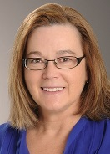
Linda Caplis, Clinical Assistant Professor
Allied Health Program, Towson University---
The only online undergraduate program at TU
QM provided professional development to become competent as online instructor
Online “can” be more robust than face-to-face learning—BUT IT TAKES TIME, ENERGY, & SUPPORT
QM Standards applicable to face-to-face teaching
ALIGNMENT, ALIGNMENT, ALIGNMENT

Slide 11
Mickey Jancewski
Department of Health Science
Full time Lecturer, College of Health Professions
Peer reviewer, training to chair course reviews
Why?
  Learning Platforms/courses should be easy to use
  Student learning
  Professional growth
Course changes?
  Organization and structure
  Student engagement
  More diverse learning materials

