Slide 1

Oh Caption,
My Caption!
Quality Matters Conference
October 31, 2018
bit.ly/OhCaption

Slide 2


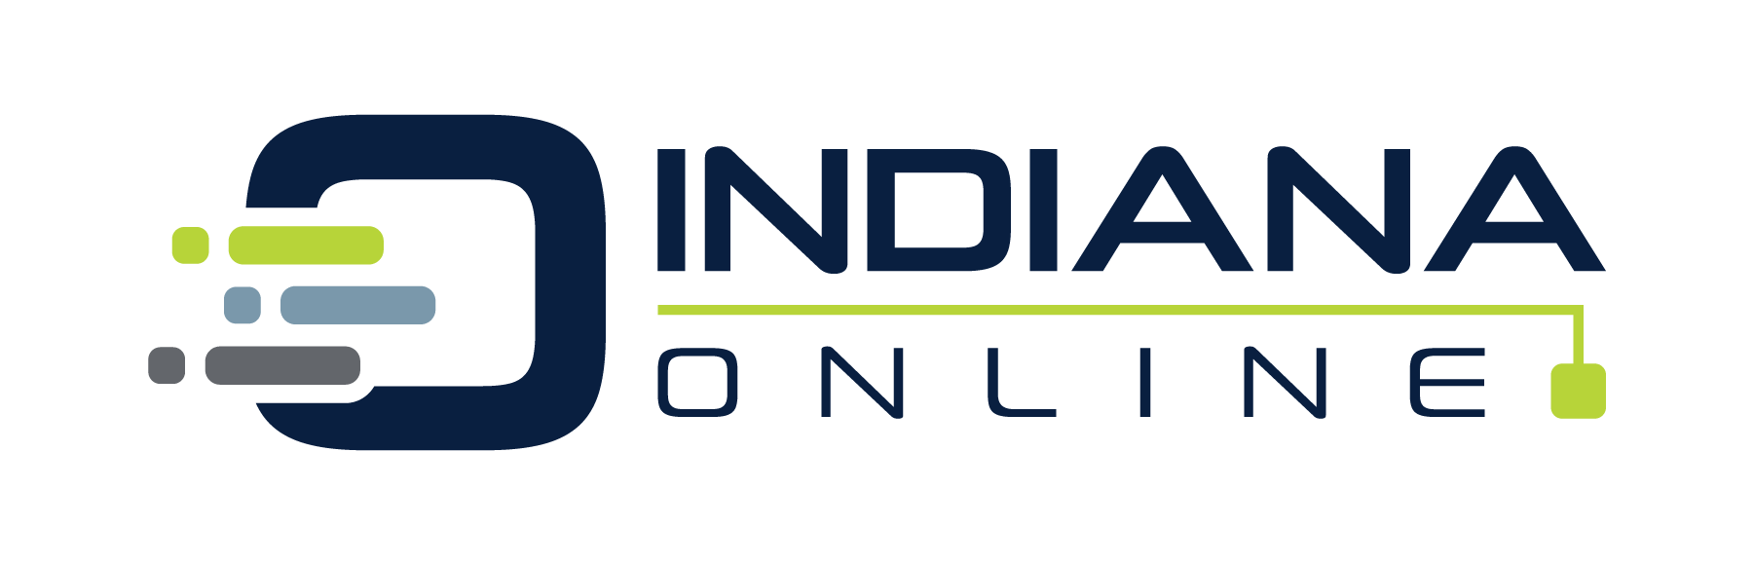

Laura Garmire
@LauraGarmire
Virtual Learning Specialist
Indiana Online | CIESC

Slide 3


Kim Hendrick
@evolvewithkim
Director of Innovation
Indiana Online | CIESC

Slide 4


Why is Closed Captioning Important?
Standard 8
Notes:
kim

Slide 5
Standard 8
The course design reflects a commitment to accessibility, so all learners can access all content and activities, and to usability, so that all learners can easily navigate and interact with all course components.
Notes:
kim

Slide 6
Standard 8
8.1 Navigation throughout the course is logical, consistent, efficient, and intuitive. (3)
8.2 Information is provided about the accessibility of all technologies required in the course. (3)
8.3 The course provides alternative formats of course materials that meet the needs of diverse learners in order to accommodate alternative means of access. (2)
8.4 The course design facilitates readability. (2)
8.5 Course multimedia facilitate ease of use. (2)
Notes:
kim

Slide 7

Closed Captioning Goal
The idea is anyone should be able to watch with the sound turned off and still get the full experience of what’s happening on screen.
Notes:
kim

Slide 8
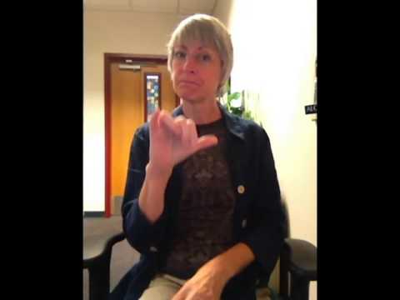
The Importance of CC Demonstrated

Slide 9
Why Should We CC?
Watch Time - shown to increase
Inclusion - accessible to deaf and hard of hearing
Focus - help viewers stay focused and retain information
Learning Styles - helps ELL, LD, Visual Learners
Quality Matters Standard 8.2
Most Important:
It’s the Law!

Slide 10
Federal Laws
Twenty-first Century Communications and Video Accessibility Act of 2008 and 2009: An Act designed to ensure that individuals with disabilities have access to emerging Internet Protocol-based communication and video programming technologies. This Bill applies to broadcasters who have online video content.
Americans with Disabilities Act of 1990: Sections of this act prohibit discrimination against those with disabilities and applies to state and local government.
Rehabilitation Act of 1973: Section 508: Section 508 requires captioning and transcription of any video content made public by federal agencies or organizations receiving federal funds, including higher education institutions.
Section 504 and Title II of the ADA: Designed to prevent discrimination, Title II of the Americans with Disabilities Act (ADA) and Section 504 of the Rehabilitation Act of 1973 require all elementary and secondary schools to make accommodations for students with disabilities.
Television Decoder Circuitry Act of 1990: This act requires new televisions to have built-in closed caption decoder circuitry
Assistive Technology Act of 1998: By virtue of this act (29 U.S.C. 3002), the Rehabilitation Act’s Section 508 regulations are applicable to the states, and thus to the colleges, universities and its contractors and grantees.
Telecommunications Act of 1996: The Telecommunications Act of 1996 requires virtually broadcast and cable programs to be captioned.
Cable Television Captioning Requirements under 47 C.F.R. 76.606: Cable Television Captioning Requirements under 47 C.F.R. 76.606 protect captioning data and quality for all cable television systems.
"Accessibility Regulations And Closed Captioning." CaptionSync by Automatic Sync. N. p., 2018. Web. 2 Oct. 2018.

Slide 11
U.S. State Laws
The following states (not comprehensive) have enacted policies on accessibility of media and websites: Arizona, Arkansas, California, Colorado, Indiana, Kentucky, Louisiana, Illinois, Maryland, Minnesota, Missouri, Montana, Nebraska, North Carolina, Texas, Virginia, West Virginia, and Oklahoma. Most of these states have adopted laws similar to the Federal Laws. Several states have enacted or have pending specific laws addressing issues such as captioning and publishers’ obligations to provide captioned materials or to provide copyright clearance to enable non-captioned materials to be captioned. Missouri Law (RSMo 170.135) requires publishers or manufacturers of electronic video instructional materials to supply the videos with open or closed captions to make the materials more accessible for students with hearing impairment as of January 1, 2008. Failure to comply will include financial penalties. California Assembly Bill 386 introduced in February, 2009 would require that publishers caption upon request or provide a license to caption to California schools who need captioned material. The law would impose tight deadlines of actions, and provide options to allow schools the ability to caption materials on their own with no copyright constraints if the publisher is not able to comply.
"Accessibility Regulations And Closed Captioning." CaptionSync by Automatic Sync. N. p., 2018. Web. 2 Oct. 2018.

Slide 12
Government Agencies and Government Funded Entities Including Educational Organizations
Rehabilitation Act: Sections 504 and 508
  The Rehabilitation Act was put in place to prevent disability discrimination by government entities or organizations receiving federal funding. Section 504 and 508 expand the application to electronic media and online video content .
Assistive Technology Act of 1998
  This Act extends the requirements of the Rehabilitation Act’s Section 508 regulations to individual states, and thus to the colleges, universities, its contractors and grantees.
"AST Services Comply With Captioning Laws & Standards." CaptionSync by Automatic Sync. N. p., 2018. Web. 2 Oct. 2018.

Slide 13
Reasons
Watching something in a loud environment
Watching something without distracting others
When audio speakers on a device aren't loud enough
When the volume of a video is inconsistent
Watching something with sensitive subject matter in public

Slide 14
Trials and Tribulations of adding CC
Time
Expense
What else???

Slide 15
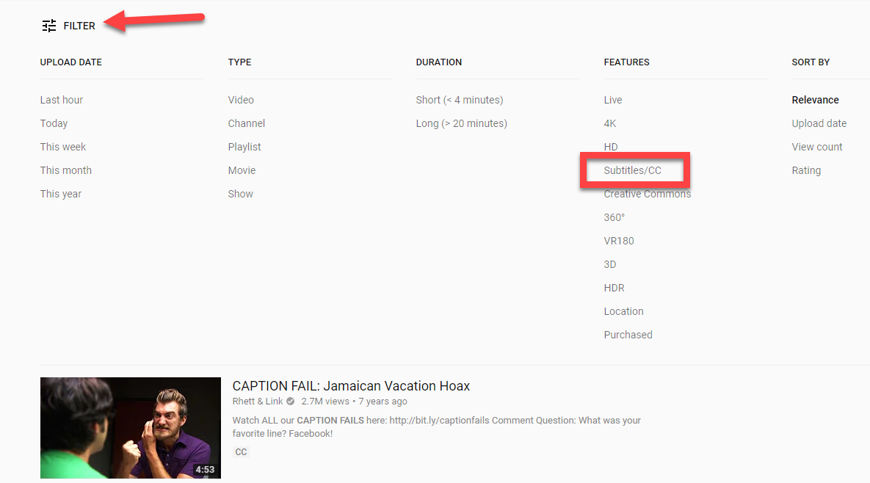
YouTube
Search for your topic
Click Filter
Under Features, choose Subtitles/CC

Slide 16
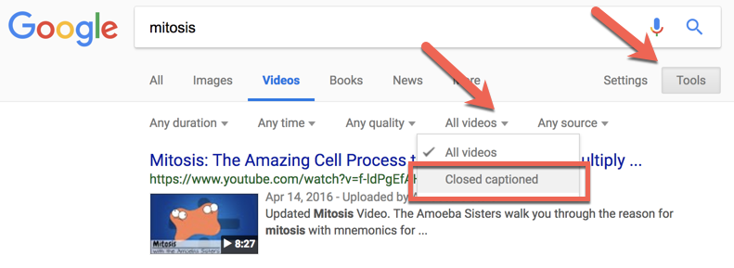
Google
Search for your topic
Click Videos
Click Tools
Under All videos, choose Closed captioned

Slide 17
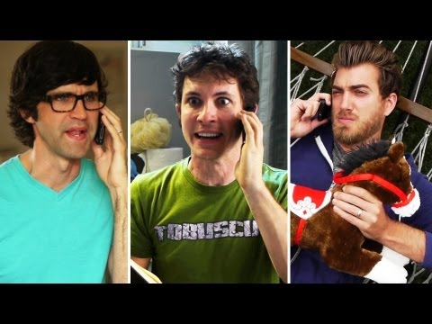
Caption Fail

Slide 18
Great Video - No CC
Contact the owner to see if they will CC the video
Amara.org
  Longer process
  How-To Playlist

Slide 19
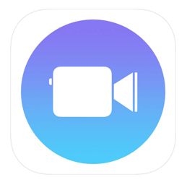
Clips
iPhone, iPad, iPod Touch
On the fly recording
Live text
Save
Upload to YouTube or your LMS

Slide 20

Clips

Slide 21
Movp4
iPhone, iPad, and iPod Touch
Quickly converts the Clips video file (.mov .m4v and so on) to mp4
Now goes seamlessly into your LMS

Slide 22

Clipomatic
iPhone, iPad, iPod Touch $4.99
Android
On the fly recording
Live text
Save
Upload to YouTube or your LMS

Slide 23
Google Slides
Chrome Only
The feature will roll out to users beginning this week. It works by accessing your computer's microphone to pick up on what you're saying during a presentation. It then transcribes your speech as captions, which appear on the slides you're presenting in real time.

Slide 24
PowerPoint Translator
Windows Only
Latest version of PPT & Windows 10 recommended
Install software
Activate subtitles
Record Slide Show
Save Subtitles (remember to change .txt to .srt)
Save a .mp4
Upload to YouTube & add the subtitles
Notes:
Switch out to a PC

Slide 25
Uploading Video to YouTube
Login to your YouTube account
Upload the video
Click on Creator Studio or Video Manager
Dropdown arrow next to Edit
Add new subtitles or CC - Choose English
  Upload a file (must be a srt file)
  Transcribe and auto-sync (if you have a transcript)
  Create new subtitles or CC (add by typing)

Slide 26
Create a Transcript
Google Docs - Voice Typing
  Copy and paste the transcript into Transcribe and auto-sync
Download as a .txt file
Change the extension to .srt
  Upload the .srt file

Slide 27

Crowdsource
Let’s crowdsource websites, programs, tips!

Slide 28










