Slide 2
Operational Quality Assurance - Ensuring Quality Across an Organization!
Crystal Guiler

Slide 3

Agenda
Decisions in Leadership
Who/What do we ultimately serve?
Decision Mapping
Prove it before you bruise it!

Slide 4
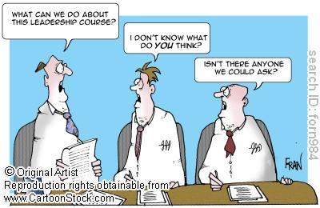
Decisions in Leadership

Slide 5





Slide 6

Most Importantly…

Slide 7
What is your goal?
How does it impact your mission/vision/values?
Who does this serve? Does your decision serve the right people?

Slide 8

OK and what does this have to do with Quality Assurance?

Slide 9

Define Quality

Slide 10
Define Quality
the standard of something as measured against other things of a similar kind; the degree of excellence of something (Google, 2017)

Slide 11

Example
Our Mission:
To deliver a high quality, technology-based education that provides the skills and knowledge students need for success.
Our Vision:
To transform education worldwide—one student at a time.
Our Commitment:
The student is at the center of every decision we make.

Slide 12
Decisions with Quality Assurance at the Forefront.
Our Mission:
To deliver a high quality, technology-based education that provides the skills and knowledge students need for success.
Our Vision:
To transform education worldwide—one student at a time.
Our Commitment:
The student is at the center of every decision we make.
Quality as defined by the FLVS mission is to ensure that ALL decisions are made with the student at the center, that they have some impact on transforming education, and that they lead to student success.

Slide 13

QM Standards can help!

Slide 14
Departments and QM
Instruction – Quality Assurance Instructors
Notes:
The Python 3.5 software is free and is integrated into the course. There is no need for materials or student downloads.

Slide 15
Why do we have QAI?
Quality as defined by the FLVS mission is to ensure that ALL decisions are made with the student at the center, that they have some impact on transforming education, and that they lead to student success.
Guaranteed review and assurance of QM standards.
Data to drive student achievement and policy decisions.
Quantitative and qualitative data to inform performance reviews.

Slide 16
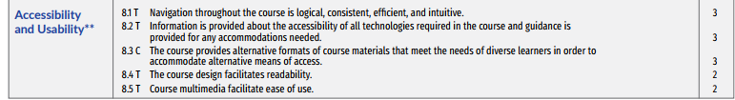
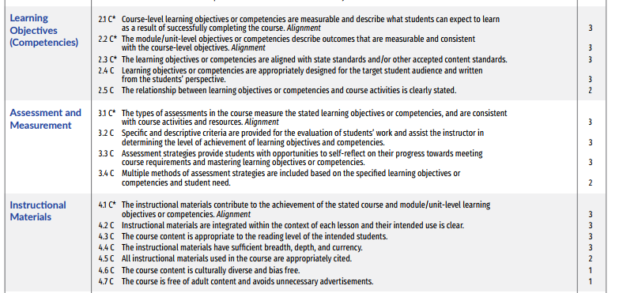
Departments and QM
Course Design –
Quality Assurance Analysts
Course Design –
Curriculum Specialists
Notes:
The Python 3.5 software is free and is integrated into the course. There is no need for materials or student downloads.

Slide 17
Why do we have a team for QA and CS?
Quality as defined by the FLVS mission is to ensure that ALL decisions are made with the student at the center, that they have some impact on transforming education, and that they lead to student success.
Guaranteed review and assurance of QM standards.
Expert reviewers to ensure learning transforms education with students at the focus.

Slide 18
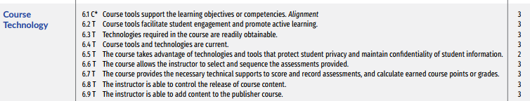
Departmental Decisions and QM
IT – Quality Assurance Analysts
Notes:
The Python 3.5 software is free and is integrated into the course. There is no need for materials or student downloads.

Slide 19
Why do we have a team for QA in IT?
Quality as defined by the FLVS mission is to ensure that ALL decisions are made with the student at the center, that they have some impact on transforming education, and that they lead to student success.
Guaranteed review and assurance of QM standards.
Opportunity to gather real-time data on student use of technology, barriers, and solutions.

Slide 20
How does this all come together?
Quality as defined by the FLVS mission is to ensure that ALL decisions are made with the student at the center, that they have some impact on transforming education, and that they lead to student success.
  Quality does not just live with one department.
  Quality is the driving force in decision making.
  Quality cannot be sacrificed.
  Quality decisions are mapped from your mission.

Slide 21
Example
You have $25,000 to spend in instruction. What do you do with it?
  What is your mission?
  What does the data say is the highest need?
    Teacher PD?
    Lower student loads?
    Hiring outside support in web development or accessibility?
    Don’t have the data? Invest in the data! What we think we need is not always what we do need. Only data can tell us this.

Slide 22
Example
You have $30,000 to spend on IT. What do you do with it?
  What is the biggest need?
  How do you know that is the biggest need?
  Data
    Data
      Data
        Data

Slide 23
Invest
Take your organization’s mission/values/commitment and define quality.
Ask yourself: How are we measuring this in every department?
  If you can answer this: Get the data! Never make a decision without data to support.
  If you cannot answer this, consider what you can do based on your definition of quality to gather this data.
    Do you need more roles? This doesn’t always mean more people?
    Do you need review processes in place?
    Do you need documentation (checklists/guidelines?

Slide 24
Don’t get caught up in the tennis match!
Decision-making with quality in mind is not easy.
A quick decision can only be made with data. If data does not exist then invest in the data not the decision.
Prove it before you bruise it.

Slide 25
Prove it before you bruise it!
What if I don’t have the data?
Pilot the decision and gather that data!
Decisions made solely without data are like gambling on a slot machine. You may win but likely you’ll be in the same or a worse state at the end.
Ask yourself
  How long do we have to make this decision?
  Does it align with our mission?
  If I have to make it now what data do I wish I had to make it?
  Get that data!

Slide 26
Contact
cguiler@flvs.net
813-446-6215

