Slide 1
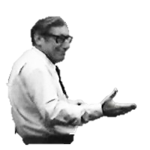
Outfoxing Dr. Fox:
Alternatives to Student Evaluation Data for Measuring QM Impact

Slide 2
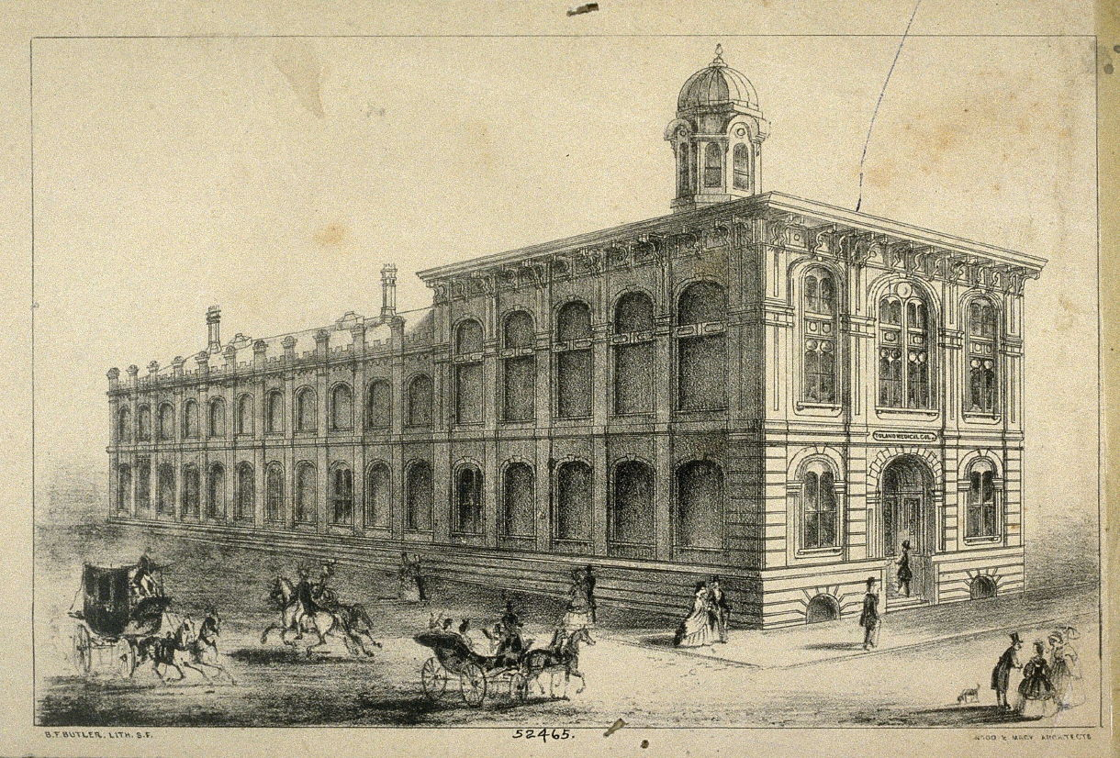

Slide 3
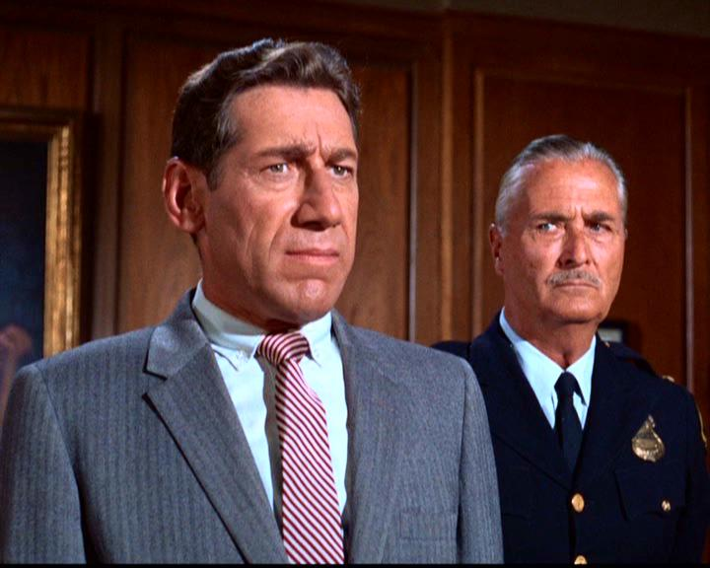

Slide 4
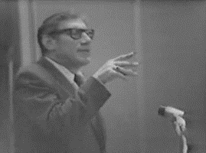

Slide 5
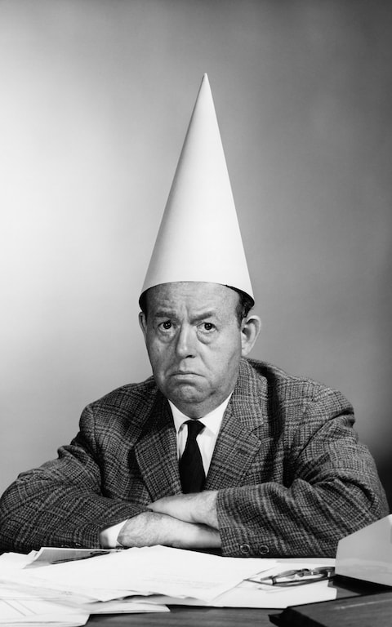

Slide 6
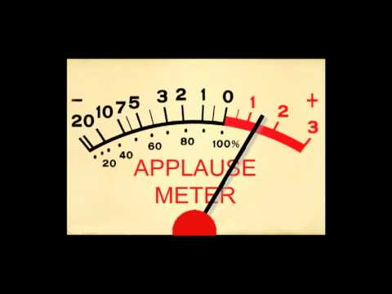

Slide 7
mht

Slide 8
mht

Slide 9
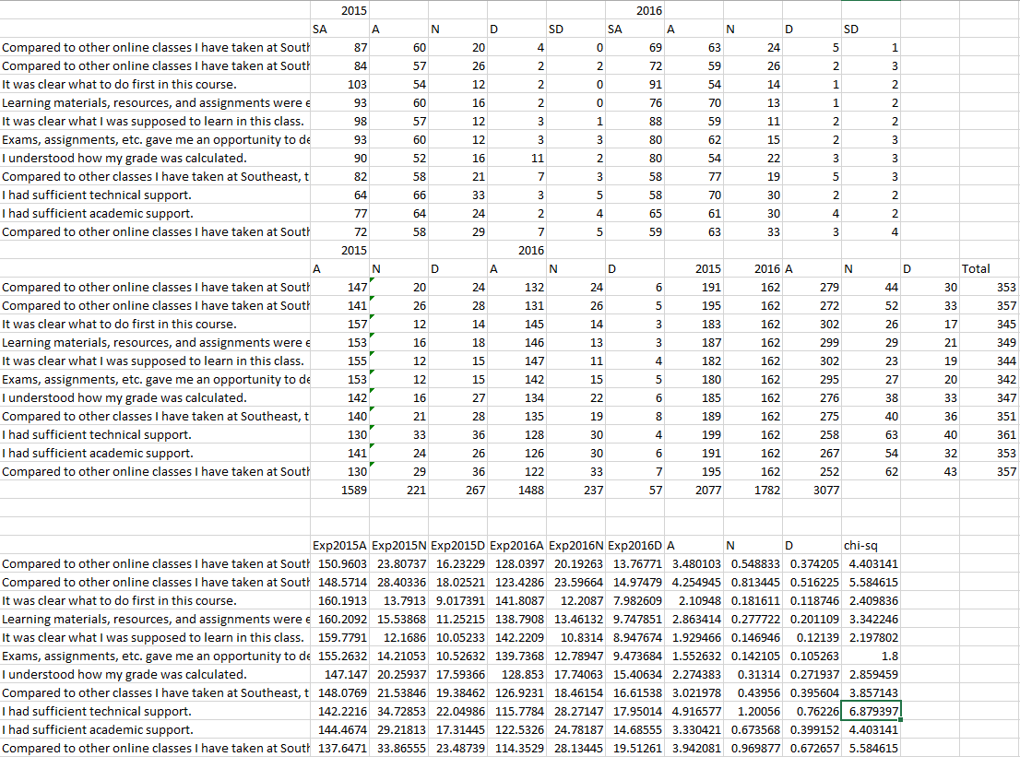

Slide 10


Slide 11
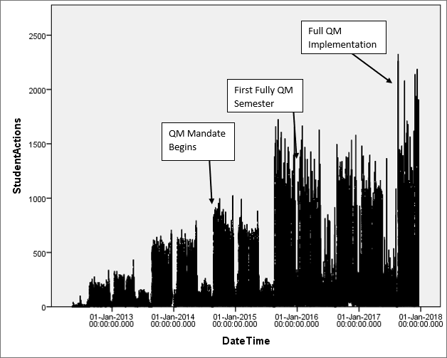

Slide 12


Slide 13
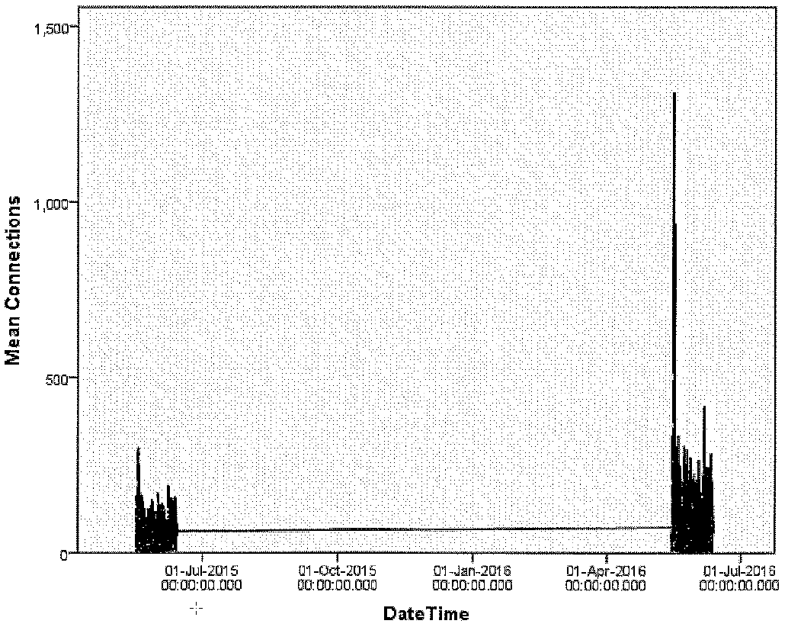

Slide 14
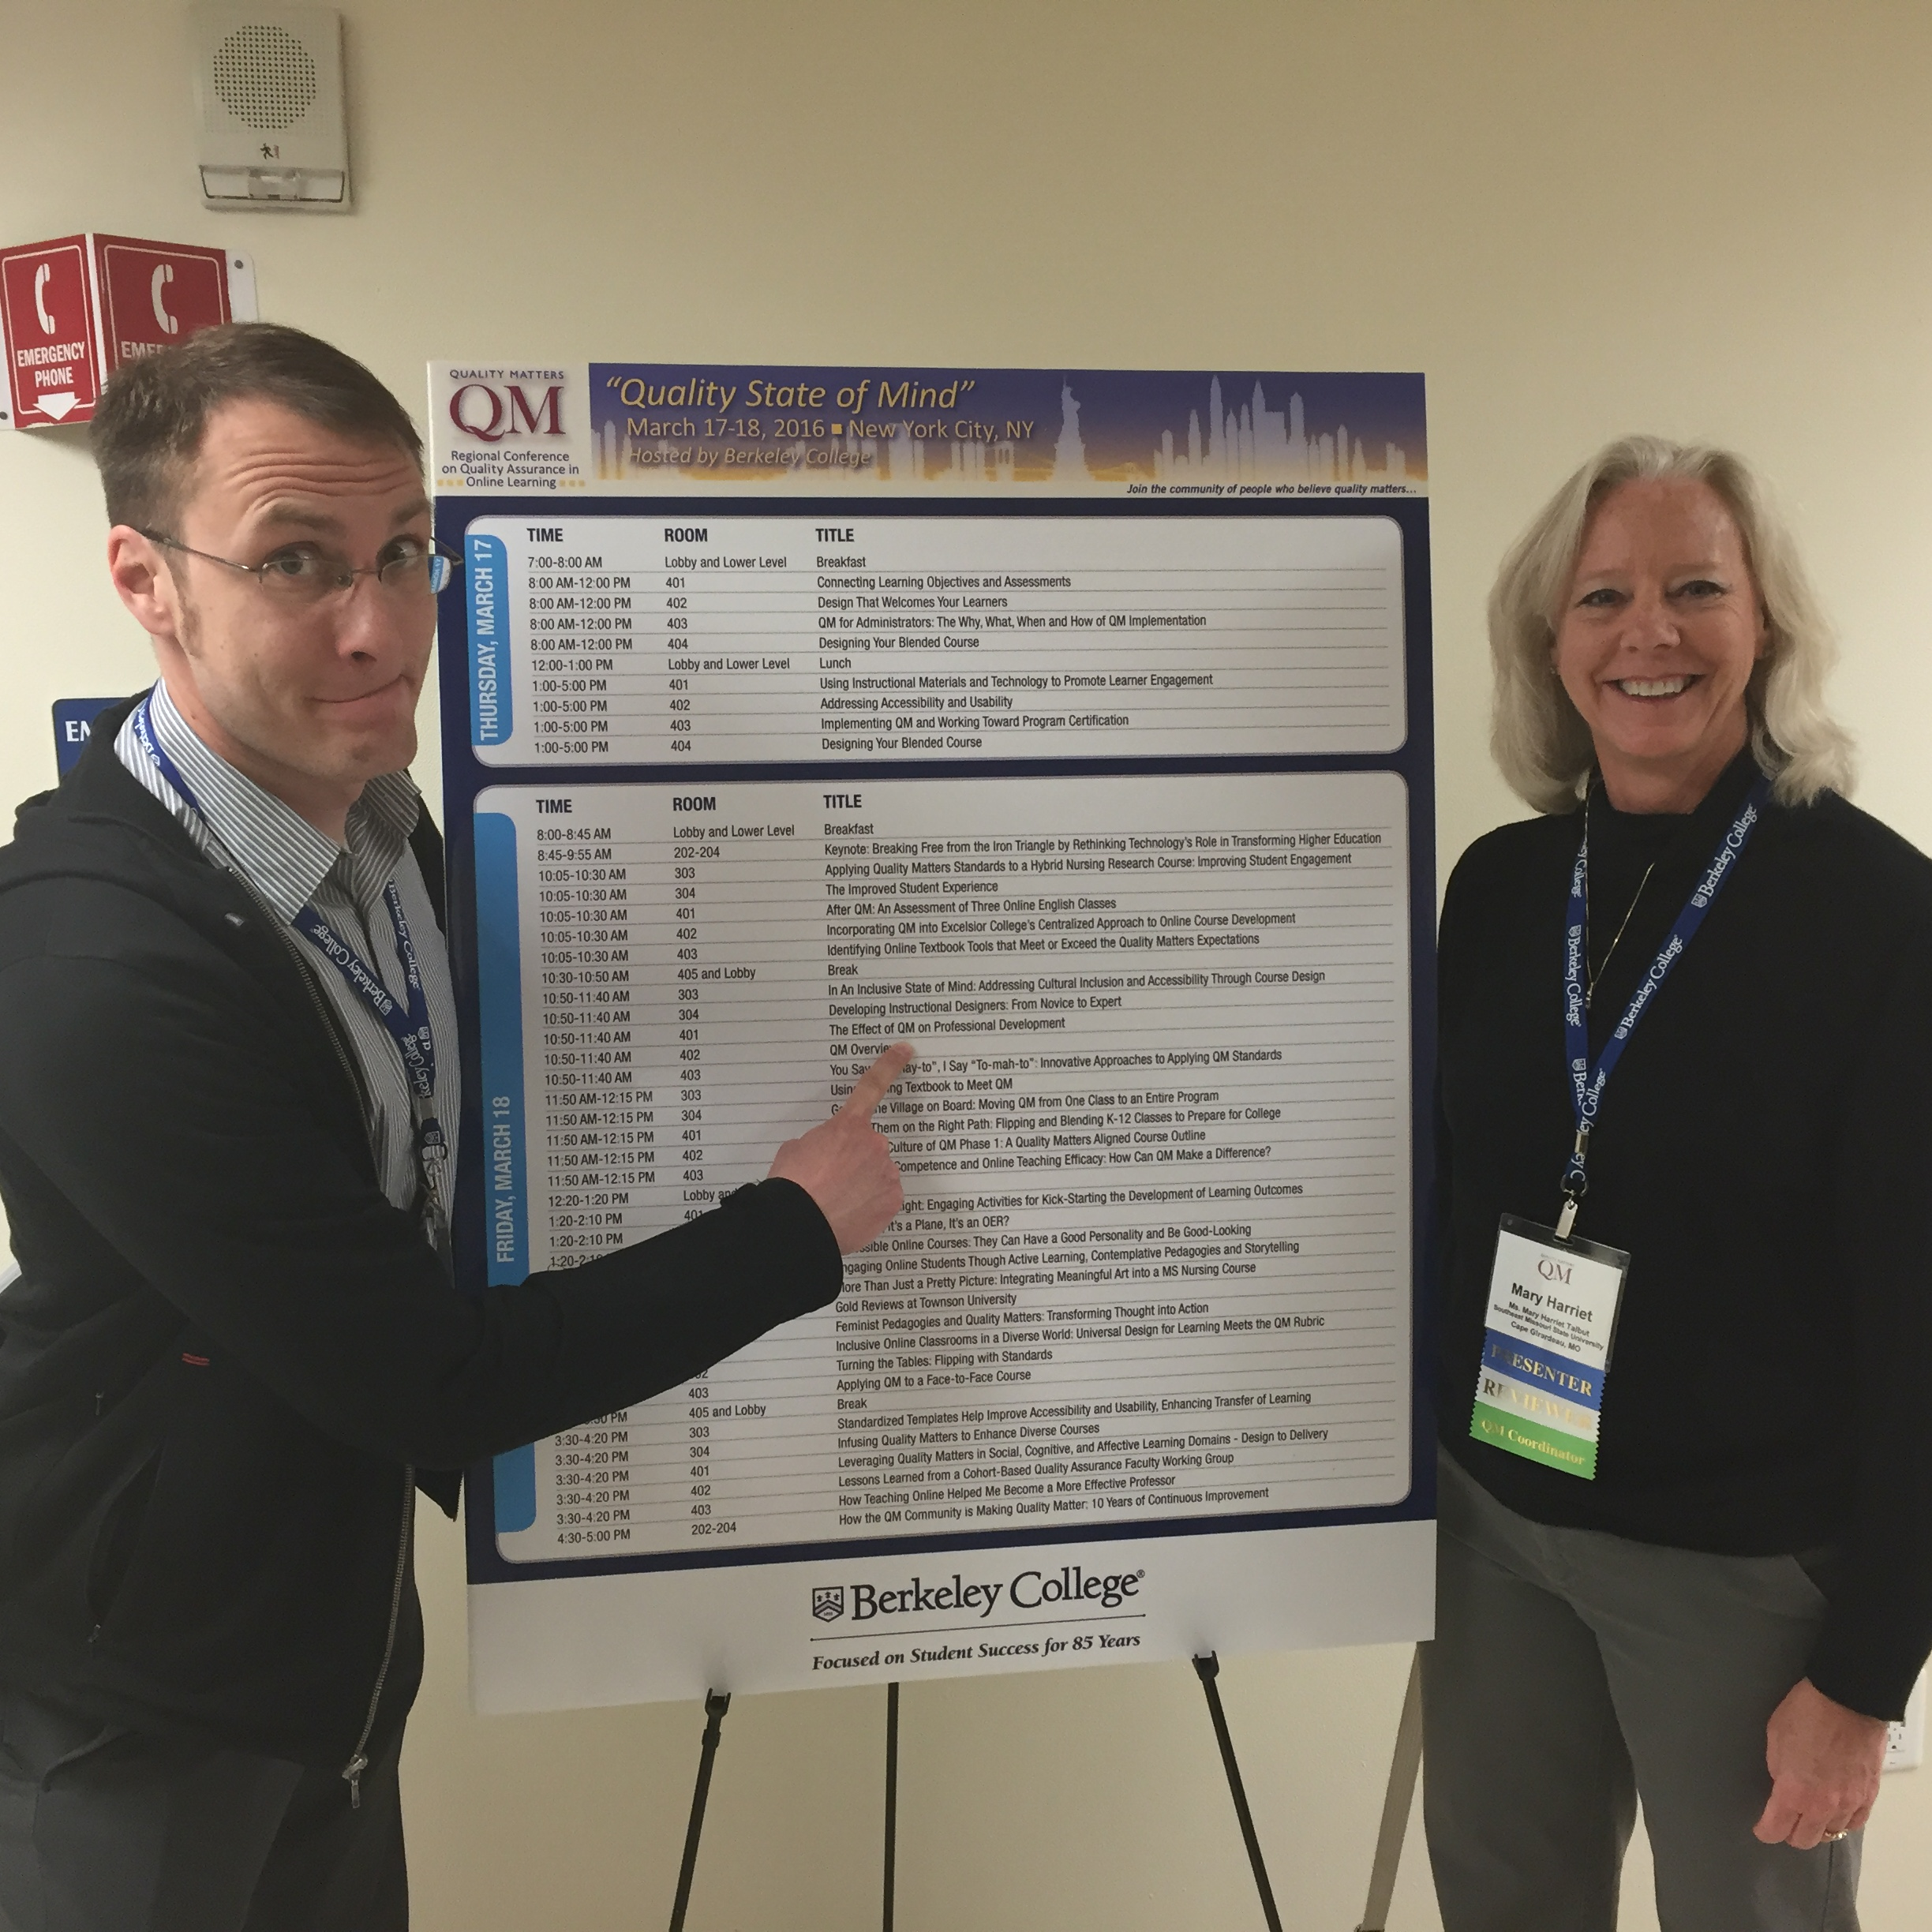

Slide 15
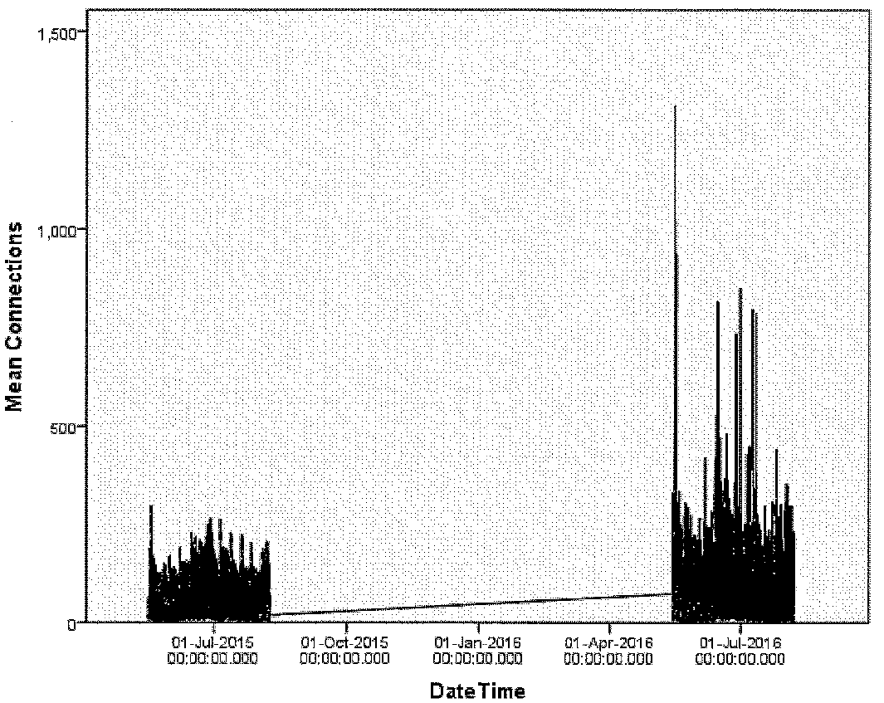

Slide 16
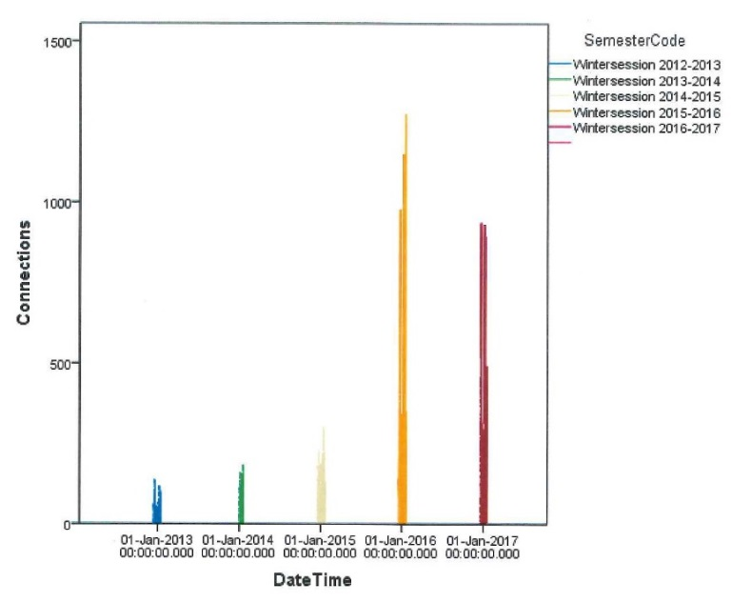

Slide 17
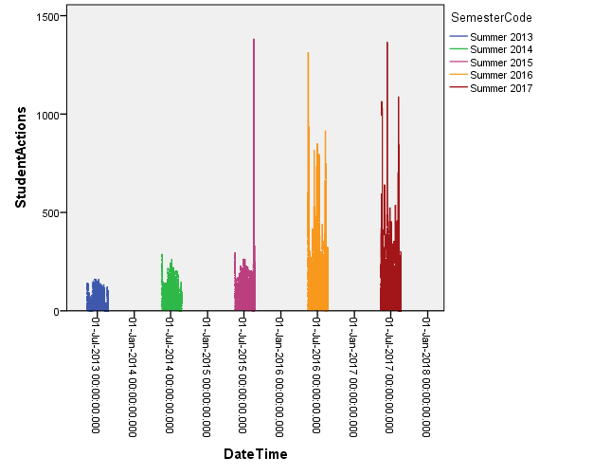

Slide 21
mht

Slide 22
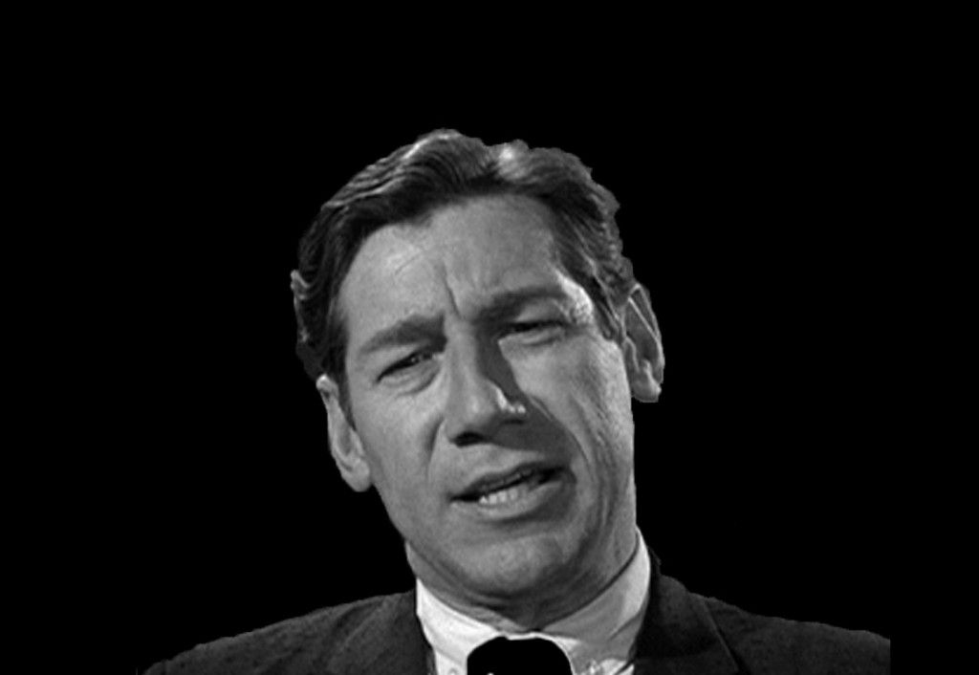

Slide 23
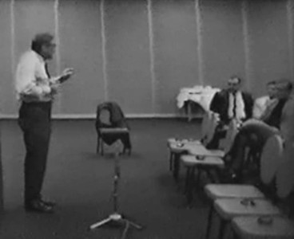

Slide 24
Notable References
Peer, E. and E. Babad. (2013). The Doctor Fox research (1973) re- revisited: ‘Educational seduction’ ruled out. Journal of Educational Psychology, 106.1, pp. 36-45.
Carrell, S. and J. West. (2010). Does professor quality matter? Evidence from random assignment of students to professors. Journal of Political Economy, 118.3. pp. 409-432.

