Slide 1

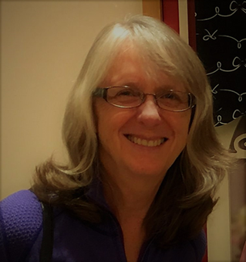

Margaret Haefner,
Professor of Communications
Katie Maier-O’Shea,
Dean of the Library & Academic Technology
Peer Mentoring for Online Course Development

Slide 2
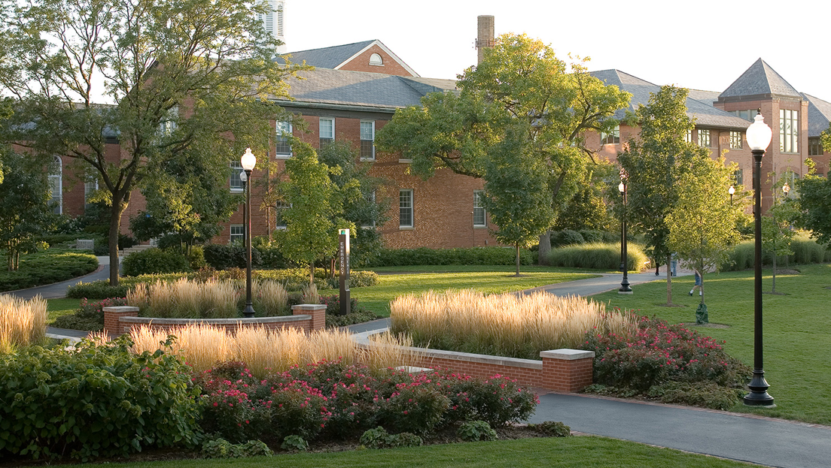

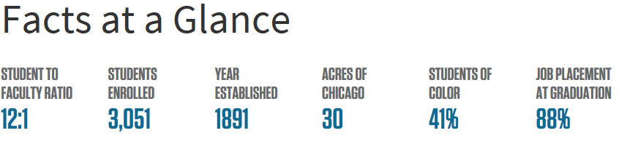

Slide 3


Online Learning at North Park University
Primarily a face-to-face university
Most online learning is in:
  School of Business and Nonprofit Management
  School of Professional Studies (Adult Learning)
  Seminary
Very recent growth in traditional undergraduate
New fully online DNP
Courses are designed by people who teach them; largely full-time faculty

Slide 4
Origins of the Peer Mentor Program
Severe understaffing in a time of administrative change
Needed quick solutions without significant full-time hiring
Remained committed to:
  Improving quality
  Increasing the number of online courses and programs
  Strategic placement of online and hybrid courses in undergraduate and graduate
  Cost-effectiveness
  Building acceptance

Slide 5
General Attitudes about online learning
Seen as a poor substitute for face-to-face learning
A threat to the liberal arts
The process was picky and controlling
Disliked the LMS and Quality Matters
Interfered with the experts in teaching (professors)
Not a good fit for North Park; “necessary evil” for limited programs
Office of Distributed Learning was a gatekeeper and did not understand faculty

Slide 6
Existing Consultants’ Report
“Implement a collaborative approach to course design. Locate faculty to help as Course Writing Coaches during the initial course development phase. ”

Slide 7
Peer Mentors at North Park University
Faculty and staff members who:
Have developed and taught online and hybrid courses
Are Quality Matters certified peer reviewers.
All are QM Master reviewers (though not required)
Currently have two active peer mentors – more needed

Slide 8
Peer Mentors at North Park University
Collaborate with Center for Online Learning (COE) instructional designer to develop online and hybrid courses.
  Coach faculty through online course development course (COE 102) designed to lead them through course development process
  The goal is to ensure the newly developed course meets QM standards.
  Serve as liaison between COE and academic units.
  Recruit potential online and hybrid professors.
  Mentor six faculty members per semester.
  May serve as QM reviewer on minimal number of courses for which they have not served as peer mentor (external QM reviewers preferred).
  Stipend = one course overload/semester.

Slide 9
Peer Mentors at North Park University
Benefits of the peer mentor program:
Builds collegiality among faculty colleagues
  Trust and shared expertise
  Collaborative process for building quality instruction with COE partners.
  More voices contributing to learning community
Growing number of course offerings for students that are based on best practices (QM)
  Ideally, better student learning experience
Significantly lower cost than instructional designer position.

Slide 10
Peer Mentors at North Park University
How to entice online/hybrid faculty to become peer mentors
  Benefits:
    Strong stipend
    COE paid initial and ongoing professional development
    Collaborative learning community
  Detriments:
    Uneven time commitment, sometimes during busy times in semester
  Suggestions?

Slide 11
Results
Sharp increase in the capacity to create online courses
More hybrid and online courses
New courses online and hybrid courses in the traditional undergrad program (summer, GE) greater than all graduate and professional combined
Successful targeting of tenured faculty as online instructors
Trust, acceptance

Slide 12
Next Steps
Outsource many QM reviews (comparable cost to in-house) to:
  Allow mentors to focus on the course development process
  Better compliance with external/SME QM policies
Continue to recruit more mentors
Hire a second instructional designer and part-time media assistant rather than an associate dean

Slide 13
?

