Slide 1



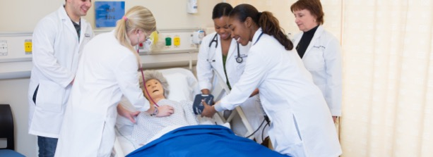
Photovoice
A Teaching & Learning Strategy for Promoting Empathy and Critical Thought

Slide 2



Presenter Information
Tiffany Moy
Instructional Designer ​
School of Nursing​
​
Heidi Schroeder
Senior Instructional Designer:
School of Nursing
Adjunct Instructor:
Education & Student Life Skills
Joy Wu, PhD
Senior Instructional Designer:
School of Nursing
Adjunct Assistant Professor:
Health Professions Education
Health Analytics

Slide 3
Getting to Know You
Question 1: How long have you taught and/or designed courses?
Question 2: Have you utilized PhotoVoice previously as a teaching strategy?
Question 3: How would you rate your comfort level with implementing new teaching strategies? (post the letter for the best description)
  Very uncomfortable
  Uncomfortable
  Indifferent
  Comfortable
  Very Comfortable)
Please share your answers using the Zoom Chat feature

Slide 4
Getting to Know You
Question 4: What would you like to walk away with at the end of the session?
(post letter for all that apply)
  Strategy for motivating critical thinking;
  Strategy for motivating empathy;
  “Step by step” instructions for implementing PhotoVoice;
  Template for developing PhotoVoice prompt;
  Examples of how Photovoice can be used in various subjects
  Other (Post in Chat)
Please share your answers using the Zoom Chat feature

Slide 5
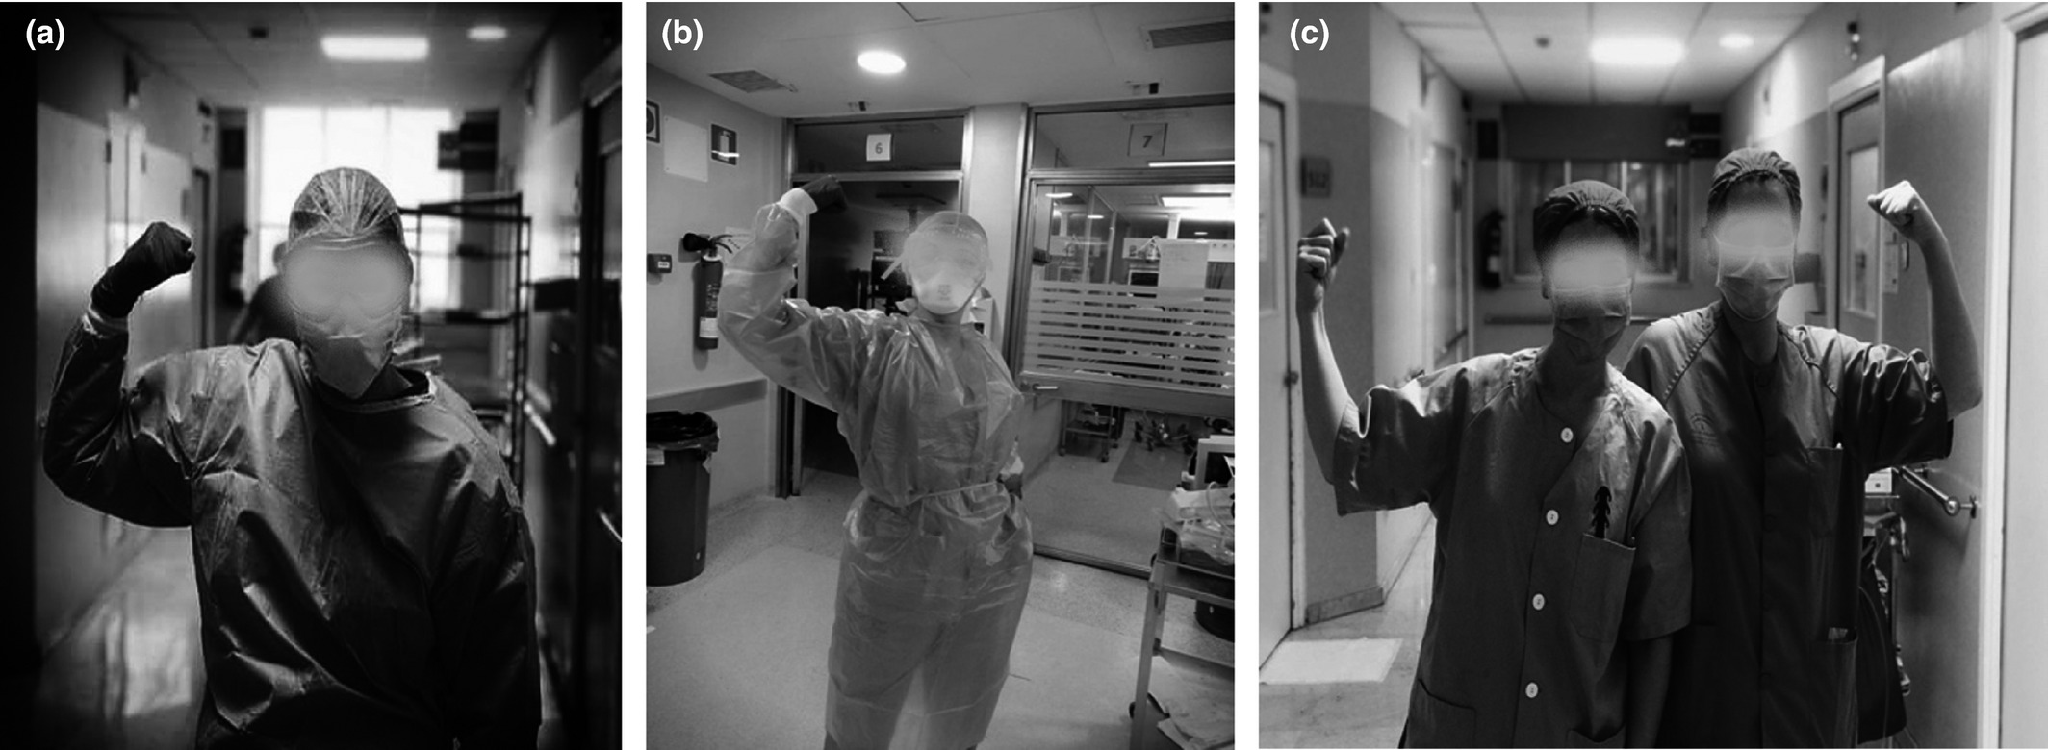
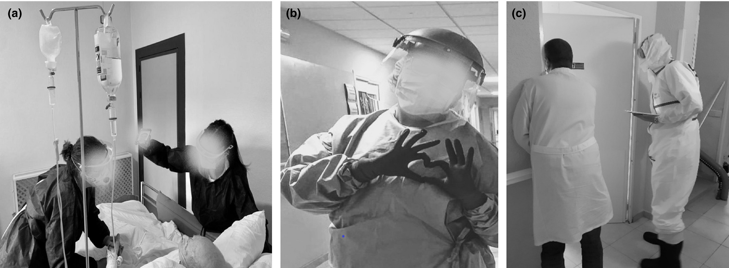
Session Objectives
Identify origins and uses of Photovoice strategy for teaching and learning
Discuss Photovoice prompts and best practices
Arm raised and clenched fist as a symbol of strength working on the frontline in the COVID‐19 pandemic.
Humanization of care and daily attention to patients.
Journal of Clinical Nursing, Volume: 30, Issue: 23-24, Pages: 3657-3669, First published: 30 May 2021, DOI: (10.1111/jocn.15887)
Notes:
.

Slide 6

Photovoice as a Qualitative Research Method
Images from Rutgers.international/photovoice

Slide 7

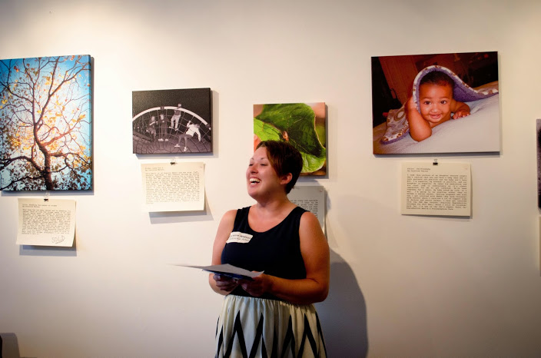
Photovoice as an Instructional Strategy
  Instructor: Craft a thoughtful prompt aligned with objective(s)
  Students: Respond by sharing a photo that they took or located.
    Title the photo
    Include a brief paragraph indicating how the photo connects to the question prompt.
  Options:
    Discussion (Synchronous or Asynchronous)
    Assignment (Group or Individual)
    Digital Story
Beams of Hope
This Photo by Unknown Author is licensed under CC BY-SA-NC

Slide 8
Photovoice Outcomes
Students have the opportunity to:
Draw attention to Social Problems
Stimulate Critical Thinking & Creativity
Strengthen ties with others; Empathize
Express Beliefs and Values
Develop Research Skills
Andina-Díaz, E. (2020). Using Photovoice to stimulate critical thinking: An exploratory study with Nursing students. Revista Latino-Americana De Enfermagem; Rev.Latino-Am.Enfermagem, 28, e3314. https://doi.org/10.1590/1518-8345.3625.3314

Slide 9

Photovoice and the QM Rubric
SRS 5.2: Learning activities provide opportunities for interaction that support active learning
SRS 6.2: Course tools promote learner engagement and active learning
++ Promotes empathy as well as creative and critical thinking

Slide 10
Activity 1: Getting Started with Photovoice
Questions to Consider
What course(s) would benefit from Photovoice?
What course objective(s) and/or weekly session objective(s) align with the intention of Photovoice?
What existing assignments/instructions in the course would be beneficial with Photovoice concepts?
What materials do instructors/students need to be successful in completing the assignment?
Consider a discussion board prompt or activity in a current course that could be used for a Photovoice activity

Slide 11
Prompt Example: EME 2040 - Educational Technology
Objective:
Describe legal and ethical issues teachers face as they implement classroom technology.
Title: Ethics of Technology Integration
For this assignment, temporarily put yourself in the shoes of a child experiencing either cyber bullying or the negative effects of the digital divide. Imagine what it feels like to be bullied online OR imagine what it feels like to be in a home/school environment that can not afford educational technology resources. Sit with that just a bit. Reflect on how different your life might be if you were on the receiving end of one of the negative side effects of technology integration.
Locate at least three images that demonstrate the child’s perspective of the ethical issues that can be associated with technology integration. Place each image on a separate page in MS Word or PPT. Attribute the image appropriately.
Provide a caption for each photo. These captions should not be descriptive. Rather they should reflect creative thought. Much like an artist titles their work, so too will you title your images.
Write a one paragraph summary of what the image represents. Provide deeper analysis through this 8+ sentence paragraph.

Slide 12


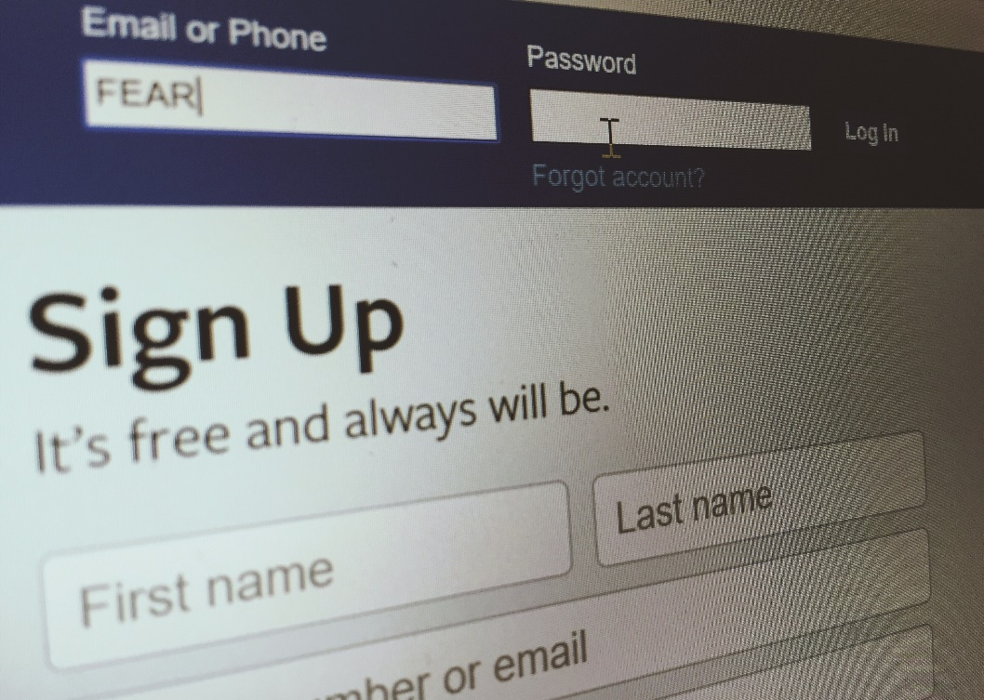
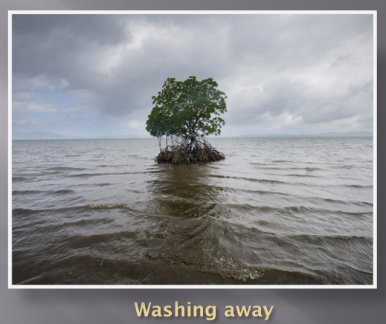
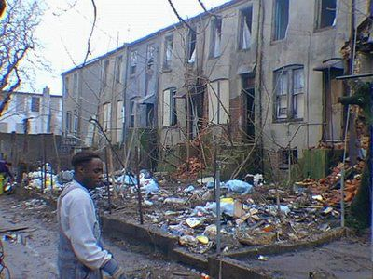
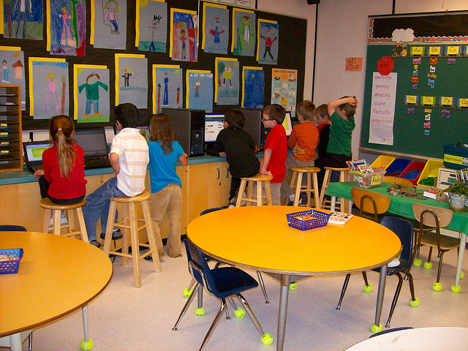


Prompt Example: EME 2040 - Educational Technology
Filling the Basket
Book of Fears
Washing Away
Digital Divide
Cyberbullying
Call me when the iPad feeds my family
Closing the Gap
Don’t Break Down
Finally Free

Slide 13
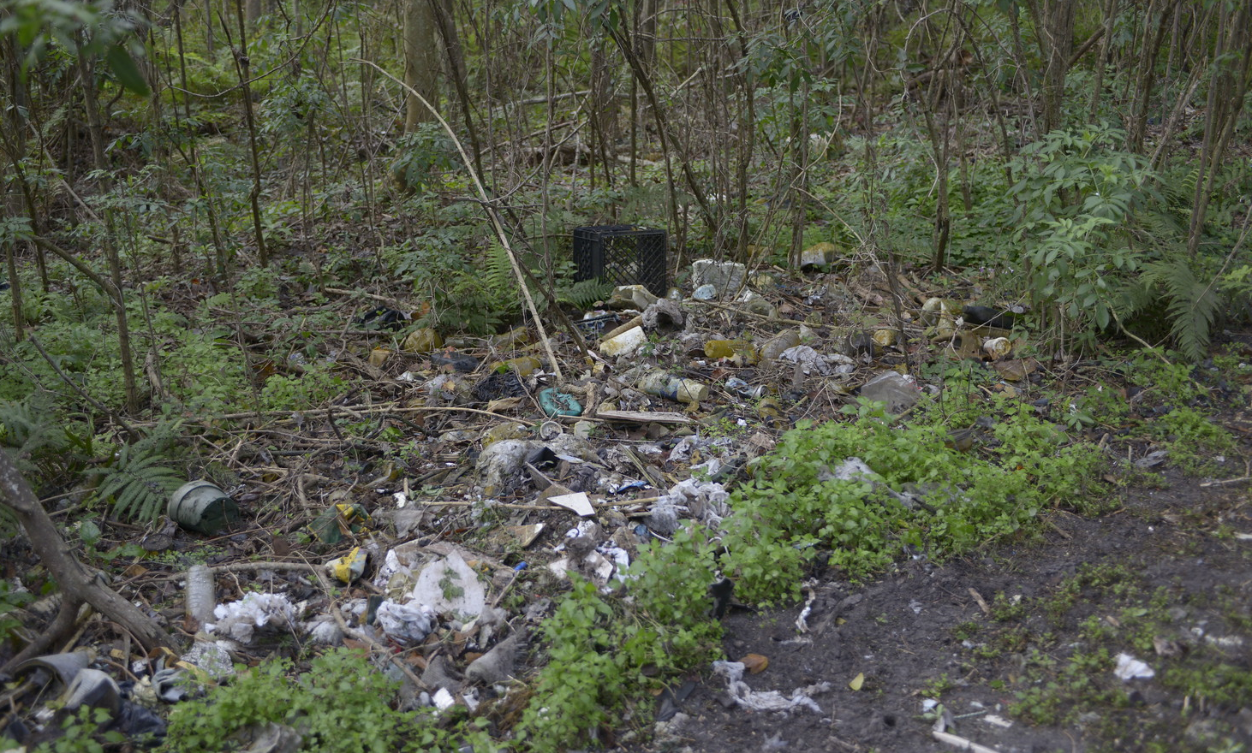

Prompt Example: SLS 1107 - Freshman Experience
Objective: Analyze, synthesize, and articulate the relationship between community engagement and university success
Title: Service Learning Project
For this assignment, temporarily put yourself in the shoes of those who you are trying to help. Imagine what it feels like to be served by the organization with which you volunteered.
Take at least three images that capture personal, significant, and meaningful themes related to the agency with which you volunteered. Your images might represent what you think it would feel like to be homes; they might capture the difference the community partners you are working with are making in the community; they might capture something abstract. I simply ask that you think beyond the obvious. Think critically about the issue that your volunteer activity impacts and capture three images that reflect this experience from your point of view.
The Beginning
Beams of Hope

Slide 14
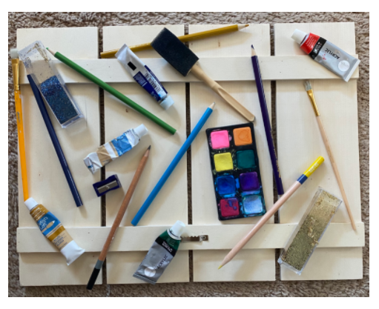
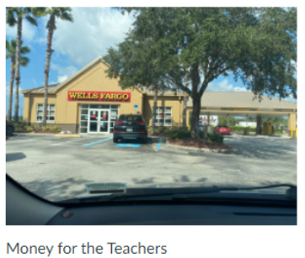
Prompt Example: EDF 2005 - Foundations of Education
Objective: Describe ways that an arts integrated curriculum can be connected to positive school reform
The Arts as Testing
Title: Educational Reform
This week we are going to “discuss” educational reform with an arts-integrated activity – Photovoice. Take a photo that displays something significant related to an educational reform that you believe could enhance academic achievement.
In your initial post, share the following information:
Embed your photo.
Give your photo a title.
Write at least 2 full paragraphs describing the connection between your photo, arts-integrated curriculum and school reform.
Read posts shared by your classmates and respond to at least 2 classmates to expand a comment they shared in their reflection or to ask a question for further clarification. Use your responses to make connections with others in our course and learn from one another.

Slide 15
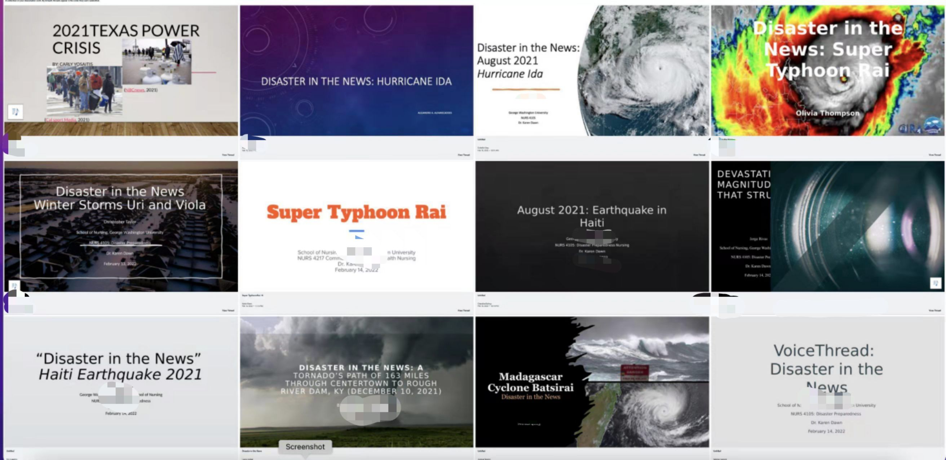
Disaster Preparedness for Underserved Communities
Drs Karen Dawn, Joy Wu
School of Nursing, The George Washington University
Using VoiceThread to engage students at different cognitive levels:
At the comprehension level: A VoiceThread project to describe a disaster within the past year and its impact.
At the analytic level: A VoiceThread project to analyze the disaster preparedness of a community of interest.
At the application and creation level: A VoiceThread project to develop a public announcement (PSA) for a student-chosen community. With faculty's approval, share the PSA with the community leader.

Slide 16
Disaster in the News
Objectives:
Appraise peer presentations on current disasters. (CO 3)
Summarize the impact of disasters on vulnerable and under-resourced communities. (CO 4)
Choose a disaster within the past year create a VoiceThread slide deck presentation addressing the following: (one slide for each topic):
precipitating factors to this disaster;
how public health officials responded within the disaster management cycle;
how did this disaster impact the public’s health;
how did the disaster impact the mental health of responders,
discuss the nurse’s role in the disaster management cycle;
include at least 10 photos;
include at least 5 EBP citations in APA format.
This VoiceThread assignment includes three steps:
Step 1: Upload your VoiceThread Disaster in the News Presentation Monday 11:59PM ET.
Step 2: Review your peer's VoiceThread presentation. Comment through VoiceThread to two peer’s posts by Wednesday 1700 ET. Your comment shall include:
  Identify the strengths of their presentation, including the recommendations for the community.
  Ask ONE thought-provoking question about the presentation.
Step 3: Respond to both peers' questions to YOUR presentation by Saturday 1700 ET.

Slide 17
Community Disaster Preparedness
Objectives: ​
Develop a disaster community education plan for an under-resourced population within a selected community. (CO 1-6)​
Compare two communities- with under-resourced populations- disaster preparedness education. (CO 1-6)​
Develop and present a slide deck presentation via VoiceThread addressing the following:​
Identify a community of interest (consider where you currently or have previously lived).​
  Your community can be large, for example a town or city; or small, like a church, neighborhood, apartment building, or dormitory.​
Use this slide deck as an education tool to present to the community on Disaster Preparedness;​
Focus on an under-resourced portion of the population;​
Identify a community member(s) who is a resource or expert for this community. Discuss with this community member the specific disaster preparedness needs of this population;​
Create a resource, in the form of a slide deck presentation for the community including:​
  personal preparedness,​
  family preparedness, ​
  home preparedness,​
  Community resources that are available if/when disaster strikes.​
This VoiceThread assignment includes three steps: ​
Step 1: Upload your VoiceThread Presentation Monday 11:59PM ET. ​
Step 2: Review your peer's VoiceThread presentation. Comment through VoiceThread to two peer’s posts by Wednesday 1700 ET. Your comment shall include: ​
  Identify the strengths of their presentation, including the recommendations for the community. ​
  Ask ONE thought-provoking question about the presentation. ​
Step 3: Respond to both peers' question to YOUR presentation by Saturday 1700 ET. ​

Slide 18
Public Service Announcement – Disaster Preparedness
Objectives: ​
Judge public service announcement’s appeal to under-resourced populations in specific communities. (CO 1,4.6)​
Evaluate the effectiveness of targeted health messages to under-resourced populations. (CO 1,4.6)​
Instructions:
1. Develop a 1-3 minute PSA for your specific community (see above- under “Community Disaster Preparedness") and share with your classmates through VT. No references or other document required for this assignment.​
2. Share your PSA on a social media platform (think Twitter / Instagram or other platform) and upload the link of your social media PSA to the assignment tab in BlackBoard.​
3. Share your PSA with your community, and upload a copy of the email sent to your community partner to the same assignment tab.​ Here are some Resources on creating a PSA:​
Government Technology​
SAMHSA​
Ready.gov Preparedness Videos​
This VoiceThread assignment includes three steps: ​
Step 1: Upload your VoiceThread Presentation Monday 11:59PM ET. ​
Step 2: Review your peer's PSA. Comment through VoiceThread to two peer’s posts by Wednesday 1700 ET. Your comment shall include: ​
  How will this PSA impact the community’s ability to engage in disaster preparedness and/or response?​
  Does this PSA accomplish the goal of community engagement and support, why or why not?​
Step 3: Respond to both peers' questions to YOUR presentation by Saturday 1700 ET. ​

Slide 19
Prompt Example: U.S. Global Health
Objectives:
Discuss the burden of disease in selected regions of the world; how they vary by age, gender, location, resources and major risk factors for this burden (B 1,3,7,8, 9).
Title: Global Health News Summary
The purpose of this assignment is to raise awareness of the other aspects of global health, many an indirect consequence of COVID-19, which pose significant health challenges, particularly to socioeconomically disadvantaged countries.
Locate an image from the current news which best represents the impact of population health in the US or other countries. After selecting an image, please add an appropriate caption to that image that would provoke more discussion. Finally, write a summary of how the image impacts population health in the US or other countries.
Post your image to the Global Health News Discussion Board. Include the caption, date and source from where you located the image. The news must be current (occurred within the last 30 days) – Remember, the image should represent the impact on the health and health risks to the population affected.
Resources:
Sources of current news include; TV news programs, National Public Radio (NPR), British Broadcasting Corporation, WHO, CDC daily updates, etc.

Slide 20




Faculty Implementation Considerations:
Participant Privacy & Image Ownership
Ensure you & your students are responsible when taking and sharing images
Provide training and resources as needed
(GUILLEMIN & DREW, 2010)
Suggested Materials
Course Syllabus
Weekly Session Schedule
Assignments and Rubrics
Creative Commons image website(s)
Instructions for embedding image(s)
Appropriate topics and activities
Identify the course objective(s) and/or weekly session objective(s) that align with the intention of Photovoice.
Overuse may result in lower quality submissions
.
This Photo by Unknown Author is licensed under CC BY-ND

Slide 21
Activity: Getting Started with Photovoice
Try it on your own!
As you try it yourself, additional tips/suggestions to consider:
  Consider a course or an assignment you currently design or teach.
  Identify existing assignments and rubrics that could be modified with Photovoice's concepts.
  Consider the variety of assignments currently in the course. If they are repetitive in format and output, this may be a good place to embed Photovoice as an activity or assignment.
  Keep it simple.
Access the Photovoice Template: bit.ly/QMPhotovoice

Slide 22


Slide 23
References
Andina-Díaz, E. (2020). Using Photovoice to stimulate critical thinking: An exploratory study with Nursing students. Revista Latino-Americana De Enfermagem; Rev.Latino-Am.Enfermagem, 28, e3314.
Badanta, B., Acevedo‐Aguilera, R., Lucchetti, G., & Diego‐Cordero, R. (2021). ‘A picture is worth a thousand words’—A photovoice study exploring health professionals’ experiences during the COVID‐19 pandemic. Journal of Clinical Nursing, 30(23-24), 3657-3669.
Edwards, M., Perry, B., Janzen, K., & Menzies, C. (2012). Using the Artistic Pedagogical Technology of Photovoice to Promote Interaction in the Online Post-Secondary Classroom: The Students' Perspective. Electronic Journal of E-Learning, 10(1), 32.
Garner, S. L. (2014). Photovoice as a teaching and learning strategy for undergraduate nursing students. Nurse Education Today; Nurse Educ Today, 34(10), 1272-1274.
Guillemin, M. & Drew, S. (2010). Questions of process in participant-generated visual methodologies. Visual Studies. 25. 175-188. 10.1080/1472586X.2010.502676.
Liebenberg, L. (2018). Thinking Critically About Photovoice: Achieving Empowerment and Social Change. International Journal of Qualitative Methods, 17(1), 160940691875763.
Reyes-Foster, B., & DeNoyelles, A. (2018). Using the Photovoice Method to Elicit Authentic Learning in Online Discussions. Journal of Teaching and Learning with Technology, 7(1), 125-138.
Wang, & Burris, M. A. (1997). Photovoice: Concept, Methodology, and Use for Participatory Needs Assessment. Health Education & Behavior, 24(3), 369–387.
Woodgate, Roberta L.; Zurba, Melanie & Tennent, Pauline (2017). Worth a Thousand Words? Advantages, Challenges and Opportunities in Working with Photovoice as a Qualitative Research Method with Youth and their Families [30 paragraphs]. Forum Qualitative Sozialforschung / Forum: Qualitative Social Research, 18(1), Art. 2.

Slide 24
Thank you for participating!
Tiffany Moy
tmoy@gwu.edu
Heidi Schroeder
hschroeder@gwu.edu
Joy Wu
joywu@gwu.edu

