Slide 1

Plagiarism:
The Devil is in the details
Dr. Rebecca Graetz

Slide 2



Introduction
Sr. Online Instructional Design Consultant
Sr. Instructional Designer and Canvas LMS Admin
(contract)
Dr. Rebecca Graetz

Slide 3

Outcomes
Choosing a plagiarism checker.
Define a student's perspective on what plagiarism is or is not.
Working with faculty on use in an LMS.
Analyze what is submitted to a plagiarism checker and how it was missed.
Discuss creating content that will bring student awareness to the next level of understanding.

Slide 4




Choosing a Plagiarism Checker
These are not equal, and each have different features.
Create a group of faculty who can vet
these tools.
Ask for demos from the companies.
Integrate into an LMS that you are using.
Notes:
Ask in chat who uses what tool

Slide 5
Defining a student’s perspective on Plagiarism
International Students perceive plagiarism in different ways. Other countries see this as collaboration with peers and not plagiarism. Parnther (2022) states “International students experience unique challenges that place them at risk for academic misconduct violations, including language, academic expectations, cultural differences, academic preparedness, and policy understanding. “
Those coming from K-12 are taught to “Google it” and copy/paste. (conversation with a peer)
What does it look like for most students? Lesisko (2018) states “Plagiarism can mean distinct things to different people, but ultimately, it is still cheating, and cheating is rife. Family values can also play a factor. If a brother or sister plagiarized successfully in the past, a sibling may feel allowed to do the same.”
QM Standard 1.4 addresses course and institutional policies. Is it posted in the syllabus?

Slide 6

Working with Faculty on Plagiarism
Actual comment from faculty:
My students don’t look like me, so they plagiarize.
All online students plagiarize.
Ask these questions:
Did you have the plagiarism checker on in your assignment?
Why do you think they plagiarized?
Have you posted the Academic Honesty Policy in your syllabus?
What is a way to work with students, so they know what is wrong
and how to correct this?
Notes:
True comment from a faculty member. Any other comments from faculty about plagiarism?

Slide 7
Two examples of plagiarism
Even though Professor Ramirez deviated from the school's policy regarding plagiarism, doyou feel she acted ethically?
Professor Julia Ramirez acted ethically although she deviated from the college’s policy re-garding plagiarism. The ethic played a major role in this case as Professor Ramirez showed re-sponsibility of being considerate. Although she did not report the plagiarism to the student re-view board, but she has considered the school policy and graded Kelly’s assignment to 0. She also considers Kelly’s difficult situation that she will be kicked out if the school has confirmed plagiarism. Professor Ramirez also compassionate about how Kelly needs to spend a lot of time taking care of her mom who is suffering cancer. Professor Ramirez acted ethically by being con-siderate and compassionate.
In Table 11.1 the Six Pillars of Character are detailed. Which of these six pillars did Professor Ramirez display in consideration for her student, and how?
Professor Ramirez is a leader will character. The six pillars professor Ramirez displayed in the case was: trustworthiness, respect, responsibility, and caring. Initially, She showed trustworthi-ness from having the courage to do the right thing. Based on her own value, she did not report Kelly’s case to student review board even it against school’s policy. To show the respect, one needs to be considerate of others. Before Professor Ramirez made the decision, she considered Kelly’s difficult situation as the cause of the issue. Additionally, Professor Ramirez considered the consequence of the reporting the issue, and then she decided not to report. Due to school’s policy, the student will be kicked out once plagiarism has confirmed by student review borad. Ejected from school will result Kelly to lose her Job offer, which won’t benefit for both Kelly and the school. Responsibility was displayed. Professor Ramirez also being very caring by show-ing sympathy to Kelly’s hard situation and forgive the mistake she had made. Professor Ramirez has a personal value of acknowledging the people make mistakes and deserve second chance.
Even though Professor Ramirez deviated from the school's policy regarding plagiarism, Do you feel she acted ethically?
Professor Julia Ramirez acted ethically although she deviated from the college's policy regarding plagiarism. The ethic played a major role in this case as Professor Ramirez showed responsibility of being considerate. Although she did not report the plagiarism to the student review board, she has considered the school policy and graded Kelly's assignment to zero. She also considers Kelly's difficult situation that she will be kicked out if the school has confirmed plagiarism. Professor Ramirez also compassionate about how Kelly needs to spend a lot of time taking care of her mom who is suffering from cancer. Professor Ramirez acted ethically by being considerate and compassionate.
In Table 11.1 the Six Pillars of Character are detailed. Which of these six pillars did Professor Ramirez display in consideration for her student, and how?
Professor Ramirez is a leader of character. The six pillars professor Ramirez displayed in the case were trustworthiness, respect, responsibility, and caring. Initially she showed trustworthiness from having the courage to do the right thing. Based on her own values, she did not report Kelly's case to the student review board even against school's policy. To show respect, one needs to be considerate of others. Before Professor Ramirez made the decision, she considered Kelly's difficult situation as the cause of the issue. Professor Ramirez considered the consequence of reporting the issue, and then she decided not to report. Due to the school's policy, the student will be kicked out once plagiarism has been confirmed by the student review board. Ejected from school will result in Kelly to lose her Job offer which won't benefit both Kelly and the school. Responsibility was displayed and Professor Ramirez is also very caring by showing sympathy to Kelly's hard situation and forgiving the mistake she had made. Professor Ramirez has a personal value of acknowledging the people who make mistakes and deserve a second chance.
Notes:
Found on Course Hero, Chegg and Study Pool. PapersOwls

Slide 8
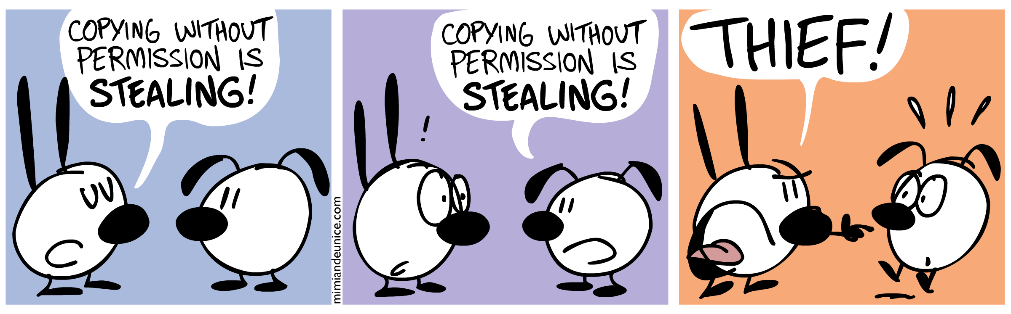
Bringing content to students for awareness
First Year Experience
Have students sign a contract stating the understanding of plagiarism
Post the campus policy in syllabi as well as an assignment
Use the plagiarism checker in an LMS
Resource: Mimi and Eunice
Notes:
When do you introduce students to plagiarism? How do you deliver the message to them?

Slide 9
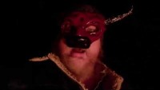

Bringing content to students for awareness
Dr. Jerome Stueart,
Creative Arts Writing Instructor
Thomas More University
(used with permission)
Create content that students will remember

Slide 10
References
Parnther, C. (2022) International Students and Academic Misconduct: Considering Culture, Community, and Context, Journal of College and Character, 23:1, 60-75, DOI: 10.1080/2194587X.2021.2017978
Lesisko, L., Mauro, R., Sebelin, J. (2018) Plagiarism: A Guide for K-12 Online Learners. Retrieved from
ERIC on April 22, 2022, from https://eric.ed.gov/?id=ED608766

