Slide 1

Using the QM CPE Rubric to Develop Micro-Credentials
Melissa Kaufman
Interim associate dean for education
Dornsife school of Public Health, Drexel University
Notes:
Hi, my name is Melissa Kaufman, I am the Interim Associate Dean for Education at the Dornsife School of Public Health at Drexel University. And I’m so excited to be talking to you today about Applying the QM Continuing and Professional Education Rubric to Micro-Credentials.

Slide 2
Learning Objectives
Define
Define Micro-Credentials
Describe
Describe best practices in developing micro-credentials
Evaluate
Evaluate a micro-credential using the QM Rubric
Notes:
The learning objectives for this session are to:
define micro-credentials
Describe best practices in developing micro-credentials
Evaluate a micro-credential using the QM Rubric

Slide 3
About our Program
Pennsylvania Department of Health
Infection Prevention in Long-Term Care Facilities
Notes:
So, I wanted to start by giving you some background on our program. We were approached by the Pennsylvania Department of Health to develop a training program on infection prevention for folks working in Long-Term Care facilities, so like nursing homes, rehab facilities, etc. And what we saw during COVID is that there was a lot of mortality in these facilities and that there was room for additional training around infection prevention.

Slide 4
Continuing Education
Development Time
Learner Level
Contact Hours
Notes:
In developing this program, we identified that it needed to be done as “continuing education” rather than through our traditional credit-bearing programs. There were a couple of reasons for this.
Time. It takes about 18 months to submit a new program through our curriculum review process. And that is just the review process, not the actual development of the program. And we wanted to launch the program in about 9 months, so that time frame was not going to work.
We didn’t want the level of the training to be at the college level. The audience for this training are people working in long-term care facilities, and many of them do not have higher than a high school education level. So, we didn’t want to create any barriers for the learners in accessing the training.
We didn’t want to be held to the traditional credit-bearing structure. So, at Drexel we use the “Carnegie hour” for developing classes which dictates the amount of “in-class” and “out-of-class” time students will spend on the course.

Slide 5
Structure Needed
Continuing & Professional Education Rubric
Micro-Credentials
Notes:
So, because we were going to create these trainings as continuing education, there were essentially no rules to follow.
Now I don’t know about you, but I love a good rule, and the lack of structure was a bit overwhelming. And what I quickly decided was that we should use the Quality Matters Continuing and Professional Education rubric as kind of our north star as we developed these programs.
We also decided to develop them as micro-credentials since that is a trending format in higher education.

Slide 6

How do you define micro-credentials?
Notes:
Take a minute and turn to the person next to you and share how you define a micro-credential.
Okay, who would like to share?

Slide 7
Micro-Credentials
Four-Week Modules
Three Modules per Micro-Credential
75% or higher on Final Exam
Digital Badge
Notes:
So, when I pitched doing these trainings as micro-credentials to my Co-I on the project she said: okay – what’s a micro-credential. And as we just heard, there isn’t one standard definition of what exactly a micro-credential is or what it means.
So, we had to define it.
For this program, a micro-credential is a training comprised of three, four-week modules that is assessed through a multiple-choice final exam. Upon successful completion of the final exam (75% or higher) learners will earn a digital badge for the micro-credential.
My main takeaway from this is not that this is the best definition of a micro-credential, but that you should internally decide what it is for your organization. Because it can be very confusing for students if two very different structures are both considered a micro-credential.

Slide 8
Evaluating the Clinical Knowledge Micro-Credential with QM CPE
Notes:
Okay, so as I said, we used the QM CPE rubric at our guide to develop these micro-credentials, and in preparing for this talk, I went though the rubric to evaluate and see if we met the standards.
One other thing I’ll say is that I know the HE 7th is now approved to evaluate continuing education, which is awesome, but in looking at them, the differences aren’t so large that I think we would need to make a ton of major changes to meet the HE 7th edition.

Slide 9
Standard 1 The overall design of the course is made clear to the learner at the beginning of the course.
1.1 Instructions make clear how to get started and where to find various course components.
1.2 Learners are introduced to the purpose and structure of the course.
1.3 Etiquette expectations (sometimes called “netiquette”) for online discussions, email, and other forms of communication are stated clearly.
1.4 Course, institutional, or organizational policies with which the learner is expected to comply are clearly stated, or a link to current policies is provided.
1.5 Minimum technology requirements are clearly stated, and instructions for use are provided.
1.6 Prerequisite knowledge in the discipline and/or any required competencies are clearly stated.
1.7 Minimum technical skills expected of the learner are clearly stated.
1.8 The self-introduction by the instructor/facilitator is appropriate and available online.
1.9 Learners are asked to introduce themselves to fellow learners.

Slide 10
Standard 1 The overall design of the course is made clear to the learner at the beginning of the course.
1.1 Instructions make clear how to get started and where to find various course components.
1.2 Learners are introduced to the purpose and structure of the course.
1.3 Etiquette expectations (sometimes called “netiquette”) for online discussions, email, and other forms of communication are stated clearly.
1.4 Course, institutional, or organizational policies with which the learner is expected to comply are clearly stated, or a link to current policies is provided.
1.5 Minimum technology requirements are clearly stated, and instructions for use are provided.
1.6 Prerequisite knowledge in the discipline and/or any required competencies are clearly stated.
1.7 Minimum technical skills expected of the learner are clearly stated.
1.8 The self-introduction by the instructor/facilitator is appropriate and available online.
1.9 Learners are asked to introduce themselves to fellow learners.

Slide 11
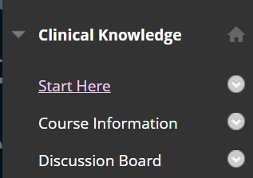
Start Here & Course Information
Notes:
1.1 Instructions make clear how to get started and where to find various course components.
1.2 Learners are introduced to the purpose and structure of the course.
1.4 Course, institutional, or organizational policies with which the learner is expected to comply are clearly stated, or a link to current policies is provided.
1.5 Minimum technology requirements are clearly stated, and instructions for use are provided.
1.6 Prerequisite knowledge in the discipline and/or any required competencies are clearly stated.
1.7 Minimum technical skills expected of the learner are clearly stated.
1.8 The self-introduction by the instructor/facilitator is appropriate and available online.

Slide 12
Standard 1 The overall design of the course is made clear to the learner at the beginning of the course.
1.1 Instructions make clear how to get started and where to find various course components.
1.2 Learners are introduced to the purpose and structure of the course.
1.3 Etiquette expectations (sometimes called “netiquette”) for online discussions, email, and other forms of communication are stated clearly.
1.4 Course, institutional, or organizational policies with which the learner is expected to comply are clearly stated, or a link to current policies is provided.
1.5 Minimum technology requirements are clearly stated, and instructions for use are provided.
1.6 Prerequisite knowledge in the discipline and/or any required competencies are clearly stated.
1.7 Minimum technical skills expected of the learner are clearly stated.
1.8 The self-introduction by the instructor/facilitator is appropriate and available online.
1.9 Learners are asked to introduce themselves to fellow learners.

Slide 13
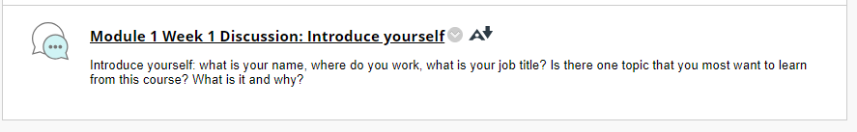
Module 1, Week 1
Notes:
1.9 Learners are asked to introduce themselves to fellow learners.

Slide 14
Standard 1 The overall design of the course is made clear to the learner at the beginning of the course.
1.1 Instructions make clear how to get started and where to find various course components.
1.2 Learners are introduced to the purpose and structure of the course.
1.3 Etiquette expectations (sometimes called “netiquette”) for online discussions, email, and other forms of communication are stated clearly.
1.4 Course, institutional, or organizational policies with which the learner is expected to comply are clearly stated, or a link to current policies is provided.
1.5 Minimum technology requirements are clearly stated, and instructions for use are provided.
1.6 Prerequisite knowledge in the discipline and/or any required competencies are clearly stated.
1.7 Minimum technical skills expected of the learner are clearly stated.
1.8 The self-introduction by the instructor/facilitator is appropriate and available online.
1.9 Learners are asked to introduce themselves to fellow learners.

Slide 15

Fail
Notes:
1.3 Etiquette expectations (sometimes called “netiquette”) for online discussions, email, and other forms of communication are stated clearly.
So yeah – we missed this one. It is on my notes for the next micro-credential that starts in January.

Slide 16
Standard 2 Learning objectives or competencies describe what learners will be able to do upon completion of the course.
2.1 The course learning objectives, or course/program competencies, describe outcomes that are measurable.
2.2 The module/unit learning objectives or competencies describe outcomes that are measurable and consistent with the course-level objectives or competencies.
2.3 All learning objectives or competencies are stated clearly and written from the learner’s perspective.
2.4 The relationship between learning objectives or competencies and course activities is clearly stated.
2.5 The learning objectives or competencies are suited to the purpose or level of the course.

Slide 17
Standard 2 Learning objectives or competencies describe what learners will be able to do upon completion of the course.
2.1 The course learning objectives, or course/program competencies, describe outcomes that are measurable.
2.2 The module/unit learning objectives or competencies describe outcomes that are measurable and consistent with the course-level objectives or competencies.
2.3 All learning objectives or competencies are stated clearly and written from the learner’s perspective.
2.4 The relationship between learning objectives or competencies and course activities is clearly stated.
2.5 The learning objectives or competencies are suited to the purpose or level of the course.

Slide 18
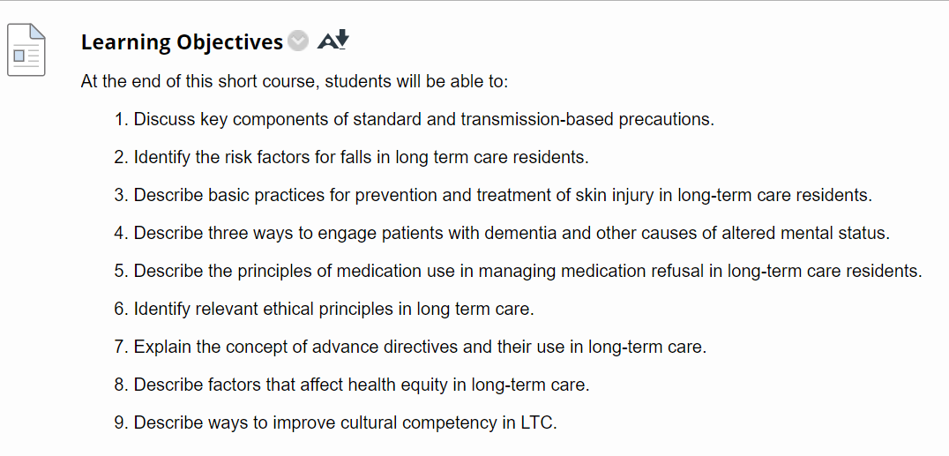
Learning Objectives
Notes:
2.1 The course learning objectives, or course/program competencies, describe outcomes that are measurable.
2.3 All learning objectives or competencies are stated clearly and written from the learner’s perspective.
2.4 The relationship between learning objectives or competencies and course activities is clearly stated.
2.5 The learning objectives or competencies are suited to the purpose or level of the course.

Slide 19
Standard 2 Learning objectives or competencies describe what learners will be able to do upon completion of the course.
2.1 The course learning objectives, or course/program competencies, describe outcomes that are measurable.
2.2 The module/unit learning objectives or competencies describe outcomes that are measurable and consistent with the course-level objectives or competencies.
2.3 All learning objectives or competencies are stated clearly and written from the learner’s perspective.
2.4 The relationship between learning objectives or competencies and course activities is clearly stated.
2.5 The learning objectives or competencies are suited to the purpose or level of the course.

Slide 20
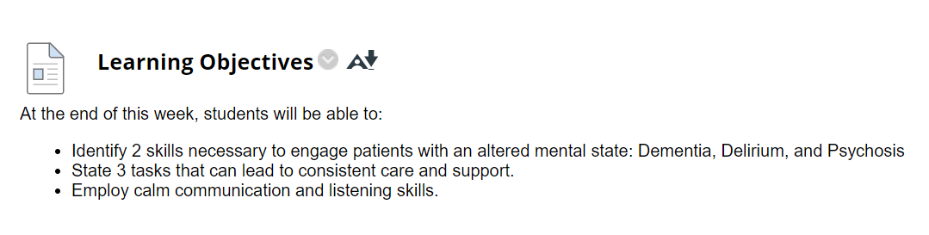
Learning Objectives
Notes:
2.2 The module/unit learning objectives or competencies describe outcomes that are measurable and consistent with the course-level objectives or competencies.
One thing I’ll note is that not all of the weekly/module level objectives are as great as I’d like them to be. I found with this project that I needed to pick my battles.

Slide 21
Standard 3 Assessment strategies are integral to the learning process and are designed to evaluate learner progress in achieving the stated learning objectives or mastering the competencies.
3.1 The assessments measure the stated learning objectives or competencies
3.2 Course information specifies how successful completion of the course will be recognized.
3.3 Specific and descriptive criteria are provided for the evaluation of learners’ work and are tied to the course policy for determination of successful course completion.
3.4 The assessment instruments selected are sequenced, varied, and suited to the learner work being assessed.
3.5 The course provides learners with multiple opportunities to track their learning progress.

Slide 22
Standard 3 Assessment strategies are integral to the learning process and are designed to evaluate learner progress in achieving the stated learning objectives or mastering the competencies.
3.1 The assessments measure the stated learning objectives or competencies
3.2 Course information specifies how successful completion of the course will be recognized.
3.3 Specific and descriptive criteria are provided for the evaluation of learners’ work and are tied to the course policy for determination of successful course completion.
3.4 The assessment instruments selected are sequenced, varied, and suited to the learner work being assessed.
3.5 The course provides learners with multiple opportunities to track their learning progress.

Slide 23

Assessment Alignment
Notes:
3.1 The assessments measure the stated learning objectives or competencies
These are all at the lower end of blooms so a multiple-choice test aligns with the learning objectives.

Slide 24
Standard 3 Assessment strategies are integral to the learning process and are designed to evaluate learner progress in achieving the stated learning objectives or mastering the competencies.
3.1 The assessments measure the stated learning objectives or competencies
3.2 Course information specifies how successful completion of the course will be recognized.
3.3 Specific and descriptive criteria are provided for the evaluation of learners’ work and are tied to the course policy for determination of successful course completion.
3.4 The assessment instruments selected are sequenced, varied, and suited to the learner work being assessed.
3.5 The course provides learners with multiple opportunities to track their learning progress.

Slide 25

Complete the Micro-Credential
Notes:
3.2 Course information specifies how successful completion of the course will be recognized.

Slide 26
Standard 3 Assessment strategies are integral to the learning process and are designed to evaluate learner progress in achieving the stated learning objectives or mastering the competencies.
3.1 The assessments measure the stated learning objectives or competencies
3.2 Course information specifies how successful completion of the course will be recognized.
3.3 Specific and descriptive criteria are provided for the evaluation of learners’ work and are tied to the course policy for determination of successful course completion.
3.4 The assessment instruments selected are sequenced, varied, and suited to the learner work being assessed.
3.5 The course provides learners with multiple opportunities to track their learning progress.

Slide 27
Assessments
In Video Quizzes
Optional Quizzes
Final Exam
Notes:
3.4 The assessment instruments selected are sequenced, varied, and suited to the learner work being assessed.
3.5 The course provides learners with multiple opportunities to track their learning progress.

Slide 28
Standard 4 Instructional materials enable learners to achieve stated learning objectives or competencies.
4.1 The instructional materials contribute to the achievement of the stated course and module/unit learning objectives or competencies.
4.2 Both the purpose of instructional materials and how the materials are to be used for learning activities are clearly explained.
4.3 All instructional materials used in the course are appropriately cited.
4.4 The instructional materials are current.
4.5 A variety of instructional materials is used in the course.
4.6 The distinction between required and optional materials is clearly explained.

Slide 29
Standard 4 Instructional materials enable learners to achieve stated learning objectives or competencies.
4.1 The instructional materials contribute to the achievement of the stated course and module/unit learning objectives or competencies.
4.2 Both the purpose of instructional materials and how the materials are to be used for learning activities are clearly explained.
4.3 All instructional materials used in the course are appropriately cited.
4.4 The instructional materials are current.
4.5 A variety of instructional materials is used in the course.
4.6 The distinction between required and optional materials is clearly explained.

Slide 30
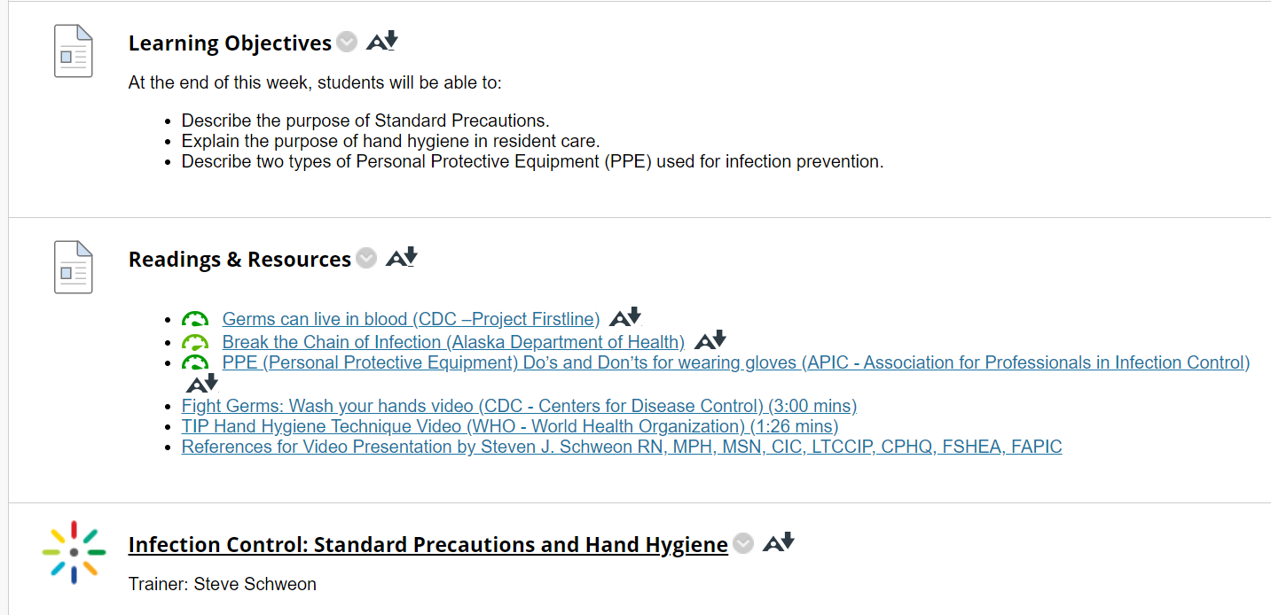
Videos
Notes:
4.1 The instructional materials contribute to the achievement of the stated course and module/unit learning objectives or competencies.
4.2 Both the purpose of instructional materials and how the materials are to be used for learning activities are clearly explained.
4.3 All instructional materials used in the course are appropriately cited.
4.4 The instructional materials are current.
1:25

Slide 31
Standard 4 Instructional materials enable learners to achieve stated learning objectives or competencies.
4.1 The instructional materials contribute to the achievement of the stated course and module/unit learning objectives or competencies.
4.2 Both the purpose of instructional materials and how the materials are to be used for learning activities are clearly explained.
4.3 All instructional materials used in the course are appropriately cited.
4.4 The instructional materials are current.
4.5 A variety of instructional materials is used in the course.
4.6 The distinction between required and optional materials is clearly explained.

Slide 32
Readings & Videos
Notes:
4.5 A variety of instructional materials is used in the course.

Slide 33
Standard 4 Instructional materials enable learners to achieve stated learning objectives or competencies.
4.1 The instructional materials contribute to the achievement of the stated course and module/unit learning objectives or competencies.
4.2 Both the purpose of instructional materials and how the materials are to be used for learning activities are clearly explained.
4.3 All instructional materials used in the course are appropriately cited.
4.4 The instructional materials are current.
4.5 A variety of instructional materials is used in the course.
4.6 The distinction between required and optional materials is clearly explained.

Slide 34
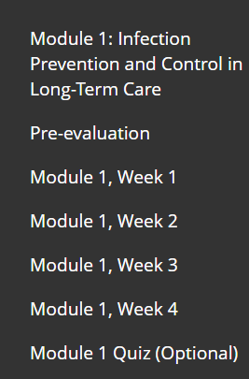
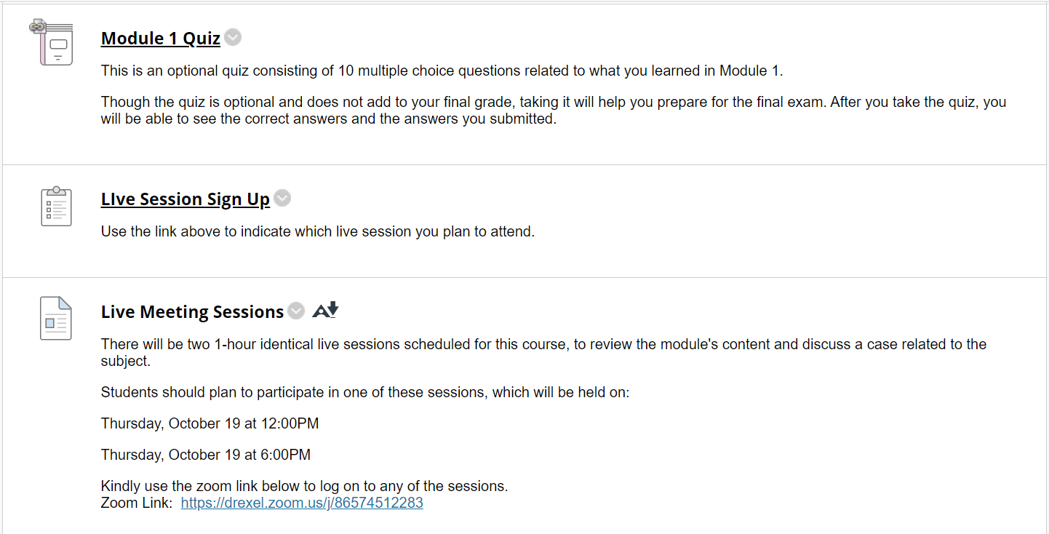
Optional Live Sessions
Notes:
4.6 The distinction between required and optional materials is clearly explained.
Lost the battle on the live session language

Slide 35
Standard 5 Course activities facilitate and support learner interaction and engagement.
5.1 The learning activities promote the achievement of the stated learning objectives or competencies.
5.2 Learning activities provide opportunities for interaction that support active learning.
5.3 The instructor/facilitator’s plan for classroom response time and feedback on assignments is clearly stated.
5.4 The requirements for learner interaction are clearly stated.

Slide 36
Standard 5 Course activities facilitate and support learner interaction and engagement.
Standard 5 Course activities facilitate and support learner interaction and engagement.
5.1 The learning activities promote the achievement of the stated learning objectives or competencies.
5.2 Learning activities provide opportunities for interaction that support active learning.
5.3 The instructor/facilitator’s plan for classroom response time and feedback on assignments is clearly stated.
5.4 The requirements for learner interaction are clearly stated.

Slide 37
Activities
In-video quiz
Optional quiz
Discussion Board
Live Sessions
Notes:
5.1 The learning activities promote the achievement of the stated learning objectives or competencies.
5.2 Learning activities provide opportunities for interaction that support active learning.
5.4 The requirements for learner interaction are clearly stated.

Slide 38
Standard 5 Course activities facilitate and support learner interaction and engagement.
Standard 5 Course activities facilitate and support learner interaction and engagement.
5.1 The learning activities promote the achievement of the stated learning objectives or competencies.
5.2 Learning activities provide opportunities for interaction that support active learning.
5.3 The instructor/facilitator’s plan for classroom response time and feedback on assignments is clearly stated.
5.4 The requirements for learner interaction are clearly stated.

Slide 39
Fail
Notes:
5.3 The instructor/facilitator’s plan for classroom response time and feedback on assignments is clearly stated.

Slide 40
Standard 6 Course technologies support learners’ achievement of course objectives or competencies.
6.1 The tools used in the course support the learning objectives or competencies.
6.2 Course tools promote learner engagement and active learning.
6.3 Technologies required in the course are readily obtainable.
6.4 The course technologies are current.
6.5 Links are provided to privacy policies for all external tools required in the course.

Slide 41
Standard 6 Course technologies support learners’ achievement of course objectives or competencies.
Standard 6 Course technologies support learners’ achievement of course objectives or competencies.
6.1 The tools used in the course support the learning objectives or competencies.
6.2 Course tools promote learner engagement and active learning.
6.3 Technologies required in the course are readily obtainable.
6.4 The course technologies are current.
6.5 Links are provided to privacy policies for all external tools required in the course.
Notes:
So for these four – Because we are using Blackboard as our LMS, they are all met.

Slide 42
Standard 6 Course technologies support learners’ achievement of course objectives or competencies.
Standard 6 Course technologies support learners’ achievement of course objectives or competencies.
6.1 The tools used in the course support the learning objectives or competencies.
6.2 Course tools promote learner engagement and active learning.
6.3 Technologies required in the course are readily obtainable.
6.4 The course technologies are current.
6.5 Links are provided to privacy policies for all external tools required in the course.
Notes:
No External Tools

Slide 43
Standard 7 The course facilitates learner access to support services essential to learner success.
7.1 The course instructions articulate or link to a clear description of the technical support offered and how to obtain it.
7.2 Course instructions articulate or link to the institution or organization’s accessibility policies and services.
7.3 Course instructions articulate or link to an explanation of how the institution or organization’s course support services and resources can help learners succeed in the course and how learners can obtain them.
7.4 Course instructions articulate or link to an explanation of how the institution or organization’s learner services and resources can help learners succeed and how learners can obtain them.

Slide 44
Standard 7 The course facilitates learner access to support services essential to learner success.
Standard 7 The course facilitates learner access to support services essential to learner success.
7.1 The course instructions articulate or link to a clear description of the technical support offered and how to obtain it.
7.2 Course instructions articulate or link to the institution or organization’s accessibility policies and services.
7.3 Course instructions articulate or link to an explanation of how the institution or organization’s course support services and resources can help learners succeed in the course and how learners can obtain them.
7.4 Course instructions articulate or link to an explanation of how the institution or organization’s learner services and resources can help learners succeed and how learners can obtain them.

Slide 45
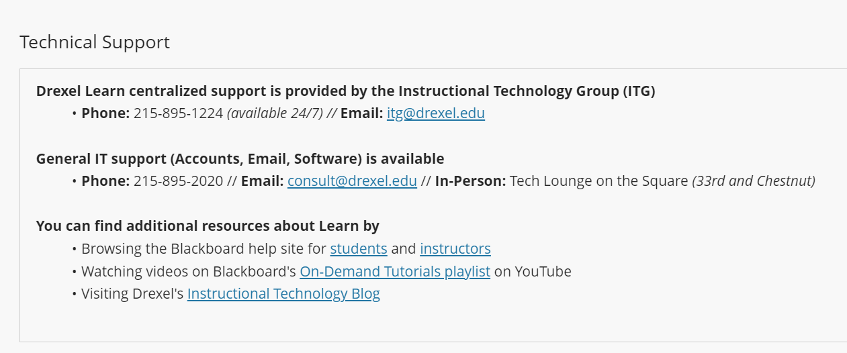
Institution Page on Blackboard
Notes:
7.1 The course instructions articulate or link to a clear description of the technical support offered and how to obtain it.
7.2 Course instructions articulate or link to the institution or organization’s accessibility policies and services.
7.3 Course instructions articulate or link to an explanation of how the institution or organization’s course support services and resources can help learners succeed in the course and how learners can obtain them.
7.4 Course instructions articulate or link to an explanation of how the institution or organization’s learner services and resources can help learners succeed and how learners can obtain them.

Slide 46
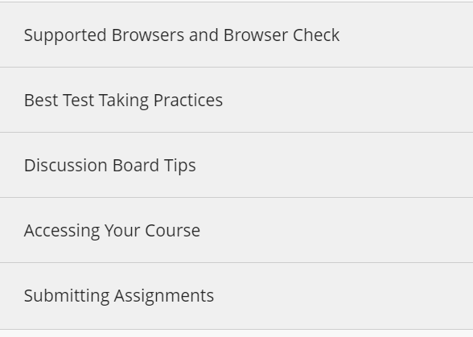
Institution Page on Blackboard
Notes:
7.1 The course instructions articulate or link to a clear description of the technical support offered and how to obtain it.
7.2 Course instructions articulate or link to the institution or organization’s accessibility policies and services.
7.3 Course instructions articulate or link to an explanation of how the institution or organization’s course support services and resources can help learners succeed in the course and how learners can obtain them.
7.4 Course instructions articulate or link to an explanation of how the institution or organization’s learner services and resources can help learners succeed and how learners can obtain them.
Could we do this better – yes, yes we could.

Slide 47
Standard 8 The course design reflects a commitment to accessibility and usability for all learners.
8.1 Course navigation facilitates ease of use.
8.2 Information is provided about accessibility of all technologies required in the course.
8.3 The course provides alternative means of access to course materials in formats that meet the needs of diverse learners.
8.4 The course design facilitates readability.
8.5 Course multimedia facilitate ease of use.

Slide 48
Standard 8 The course design reflects a commitment to accessibility and usability for all learners.
Standard 8 The course design reflects a commitment to accessibility and usability for all learners.
8.1 Course navigation facilitates ease of use.
8.2 Information is provided about accessibility of all technologies required in the course.
8.3 The course provides alternative means of access to course materials in formats that meet the needs of diverse learners.
8.4 The course design facilitates readability.
8.5 Course multimedia facilitate ease of use.

Slide 49
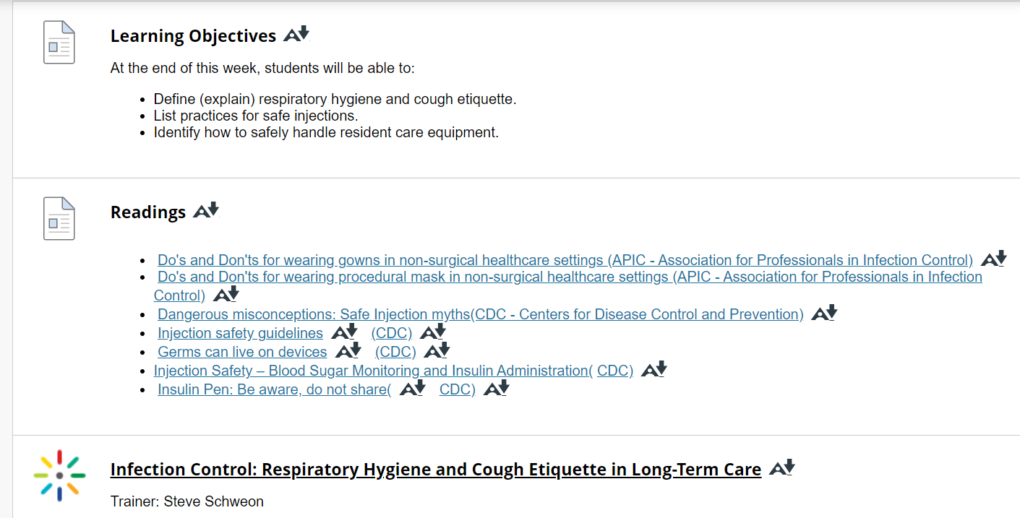
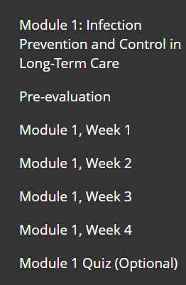
Course Navigation
Notes:
8.1 Course navigation facilitates ease of use.
8.4 The course design facilitates readability.

Slide 50
Standard 8 The course design reflects a commitment to accessibility and usability for all learners.
Standard 8 The course design reflects a commitment to accessibility and usability for all learners.
8.1 Course navigation facilitates ease of use.
8.2 Information is provided about accessibility of all technologies required in the course.
8.3 The course provides alternative means of access to course materials in formats that meet the needs of diverse learners.
8.4 The course design facilitates readability.
8.5 Course multimedia facilitate ease of use.

Slide 51
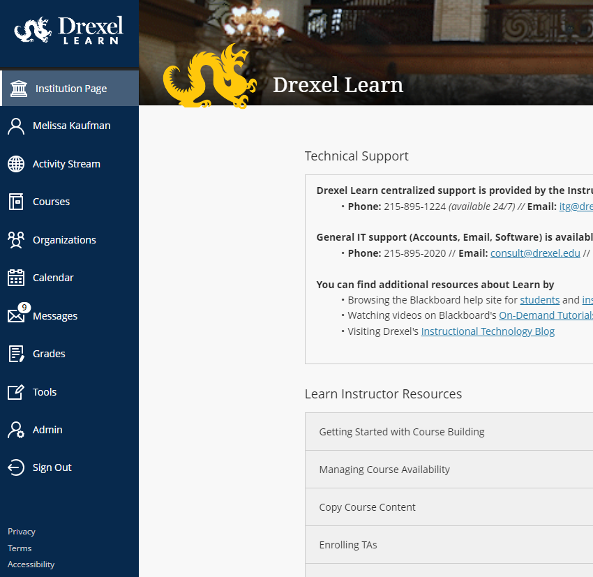

Accessibility
Notes:
8.2 Information is provided about accessibility of all technologies required in the course.

Slide 52
Standard 8 The course design reflects a commitment to accessibility and usability for all learners.
Standard 8 The course design reflects a commitment to accessibility and usability for all learners.
8.1 Course navigation facilitates ease of use.
8.2 Information is provided about accessibility of all technologies required in the course.
8.3 The course provides alternative means of access to course materials in formats that meet the needs of diverse learners.
8.4 The course design facilitates readability.
8.5 Course multimedia facilitate ease of use.

Slide 53
Alternative Means of Access
Closed Captioning
Blackboard Ally
Zoom Closed Captioning & Chat
Notes:
8.3 The course provides alternative means of access to course materials in formats that meet the needs of diverse learners.
8.5 Course multimedia facilitate ease of use.

Slide 54
Lessons Learned
Hire an Instructional Designer!
Lean on QM as the experts
Review institutional resources
Notes:
Hire an id if at all humanly possible
Lean on QM as the experts – you won’t win all the battles with your collaborators, but it will help.
Review institutional resources and determine which you can use and which you cant (i.e. no library, no library videos, no student services).

Slide 55
Thank you
Melissa Kaufman
Interim Associate Dean for Education
Dornsife School of Public Health, Drexel University
mjk397@drexel.edu

