Slide 1

Preventing a Domino Effect:
Achieving Alignment
Anna Gonzalez
Lead Instructional Design Specialist
Laredo College

Slide 2


Learning Objectives:
Define Alignment in the context of Quality Matters
Discuss the importance of alignment in quality assurance
Identify similarities between the domino effect and alignment in terms of stability, interconnectedness, and preventive measures

Slide 3

What is Alignment?
“Critical course components reinforce one another to ensure that learners achieve the desired learning outcomes.”
“arrangement in a straight line, or in correct or
appropriate relative positions.”
“a position of agreement or alliance.”
Notes:
“Critical course components reinforce one another to ensure that learners achieve the desired learning outcomes.”

Slide 4

Alignment with Course Objectives
Defining the Destination.
Role of Objectives:
Define what students are expected to learn by the end of the course.
Set the direction of the course and establish the foundation.

Slide 5
Alignment with Assessments:
Measuring the Destination.
Role of Assessments:
Measure students’ progress toward achieving the course objectives.
Directly test the skills and knowledge outlined in the objectives.
If assessments align with the objectives, students are evaluated fairly and consistently on what they were taught. This alignment ensures that assessments are purposeful and accurately reflect the intended learning outcomes.
Notes:
Purpose of Assessment Alignment: If assessments align with the objectives, students are evaluated fairly and consistently on what they were taught. This alignment ensures that assessments are purposeful and accurately reflect the intended learning outcomes, reducing student frustration and improving the reliability of assessment data.

Slide 6
The Importance of Alignment
Clear expectations.
Efficient use of time.
Creates a cohesive, meaningful, and effective learning experience.
Each component has a purpose.
Each part of the course builds toward a shared goal.
Student success!
Notes:
Clear Expectations: Aligned courses provide students with clear expectations about what they will learn and how they will be evaluated. This transparency helps reduce uncertainty, making students more likely to engage with the course content and focus on what truly matters.
Efficient Use of Time: When all components are aligned, instructional time is used efficiently. Instructors avoid spending time on content or activities that don’t contribute to course goals, and students focus on what’s most relevant, increasing the overall effectiveness of the course.

Slide 7
Misalignment
Some examples of misalignment are:
If learning objectives aren’t clearly defined, the assessments might not accurately measure student achievement.
If instructional activities don’t align with the objectives, students might not learn the intended skills, which will affect their performance in assessments.
The domino effect demonstrates how small, seemingly isolated issues can lead to larger failures if all the elements in a system are not properly aligned.
Notes:
Use this setup to show how misalignment in one part of the course affects other areas, potentially undermining the entire learning experience.
Reinforce how interconnected course components are.

Slide 8

Consequences of Misalignment
Collapse
Split Path
Misalignment can lead to confusion for students, poor outcomes, and an overall ineffective learning experience—like dominoes toppling in a chain reaction.
Notes:
Split Path: Use this to show the consequences of choices in course design: when alignment is strong, the course stays on track (one path); when alignment is weak, it veers off and doesn’t reach the intended outcomes (the other path). This visual can reinforce the importance of making thoughtful design decisions to keep everything on the right track.

Slide 9

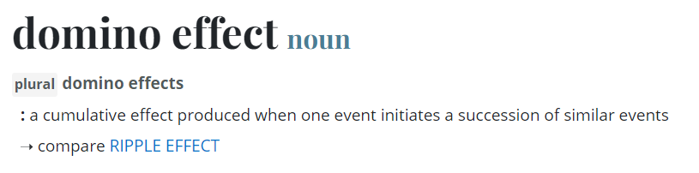
The Domino Effect
Key Elements:
Initial Action
Interconnectedness
Chain Reaction
Notes:
Initial Action: The first "domino" is tipped, which starts the chain reaction. This represents an initial event or decision.
Interconnectedness: Each subsequent domino is placed in such a way that it depends on the one before it to fall. This shows how one event can influence or depend on others.
Chain Reaction: Once the first domino falls, it causes a ripple effect that continues down the line, affecting everything connected to it.

Slide 10

Preventing a Domino Effect
Clear, Specific, and Measurable Learning Objectives
Alignment of Materials and Activities
Accurate and Relevant Assessments
By ensuring that each critical course component is aligned with the others – just as perfectly spaced dominoes – you prevent the risk of a “domino effect” that could lead to a breakdown in the course structure and, ultimately, student success.

Slide 11
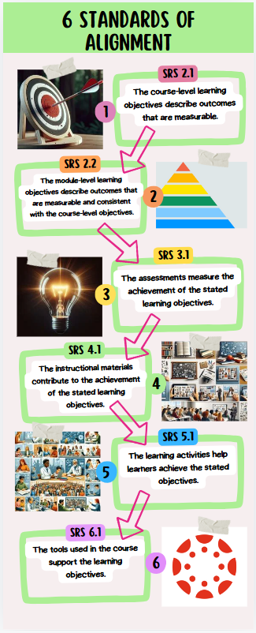
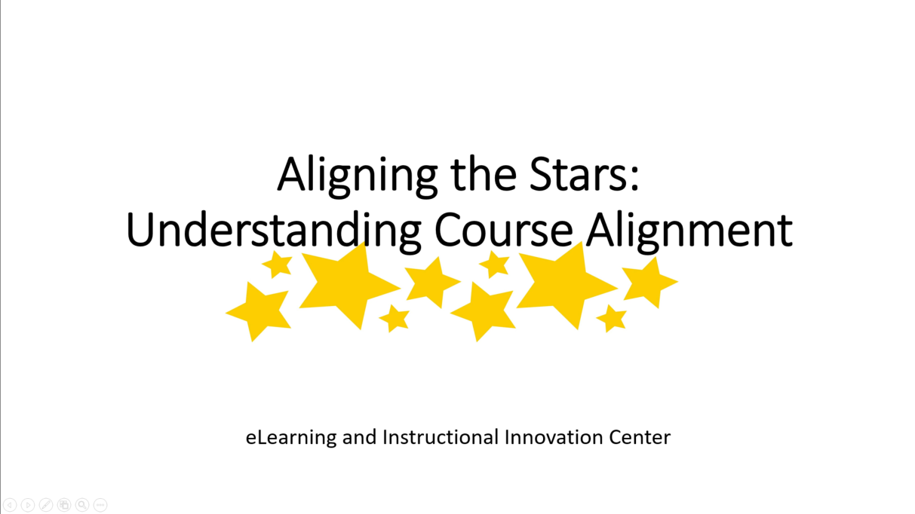
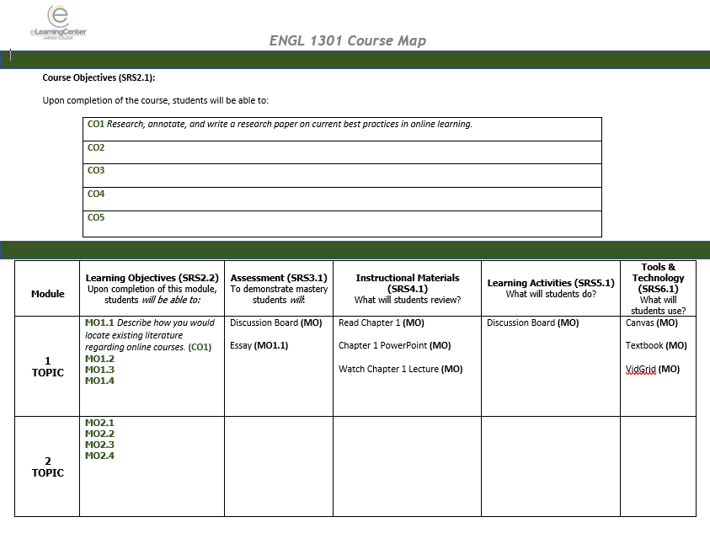
Visualize it!
Course Map
Infographics
Alignment Workshop

Slide 12

Thank you!

