Slide 1
Promoting Relationships, Rubrics, and Robustness
Building a Collaborative Culture of Course Quality

Slide 2


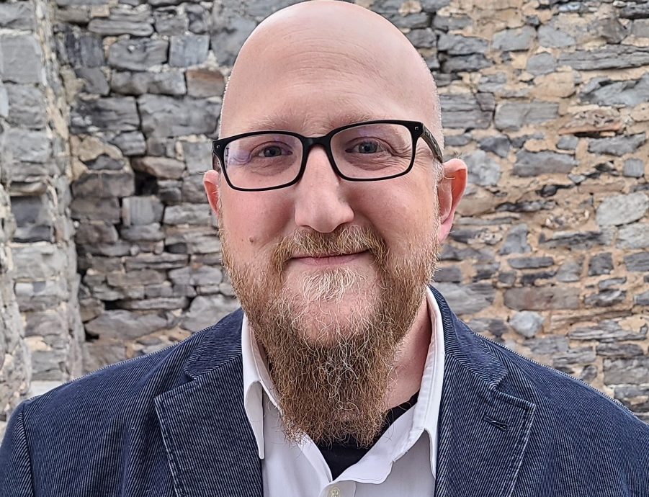
Presenters
Jason Garvey
Brian Becker
Ben Erwin
Lead Instructional Designer with Purdue University Online and manager of the Course Review Process.
Senior Instructional Designer with Purdue University Online and a Course Review Coordinator.
Instructional Designer with Purdue University Online and a Course Review Coordinator.

Slide 3
Session Objectives
#1
#2
#3
Describe how an internal course review rubric and process were developed and implemented to improve quality, facilitate collaboration, and improve the learner experience.
Analyze the progression of the course review process into a continuous improvement model through stakeholder feedback and data-informed revisions.
Identify transferable strategies for fostering a collegial course review process that improves buy-in from stakeholders, leadership, faculty, and instructional designers.

Slide 4

Overview and Context
A grassroots approach to fostering quality and collaboration
Origin, Purpose, Evolution
Truncating QM to create an adaptable model​
Alignment, Organization, Communication, Accessibility
Revision, Improvement, and Iteration​
Collaborative, iterative processes
Provide meaningful, substantive feedback
Feedback-Driven Processes
Stakeholders collaborate, provide input
Improve clarity, consistency, effectiveness
Outcomes and Continuous Improvement
Ongoing training, feedback, discussion loops
Enhance course quality and collaboration

Slide 5

Development of the Internal Rubric
Structure, Purpose, and Unique Position of the Course Production Rubric
Previous Processes
Confusion and Inconsistency
ID Dissatisfaction
2019 to 2023
Assessment and Collaborative Feedback
Designing new Processes
Feedback and Revision
Truncating and streamlining processes
Promoting Collaboration
Transition and Trajectory
New Processes
New Perspectives

Slide 6

Implementation of the Review Process
Review Process and Logistics
Team Dynamics and Culture
Course Review Coordinators
Internal and external training
Promoting professional trust
Method to our Madness
Number of reviewers, roles, quantity, time
Shared resources
Faculty/SME relationship
Workzone and communication
Engagement Strategies
Team representation
Yearly survey and Course Review Summit
Monthly All-Team Meeting (5 minutes)

Slide 7

From Static to Continuous
The shift from a one-time review model to a continuous improvement model
Evolving the Process
Feedback-driven transformation
Guided by survey & summit feedback
Leadership alignment through data
Data-Driven Revisions
"Met / Not Met” standardization
Non-credit exception added
Unified rubric + worksheet
Clarified QA vs. CP roles
Collaboration & Culture
Dual-reviewer, unified approach
Coordinator support structure
Annual summit + surveys
Notes:
Evolving the Process
Our course review process has evolved from a single-point evaluation into a continuous, feedback-driven system. Annual surveys, summit conversations, and leadership data reviews have guided this evolution toward a more iterative and meaningful model.
Data-Driven Revisions
Survey data directly informed targeted revisions to the rubric and process. We standardized the rating language to ‘Met/Not Met,’ added a non-credit exception for self-paced courses, unified the rubric and worksheet, and clarified QA and Course Production roles to reduce overlap.
Collaboration & Culture
Collaboration is central to this process. Two instructional designers independently complete reviews and merge their findings into one unified report. Coordinators help ensure consistency and communication across teams, while the annual summit and surveys sustain a feedback loop that keeps the process responsive and collegial.

Slide 8

Outcomes and Lessons Learned
Measurable impacts and broader takeaways
Cultural shift from Resistance to Embrace
Clear Definitions and Purpose
Course Review Coordinators
Survey Questions
Indicate your level of satisfaction with the course review process.
What is one area that works well?
What is one area that does not work well?
How would you improve this area?
What needs to be clarified?
Survey Results
2024 = 33% satisfied
2025 = 72% satisfied
QA and CP Reviews
Distinct and complementary
The process is great! I love the transparency, instructions, and ease. It’s so easy.
I like to see how other courses are built and what type of approaches to design are being used.
The combined format of the worksheet and rubric streamlines the process significantly.
Responses from the Annual Survey

Slide 9
Questions?

Slide 10
Thank You
To continue to the conversation:
Jason Garvey | Brian Becker | Ben Erwin
jpgarvey@purdue.edu | beckerbc@purdue.edu | bmerwin@purdue.edu

