Slide 1
QM – Putting the Pieces Together for Strategic Visioning and Accreditation Planning
QM East Regional Conference
April 26, 2019

Slide 2
Objectives
Examine the role that Quality Matters plays in strategic planning and visioning at the University of Mississippi School of Nursing.
Discuss the integration of QM Principles into the creation of the best physical and virtual spaces for teaching and learning.
Assess potential approaches to strategic planning, visioning and accreditation planning at participants’ institutions.​

Slide 3
About the School of Nursing
BSN
Traditional BSN
RN-BSN
MSN
Multiple MSN Track Options
RN-MSN
Doctoral
DNP
BSN-DNP
Accelerated BSN
PhD
BSN-PhD

Slide 4
Start of QM at the School of Nursing
Started in 2016
Two Certified Reviewers
Six QM Certified Courses
QM Evaluation Team

Slide 5
OUR QM GOALS
Bring a consistent standard to assess quality in our blended and online course environments.
Create best practices to guide decision making around course design, instructional content creation and faculty development.
Engage all faculty in discussions around alignment based upon proven methodologies.
Embed quality into the fabric of our organization.

Slide 6
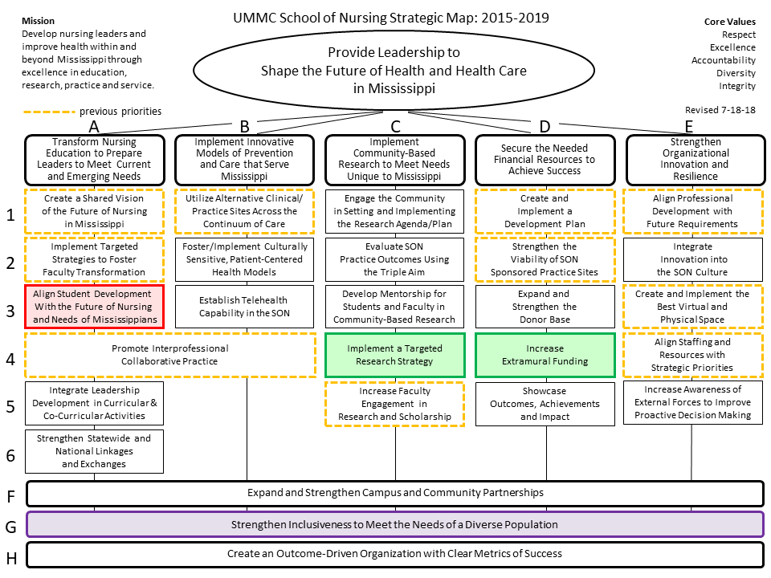
The Strategic Plan

Slide 7
Accreditation Visit
Conducted by the Commission of Collegiate Nursing Education (CCNE)
February 15 – 17, 2017
Reviewed DNP Program and Post-Graduate APRN Certificate Program
Reviewed self-study documentation, classroom and clinical activities, resource room, and other materials provided upon request

Slide 8
Accreditation Findings
The role of the Instructional Designer is critical for any organization.
QM was presented as being the 'Gold Standard' for quality in our DNP courses.
Reviewers provided positive feedback during interviews around efforts to integrate QM into strategic planning in the DNP program.
We learned that we were 'on the right track' in terms of providing a benchmark for quality.

Slide 9
Impacts of QM on Teaching and Learning in the SON
Universal Design
  A QM Template is available to ALL faculty for use in Canvas, our Learning Management System.
  All faculty are encouraged to utilize a course blueprint for alignment.
Classroom Design
  Our physical and virtual spaces are all consistent.
Faculty Development
QM Evaluation Model

Slide 10
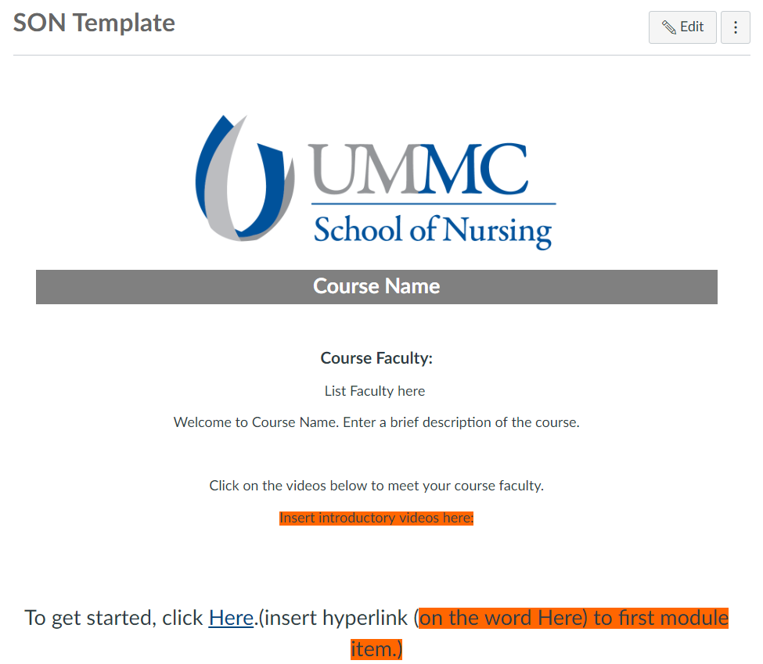
Homepage Template

Slide 11
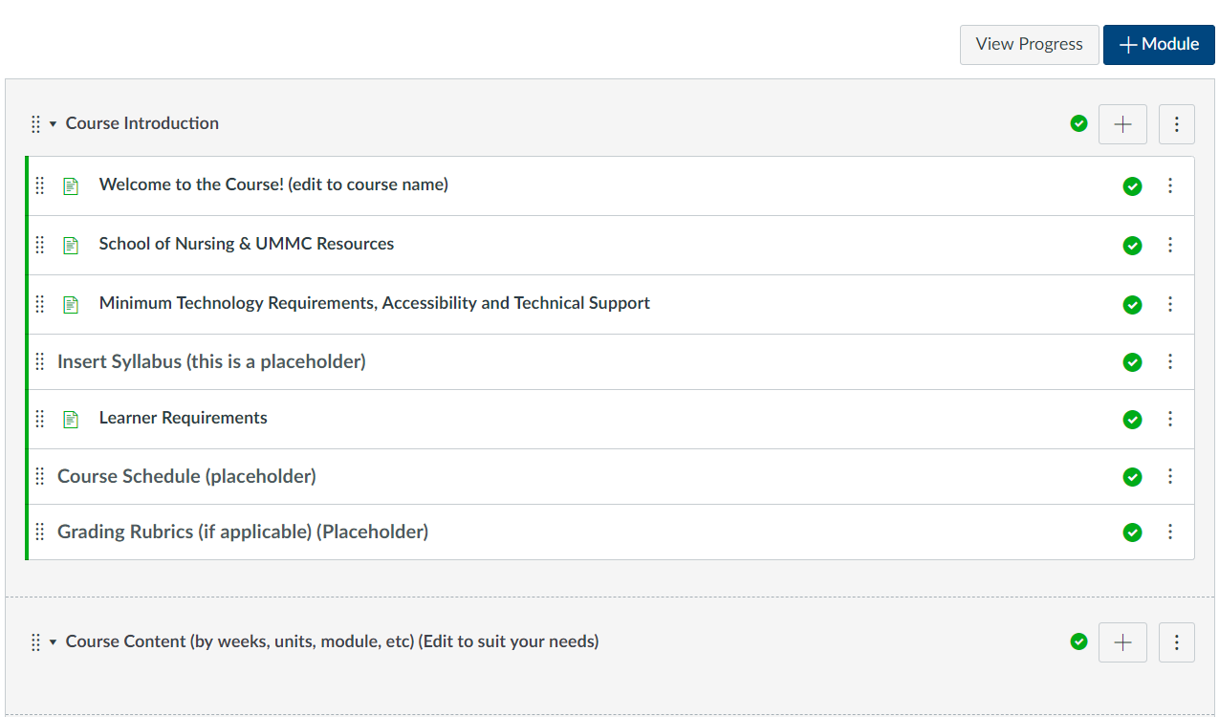
Course Module

Slide 12
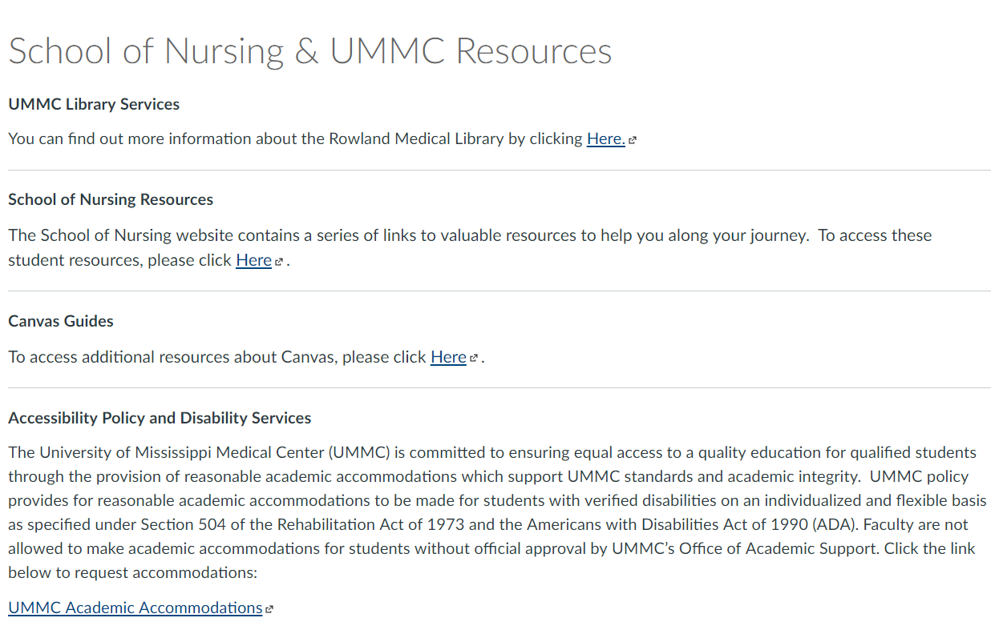
Resources

Slide 13
Classroom Design
Classroom Remodel
  Long-Term Project Involving Multiple Stakeholders
  Discussions took place on:
    What we are teaching
    How we would like to teach
    The student experience
Standardized Technology
  All classrooms are now consistent
    Each classroom is similar in design and functionality
  One-Button Connectivity
    Every room in the SON is interconnected so that teaching and learning can happen synchronously throughout the building, as well as off-campus.

Slide 14
Faculty Development
CINE Advisory Council
Faculty/Staff Orientation Course
Online Instructional Materials (SONcine Course)
Monthly Lunch-and-Learn High Noon Tech Tips Meetings
Teaching Innovation Faculty Fellowship
Quality First Training Initiative

Slide 15
Lessons Learned
QM brings so much to an institution, essentially making this partnership one of the best decisions we have made.
We learned the value of collaboration and thinking more strategically through curriculum and pedagogical training.
QM brings people together, creating a commonality of mindset and a framework around quality across the organization.
QM is a part of EVERYTHING WE DO!

Slide 16
Now…It’s Your Turn!
What accreditation and strategic planning efforts are currently ongoing in your institutions?
What role does QM play in those efforts?
What advice would you give to other institutions in implementing QM more effectively?

Slide 17
Questions?
Christian Pruett
cpruett@umc.edu
601-915-1909
Anitra Blake
amblake@umc.edu
601-984-6203

