Slide 1
Standards to Success:
Using the NSQ Standards to Achieve Online Teaching Excellence
Notes:
Good morning/afternoon everyone! Thank you for joining me today for this session on "Standards to Success: Using the NSQ Standards to Achieve Online Teaching Excellence."

Slide 2

Notes:
As our world grows ever more reliant on technology, the demand for online learning grows with it. However, many K-12 teachers may be unprepared for the unique challenges of the virtual classroom.
Quality Matters is here to help. We have developed a comprehensive professional development program that directly addresses this preparation gap.
Today, I'm excited to share with you a new workshop series that's fully aligned with the National Standards for Quality Online Teaching. This certificate program is designed specifically for K-12 educators who want to excel in online environments.

Slide 3
Topics We’ll Cover
How the NSQ Standards create a framework for online teaching excellence
Structure and content of the workshop series
How this program is different from traditional professional development
How you can transform your online teaching practice
Notes:
By the end of our time together, you'll understand:
How the NSQ standards create a framework for online teaching excellence
The structure and content of our five comprehensive workshops
How this program differs from traditional professional development
How you can participate and transform your online teaching practice

Slide 4
The NSQ Framework
Foundation for Excellence
Notes:
The National Standards for Quality Online Teaching, or NSQ, provides the foundation for everything we'll discuss today. These standards were developed by experts in online education and have become the benchmark for quality in K-12 online teaching since 2007.
Use the chat and let me know if you are familiar with the NSQ Standards.

Slide 5
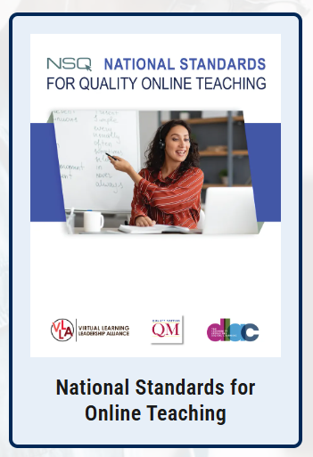
Notes:
The NSQ framework for Quality Online Teaching has five standards with indicators in each standard that comprehensively address what teachers need to know and be able to do to succeed in online environments.
Why are these standards so important? Simply put, they are the best practices for effective online teaching. They are research-based. Teachers who use these standards to inform their instruction report greater student engagement, improved learning outcomes, and increased confidence in their online teaching abilities.

Slide 6









NSQ Framework: Foundation for Excellence
Digital Citizenship
Safe, ethical online environments, privacy, and appropriate technology use.
Professional Responsibilities
Professional knowledge, growth mindset, and teaching management.
Engagement & Belonging
Instructional Design
Fostering relationships and creating belonging in virtual spaces.
Designing, delivering, and evaluating online learning experiences.
Learner-Centered Instruction
Responding to individual needs and adapting instruction accordingly.
Notes:
The five core areas covered by the standards include:
Professional Responsibilities (Standard A): This addresses the teacher's professional knowledge, growth mindset, and management of teaching responsibilities.
Digital Citizenship (Standard B): This focuses on creating safe, ethical online learning environments, including privacy, intellectual property, and appropriate technology use.
Engagement and Belonging (Standard C): This highlights strategies for fostering relationships, providing support, and creating a sense of belonging in virtual spaces.
Learner-Centered Instruction (Standard D): This examines how teachers can respond to individual learner needs, monitor progress, and adapt instruction accordingly.
Instructional Design (Standard E): This explores how teachers design, deliver, and evaluate online learning experiences.
These standards aren't just theoretical—they translate into practical skills that directly impact student success. When teachers master these standards, they create learning environments where students thrive, even without the physical presence that traditionally characterizes education.

Slide 7
Introducing the K-12 NSQ-Aligned Teaching Online Certificate Series
Notes:
Now that we understand the importance of the NSQ standards, let me introduce the new Quality Matters K-12 NSQ-Aligned Teaching Online Certificate program.

Slide 8

K-12 NSQ-Aligned Teaching Online Certificate
Self-Paced Structure
Practical Application
Complete each 10-15 hour workshop within a three-week window. Balance flexibility with accountability.
Create immediately applicable tools for your classroom. Move beyond theory to implementation.
Personalized Feedback
Receive both auto-graded assessments and facilitator feedback. Build skills with expert guidance.
Notes:
This comprehensive program consists of five workshops that together cover all 37 NSQ teaching standards indicators. It's designed to provide K-12 educators with both the theoretical knowledge and practical skills needed to excel in online teaching environments. Upon completion of each workshop, you will earn a digital credential.
What makes this program unique is its structure. These workshops have been designed to work with the demanding schedules of the K-12 educator, and are very different from anything QM has previously offered. Each workshop:
Is self-paced, giving you flexibility to fit professional development into your busy schedule
Requires 10-15 hours to complete, divided into manageable modules
Gives you a three-week window to finish, balancing flexibility with accountability
Most assessments will be auto-graded, with one final project submitted for feedback from a facilitator
Results in practical, immediately applicable tools and strategies for your classroom

Slide 9

Self-paced
Self-evaluation
One assignment submitted to facilitator
No deadlines - other than the end of the session
Notes:
I really want to highlight how this format is different from the traditional QM workshops.
Unlike QM’s asynchronous workshops, where there are specific deadlines for completing individual assignments, these self-paced modules allow you to engage with the content when it's most convenient for you. As you move through the content, the assessments will consist of knowledge checks and opportunities for self-evaluation. Each workshop culminates in the creation of a practical tool or strategy you can implement immediately in your classroom. This culminating assignment is the only one that will be submitted to a facilitator for review and will serve as the evidence for the digital credential.
The workshops can be taken in any order, and you can take them based on your specific needs and interests. Upon completion of all five workshops, you'll receive the K-12 NSQ-Aligned Teaching Online Certificate, demonstrating your commitment to excellence in online teaching.

Slide 10



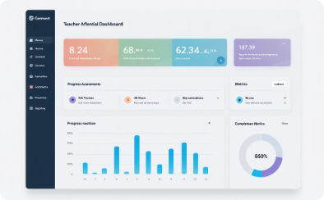
Each Workshop Includes:
Clear Learning Objectives
Multi-Format Content
Interactive Activities
Comprehensive Assessment
Each workshop features actionable objectives that directly align with NSQ standards and classroom application.
Access engaging materials through videos, readings, and interactive modules designed for different learning preferences.
Apply concepts immediately through scenario-based exercises that mirror real online teaching challenges.
Validate your knowledge through auto-graded checks and a culminating project reviewed by experienced facilitators.
Notes:
Each workshop includes:
Clear, actionable learning objectives
Engaging content in multiple formats
Interactive activities that reinforce learning
Auto-graded assessments to check understanding
A culminating project reviewed by a facilitator
Now, let's take a closer look at each of the five workshops and what you'll gain from them.

Slide 11
Workshop Highlights

Slide 12





Workshop 1: The Professional Online Teacher
Professional Development
Create a personalized growth plan with specific goals and timelines.
Time Management
Develop strategies specifically for online teaching environments.
Resource Evaluation
Learn frameworks for evaluating digital tools and activities.
Record-Keeping Strategies
Develop strategies for documentation that include maintaining the privacy of student records.
Notes:
Workshop 1: The Professional Online Teacher (TPOT)
One of the biggest challenges online teachers face is effectively managing their professional responsibilities in a virtual environment. Without the structure of a physical classroom and school building, many teachers struggle with time management, professional growth, and digital resource evaluation.
In this workshop, you'll develop the foundational skills needed to thrive as an online educator. You'll create a personalized professional development plan that includes specific goals and timelines for improving your practice. This isn't just a theoretical exercise—you'll walk away with a concrete roadmap for your professional growth.
A highlight activity in this workshop is designing and evaluating digital learning activities that incorporate responsible technology use. You'll learn frameworks for evaluating digital tools and create opportunities that encourage positive digital citizenship among your students.
One immediate takeaway you'll gain is a set of practical time management strategies specifically designed for online teachers. These strategies will help you balance communication with students and parents, maintain high-quality learning environments, and ensure student safety and success—all while preserving your own well-being.

Slide 13




Workshop 2: Modeling Responsible Online Presence
Classroom Guidelines
Copyright Compliance
Develop comprehensive guidelines for responsible digital citizenship and netiquette.
Evaluate materials for copyright and fair use policy compliance.
Privacy Framework
Apply FERPA regulations to protect student information online.
Notes:
Workshop 2: Modeling Responsible Online Presence (MROP)
Online learning environments present unique challenges for student safety, privacy, and ethical behavior. Many teachers worry about keeping students safe online while fostering authentic engagement.
This workshop delves into creating and maintaining a responsible digital learning environment. You'll develop comprehensive classroom guidelines that define and promote responsible digital citizenship behaviors, including netiquette and appropriate online conduct.
A key activity you'll complete is evaluating instructional materials for compliance with copyright and fair use policies. You'll also create strategies to teach these essential concepts to your students, helping them become responsible digital citizens themselves.
A practical takeaway from this workshop is a framework for applying federal privacy regulations like FERPA to your online classroom. You'll develop procedures that protect student information in the online environment, ensuring compliance with all relevant regulations.

Slide 14



Workshop 3: Developing an Online Community of Learners
Build Community
Design strategies for the crucial first weeks.
Foster Engagement
Identify patterns and support active collaboration.
Provide Feedback
Develop timely, actionable communication approaches.
Notes:
Workshop 3: Developing an Online Community of Learners (DOCL)
Perhaps the biggest challenge in online teaching is creating a sense of community and belonging when students aren't physically together. Without intentional strategies, online learners often feel isolated and disengaged.
This workshop explores strategies for building and nurturing a vibrant online learning community. You'll design specific approaches to cultivate a strong sense of community in your online classroom, particularly during those crucial first weeks of the course.
An exciting activity in this workshop involves identifying patterns in learner engagement and developing strategies to support active learning and collaboration. You'll learn how to leverage student voice and choice to increase motivation and participation.
A valuable takeaway is a comprehensive plan for providing timely, actionable feedback to students. You'll develop communication strategies that strengthen relationships and help students feel connected to you and to each other, even in a virtual environment.

Slide 15
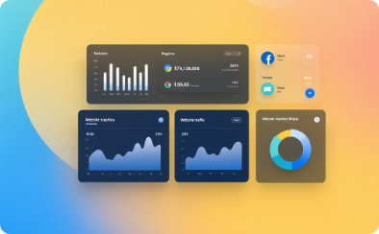



Workshop 4: Facilitating Meaningful Learner Engagement
Data-Driven Decisions
Learner Profiles
Support Strategies
Assistive Technologies
Create detailed profiles to understand each student's needs.
Implement targeted interventions for struggling learners.
Leverage data insights to inform and enhance instruction.
Provide tools that ensure access for all students.
Notes:
Workshop 4: Facilitating Meaningful Learner Engagement (FMLE)
Personalizing instruction is challenging enough in a traditional classroom—it can seem nearly impossible online. Many teachers struggle to identify and respond to individual learner needs in virtual environments.
This workshop concentrates on using data to drive personalized instruction. You'll learn to design comprehensive learner profiles that include academic, social, and technological needs to guide your instructional decisions.
A powerful activity in this workshop involves analyzing multiple sources of learner data to create targeted interventions and support strategies. You'll also learn how to implement appropriate assistive technologies to ensure all students can access and engage with your online content.
An immediate takeaway is a set of strategies for continuously monitoring student progress and collaborating with stakeholders to provide comprehensive support. These approaches will help you identify struggling students early and connect them with the resources they need to succeed.

Slide 16

Workshop 5: Instructional Design to Facilitate Learning
1
Alignment
Connect objectives, activities, and assessments in perfect harmony.
2
Resource Selection
Evaluate and choose high-quality, relevant learning materials.
3
Assessment Design
Create assessments offering choice in demonstrating understanding.
4
Content Adaptation
Modify inherited content to meet specific student needs.
Notes:
Workshop 5: Instructional Design to Facilitate Learning (IDFL)
Many online teachers inherit or purchase content but struggle to adapt it to meet their specific students' needs. Understanding the principles of effective instructional design is crucial for online teaching success.
This final workshop focuses on practical instructional design principles for online learning environments. You'll explore the interactive relationship between learning objectives, activities, and assessments, ensuring perfect alignment in your online courses.
A highlight activity involves evaluating and selecting learning resources that support state learning objectives while meeting the diverse needs of your students. You'll develop criteria for choosing high-quality, relevant materials that engage learners.
A valuable takeaway is a framework for creating assessments that offer students choice in demonstrating their understanding of course concepts. You'll learn to design activities and assessments that not only engage learners but also provide clear evidence of mastery of learning objectives.

Slide 17
Your Pathway to Online Teaching Excellence
Notes:
Now that you've seen the rich content offered in each workshop, let me share how you can participate in this transformative professional development opportunity.

Slide 18
June
August
The Professional Online Teacher
Developing an Online Community of Learners
Facilitating Meaningful Learner Engagement
Modeling Responsible Online Presence
Instructional Design to Facilitate Learning
Notes:
We'll begin piloting three workshops in June, with the remaining two launching in August. Each workshop costs $200 for QM members, and you can register for individual workshops or the entire certificate program on the Quality Matters website.
The investment of time—10-15 hours per workshop—is specifically designed to be manageable for busy educators. The three-week completion window for each workshop gives you flexibility while ensuring you maintain momentum in your professional growth.
Throughout each workshop, you'll have access to a facilitator who can answer questions and provide guidance. These facilitators are experienced online educators who understand the challenges you face and can offer practical solutions.

Slide 19


Your Pathway to Online Teaching Excellence
Earn Your Certificate
Transform Your Practice
Complete all five workshops to receive the K-12 NSQ-Aligned Teaching Online Certificate.
Gain concrete skills that increase confidence and improve student outcomes.
Notes:
Upon completing all five workshops, you'll receive the K-12 NSQ-Aligned Teaching Online Certificate, which demonstrates your commitment to excellence in online teaching. This credential can be valuable for career advancement and professional recognition.
Most importantly, you'll gain concrete skills and strategies that will transform your online teaching practice. Past participants in our professional development programs report increased confidence, greater student engagement, and improved learning outcomes.

Slide 20
Registration
Notes:
I hope I've conveyed my excitement about this new program and the potential it has to transform online teaching practice. The NSQ standards provide a powerful framework for excellence, and these workshops translate that framework into practical skills you can implement immediately.

Slide 21
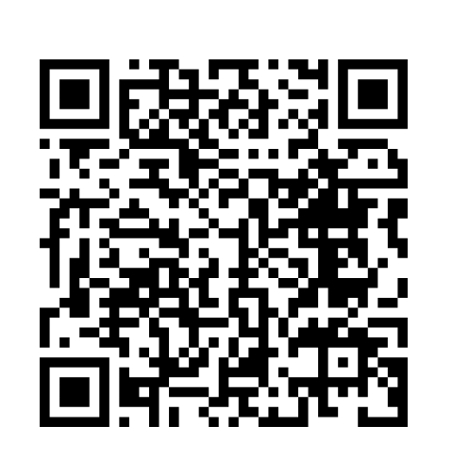
Registration Link:
Notes:
To register for the workshops, simply visit Quality Matters .org or scan this QR code. You can also sign up on the interest list to be notified when registration opens.
I believe that every student deserves a high-quality online learning experience, and every teacher deserves the support and training needed to provide that experience. These workshops are designed to empower you to become the online teacher you aspire to be.
I'd be happy to answer any questions you might have about the program or the NSQ standards.

Slide 22

Contact:
Elisa White
ewhite@qualitymatters.org
Notes:
[Q&A]

