Slide 1
QM Self Reviews: You Review, I Review, We All Review
How we utilize the QM Self Review Tool to prepare for official Quality Matters Peer Reviews
Larissa Cremeens, Christine Nelson, & JD Weagley
The Instructional Designer Team @ USI

Slide 2
Presentation Outline
Overview of Online Course Development Program (OCDP)
How we utilize the QM Self Review Feature
Impact of the OCDP

Slide 3
Insert Poll/Wordle
Who are you?
ID, Faculty, Admin, Other

Slide 4
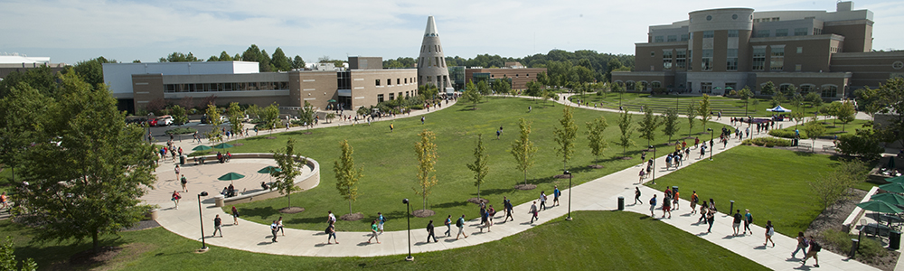

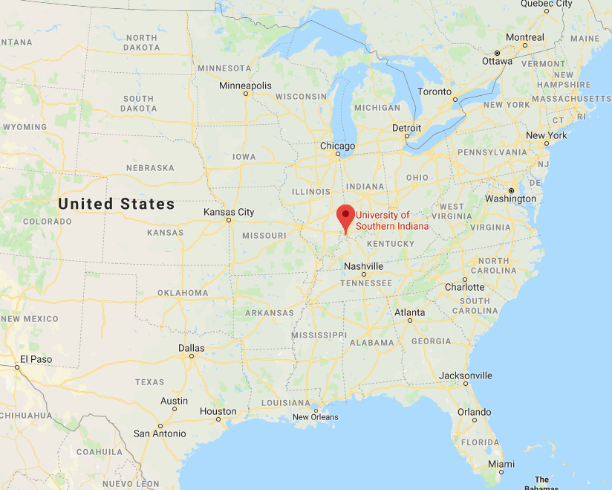
Who We Are
Founded in 1965
Enrollment: 10,734
The University employs:
659 full-time faculty and administrative staff
251 part-time faculty
369 full-time support staff
333 part-time staff

Slide 5
Online Course Development Program (OCDP)
Stipend-based professional development to support faculty in design and development of quality online courses
    Target Learners- Faculty across colleges and disciplines
    Offered 3x a year
      Developing courses for the following semester
    Instructional Designer Support
    Quality Matters Rubric & Peer Review Process
  Phase 1: Course Planning
  Phase 2: Course Development
  Phase 3: Course Review

Slide 6
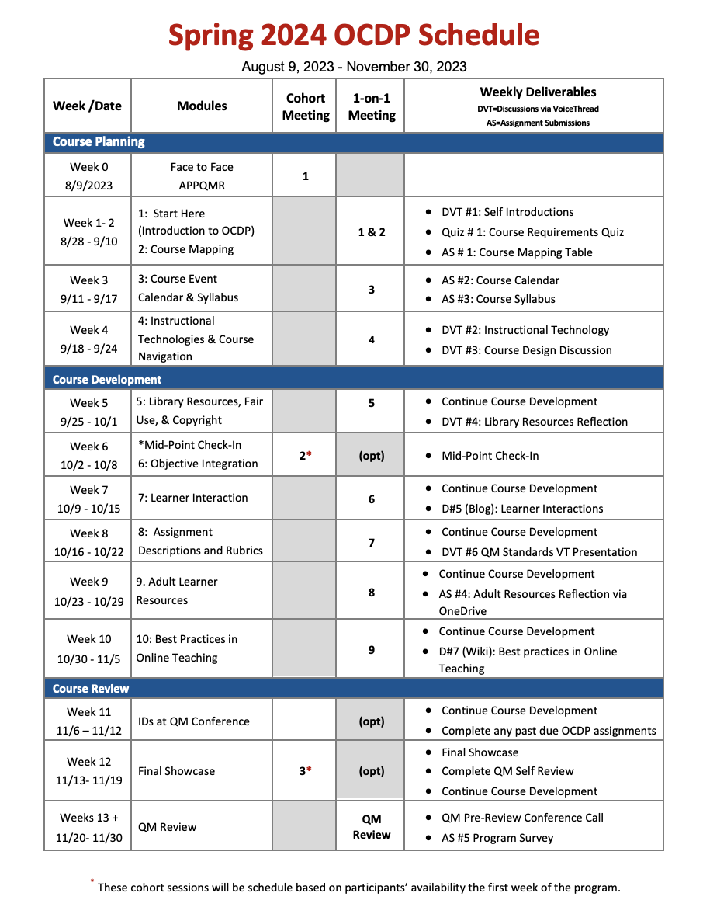
Spring 2024 OCDP Schedule

Slide 7
Program Requirements
  Attend APPQMR QM Workshop
  Attend 2 cohort meetings
  Complete all OCDP Modules on Bb site
  Attend scheduled meetings w/ ID
  Present work at the faculty final showcase
  Develop the entire course prior to QM Review
  Complete a self-review
  Participate in QM review and make changes (as needed)

Slide 8
History & Versions of the OCDP
Online Course Development Program
  Started in Spring 2015
Self-Paced Online Course Development Program
  Started Summer 2018
  Not for stipend
  Adjunct, other professional staff
  Internal QM Review Only
Learning to Teach Online
  Started Summer 2019
  Open to anyone
  Focus on Delivery
Investigating Other Formats Currently

Slide 9
Insert Poll
How does your institution incentivize online course development?

Slide 10
Collaboration is Key
Library
  Mid-Point Check In
  Embedded Module in Organization Site
  Online Resources
    Streaming Services
    Research Services
  Open Educational Resources (OER)
    Incorporating
    Modifying
    Creating
  Share best practices for online course delivery
  Copyright overview
Disability Resources
  Tech Take-Aways
  Mid-Point Check-in
    Highlights Standard 8 specifically
  Reviewing Blackboard Ally
IT
  Overview best technical practices
  Stay up to date with upcoming events/dates
  Tutorials
  + More opportunities for collaboration!

Slide 11
OCDP Organization Site Overview

Slide 12
OCDP LMS
Breaks down QM standards into 10 Modules
Course alignment
Syllabus/Calendar
Effective online course navigation
Instructional technologies
Assignment descriptions & rubrics
Learner interactions
Creating/finding equitable/diverse instructional materials
Accessibility
Student Resources
Start here information

Slide 13
QM Self-Review

Slide 14
OCDP Capstone
Submitting for QM-Managed review is the "cumulative final" for the OCDP.
The final step before submission is for the ID and faculty to complete the SELF-REVIEW

Slide 15
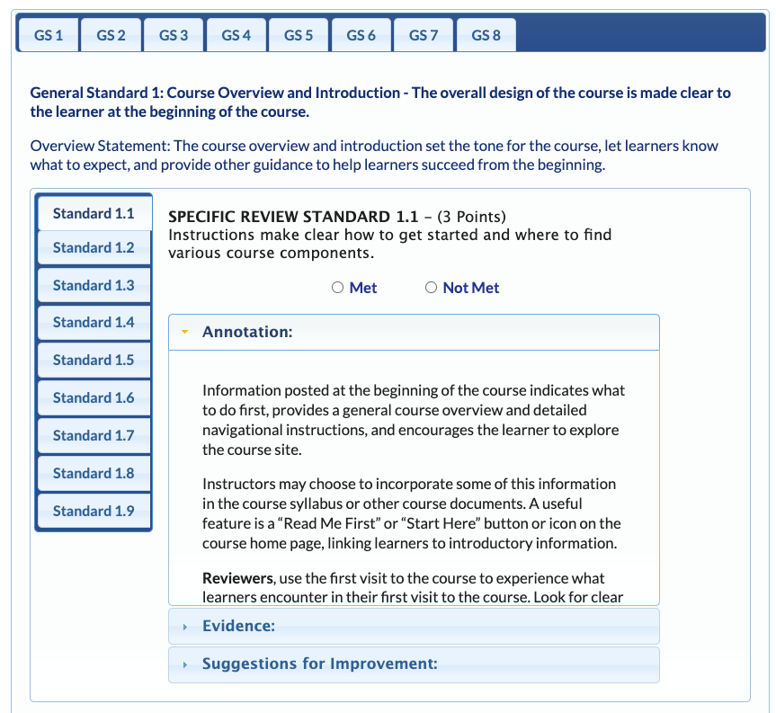
Self-Review
  Who completes the self-review?
  Course Faculty
  Instructional Designer
How is the self-review completed?
  Using QM's Self-Review tool
  Independently
What happens after the self-review is completed?
  Final meeting to discuss review findings/questions
  Make any necessary changes
  Final Submission to QM

Slide 16
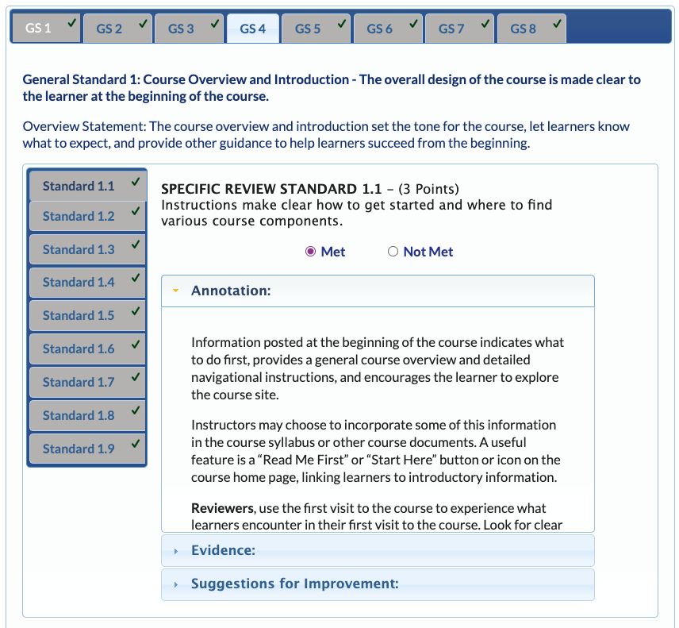
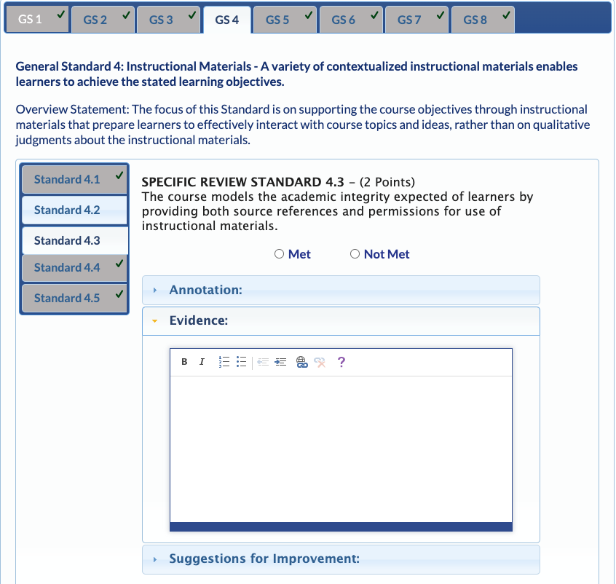
Why Use QM's Self-Review Tool?
  Brings focus back to objectives and alignment
  Has all the annotations embedded without needing the rubric book
  Easy to use online tool that keeps track where you left off
  Frees up time to work with more faculty

Slide 17
OCDP Impact

Slide 18
Courses Developed
400
Nearly Courses Developed
Since Spring 2015
16
Courses Currently in Development
275
More Than Faculty Members
Since Spring 2015
237
QM-Certified Courses Since 9/2018
+8 Courses Currently in Review

Slide 19
Course Survey
Small Sample QM-Reviewed Courses
4 Key Areas
  Start of the Course (4 questions)
  Learning Objectives (7 questions)
  Tools, Interaction, & Support (7 questions)
  Grading Policy (3 questions)

Slide 20
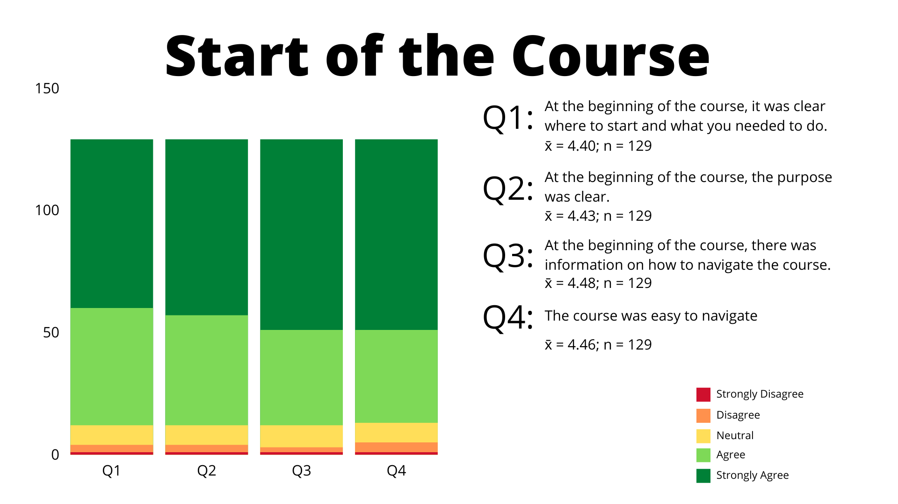
Start of the Course 1

Slide 21
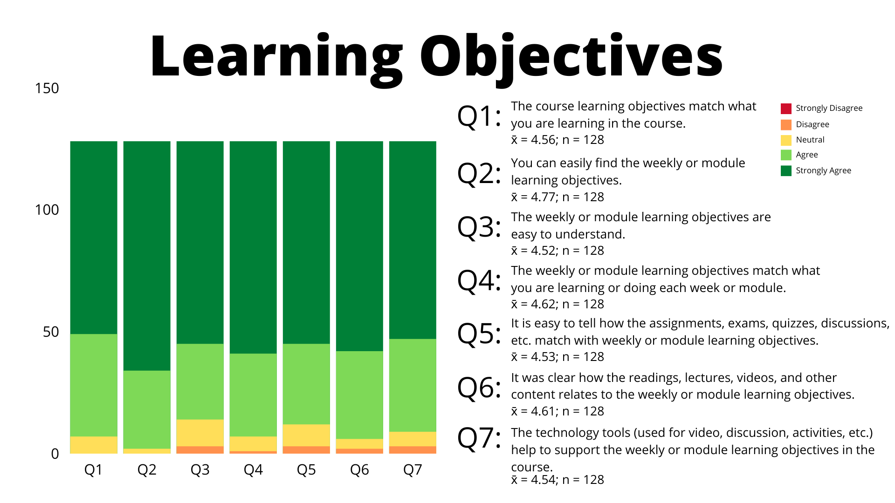
Learning Objectives

Slide 22
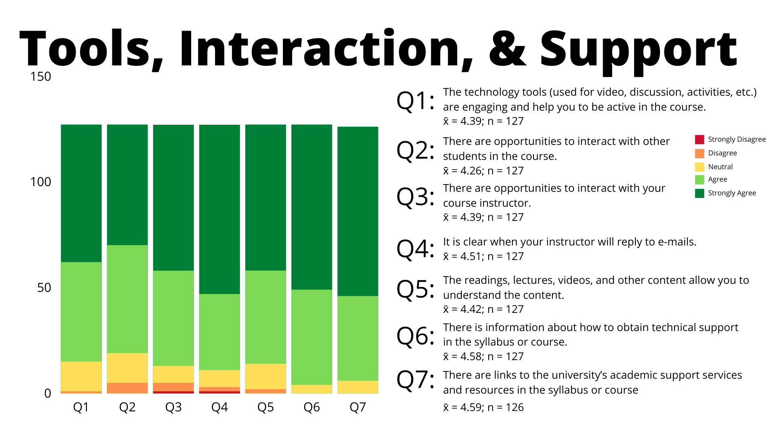
Tools, Interaction, & Support

Slide 23
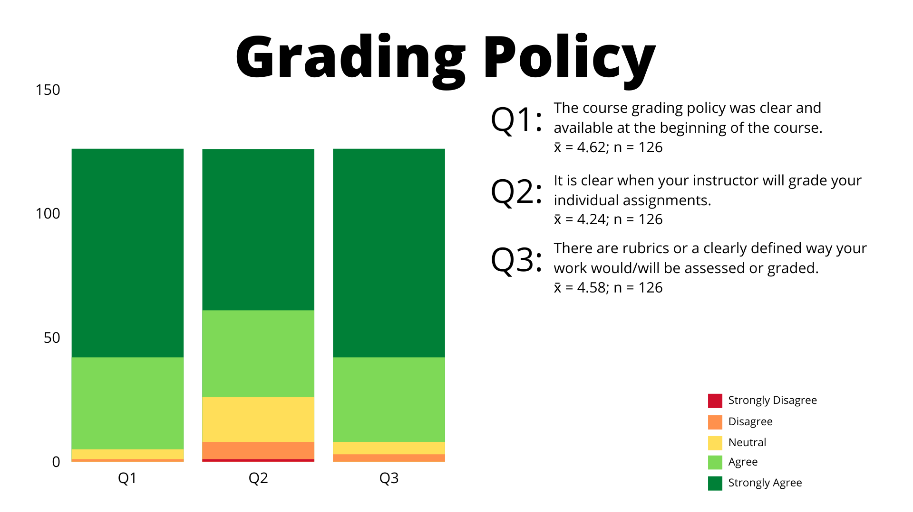
Grading Policy

Slide 24
Thank You!
Have questions? Contact us at online.support@usi.edu
Larissa Cremeens, Christine Nelson, & JD Weagley
The Instructional Designer Team @ USI

