Slide 1
Now with More Human!
How to Build Presence in Online Courses with the Community of Inquiry Framework

Slide 2






Toni DiMella, EdD
Executive Director for Quality Assurance, eLearningDOC
Adjunct Stats Instructor at USC-Upstate, previously the Director for Inclusive and Transformative Pedagogy in CAIFS.
Adjunct Math Instructor at Mitchell Community College, previously a full-time faculty member.
Credit Recovery teacher and Course Developer with NCPVS (2008-2013)
Math Teacher with CCTL Early College (2005-2009)

Slide 3
Learning Objectives
Identify connections between RSI, the Community of Inquiry Framework, and the Quality Matters Standards.
Develop a communication plan that enhances instructor presence and supports student engagement.
Explore how formative discussion forums and staggered grading can increase learner-learner and faculty-learner interactions and reduce instructor workload.

Slide 4
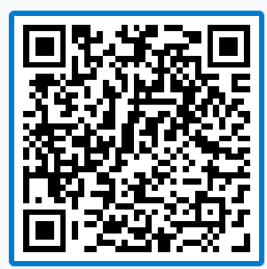
How do you communicate with your students?
Announcements?
Emails?
Feedback?
Text?
Phone calls?
Other?
PollEv.com​/tonidimella967

Slide 5

RSI, COI, and QM
You look familiar…

Slide 6
Regular and Substantive Feedback
“Education that uses one or more of the technologies … to deliver instruction to students who are separated from the instructor or instructors and to support regular and substantive interaction between the students and the instructor or instructors, either synchronously or asynchronously.”
34 CFR § 600.2
Notes:
To ensure that online content is accessible to learners of all abilities, the Accessibility Guidelines Working Group of the Web Accessibility Initiative (WAI) created a robust set of guidelines called the "Web Content Accessibility Guidelines" (WCAG) in 1999. The WAI is a World Wide Web Consortium (W3C) member. The W3C is an international community that works collaboratively with industry experts, academics, organizations, and governments worldwide to develop consensus-based technical specifications and guidelines that shape the future of the web.
The WCAG provides a globally recognized standard for web accessibility, ensuring consistency in how accessibility is approached across different websites and applications. WCAG provides specific guidelines under four principles (Perceivable, Operable, Understandable, and Robust), each addressing various aspects of web content and interaction. Each guideline has associated success criteria, which are testable statements that help determine whether the guideline has been satisfied. This helps create a uniform experience for users with disabilities.

Slide 7
Definitions
Regular
Substantive
“An institution ensures regular interaction between a student and an instructor or instructors by, prior to the student’s completion of a course or competency—
Providing the opportunity for substantive interactions with the student on a predictable and scheduled basis commensurate with the length of time and the amount of content in the course or competency; and
Monitoring the student’s academic engagement and success and ensuring that an instructor is responsible for promptly and proactively engaging in substantive interaction with the student when needed, on the basis of such monitoring, or upon request by the student.”
“For purposes of this definition, substantive interaction is engaging students in teaching, learning, and assessment, consistent with the content under discussion, and also includes at least two of the following—
Providing direct instruction;
Assessing or providing feedback on a student’s coursework;
Providing information or responding to questions about the content of a course or competency;
Facilitating a group discussion regarding the content of a course or competency; or,
Other instructional activities approved by the institution’s or program’s accrediting agency.”

Slide 8
More Simply Put
Regular
Substantive
You must be present and predictable. This means:
Scheduling communication and feedback
Checking on student progress
Reaching out when someone is struggling or asks for help
Students shouldn’t wonder if you’re real. You show up consistently and proactively.
You must teach, guide, and support learning, not just monitor it. This means:
Explaining content
Giving meaningful feedback
Answering questions about material
Leading or facilitating discussions
Helping to guide learning
Students should feel you’re teaching them, not just grading them.

Slide 9
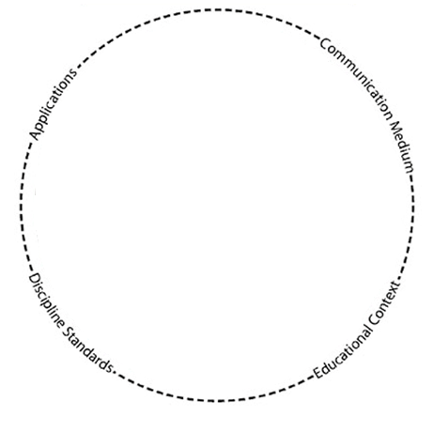
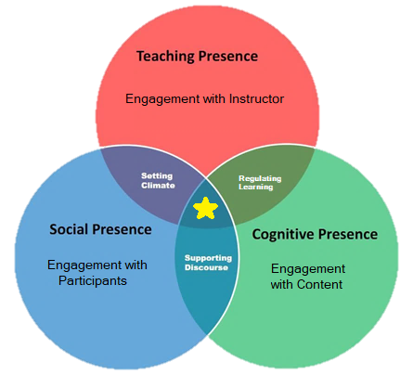
Community of Inquiry
How learning takes place for a group of individual learners through the educational experience that occurs at the intersection of social, cognitive and teaching presence.
-Garrison, Anderson, & Archer, 2000

Slide 10
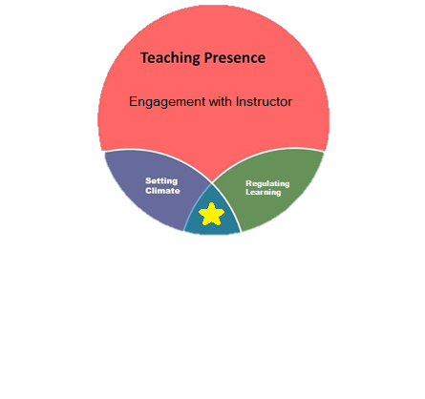
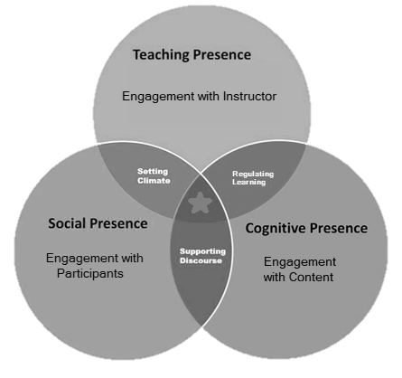
Teaching Presence
Elements
Instructional Design and Organization
Direct Instruction
Facilitating Discourse
Helps create and maintain a Coi relationship with learners to promote meaningful learning.
Mohsen Saadatmand et al.

Slide 11
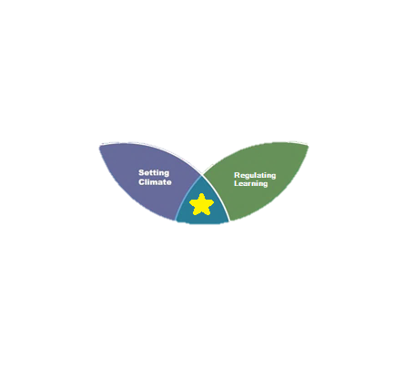
Focus on Intersections
Indicators
Setting Curriculum and Guidelines
Building Understanding and Meaning
Focusing Discussions and Activities
Faculty ↔ Student Interactions

Slide 12
Trifecta of Presence
CoI
RSI
Course Design
Predictable communication and feedback
1.2 Build connections
Instruction
Facilitation
Meaningful Feedback
Instructor-initiated monitoring
Direct instruction, guidance, and facilitation
Documented evidence
3.3-3.5 Feedback for learning
5.2 Learner-instructor
5.3 Time expectations
5.4 Communication norms
6.1-6.3 Purposeful Technology
QM
Notes:
Design for CoI → Meet RSI → Validate with QM
compliant by design.
CoI provides a framework
RSI states the requirements
QM gives us context and process

Slide 13
When do you communicate with students?
Once a week.
When assignments are due.
The beginning of the unit/module.
Whenever I think of things.
Other?
PollEv.com​/tonidimella967

Slide 14
Effective Communication for Courses
It must be:
Genuine, but crafted.
Supportive, but provide direction.
Consistent, but not repetitive.
Widespread, but not scattered.

Slide 15



Communication Plan
Announcements
(Teaching)
Staggered Grading
(Cognitive)
Formative Forums
(Social)

Slide 16

Pretend to be Human
The Real Teacher Superpower
Notes:
https://www.shutterstock.com/search/spinning-plates

Slide 17
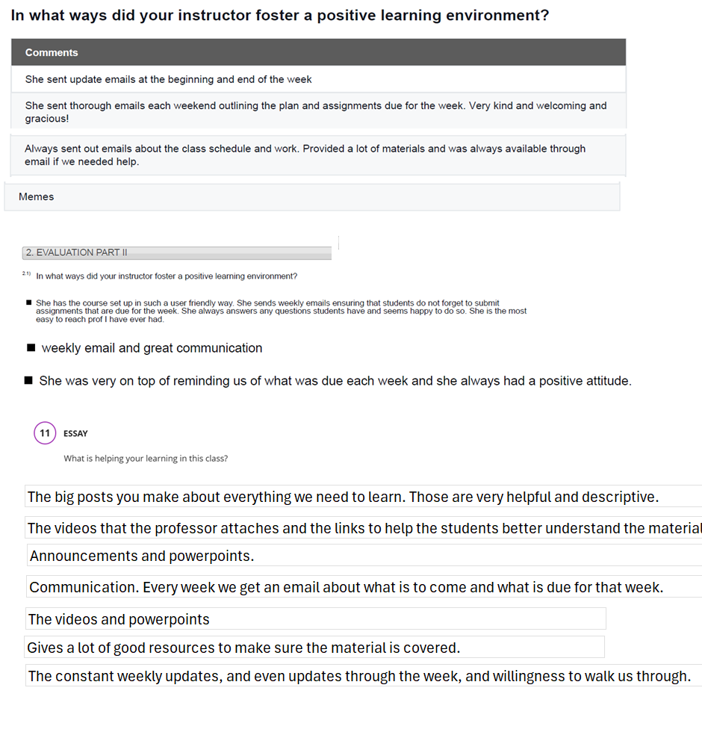
Announcements
Multipurpose
Reminders
Relationship
Reteaching
Not just text!!

Slide 18
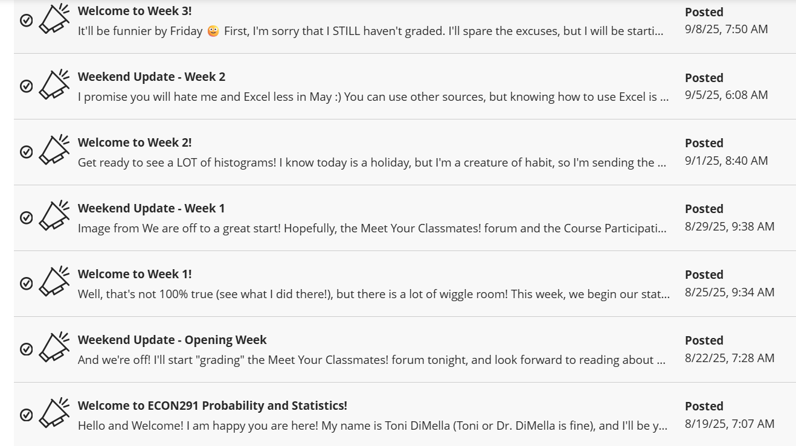
Announcement Communication Plan
Set day (days)
Notes:
https://www.clemson.edu/accessibility/digital/guides/canvas/headings.html

Slide 19
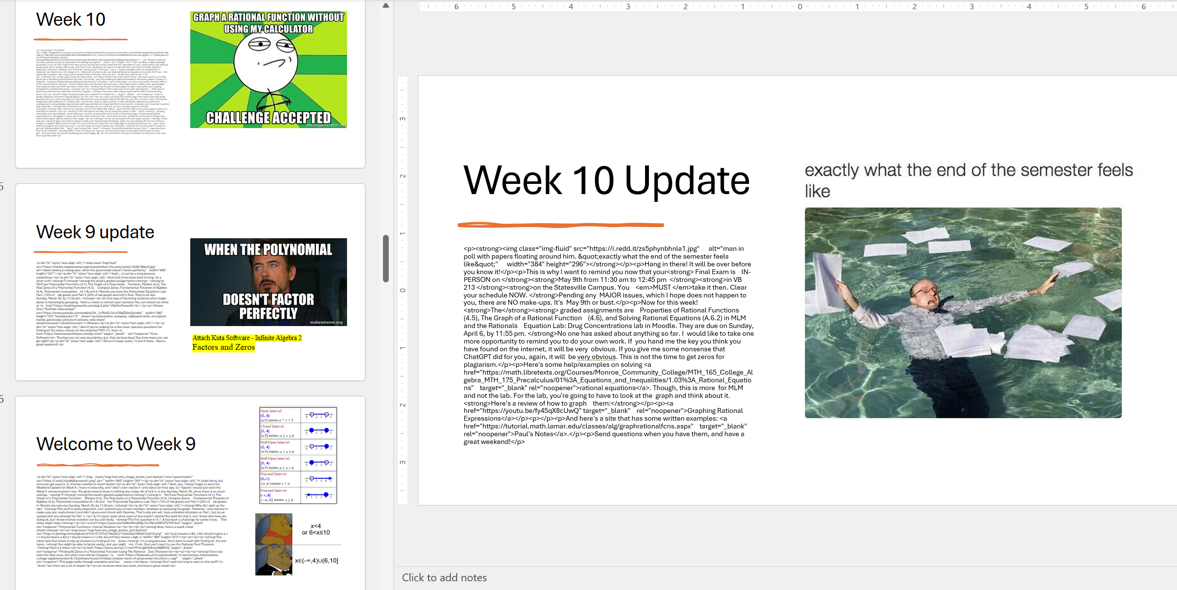
Announcement Communication Plan
Set day (days)
SAVE THEM
Avoid dates/holidays
Notes:
https://www.clemson.edu/accessibility/digital/guides/canvas/headings.html

Slide 20
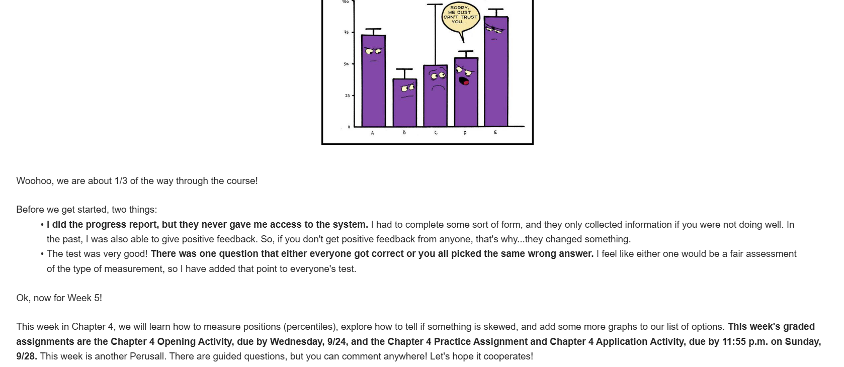
Announcement Communication Plan
Set day (days)
SAVE THEM
Avoid dates/holidays
Have a flow
Opener
Reminder
Notes:
https://www.clemson.edu/accessibility/digital/guides/canvas/headings.html

Slide 21
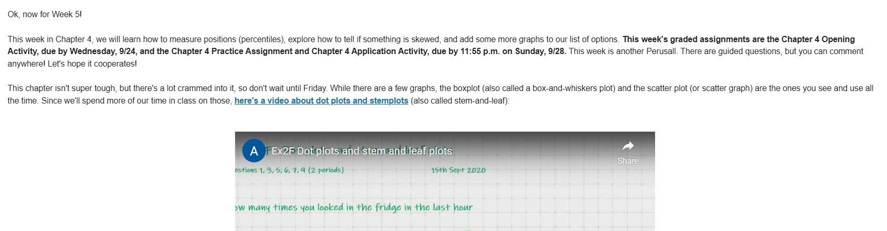
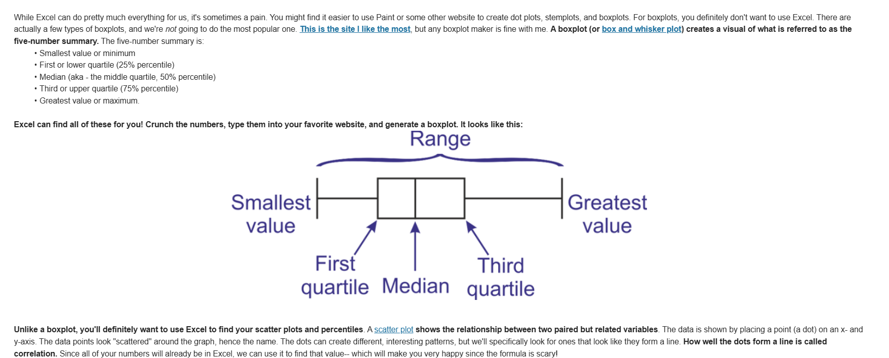
Announcement Communication Plan
Set day (days)
SAVE THEM
Avoid dates/holidays
Have a flow
Opener
Reminder
Content
Notes:
https://www.clemson.edu/accessibility/digital/guides/canvas/headings.html

Slide 22
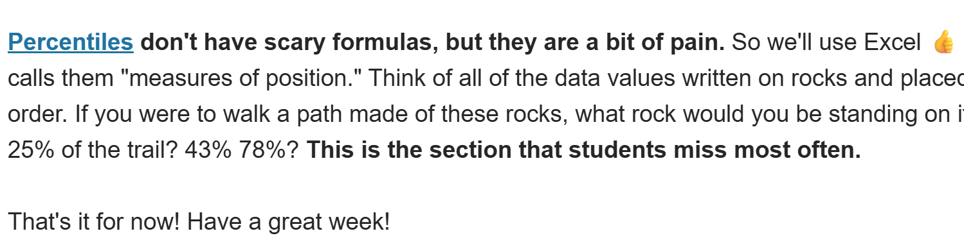
Announcement Communication Plan
Set day (days)
SAVE THEM
Avoid dates/holidays
Have a flow
Opener
Reminder
Content
Issues
Closing
Notes:
https://www.clemson.edu/accessibility/digital/guides/canvas/headings.html

Slide 23
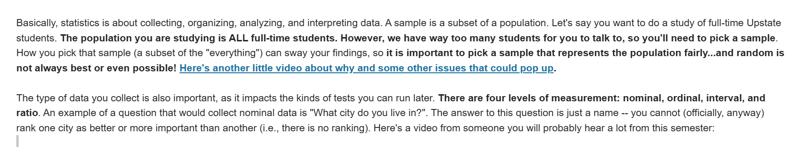
Announcement Communication Plan
Conversational(ish)
Notes:
https://www.clemson.edu/accessibility/digital/guides/canvas/headings.html

Slide 24
Announcements Check
QM
CoI
RSI
Course Design
Predictable communication and feedback
1.2 Build connections
Instruction
Facilitation
Meaningful Feedback
Instructor-initiated monitoring
Direct instruction, guidance, and facilitation
Documented evidence
3.4, 3.5 Feedback and Varied Feedback
5.2 Active Learning
5.3 Interactions
6.1-6.3 Purposeful Technology
Notes:
QM gives us context and process

Slide 25

Think About It
What will you use to humanize your communications?
How many announcements do you think you will need?
PollEv.com​/tonidimella967

Slide 26

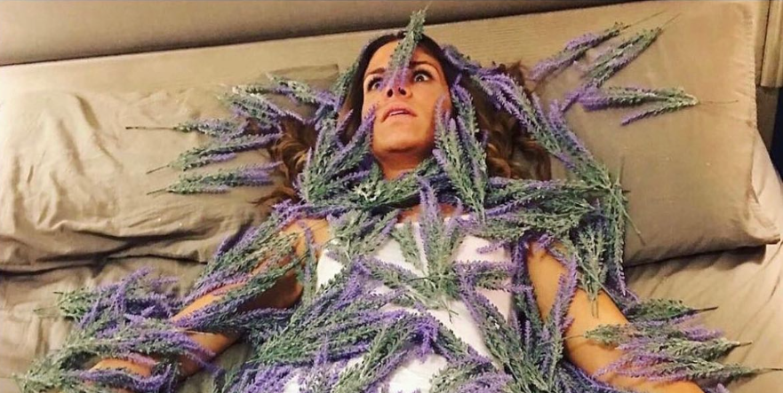
(Grading) Time Management
You can’t pour from an empty cup
Notes:
https://www.shutterstock.com/search/spinning-plates

Slide 27
How often are you manually grading?
Weekly
Once a unit/module/chapter
Monthly
Once or Twice a semester
Never
PollEv.com​/tonidimella967

Slide 28
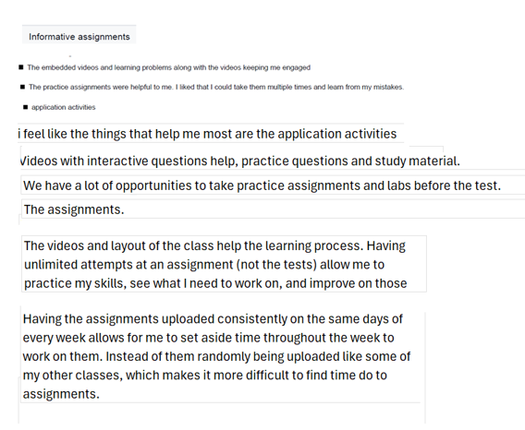

Staggered Grading
Variety of assignments
Gives everyone a break or multiple attempts
Different types of applications

Slide 29
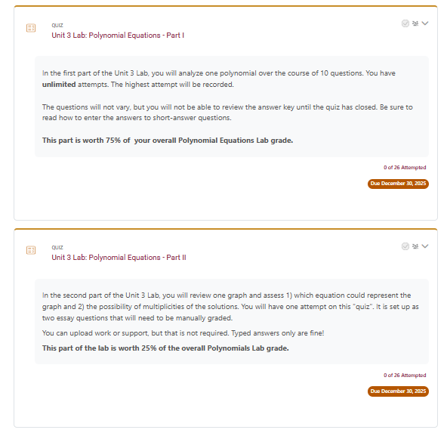
Feedback Plan
Partial manually graded assignments by adding one or two questions to a bigger assignment.
Notes:
https://www.clemson.edu/accessibility/digital/guides/canvas/headings.html

Slide 30
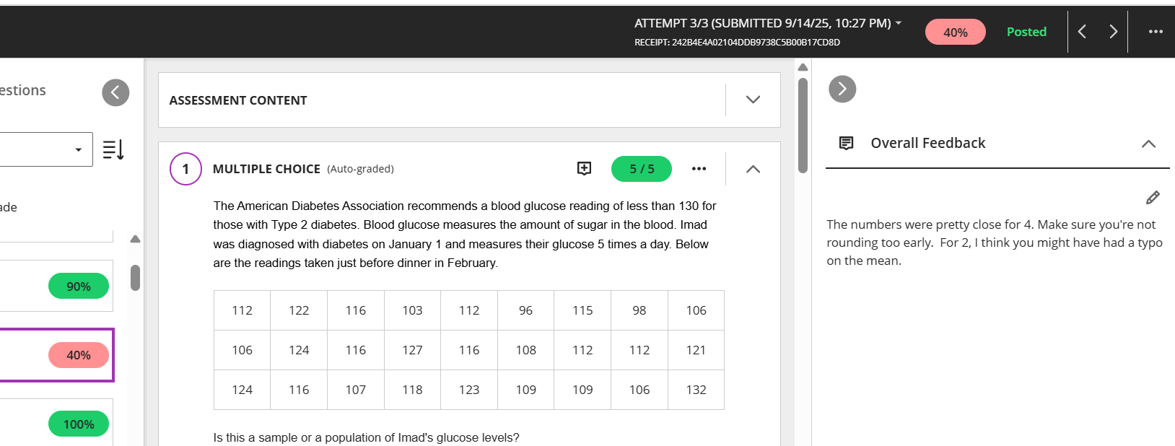
Feedback Plan
Partial manually graded assignments by adding one or two questions to a bigger assignment.
Review auto-graded assignments for low grades.
Notes:
https://www.clemson.edu/accessibility/digital/guides/canvas/headings.html

Slide 31
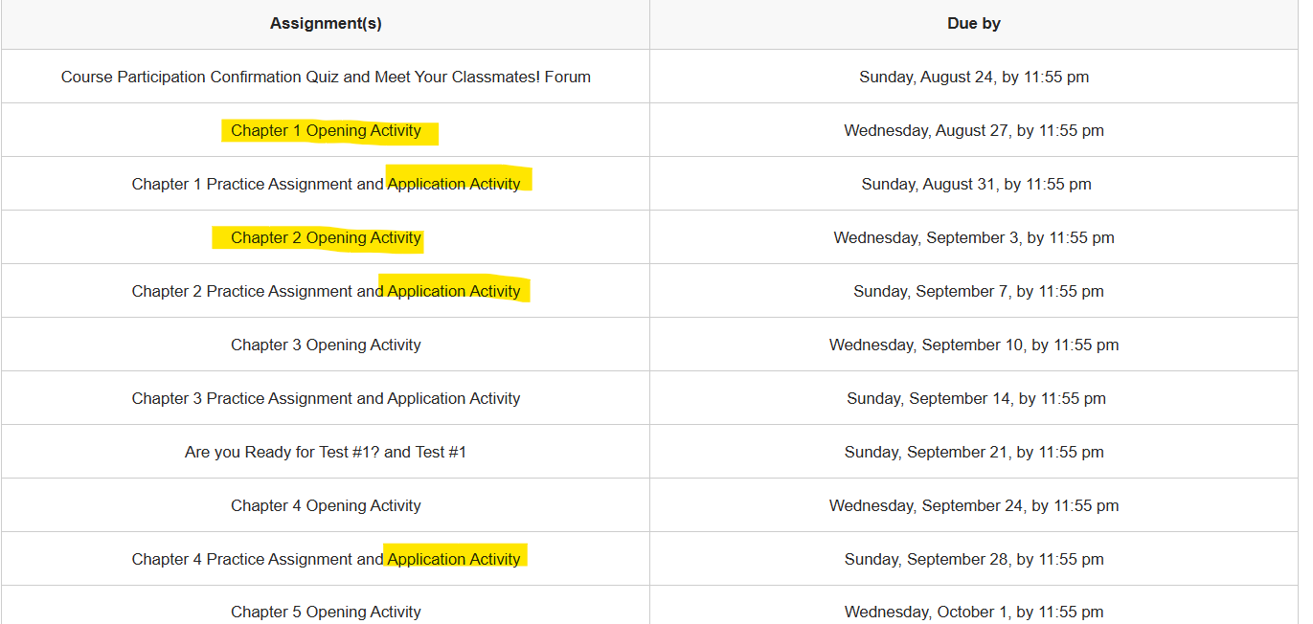
Feedback Plan
Partial manually graded assignments by adding one or two questions to a bigger assignment.
Review auto-graded assignments for low grades.
Well-timed manual graded assignments. Make sure to look at all your classes!
Notes:
https://www.clemson.edu/accessibility/digital/guides/canvas/headings.html

Slide 32
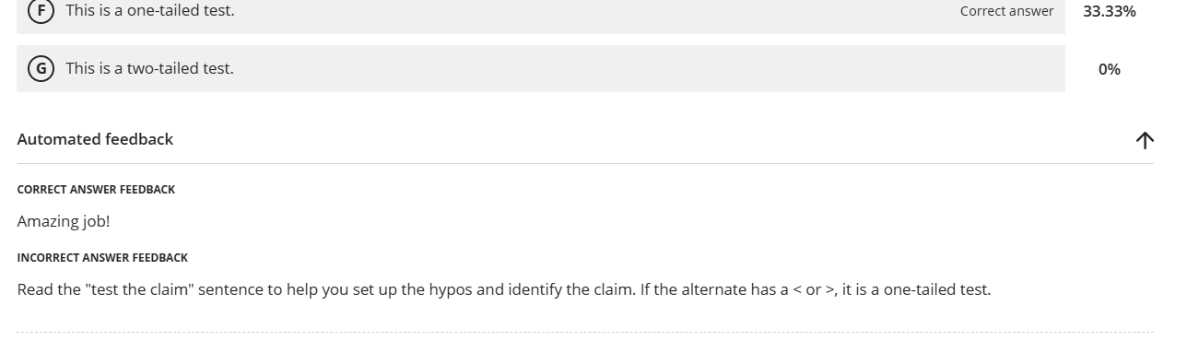
Feedback Plan
Partial manually graded assignments by adding one or two questions to a bigger assignment.
Review auto-graded assignments for low grades.
Well-timed manual graded assignments. Make sure to look at all your classes!
“Pre”grading by adding feedback to quiz-style assignments.
Notes:
https://www.clemson.edu/accessibility/digital/guides/canvas/headings.html

Slide 33
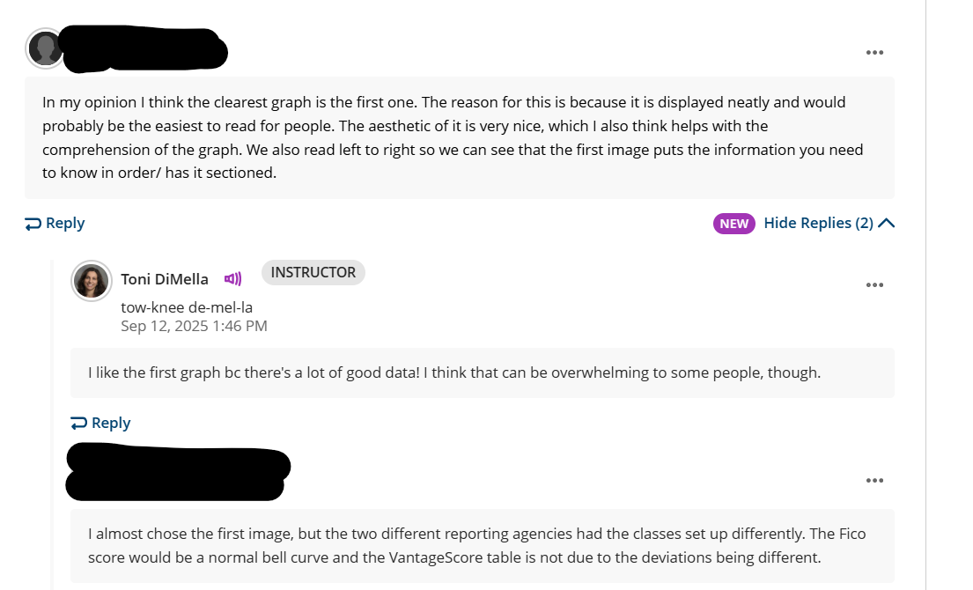
Feedback Plan
Partial manually graded assignments by adding one or two questions to a bigger assignment.
Review auto-graded assignments for low grades.
Well-timed manual graded assignments. Make sure to look at all your classes!
“Pre”grading by adding feedback to quiz-style assignments.
Remember low-stakes assignments!
Notes:
https://www.clemson.edu/accessibility/digital/guides/canvas/headings.html

Slide 34
Staggered Grading Check
QM
CoI
RSI
Course Design
Predictable communication and feedback
Instruction
Facilitation
Meaningful Feedback
Instructor-initiated monitoring
Direct instruction, guidance, and facilitation
Documented evidence
3.4,3.5 Feedback and Varied Assessment
5.2 Active Learning
5.3 Interactions
6.1-6.3 Purposeful Technology
1.2 Build connections
Notes:
Design for CoI → Meet RSI → Validate with QM
compliant by design.
CoI provides a framework
RSI states the requirements
QM gives us context and process

Slide 35

Think About It
What’s one assignment you can convert with an auto-grade with embedded meaningful feedback?

Slide 36
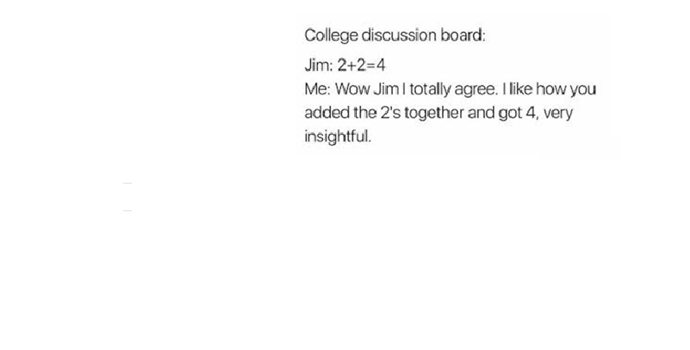
Give Them Something to Talk About
Conversation builds community
Notes:
https://www.shutterstock.com/search/spinning-plates

Slide 37
Forums in my class...
Have been underwhelming.
Required too much grading.
Can be hit-or-miss. Sometimes they work, sometimes they don’t
Are my go to!
Don’t exist. I don’t use them.
PollEv.com​/tonidimella967

Slide 38
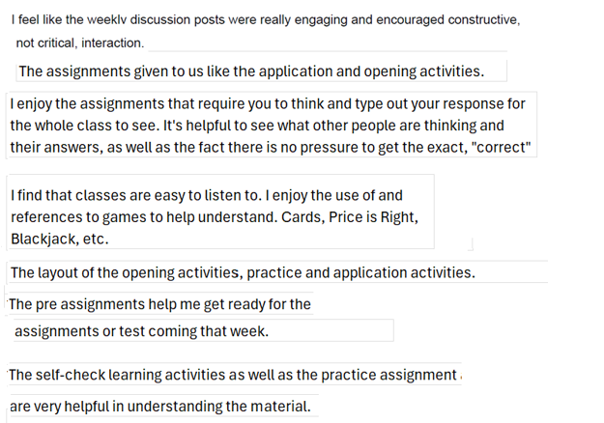
Formative Forums
Gets them thinking, not repeating content.
Great for building community.
Serves as a “hook”
Provides a bridge between the world and content.
Easy to grade!

Slide 39
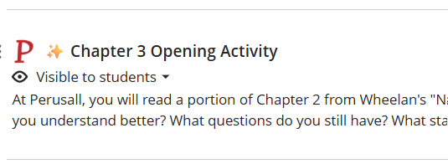
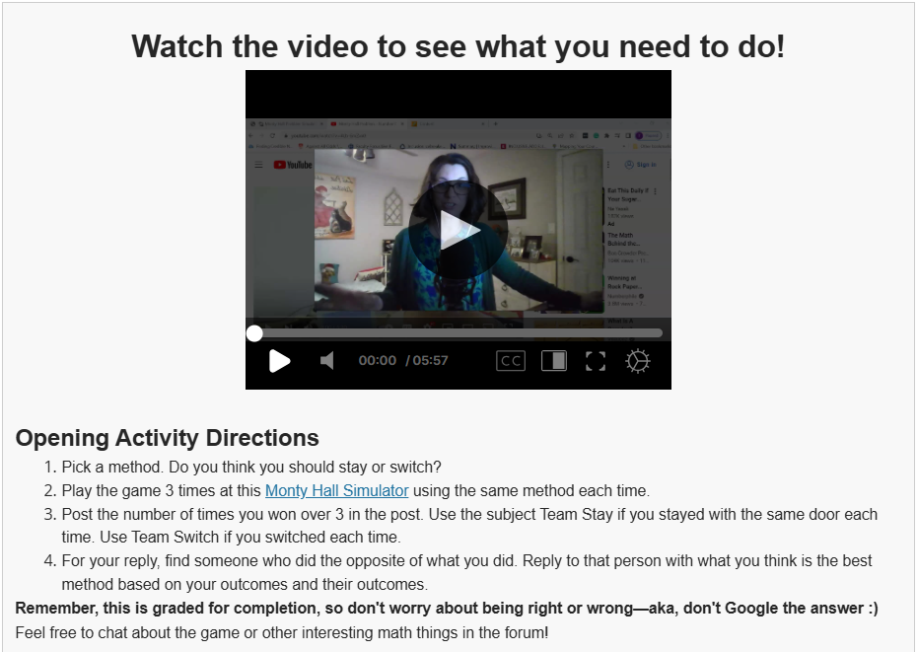
Low-Stakes Interaction Plan
Use as a kick-off.
Not just for ask/answer!
Notes:
https://www.clemson.edu/accessibility/digital/guides/canvas/headings.html

Slide 40
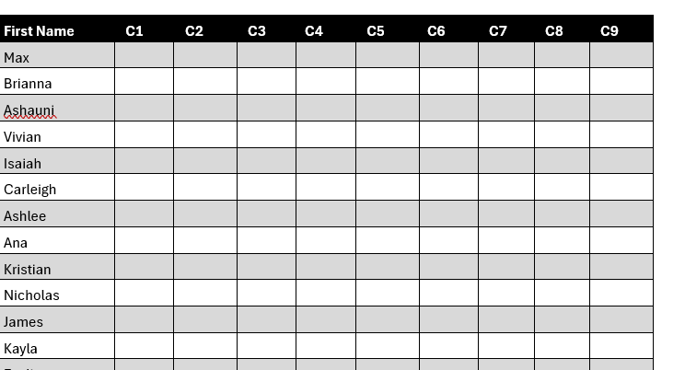
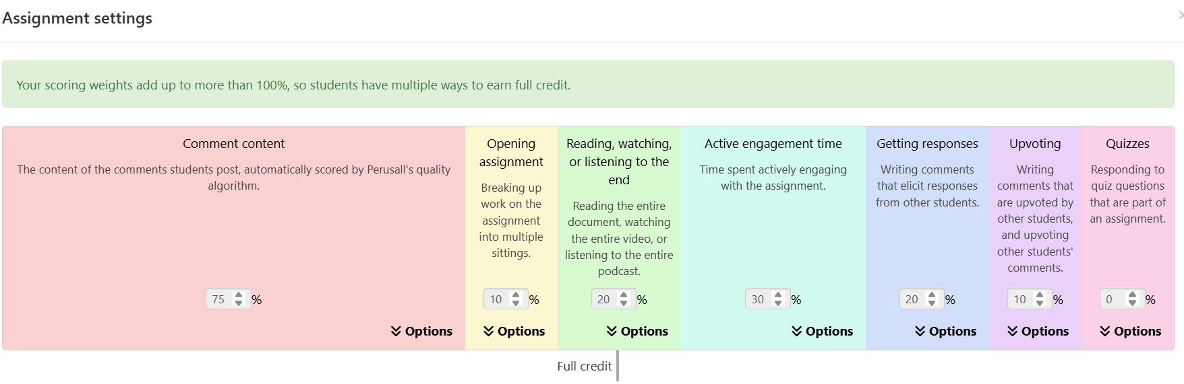
Low-Stakes Interaction Plan
Use as a kick-off.
Not just for ask/answer!
Don’t ALL need to be read carefully.
May not need to “grade”
Notes:
https://www.clemson.edu/accessibility/digital/guides/canvas/headings.html

Slide 41
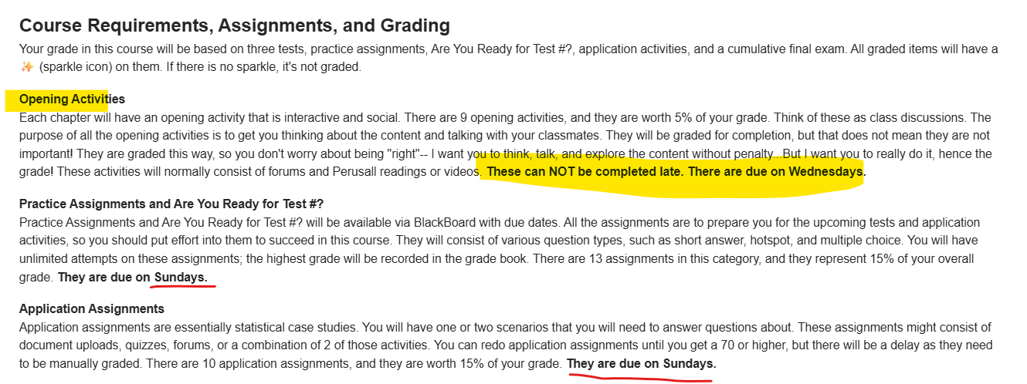
Low-Stakes Interaction Plan
Use as a kick-off.
Not just for ask/answer!
Don’t ALL need to be read carefully.
May not need to “grade”
Can help students “remember” to log in.
Notes:
https://www.clemson.edu/accessibility/digital/guides/canvas/headings.html

Slide 42
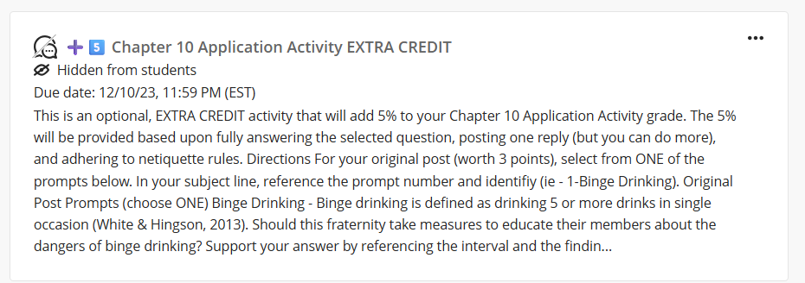
Low-Stakes Interaction Plan
Use as a kick-off.
Not just for ask/answer!
Don’t ALL need to be read carefully.
May not need to “grade”
Can help students “remember” to log in.
Set the stage for other higher-stakes forums or reflections.
Notes:
https://www.clemson.edu/accessibility/digital/guides/canvas/headings.html

Slide 43
Formative Forums Check
QM
CoI
RSI
Course Design
Predictable communication and feedback
Instruction
Facilitation
Meaningful Feedback
Instructor-initiated monitoring
Direct instruction, guidance, and facilitation
Documented evidence
3.4, 3.5 Feedback and Varied Assessment
5.2 Active Learning
5.3 Interactions
6.1-6.3 Purposeful Technology
1.2 Build connections
Notes:
Design for CoI → Meet RSI → Validate with QM
compliant by design.
CoI provides a framework
RSI states the requirements
QM gives us context and process

Slide 44

Think About It
What is one formative forum you can use as an opener or closer?

Slide 45

What tools are you using? What ideas do you want to share? What questions do you have?
Notes:
https://www.shutterstock.com/search/spinning-plates

Slide 46
Thank you!
toni@elearningdoc.com
tdimella@uscupstate.edu

