Slide 1
Quick Fixes & Long-Term Wins
A Guide for Creating Accessible Courses

Slide 2
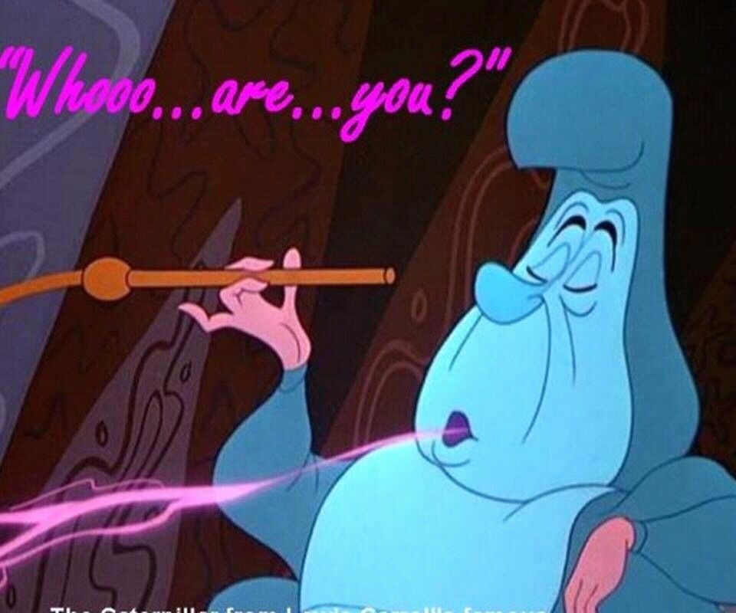





Toni DiMella, EdD
Executive Director for Quality Assurance, eLearningDOC
Adjunct Stats Instructor at USC-Upstate, previously the Director for Inclusive and Transformative Pedagogy in CAIFS.
Adjunct Math Instructor at Mitchell Community College, previously a full-time faculty member.
Credit Recovery teacher and Course Developer with NCPVS (2008-2013)
Math Teacher with CCTL Early College (2005-2009)

Slide 3
Learning Objectives
Explain WCAG 2.1 standards and how they align with Quality Matters and UDL principles.
Identify methods for creating LMS courses that are accessible and inclusive.
Use tools that support the development and review of accessible content.

Slide 4
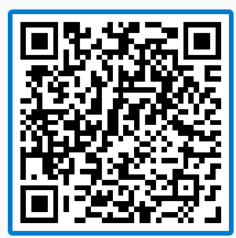
Where are you on your accessibility journey?
Just getting started! I’m still learning the basics and exploring accessibility requirements.
I don't know what I don't know. I know key principles and use some tools, but I am still learning.
I have the basics down, and I'm ready to grow. I intentionally design for accessibility and apply standards consistently.
I'm the person everyone comes to for help. I intentionally design for accessibility and apply standards consistently.
Send tonidimella967 and your message to 37607

Slide 5
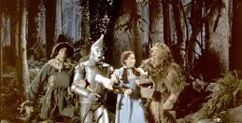
WCAG, QM, and UDL
Oh my!

Slide 6
What is WCAG, Anyway?
Web Content Accessibility Guidelines (WCAG)
  Working Group of the Web Accessibility Initiative (WAI)
  World Wide Web Consortium (W3C)
Provides Globally Recognized Standards for Web Accessibility
Started in 1999 with WCAG 1.0
  Updated to 2.0 in 2008, 2.1 in 2018, and 2.2 in 2020.
Notes:
To ensure that online content is accessible to learners of all abilities, the Accessibility Guidelines Working Group of the Web Accessibility Initiative (WAI) created a robust set of guidelines called the "Web Content Accessibility Guidelines" (WCAG) in 1999. The WAI is a World Wide Web Consortium (W3C) member. The W3C is an international community that works collaboratively with industry experts, academics, organizations, and governments worldwide to develop consensus-based technical specifications and guidelines that shape the future of the web.
The WCAG provides a globally recognized standard for web accessibility, ensuring consistency in how accessibility is approached across different websites and applications. WCAG provides specific guidelines under four principles (Perceivable, Operable, Understandable, and Robust), each addressing various aspects of web content and interaction. Each guideline has associated success criteria, which are testable statements that help determine whether the guideline has been satisfied. This helps create a uniform experience for users with disabilities.

Slide 7
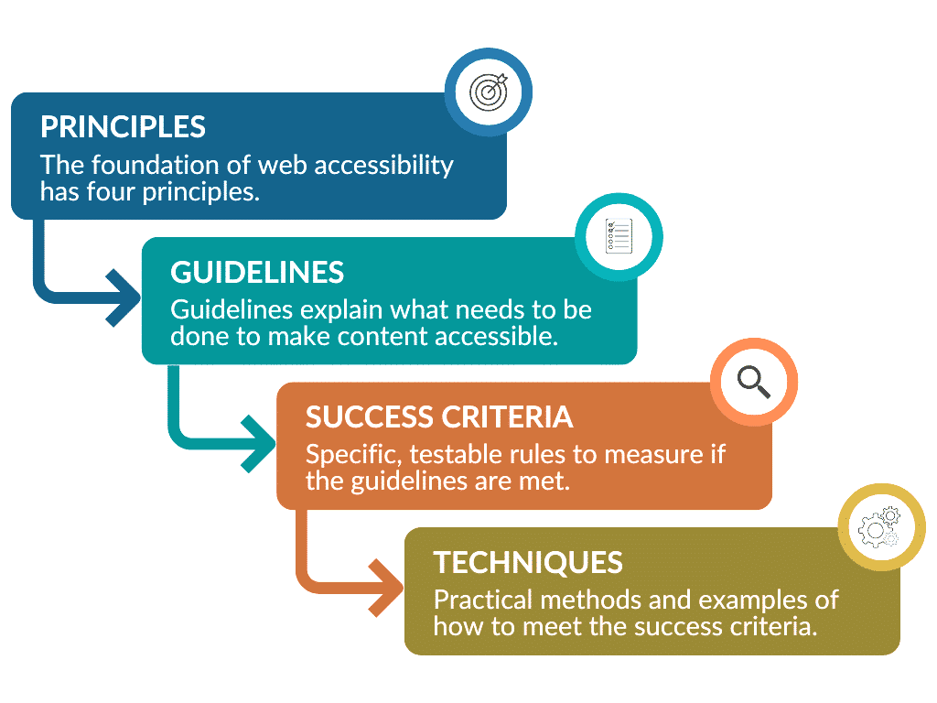
WCAG Structure

Slide 8
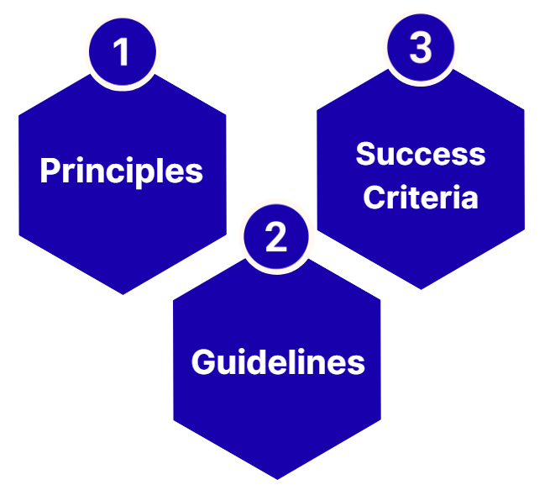
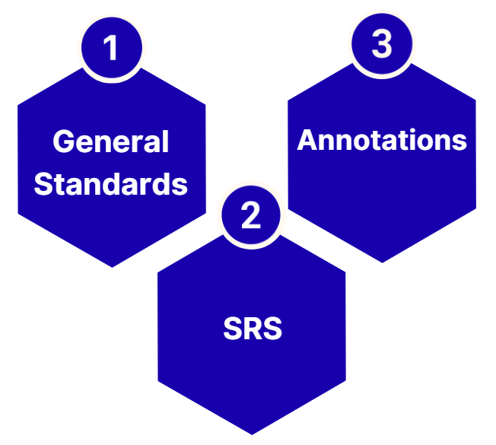
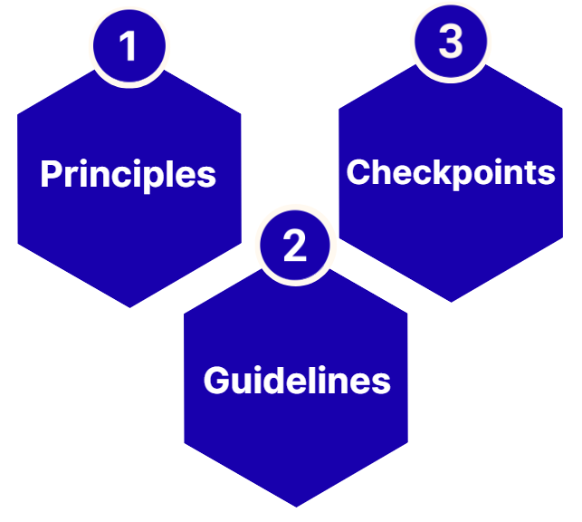
Look Familiar?
WCAG
QM
UDL

Slide 9
Four Principles
Four Principles 1
P
Perceivable
Information and user interface components must be presentable to users in ways they can perceive.
O
U
R
Notes:
Content must be presented in ways that users can perceive, ensuring that all information is available to everyone, regardless of their sensory abilities.
Examples:
Add alt text to images and provide transcripts for audio files
A video lecture that includes both captions and a separate transcript
Ensuring a webpage can be resized without cutting off text or losing functionality
Use sufficient color contrast between the text and its background to ensure readability

Slide 10
Four Principles 2
Four Principles
P
Operable
User interface components and navigation must be operable.
O
U
R
Notes:
User interface components and navigation must be operable, meaning that users must be able to interact with all of the interface's elements.
Examples:
Users can navigate through a website using the Tab key and activate buttons using the Enter key.
Offer options to extend quizzes' time limits or pause a scrolling ticker.
Ensure that no content flashes more than three times during a one-second period.
Use logical heading structure (H1, H2, H3) to organize content.
Ensure that buttons are large enough to be easily tapped on a touchscreen device.

Slide 11
Four Principles 3
Four Principles
P
Understandable
Information and the operation of the user interface must be understandable.
O
U
R
Notes:
Information and the operation of the user interface must be understandable. This means that users should be able to comprehend the information being presented and the actions they need to take.
Examples:
Use simple, straightforward language and provide a glossary for technical terms.
Keep navigation menus in the same location across different pages of a website.
When a user submits a form incorrectly, provide specific error messages that explain what went wrong and how to fix it.

Slide 12
Four Principles 4
Four Principles
P
Robust
Content must be robust enough that it can be interpreted by a wide variety of user agents, including assistive technologies.
O
U
R
Notes:
Content must be robust enough to be interpreted reliably by a wide variety of user agents, including assistive technologies. This ensures that as technologies evolve, the content remains accessible.
Examples:
Use standard HTML and CSS to ensure screen readers and other assistive devices can read content.
Use HTML5 and ARIA (Accessible Rich Internet Applications) landmarks to provide additional information about the web page's structure and functionality.

Slide 13
13 Guidelines
Perceivable | Operable | Understandable | Robust
Text Alternatives Time-Based Media Adaptable Distinguishable | Keyboard Accessible Enough Time Seizure/Physical Reactions Navigable Input Modalities | Readable Predictable Input Assistance | Compatible
Notes:
78 SC

Slide 14
Perceivable
1.1
Text Alternatives
1.4 Distinguishable
1.2
Time-based Media
1.3
Adaptable
1.1.1 Non-text Content
1.2.1 Audio-only and Video-only (Prerecorded)
1.2.2 Captions (Prerecorded)
1.2.3 Audio Description or Media Alternative (Prerecorded)
1.2.4 Captions (Live)
1.2.5 Audio Description
1.2.7 Extended Audio Description (Prerecorded
1.2.9 Audio-only (Live)
1.2.8 Media Alternative (Prerecorded)
1.2.6 Sign Language (Prerecorded)
1.3.1 Info and Relationships
1.3.2 Meaningful Sequence
1.3.3 Sensory Characteristics
1.3.4 Orientation
1.3.5 Identify Input Purpose
1.3.6 Identify Purpose
1.4.1 Use of Color
1.4.3 Contrast (Minimum)
1.4.4 Resize Text
1.4.5 Images of Text
1.4.10 Reflow
1.4.11 Non-text Contrast
1.4.13 Content on Hover or Focus
1.4.2 Audio Control
1.4.12 Text Spacing
1.4.6 Contrast (Enhanced)
1.4.7 Low or No Background Audio
1.4.8 Visual Presentation
1.4.9 Images of Text

Slide 15
Perceivable - A
1.1
Text Alternatives
1.4 Distinguishable
1.2
Time-based Media
1.3
Adaptable
1.1.1 Non-text Content
1.2.1 Audio-only and Video-only (Prerecorded)
1.2.2 Captions (Prerecorded)
1.2.3 Audio Description or Media Alternative (Prerecorded)
1.2.4 Captions (Live)
1.2.5 Audio Description
1.2.7 Extended Audio Description (Prerecorded
1.2.9 Audio-only (Live)
1.2.8 Media Alternative (Prerecorded)
1.2.6 Sign Language (Prerecorded)
1.3.1 Info and Relationships
1.3.2 Meaningful Sequence
1.3.3 Sensory Characteristics
1.3.4 Orientation
1.3.5 Identify Input Purpose
1.3.6 Identify Purpose
1.4.1 Use of Color
1.4.3 Contrast (Minimum)
1.4.4 Resize Text
1.4.5 Images of Text
1.4.10 Reflow
1.4.11 Non-text Contrast
1.4.13 Content on Hover or Focus
1.4.2 Audio Control
1.4.12 Text Spacing
1.4.6 Contrast (Enhanced)
1.4.7 Low or No Background Audio
1.4.8 Visual Presentation
1.4.9 Images of Text

Slide 16
Perceivable - AA
1.1
Text Alternatives
1.4 Distinguishable
1.2
Time-based Media
1.3
Adaptable
1.1.1 Non-text Content
1.2.1 Audio-only and Video-only (Prerecorded)
1.2.2 Captions (Prerecorded)
1.2.3 Audio Description or Media Alternative (Prerecorded)
1.2.4 Captions (Live)
1.2.5 Audio Description
1.2.7 Extended Audio Description (Prerecorded
1.2.9 Audio-only (Live)
1.2.8 Media Alternative (Prerecorded)
1.2.6 Sign Language (Prerecorded)
1.3.1 Info and Relationships
1.3.2 Meaningful Sequence
1.3.3 Sensory Characteristics
1.3.4 Orientation
1.3.5 Identify Input Purpose
1.3.6 Identify Purpose
1.4.1 Use of Color
1.4.3 Contrast (Minimum)
1.4.4 Resize Text
1.4.5 Images of Text
1.4.10 Reflow
1.4.11 Non-text Contrast
1.4.13 Content on Hover or Focus
1.4.2 Audio Control
1.4.12 Text Spacing
1.4.6 Contrast (Enhanced)
1.4.7 Low or No Background Audio
1.4.8 Visual Presentation
1.4.9 Images of Text

Slide 17
Perceivable - AAA
1.1
Text Alternatives
1.4 Distinguishable
1.2
Time-based Media
1.3
Adaptable
1.1.1 Non-text Content
1.2.1 Audio-only and Video-only (Prerecorded)
1.2.2 Captions (Prerecorded)
1.2.3 Audio Description or Media Alternative (Prerecorded)
1.2.4 Captions (Live)
1.2.5 Audio Description
1.2.7 Extended Audio Description (Prerecorded
1.2.9 Audio-only (Live)
1.2.8 Media Alternative (Prerecorded)
1.2.6 Sign Language (Prerecorded)
1.3.1 Info and Relationships
1.3.2 Meaningful Sequence
1.3.3 Sensory Characteristics
1.3.4 Orientation
1.3.5 Identify Input Purpose
1.3.6 Identify Purpose
1.4.1 Use of Color
1.4.3 Contrast (Minimum)
1.4.4 Resize Text
1.4.5 Images of Text
1.4.10 Reflow
1.4.11 Non-text Contrast
1.4.13 Content on Hover or Focus
1.4.2 Audio Control
1.4.12 Text Spacing
1.4.6 Contrast (Enhanced)
1.4.7 Low or No Background Audio
1.4.8 Visual Presentation
1.4.9 Images of Text

Slide 18
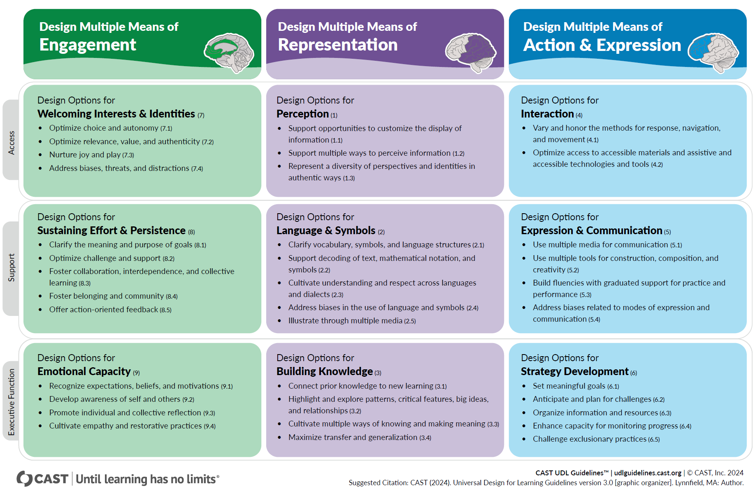
UDL Graphic Organizer

Slide 19
Same Idea, Different Lens
WCAG Principle | WCAG Success Criteria | QM GS | UDL Guideline | Example Course Action
Perceivable | 1.1 Text Alternatives | QM 8.3 | UDL 1.2 | Provide meaningful alt text for all images
Operable | 2.1 Keyboard Accessible | QM 8.5 | UDL 4.2 | Ensure all activities work without a mouse
Understandable | 3.2 Predictable | QM 4.1 | UDL 6.3 | Use consistent navigation and module structure
Robust | 4.1 Compatible | QM 8.5 | UDL 4.1 | Use semantic headings and accessible HTML

Slide 20
There are a LOT of Examples!
QM SRS | Related UDL Checkpoints | WCAG SC Alignment
1.1 Course instructions are clear and accessible | 6.3 Organize info and resources, 2.4 Address bias in language | 3.1 readable content, 3.2 predictable instructions
6.2 Tools support accessibility | 4.2 assistive tech access, 6.2 plan for challenges | 4.1 compatibility, 2.1 keyboard access
8.1 Disability services access | 6.2 anticipate challenges, 6.3 organize info | 2.3 seizures etc., 3.3 input assistance (procedural connection — supports accommodation process)
8.2 Accessibility tools & policies shared | 6.2 plan ahead; 6.3 organize resources | 3.2 predictable, 3.3 input assistance (communication clarity)
8.3 Alternative access for content | 1.1 customize display, 1.2 multi-sensory input, 5.4 expression choice | 1.1–1.2 text alt and captions, 1.4 contrast, 1.3 adaptable content
8.4 Proactive accommodations | 1.2 multi-modal design, 4.1 varied navigation, 6.2 anticipate challenges | 1.2 captions/audio descriptions, 2.4 navigability, 3.3 error help
8.5 Logical navigation & structure | 4.1 variations in navigation, 6.3 organization | 1.3 semantic structure, 2.4 navigation, 2.5 inputs
8.6 Accessibility of materials verified | 4.2 AT support, 5.1 multi-media content, 2.5 illustration | 4.1 compatibility, 1.1 alt text, 1.2 captions, 1.4 contrast

Slide 21
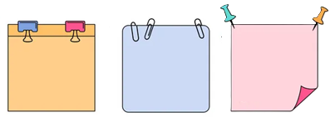
Key Takeaway 1
Key Takeaway
The frameworks don’t compete with each other.
They reinforce each other.

Slide 22
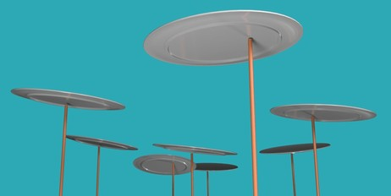
Focusing on the LMS
What to Review and How
Notes:
https://www.shutterstock.com/search/spinning-plates

Slide 23
Good News!
Graphical User Interface (GUI)
Focused Use
Built-in and LTI Tools

Slide 24
Good News! 2
Good News!
Graphical User Interface (GUI)
Focused Use
Built-in and LTI Tools
Bad News: List looks short, but takes time.

Slide 25
LMS Items to Review
Headings
Links
Lists and Tables
Alt Text
Captions and Transcripts
Documents
Color Contrast
Notes:
Keyboard nav
Language
Header/footer
Buttons, labels, forms.
These items are not normally an issue, but they can be.

Slide 26
LMS Items to Review
Headings
Links
Lists and Tables
Alt Text
Captions and Transcripts
Documents
Color Contrast
Many other times are addressed using the LMS, like keyboard navigation and button labels.
Notes:
Keyboard nav
Language
Header/footer
Buttons, labels, forms.
These items are not normally an issue, but they can be.

Slide 27
Which is a Header?
Header A
Header B
Header C
Header D
All of the above.
None of the above.
Unable to tell.
Send tonidimella967 and your message to 37607

Slide 28
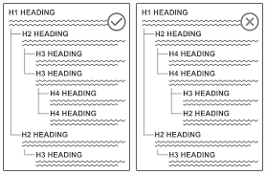
Headings
Level numbers are meaningful
        Page title is H1
        On page starts with H2
Order matters
        Provides an outline for screen readers
Big and Bold ≠ Headings
        Must have the HTML tag
        Should look different also
Notes:
And you only want ONE heading one on a page.
https://www.section508.gov/blog/accessibility-bytes/document-headings/

Slide 29
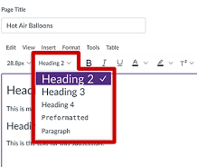
Proper Headings
Style Format options
Code Editor
      <h1>HEADING</h1>
      Change numbers for others
Notes:
https://www.clemson.edu/accessibility/digital/guides/canvas/headings.html

Slide 30
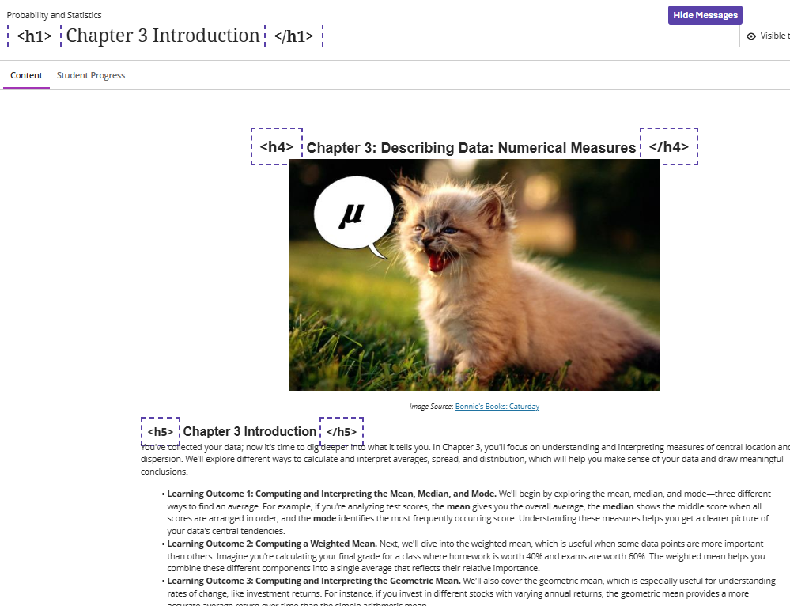
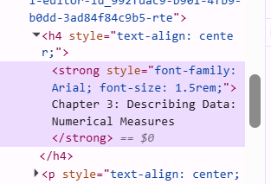
Proper Headings
Style Format options
Code Editor
      <h1>HEADING</h1>
      Change numbers for others
My Go To: A11y
Honorable Mention: Inspect Tool
Notes:
https://www.clemson.edu/accessibility/digital/guides/canvas/headings.html

Slide 31
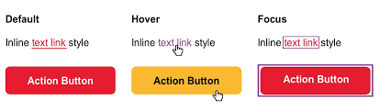
Links
Must be meaningful
    No “Click Here”
Underlined or Meets color contrast rules
  More about that in color section!
Should work!

Slide 32
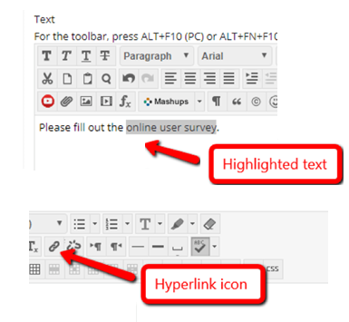
Proper Links
Use the page name for link text
Underline or change color with Style Pane
  Recommend doing both
Notes:
https://openlab.sps.cuny.edu/sps-faculty-community-hub/adding-a-hyperlink-in-blackboard/

Slide 33
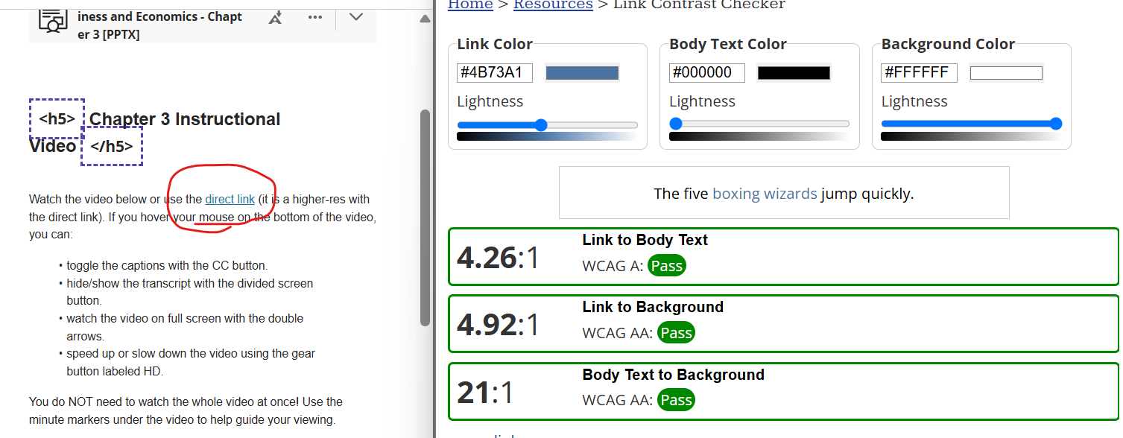
Proper Links
Use the page name for link text
Underline or change color with Style Pane
  Recommend doing both
My Go To: WebAIM Link Color Contrast Checker
Notes:
https://openlab.sps.cuny.edu/sps-faculty-community-hub/adding-a-hyperlink-in-blackboard/

Slide 34
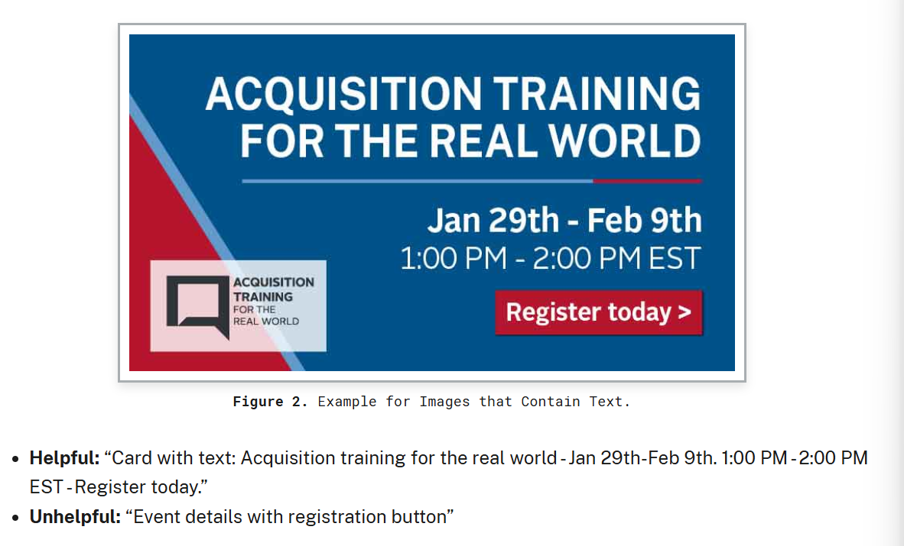
Alt Text
Provided for meaningful images only
        Others are marked decorative
      Concise and accurate
      Paragraph style
        No “image of…”
        No file names
      Also applies to buttons
Notes:
https://www.section508.gov/create/alternative-text/

Slide 35
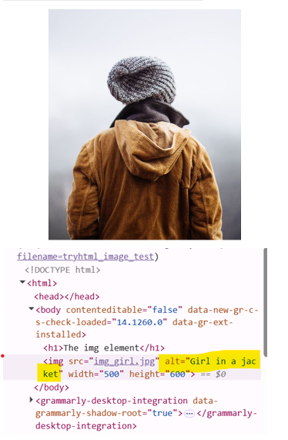
Proper Alt Text
Image options
Code Editor
      Alt=“text”
      Alt=“” for decorative
    Fig Caption or on-page text for long alt text.
Notes:
https://www.w3schools.com/tags/tryit.asp?filename=tryhtml_image_test

Slide 36
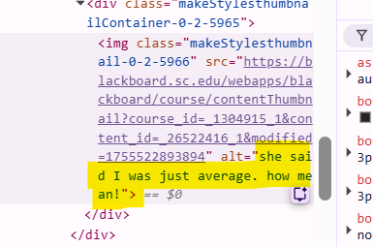
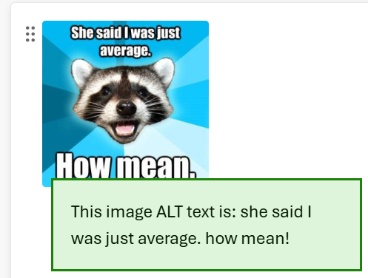
Proper Alt Text
Image options
Code Editor
      Alt=“text”
      Alt=“” for decorative
    Fig Caption or on-page text for long alt text.
My Go To: ImageALT
Honorable Mention: Inspect
Notes:
https://www.w3schools.com/tags/tryit.asp?filename=tryhtml_image_test

Slide 37
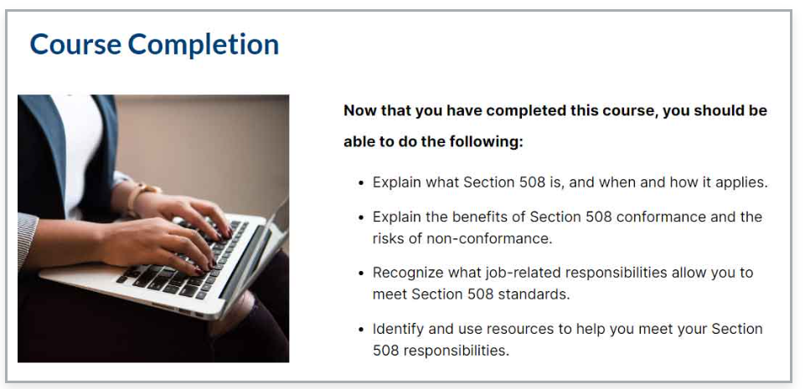
What should the alt text be for the image?
None. This image is decorative and should be marked as decorative.
Person typing on a laptop computer.
Woman sitting at a desk completing online Section 508 training.
Laptop keyboard with hands and the screen visible.
Send tonidimella967 and your message to 37607

Slide 38
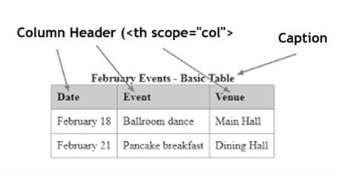
Lists and Tables
Lists
Use HTML <ol> or <ul>
  ol = ordered
  ul = unordered
Tables
Marked header row
Title/caption
For data only
Notes:
https://myusf.usfca.edu/digital-accessibility/tables

Slide 39
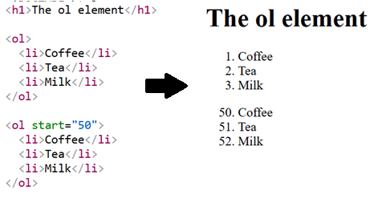
Proper Lists and Tables
Lists
Style Pane or code
Proper selection of ol or ul
Notes:
https://www.w3schools.com/tags/tryit.asp?filename=tryhtml_caption_test

Slide 40
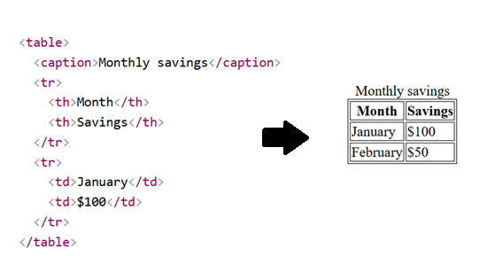
Proper Lists and Tables
Lists
Style Pane or code
Proper selection of ol or ul
Tables
Style Pane or code
Update table properties
Notes:
https://www.w3schools.com/tags/tryit.asp?filename=tryhtml_caption_test

Slide 41
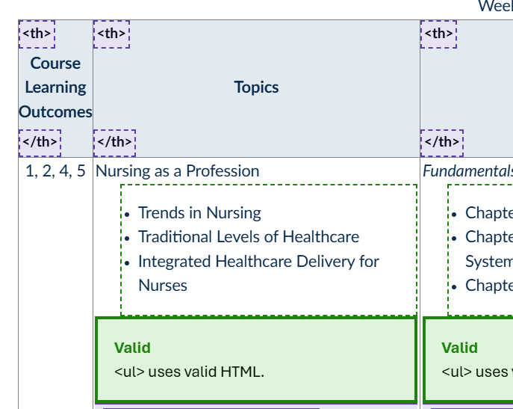
Proper Lists and Tables
Lists
Style Pane or code
Proper selection of ol or ul
Tables
Style Pane or code
Update table properties
My Go To: A11y
Honorable Mention: Inspect
Notes:
https://www.w3schools.com/tags/tryit.asp?filename=tryhtml_caption_test

Slide 42
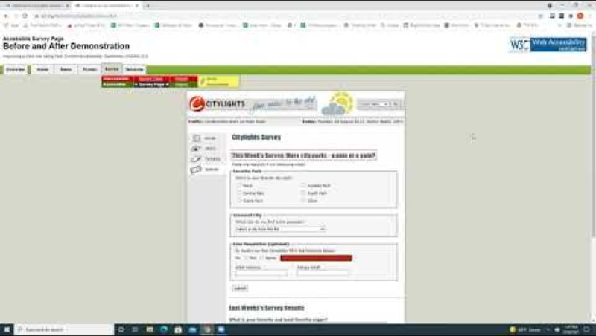
Example of a Screen Reader
Notes:
:50 – good
2:24 bad

Slide 43
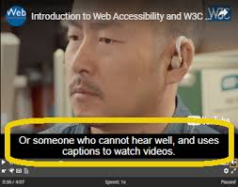
Caption and Transcripts
Accurate for spelling, grammar, etc.
Add in meaningful actions and sounds, and speaker names.
Captions must be synchronized and meet contrast requirements
  Two lines per frame, but try for logical breaking points.
Notes:
https://encrypted-tbn0.gstatic.com/images?q=tbn:ANd9GcQYFcbjAm8ADUEArne8K_RaZEiIM0WGOmjBVQ&s

Slide 44
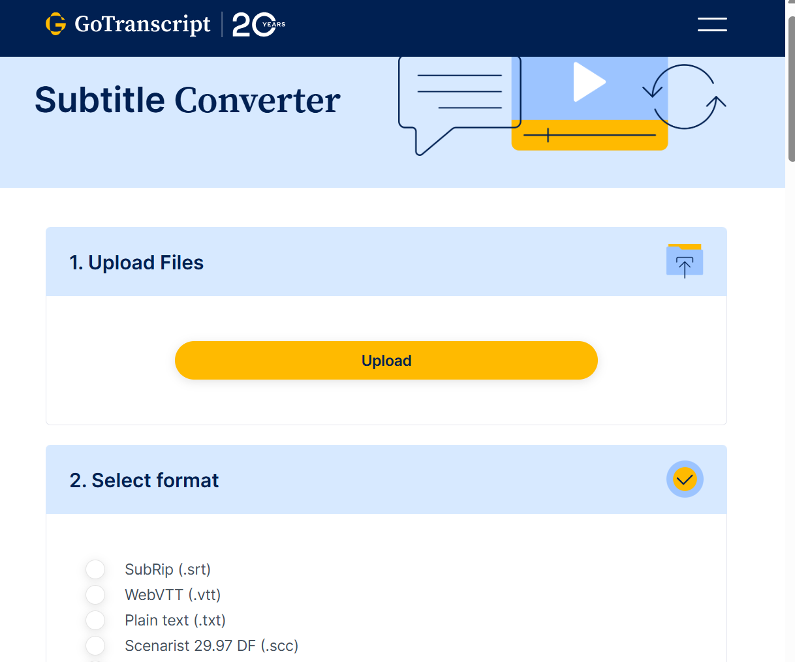
Proper Captions and Transcripts
Depends on the video editor
Manually check ALL videos and ALL of the videos
My Go-Tos: Grammarly to check, GoTranscript to convert to vtt, SRT/VTT Translator by ChatGPT

Slide 45
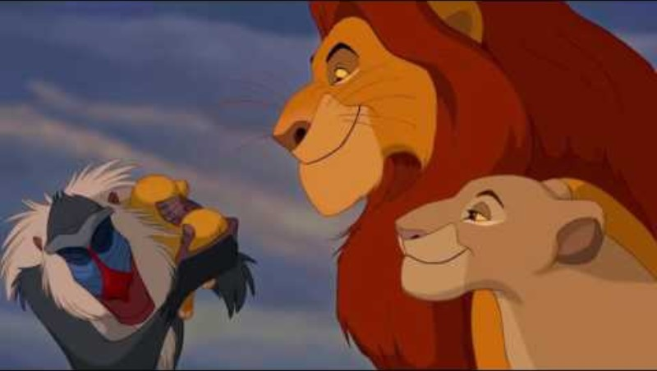
The Importance of Audio Descriptions
Notes:
3x&utm_name=web3xcss&utm_term=1&utm_content=share button
Lion king: https://youtu.be/i_GrYOruY7w

Slide 46
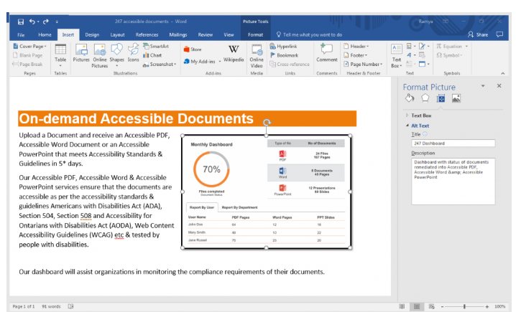
Documents
Documents need to be accessible too!
Follow the same rules
Watch for metadata
Review the names and naming conventions
PPTs and PDFs will need reading order review.
Notes:
https://247accessibledocuments.com/accessible-word-document-checklist/

Slide 47
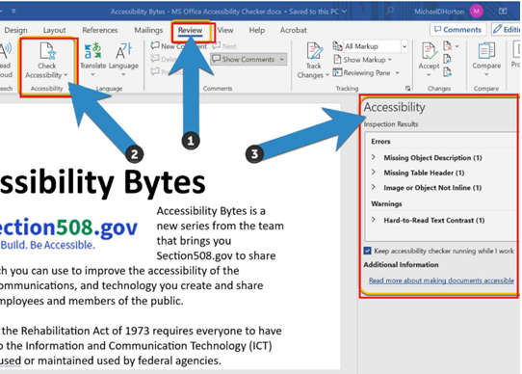
Proper Documents
“Check Accessibility”
Notes:
https://www.section508.gov/blog/accessibility-bytes/use-document-accessibility-checkers/

Slide 48
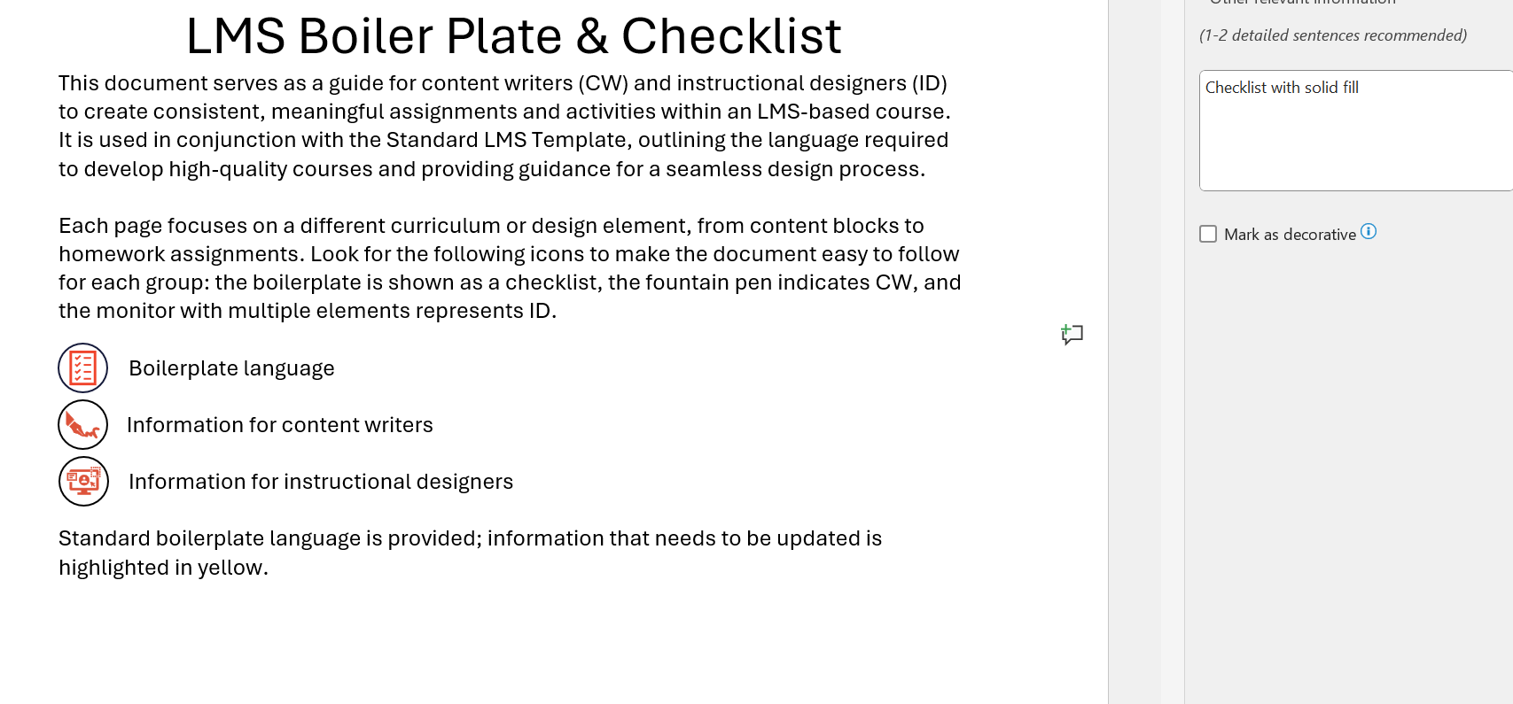
Proper Documents
“Check Accessibility”
Must review manually
Notes:
https://www.section508.gov/blog/accessibility-bytes/use-document-accessibility-checkers/

Slide 49
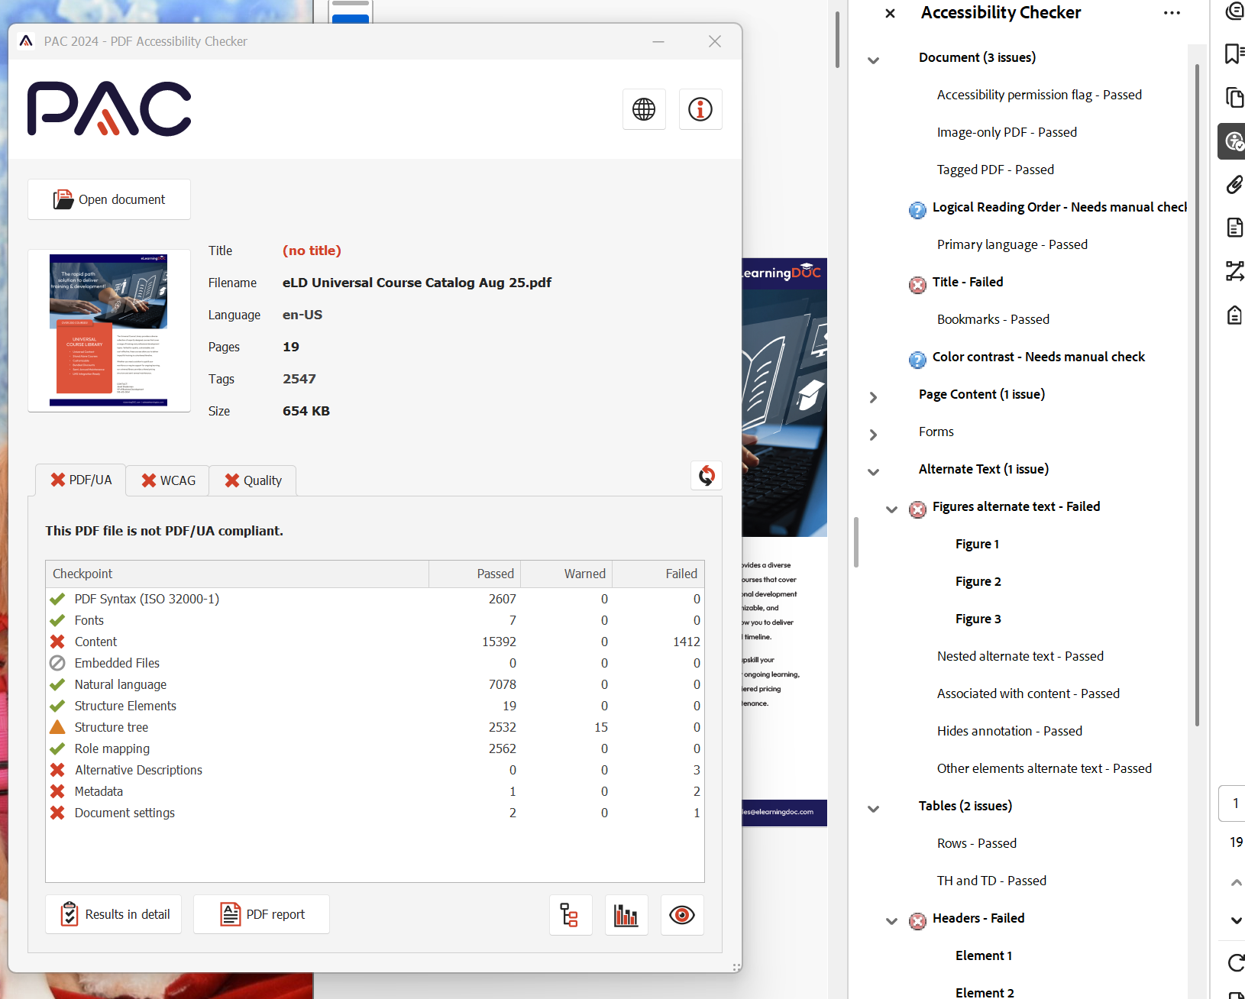
Proper Documents
“Check Accessibility”
Must review manually
PDFs need DC
  PAC.exe will do more!
My Go To for PDFs: PAC
Notes:
https://www.section508.gov/blog/accessibility-bytes/use-document-accessibility-checkers/

Slide 50
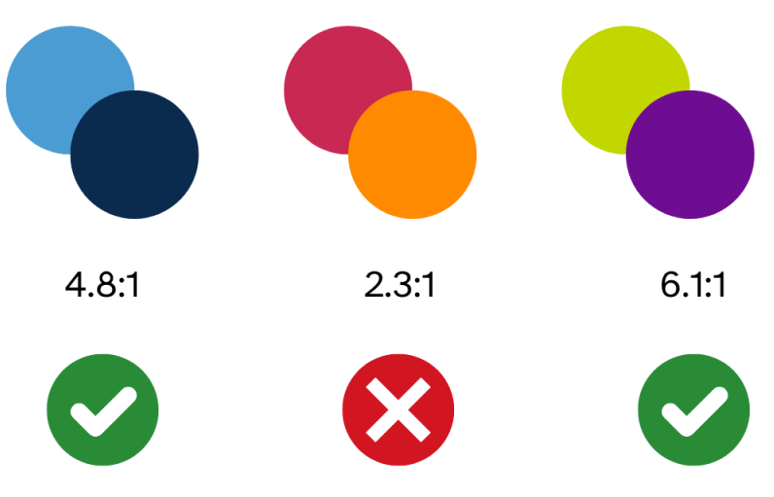
Color Contrast
Multiple measures
    Normal Text 4:1
    Large Text and UIs 3.5:1
Large text is 14 to 17.9 pt and bold, or 18pt or larger
Order doesn’t matter
Still can’t rely on color alone
Notes:
https://digitalaccessibility.unc.edu/wp-content/uploads/sites/1408/2024/06/colorcontrast-1024x576.png

Slide 51
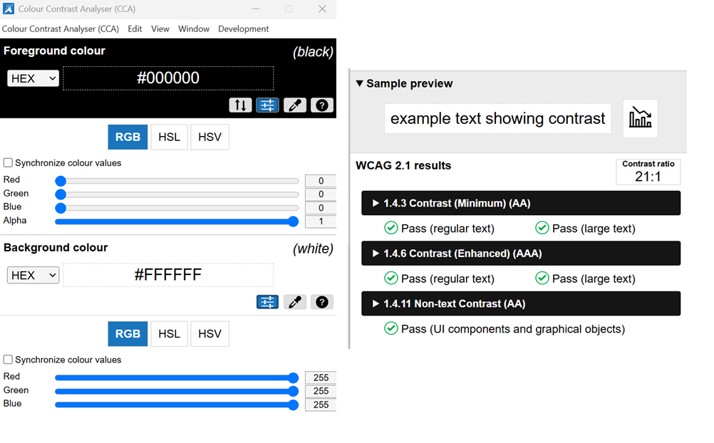
Proper Color Contrast
There are different ways to get the same color
Pixelization may be a challenge
My Go To: Colour Contrast Analyzer
Honorable Mention: WebAIM Color Contrast Checker, Andrew Hick site
Notes:
https://www.andrewhick.com/colour/

Slide 52
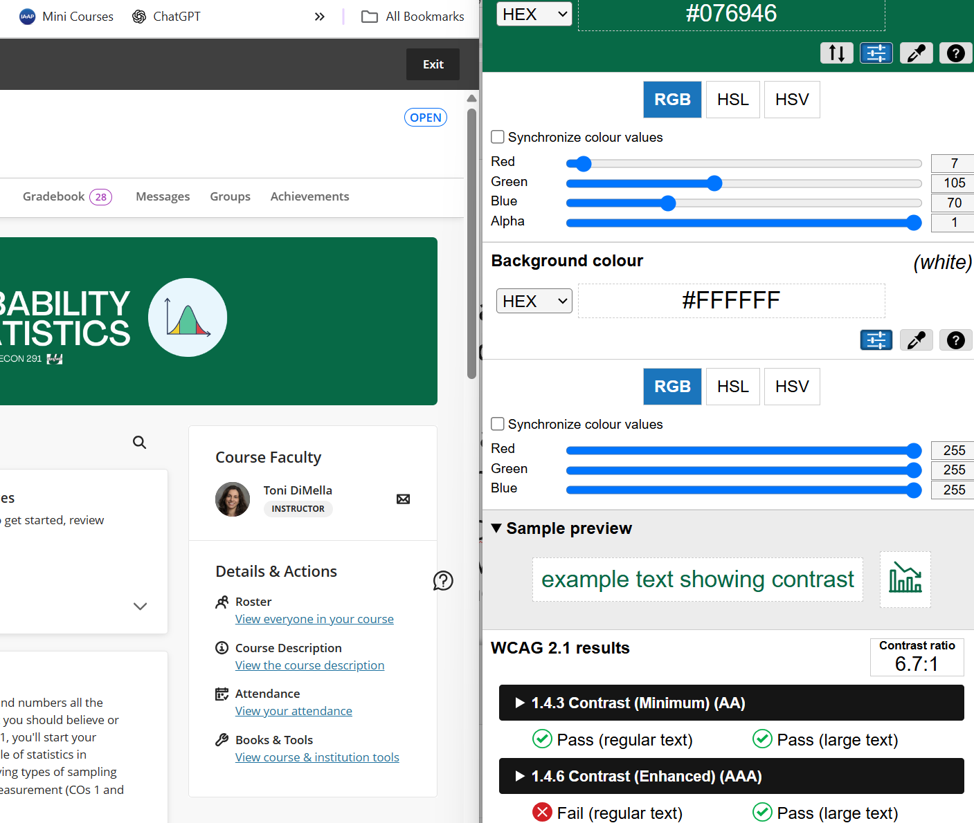
Proper Color Contrast
There are different ways to get the same color
Pixelization may be a challenge
My Go To: Colour Contrast Analyzer
Honorable Mention: WebAIM Color Contrast Checker, Andrew Hick site
Notes:
https://www.andrewhick.com/colour/

Slide 53
Decorative images must have sufficient color contrast.
True. Everything needs to meet contrast.
False. It has no meaning, so it doesn’t matter.
Send tonidimella967 and your message to 37607

Slide 54
Key Takeaway 2
Key Takeaway
The frameworks don’t compete with each other.
They reinforce each other.
It’s not a hard process.
It’s a long process.
And you need a human.

Slide 55
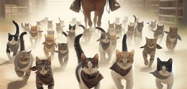
Managing the Process
And the People Involved!
Notes:
https://www.shutterstock.com/image-generated/realistic-photo-unfiltered-taken-on-medium-2447366383

Slide 56

Don’t Wait
Embed in Creation Process
Notes:
Do it when you’re creating things. You might forget to go back. And if you do remember, you’ll kick yourself for leaving 400 images to provide alt text. It’s faster to do it right the first time.

Slide 57

They Don’t Know
Embed in Creation Process
Train Multiple Times
Notes:
But they need to know how to do it right and why. It’s a lot when you first start, so you’ll need to go over it mannnnnnnny times. Plus there is always new faculty and new tools.

Slide 58
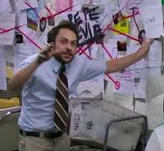
Have a Schedule
Embed in Creation Process
Train Multiple Times
Create a Roll-out Plan
Notes:
You can’t help everyone at once. Start with particular departments and then courses in that department. We tend to teach the same courses. Start with the ones that hit the most students, but don’t give a faulty member all of the courses to do in one semester…unless you’re going to provide assistance.

Slide 59
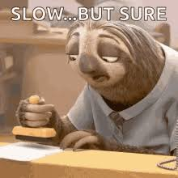
NOT Everything, Everywhere, All at Once
Embed in Creation Process
Train Multiple Times
Create a Roll-out Plan
Focus on a Few Items
Notes:
It takes a lot of time to go back and fix things. Identify the major things first. Headings, alt text, color…stuff you know is not there. Captions are properly there…they may not be perfect, but they’re there. Deal with those later. By that time, it may be time for new videos anyway.
Teach home to do it right the first time moving forward. Be sure to show it’s not more work. It’s different work.

Slide 60

Key Takeaway 3
Key Takeaway
The frameworks don’t compete with each other.
They reinforce each other.
It’s not a hard process.
It’s a long process.
And you need a human.
It’s not more work.
It’s different work.
And it’s faster to do it the right way.

Slide 61

What are your pain points? What questions do you have?
Send tonidimella967 and your message to 37607
Notes:
shutterstock.com/image-photo/confused-frustrated-young-businesswoman-studying-online-1825842224

Slide 62
Thank you!
toni@elearningdoc.com
tdimella@uscupstate.edu

