Slide 1

One Bite at a Time:
How to Eat the QM Elephant
Richland College, Dallas, TX
Cameron Maynard – English faculty
Susan Long – dean, technology enhanced learning
Justine White – English Faculty

Slide 2
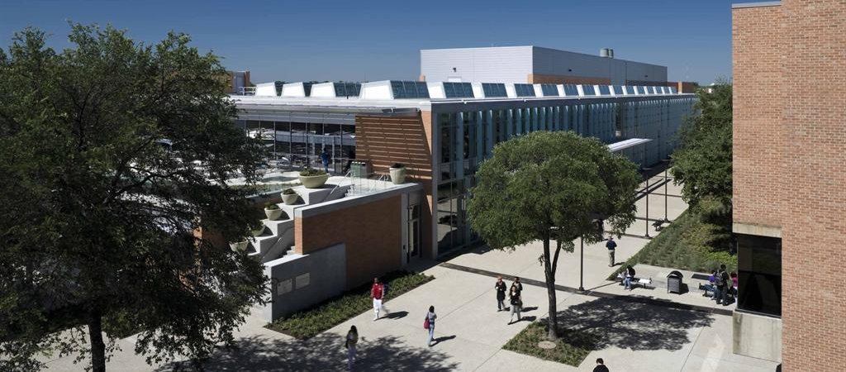
Richland College
Notes:
Located in Dallas with an annual enrollment of around 20k credit students. Roughly 1/3 of classes are online. We are one of seven separately accredited colleges that make up the Dallas County Community College District.

Slide 3
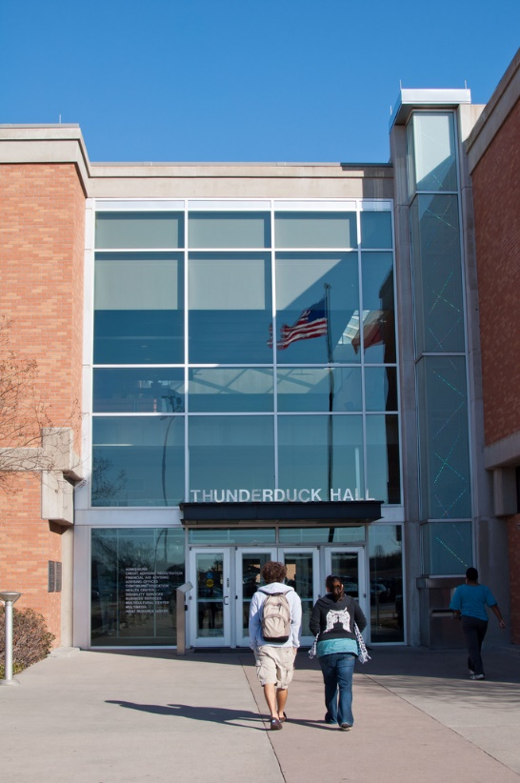
Richland College Faculty
180+ full-time faculty
700-900 adjuncts

Slide 4
Technology Enhanced Learning Team
(TEL Team)
The Mission of Technology Enhanced Learning is to ensure the quality of distance education and the appropriate use of classroom technology at Richland College through providing peer-to-peer training and mentoring, targeting appropriate market segments, and improving key processes continuously.
Notes:
Created in 2010. At Richland College we don’t have separate departments for distance learning and on campus learning. We combine and support the two together as instructional technology. The TEL Team is comprised of around 30 people. The team is mostly faculty with representation from the library, technology enhanced learning department, and our tutoring center. They not only serve the college by assisting faculty, but also serve as the unofficial distance learning advisory group.

Slide 5
Current Richland QM Classes
2015/2016:
ARTS 1301 – Vicki Mayhan
2016/2017:
BIOL 1408 – Jennifer Baggett
HUMA 1315 – Lois Parrott
ESOL 0033 – Mary Peacock
2017-2018:
PHIL 1301 – Luisa Benton
2018-2019:
HUMA 1315 – Caryn Voskuil
SPCH 1321 – Jennifer Gray
ENGL 1302 – Justine White
EDUC 1300 – Chaelle Norman
ENVR 1404 – Tara Urbanski
PHYS 1404 – ZhunJun Li

Slide 6
Department Templates
Course | Student Count/Semester
ARTS 1301 – Art Appreciation | 525
HUMA 1315 – Fine Arts Appreciation | 175
PHIL 1301 – Introduction to Philosophy | 325
SPCH 1321 – Business and Professional Communication | 150

Slide 7
Courses Being Prepared for a Review
Evita Medina – EDUC 1301
Carlos Martinez – ECON 1301
Jon Havens – KINE 1321
Miguel Marrero – ENGL 1301
Lorraine McCord – IBUS 1300
Libiya Shah – BIOL 1409
Luisa Benton – PHIL 2301
Michael Wo Man Li – GEOL 1401
Praveena Dhayanithy – MATH 1332
Andrea Stewart – KINE 1306

Slide 8
QAP Peer-Review Process
All online faculty have to meet minimum design standards
Faculty conduct the design portion of peer reviews
Technology Enhanced Learning staff conduct the accessibility portion of the review
Starting point for QM

Slide 9
Baby Steps #1
Modular Design and Consistency
QM Standard 8: Accessibility and Usability

Slide 10
Baby Steps #2
Module-level Learning Objectives
QM Standard 2: Learning Objectives

Slide 11
Baby Steps #3
Communication and Interactive Learning
QM Standard 2: Learning Objectives
QM Standard 4: Instructional Materials
QM Standard 5: Learning Activities and Learner Interaction
QM Standard 6: Course Technology

Slide 12
Baby Steps #4
Accessibility Compliance
QM Standard 8: Accessibility and Usability

Slide 13
Baby Steps #5
Permissions and Citations
QM Standard 4: Instructional Materials

Slide 14
Baby Steps #6
Putting it all Together
QM Standard 1: Course Overview and Introduction
QM Standard 6: Course Technology
QM Standard 7: Learner Support

