Slide 1

ESCAPE THE INACCESSIBLE: THE DIGITAL ESCAPE ROOM ABOUT INCLUSIVE DESIGN
Dr. Heather Wire,
Adjunct Instructor and
Technical Learning Experience Designer
Notes:
Introduction
Today we are going to talk about my research which could be used as professional development for faculty who teach online. The intent of this research is to examine how a Digital Escape Room (DER) contributes to the potential change of faculty behavioral intentions towards developing accessible online course content.

Slide 2
OUTLINE
Research Overview
Digital Escape Room
Demonstration
Group Discussion / Q&A

Slide 3
RESEARCH OVERVIEW

Slide 4
FORMING THE IDEA
Digital escape room:
Digital accessibility
Online learning
Course development process
Awareness and empathy
Influence behavior
  Game-based
  Learning
  Course Development
Digital Escape Room
  Professional Development

Slide 5
THE PROBLEM
Creating accessible content requires:
  High intentions
  Knowledge and skills
Knowledge and performance gaps are addressed:
  Resources
  Training
Integrated Behavior Model (IBM):
  Behavior change
  An individual’s intentions to perform the behavior (developing accessible materials) are the most critical determinants of the behavior
Notes:
For creating accessible content you need to have : (screen)
Currently institutions are focus on addressing performance and knowledge gaps, (screen) and they address these gaps with providing resources, training, webinars, workshops
However, according to the Integrated Behavior Model (IBM), addressing the individual’s knowledge and skills is only part of the process for getting them to change their behaviors towards developing accessible course content
The individual’s intentions to perform the behavior (developing accessible materials) are the most critical determinant of the behavior.
And that was the focus of our research .
The IBM is commonly used for predicting behaviors. In this study, it serves as an overarching umbrella to examine barriers for developing accessible content and faculty intention to develop it.

Slide 6
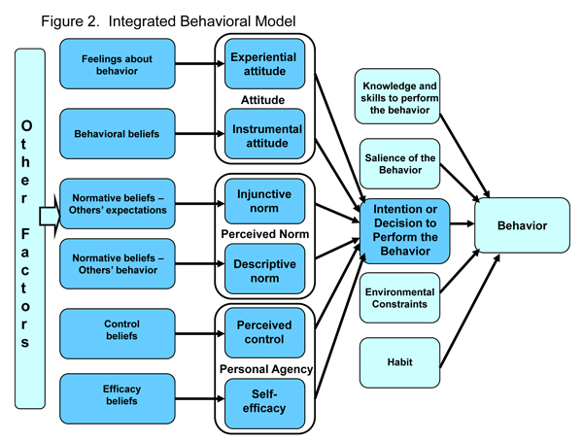
INTEGRATED BEHAVIOR MODEL
  University of Pennsylvania. (n.d.). Integrated behavior model. In Health Behavior and Health Education, Part Two, Chapter Four. Retrieved April 3, 2021, from https://www.med.upenn.edu/hbhe4/part2-ch4-integrated-behavior-model.shtml

Slide 7

RESEARCH AIMS
Influence intentions and saliency
Provoke self-reflection on obstacles
Close gaps
Notes:
This study aimed to pilot a Digital Escape room designed to influence faculty intentions to develop accessible content and affect saliency of the behavior
The study encouraged participants to reflect on some of the constructs of the IBM (knowledge and skills, environmental constraints and habits) and consider solutions to their identified barriers for development of accessible content.
The research exposed to gaps. 1. There is little to no literature on influencing the behavioral intentions of content developers to create accessible online content. 2. There is no other digital escape room that targets content developers' intentions to create accessible content. This study aims to close both identified gaps by using digital game-based learning.

Slide 8
ASK YOURSELF…
How strong are your intentions?
Do you feel it is important?
Do you have the appropriate knowledge and skills?
Do you face any constraints?
How can you make it a habit?

Slide 9
DIGITAL ESCAPE ROOM

Slide 10
DIGITAL ESCAPE ROOM
What is a digital escape room?
Intervention description:
The user is the investigator
Investigating a murder
Visit each member/suspect
The witness statements/clues highlight online learning obstacles
The puzzles are inaccessible, but clues are provided
Solve all the clues to determine the murderer and make an arrest
Notes:
A digital escape room (DER) is defined as “[a]n escape room [that] uses a game-based active learning approach to develop students’ critical thinking and problem-solving skills in an immersive environment”
In this escape room, there has been a murder and the user is the investigator who tries to find out who the murder is by visiting the suspects to gather clues. Each suspect’s clue put the user in the shoes of an online learner who may have a disability. The user must solve all the clues, determine who to arrest, and escape with their lives.

Slide 11
DEMONSTRATION

Slide 12
GROUP DISCUSSION
AND Q&A

Slide 13
SUSPECTS AND WCAG GUIDELINES
Suspect | Guidelines (Success Criterion)
Capt. Closed | 1.2 Time-based Media (1.2.2 Captions)
Bea Raille | 1.2 Time-based Media (1.2.5 Audio description (Prerecorded))
Hugh Hunter | 1.4 Distinguishable (1.4.1 Use of color)
Al Tex | 1.1 Text Alternatives (1.1.1 Non-text content)
Tabitha Order | 2.1 Keyboard accessible (2.1.1 Keyboard)
Linkon Clear | 2.4 Navigable (2.4.4 Link purpose (In context))

Slide 14
How does inaccessible content hinder learning experiences?
Name any barriers that you may face that impacts your ability to develop accessible content.
GROUP DISCUSSION

Slide 15
Anyone want to share their thoughts on this brief activity?
How would you connect the activity to what an online learner with a disability may experience in an online environment?
THOUGHTS?

Slide 16
CONTACT INFORMATION
Dr. Heather Wire
hwire@westga.edu

