Slide 1
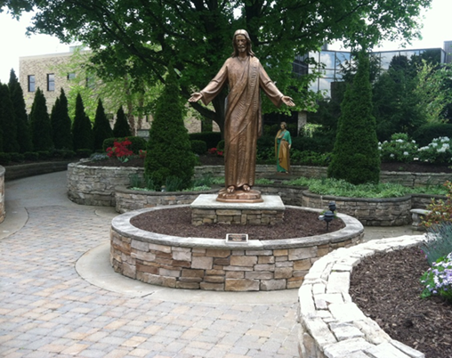

QM Faculty Liaison for e-Learning: From Vision to Reality
Dr. Amy J. Heston
Professor of Inorganic Chemistry
Walsh University, North Canton, Ohio
aheston@walsh.edu

Slide 2
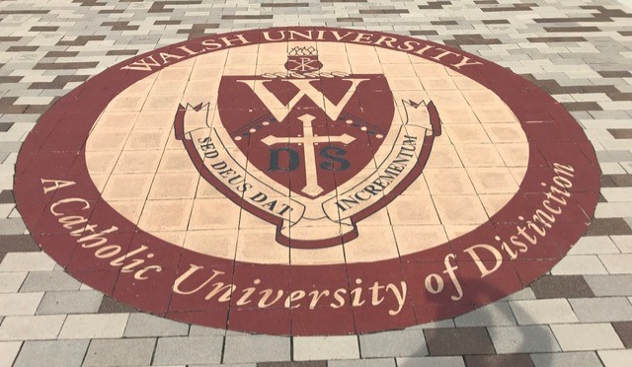
Introduction
Walsh University
Private, liberal arts university
North Canton, OH
Founded by the Brothers of Christian Instruction in 1960
2,311 students (Fall 2022)
Undergraduate & graduate programs

Slide 3


What is your role at your institution?(administrator, faculty, ID, Director, QMC, etc.)
ⓘ Start presenting to display the poll results on this slide.

Slide 4
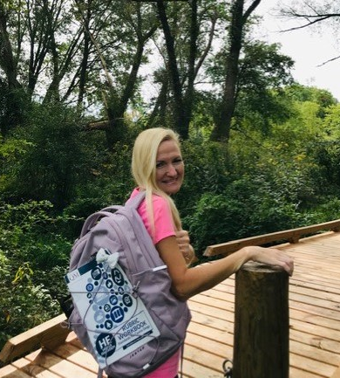
My QM Journey: A Personal “Calling”
How can a QM vision become a reality?
Let’s go on a journey
Interactive presentation
“My QM Vision”:
  From making a positive impact for Walsh students to my current progress as our first QM Faculty Liaison for e-Learning

Slide 5


Journey Begins
Upon personal reflection, I knew my goal should begin with:
  acquiring essential knowledge focusing on learner academic success
  new skills in interpretating QM Standards
Then, I could lead and inspire others to join in my efforts.
https://ethicalleadership.nd.edu/news/self-reflection-helps-you-build-your-roadmap-to-better-leadership/
https://www.sciencelearn.org.nz/resources/48-reflection-of-light

Slide 6
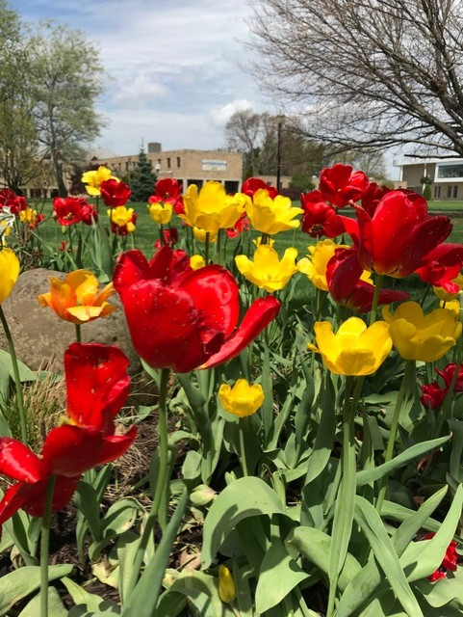
Learning Outcomes
1. Use the QM Faculty Liaison for e-Learning Builder in order to create an initiative on your campus
2. Distinguish between various pathways in order to gain momentum in QM interest and participation on your campus
3. Choose pathways that align with your institution's mission and goals in order to ensure student success

Slide 7
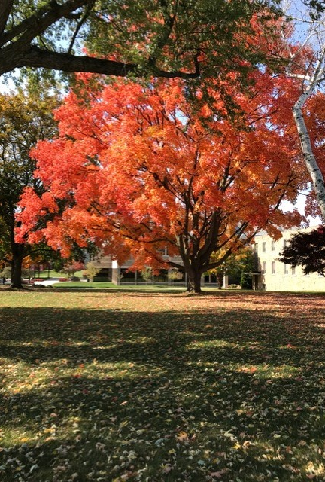
It all started with the APPQMR
Special invitation: APPQMR Fall 2020
Light bulb moment: More QM involvement is what our campus needs, but how can a QM vision become reality?
How can I help Walsh students so that we can move forward during uncertain times and this pandemic?
Continuing Fall 2020:
DYBC, my warm-up & gaining experience with Canvas
TOC, committed to all 7 courses at once, wow!
Dec 2020 PR HE, then PR CPE ad PR K12

Slide 8
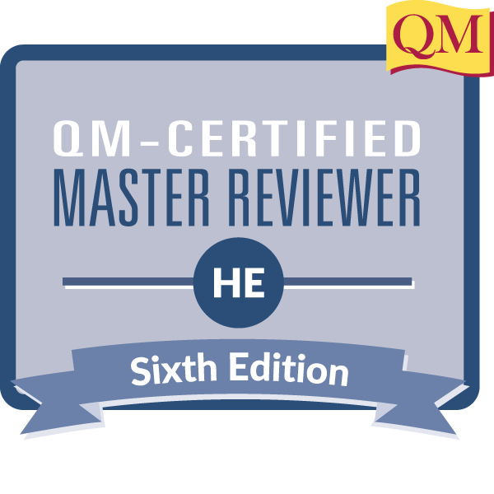

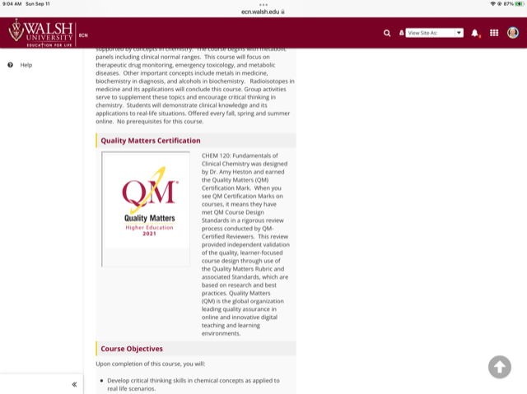
More QM Momentum: Courses & Reviews
Spring 2021
Continuing TOC
Started my 1st review
Earned TOC
Completed my 2nd review
Earned MR HE
My first QM certified course Fundamentals of Clinical Chemistry, CHEM 120
This certification mark recognizes that this course met Quality Matters Review Standards

Slide 9

More QM Momentum: Making a “Bridge”
More adventures awaited me as I worked on my approach for gaining momentum across campus.
Established new role
QM Faculty Liaison for e-Learning
I serve as a necessary “bridge” for e-Learning:
inspiring colleagues from different directions and varying capacities
key = inspiration, but inspiring what?

Slide 10

Planting Small “Seeds” in Course Development Outside My Discipline
Math faculty:
General course design
Embedding video content
Editing transcripts
Biology faculty:
General course design
Creating the course map
Writing measurable MLOs
https://es.123rf.com/photo_90602415_diagrama-del-crecimiento-del-%C3%A1rbol-con-la-hoja-verde-planta-de-la-naturaleza-conjunto-de-ilustracion.html

Slide 11

Bigger “Seeds” in Division of Math & Science
Where do I start?
Division Meeting for Math and Science
I approached the group by planting small “seeds” of information.
I created “QM Quick Minute” videos for faculty that demonstrated:
  how the standards provide us with tools to become better educators course designers, etc.
  tips and shortcuts, creating social presence, course review process
This resulted in an increased interest in QM and thinking about the APPQMR
https://es.123rf.com/photo_38491933_el-cultivo-de-plantas.html

Slide 12
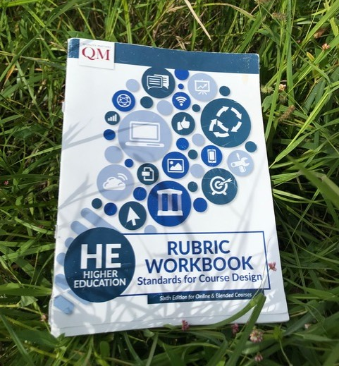
“Seeds” in Workshops
As Vice-Chair of our University Program Assessment Committee(UPAC) in Spring 2022, I again took the opportunity to plant small “seeds” of information
Walsh’s May Days Workshop
  Connect QM SRS 4.2 and SRS 2.1 for creating more effective learning outcomes
Additionally, this workshop led the way for more faculty engagement
  learning outcomes activity that helped participants relate to the importance of QM SRS 2.1.

Slide 13
“Seeds” in Professional Development
Presentation on campus:
  shared the significance of QM SRS 1.1
  particularly how to create an effective course “tour”.
Collectively, my campus-wide efforts have made positive impacts:
  generating interest and involvement in QM
  its importance to learner success and academic achievement

Slide 14
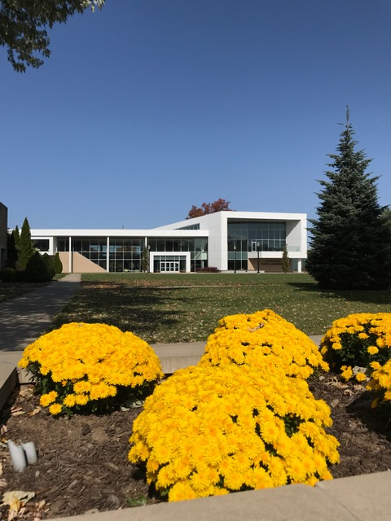
Looking Across Campus: “Seeds” in Assessment
Currently, elected at Chair UPAC, so continue to plant seeds: Assessment Summit, etc.
Assessment Summit: Shared assessment methods, rubric, further actions, & assessment reflection
Highlights from various faculty across campus, academic & co-curricular

Slide 15
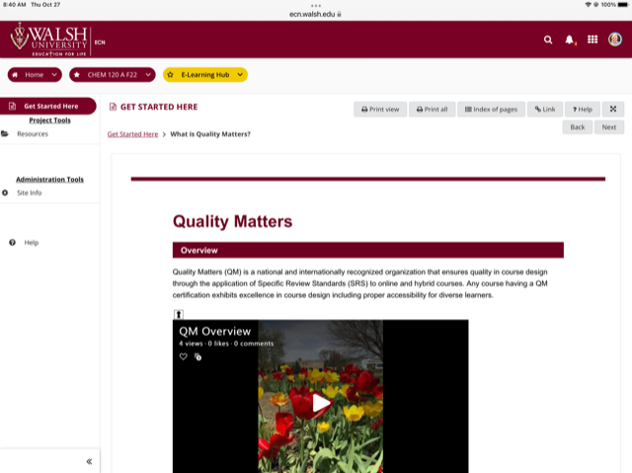
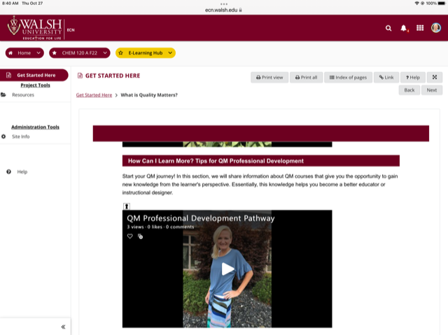
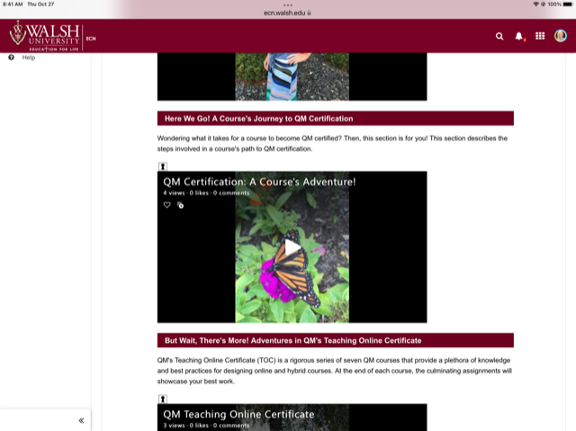
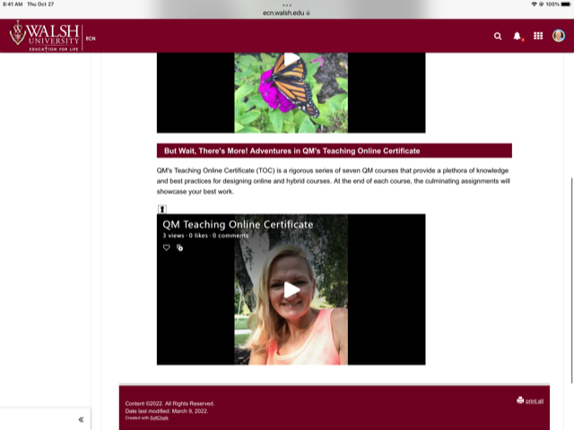
e-Learning “Seeds”: The e-Learning Hub
LMS = Sakai
“What is Quality Matters?” Section
4 Subsections, engaging titles
1) “Overview”
  QM Overview video
2) “How Can I Learn More? Tips for QM Professional Development”
  Pathway video
3) “Here We Go! A Course’s Journey to QM Certification”
  A Course’s Adventure! Video
4) “But Wait, There’s More! Adventures in QM’s Teaching Online Certificate”
  QM TOC video

Slide 16

Beyond Walsh Campus: “Seeds” in QM Ohio Consortium
QM Ohio Executive Board
Elected member: NE Ohio Regional Representative
Helping 19 HE institutions
Mentoring:
  QM standards
  QM professional development courses, etc.
Networking:
  Organizing a summer gathering for all NE Ohio QMCs
New Opportunity:
  Walsh selected to host 2023 QM Ohio Annual Member Meeting
  May 12, 2023
  Call for proposals opens Dec. 7th

Slide 17

From “Seeds” to Momentum to New Strategies
I looked up
I asked myself “What do I see?”
Momentum that could be shared
How could I help others outside Walsh?
My New Strategy:
QM Faculty Liaison for e-Learning Builder

Slide 18
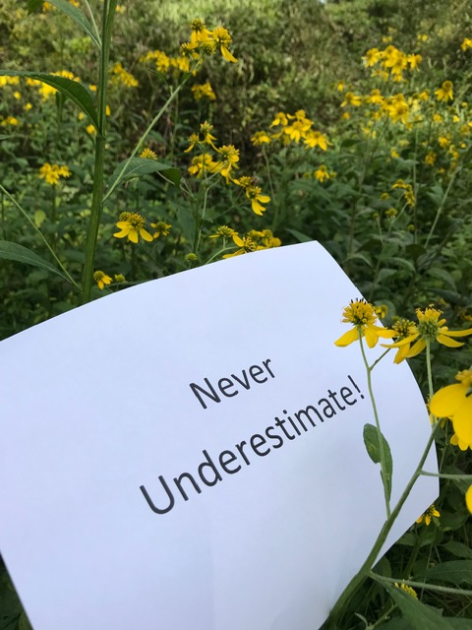
Special Message
With patience and perseverance, my vision has come into action.
Never underestimate the power of a small “seeds” for QM momentum because your QM dream can become your reality!

Slide 19
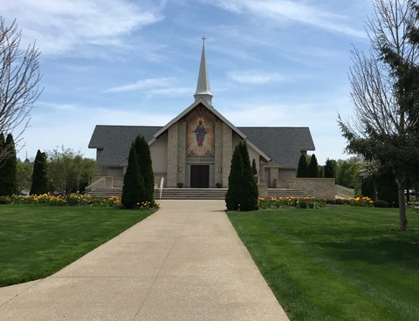
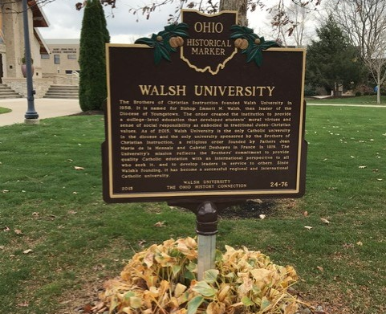
Start Creating Your Own QM Momentum Today!
What strategy can I design to help colleagues?
QM Faculty Liaison for e-Learning Builder
Utilize the builder:
  Create new QM initiative on your campus

Slide 20
Utilizing the QM Faculty Liaison for e-Learning Builder
QM Faculty Liaison (YOU)
QM Faculty Liaison Builder
Goal: Consider the essential leadership steps to create QM momentum on your campus.
Step 1. Distinguishing between various pathways in order to gain momentum in QM interest and participation. Designate the center of a page for your name.

Slide 21
Identifying Strategies & Goals
Internal Professional Development to Share QM SRS
Step 2. Identify Strategies
Ideas for creating a significant impact to student success, a criterion for accreditation, Ohio = Higher Learning Commission
  Make a broad impact in the university’s future as well as aiding in the achievement of QM momentum
  Write these pathways, making a final arrangement around the center
  Here are some examples:
Lead by Example: Submit your course for QM cert.
Positive Impact via Committees
Ideas for Student Success: Criterion for accreditation
Helping Individuals: Course design
QM Faculty Liaison
Approaches for Change via Local/State Professional Development Workshops
Strategies for Positive Impacts via Committees & Division Meetings

Slide 22
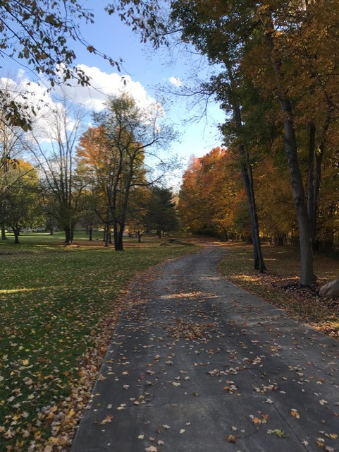
Finding Your Path
Step 3. Link those strategies that you might be able to cover at the same time making an efficient pathway
  Multi-directional approach
  Choose the path that fits your mission and goals
Step 4. Arrange so that you can make a plan for execution
Ideas for student success, criterion for accreditation
Design a workshop at Faculty Scholarship Day: Course Design Tips & Tricks or QM Proposals
Visit and/or present at meetings outside your discipline:
ID meetings, etc. building relationships
Help any faculty with course design
QM Faculty Liaison

Slide 23
Special Features of QM Faculty Liaison for e-Learning Builder
Special Features: :
  It can be used for any level of institution
  Multi-directional approach for any group/discipline
You discover new ways in creating QM momentum in both academic and co-curricular areas
Start creating your own momentum today!

Slide 24
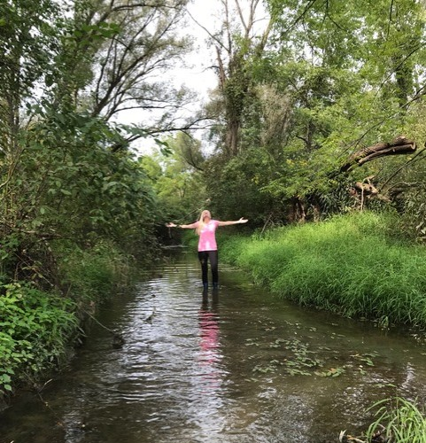
A Deeper Look and Let’s Reflect
Your initiatives in student success support:
  assessment efforts to strive for continuous improvement in your program
  annual program assessment report (APAR)
  university accreditation efforts, HLC Criteria for Accreditation (Criterion 4)
  sharing info. regarding student learning on your website, NILOA Transparency Framework
  EIA Designation: Greatly dependent upon Transparency Framework
  Benefits to Institutional Effectiveness & Research, AIR = Assoc. for Institutional Research
  Links to mission of AAC&U, American Association of Colleges & Universities
HLC = Higher Learning Commission
NILOA = National Institute of Learning Outcomes Assessment
EIA = Excellence in Assessment

Slide 25
Keeping Momentum at Walsh
Future Goals:
Create a QM Research Project
Which area needs me as the “biggest bridge”?
Make new strides and collaborations across campus and continue my dedication to student success
  via QM National & QM Ohio Consortium

Slide 26

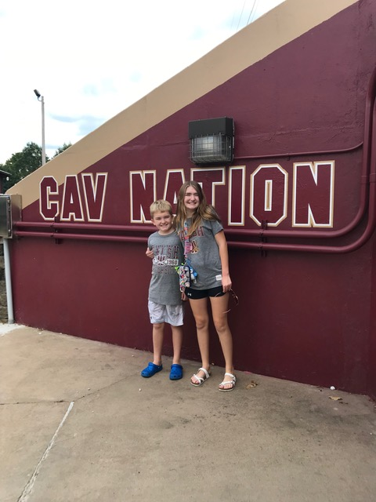
Acknowledgements
QM Staff & Board of Directors
QM Connect Conference
QM Ohio Consortium
Walsh University
Today’s Participants
Madee & Travis Heston

Slide 27
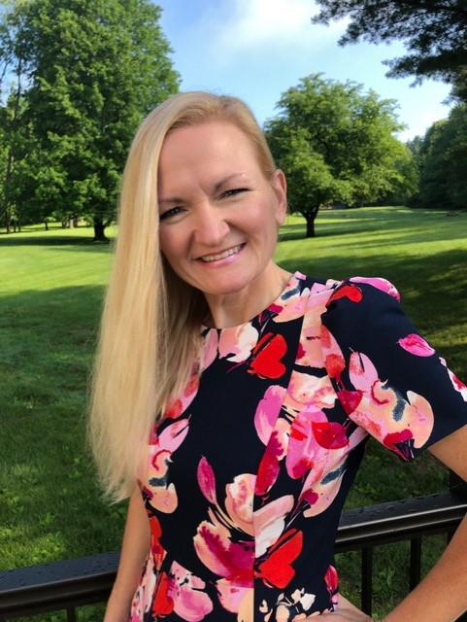
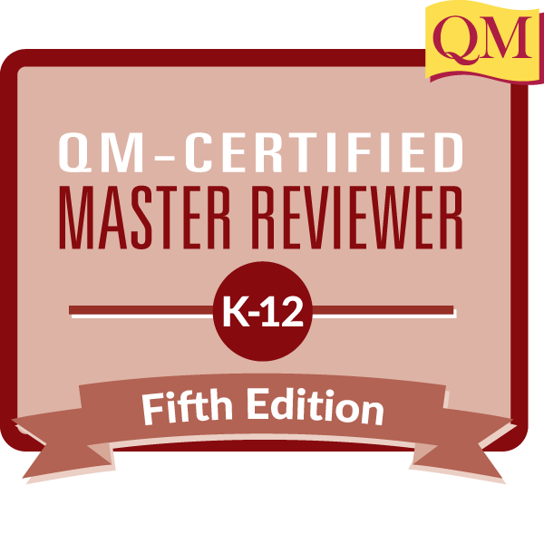
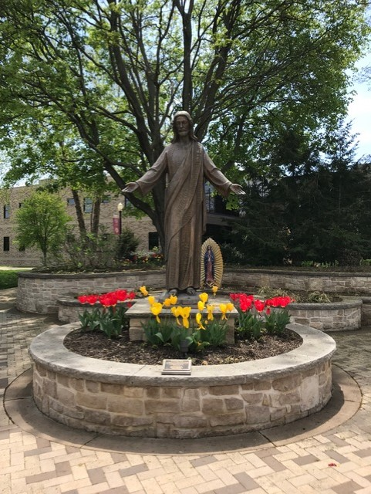
Q & A
Any questions?
Questions later? Please contact me!
Dr. Amy J. Heston
Professor of Inorganic Chemistry
QM Ohio NE Regional Rep &
QM Faculty Liaison for e-Learning
Walsh University
2020 E. Maple St.
North Canton, OH
330-244-4671
aheston@walsh.edu

