Slide 1



PRESENTATION TITLE
Presenter
date
Creating the Pathway to Engage Faculty
Throughout the Institution

Slide 2
PRESENTATION TITLE
Creating the Pathway to Engage Faculty Throughout the Institution
Presenter
date
Sinjini Mitra, Ph. D.
Associate Professor, ISDS Department, Mihaylo College of Business and Economics
Marsha Orr, MSN, RN
Coordinator, Distance Education, School of Nursing

Slide 3
Slide Title
Learning Objectives:
Identify sources of faculty resistance to online teaching, QA, and online course development
Identify strategies to address barriers to engagement in campus-wide adoption of QM
Identify promising approaches to engage and expand a campus-wide QM Community of Practice

Slide 4

Identify Sources of Faculty Resistance to Online Teaching, QA, and Online Course Development

Slide 5

What are Major Drivers of Faculty Resistance?
Pair and Share
Post your top reasons to:
http://tinyurl.com/ycnjw5f5

Slide 6

What are Major Drivers of Faculty Resistance?
Cultural Assumptions and Values
Fear of the Unknown, Loss, and Failure
Fear of Disruption of Interpersonal Relationships
Concerns about the External Impact
Lloyd, Byrne, & McCoy

Slide 7

What are Major Drivers of Faculty Resistance?
Vivolvo - Why Faculty Refuse

Slide 8

What are Major Drivers of
Faculty Resistance?
Ubell - Why Faculty Don't want to Teach Online
Concern about the impact on career/promotion
Perception that quality of online is less than that of face to face
Faculty with most resistance are least familiar with online
Online is perceived to threaten faculty autonomy
Development of an online course requires more work than a traditional course

Slide 9
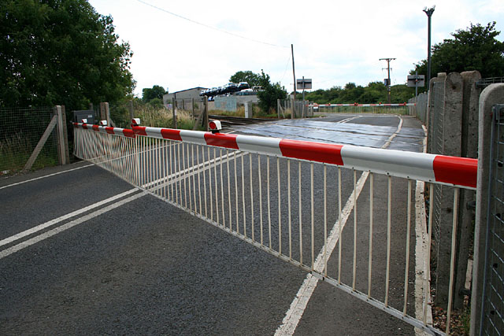
Identify Strategies to Address Barriers to Engagement in Campus-wide Adoption of QM

Slide 10
Discuss in groups or pairs
What steps are taken on your campus to address barriers to faculty participation or engagement in QM?
Post your thoughts on:
http://tinyurl.com/y6vmbmro

Slide 11
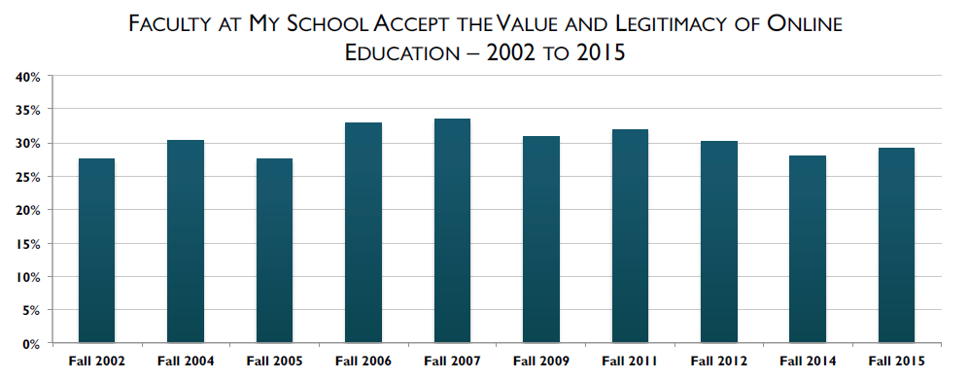
Faculty Acceptance
Data source: Babson Survey Research Group, 2016

Slide 12
Faculty interest in online teaching
Moderate level of interest

Slide 13
Faculty confidence in online teaching
Lower level of confidence in online settings

Slide 14
Faculty barriers to online teaching
Beliefs about online teaching
Extra time/effort
Recognition of time/effort

Slide 15

Addressing barriers to more faculty engagement in QM
Create motivation for faculty to increase their confidence and interest in creating online courses
  Professional development trainings, workshops
  Make faculty familiar with research on online teaching and learning (like QM)
  Recognition in terms of RTP points
  Incentives (like stipend, course release) to compensate for the additional time and efforts needed by faculty to develop online courses

Slide 16

Addressing barriers (cont.)
Make faculty aware of campus resources to help them design quality online courses
  Technology experts
  Software availability
  Training videos
Creating a campus culture of online teaching
  Community of faculty teaching online courses who can support each other
  Can also help boost faculty motivation and interest
Collegial and administrative support
  Assessment

Slide 17
Identify Promising Approaches to Engage and Expand a campus-wide QM Community of Practice
Notes:
Will try to find a picture with better resolution

Slide 18
Promising Practices
To be filled in based on participants’ discussions earlier

Slide 19
Our campus
40,000 students
Over 200 faculty
Online Learning at CSUF:
  18 degree programs
  18 Certificate programs
  2 degree completion programs
  450 – 470 online courses every semester (Fall 2016, Spring 2017 data) and about 200 in Summer 2016

Slide 20
Our progress thus far
Starting the community
Establishing the community
Understanding faculty needs
Expanding the community
Responding to faculty needs
Sustaining the community
Spring 2014
27 Faculty
primarily from
School of Nursing
2014-2015
11 Faculty & Staff
from
8 Colleges
2015-2016
15 Faculty
from
7 Colleges
2016-2017
38 Faculty
from
8 Colleges
Notes:
Continuing our efforts in 2017 – 18 also.

Slide 21
QM Trainings on campus
Type of QA training | Number of faculty/staff
APPQMR | 83
PRC | 8
Master Reviewer | 1
Other QA-related training | 14
APPQMR workshops held on campus every Fall and Spring, starting from Fall 2016

Slide 22
Strategies moving forward
ADDRESSING BARRIERS:
Beliefs Time/Effort Recognition/Support
Faculty
expertise development
Community building
activities
Campus technology
experts and
support
Video on
online
teaching
INSTITUTIONAL CHANGE

Slide 23
Slide Title
Our Objectives Were To:
Identify sources of faculty resistance to online teaching, QA, and online course development
Identify strategies to address barriers to engagement in campus-wide adoption of QM
Identify promising approaches to engage and expand a campus-wide QM Community of Practice

