Slide 1
Going Hybrid While Quelling the Disbelievers:
QM to the Rescue!
Presentation at the Quality Matters Regional Conference
Denver, CO
April 13, 2018
Chris Street, PhD
Professor of Secondary Education
California State University, Fullerton
Lori Campbell
ERWC Online Teacher
Kern High School District
Notes:
1

Slide 2
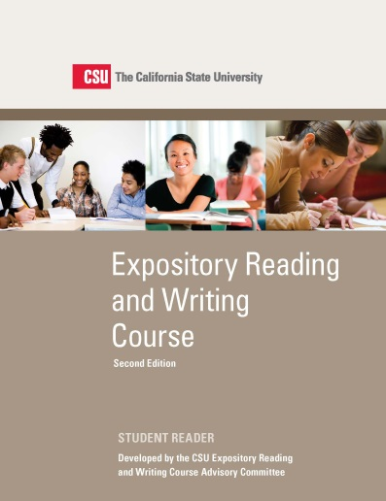
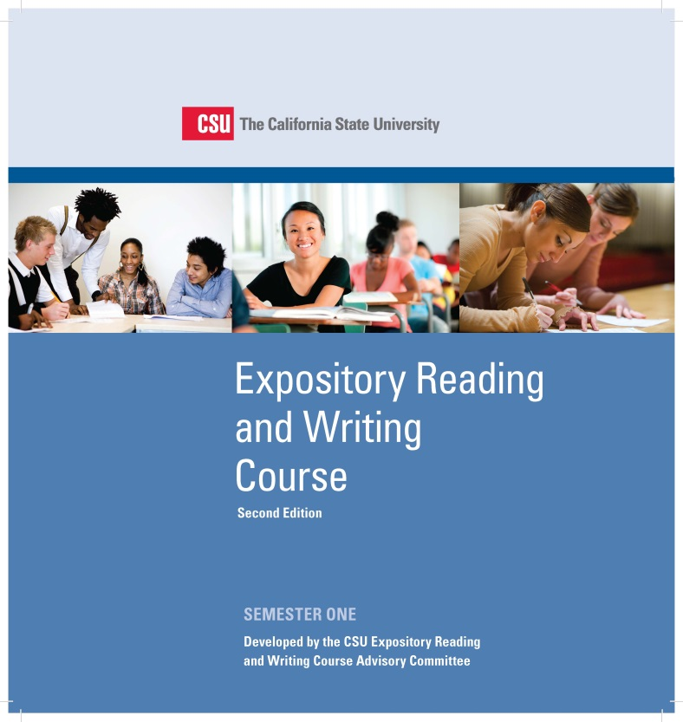
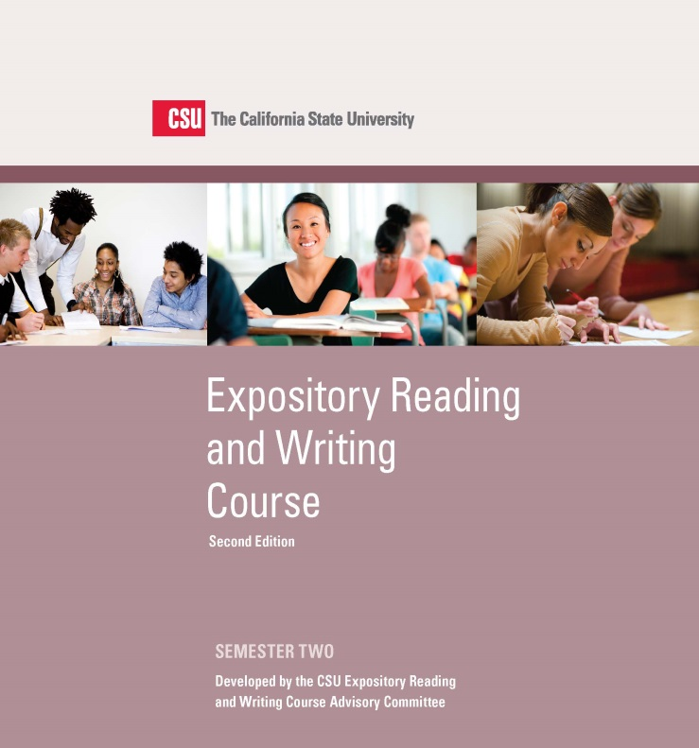
Expository Reading and Writing Curriculum
Notes:
2

Slide 3
A Few Facts about the ERWC
The ERWC has been around since 2004.
ERWC developed through a unique partnership between university faculty and high school teachers
Across California, more than 14,000 educators have been through ERWC professional development seminars.
951 California high schools have adopted the ERWC as a full, 12th grade course.
Many other middle and high schools are integrating some ERWC modules into existing classes.
The ERWC is also being taught in Hawaii—and it is expanding into Washington State.

Slide 4
What is ERWC?
The ERWC (Expository Reading and Writing Course) is a college preparatory, rhetoric-based English language arts course for grade 12 designed to develop academic literacy (advanced proficiency in rhetorical and analytical reading, writing, and thinking).
Notes:
So what exactly is the ERWC?
It is a systematic rhetorical approach to teaching reading and writing.
The C in ERWC can stand for two things: course or curriculum. The ERWC is actually both. At the 12th grade level, it is a two semester course. In grades 7-11 it is a curriculum that can be integrated into a host of different classes. The 12th grade course exists in both hard copy and digital formats on the ERWC Community site (hold it up). The grade 7-11 modules are available for free download from the community site, which is available to all teachers who have been through our free ERWC professional learning workshops. Teachers who attend ERWC workshops also receive a flash drive that contains the curriculum.

Slide 5
The 12th Grade Course
Approved by the University of California and the CSU as a year-long college-preparatory English course in 2006 [satisfying the “b” English requirement in the “a-g” sequence]
Curriculum is aligned with the Common Core State Standards.
Curriculum prepares students for college-level reading, writing, and thinking tasks.
The ERWC course can also exempt future CSU students from needing to take remedial college courses.
Notes:
As you can see in this slide, the ERWC recently celebrated its 10th birthday. Thousands of teachers use this curriculum and the 12th grade course is now in over 600 high schools across the state. Due to its alignment with the Common Core it is gaining a great deal of interest from other states, all of which are searching for effective common core aligned curriculum. Hawaii has been using it for years and other states continue to express their interest in learning more about the course.

Slide 6
What is ERWC?
The ERWC also offers curriculum for grades 7-11, with four extended modules per grade level.
Notes:
So what exactly is the ERWC?
It is a systematic rhetorical approach to teaching reading and writing.
The C in ERWC can stand for two things: course or curriculum. The ERWC is actually both. At the 12th grade level, it is a two semester course. In grades 7-11 it is a curriculum that can be integrated into a host of different classes. The 12th grade course exists in both hard copy and digital formats on the ERWC Community site (hold it up). The grade 7-11 modules are available for free download from the community site, which is available to all teachers who have been through our free ERWC professional learning workshops. Teachers who attend ERWC workshops also receive a flash drive that contains the curriculum.

Slide 7
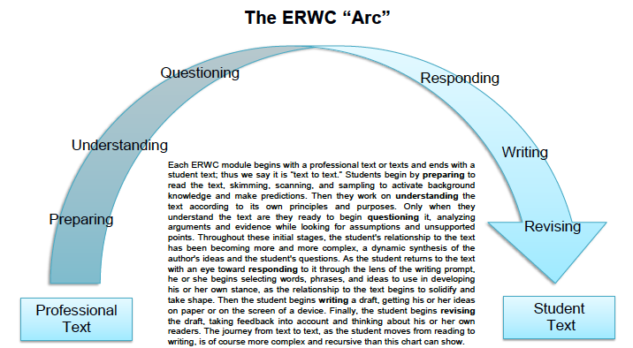
Notes:
READING RHETORICALLY
Prereading
Getting Ready to Read
Introducing Key Concepts
Surveying the Text
Making Predictions & Asking Questions
Introducing Key Vocabulary
Reading
First Reading
Looking Closely at Language
Rereading the Text
Analyzing Stylistic Choices
Considering the Structure of the Text
Postreading
Summarizing & Responding
Thinking Critically
CONNECTING READING TO WRITING
Writing to Learn
Using the Words of Others
Negotiating Voices
READING RHETORICALLY
Prewriting
Reading the Assignment
Getting Ready to Write
Formulating a Working Thesis
Writing
Composing a Draft
Organizing the Essay
Developing the Content
Revising & Editing
Revising the Draft
Revising Rhetorically
Editing the Draft
Reflecting on the Writing
Evaluating & Responding
Grading Holistically
Responding to Student Writing
Using Portfolios

Slide 8
ERWC Compliments Common Core
ERWC Key Principles
7 Common Core ELA Capacities
The integration of interactive reading and writing processes;
A rhetorical approach that fosters critical thinking and engagement through a relentless focus on the text;
Materials and themes that engage student interest;
Classroom activities designed to model and foster successful practices of fluent readers and writers;
Research-based methodologies with a consistent relationship between theory and practice;
Built-in flexibility to allow teachers to respond to varied students' needs and instructional contexts; and
Alignment with California’s Common Core State Standards for English Language Arts and Literacy.
Demonstrate independence
Build strong content knowledge
Respond to audience, task, purpose, and discipline
Comprehend and critique
Value evidence
Use technology and digital media
Understand other perspectives and cultures

Slide 9
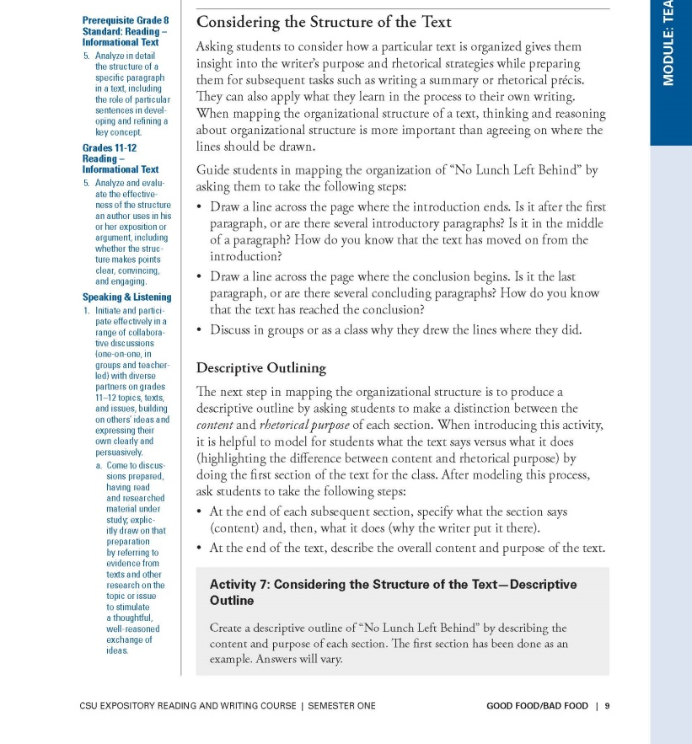
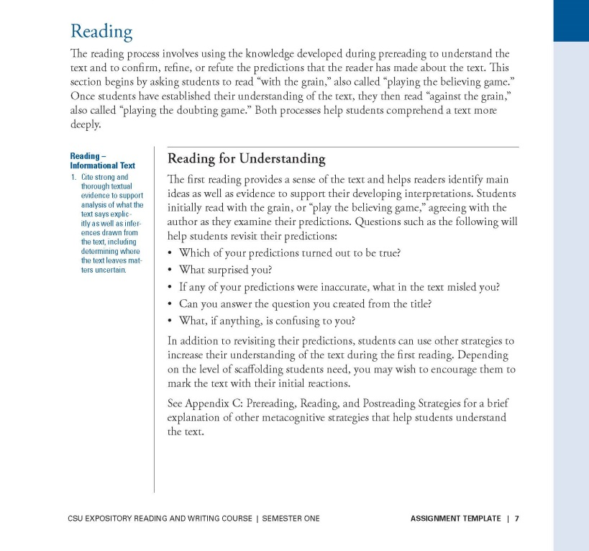
CA CCSS for ELA/Literacy in Left Margin
Assignment Template
Teacher Version:
Good Food/Bad Food

Slide 10

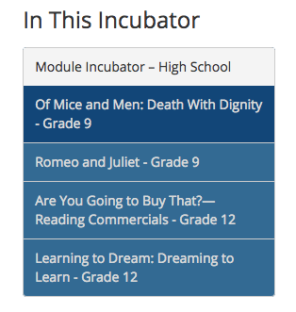
ERWC Module Incubator is LIVE!
And more modules will be coming soon!
Notes:
Obligation on the part of users to provide feedback on these modules.

Slide 11
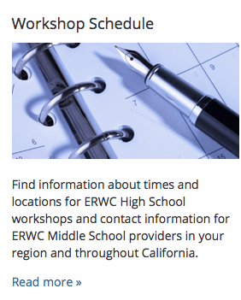
Getting Access to the ERWC Curriculum
To be considered “certified” to teach the curriculum, educators need to complete a required professional learning experience (MS, 18 hrs; HS, 24 hrs).
Middle school and high school workshops are scheduled locally, as well as statewide.

Slide 12
ERWC Is Expanding and Evolving
The Investing in Innovation Validation grant
13.2 million over 5 years
Expand the course beyond California into Washington State
Revise the curriculum to include grade 11 as well as grade 12
The National Professional Development Grant
2.75 million over 5 years
ERWC modules will be revised to include integrated and designated English language development (ELD) and provide related professional learning for high school English language arts and ELD teachers.
Notes:
More literature. Our same ERWC approach with more modules that address all standards for grades 11 and 12. Schools will, as always, have the choice whether they want to adopt the 11th grade course.

Slide 13
ERWC Is Moving Online
Technology-Enhanced
Brick and Mortar classroom
Direct instruction and activities online.
Hybrid:
Brick and Mortar Computer Lab
Teacher is present
Fully Online Delivery
No classroom
Students meet with teacher at district site or virtually for seminars or assistance periodically throughout semester.
Online discussion boards
Notes:
More literature. Our same ERWC approach with more modules that address all standards for grades 11 and 12. Schools will, as always, have the choice whether they want to adopt the 11th grade course.

Slide 14
The Need for Quality Matters!
To be considered “certified” to teach the curriculum, educators need to complete a required professional learning experience (MS, 18 hrs; HS, 24 hrs).
Middle school and high school workshops are scheduled locally, as well as statewide.
Right now, we have no
professional development or
standards for teachers using
ERWC is digital settings.

Slide 15
Lori Campbell
28th year
3 years classroom
ERWC
3rd year online blended
www.kernlearn.org
Blended learning model that combines online learning and face-to-face education
Uses internet-based learning management system as a digital classroom environment to teach courses for KHSD credit.
Offers increased access to standards-based courses taught by highly qualified staff.
The use of digital curriculum enables flexible scheduling options for students.
Students may take Kern Learn courses to supplement their traditional schedule, or may enroll as a full-time online student.

Slide 16
Rear Admiral
Grace Hopper
“It's easier to ask forgiveness than it is to get permission.”

Slide 17
On-line
As of this date, there is NO approved online ERWC course.
There may never be an approved online ERWC course.
ERWC
HYBRID

Slide 18

What Hybrid ERWC Needs:
Students MUST be able to interact, discuss, and respond to each other’s feedback.
The teacher MUST be an available resource either through phone, message, or Google Hangouts. Sitting right beside you is the best method.
This is known as “HYBRID” or “Blended.”
In short, interaction is a vital component of the course, and that needs to be highlighted in hybrid and online settings.

Slide 19
QM Rubric can act as a guide for
Side-by-side standards comparison between ERWC requirements and online program design.
Program fidelity
Ability to see multiple formats of delivery for common curriculum (discussion boards, recorded seminars, and teacher interaction).
Smooth transition from high school to college courses.

Slide 20
Questions for our audience to consider
All Cal State University campuses have access to QM resources, but our high schools are not affiliated with QM. Can they work under the umbrella of the CSU?
Are there other HS/University models out there similar to ours that we might consider?
If we develop a course for adoption, what platform (LMS) is best, since not all schools use the same ones.
What QM professional learning would be most appropriate for the high school teachers who will be teaching in digital settings?

Slide 21
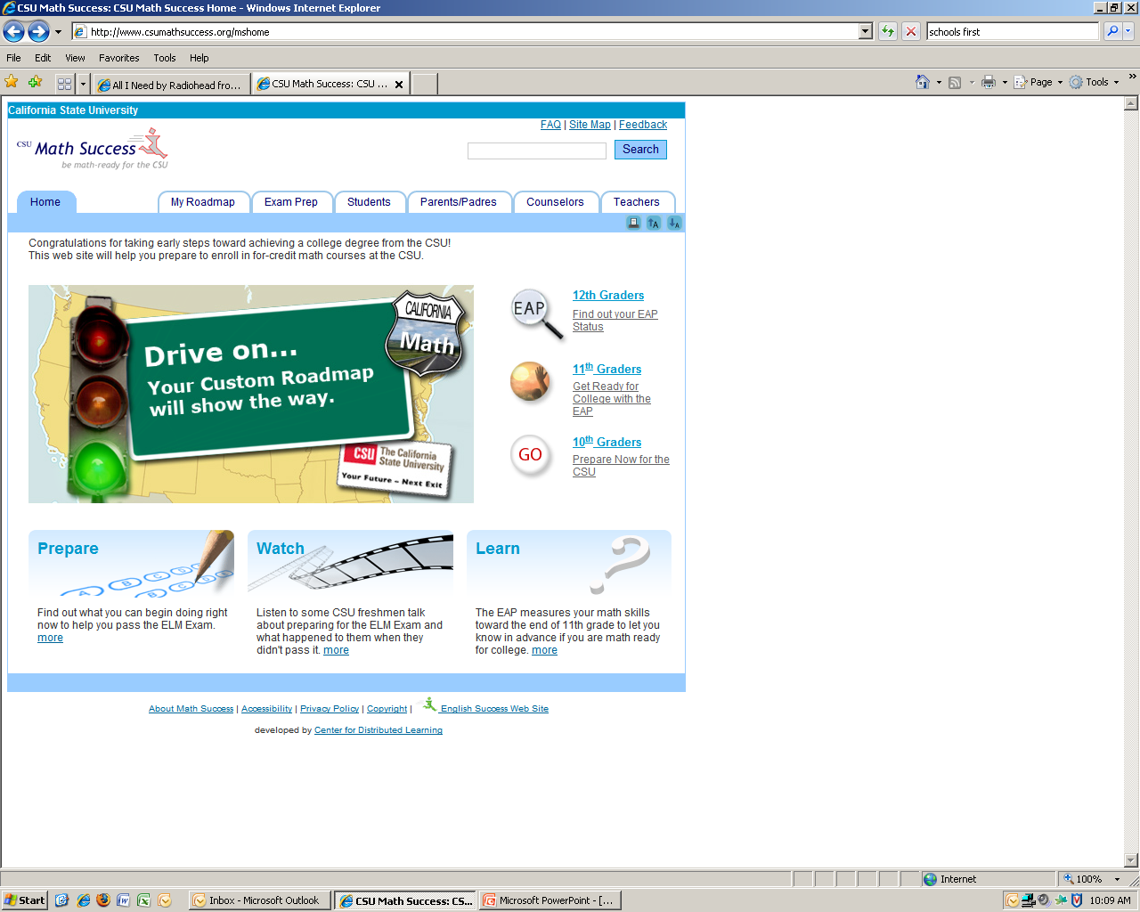
To Learn More….
ERWC
ERWC
http://www.calstate.edu/eap/englishcourse/
  If you have any questions, please contact:
  Chris Street
  cstreet@fullerton.edu
  or
  Lori Campbell
  Lori_Campbell@kernhigh.org

