Slide 1

Applying the Quality Matters Rubric to Culminating Experiences and Individualized Research Courses

Slide 2
Elizabeth Crawford, EdD
UC Foundation Associate Professor
The University of Tennessee at Chattanooga

Slide 3
Session Objectives
  Identify opportunities for application of QM guidelines to graduate culminating projects/courses
  Share challenges related to course development of non-traditional course delivery options
  Plan potential next steps for implementation and application at their own institutions

Slide 4
Session Learning Outcomes
Recognize the importance of framework design for consistent assessment and progression in graduate culminating projects
Determine applicability of organized frameworks for assessment of graduate program culminating projects at your own institutions
Begin specific plans for implementation of similar frameworks

Slide 5
Culminating Projects:
Dissertations, Theses, Capstones, etc.
Broad journey of research and inquiry
Often unstructured and loosely managed
High rates of attrition
Please share what types of Culminating Projects you use at your universities

Slide 6
Attrition and Graduate Projects
Shift from Student to Scholar (loss of cohort / colleagues)
Lacking or contradictory feedback from faculty and committee members
Self-discipline, self-doubt, and isolation
Other reasons?

Slide 7
Work embedded and applied programs – Higher risk?
Working professionals
Usually cohort-based
Back to work after coursework completed
(Pena, et al, 2010)

Slide 8
Support for Completion
Timelines and flow charts
Dialogue for collaborate interchange and partnerships
Constant and consistent faculty feedback
(DiPierro, 2007)
(Ali, et al, 2007)

Slide 9
Successful Completion through the lens of Sociocultural Theory
Individual zones of current and potential development
Capacity of more knowledgeable others (faculty, peers, etc.)
Scaffolded guidance in response to learning needs
(Liechty, et al, 2009)

Slide 10
Challenges: Creating an Organizing Structure and Assessment of Outcomes
  Consistent method of organizing and documenting project process and progress
  Documentation of communication and feedback between student (candidate) and faculty / committee members
  Often not a semester-driven process
  Other challenges?

Slide 11
LMS Course Spaces for Culminating Events
DNP – Translational project
Learning and Leadership Doctoral Program – Dissertation Course Space

Slide 12

DNP Translational Project

Slide 13
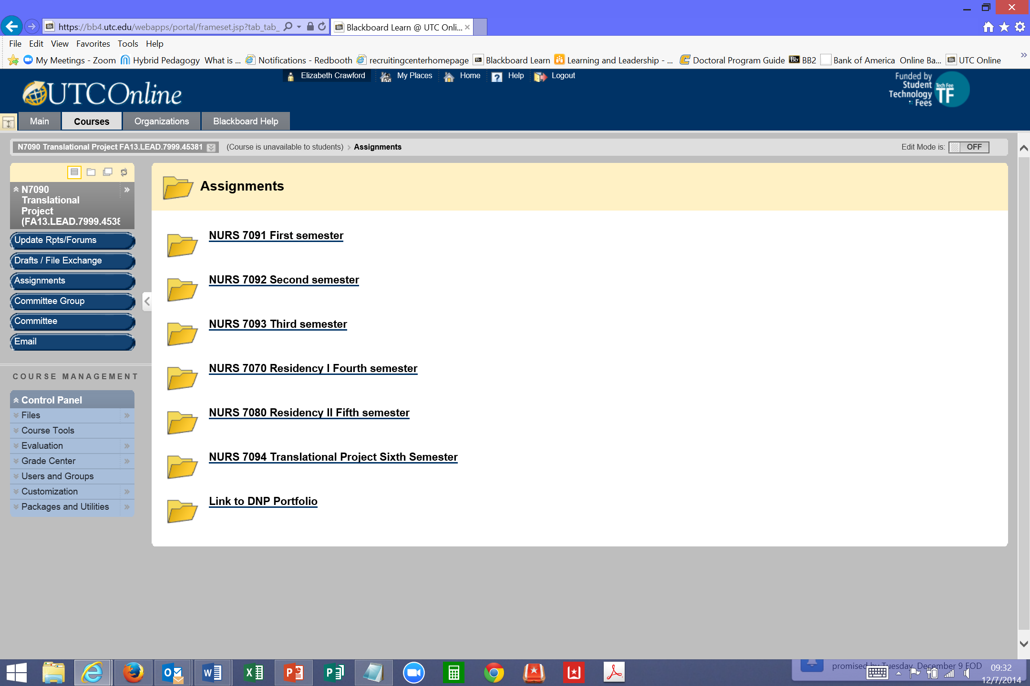
DNP TP – semester view

Slide 14
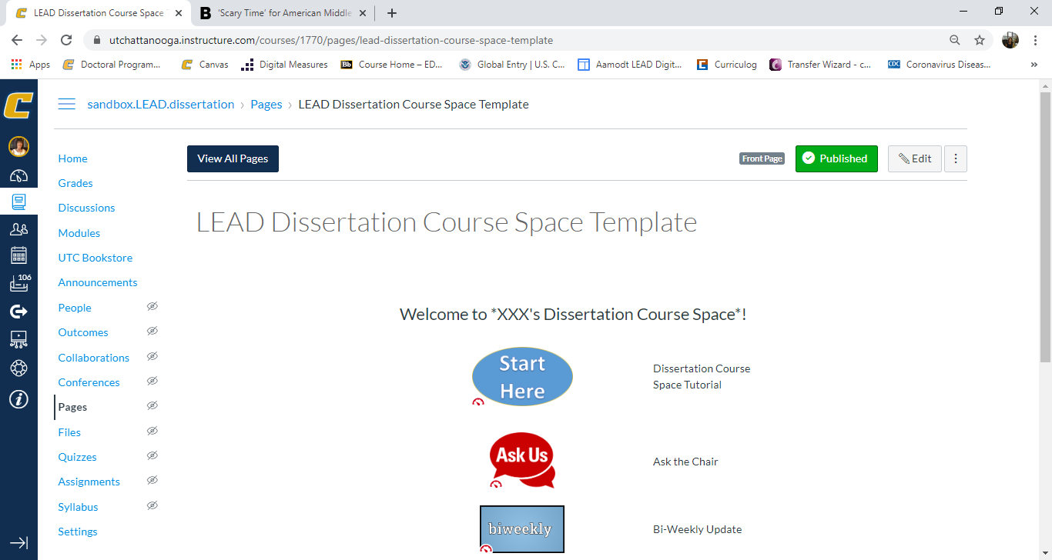
Dissertation Course Space

Slide 15
Dissertation Course Spaces Components
Discussions
  Chair and Candidate
  Chair and Committee
  Full Committee and Candidate
Draft Submission options
Committee List
Timelines / Progress
Email
Resources

Slide 16
Challenges to QM process
Lack of specific rubrics for Dissertation/Research process
Not bound by traditional semester
Only one student per course space
Other challenges?

Slide 17
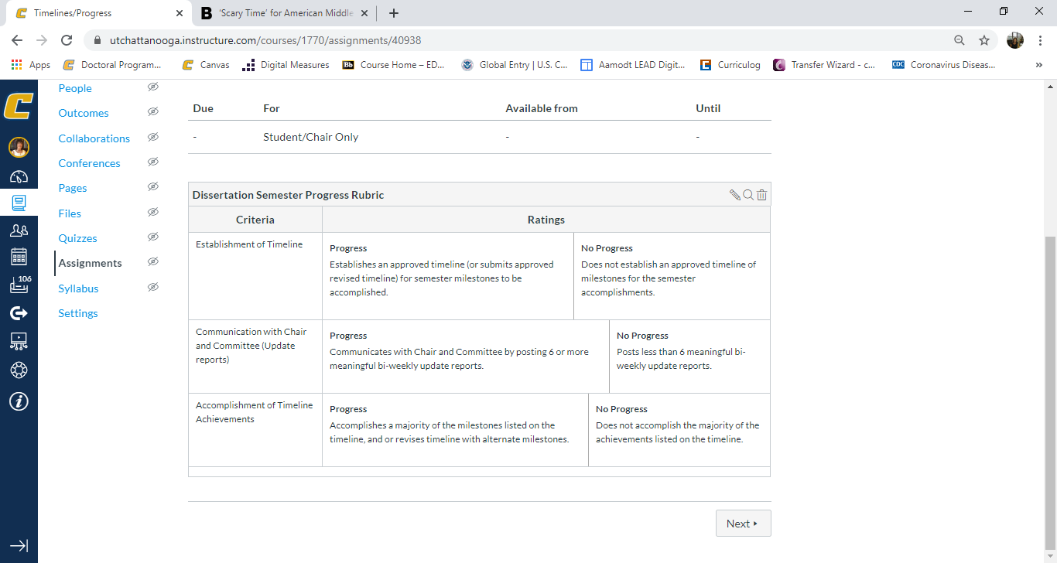
Dissertation Semester Rubric

Slide 18
QM Standards “Not Met”?
Most QM specific standards have been met in course spaces. Three specific standards are challenging and response described below.
Specific Standards- 1.9, 5.4 related to learner interactivity. Only one student in course space...
1.8 The self-introduction by the instructor is professional and is available online.
1.9 Learners are asked to introduce themselves to the class
    Due to the nature of the course, the learners already known to Chair and Committee members.
5.4 The requirements for learner interaction are clearly stated.
    Candidate will not have interaction with other learners, requirements for interaction with Chair and Committee members clearly defined in course outcomes and activities.

Slide 19
First steps for planning and implementation
Identify appropriate program(s)
  Multi-semester culminating project
  Committee / collaborative
Script the needs / purpose of the project
Build a sandbox / framework space
Request course spaces from LMS group (not semester bound)
Course copy or export into spaces
QM review

Slide 20
Questions??

Slide 21
References
Ali, A., Kohun, F., & Levy, Y. (2007). Dealing with social isolation to minimize doctoral attrition- a four stage framework. International Journal of Doctoral Studies, 2(1), 33-49.
Di Pierro, M. (2007). Excellence in doctoral education: Defining best practices. College Student Journal, 41(2), 368-375.
Liechty, J. M., Liao, M., & Schull, C. P. (2009). Facilitating dissertation completion and success among doctoral students in social work. Journal of Social Work Education, 45(3), 481-497.
Peña, E. V., Jimenez y West, I., Gokalp, G., Fischer, L., & Gupton, J. (2010). Exploring Effective Support Practices For Doctoral Students' Degree Completion. College Student Journal, 45(2).

