Slide 1
Promoting Competency-Based Learning in a Hybrid Research Methods Course
Leanne Havis, Ph.D., Neumann University
QM East Coast Regional Conference (March 2018)

Slide 2
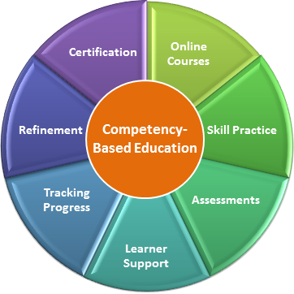
Session Overview
Course background
Guiding questions in the redesign
Incorporating CBL elements
Did it work?
How can you adapt elements of CBL to work for your students?

Slide 3


Think-Pair-Share #1
Take a minute to think about one course that you teach and jot down an answer to the following question:
  In ten words or less, how would you describe what you want your students to know or to do as a result of taking your class?
Turn to a partner and share your answers.

Slide 4

Well…?
How many of you identified an area of knowledge or content?
How many of you identified a skill or competency?
How easy was it to narrow your course goal(s) to ten words or less?

Slide 5
The History of CJ 303
“Traditional” research methods course
Focus on content (knowledge), “little real world relevance”
Low student grades, high student resentment
Continuous tinkering with scaffolding and small-stakes assignments
Students seemed unable to make the leap from one step to the next
What wasn’t working???

Slide 6
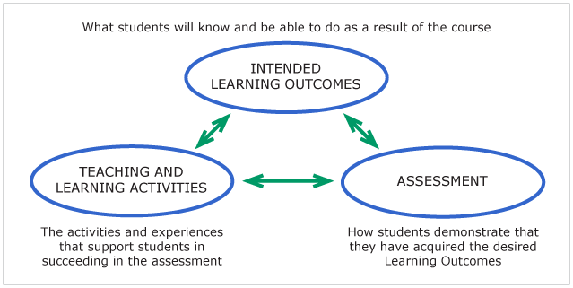
Guiding Questions in the Course Redesign
Outcomes: What do I want students to demonstrate that they know or that they can do upon completion of this course?
Assessment: What evidence can I use to evaluate whether students have successfully met this outcome?
Learning Activity: What opportunities can I introduce to promote student engagement with the learning process?

Slide 7

The Outcomes
Sometimes less is more – keep it simple
Focus on skills and competencies, not knowledge or content – why?
Which skills and competencies?
  Written communication
  Critical thinking

Slide 8
Think-Pair-Share #2
Revisit the outcome you identified a few minutes ago for one of your courses and jot down an answer to the following question:
  How will you know whether your students have achieved that outcome?
Turn to a partner and share your answers.

Slide 9

Assessment:
Formative and summative – emphasis on learning by practicing
  Multiple drafts, multiple rounds of revisions
  Students learn at their own pace and progress to the next level only when they have demonstrated competency
AAC&U VALUE Rubrics for Written Communication and Critical Thinking
  “Competency” defined as Level 3 milestone (between “developing” and “mastery”)

Slide 10


Think-Pair-Share #3
Revisit the assessment method or measure that you identified a few minutes ago for meeting a desired outcome in one of your courses and jot down an answer to the following question:
  What could you ask your students to do, or what could you do with your students, to help them achieve that outcome?
Turn to a partner and share your answers.

Slide 11
Learning Activities
Intentional maximization of the hybrid format
  Online: use of technological resources (Purdue OWL, TurnItIn, journal articles, rubrics, discussion boards)
  F2F: workshop-style sessions to allow for individual and small-group work (peer evaluation, faculty-student conferencing, self-assessments)

Slide 12
Old vs. New
“Traditional” Course Format: | CBL Course Format:
Assignments: Annotated bibliography First draft of literature review Second draft of literature review (due one week later) Discussion board posts about data collection, data analysis, ethical practice (weekly) First draft of complete research proposal (due two weeks before the end of the semester) Final draft of complete research proposal (due during final exams week) | Assignments: Annotated bibliography First draft of literature review Final draft of literature review (may be more than two) Discussion board posts about data collection, data analysis, ethical practice First draft of complete research proposal No due dates for individual allied assignments; students progress to the next stage only when Level 3 competency on the appropriate rubric has been reached. Final draft of complete research proposal (due during final exams week)

Slide 13
Real-Time, Meaningful Feedback
Timely – typically within 48-72 hours
Concrete – specific, measurable, observable
Manageable – no more than three items to address each time
Multifaceted – from the faculty member, peers, and self

Slide 14
Direct Evidence of Student Learning:
Final Proposal Grades
“Traditional” Course Format (n=19): | CBL Course Format (n=9):
Scores ranged from 35.68 to 93.22 Mean: 72.56 Median: 72.55 Variance: 180.95 Standard deviation: 13.45 | Scores ranged from 71.16 to 91.03 Mean: 81.62 Median: 78.63 Variance: 56.35 Standard deviation: 7.51
There were statistically significant differences in final proposal grades across the two semesters.
Moreover, no student in the CBL semester scored lower than a 3 on the final proposal on either the Written Communication or Critical Thinking Rubric; sample means were 3.33 and 3.22 respectively.

Slide 15
Indirect Evidence of Student Learning
Student reflections on the CBL process noted the following:
  Relevance and transfer to real world setting
  Focus on ownership and accountability, leading to confidence building
  Self-paced and self-directed
  Flexibility, not constrained by deadlines

Slide 16
Challenges to Consider
Small vs. not-so-small class size (given individualized/personalized emphasis)
Delivery format (fully online vs. hybrid vs. fully F2F)
Emphasis on content vs. competency
Highly time-consuming
Identifying the “right” outcomes, assessment measures, and learning activities is key - and they all have to be aligned

Slide 17
Your Turn…
How could you incorporate elements of CBL into the course you’ve been thinking about during this session to help students meet the outcome you’ve identified?

Slide 18


