Slide 1
Online Course Design,
Quality Matters Training, and Student Outcomes
QUALITY MATTERS AT NCCU
Racheal Brooks
Coordinator, Office of e-Learning
Gail Hollowell
Associate Professor, Biological and Biomedical Sciences
Yolanda Anderson
Associate Vice Chancellor for Faculty Development/Resources

Slide 2


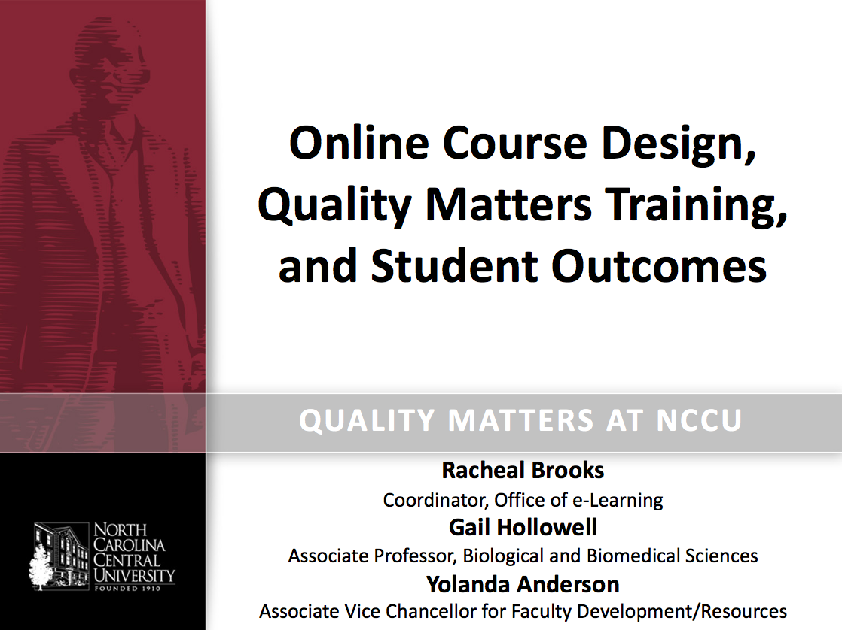
Blippar Download
To access additional resources:
Choose “Settings” from menu
Enter code 609083
Choose Blipp dots from menu
Tap screen to begin
Scan mini-handout

Slide 3
“[S]tudent populations with high dropout rates, especially minority students, will have to exponentially increase their college graduation rates…[Therefore,] HBCUs will—and must—play a critical leadership role in meeting this challenge.”
-U.S. Secretary of Education Arne Duncan
Changing the HBCU Narrative: From Corrective Action to Creative Investment

Slide 4
Considerations Regarding
Online STEM Education
Major deficit in number of online STEM courses versus the humanities
Higher attrition rates due to transactional distance and technology problems due to:
  Students’ inability to ”catch up”
  Lack of meaningful and frequent learner-instructor interactions
Proper use of technology plays an important role in successful online experiences
Professional preparation of faculty to design and deliver online courses is paramount

Slide 5
Online STEM Education at NCCU
Increased course enrollment despite limited space
60% increase in online course offerings from 2011 to 2016
  STEM course offerings account for 7% of this amount
NCCU General Education Curriculum (GEC) requirements:
  1 mathematics course
  2 science courses
3 out of 5 mathematics GEC courses offered online
10 out of 17 science GEC courses offered online

Slide 6
NCCU STEM Faculty
Quality Matters Training
Beginning in 2014, NCCU participated in the Preparing Critical Future Faculty program
  Funded by the National Science Foundation’s Historically Black Colleges and Universities-Undergraduate Program (HBCU-UP)
Led by 2 STEM faculty and in partnership with Division of Extended Studies
10-faculty member cohort participated in a professional development workshop series
  Biology, Chemistry, Environmental Science, Mathematics, and Physics
  Faculty completed the Applying the Quality Matters Rubric (APPQMR) workshop
  Utilized lessons learned to revise online courses

Slide 7
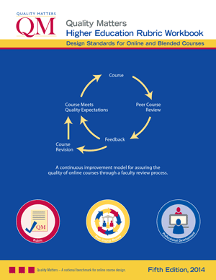
Quality Matters Rubric
Overview
Course Overview Introduction
Course Activities and
Learner Interaction
Course Technology
Learner Support
Accessibility and Usability
Learning Objectives (Competencies)
Assessment and Measurement
Instructional Materials

Slide 8
Methodology
Online Introductory Biology Course
QM Training Highlights
Online biology course taught by single instructor
Completion of Applying the QM Rubric workshop in Spring 2015
Informal QM Review of six sections taught before and after training
  Spring 2015 – 1 section
  Summer 2015 –3 sections
  Fall 2015 – 1 section
  Spring 2016 – 1 section
Set of 101 cases
Final Exam
Course Average
Post-QM training data produced higher values for these variables
Informal Review Score

Slide 9
Methodology
Instructor was 1 of 10 members of faculty learning community
Made revisions during term immediately following training
Revisions related to:
  Blackboard content
  Course shell
  Overall course layout
  Student learning styles
Course not initially designed or modified for an official Quality Matter Peer Review
Instructor applied lessons learned from APPQMR to enhance learning experience
Quality Matters informal review scores were significantly correlated with final exam performance and overall course averages

Slide 10
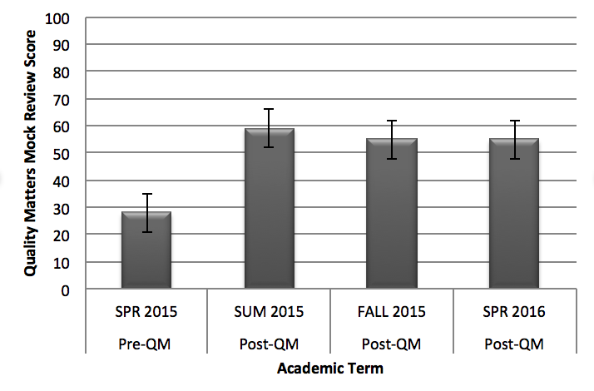
Quality Matters Informal Review
Scores by Term

Slide 11
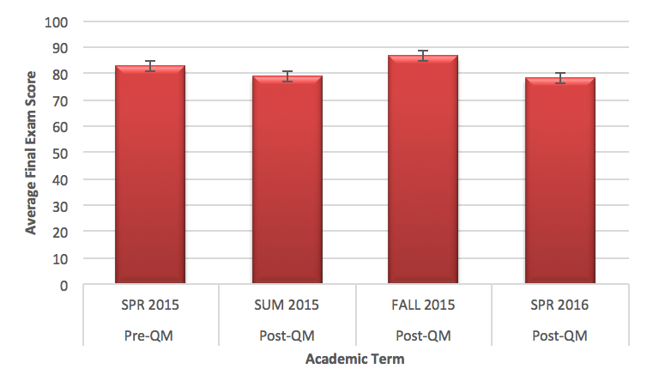
Biology Final Exam Performance by Term: Pre and Post QM Training
Hypothesis: Students would earn higher scores on final exam post QM training
Pre QM Training final exam scores (M = 82.65, SD = 6.95) increased in semesters post QM Training (M = 86.24, SD = 7.86), t(99) = 0.124, p =.015, two-tailed.
.124 in final exam scores
QM score

Slide 12
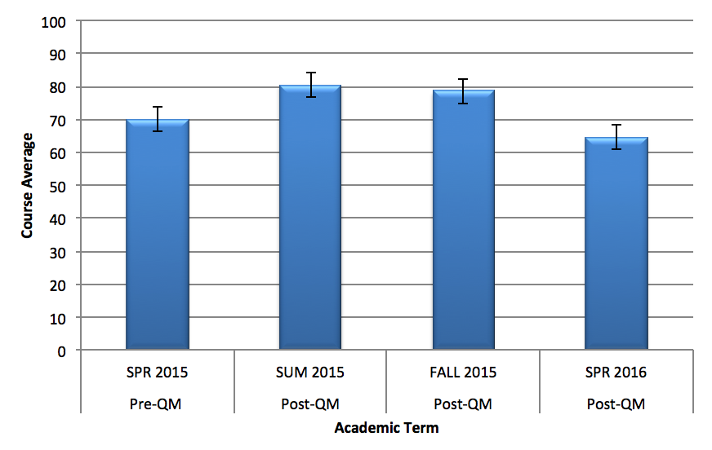
Overall Course Averages by Term: Pre and Post QM Training
Hypothesis: Students would earn higher course averages post QM training
Pre QM Training course averages (M = 77.75, SD = 10.14) increased in semesters post QM Training (M = 82.71, SD = 9.16), t(99) = 0.175, p =.008, two-tailed.
.175 in overall course average
QM score

Slide 13
Student Rating of Instruction
Average ratings increased immediately following training in the following areas:
SRI Category | Related QM Standards
Alignment of course goals and objectives with instruction | Course purpose and structure (1.2) Alignment of assessments (3.1) instructional materials (4.1) learning activities (5.1), and course technologies (6.1)
Presentation of subject matter | Purpose of instructional materials (4.2) Requirements for learner interaction (5.4) Alternative means of access (8.3)
Organization of subject matter | Facility of course navigation and design (8.1)
Enhancement of ability to think, criticize, and create | Link between objectives and learning activities (2.4) Appropriate objectives for course level (2.5)

Slide 14
Student Rating of Instruction
Average ratings also increased immediately following training in the following areas:
SRI Category | Related QM Standards
Assignment of helpful tests and course readings | Alignment of assessments (3.1) and instructional materials (4.1) with learning objectives
Use of instructional approaches that effectively enhance learning | Use of various instructional materials (4.5) Opportunities that support active learning (5.2) Tools promote learner engagement and active learning (6.2)
Inclusion of examinations that are consistent with course objectives | Alignment of assessments with learning objectives (3.1)
Provision of assessments that are provided frequently enough to help evaluate student progress | Multiple opportunities for learners to track progress (3.5)

Slide 15
Fall 2015 Reversion
The Informal QM Review score lowered slightly, and the following trends were also observed:
Course no longer ”Met” 4 Specific Review Standards:
  Omission of required technical skills (SRS 1.7)
  No denotation of required or optional instructional materials (SRS 4.6)
  No identified alignment between at least 85% of instructional materials and learning objectives (4.1)
  No identified alignment between at least 85% of learning activities and stated learning objectives (5.1)

Slide 16
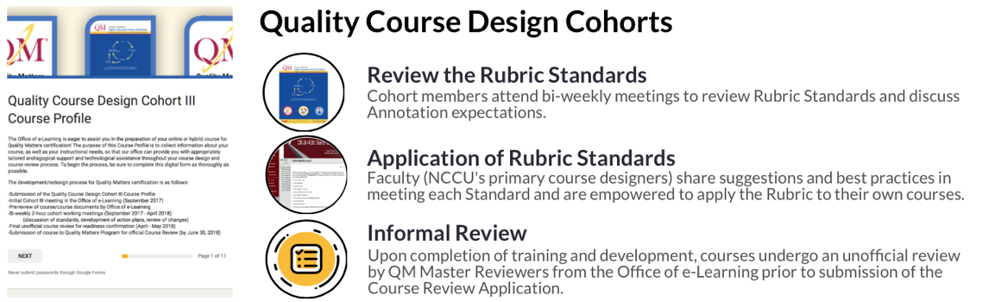
Moving Forward
Additional research underway:
Study | Collaborators
Online Course Design and Course Outcomes | Office of e-Learning; Biological and Biomedical Sciences
Like it or not, Online Education is Here to Stay: Best Practices for Online Teaching | Office of e-Learning; Allied Professions (Counselor Education)
Promoting Affordable Learning for Student Success (PALSS) | Criminal Justice; Office of e-Learning; Office of Faculty Professional Development

Slide 17

APPQMR Mobile Application

Slide 18
This project was generously supported by the National Science Foundation HBCU-UP Program (NSF ID 1235727).
Any opinions, findings, conclusions, or recommendations expressed in this material are those of the authors and do not necessarily reflect the views of the National Science Foundation.

Slide 19
For additional information, contact:
Dr. Racheal M. Brooks
Coordinator, Office of e-Learning rmbrooks@nccu.edu
Dr. Gail P. Hollowell
Associate Professor, Biological and Biomedical Sciences ghollowell@nccu.edu
Dr. Yolanda B. Anderson
Office of the Provost and Associate Vice Chancellor for Faculty Development/Resources yandersn@nccu.edu

