Slide 1

QA Elevate
Virtual Retreat
Aligning QA Goals of Online Learning to
University Strategic Planning
October 6, 2023| Online
Val Kelly
AVP, Kent State Online

Slide 2

Does the work you do align well with the mission and goals of your university?
This Photo by Unknown Author is licensed under CC BY-NC

Slide 3

What is your university strategic plan?

Slide 4
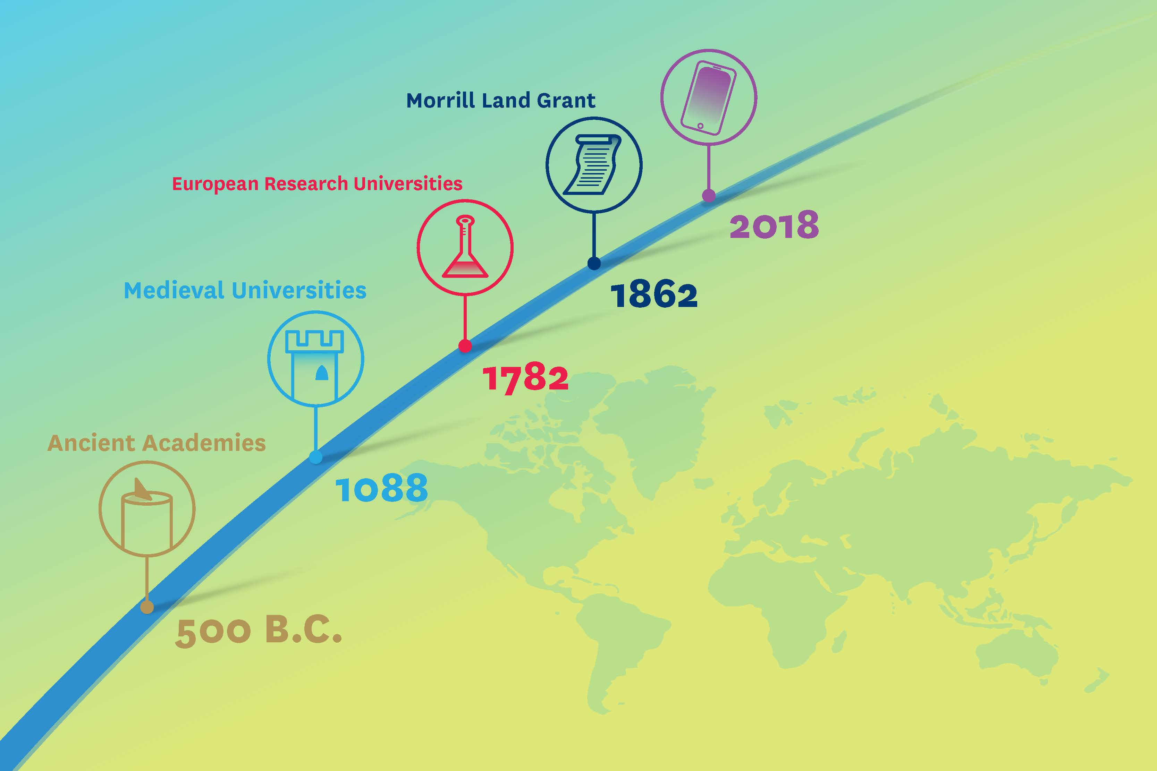

Slide 5
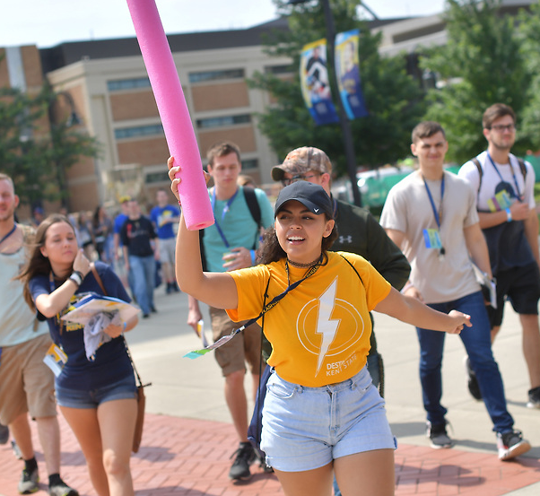
Disruptions facing higher education
Changing demographics
Societal perceptions about the value of education
Impact of the pandemic
Greater awareness of student needs
Impact of innovations

Slide 6
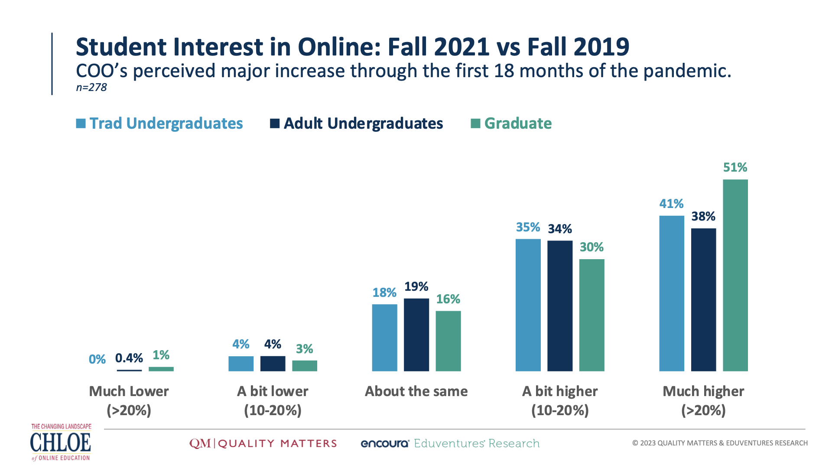

Slide 7
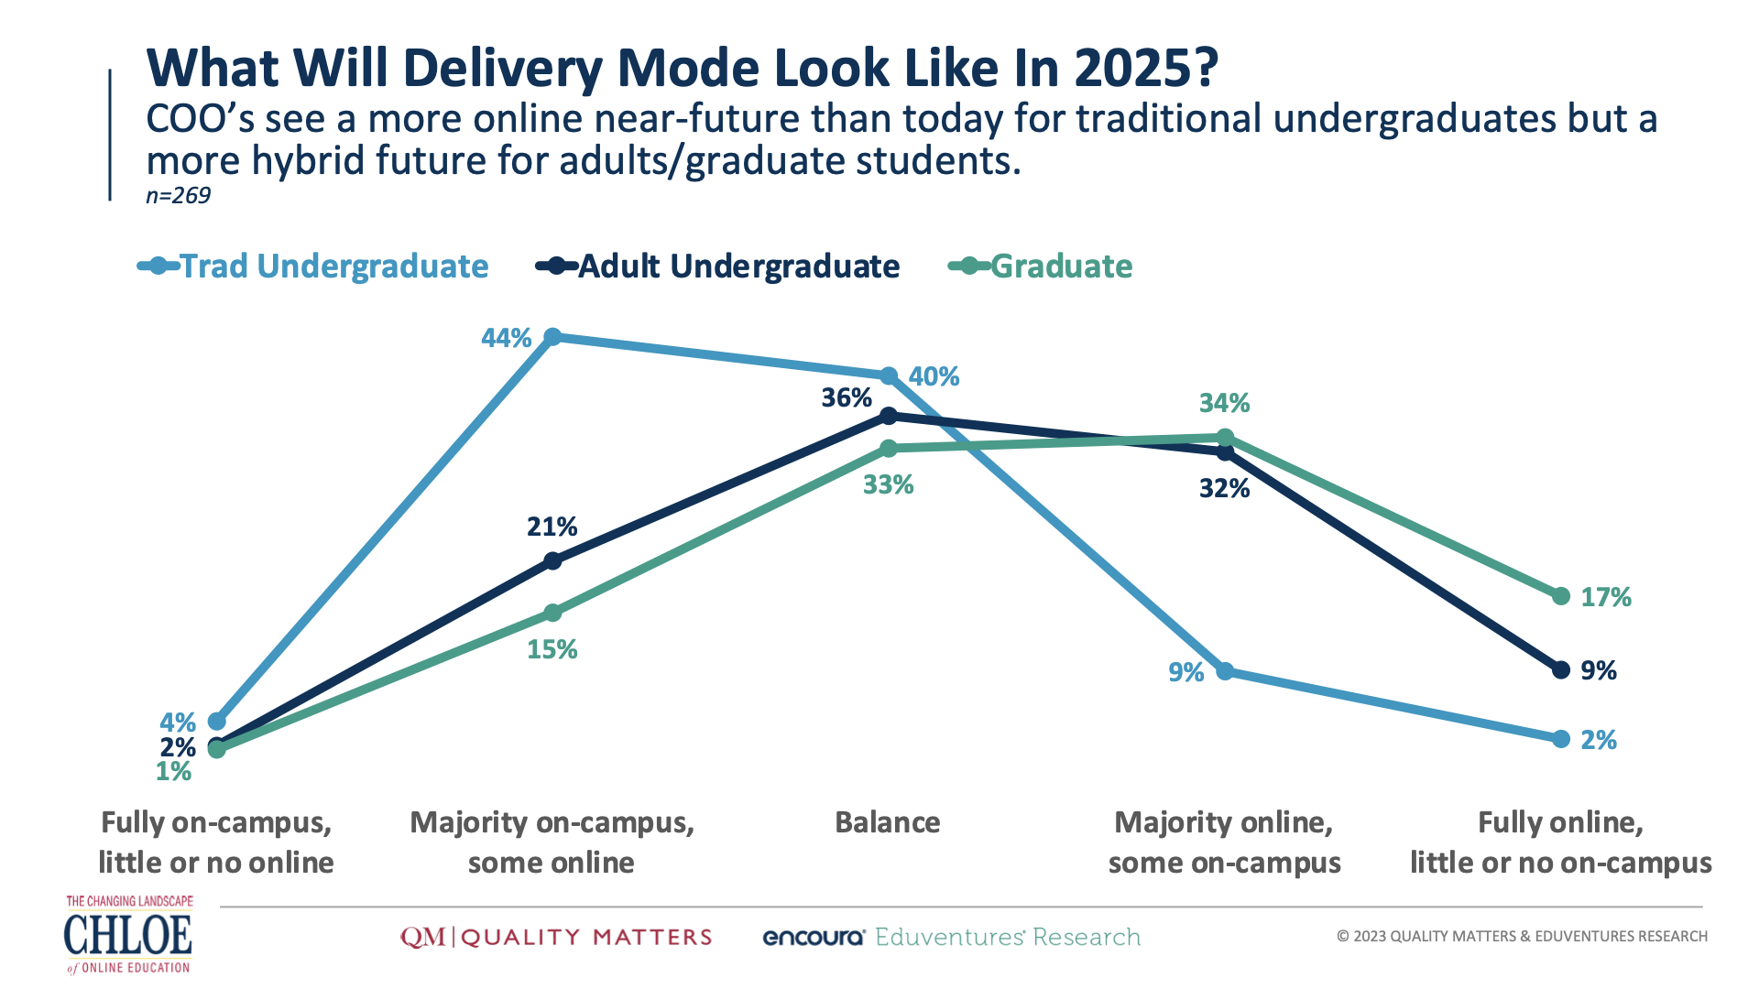

Slide 8
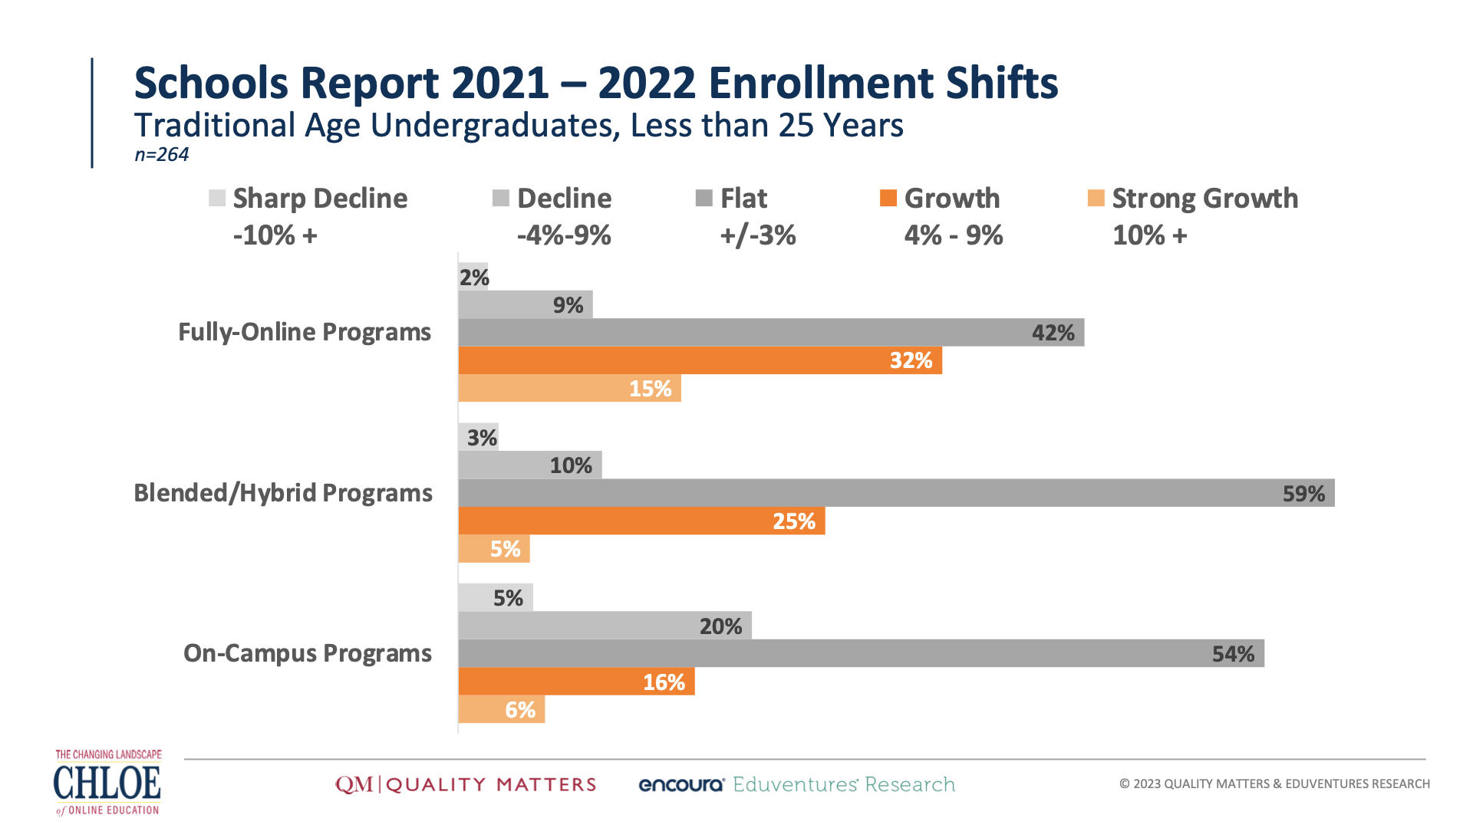

Slide 9
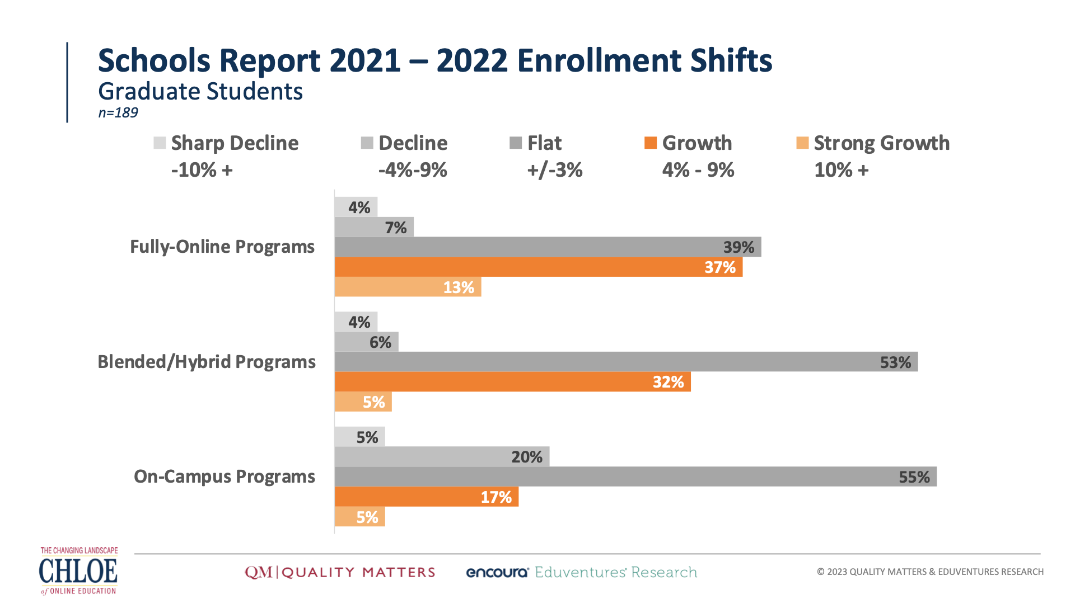

Slide 10
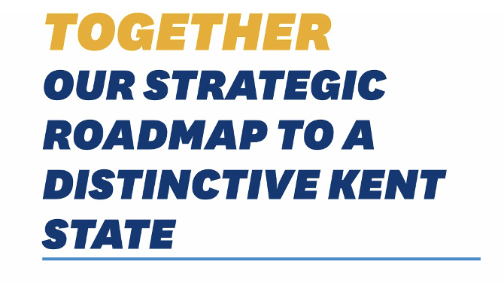
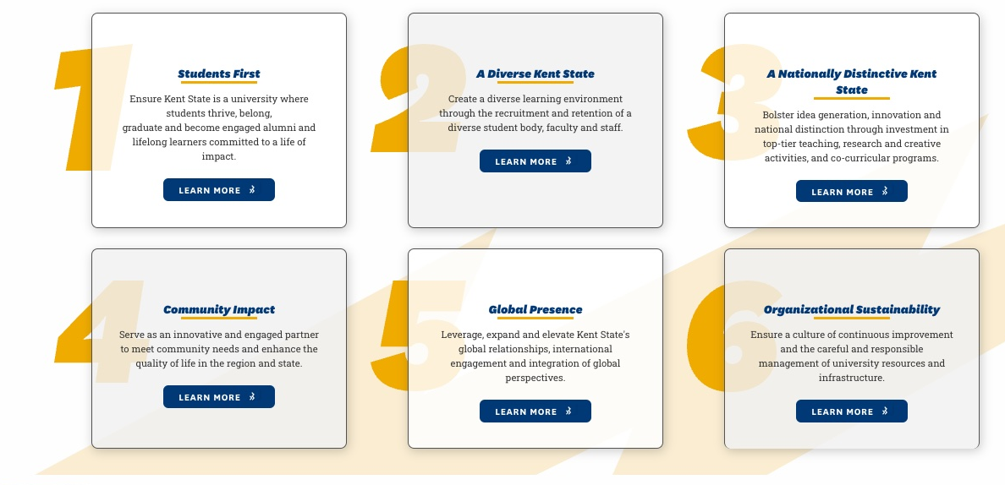

Slide 11
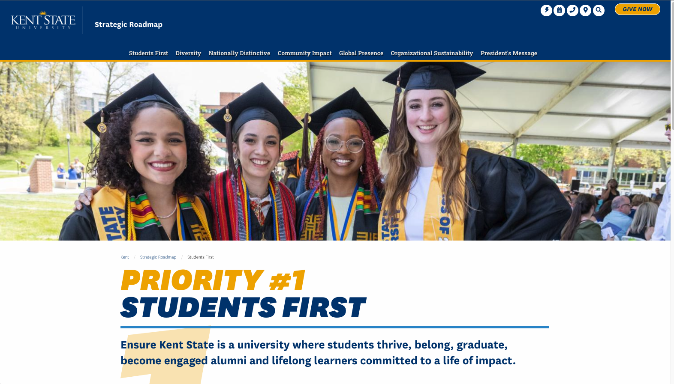


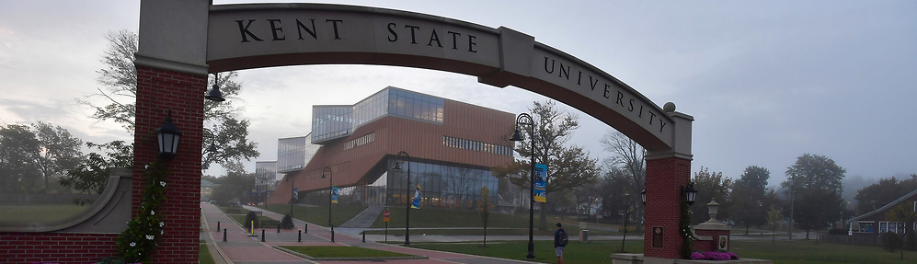
Awareness of Student Needs

Slide 12
Awareness of Student Needs
Notes:
The awareness of student needs is compelling universities to begin to rethink the design and delivery of courses. Giving students more options of modality of delivery and designing course work to help them succeed.
What are some ways the work we’ve done in online education impact university strategic planning?
BETHANY FEEDBACK: Here you might list the many ways that IDs, QMCs, online directors, etc can contribute:
How does this audience already have invaluable information about what online students need? (surveys in courses, faculty surveys, student surveys, working with online students, etc.)
How can this audience help to gather more information on this that can contribute to their own work and the strategic plan?
Is faculty PD part of supporting students (that’s a way to mention that their own strategic planning (not the institutional Strategic Plan) should include considerations of ways to support online students by supporting online faculty (faculty training (can reference the session on PD on this), resources like an LMS template (can make the connection to the presentation that Cristi Ford is doing on this, etc.)

Slide 13
How does instructional design and the incorporation of Quality Matters Standards into courses and programs help the university align with Student First goals?
This Photo by Unknown Author is licensed under CC BY-NC

Slide 14
What has been the impact of RSI?
“Regular and substantive interaction” is used in the “distance education” definition as a consumer protection mechanism for students and to delineate federal financial aid eligibility for courses and competencies.
WCET | 8/26/2021

Slide 15
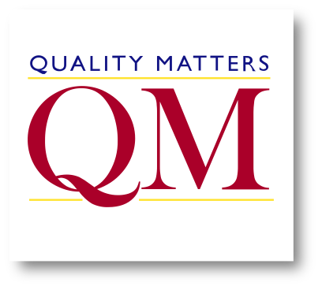
Grounded in research.
Driven by best practices.
A community that puts learners first.

Slide 16

ALIGNMENT
Notes:
Before I conclude, I’d like to bring up the word/concept that have we introduced at our institutions– so, so, very often –
Alignment!
Alignment has been a guiding force in the design of online courses and online programs. It is critical in designing a quality course
It is imperative that we check that our own objectives, strategies, and tactics are aligned with the university mission in order to ensure quality.
As I mentioned at the beginning, I have been involved in the strategic planning at our university. I have been very aware of making sure online education is adequately reflected in the planning, and continue to work to align our own strategic plan with the Academic Affairs strategic plan and the university strategic planning, - It has also made me much more aware that a variety of units may have elements of online education in their own strategic plans which should be aligned and coordinated with our own.
For example I saw that our Enrollment Management unit had as one of their tactics “Help Online Students Feel Engaged”. This is great, but also something that we clearly need to collaborate on.
As we online units grow and become more central in university planning, it is imperative that we see ourselves as part of something much bigger than ourselves. We are an important component in the future university, but we must stay aligned with the potentially changing goals and strategies of the university.
For all of your amazing work of introducing quality concepts at your university which will clearly be fundamental to the future success of the institution…
BETHANY FEEDBACK: I’d make the takeaway point here be:
YOU have important and deep knowledge about online learning and serving online faculty and students. It’s vital that you become engaged in campus conversations around institutional strategy to meet current and future needs for online. ALIGN YOUR WORK with the strategic plan as a best, first step. Make this into a “next steps” or “where do I go from here”
1. Locate your current institutional SP (where? How)
2. Align your current work (and goals, if you have them) with the current plan
3. What’s not there that should be? Where can you already show efficacy?
4. For the responses to Q3, then, who do they share this info with? How do they impact conversations around strategy or the SP when they are only an (ID, Coordinator, Director, etc)

Slide 17



Slide 18


Slide 19

Notes:
Thank you…
I’ve added a slide with references and some common resources for staying abreast of what is going on in higher ed.
BETHANY FEEDBACK: No, thank YOU! ;)

