Slide 1


QM & Faculty:
Internal QM Partnership – Our Why, What and How
✓ Scoot ✓ Balance ✓ Pedal
Sam Diomede, Sr. Instructional Designer
LeAnn Krosnick, Sr. Instructional Designer
Notes:
BOTH
Introduce ourselves

Slide 2
QM & Faculty:
Internal QM Partnership – Our Why, What and How
Why are we here?
To share our recent work to educate and motivate some of our faculty toward an appreciation and application of QM Standards.
✓ Scoot ✓ Balance ✓ Pedal
Notes:
LEANN
TODAY’S MISSION
To share our recent work to educate and motivate some of our faculty toward an appreciation and application of QM Standards.
For us this started with some typical requests for formal QM Review
It has since evolved into a process that we can use with requests for informal, internal reviews for programs and courses
AND we may or may not have worked with these faculty in the past
So we might be coming in after the fact - to look for possible course improvements, with faculty who have not partnered with an ID, and may not have knowledge about QM
BIKING METAPHOR
And so we thought – this is a little like learning to ride a bike
Just as we start with bike riding at various levels - We have faculty with different QM experiences and levels
Many who have never worked with an ID before
Varying acceptance rates
And like learning to ride a bike – we needed to understand these challenges and meet our faculty where they are
CYCLING LEVELS
Some of our faculty may be starting at the training wheel level
Others may just need a little help with balancing on 2 wheels
While a few are already pedaling like a race champion
How did we meet them at various levels?
(Scoot, Balance & Pedal)

Slide 3








Public urban university
Cleveland, Ohio
Est. 1964
Enrollment 16,000 +
Graduates 140,000 +
80% reside in area
511 Faculty, 1007 Staff
AAUP faculty
Notes:
SAM
Intro CSU
Next Slide: objectives

Slide 4
At the completion of this session, you will be able to:
Describe a process for internal QM Partnership
Identify internal QM partnership tools
(QM Overview, QM Internal Review, QM Consultation)
Plan for your own internal QM partnership
Notes:
SAM

Slide 5

Where do we Start Our QM Partnership?
Scoot – begin with support!
Video Credit: YouTube - https://youtu.be/hyrea1rEG0s
Notes:
SAM
GAUGE WHERE FACULTY ARE
When we begin working with any instructor we try to determine where they are coming from – are they just learning about QM?
Where do we start?
COMPARISON TO BIKING
Like learning to ride a bike, some may be starting with little to no knowledge
If you learned to ride a bike as a child, think back to what that felt like.
How many bike riders do we have in here?
Did you have training wheels to learn
And do you also remember a parent or older sibling holding you and helping you?
And probably a few of you remember falling a few times
But I bet most of you remember getting really good, and comfortable on your bike, with the safety of those training wheels?
Maybe you started out something like this video
PLAY VIDEO UNTIL THE DAD SAYS “FORWARD, FORWARD”
AUDIENCE: What all was happening in that video?
*We saw that with his support and encouragement, her confidence is growing along with her skills.

Slide 6

Building the Partnership: Are We Ready to Balance?
Balance - taking the next step!
Photo Credit: Getty Images
Notes:
LEANN
BUILDING ON OUR PARTNERSHIP
And just when you got really good with your training wheels, maybe someone suggested you remove the training wheels to get better
and you were might have been thinking “What??, but I’m so good on my bike now!”
COMMON REACTION TO CHANGE
And isn’t this how we all feel when we get really good at something, and then we are asked to make a change, or consider something new and different?
So how do we continue to build on this QM partnership, when the training wheels come off?
How do we encourage this balance?

Slide 7
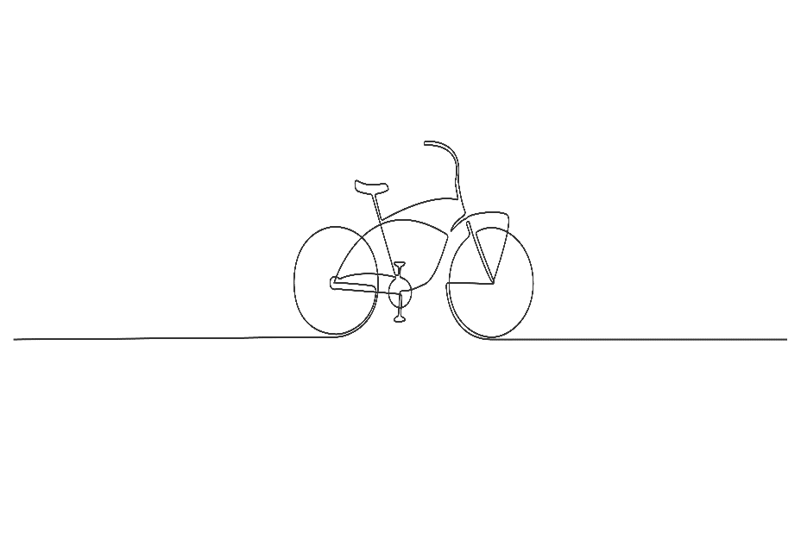
Preparing for Partnership Challenges!
Pedaling - putting it all together!
Video Credit: Youtube – WSH How to Ride a Bike for Adults https://youtu.be/NIsDrtPTTd8
Notes:
LEANN
A REALLY BIG CHALLENGE
And sometimes we are faced with some pretty big challenges -
Maybe we are asked to work with someone very resistant to QM or to working with an ID
Or opening themselves up to any type of outside help or perceived critique
And like learning to ride a bike – it can feel like you are being asked to teach them to ride for the first time – as an adult!
This video we are about to play gives us a good idea of how that might feel
Please consider as you watch this, that maybe this is how some of our faculty might feel when we ask them to consider change, to consider something completely new and outside their expertise.
PLAY FULL VIDEO
NEXT FEW SLIDES: What are some things you noticed during the video

Slide 8
What are some things you noticed in this video?
Notes:
SAM
Ask Audience – what did they notice in the video?
Three steps? – scoot, balance, pedal?
Some things he said during the video?
“I’m looking out there, I’m picking a spot, and I’m just going to go for it.”
“Step into it and push off!”
“It’s a little bit of a leap of faith”
Pretty relevant for any new undertaking

Slide 9
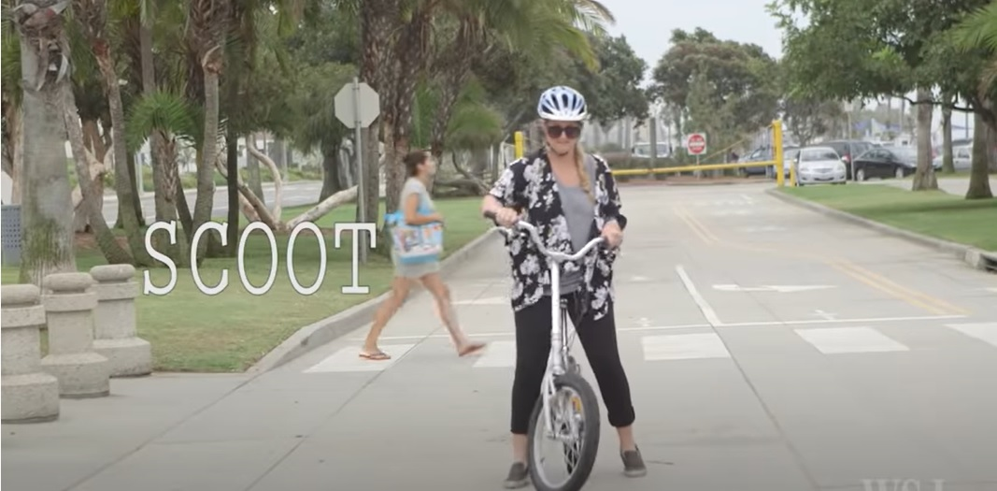
“Why Quality Matters”
1. (Scoot) into Partnership
Photo Credit: Youtube – WSH How to Ride a Bike for Adults https://youtu.be/NIsDrtPTTd8S
Notes:
SAM
So where did we start AT CSU
(what was our scoot?)
In meeting with our faculty we started with presenting to them “Why Quality Matters”
For this, we developed a QM Overview presentation
It can be customized for many purposes – those new to qm or who want a refresher, those who want a formal review, those who just want to improve their courses
NEXT SLIDE - Show quick peek at slide show presentation

Slide 10
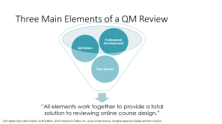
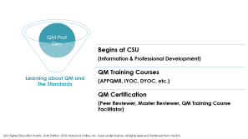
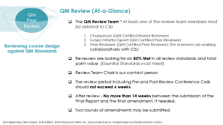
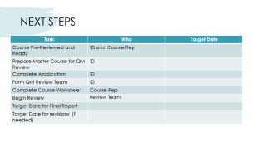
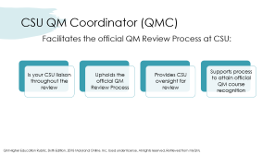
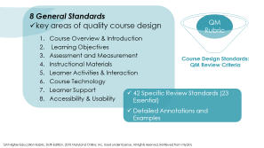
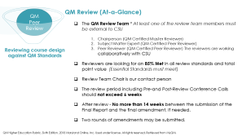
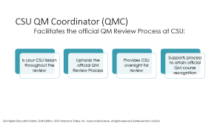
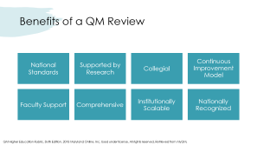
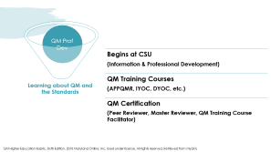
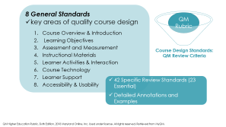
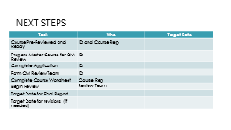
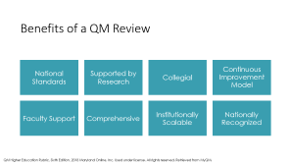
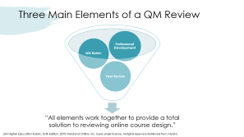
How we (Scoot) Into a Partnership
Benefits
QMC Role
Three Elements
QM Rubric
Professional Development
QM Review
Next Steps
Notes:
LEANN
Point out the various presentation topics
State again that it can be customized for various levels

Slide 11
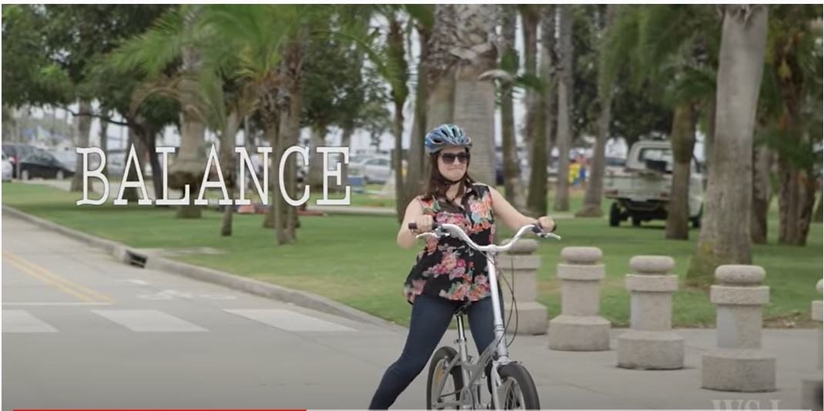
2. (Balance)
Building the Partnership
Internal QM Review
Photo Credit: Youtube – WSH How to Ride a Bike for Adults https://youtu.be/NIsDrtPTTd8
Notes:
SAM
Next we developed an internal qm review tool (spreadsheet)
This could be considered our next step to build on this partnership
This internal tool can be used for various needs:
Formal QM Review
Improving courses
Reviewing entire programs

Slide 12
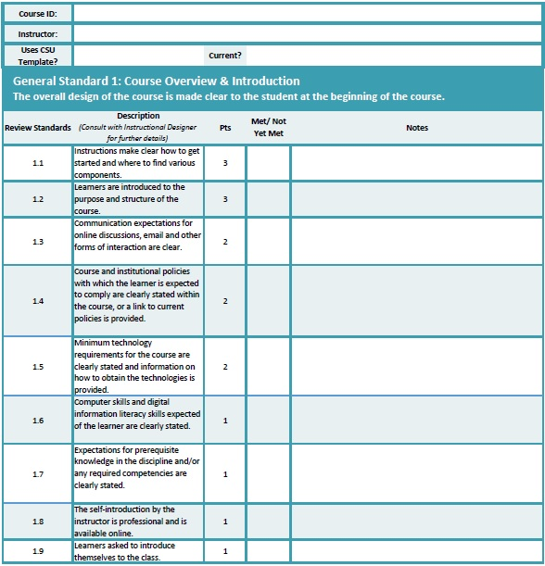
QM Internal Review Tool
Essential Standard 1
Notes:
LEANN
Simple, yet effective
Explain that it is an Excel worksheet
Point out the areas of the tool

Slide 13
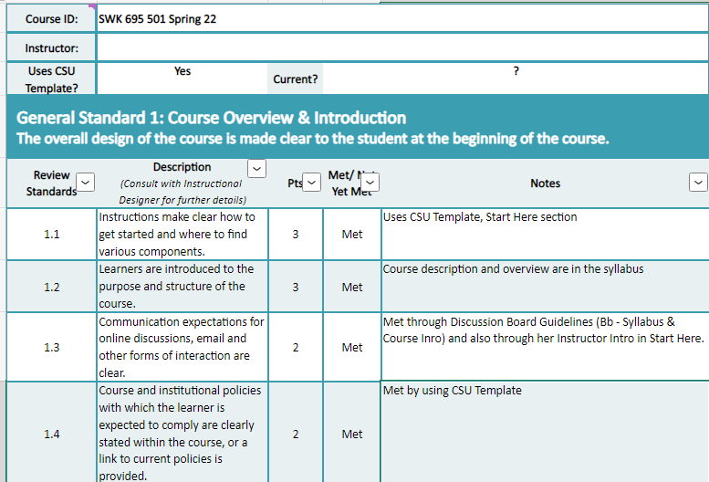

QM Internal Review Tool
Essential Standard 1
Completed
Notes:
LEANN
Example of Pre-review on a course – for Essential Standard 1

Slide 14
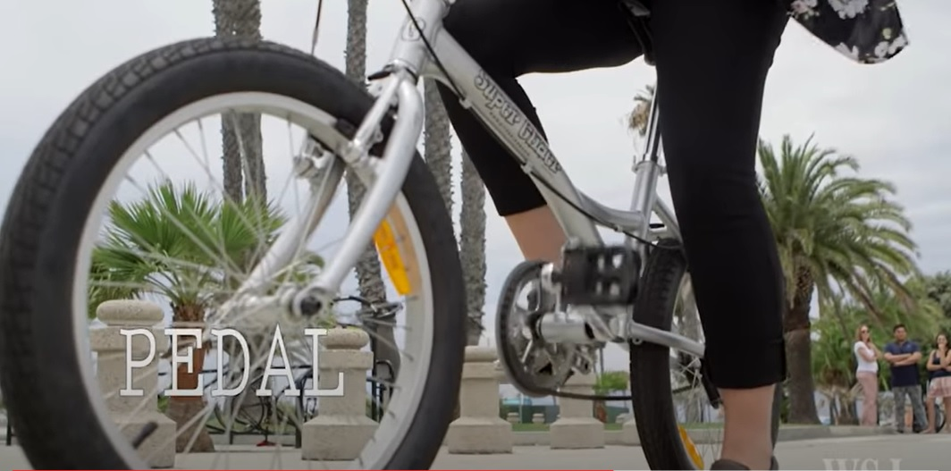
3. (Pedal)
Strengthen the Partnership
Consulting Partnership
Photo Credit: Youtube – WSH How to Ride a Bike for Adults https://youtu.be/NIsDrtPTTd8
Notes:
SAM
We meet with faculty

Slide 15
Consulting Partnership
Consultation
Learner success
Suggestions
Break-it-down
Simplify
Next Steps
Partner
Design
Development
What and Why
How to proceed
Ongoing support
Continuous Improvement
Continuous Improvement
Notes:
SAM

Slide 16
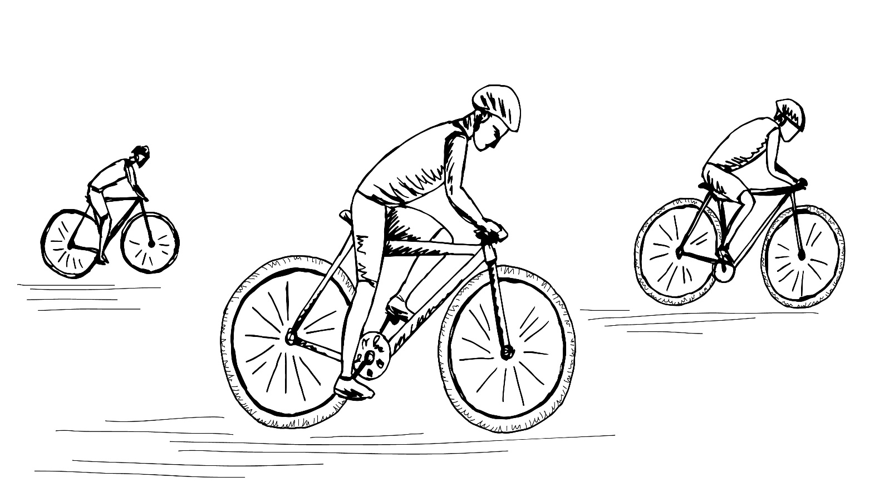
Champion in the Making
Video Credit: Youtube – Serial I: eBike Guru – Just Enjoy the Ride https://youtu.be/vAGrrtDf8KE
Notes:
LEANN
And then hopefully, you will get them to this point
And you will be so proud of (but a little concerned) about the work you have done together
Play to about 57 seconds – “Newspapers are a dying industry”

Slide 17

Q&A and Your Turn
Notes:
BOTH
Q&A Time
Now it is your turn
Sam’s Activity

Slide 18
THANK YOU FOR ATTENDING!
Sam Diomede, Sr. Instructional Designer
S.DIOMEDE@CSUOHIO.EDU
LeAnn Krosnick, Sr. Instructional Designer
V.KROSNICK@CSUOHIO.EDU
Notes:
Thank them
Offer to share any of the materials we shared today, contact us or leave us a card today.

Slide 19
Benefits of a QM Review
National
Standards
Supported by
Research
Collegial
Continuous Improvement Model
Faculty Support
Comprehensive
Institutionally Scalable
Nationally Recognized

Slide 20
CSU QM Coordinator (QMC)
Facilitates the official QM Review Process at CSU:
Supports process to attain official QM course recognition
Is your CSU liaison throughout the review
Upholds the official QM Review Process
Provides CSU oversight for review

Slide 21
Three Main Elements of a QM Review
Professional Development
QM Rubric
Peer Review
“All elements work together to provide a total
solution to reviewing online course design.”

Slide 22
8 General Standards
key areas of quality course design
QM
Rubric
Course Overview & Introduction
Learning Objectives
Assessment and Measurement
Instructional Materials
Learner Activities & Interaction
Course Technology
Learner Support
Accessibility & Usability
Course Design Standards:
QM Review Criteria
42 Specific Review Standards (23 Essential)
Detailed Annotations and
Examples

Slide 23
Begins at CSU
QM Prof Dev
(Information & Professional Development)
QM Training Courses
(APPQMR, IYOC, DYOC, etc.)
Learning about QM and
the Standards
QM Certification
(Peer Reviewer, Master Reviewer, QM Training Course
Facilitator)

Slide 24

QM Review (At-a-Glance)
QM
Peer Review
The QM Review Team * At least one of the review team members must
be external to CSU
Chairperson (QM Certified Master Reviewer)
Subject Matter Expert (QM Certified Peer Reviewer)
Peer Reviewer (QM Certified Peer Reviewer) The reviewers are working
collaboratively with CSU
Reviewing course design against QM Standards
Reviewers are looking for an 85% Met in all review standards and total point value (Essential Standards must meet)
Review Team Chair is our contact person
The review period including Pre-and Post-Review Conference Calls should not exceed 6 weeks
After review - No more than 14 weeks between the submission of the
Final Report and the final amendment, if needed.
Two rounds of amendments may be submitted.

Slide 25
NEXT STEPS
Task | Who | Target Date
Course Pre-Reviewed and Ready | ID and Course Rep
Prepare Master Course for QM Review | ID
Complete Application | ID
Form QM Review Team | ID
Complete Course Worksheet | Course Rep
Begin Review | Review Team
Target Date for Final Report
Target Date for revisions (if needed)

