Slide 1


Quia As an Online Classroom to Improve Teaching and Learning
Nouf Alsuwaida
New Mexico State University
nalsuwaida@hotmail.com

Slide 2
Agenda
What is Quia!
Tools available with Quia.(Activity, Quizzes, Survey)
Discuss how teachers can use Quia to teach their students.
Explain how teachers use Quia to evaluate their students work.

Slide 3
Quia Web
www.quia.com/web
Notes:
Hand out a brochure about Quia…

Slide 4
What is Quia?
Create your own online games & activities
Create your own online tests & assessments
Track student results
View detailed grading reports
Manage classes online
Complete online learning environment

Slide 5
About Quia
Web’s most popular “create-your-own” site
Currently used in over 12,000 schools
Used by teachers in all 50 states
Used in 70 countries world-wide

Slide 6
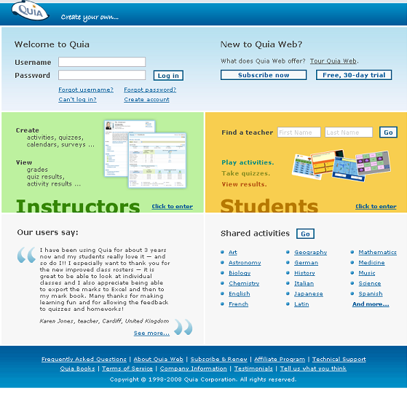
http://www.quia.com/web

Slide 7
Create 16 types of games and learning activities including:
Matching Jumbled Words
Concentration Ordered List
Word Search Picture Perfect
Flashcards Pop-Ups
Challenge Board Scavenger Hunt
Columns Cloze
Hangman Rags to Riches
Patterns Battleship

Slide 8
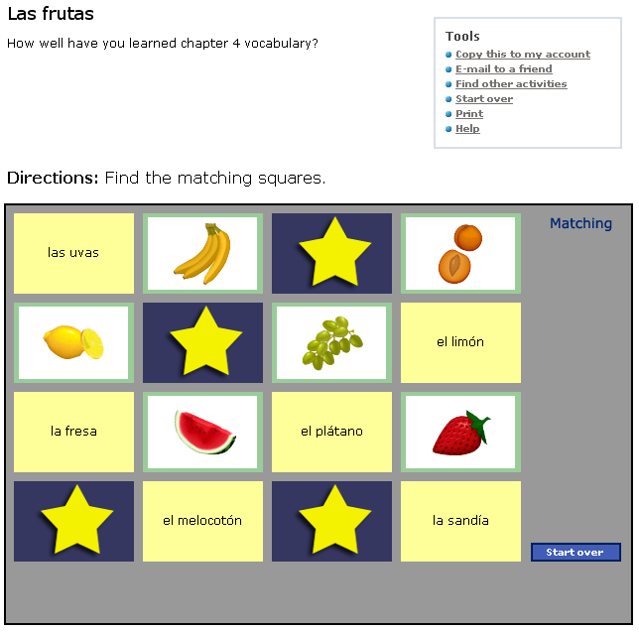
Matching

Slide 9
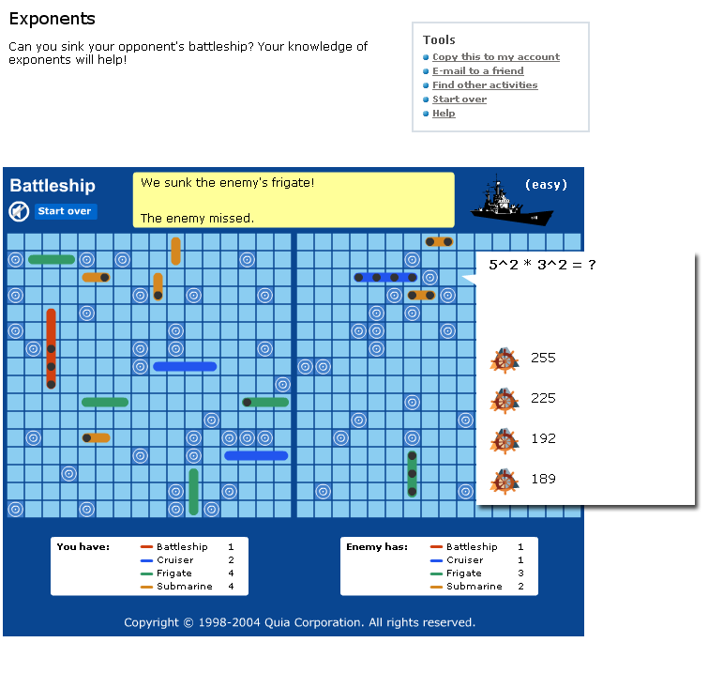
Battleship

Slide 10
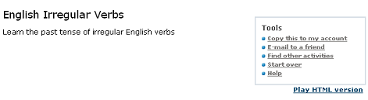
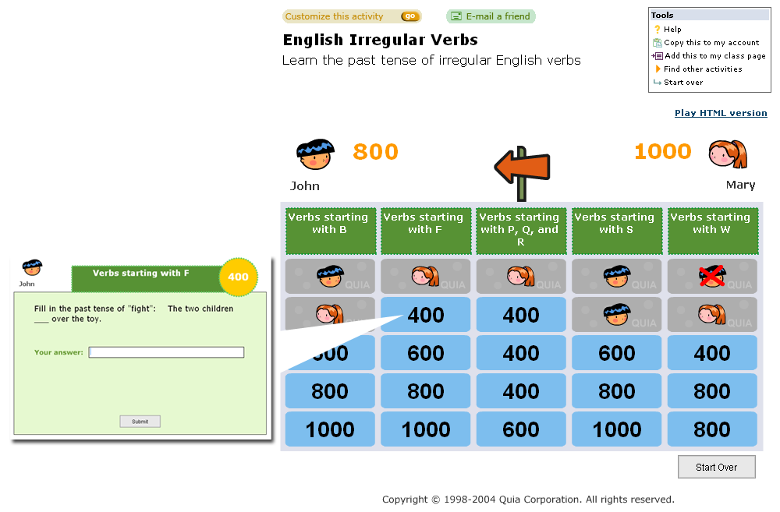
Challenge Board

Slide 11
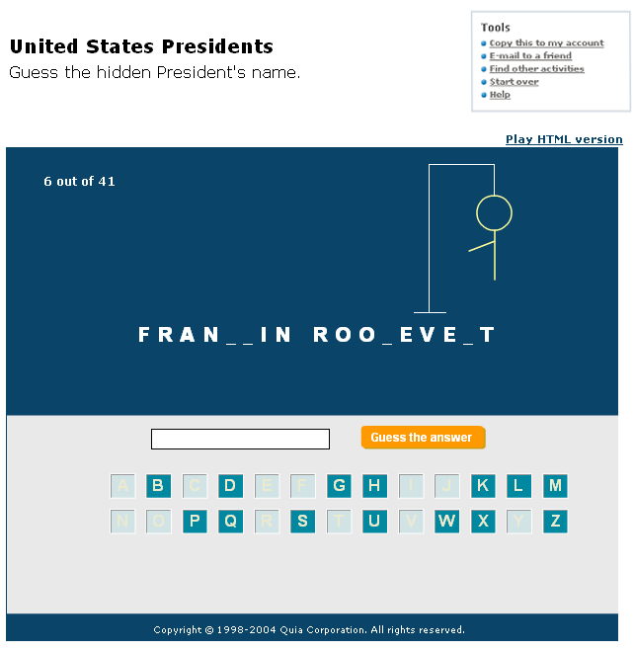
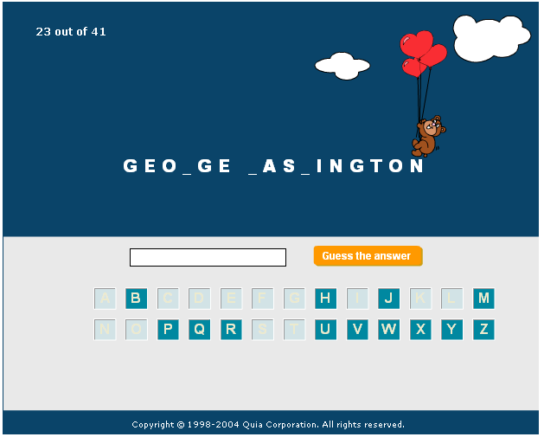
Hangman

Slide 12
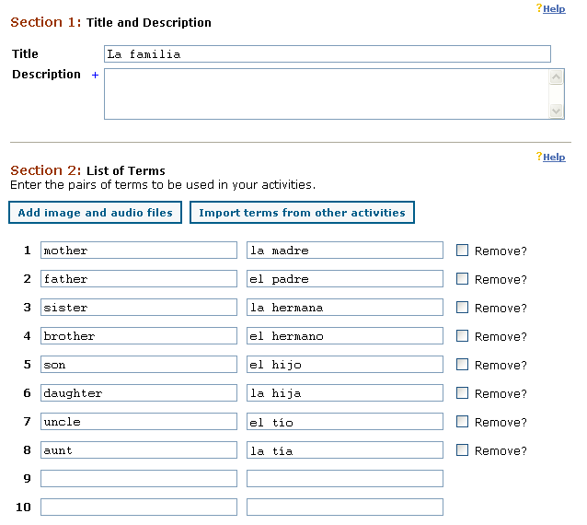
Easy to use templates

Slide 13
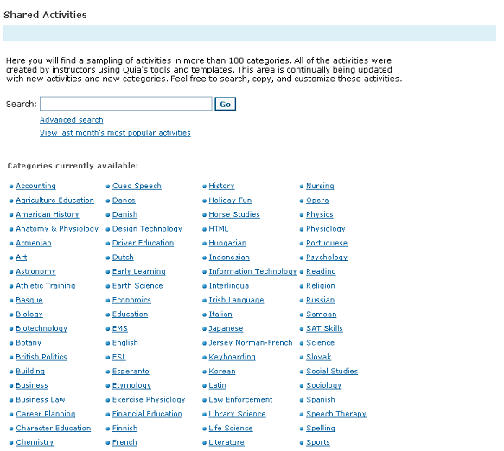
Shared Activities
– Find existing activities in more than 100 subject areas!

Slide 14
Students can access Quia anywhere!
In the computer lab
At home
Individually on classroom computers
On their own lap-tops at 1-to-1 initiative schools
Any computer with Internet access

Slide 15
What is Quia’s Network?
Easily share your games and activities with other teachers
Distribute a test across your department, school, or district
Upload a master student list for your school or district and streamline student accounts
Boost student morale and meet state and district standards

Slide 16
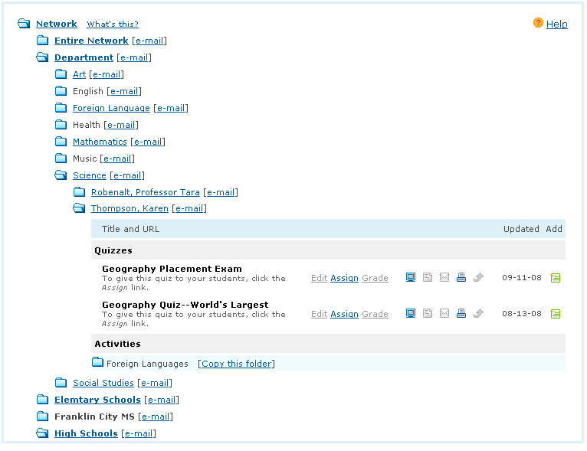
Share Activities and Distribute Quizzes

Slide 17
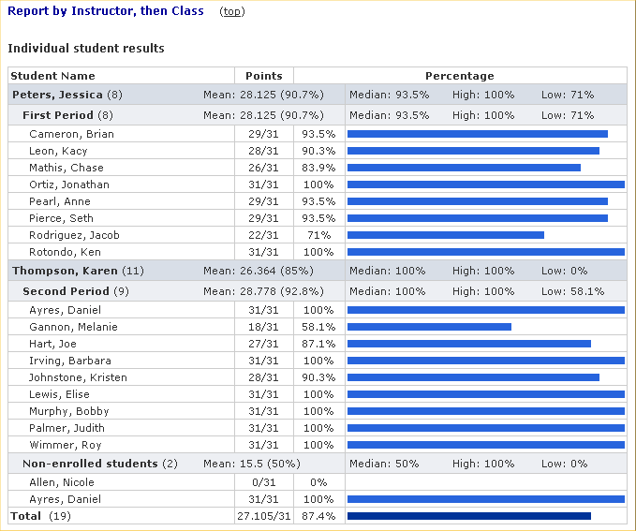
Comprehensive Reports

Slide 18
Classroom Management
Class Web pages
Class roster
Calendars
Surveys

Slide 19
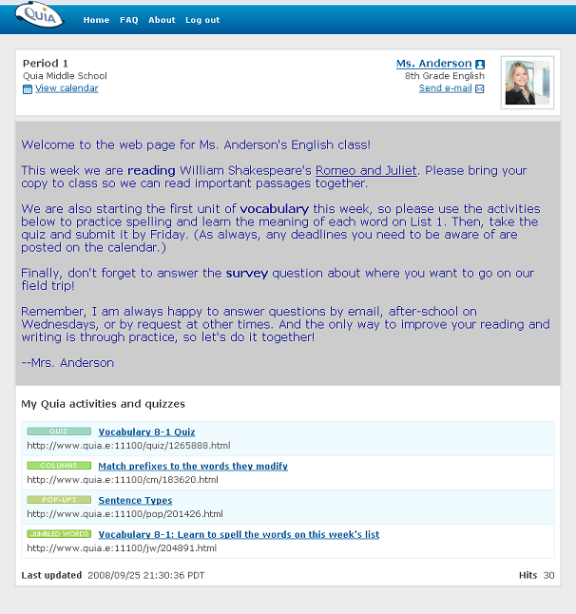
Create a class …
Your assigned activities will display on the class web page!

Slide 20
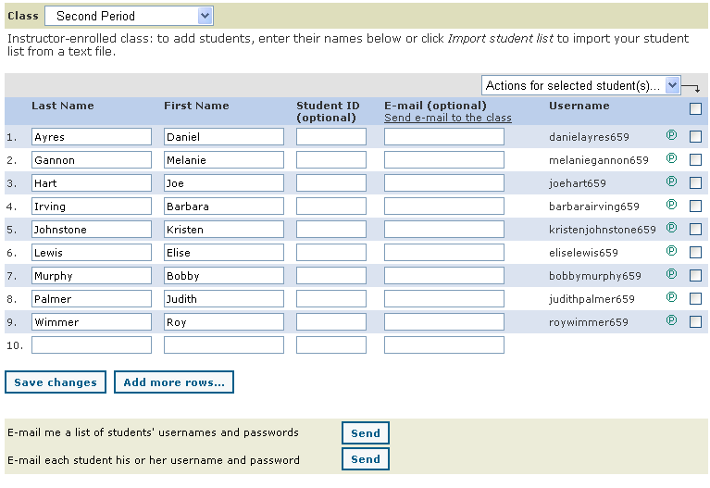
Class Rosters

Slide 21
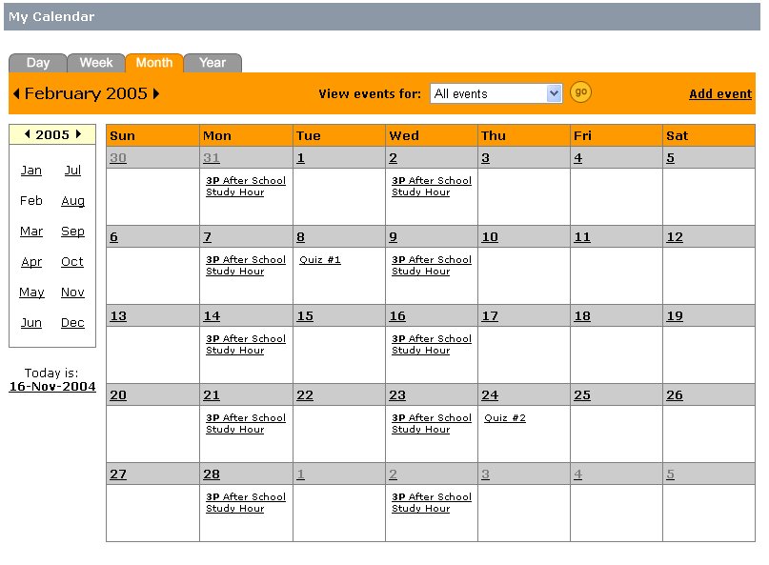
Maintain an online calendar

Slide 22
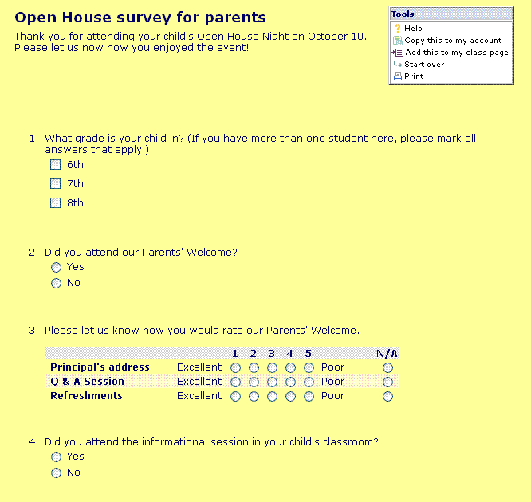
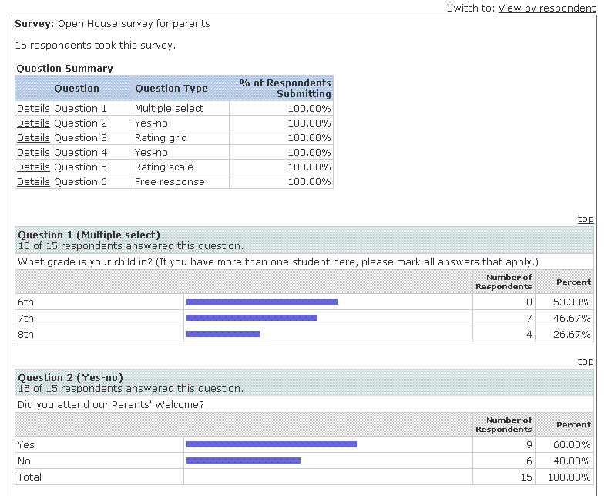
Create an online survey

Slide 23
Group Dissociation
Chat in your groups or with the person/s sitting next to you and answer the questions below:
1-Describe for me what Quia is?
2-Did you use Quia before this session? When and where?
3-Did Quia help you to improve learning in this class? How?

Slide 24
Conclusion (Why Quia?)
Fun & engaging activities
Easy-to-use templates
Automatically graded quizzes save time!
Communicate with students and parents via your profile, class Web pages, a calendar, and surveys
Collaborate with other teachers
It’s affordable

Slide 25
To sign up for a
FREE, 30-day trial
please visit
http://www.quia.com/web

Slide 26

Do You Have any question?

Slide 27



