Slide 1
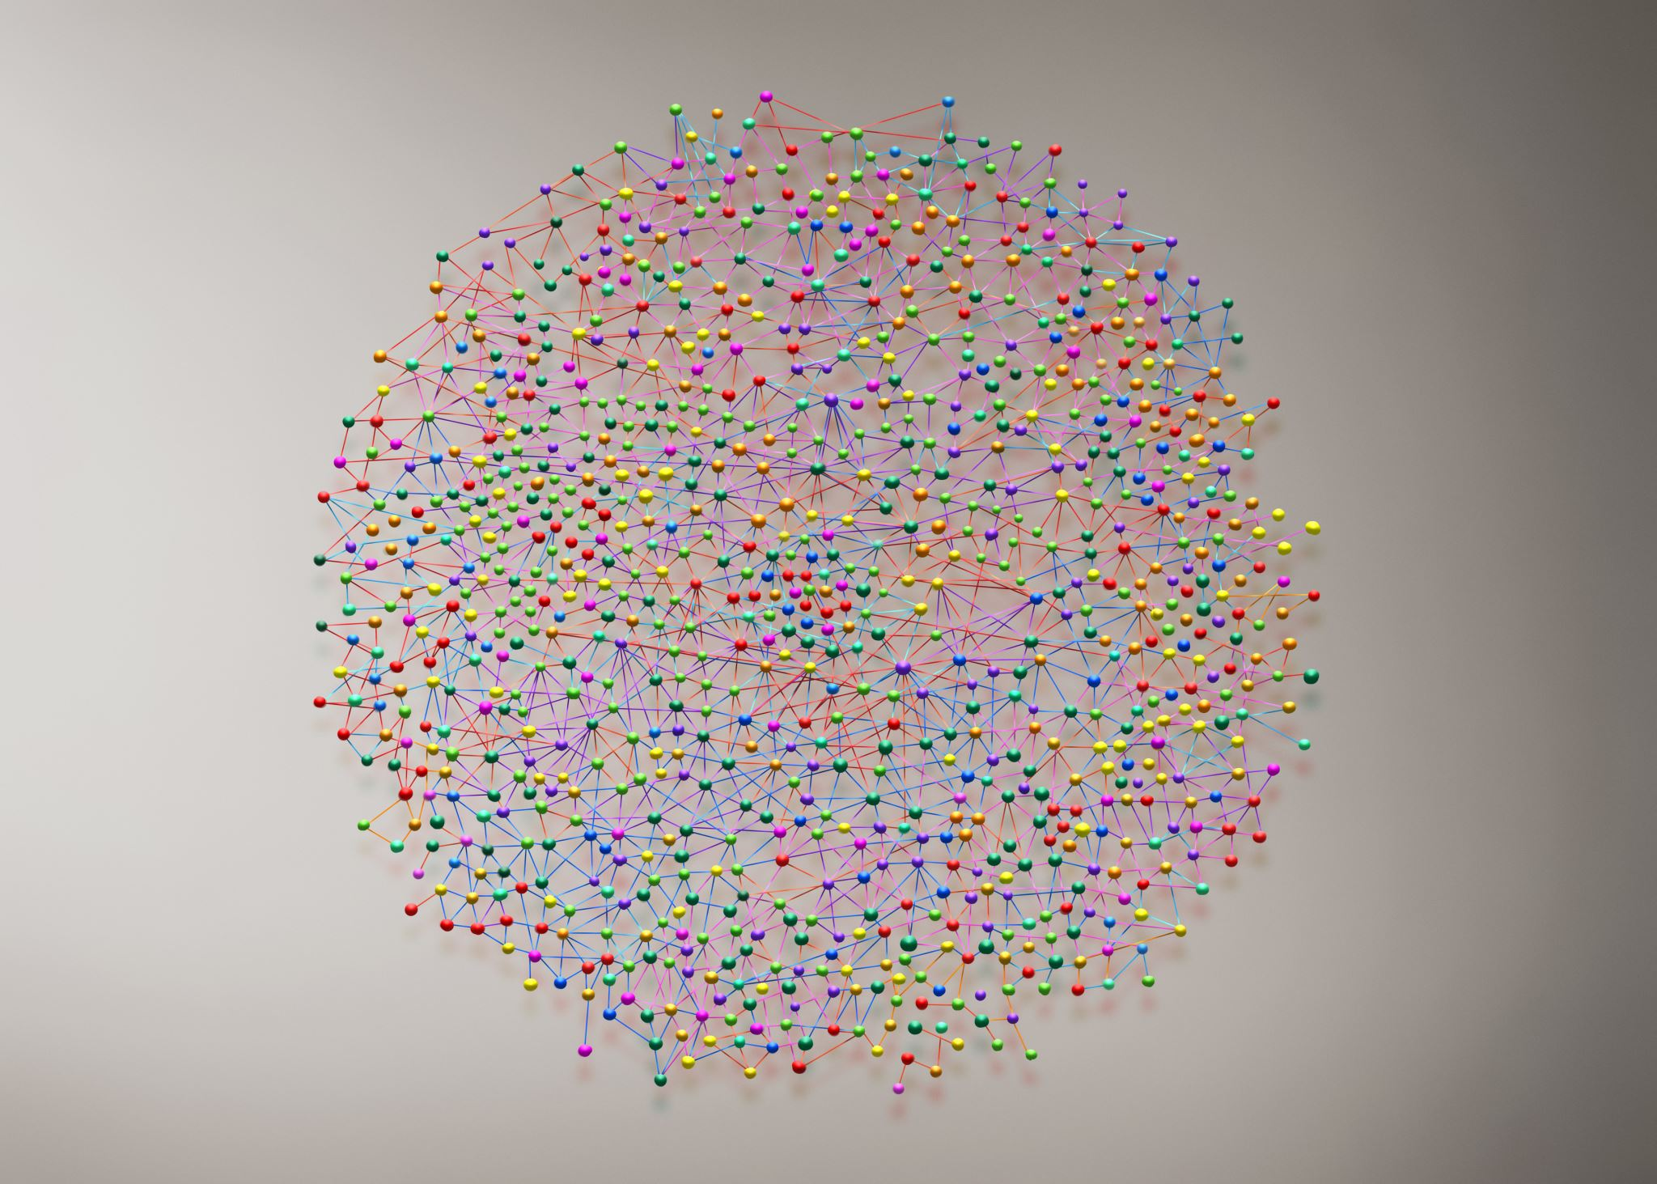
Mapping a Journey Through a Course!
Dr. Deborah Banker
Tarleton State University

Slide 2
Session Objectives
As a result of the discussion and activities in this session, the participant will be able to:
Develop a measurable course module objective
Align assessments, tools, and materials/activities to module objective
Create a Course Map

Slide 3
Availability of materials used in this session
Should be available in the session connection
Alternative location:
www.bankercuin.com
Scroll down to toolbar in middle of page
Click on “Interesting Articles”
Once there, click on “Quality Matters Presentation Handout
Materials”

Slide 4
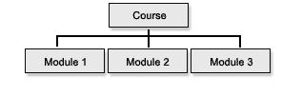
What is a module?
A module can be defined as a unit, chapter, topic, or segment of instruction.
Boise State University. (2020). Using a modular approach to course design. https://www.boisestate.edu/ctl-idea/teaching-with
-tech/primer/using-a-modular-approach-to-course-design/#:~:text=Modules%20Defined,content%20and%20your%20teaching%20style.

Slide 5
What makes an objective measurable and why it is important
It is important to have measurable objectives in order to determine if and when the objective has been achieved.
Kumar, S., Martin, F., Budhrani, K., & Ritzhaupt, A. (2019). Award-winning facultyonline teaching practices: Elements of award-winning courses.
Online Learning Journal, 23(4), 160-180. doi: 10.240549/olj.v23i4.2077
An objective is measurable if it makes a statement using an action verb that the learner can achieve.
Arizona State University. (2020). Bloom’s Taxonomy’s 6 levels of learning. Design for Online Learning Toolkit.
https://teachonline.asu.edu/2012/07/writing-measurable-learning-objectives/

Slide 6
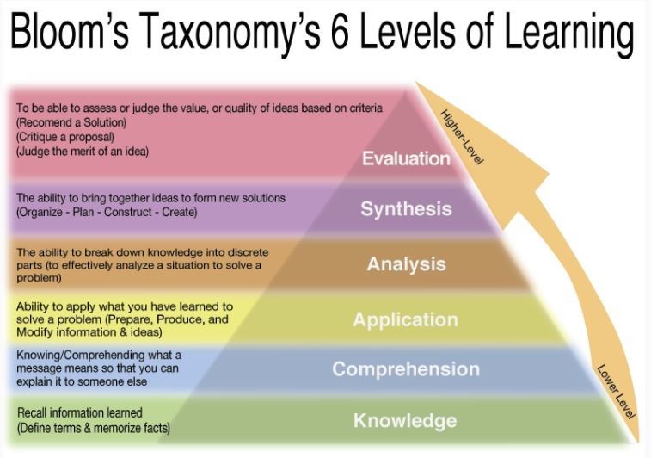
Arizona State University. (2020). Bloom’s Taxonomy’s 6 levels of learning. Design for Online Learning Toolkit.
https://teachonline.asu.edu/2012/07/writing-measurable-learning-objectives/

Slide 7
So, look at a course objective for your course and type or write it into the Course Learning Objectives Handout
Examples:
Have an appreciation for different cultures in a society
Student Learning Outcome | Measurable Yes | Measurable No | Student Learning Outcome Revised
CO#1 - Have an appreciation for different cultures in society |  | X | CO#1 - Describe how different cultures can enrich a society
CO#2 -
Adapted from Dr. Brian Beatty’s Hyflex Delivery Design Worksheet Templates

Slide 8
Now, look at (create/revise) a module level objective for your course
Example:
Understand the impact the Asian community has in New York City
Student Learning Outcome
Measurable Yes
Measurable No
Module 1 Student Learning Outcome | Measurable Yes | Measurable No | Revised Student Learning Outcome
MO#1 - Understand the impact the Asian and Italian communities have had in New York City |  | X | MO#1 - Compare and contrast the Asian and Italian community impact in New York City
MO#2 -
Adapted from Dr. Brian Beatty’s Hyflex Delivery Design Worksheet Templates

Slide 9
Content Resources?
Module 1 Student Learning Outcome | Content Resources | Online Activities | Other Resources
MO#1 - Compare and contrast the Asian and Italian community impact in New York City | Read Chapter 1 & 2 of the textbook
MO#2 -
Adapted from Dr. Brian Beatty’s Hyflex Delivery Design Worksheet Templates

Slide 10
Online Activities?
Module 1 Student Learning Outcome | Content Resources | Online Activities | Other Resources
MO#1 - Compare and contrast the Asian and Italian community impact in New York City | Read Chapter 1 & 2 of the textbook | YouTube Video
MO#2 -
Adapted from Dr. Brian Beatty’s Hyflex Delivery Design Worksheet Templates

Slide 11
Other Resources?
Module 1 Student Learning Outcome | Content Resources | Online Activities | Other Resources
MO#1 - Compare and contrast the Asian and Italian community impact in New York City | Read Chapter 1 & 2 of the textbook | YouTube Video | Attend virtual townhall meeting
MO#2 -
Adapted from Dr. Brian Beatty’s Hyflex Delivery Design Worksheet Templates

Slide 12
Assessment to measure the objective
Module 1 Student Learning Outcome | Assessment
MO#1 - Compare and contrast the Asian and Italian community impact in New York City | Create a chart that compares and contrasts the impact that Asian and Italian communities have had in New York City
MO#2 -
Adapted from Dr. Brian Beatty’s Hyflex Delivery Design Worksheet Templates

Slide 13
Put it all together and Ta-Dah! You have a course map.
Module and Topic | Module Objectives/Outcomes | Course Objectives/Outcomes | Content and Interaction | Assessment
Module 1 The Asian and Italian Influence in America | M0#1 - Compare and contrast the Asian and Italian community impact in New York City (CO#1) | CO#1 - Describe how different cultures can enrich a society | -Read Chapter 1 & 2 of the textbook -YouTube Video -Attend virtual townhall meeting | Create a chart that compares and contrasts the impact that Asian and Italian communities have had in New York City
Module 2
Module 3
Could you start with a course objective/outcome on the left? Absolutely!
Adapted from Dr. Brian Beatty’s Hyflex Delivery Design Worksheet Templates

Slide 14
Questions?
Dr. Deborah Banker
Associate Professor
Child Development and Family Studies
Department of Psychological Sciences
College of Education
Quality Matters Coordinator
Quality Matters Research Colleague
Tarleton State University
banker@tarleton.edu | P: 254.968.9941
Box T-0820, Stephenville TX 76402
ORCID # 0000-0001-6644-4112

