Slide 1
“Using Quality Matters Standards to Standardize Course Syllabi Across Nursing Programs to Improve the Student Experience”.

Slide 2
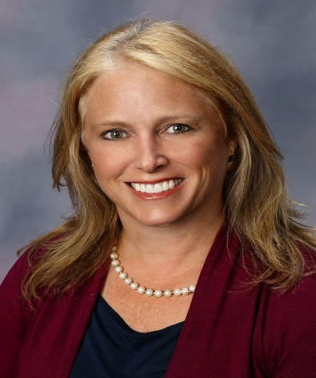

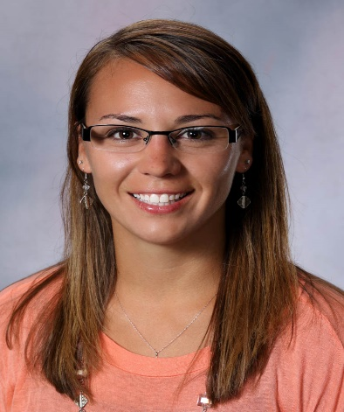
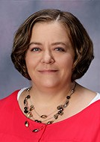
Fort Hays State University
Summer 2017 Nursing Accreditation
Congruency Task Force
Colleen Paramesh DNP, NP-C
Natasha Werth MSN, RN
Kelly Cole MSN, RN

Slide 3

Learner Objectives
Review participants’ syllabi for alignment with the QM Standards.
Apply the QM Standards to improve the student experience with course navigation.
Use the QM Standards to prepare course documents for accreditation

Slide 4
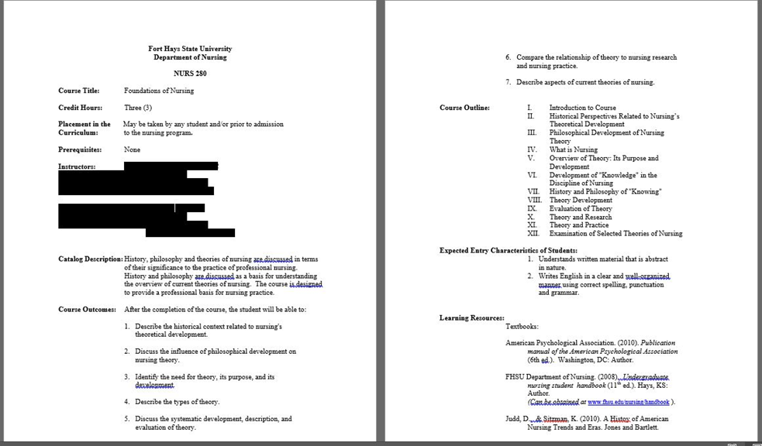
Prior Format

Slide 5
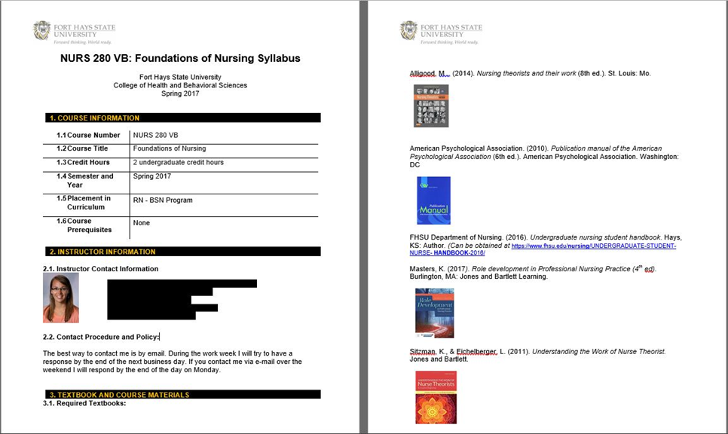
Reviewed and Revised

Slide 6

Task Force Goals
Internal review to prepare for Accreditation
Improve the student experience
Provide ongoing review and improvement of the program
Provide consistent expectations for students and faculty throughout the program

Slide 7



Guidelines Utilized by Task Force
CCNE Standards for Baccalaureate and Graduate nursing education.
QM Standards
FHSU Handbooks

Slide 8

Items Evaluated by Task Force
Syllabi for congruency
Assessment and Teaching Methods
Comparison of program and course outcomes to program specific Essentials and department goals

Slide 9



Syllabi Congruency
Old
QM Standard 8.4
New

Slide 10
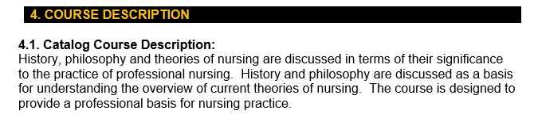
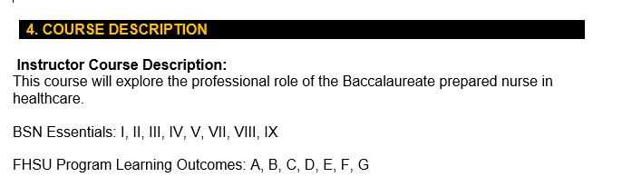
Congruency of Outcomes and CCNE Essentials
QM Standard
2.1, 2.3, 2.5

Slide 11
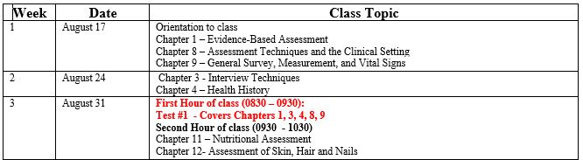
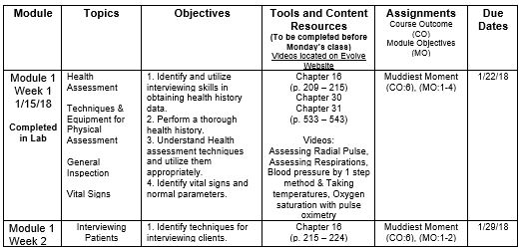
Schedule and Assessment Methods
Old
New
QM Standards
2.2. 2.3, 2.4, 2.5,
3.1, 3.2, 3.3, 3.4, 3.5,
4.1, 4.3, 4.4, 5.4

Slide 12
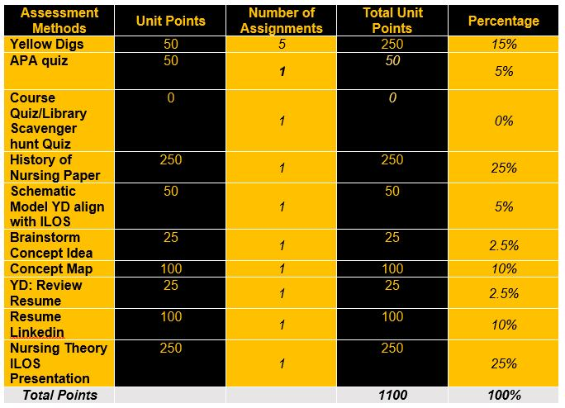
Delineation of Assessment Methods
QM Standards
3.2, 3.3, 3.4, 3.5

Slide 13
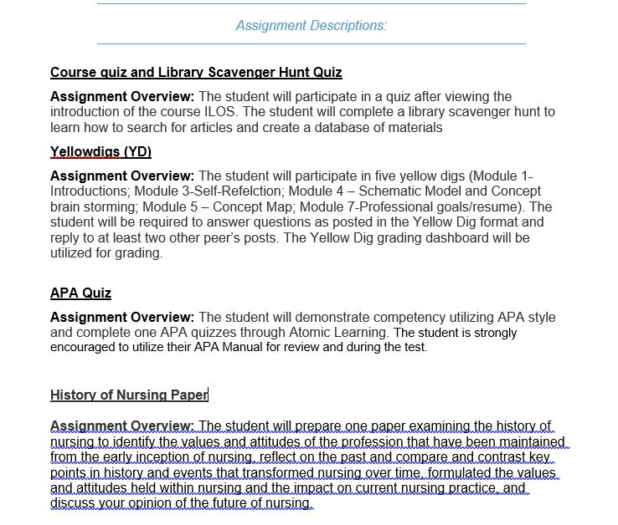

Assessment Expectation Descriptions
QM Standards 3.2, 3.3, 3.5

Slide 14
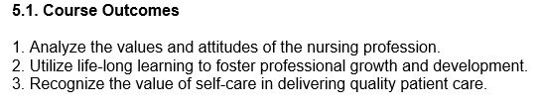
Teaching methods
Connect course outcomes back to program expectations
Provide consistent messaging (expectations, outcomes..)
Show evidence within the course calendar
QM Standard
2.1, 2.2, 2.3, 2.4, 2.5

Slide 15
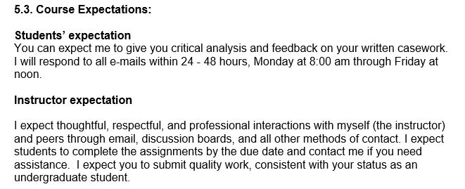
Clarification of Course Expectations
QM Standards
1.3, 1.4, 5.3

Slide 16

Conclusion
Quality Matters standards are applicable across many facets of a course and program
Quality Matters standards provide a student and success focused set of guidelines

Slide 17

Questions?

