Slide 1
A Culture of
Continuous Improvement
Quality Matters Conference
Denver, CO | 3:10 PM - 4:00 PM

Slide 2
Who are we….
Whitney Kilgore
CAO, iDesign
Joanna Shedd
Program Director,
Loma Linda University RN to BS
Diane Weaver
CMO, Coursetune
Notes:
Introductions 5 mins

Slide 3

Alignment Activity
Notes:
5-7 min activity! Hand-written sticky notes. Pass them out and have people stick them on the wall.

Slide 4

THERE HAS
TO BE A BETTER WAY!

Slide 5

Learning Objectives
At the end of this session, participants will be able to . . .
Identify optimal course design and continuous improvement opportunities within your own institution.
Associate measurable course & program outcomes to assessments in support of foundational alignment.
Visualize the alignment of learning objectives and map to course goals.
Notes:
Diane 1-2 min

Slide 6

LLU - RN to BS Case Study
Most courses were a document depository
Some courses were obese
Most courses were difficult to navigate
No consistency between courses
Poor student experience
Some courses did not align the objectives/student learning outcomes
1
2
3
4
5
6
Notes:
12 mins
Whitney to introduce Joanna
Joanna’s story of RN to BS

Slide 7
Course Design & Development
Introduce course development guide and/or checklist, used throughout the design process
Overview
Course Updates
Develop action plan, address all action items, reevaluate course
Program Review
Assess program outcomes, all course and modules level outcomes, and assessments for alignment
Program/Course Redesigns
Redesign courses to address gaps identified in the program review
Notes:
10 mins

Slide 8

Quality Throughout Course Design & Development
Learning Architect and QA Leader will introduce the quality framework early in the development cycle (after the kick-off meeting) and showcase the self-check tool
Before the course is reviewed by the iDesign QA team the Learning Architect will revisit the framework and review the self-check option with the SME/faculty
iDesign’s QA team performs the iReview process (using OSCQR & TOTE)
iDesign’s QA Leader will present findings with action plan: what needs to be addressed before the course runs and what can wait for the course update

Slide 9

Hypothetical Timeline for Course Development + Update
Assuming 12-week development timeline + 8-week course
September
Course design and development begins
January
Course is taught
June
All action items are addressed within year
SEPT | OCT | NOV | DEC | JAN | FEB | MAR | APR | MAY | JUN | JUL | AUG
December
Quality Review
May
Course delivery experience conversation based on data within 30 days of teaching

Slide 10

Course Update
The Learning Architect and the QA Leader discuss with the instructor overall impressions and experiences of the course when it was taught, review course data, student input and design the action plan for course update
Learning Architect and Instructional Technologist address all action items
QR leader performs an updated OSCQR & TOTE review

Slide 11
Hypothetical Timeline
Building Your Foundation
Course Development
Program Review
YEAR 1 | YEAR 2 | YEAR 3 | YEAR 4
Course
Update
Program/
Course Update

Slide 12

Program Review
Perform gap analysis across all program, course and module level learning objectives and assessments.
Produce program level review report that provides an action plan for continuous improvement.

Slide 13

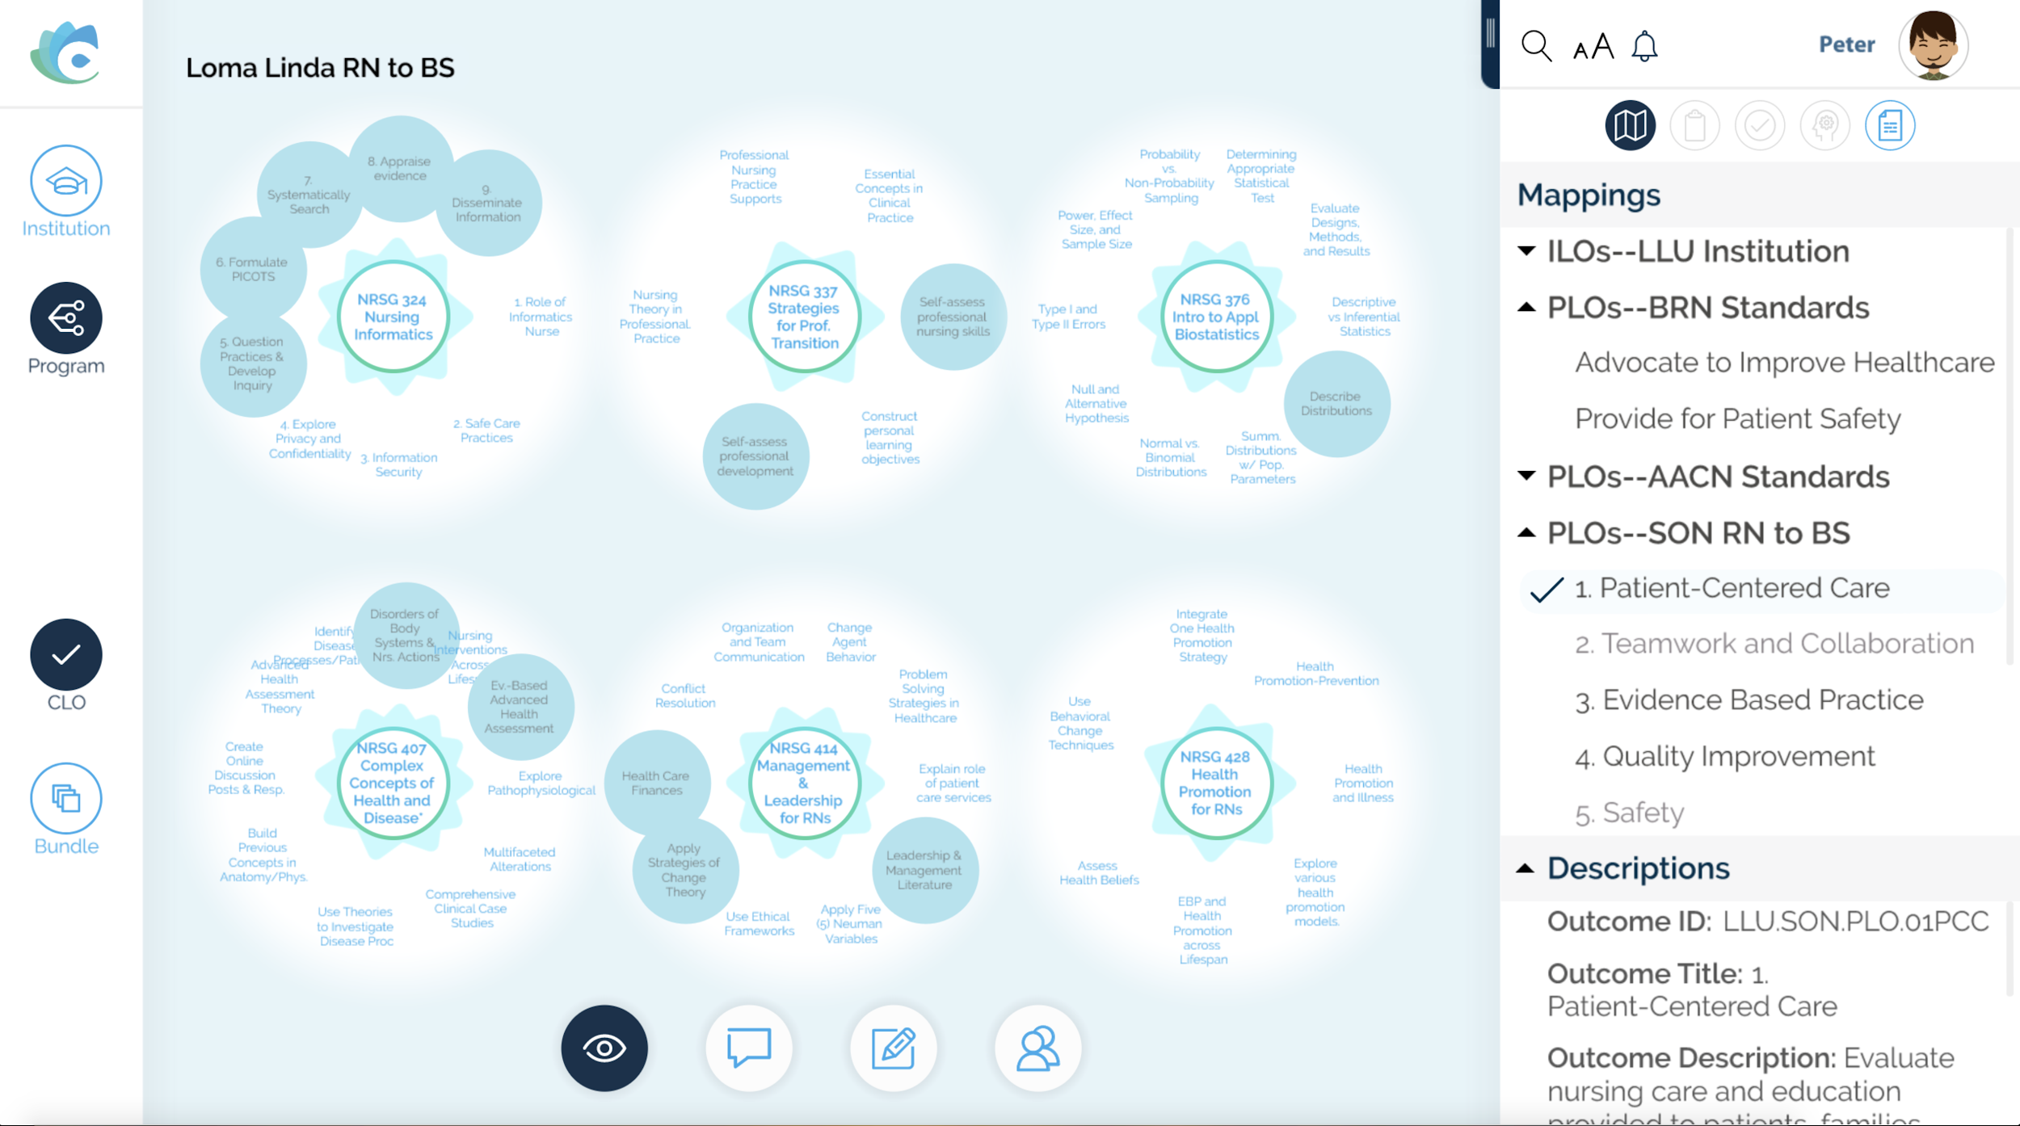
Example:
Loma Linda Nursing Program Alignment

Slide 14
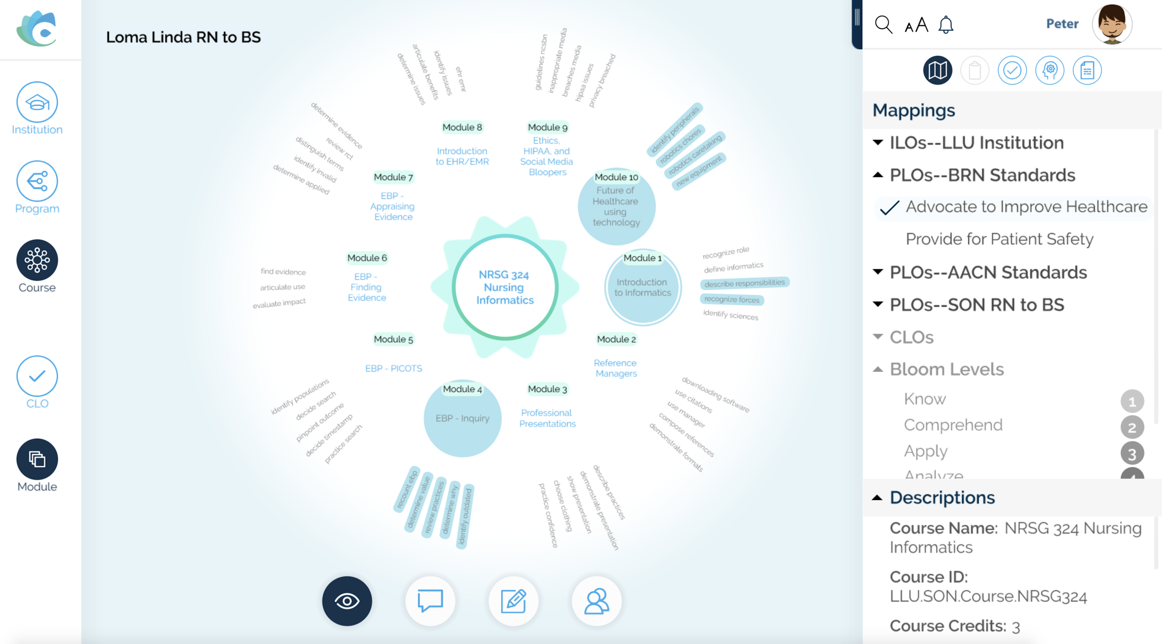
Example:
Loma Linda Nursing Course Alignment

Slide 15
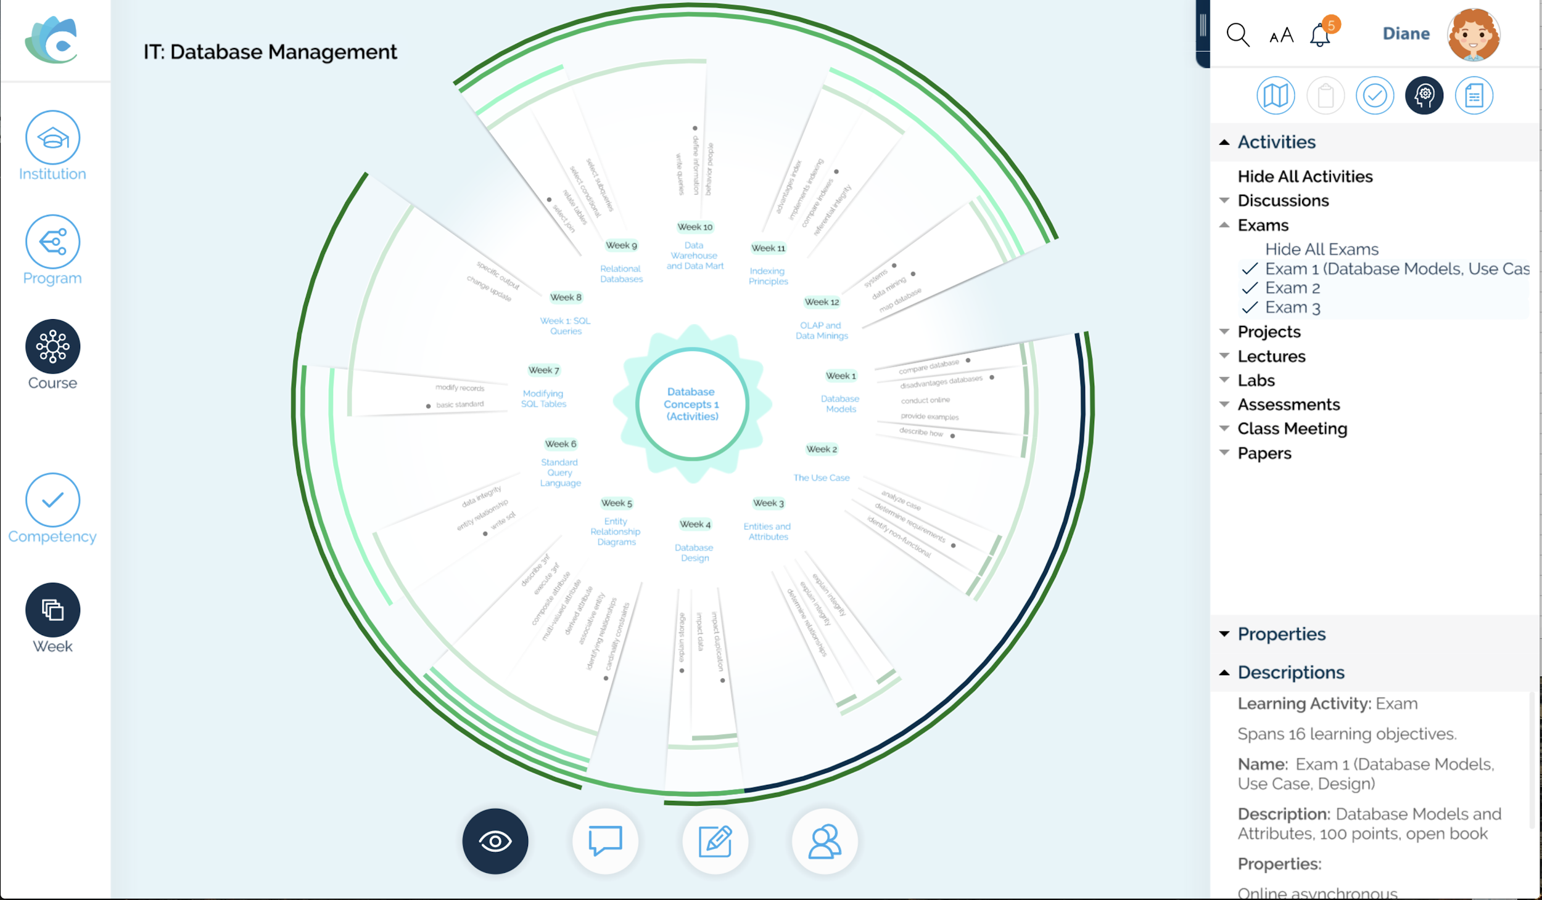
Example:
Loma Linda Nursing Assessment Alignment

Slide 16

Program/Course Update
Update and address items identified in the Program Review to make progress towards documentation and measurement of learning and alignment.

Slide 17

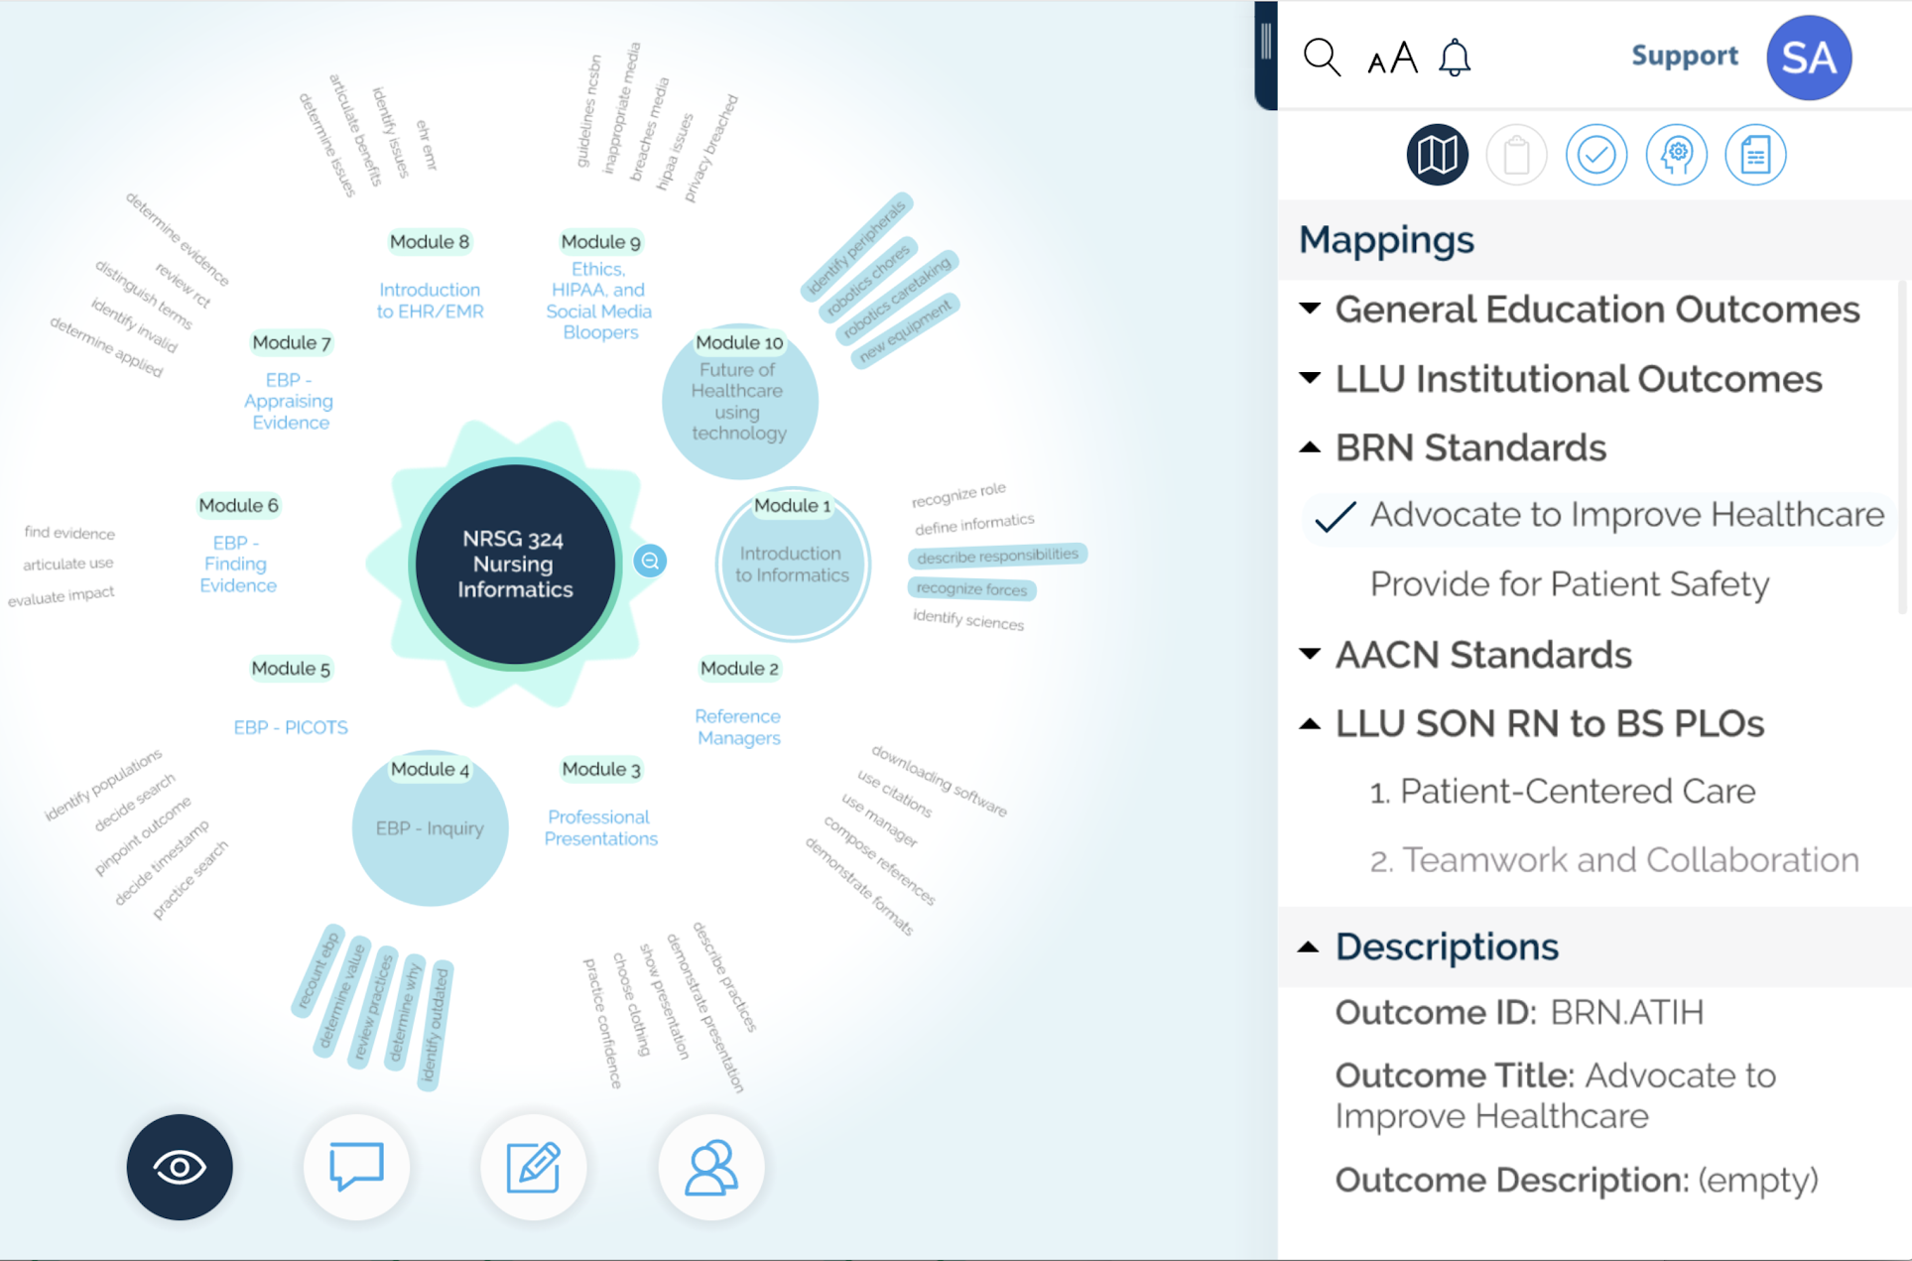
LLU - Example in Coursetune
Associate measurable course and program outcomes to standards in support of foundational alignment.
Visualize the alignment of learning objectives and map to course goals.
Notes:
Nursing Informatics is the course to dig into!
5-10

Slide 18
Identify your own opportunity….
Mentimeter
What program at your own institution would benefit from redesign and continuous improvement?
Notes:
2 mins

Slide 19
THANK
YOU!
Notes:
5-10 mins

