Slide 1
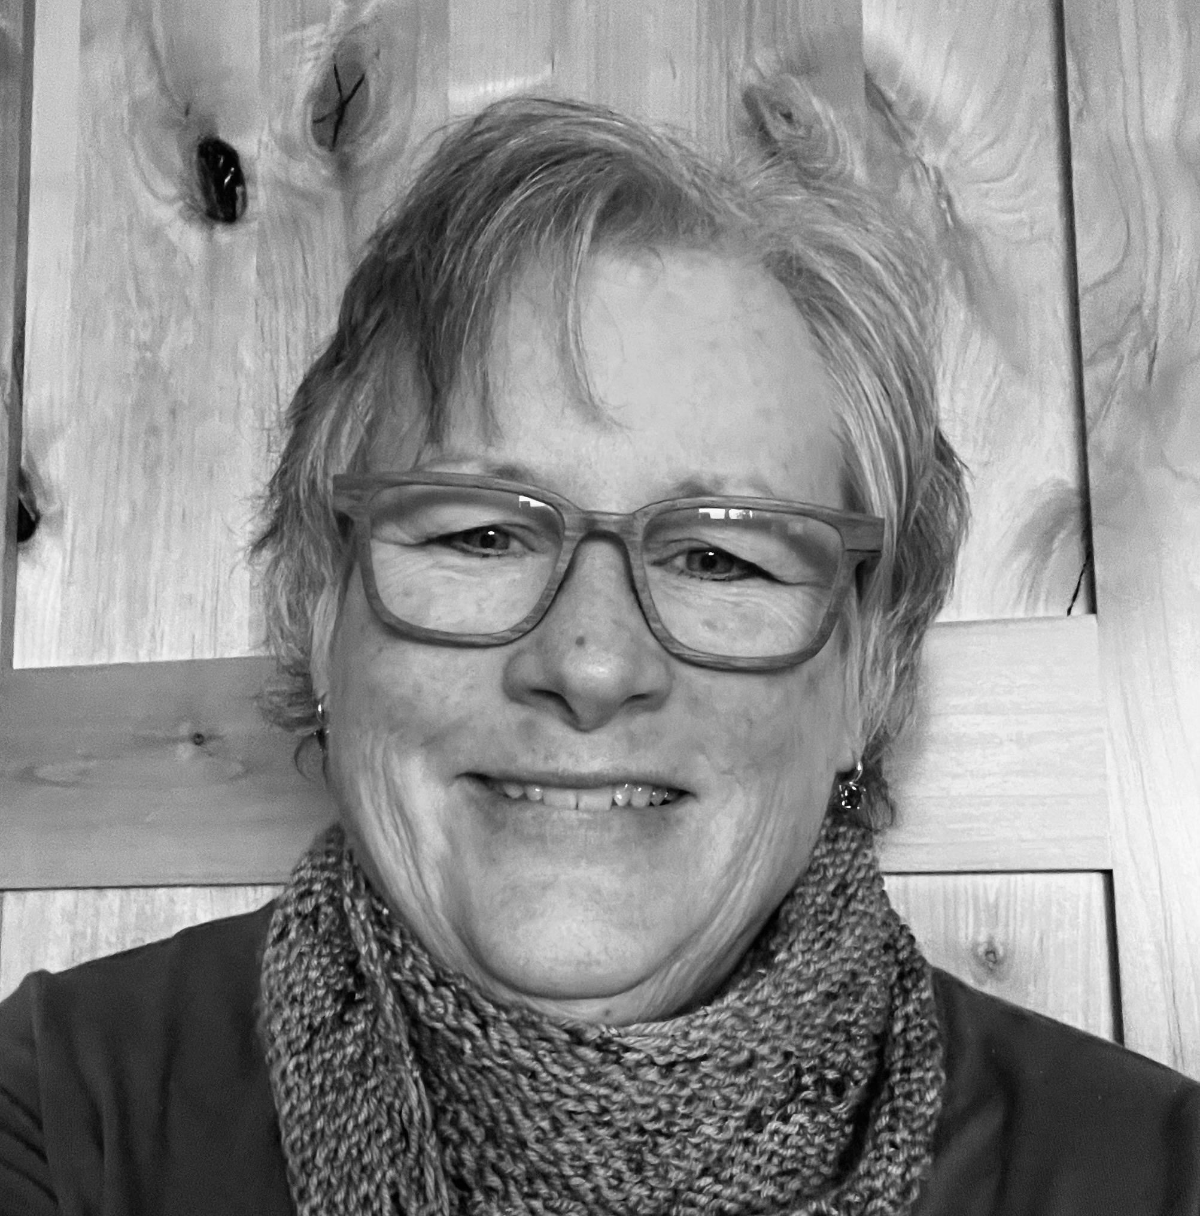
Quality Courses by Design:
Making Change
One Course at a Time
Dr. Rebecca Graetz

Slide 2
Outcomes
Describe the importance of professional development in promoting quality course design and identify a well-structured program.
Summarize Revision Letters of Agreement (RLA) process, including the purpose of RLA and how changes are tracked to meet RLA requirements.
Develop skills for collaborating with colleagues to improve course materials, and for giving and receiving feedback in a constructive and professional manner.

Slide 3

What is QCD?
A five-week asynchronous professional development opportunity for instructors to learn out to humanize teaching online as well as designing a quality course.
Instructors are students in the course.
Notes:
History of QCD from 2018 to present

Slide 4
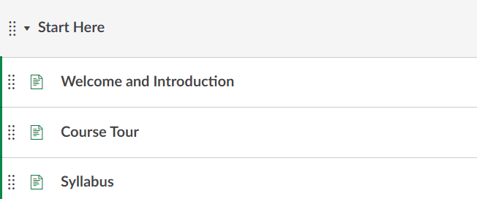
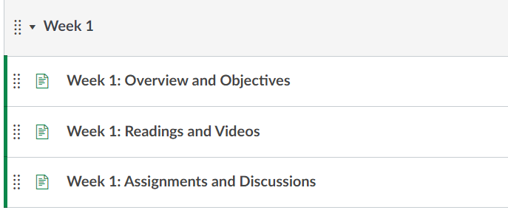
Course Structure

Slide 5
Subject Areas
Week 1: Course Planning and Design Basics
Week 2: Effective Assessments and Learning Activities
Week 3: Accessibility and Course Design
Week 4: Building Your Canvas Course
Week 5: Teaching and Facilitating using Digital Pedagogy

Slide 6




Assignments

Slide 7
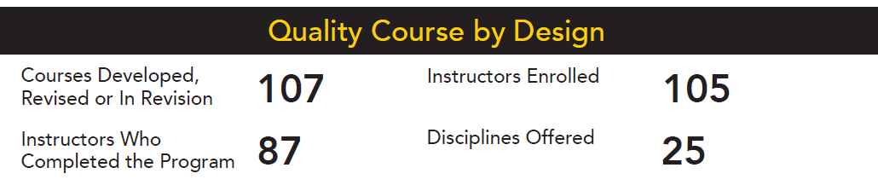
January 2022 to October 2023
Impact of QCD

Slide 8

Revision Letters of Agreement
Revision Letters of Agreement (RLA) are legal documents that include funds to be disbursed as well as checkpoints on due dates to get the work done. DocuSign was the tool used for tracking RLAs.

Slide 9
Checkpoints
Before course revision
Discuss course revision needs with instructional designer
Checkpoint #1
Start Here Module must be completed in Canvas to include the Welcome and Introduction page, Course Tour and Syllabus pages.
Checkpoint #2
All Canvas Modules to be created with Weekly Learning Objectives and Weekly Course Overviews

Slide 10
Checkpoints
Checkpoint #3
All readings, videos, assignments, and assessments will be created in Canvas AND meet accessibility standards.
Completion Date
The course is completed and has passed an internal review for quality.

Slide 11
Ownership of Course
Course materials developed as part of this agreement will remain accessible to OCE (Online and Continuing Education) and available to any instructor who might be later assigned to teach the course. With the approval of the department chair, OCE commits to offer the instructor who revises a course the opportunity to teach it for at least the first three course offerings.
UW System Administrative Policy 191, “Copyrightable Instructions Materials Ownership, Use, and Control” identifies situations in which development of copyrightable instructional materials occurs and provides guidance about ownership of these materials. The payment of a revision stipend falls under “substantial” institutional support.

Slide 12

Payment Structure
Successful completion of QCD: $500
Revision of Course: $1500
Development of 7 Week Course: $2,500
Development of 14 Week Course: $4170

Slide 13
Tracking Revisions
MS Excel used for tracking revisions
Saved in SharePoint with multiple users
Great for documenting revision progress and payment for course revisions

Slide 14

Accelerated Nursing Program Cohort
Accelerated BSN online with 52 credits done in 12 months
One on campus residency
728 clinical hours through 6 rotations
Requested to take QCD as a cohort to learn more about accessibility

Slide 15
What’s next?
UWO is $18K in deficit for Fiscal Year 2024
250 layoffs and retirements starting January 2024.
Division of Online and Continuing Education is being dismantled with 20 layoffs.

Slide 16
Contact Information
Dr. Rebecca Graetz
Sr. Online Instructional Design Consultant
QM Coordinator/Course Review Manager
www.linkedin.com/in/rebeccagraetz

