Slide 1
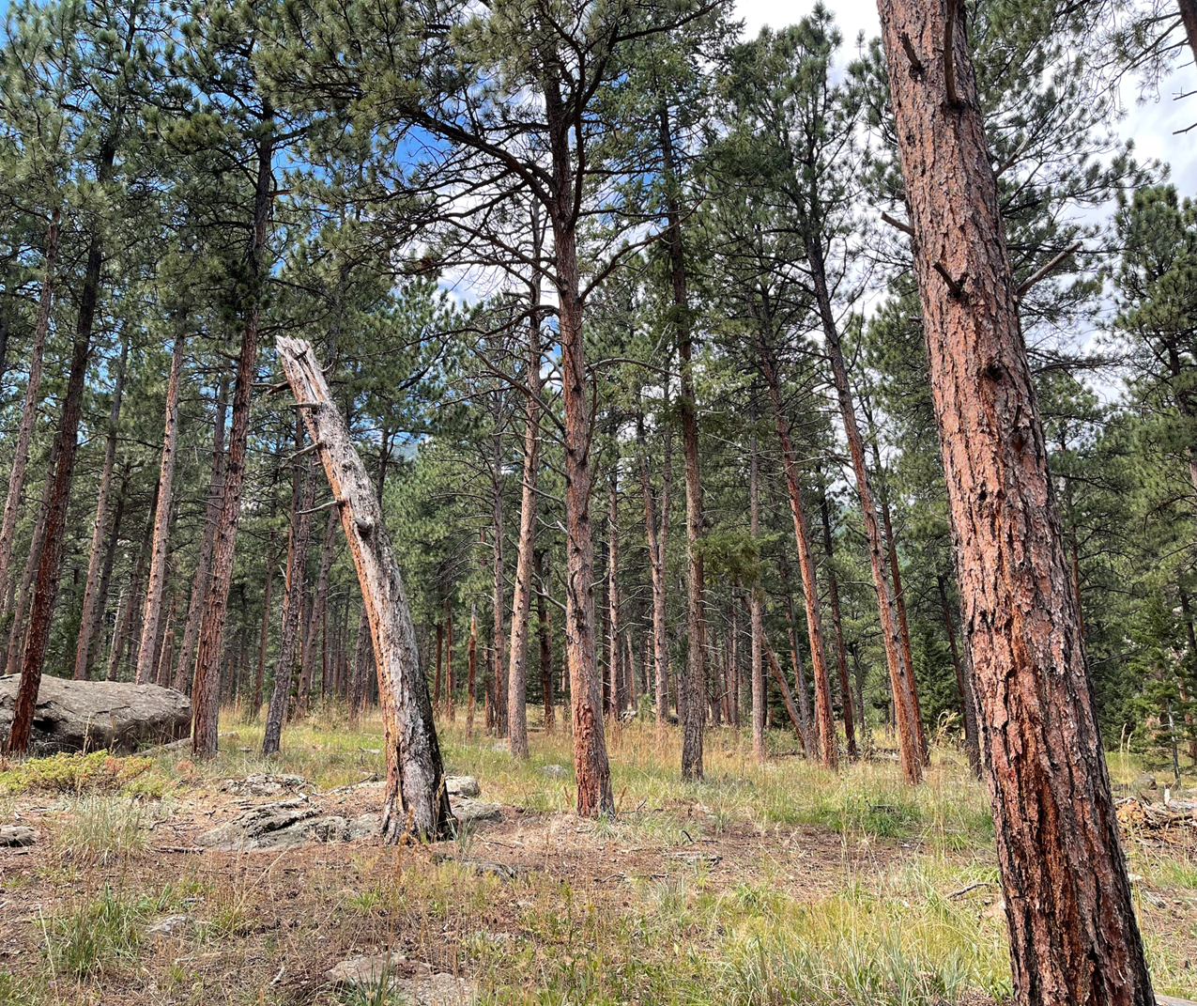
Quality Assurance to Benchmarking-can we do it?
Karen Gorton, PhD, RN, FNP, MS
Oksana Wasilik, PhD

Slide 2
Who are you?
What is your work setting and role?
What do you want to learn from this presentation?

Slide 3
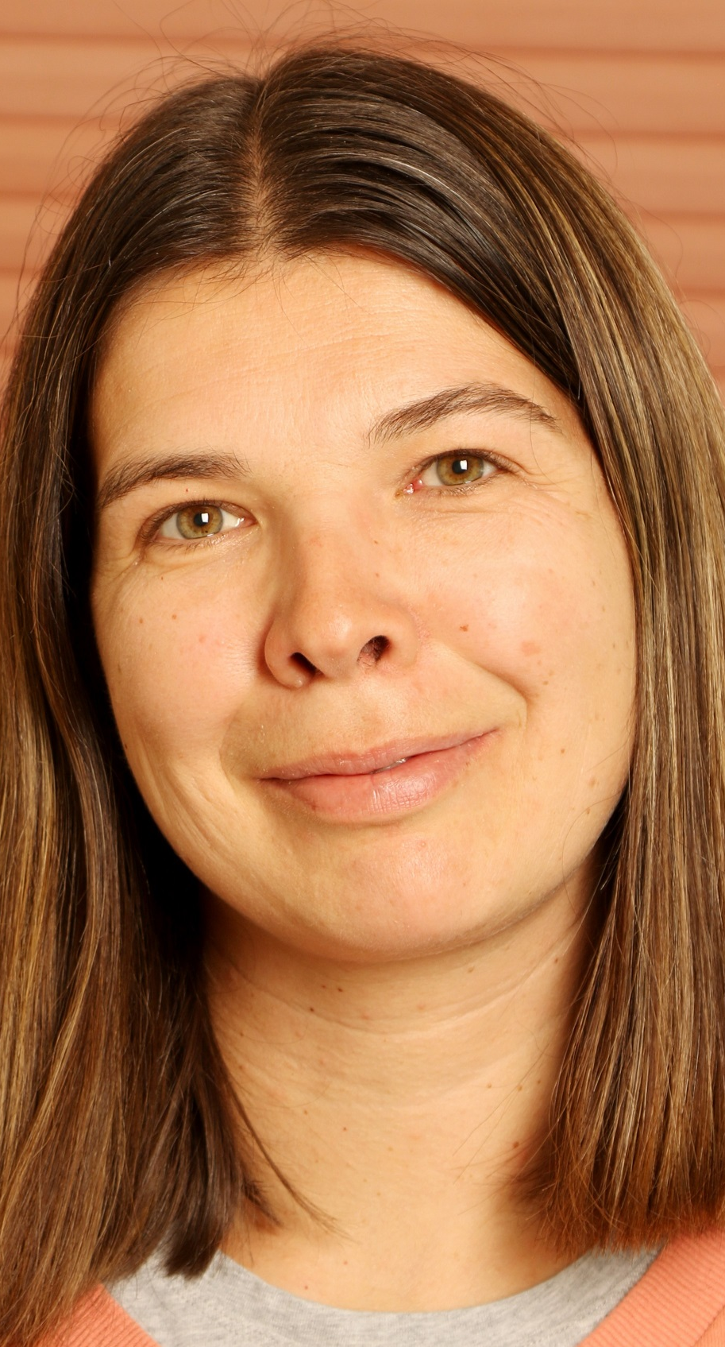
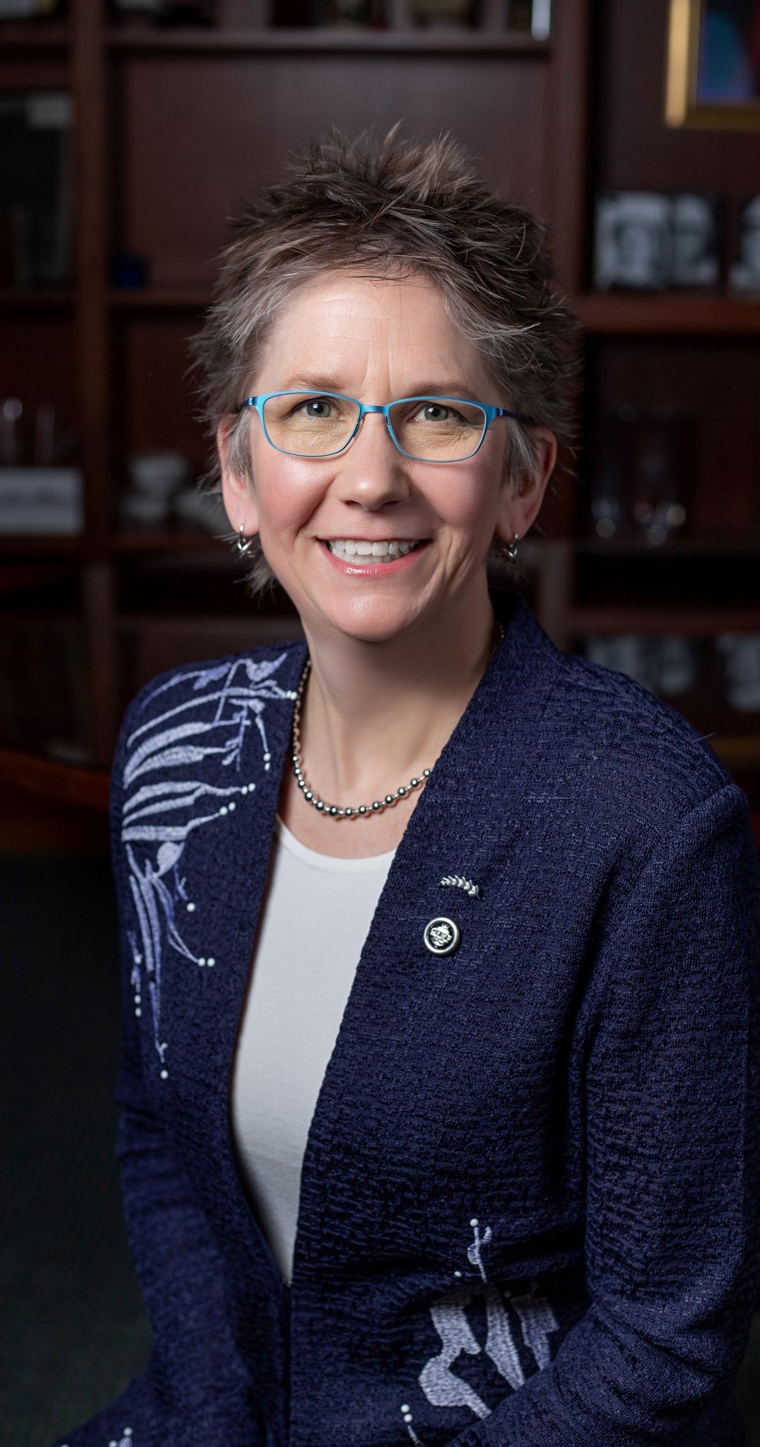
Who are we?
Karen
Oksana

Slide 4
Learning Objectives
Describe one process of curricular update as required by accreditation, using QM standards.
1
Compare and contrast strengths and weaknesses of the curricular revision process.
2
Analyze the proposed process and provide input to the presenters on the pathway to programmatic QM certification
3

Slide 5
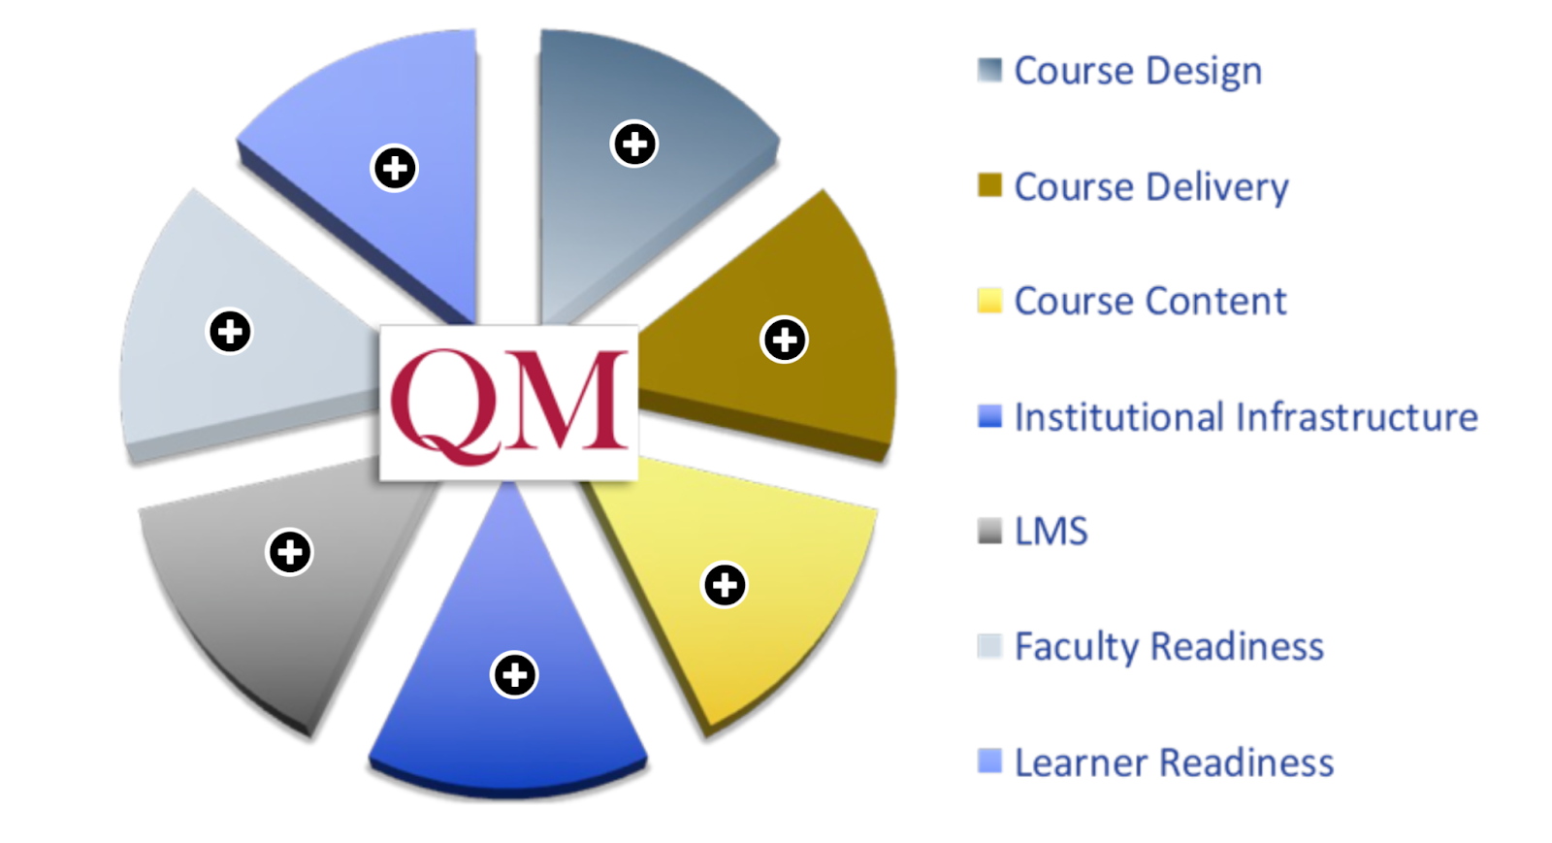
Theoretical Framework: The Online Learning Quality Pie

Slide 6
Why are we considering QM across the curriculum?
Nursing
  External accreditation
    New Standards
    New Essentials: Core Competencies for Professional Nursing Education
  External stakeholders
    Clinical practice sites
    Communities
University
  New Vice Provost for Online & Continuing Education
  Online and Digital Learning Team with improved support and access
    Hired 3 new instructional designers in 2024 (100% increase)
  Focus on Quality of Online and Digital Learning

Slide 7
The People
Nursing faculty
  Novice educators, expert clinicians
  Teaching in BSNc programs
  Spring 2024
    Curricular mapping to meet new accreditation standards
    38 % of our faculty have taken QM training overall
      63% of Undergraduate faculty
    New Program outcomes
  Two QM reviewers in the nursing faculty

Slide 8
The People
Instructional Designers
Elbogen Center for Teaching and Learning
University – Vice Provost for Online and Continuing Education
Fay W. Whitney School of Nursing
  Dean
  Associate Dean

Slide 9
The Process: Curriculum Redesign / Mapping
Current courses mapped in Fall 2023 to new accreditation standards
  Gaps identified
New program learning outcomes created during Winter 2024
Courses updated in Spring 2024
    All courses with new course learning outcomes
    Some courses with new course descriptions
New courses mapped in Spring 2024 to new accreditation standards
  Gaps identified
  Gaps addressed
Revised courses to college and university curriculum review

Slide 10
Alignment between CCNE and QM Standards
CCNE Standard III | QM Standards
Program Quality: Curriculum and Teaching-Learning Practices – 12 Key Elements | SRS 4.4. Instructional materials represent up-to-date theory and practice in the discipline
 | GS 5. Learning Activities and Learner Interaction
 | GS 2 – Learning Objectives (Competencies)
 | GS 3 – Assessment and Measurement

Slide 11
The Process: Faculty Professional Development
spring 2024
Eight nursing faculty completed the QM TOC in spring 2024
7 workshops
Cost
Time commitment
2024–2025
Three nursing faculty participating in Teaching Online Learning Community in fall 2024- spring 2025
Reading Small Teaching Online book in the fall
Implementation in the spring

Slide 12
The Process – Course Redesign
Pilot course going through updated design process
  Collaboration with Online & Continuing Education Vice Provost's office
  Collaboration with Instructional Designers
  Collaboration with Librarians
Nine of the BSN completion courses are scheduled for the updated design process in Spring 25

Slide 13
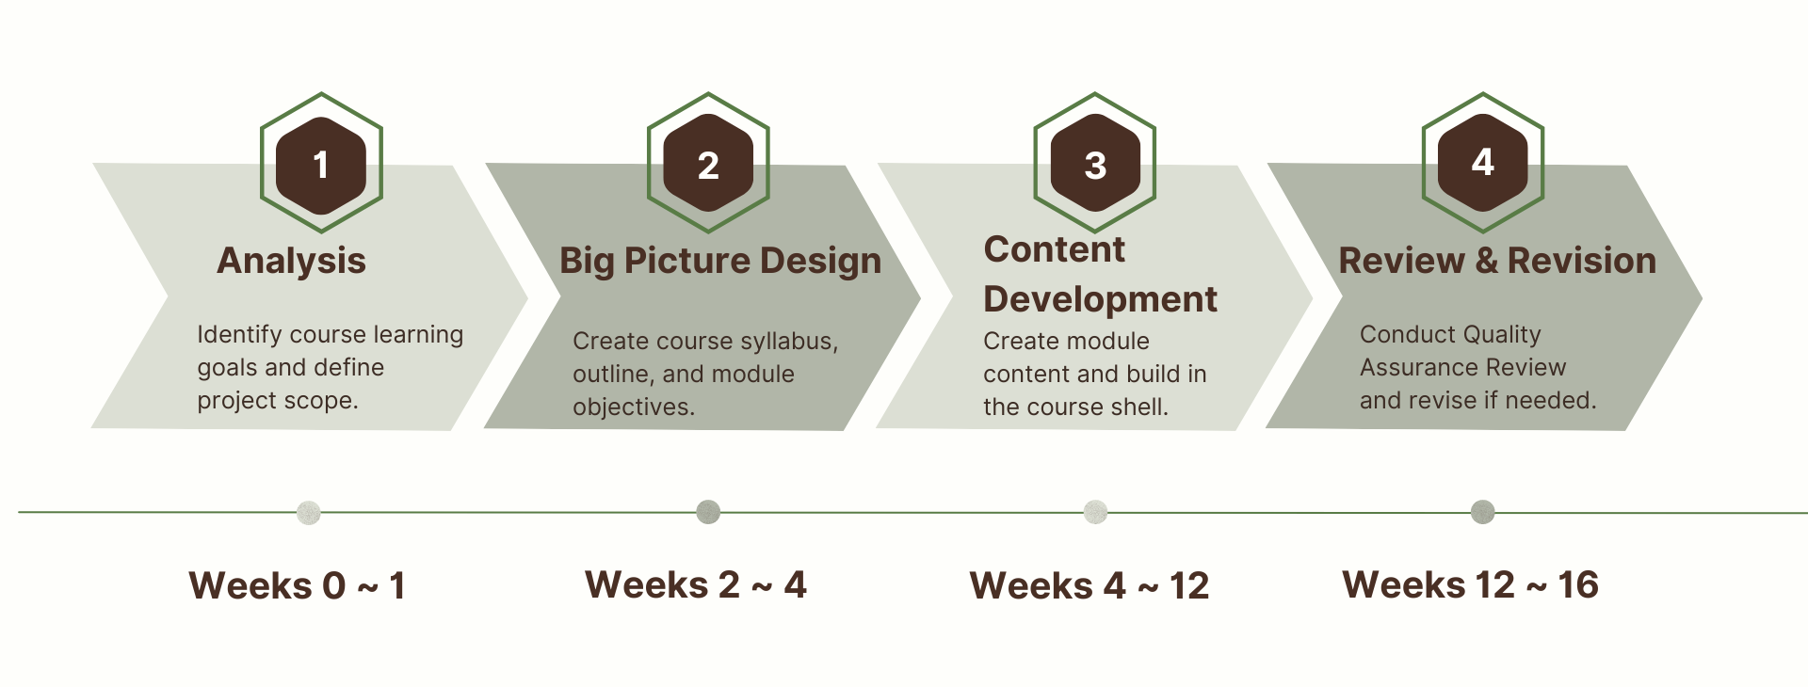
Four Design Phases
Retrieved from https://www.uwyo.edu/ctl/divisions-and-initiatives/online-and-digital-learning/online-course-design-cycle.html

Slide 14
Curricular Redesign Process: Audience Feedback
Strengths
Weakness

Slide 15
Next steps
Complete the update for all 13 BSNc (Bachelor of Science in Nursing Completion) courses to launch in Fall 2025
? QM Certification ?
  Individual Courses
  Whole Program
QM Benchmarking

Slide 16
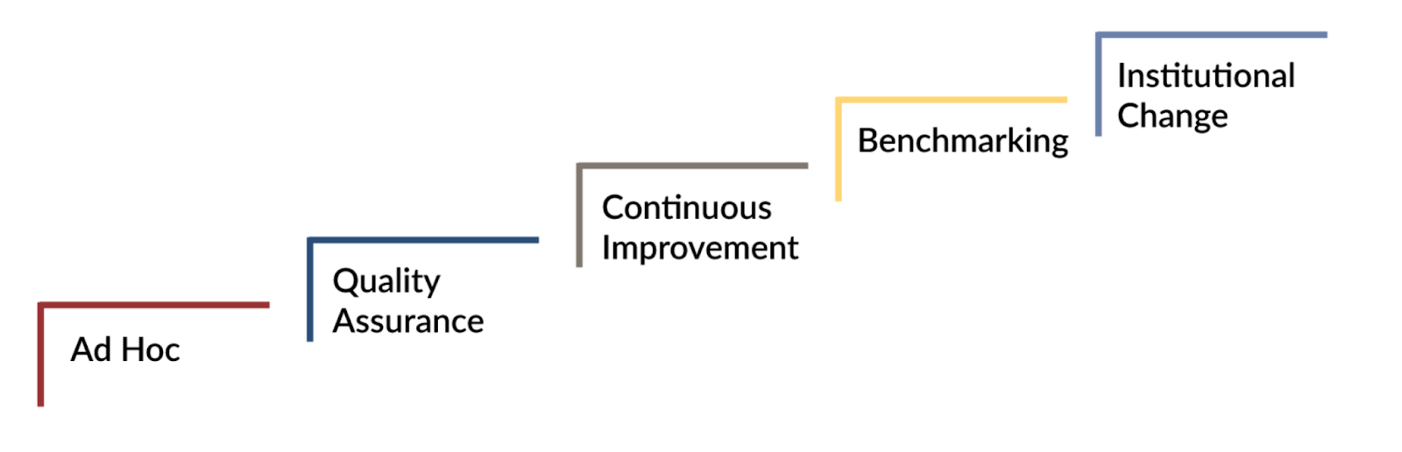
QM Implementation Model

Slide 17
Thank you
Karen Gorton, PhD, RN, FNP, MS
  Kgorton@uwyo.edu
  https://www.linkedin.com/in/karengorton/
Oksana Wasilik, PhD
  Oksana@uwyo.edu
  https://www.linkedin.com/in/oksanawasilik/

