Slide 1

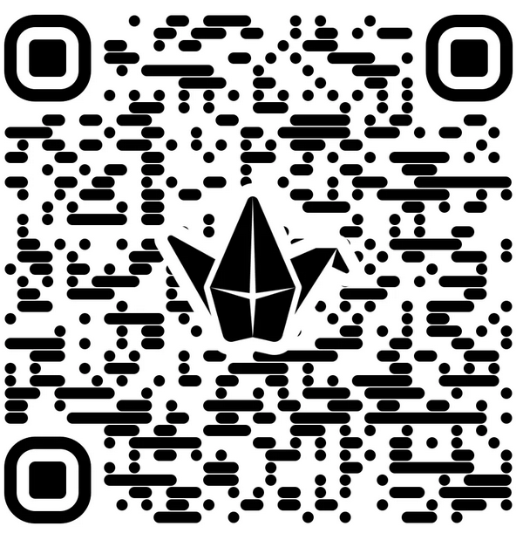
IN THE CHAT: What are your experiences with student peer mentorship?
ON THE PADLET: What are the benefits of peer mentorship?

Slide 2

Peer Mentoring as a Tool for Achieving Outcomes through Active Learning
Andria F. Schwegler, Madelynn D. Shell, and Malin K. Lilley

Slide 3

Session Learning Outcomes
Describe an example of implementing peer mentors in an online course
Recognize alignment of the mentoring program and course development with QM Standards
Evaluate data on the impact of a first year of peer mentor program on mentees and mentors
Discuss integrating peer mentors at your institution (benefits, challenges)

Slide 4
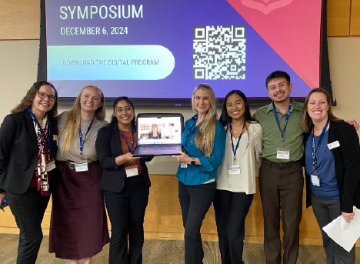
TAMUCT Psychology Program
Program guiding beliefs (Schwegler, Shell, & Clark, 2024)
  High impact practices across the curriculum (Linder & Hayes, 2018)
Students
  100% transfer (i.e., upper-division only)
  Non-traditional
  Many need entry-level skills for success
  Primarily online (i.e., synchronous and asynchronous courses)

Slide 5
Mentorship and High Impact Practices
“A mutually beneficial relationship between a specified student group (i.e. mentee) and a more experienced student (i.e. mentor) who engages with the mentee in a structured helping capacity to cultivate strong relationships and provide peer-to-peer support.” (https://www.tbr.edu/student-success/hip-taxonomy-peer-mentoring)
Benefits for all! (Newton & Ender 2010; Terrion, & Leonard 2007)
  Mentee
  Mentor

Slide 6
PSYC 3100 Psychology Major Seminar
Course plan (Moore & Shell, 2022; Shell & Moore, 2025)
  Similar to First Year Seminar (High-Impact Educational Practice)
  1-credit hour course
  Online synchronous delivery
Course design embeds QM Standards that peer mentors model

Slide 7

Course Learning Outcomes
2.1. The course-level learning objectives describe outcomes that are measurable.
CLO1: Read, discuss, and apply core academic skills and soft skills
  University resources
  Psychology program resources
  Careers in psychology
  Course planning
  Academic skills
  Information literacy
  Motivation and mindset
  Mental health and well-being
CLO2: Engage in professional written and verbal communication
  Professionalism
  Networking/relationship-building
CLO3: Apply interpersonal and intercultural responsiveness
  Cultural responsiveness
  Civic engagement

Slide 8
Defining the Peer Mentor Position
Upper-level undergraduate students
Enrolled in Internship course credit
Responsibilities
  Attend class sessions
  Plan class meetings with faculty
  Model class participation (e.g., camera on)
  Share experiences as student in program

Slide 9
In-class Activities to Help Learners
Present one slide per class session (warmup or recap)
Host discussions
Demonstrate activities
Ask questions
Moderate chat
5.1 The learning activities help learners achieve the stated objectives.

Slide 10
Opportunities for Interactions
Lead coworking breakout sessions on class topic
Hold one-on-one online meetings with mentees
Set up study groups
1.9 Learners have the opportunity to introduce themselves.
5.2 Learning activities provide opportunities for interactions that support active
learning.

Slide 11
Promoting Resources
Tutoring on course technology or resources (not course content)
  Collecting and sharing step-by-step videos
Building a library of support resources (e.g., Canvas page with resources for each topic)
6.1 The tools used in the course support the learning
objectives.
6.2 Course tools promote learner engagement and active
learning.

Slide 12
Faculty-mentor Interactions
Teach separate sections
Review previous class to adjust as needed and plan for future semester
Lesson prep as a team with peer mentors
Collaborative process
  Faculty and peer mentors for all sections
  Generate new content
  Develop engagement strategies to implement in class
  Solve problems through collaboration and discussions
5.3 The instructor’s plan for regular interaction with learners in substantive ways during
the course is clearly stated.

Slide 13
Example Lesson and Mentor Role
CLO1: Read, discuss, and apply core academic skills
  Module LO: Create a draft of degree plan and course schedule
Before Class
  Develop example degree plan
  Share with faculty any issues with registration
  or scheduling
During Class
  Share example of degree plan
  Breakout rooms to provide support as students develop their own plans
After Class
  Debrief with instructors and how to change for next semester
2.2 The module/unit-level learning objectives describe outcomes that are measurable and consistent with the course-level objectives.

Slide 14
Creating the Peer Mentor Role in the LMS
Peer Mentor role has the following access in Canvas:
  View, create, and participate in Discussions (enable permissions)
  View-only access to all course content
  Ability to use course messaging (Canvas inbox) for individual student communication
  No access to student information
  No independent course building
  No grading
6.2 Course tools promote learner engagement and active
learning.

Slide 15
Effectiveness: Mentee Perspectives
32 students enrolled in three course sections with three different mentors (1-5 point scale)
Prompt | M | SD
Contributed to my learning in class | 4.81 | 0.46
Provided useful personal experiences and knowledge | 4.91 | 0.29
Contributed to class discussions | 4.91 | 0.29
The one on one meetings were beneficial | 4.74 | 0.51
Promoted an environment that was helpful to learning | 4.84 | 0.36
Was easily accessible and helpful when needed | 4.84 | 0.36
Contributed to instructional learning strategies in the course | 4.88 | 0.33

Slide 16
Mentee Comments – Initial Coding
Emerging Themes – Mentor Helped Your Learning Experience?
  Triggered positive affect, n = 8 comments
    Comfort, motivation, support
  Shared personal experiences, n = 17
    Answered questions, stimulated discussion, related as a student
  Provided academic support, n = 7
    Tutorial tools, tips for courses, course content
  Provided advising support, n = 13
    Course planning, program expectations

Slide 17
Mentee Comments – Initial Coding
Emerging Themes – Other Ways Mentor Could Contribute?
  No comments, n = 10
  Great job! Nothing more is needed, n = 17
    Excellent, no ways to improve, amazing job!
  Recommendations, n = 6
    Discuss elective courses and student club activities
    Share more personal experiences so students don’t feel alone
    More 1:1 meetings
    Add mentors to other courses to help with content

Slide 18
Mentee Comments – Initial Coding
Emerging Themes – Other Comments about the Mentor Role?
  No comments, n = 16
  Valuable experience, n = 17
    Loved her, motivational, super helpful for learning, great to have
  Recommendations, n = 2
    Expand mentors to include graduate students
    Add mentors to other courses

Slide 19
Effectiveness: Mentor Perspectives
Progress on Program/Discipline Learning Outcomes (Inspired by APA Board of Educational Affairs Task Force on Psychology Major Competencies, 2023)
  Professional Values and Ethical Standards
  Presentation Skills
  Skills, Competencies, and Points of View Needed by Professionals
  Interpersonal and Intercultural Responsiveness
  Direction for Life after Graduation

Slide 20
Effectiveness: Mentor Perspectives
Mentor Experiences (Inspired by Marshall, Dobbs-Oates, Kunberger, & Greene, 2021)
  Growth
    Relational Knowledge and Skills
    Self-Awareness
    Career Identity and Development
  Challenges
    Learning the Mentor Role
    Relating to Students
    Student Engagement

Slide 21
Effectiveness: Mentor Perspectives
Group Identification with TAMUCT Psychology Department (Leach, van Zomeren, Zebel, Vliek, Pennekamp, Doosje, Ouwerkerk, & Spears, 2008)
  Solidarity
  Satisfaction
  Centrality
  Individual Self-Stereotyping
  In-Group Homogeneity

Slide 22
Effectiveness: Group Identification
*
*
*
ϯ p < .10
* p < 05
ϯ
*

Slide 23
Effectiveness: Mentor Perspectives
Too few mentors for quantitative data analysis on other variables
So far, mentors reported high development on
  Ability to relate to others, listen, provide feedback
  Improved relationship with faculty
  Seeing self as a leader and recognizing growth in own educational experiences
  Understanding psychology field and own career interests and opportunities

Slide 24
Barriers and Opportunities
Institutional norms
Student resistance to synchronous courses and engagement
Identifying potential mentors
  Mentor application process
  Faculty evaluation of prospective mentors
Implementing in multiple courses
Lead mentor
  Brainstorm and check in on new mentors

Slide 25
Discussion
What are your institutional norms around peer mentorship?
What are other potential barriers?
What other opportunities do you see for a peer mentor program?
Padlet: Benefits of Peer Mentorship

Slide 26
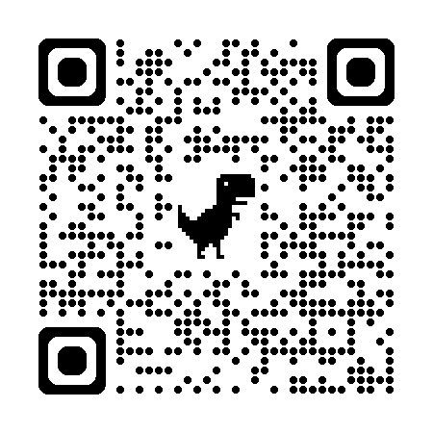
Additional Resources
Questions or comments?
mshell@tamuct.edu
malin.lilley@tamuct.edu
schwegler@tamuct.edu

