Slide 1




Alamo Colleges Online
Alamo Colleges Online
Are You Up for the
Design Challenge?
Are you up for the Quality Challenge?
Office of the Vice Chancellor for Academic Success
Dr. George Railey
Co-Presenters:
Rudolph “Rudy” Lopez
Instructional Design Team Lead
Amy Gates
Instructional Designer

Slide 2




Mission
Empowering our diverse communities for success by building and strengthening each College’s capacity to deliver premier, quality digital learning experiences for students.
ALAMO COLLEGES ONLINE
QM Quality in Action

Slide 3



Alamo Colleges District
The Alamo Colleges District empowers our diverse communities for success.
Our five colleges offer a vast array of programs and two-year degrees. Recent capital improvement programs have allowed us to create some of the best facilities for teaching and learning in the country. Our credits transfer to four-year universities for those pursuing bachelor’s or higher degrees. And our workforce development programs help individuals build new careers and meet the needs of business.
68,319+
ENROLLED
STUDENTS
(AND GROWING)
300+
DEGREE &
CERTIFICATE
PROGRAMS
851
ONLINE/HYBRID
FACULTY
ALAMO COLLEGES ONLINE
QM Quality in Action

Slide 4


DATA-INFORMED
Identifying Opportunities
for Improvement

Slide 5
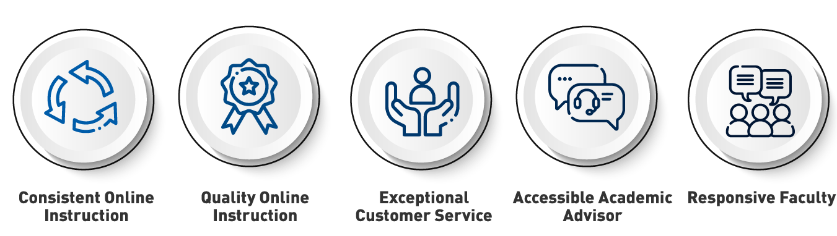
Priority Survey of Online Learners
January 2020 Survey Results
The following areas were identified as both important and ranking low on student satisfaction:
ALAMO COLLEGES ONLINE
QM Quality in Action

Slide 6
LEVERAGING EXISTING ASSETS
Instructional Designers

Slide 7
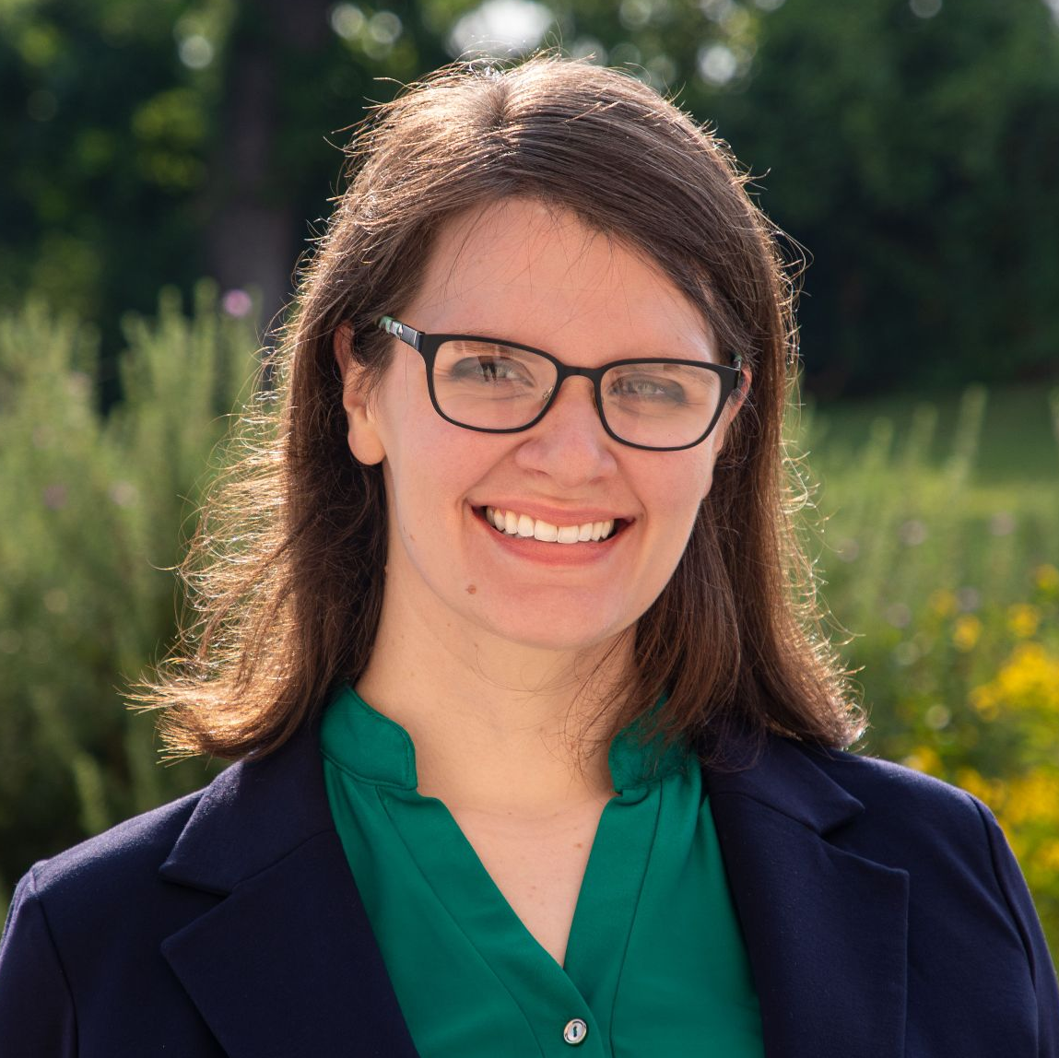
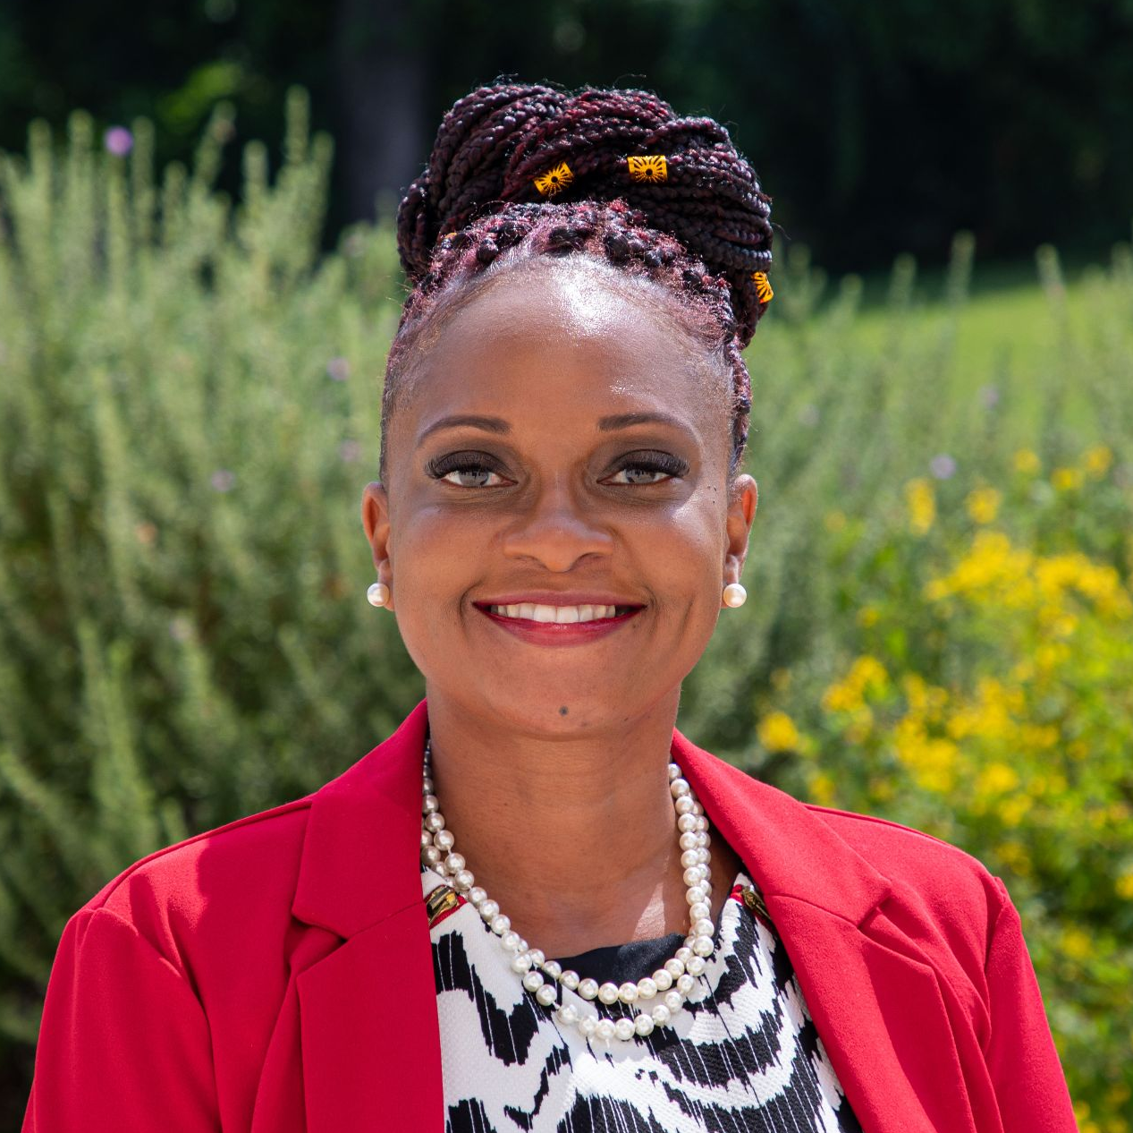
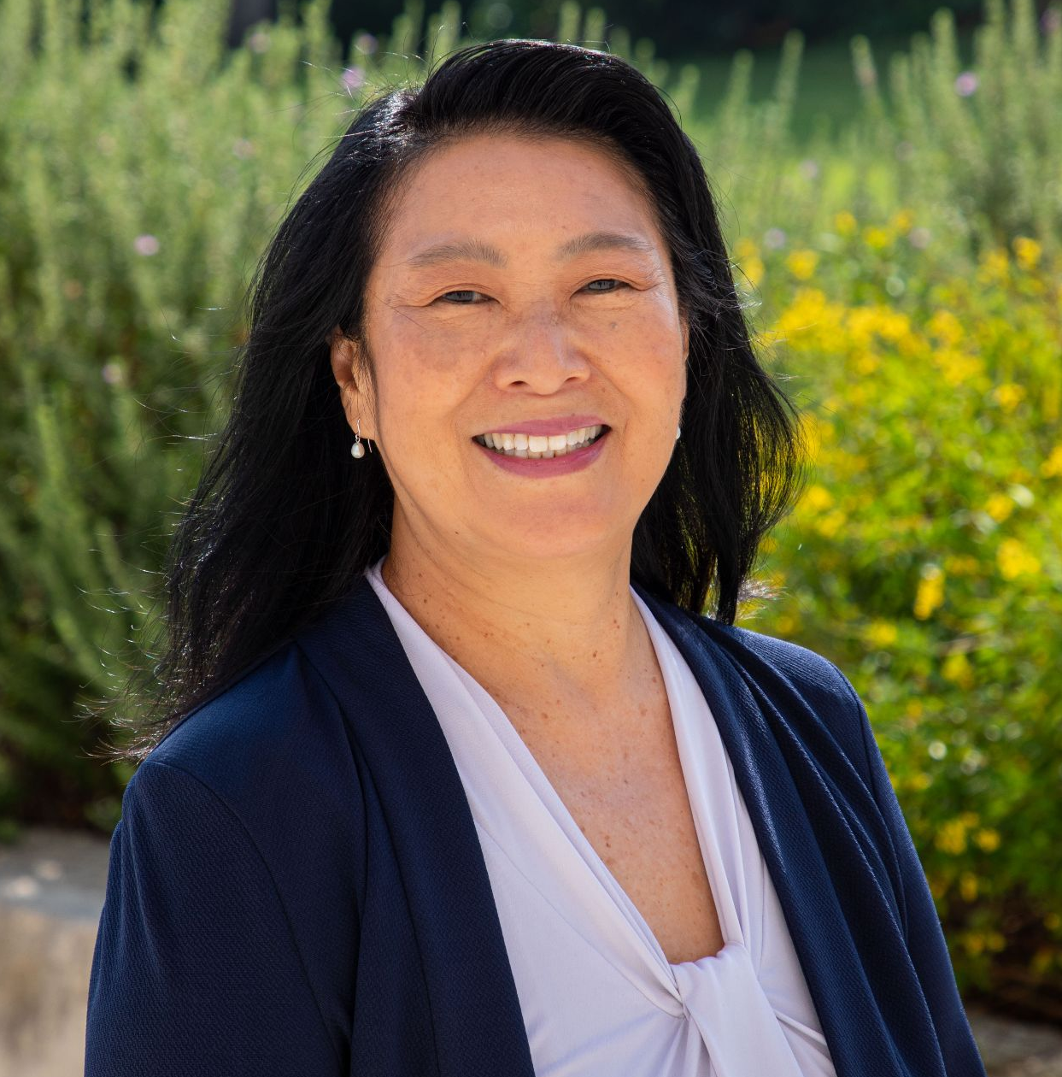
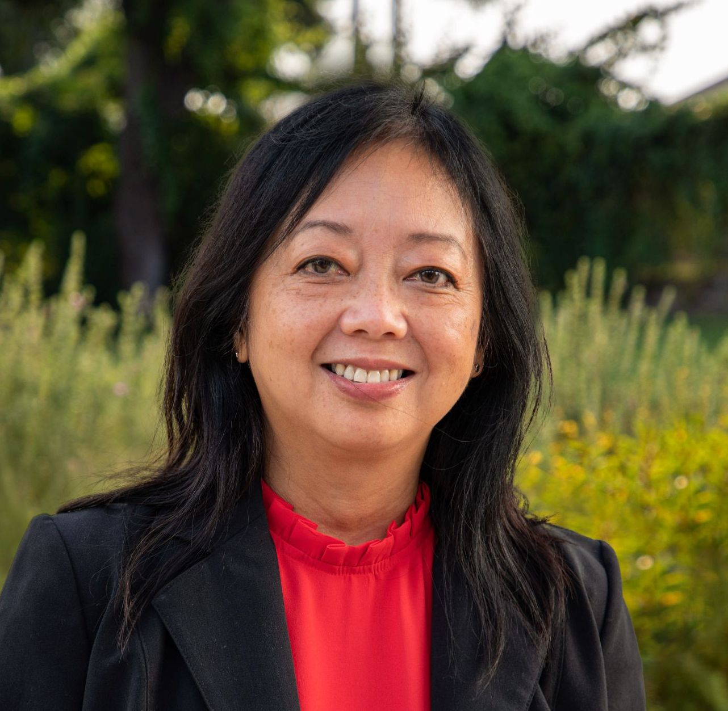
Instructional Design Team
Jen-Beth Ball
ACOL Instructional Designer
serving Northwest Vista College
Tanji Moon
ACOL Instructional Designer
serving St. Philip’s College
Amy Gates
ACOL Instructional Designer
serving San Antonio College
Barbara Wong
ACOL Instructional Designer
serving Northeast Lakeview College
Vacant
ACOL Instructional Designer
serving Palo Alto College
ALAMO COLLEGES ONLINE
QM Quality in Action

Slide 8
A NEW INITIATIVE
The Quality Challenges

Slide 9


Scope of Work
Selected faculty participants receive $1,719.81 at the completion of all Challenge deliverables.
Quality Design Challenge
Course Peer Review Challenge
Coursheet
APPQMR certification
2 consultations with ACOL ID
Essential Standards course review
Documented course improvements
Capstone video presentation
Course worksheet
PRC certification
2 consultations with ACOL ID
Course Self-Review
Course Peer Review
Documented course improvements
Experience reflection
ALAMO COLLEGES ONLINE
QM Quality in Action

Slide 10
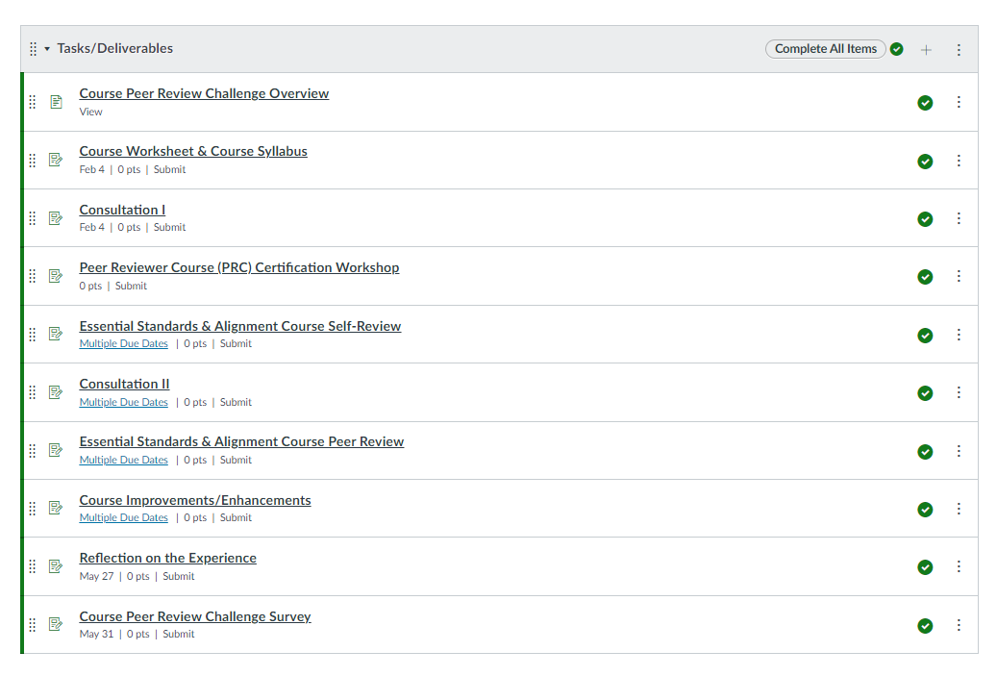
Source of Truth
Canvas Course serves as a hub:
Deliverables
Announcements
Discussions
Feedback
Central Q & A
Resources
ALAMO COLLEGES ONLINE
QM Quality in Action

Slide 11





Quality Design Challenge &
Course Peer Review Challenge
A focused opportunity for full-time and adjunct faculty members across all five Colleges to bring existing online courses to a new level of student engagement and success.
Funding for this project is made possible by the Student Success Fund as approved by the Alamo Colleges District Board of Trustees
of Faculty completed the QDC
9 cohorts
Summer 2020 -
Fall 2021
189
Unique Faculty Completers
137 QDC, 88 CPRC, and
38 Completed both
14,288
Faculty Hours committed to course enhancement
of Faculty completed the CPRC
ALAMO COLLEGES ONLINE
QM Quality in Action

Slide 12
RESULTS
Faculty Feedback

Slide 13




Quality Design Challenge
Course Peer Review Challenge
of Faculty were satisfied with their experience with their Alamo Colleges Online Instructional Designer.
of Faculty were satisfied with their experience with their Alamo Colleges Online Instructional Designer.
100%
97%
of Faculty in QDC felt confident applying the QM standards to their online courses after the challenge.
of Faculty in QDC felt confident providing and receiving feedback using the QM Rubric after the challenge.
95%
97%
95%
of Faculty felt their course was improved after participating in the challenge.
99%
of Faculty felt their course was improved after participating in the challenge.
ALAMO COLLEGES ONLINE
QM Quality in Action

Slide 14
Faculty Reflections
“Now I look at my content through a student perspective.”
“This challenge helped me to be more intentional about designing activities, materials, and assessments that align with the overall course learning objectives.”
“I feel that was invaluable experience and gives me the confidence to go on and help other instructors with their courses.”
“The chance to gain access to another’s course and have them evaluate yours is a wonderful activity that ensures we are delivering the best possible experience we can to our students.”
ALAMO COLLEGES ONLINE
QM Quality in Action

Slide 15
Quality Challenge Timeline
Initial cohorts of the QDC and CPRC.
Enhancements to Canvas course, including Orientation video and DesignPLUS tools
Standardization of review feedback
Pilot Summer 2022 QC3 Cohort
Summer 2020
Spring 2021
Summer 2021
Spring 2022
Summer 2022
Fall 2020
Fall 2021
Innovation of Canvas course to coordinate challenges
Continued refinement of challenge documents and processes
Design a new Challenge
ALAMO COLLEGES ONLINE
QM Quality in Action

Slide 16
Summer 2022 Pilot:
Quality Course Certification Challenge (QC3)
Selected faculty participants prepare and submit course designs for national Quality Matters certification.
Priority
Goal
Faculty who completed both QDC and CPRC
Faculty that completed APPQMR and PRC
Faculty that completed APPQMR OR PRC
5 participants per College
25 courses submitted for review using QM CRMS
% of courses receiving certification (Pilot to determine next steps)
ALAMO COLLEGES ONLINE
QM Quality in Action

Slide 17
QUESTIONS?

Slide 18




THANK YOU

