Slide 1
Inclusive Pedagogy Online:
Faculty Development and Effective Strategies
Notes:
Welcome everyone to our presentation on Inclusive Pedagogy Online: Faculty Development and Effective Strategies

Slide 2

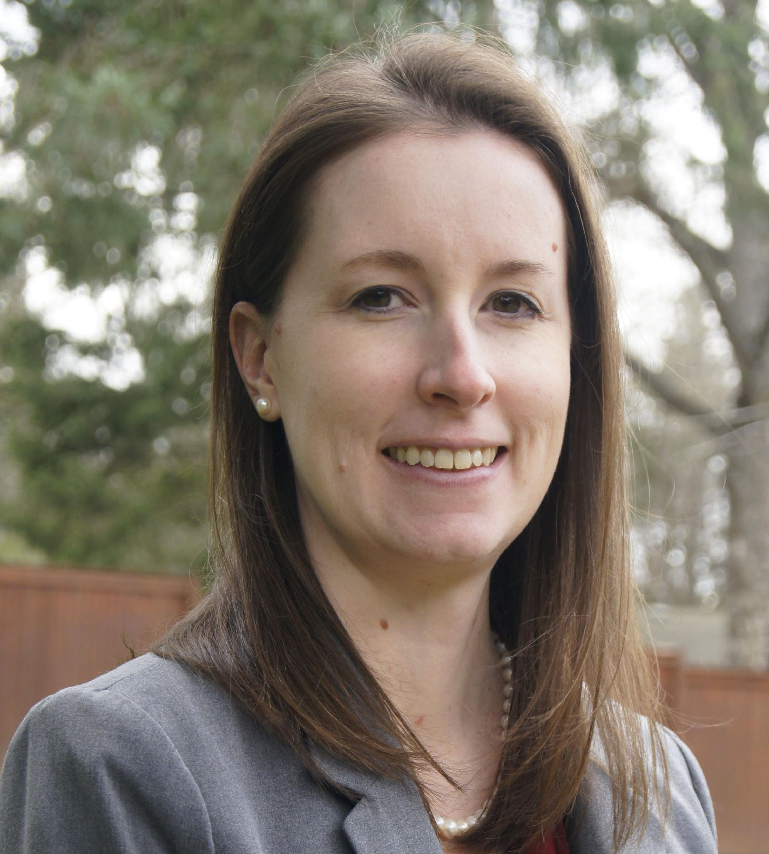

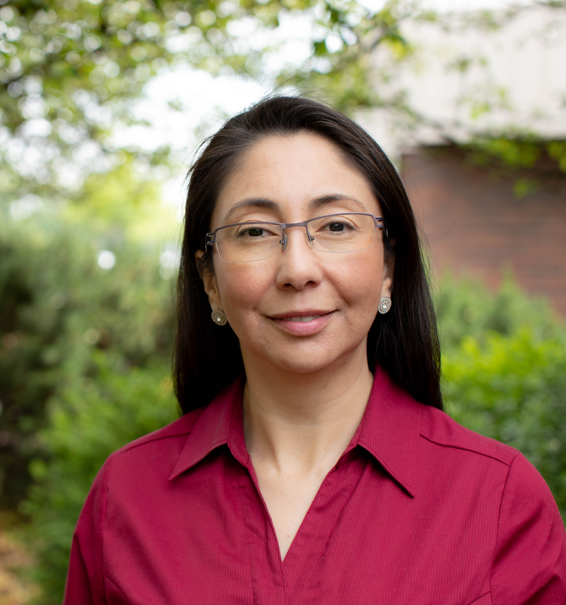

Introductions
Katherine McAlvage
Jen Myers
Assistant Director,
Course Development & Training, Ecampus; Graduate School faculty
Visiting Assistant Professor of Sustainability, Wells College &
OSU Ecampus Research Unit Fellow
Nadia Jaramillo Cherrez
Deanna Lloyd
Instructional Design Specialist,
Ecampus
Instructor, Horticulture & Sustainability; Ecampus Research Unit Fellow
Notes:
Our research team has four members. I will introduce Katherine and myself; and Jen will introduce Deanna and herself. Katherine McAlvage, Assistant Director of Course Development & Training, Ecampus; Graduate School faculty, I am Nadia Jaramillo Cherrez, Instructional Design Specialist at Ecampus.
Our two colleagues, Katherine and Deanna are unavailable today to join us live. They recorded their presentations and Jen and I will play the recordings so you can hear from them too about our study.

Slide 3
Who’s in the Room?
What area most clearly describes your role at your institution?
  faculty, academic technology, instructional design, faculty development/support
In a few words, what does inclusive teaching online mean to you?
Notes:
Let’s get started.
You all now have at least a slight sense of the roles each of us holds and we would like to hear about you so we can tailor our Q&A responses to our audience. We’d like to know more about your roles and what inclusive teaching online means to you.
You could share your answers with us via the chat.

Slide 4

Starting with QM standards
Equitable and inclusive course policies, clearly stated. (Standard 1.4)
Instructor introduction encourages communication. (Standard 1.8)
Students introduce themselves to the class and faculty respond warmly and directly to each student. (Standard 1.9)
Transparent assessment design is used to identify the relationship between the activity and the learning objective and to clearly set out evaluation criteria. (Standards 2.4 and 3.3)
Students are provided timely and actionable feedback emphasizing growth mindset through multiple opportunities to track their learning. (Standard 3.5)
The course promotes interaction through active learning and the instructor is visibly involved in and supporting that work. (Standards 5.2, 5.3, and 6.2).
Notes:
Good afternoon, everyone - this is Katherine. I’m sorry that I can’t join you synchronously today, but I’m so pleased to have the opportunity to help my colleagues share about our research project.
Oregon State is a QM subscriber, so like many (or all) of you, we offer professional development to our faculty in the QM standards. We introduce the standards in our signature online course development workshop, DOC; many of our faculty also go on to take APPQMR or additional QM workshops. All of our online courses must meet the Ecampus Essentials as they are being designed, too, and those are a subset of the QM rubric that we are emphasizing as an internal baseline.
In the past few years, we’ve started emphasizing the relationship between evidence-based course design approaches and evidence-based facilitation practices, and we have developed OTPs to supplement our Ecampus Essentials design standards. Our inclusive teaching workshop is a good example of this relationship. There are key elements of inclusive teaching that are embodied in the QM rubric. But, even a QM certified course might not be inclusive in its delivery if the instructor wasn’t present or didn’t engage with students, for example.
That said, on this slide, we’ve outlined the intersection between QM standards and inclusive teaching approaches that we use as a starting point for our workshop, noting in parentheses the specific standard or standards we’re referencing. The first item here, for instance, is linked to the standard about clearly stating course policies so that students know what to expect, and we build on that to help faculty ensure that their clearly-stated policies are equitable and inclusive. In the next few slides, you’ll hear more about our workshop content and how we help faculty work through these approaches.

Slide 5
Research Project
Initial Ecampus Faculty Survey
Inclusive Teaching Online Workshop
Follow-Up Survey
All consenting research participants
December 2019
Beginning
Winter/Spring 2021
and ongoing
Winter 2020
Summer 2020
Fall 2020
Summer 2021
Consenting research participants who are DPD faculty
Notes:
Here, we wanted to share a high-level view of our research project.
We began with a survey to all Ecampus faculty in December 2019, which helped us to understand how much value faculty place on various inclusive teaching approaches and how much confidence they have in employing those approaches. Responses were anonymous. Survey results provided valuable insight for what content should be included in a workshop on this topic — and confirmed our impression that we really needed a workshop specifically about inclusive teaching approaches in asynchronous, online courses.
All Ecampus faculty were then invited to begin participating in our Inclusive Teaching Online, or ITO, workshop. In this workshop, we have curated evidence-based practices that have been shown to work online, and adapted other strategies that have not yet been studied in depth in the online context. We have had four faculty cohorts so far. Participants are invited to participate in our research study at the beginning of the workshop, but can participate fully without taking part in the study as well. Of our consenting faculty participants, we are tracking two groups during and after the workshop: 1) all consenting research participants, and 2) consenting research participants who are “DPD” faculty. At Oregon State, our general education curriculum includes a category of courses called Difference, Power, and Discrimination, or DPD. All bachelor-degree seeking students must take a DPD course. As you might imagine by the category name, these courses address institutionalized systems of inequity and privilege in the U.S., and they can be particularly challenging to teach asynchronously online.
Finally, we have collecting and are continuing to collect follow-up data from consenting research participants who completed the workshop two or more terms ago to learn about what strategies they have implemented and how they are working.

Slide 6
Workshop Participation
Offerings
Registrants
Completions
Research Participants
Winter 2020
Summer 2020
Fall 2020
Summer 2021
54
54
23
9
49
39
15
3
48
37
11
3
Notes:
We’ve had over 100 of our 1100 online faculty complete the workshop to date, most of whom have also consented to participate in our research project. We’re pleased to have had that level of participation during Covid.

Slide 7

The Inclusive Teaching Online workshop
Module 1 | Module 2 | Module 3 | Module 4
Building awareness and reflection | Barriers to online student success and responses | Inclusive teaching in practice | Inclusive teaching in practice
Notes:
ITO is a four-week workshop, with one module per week.
Module 1 and Module 2 provide many opportunities for self-reflection and building awareness.
Modules 3 and 4 then cover specific evidence-based inclusive teaching strategies and ask faculty to start working toward possible applications.

Slide 8
The Inclusive Teaching Online workshop
Module 1 | Module 2 | Module 3 | Module 4
Building awareness and reflection | Barriers to online student success and inclusive responses | Inclusive teaching in practice | Inclusive teaching in practice
Faculty identity impacts in the online classroom Self-presentation | Social barriers Institutional barriers Teaching practices that create barriers Inclusive Excellence
Notes:
Here, we’ve provided some additional information about topics and strategies that are covered in the first two modules.
As we get started, faculty explore impacts of their own identities on their online teaching, and reflect on how and where they present themselves to their students. Then, they are introduced to different cultural constructs of teaching and learning that instructors and students bring into classrooms, and how online students specifically encounter barriers to their success, and principles of Inclusive Excellence from the Association of American Colleges and Universities.

Slide 9
The Inclusive Teaching Online workshop
Module 1 | Module 2 | Module 3 | Module 4
Building awareness and reflection | Barriers to online student success and inclusive responses | Inclusive teaching in practice | Inclusive teaching in practice
Faculty identity impacts in the online classroom Self-presentation | Social barriers Institutional barriers Teaching practices that create barriers Inclusive Excellence | Syllabus + discipline statement Equitable policies Supplemental/ refresher material Resource referrals Mid-term outreach Transparent prompts Actionable feedback | Discussion facilitation
Notes:
In Module 3, for example, we cover syllabus statements about a faculty’s personal philosophy about diversity and inclusion to set the tone for the course; equitable courses policies; adding supplemental or refresher material to support student review and activate prior knowledge; how and when to refer students to OSU resources; mid-term outreach to students who may be disengaged or struggling; transparent prompts; and actionable feedback.

Slide 10
The Inclusive Teaching Online workshop
Module 1 | Module 2 | Module 3 | Module 4
Building awareness and reflection | Barriers to online student success and inclusive responses | Inclusive teaching in practice | Inclusive teaching in practice
Faculty identity impacts in the online classroom Self-presentation | Social barriers Institutional barriers Teaching practices that create barriers Inclusive Excellence | Syllabus + discipline statement Flexible policies Supplemental/ refresher material Resource referrals Mid-term outreach Transparent prompts Actionable feedback | Discussion facilitation
Notes:
In Module 4, we focus entirely on facilitating asynchronous, online discussions, since we know this is a particularly acute challenge for Ecampus faculty. We first discuss distinguishing between different purposes for using discussion boards, namely debates, discussions, and dialogues, and how to align discussion participation requirements and grading with those purposes. We also adapted a cross-cultural communication framework for use in the online threaded discussion format, and faculty try this framework out in a case study of a problematic student post and then discuss how it worked.

Slide 11
The Inclusive Teaching Online workshop
Module 1 | Module 2 | Module 3 | Module 4
Building awareness and reflection | Barriers to online student success and responses | Inclusive teaching in practice | Inclusive teaching in practice
Pre- Survey
Post- Survey + Action Plan
+ Follow-Up Survey
Notes:
The workshop is bookended by a pre- survey and a post- survey, which illuminate how participants’ ideas about and confidence in inclusive teaching have changed. Faculty also complete an “action plan,” where they articulate what plans they have for implementing inclusive teaching strategies online and how they can measure efficacy. [*] As mentioned earlier, we have started receiving follow-up survey data as well where faculty report on what they have actually done and how it has worked out.
Research participants consented to us using these assessments anonymously as we report out. Nadia will talk more about our findings to date.

Slide 12
Preliminary Results (follow-up survey)
Plan
Implement
Inclusive teaching in mind
Inclusive teaching in action
Intentions & strategies to teaching online
Most useful tools
Specific strategies & tools implemented
Means of implementation (did they work?)
Notes:
Thanks to Katherine for sharing the overview of the workshop and research project.
I will present next a brief look at some of our preliminary results..
One aspect that we explore in the research project is the ways in which the instructors who participated in the workshop implemented inclusive teaching strategies. As Katherine mentioned, at the end of the workshop our instructors developed an action plan that described the most useful tools and strategies as well as their intentions to put strategies and tools into action. In the follow-up survey we ask the instructors to report on what their action plans includes and their experiences on the actual implementation of the inclusive tools and strategies. We also asked them to report what strategies they feel worked well and how.

Slide 13
Preliminary Results (follow-up survey, n=32*)
What strategies have you considered implementing? | What strategies have you implemented?
Strategy | Excerpt | Strategy | Excerpt
Syllabus statement (n=11) | “Using different language in my syllabus.” | Flexible policies (n=10) | “Students respond very appreciatively to my efforts to add flexibility to the course, in ways of demonstrating mastery, flexibility in deadlines, adapting to student feedback, etc.”
Curriculum (n=7) | “I am also working on implementing more inclusive content and opportunities for dialog, but that is a slower process.” | Discussion Facilitation (n=7) | “[I] started keeping a checklist of who I responded to in each class to ensure that more students get teacher-student interaction in discussion boards”
Equitable course policies (n=6) | “[B]eing flexible to the different needs of different students.” | Syllabus statement (n=6) | “[T]hey must have read my syllabus statement because they replied in a friendly way and even changed their signature from an anglicized version of their name to the real name, and I felt like I really helped the student be themselves”
Transparent prompts (n=6) | “Revised some language in the assignment introductions to explain their purpose.” | Curriculum (n=6) | “added more acknowledgments that the material is limited in some areas based on lack of data and talk about the reasons for that more.”
Discussion facilitation (n=6) | “I share information about myself when it is relevant and useful. For example, if a student is struggling with reading a difficult text, I will remind them of the reading strategies we have gone over, and talk about how I rely on those strategies myself.” | Transparent prompts (n=3) | “Students have appreciated the improved clarity in the assignment prompts.”
* Data collection in progress
Notes:
The table on the screen presents the data from 32 participants. Please, bear with us here as we are still collecting data.
We asked two questions in relation to the action plan that could give us some evidence of what instructors were considering planning in their upcoming course(s) and what they were able to implement.
On the left side of the table, we listed the strategies and a few short excerpts for the answers to the first question: What strategies have you considered implementing?
The results show five themes about the strategies and tools that faculty intended or planned to implement. Approximately a third of our instructors reported developing a syllabus statement that describes their inclusive practices. For instance, the use of different language. Other instructors reported including in their statements their welcoming of diverse perspectives, how they would address issues of respect and inclusivity, adding a lack acknowledgement.
Fewer other faculty reported making adjustments to the course curriculum where they include content from diverse authors and perspectives. Other faculty reported about planning to adopt equitable course policies such as flexibility for assignments. Another strategy included creating more transparent prompts for assignments such as a clear purpose or instructions for students to understand what they are expected to do. Adopting techniques to facilitate discussions was also in the list of planned strategies, this would help support students better and make connections with them.

Slide 14
Preliminary Results (follow-up survey, n=32*)
What strategies have you considered implementing? | What strategies have you implemented?
Strategies | Excerpt | Strategies | Excerpt
Syllabus statement (n=11) | “Using different language in my syllabus.” | Flexible policies (n=10) | “Students respond very appreciatively to my efforts to add flexibility to the course, in ways of demonstrating mastery, flexibility in deadlines, adapting to student feedback, etc.”
Curriculum (n=7) | “I am also working on implementing more inclusive content and opportunities for dialog, but that is a slower process.” | Discussion Facilitation (n=7) | “[I] started keeping a checklist of who I responded to in each class to ensure that more students get teacher-student interaction in discussion boards”
Equitable course policies (n=6) | “[B]eing flexible to the different needs of different students.” | Syllabus statement (n=6) | “[T]hey must have read my syllabus statement because they replied in a friendly way and even changed their signature from an anglicized version of their name to the real name, and I felt like I really helped the student be themselves”
Transparent prompts (n=6) | “Revised some language in the assignment introductions to explain their purpose.” | Curriculum (n=6) | “added more acknowledgments that the material is limited in some areas based on lack of data and talk about the reasons for that more.”
Discussion facilitation (n=6) | “I share information about myself when it is relevant and useful. For example, if a student is struggling with reading a difficult text, I will remind them of the reading strategies we have gone over, and talk about how I rely on those strategies myself.” | Transparent prompts (n=3) | “Students have appreciated the improved clarity in the assignment prompts.”
* Data collection in progress
Notes:
Now, on the right-hand side of the table we present the results of the second survey question, which asked about the strategies that instructors actually implemented and how they feel these strategies worked (nor not).
About a third of our instructors mentioned implementing flexible policies, particularly flexible due dates to accommodate students’ different life circumstances and needs, and also consider student feedback for course updates. Fewer faculty indicated having implemented strategies for discussions, such as documenting the student-instructor interaction to ensure that all students have this opportunity. Other instructors did add a syllabus statement for inclusive practices that set the tone of the course and also supported students identities ( as described in the example). Changes to the course curriculum was also implemented first by recognizing that resources in the course did not encompass diversity of perspectives (as indicated in the example) and second by adding readings from diverse authors. The last strategy here relates to writing more transparent prompts in activities and assignments, which help students to better understand the instructions.
There are other strategies that our instructors mentioned in the survey including timely feedback, student surveys, improved interaction. The strategies we share in the table include what resonated the most with our instructors.

Slide 15
Preliminary Results (follow-up survey, n=32*)
What strategies have you considered implementing? | What strategies have you implemented?
Strategies | Excerpt | Strategies | Excerpt
Syllabus statement (n=11) | “Using different language in my syllabus.” | Flexible policies (n=10) | “Students respond very appreciatively to my efforts to add flexibility to the course, in ways of demonstrating mastery, flexibility in deadlines, adapting to student feedback, etc.”
Curriculum (n=7) | “I am also working on implementing more inclusive content and opportunities for dialog, but that is a slower process.” | Discussion Facilitation (n=7) | “[I] started keeping a checklist of who I responded to in each class to ensure that more students get teacher-student interaction in discussion boards”
Equitable course policies (n=6) | “[B]eing flexible to the different needs of different students.” | Syllabus statement (n=6) | “[T]hey must have read my syllabus statement because they replied in a friendly way and even changed their signature from an anglicized version of their name to the real name, and I felt like I really helped the student be themselves”
Transparent prompts (n=6) | “Revised some language in the assignment introductions to explain their purpose.” | Curriculum (n=6) | “added more acknowledgments that the material is limited in some areas based on lack of data and talk about the reasons for that more.”
Discussion facilitation (n=6) | “I share information about myself when it is relevant and useful. For example, if a student is struggling with reading a difficult text, I will remind them of the reading strategies we have gone over, and talk about how I rely on those strategies myself.” | Transparent prompts (n=3) | “Students have appreciated the improved clarity in the assignment prompts.”
* Data collection in progress
Notes:
Well, what do all these results mean so far?
Overall, the results show that all the intended plans to integrate inclusive strategies and tools were implemented in the course in varying degrees.
Three of the strategies with more emphasis in the intended plan include the inclusion of a syllabus statement, equitable course policies (such as adding flexibility), and how to facilitate discussions to support and connect with students. However, the strategy that resonates the most is adding a syllabus statement, which make sense as the syllabus is the course document that presents information about the objectives, content, schedule and policies.
When we look at the results of the second question, we observe that the strategy that faculty implemented the most was flexible policies, especially around due dates for completing assignments. This suggest that faculty may recognize students’ life circumstances that happen and therefore are willing to consider more lenient due dates, flexibility then became an important characteristic of inclusive design and teaching.
The second strategy implemented is discussion facilitation, where instructors more intentionally promoted interaction between instructor-students, as we know it opens a space to increase responsiveness, connection, satisfaction with learning.
The syllabus statement was also implemented. It appears that the syllabus statement in itself may be useful but it is not enough to create an inclusive online environment. Perhaps it can be considered as the starting point. We noticed that several faculty described the use of more inclusive language and tone in the syllabus which can send a message to students that the class will be an environment where they can feel welcomed, supported, and to which they belong.
We also believe that creating the syllabus statement might be easier to plan and implement than other inclusive strategies. It is a more concrete and visible element in the course.

Slide 16
Use design as a starting point
QM course policies, clearly stated. (1.4) instructor introduction (1.8) students introduce themselves to the class (1.9) identify the relationship between the activity and the learning objective and to clearly set out evaluation criteria. (2.4 and 3.3) multiple opportunities to track their learning. (3.5) interaction through active learning (5.2, 5.3, and 6.2). | Workshop
 | Module 1 | Building awareness and reflection Identity Cultural Social justice
 | Module 2 | Barriers to online student success and responses Social structures Institutional structures Teaching practices Inclusive Excellence
 | Module 3 | Inclusive teaching in practice Syllabus + discipline statement Equitable course policies Supplemental/ refresher material Resource referrals Mid-term outreach Transparent prompts Actionable feedback
 | Module 4 | Inclusive teaching in practice Discussion facilitation
Equitable Course Policies
Discussion
facilitation
Syllabus
statement
Curriculum
Transparent
prompts
Notes:
With the preliminary findings, we are also establishing connections between the strategies that resonate the most to faculty and the content of the workshop to see areas where we can connect design and facilitation.
Equitable Policies is clearly one of those areas. As facilitators of the workshop, Katherine and I discuss with instructors the overall characteristics and demographic information of our online student population to help instructors develop more awareness of these students’ needs in case students reach out to them for help. We also explore with our instructors areas of contextual challenges that can impact students and the ways in which equitable practices can help them overcome those challenges. During the workshop we model some equitable practices illustrate that these may benefit all students in the course, not always just one of them. The conversation about equitable practices should begin at the design level and evolve as instructors get to know students more.
The facilitation of discussions is another topic that can begging with the design of active learning for example. In the workshop, we present faculty with a scenario where they need to respond to a student’s controversial post. We discuss the several ways in which the instructors can prepare to respond rather than to react. Also, instructor discuss how much they plan to share with students in the introduction forum, and possible future interactions in which may reveal more aspects of their identities.
The syllabus being a mechanism itself to communicate the details of the course helps set the tone for the type of learning environment and instructor’s teaching approach. During the workshop, our instructors discuss elements of the syllabus statement that can speak to the type of learning environment they aim to create. For instance, inclusive language as we have seen in the previous examples, their own approaches and commitment to welcome everyone in the course. We also share some examples from previous participants from different disciplines. In our workshop discussions, we realize that the syllabus statement appears to consolidate instructors’ personal philosophies for promoting an inclusive learning environment. And as we have seen in the results, the syllabus statement alone is not sufficient. For example, a recent study on syllabus suggests that the tone used in it might prompt students to seek help. This study was not on inclusive teaching but gives us some insights about how to better support students.
https://journals.sagepub.com/doi/abs/10.1177/0098628321994632
When we discuss about the different barriers that students may face, diversifying the curriculum comes into the conversation. This element can also begin at the design level when planning the content. Then in facilitating the course, instructors can expand on the diverse perspectives that they and their students bring to the course.
Finally, transparency in assignments is important and begins with design when we align the outcomes with activities. During the workshop, we discuss about creating clear assignment description and the plan for actionable feedback.

Slide 17

Expanding QM Course Design through Inclusive Facilitation
Notes:
We will next look at some examples with Jen and Deanna.

Slide 18

ITO Strategies in DPD classrooms
Students in Difference, Power, and Discrimination (DPD) courses shall:
Explain how difference is socially constructed,
Using historical and contemporary examples, describe how perceived differences, combined with unequal distribution of power across economic, social, and political institutions, result in discrimination, and
Analyze ways in which the interactions of social categories, such as race, ethnicity, social class, gender, religion, sexual orientation, disability, and age, are related to difference, power, and discrimination in the United States.
Notes:
Jen
Thanks, Nadia. So as Katherine mentioned at the beginning of the presentation, our study evaluates the experiences of two faculty cohorts - all consenting faculty enrolled in the training and faculty who teach Difference, Power, and Discrimination courses as part of OSU’s general education requirements. We are focusing on the experiences of DPD faculty, in particular, because, as you might imagine, facilitating conversations around sensitive topics in online classrooms adds additional challenges, responsibilities, and opportunities.
In addition to our roles on the research team, Deanna Lloyd and I have both taught Difference, Power, and Discrimination courses online. We’d like to take this opportunity to share a few tangible examples from our teaching experience to illustrate how the strategies discussed in the workshop can help expand upon the foundations provided by QM standards in ways that promote trust and engagement around difficult topics. In order to operationalize the standards in support of inclusive pedagogy, faculty can think creatively about course design elements and facilitation techniques.

Slide 19
ITO Strategies Strengthen QM Standards
Learning Activities and Learner Interaction
1.8 The self-introduction by the instructor is professional and is available online.
5.4 The requirements for learner interaction are clearly stated.
5.2 Learning activities provide opportunities for interaction that support active learning.
6.2 Course tools promote learner engagement and active learning.
Building a community for dialogue about difficult topics is essential in DPD course design and facilitation.
Notes:
In the following examples, we’ll look specifically at strategies we’ve employed to expand upon standards 1.8 and 5.3 in ways that complicate the suggestion of what a “professional” introduction includes and the ways we can further humanize ourselves in our interactions with students. Deanna Lloyd will share an example from her course. I will then describe an example of a method I developed to utilize the course technology to promote student interaction and active learning about the history of the environmental movement in a Social Sustainability course.

Slide 20
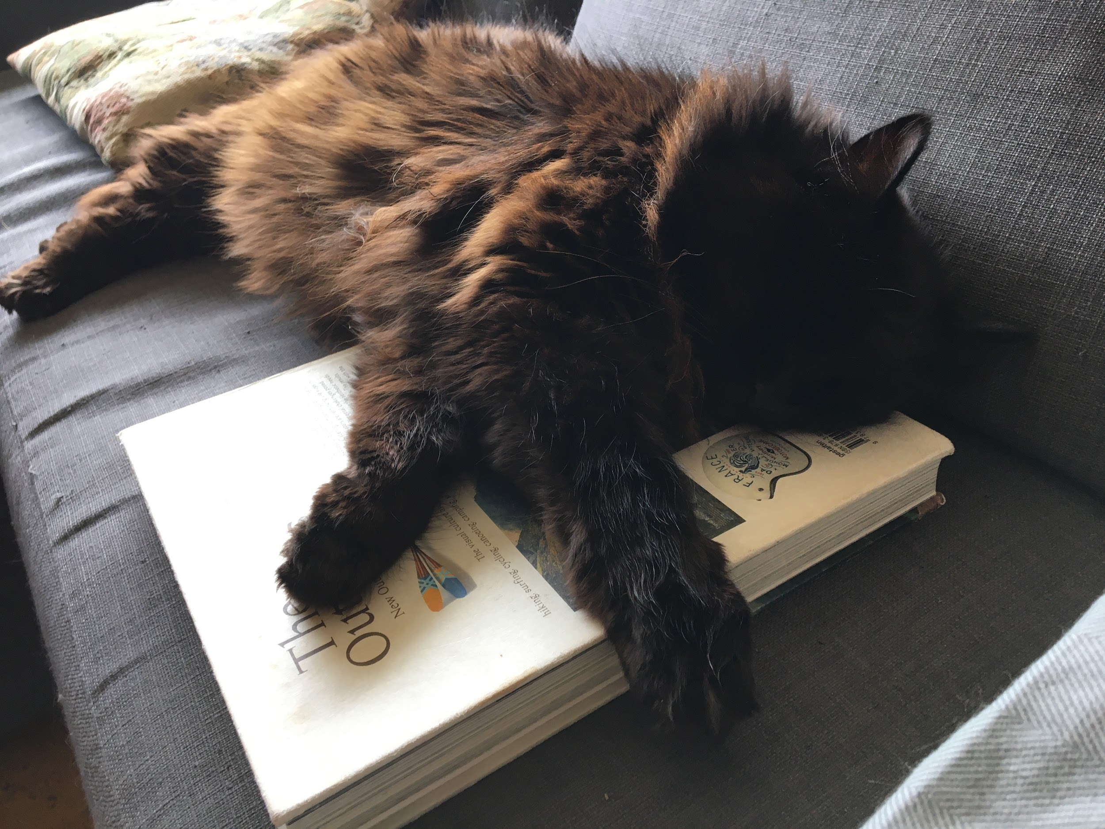

Strategies for Inclusive Teaching Example
Introduction video (Standard 1.8)
  Shares aspects of my positionality
  Models humanity and vulnerability
  Sets tone for the course
Notes:
Deanna
Hi all, this is Deanna and I teach an online class called Sustainability, Justice, and Engagement and as Jen mentioned, it is designated as one of those Difference, Power, and Discrimination general education course. In it, we examine social constructs, systems of oppression and do a lot of self-reflection on our privileges and biases as we explore how frontline communities are engaging in sustainability action.
Thinking about standard 1.8, it requires there to be a professional self-introduction by the instructor that is available online. This is an opportunity to introduce myself in a way that sets the tone for the course. Recognizing societal systems and our positionality within them is important in this class so I model that right from the start by sharing aspects of my positionality and how that influences my lived experiences, privileges, and potential biases. For some people, sharing in that open way may not be deemed professional, but it models for the students self-reflection and helps shift power dynamics. Students start off the course seeing that I too am a person who is engaging in the world in various ways, not just a detached expert. I also use the introduction to articulate why this class centers voices from frontline and minoritized communities. So the introduction is not only an introduction - it is also a learning opportunity for students to begin thinking about the big ideas covered in class and it is an example of vulnerability and reflection.

Slide 21
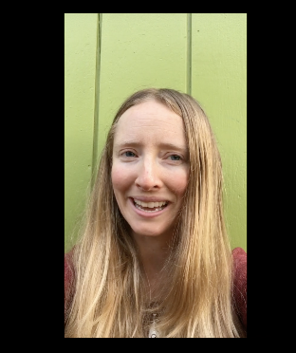
Strategies for Inclusive Teaching Example
Video announcement to class sharing personal stories highlighting instructor fallibility
Models vulnerability, self-reflection, and ways to engage (Standard 5.2)
Clear communication provided about when a submission is viewed by class or just by instructor (Standard 5.4)
Notes:
Deanna
As the course progresses, self-reflection, vulnerability, and humility play a key role in the learning process. I emphasize to students that we are all fallible, but how we react to our mistakes and learn to be better is part of what can make us effective change agents. Recognizing my positionality as the instructor, I could just ask students to be vulnerable and share their reflections to various prompts, but that keeps all the power with me. Instead, I too expose my vulnerability and fallibility. Even here with you all now, I’m pushing beyond my comfort zone by sharing this photo of me that I extracted from a class announcement video. This class video reflects on two different times when I made mistakes with my language around social justice issues and then how I was called upon to be accountable for those mistakes - one in a very public way and one in a more intimate and individual way - and then I disclose my internal feelings as I processed and considered how to respond. It has been powerful to see how students engaged and reacted to my vulnerability. As one student noted the last day of class, quote “Hearing about your experiences felt authentic, supportive and showed us how it is possible to lead by example. Also, I felt hopeful in that I can learn from my mistakes and continue to grow and evolve.” end quote.
While my syllabus and assignment and assessment instructions articulate different ways I will be engaging with the learners - as required in standard 5.2 - both my introduction and fallibility videos are attempts to exemplify vulnerability and reflection, both of which I clearly ask from my students. These videos help move that requirement of clear communication from a one-way, didactic exchange of information to a more democratic, two-way form of sharing information and modeling learning and growth.. This also connects with standard 5.4 about clearly identifying learner interactions. Since assignments are either discussion-based or individual self-reflections, I clearly note when a submission will be viewed by the class or just by me. Students are at different levels of understanding and comfort with this material and they may share more openly in one setting versus another. So by identifying who will see their submission, it is not only clear communication, but also a form of scaffolding to students’ various needs, experiences, and identities.
And although being open has been a powerful tool for me, I recognize that my identity and privileges as an educated, white woman influences how students perceive this expression of vulnerability.

Slide 22
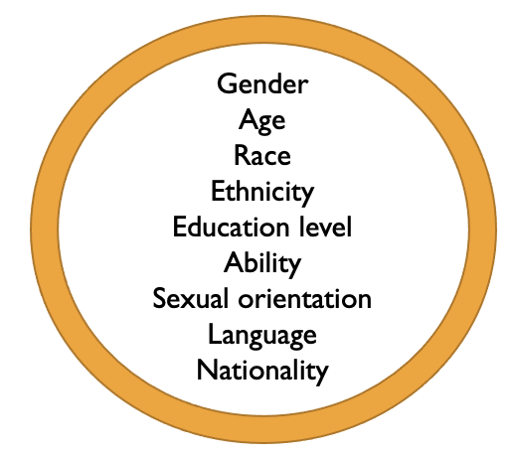
Social Identities and Positionality
Notes:
Deanna
Connecting to that idea of student perceptions, the center of this graphic lists a few of the different social identities that can influence the positionality of an instructor. Based on their identities, an instructor may experience different risks and benefits to modeling vulnerability in the classroom such as lower or higher student evaluation scores, more or less pushback from students, or a questioning of credibility or bias. Not only has awareness of my positionality helped me critically consider when to be vulnerable in a way that is meaningful to most students (not all), and is relevant to the class, it has also helped me reflect on my course design and curriculum and interrogate whose perspectives are being shared through my materials, what knowledge is being validated, and what narratives are being communicated. I’ve also been intentional about decentering myself as the expert and I strive to design courses that center around student knowledge and experience so I act more as a facilitator rather than conveyor of knowledge.
This recognition of positionality is a key component of the Inclusive Teaching Online workshop and, as mentioned earlier, participants in the workshop are asked to reflect on their positionality and prompted to consider how much personal information they reveal to students. Some folks answer that they reveal a lot, some express purposely hiding aspects of their identity, and others haven’t really thought about what personal information or identities are conveyed to students. Personal positionality is just one influence on barriers or opportunities to creating an inclusive classroom and it influences how we see and experience the world and thus how we design courses and interact with students.

Slide 23
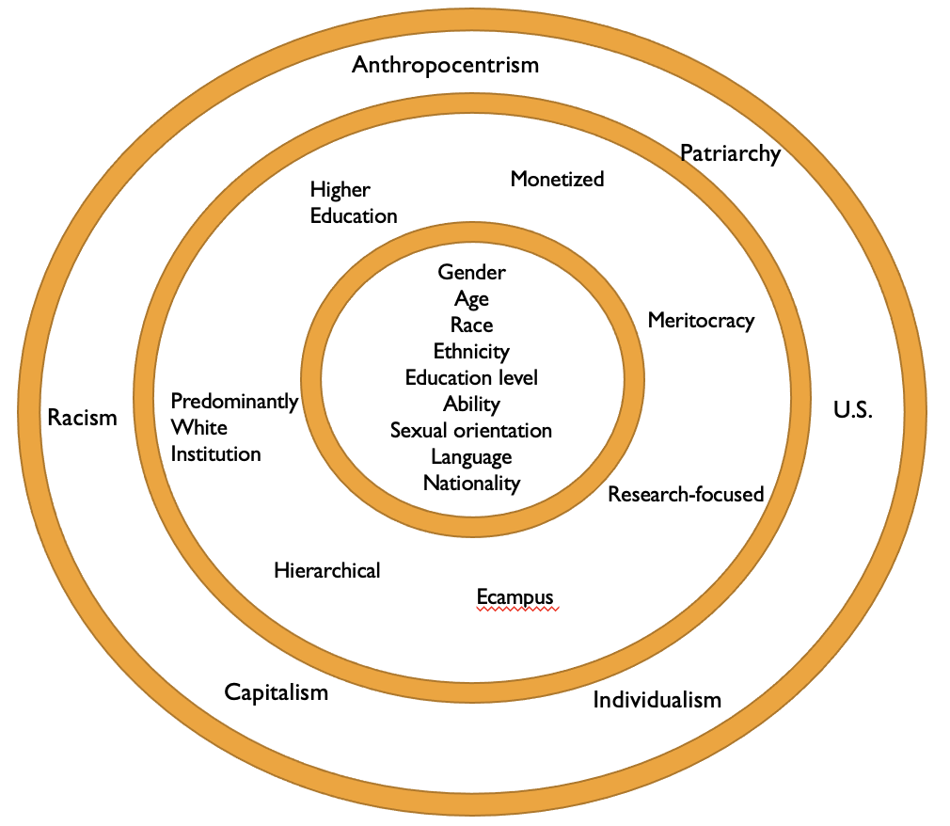
Social Identities and Positionality
Notes:
Deanna
We just talked about instructor positionality and, of course, each of our students also have their own identities and positionality. These identities are influenced by and operate within larger institutional and societal systems, some of which are listed in the outer two rings on this graphic. As Katherine noted earlier, there are intersections between inclusive teaching approaches and QM Standards. Considering standard 1.4 and how it requires clearly stating course policies, I first consider how these different systems influence my students, what narratives and assumptions I may be making about them, and then do my best to craft policies that are not only clearly stated, as required, but also equitable and inclusive.
These are a few ways that I’m using QM standards as a foundation to then integrate inclusive teaching strategies. Now back to Jen to share examples from her class.

Slide 24

Facilitating Difficult Dialogue:
Design simulates institutional bias using technical elements & assignment instructions
Students create biographical timeline profiles and evaluate each other’s work
Instructor facilitates discussion connecting the experience to course themes
Notes:
Jen
One of the courses I teach on social sustainability focuses on the experiences of minoritized individuals as environmental leaders and on communities facing environmental injustice. I designed an assignment that allows students to collaborate in small groups to create our course content on a multi-media biographical timeline. The assignment facilitates peer-to-peer learning, experiential learning, and offers students a creative way to demonstrate their understanding of the material.
In addition to these goals, I worked with an Ecampus Instructional Designer to illustrate themes of institutional bias, privilege, and cognitive bias, by simulating institutional discrimination in the assignment design using features available in Canvas.

Slide 25
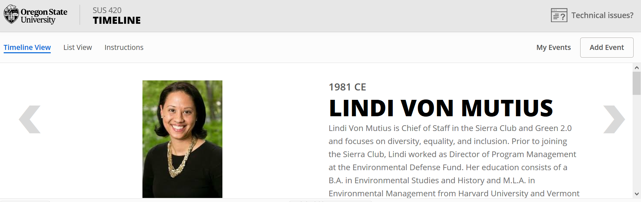
Multimedia Timeline Assignment
Notes:
Jen
In the assignment, groups of five students create profiles of environmental leaders from minoritized communities for the multimedia timeline. The majority of the class is required to submit a photo or video of the people that they profile, but I randomly select one group and provide them a truncated version of the assignment instructions. Students in this group are restricted to text submissions in the assignment settings.
At the end of the week, all of the students review the timeline, evaluate the profiles, and nominate their picks for the best contributions for extra credit. The evaluation criteria include how well the profile creatively illustrates the person’s work. The following week, I explain that the assignment was designed with built-in inequities and we have a discussion about the experience as a class.

Slide 26
What resonates with you?
What barriers do you experience in your own role that make it challenging to implement (or advocate for) inclusive teaching strategies?
What opportunities do you have to bring these strategies to your work?
Notes:
You all now have at least a slight sense of our roles and we would love to hear about you so we can tailor our Q&A responses to our audience. We’d like to know more about your roles and what inclusive teaching online means to you.

Slide 27
THANK YOU

Slide 28

Questions?

