Slide 1
OPENOTHEROPEN
Patrick Dempsey, EdD, MBA, MDiv, MAPC
Director of Digital Teaching & Learning
Loyola University Maryland
OTHEROPENOTHE
ROPENOTHEROPE
OPENNESS
TO
NOTHEROPENOTHE
OTHERNESS
OPENOTHEROPEN
creating transformative online communities

Slide 2
state whether you believe the earth is flat or round.

Slide 3

“
Several million Americans believe in a Flat Earth. Tens of millions more are open to the idea or unsure what to believe.
“
Loxton, 2019

Slide 4
explain why you think so many people believe in a flat earth.

Slide 5
“
Skeptics often talk about cognitive dissonance. One of the interesting things about people is just how little of it we experience.
Yes, it’s uncomfortable to confront a contradiction between two beliefs, but we rarely have to. Our contradictory ideas can co-exist in unexamined harmony until something forces us to contrast them against each other.
Noticing a contradiction takes mental effort. Resolving it takes more effort. This is especially true when our ideas are fuzzy or incomplete to begin with.
There is little obvious contrast between two patches of mental fog.
“
Loxton, 2019

Slide 7
personal experience

Slide 8
personal experience
public evidence

Slide 9
personal experience
public evidence
we don’t seem to spinning 1,000 mph and moving through space at 66,000 mph

Slide 10
personal experience
public evidence
we don’t seem to spinning 1,000 mph and moving through space at 66,000 mph
but we have lots observations, images, equations, experiments that say we are

Slide 11
list the evidence you have personally verified that support your beliefs.

Slide 12

explain what might happen as someone starts searching for flat earth evidence.

Slide 13
explain what you believe all this has to do with transformation.

Slide 14
openness to otherness
describe the common features of transformative learning experiences
explain the importance of course design in supporting transformative learning
identify practical ways to apply transformative principles and practices to the instructional design process

Slide 15
openness to otherness
describe the common features of transformative learning experiences
explain the importance of course design in supporting transformative learning
identify practical ways to apply transformative principles and practices to the instructional design process

Slide 16
explain your understanding of transformative learning.
describe the common features of transformative learning experiences

Slide 17
uniquely adult form of metacognitive reasoning by which we justify our beliefs
through critical assessment
describe the common features of transformative learning experiences
PREMISES | PROCESSES | PRODUCTS
why | how | what
Mezirow, 2003

Slide 18
1. experiencing a nondetermining start
2. undirected inquiry about the idea
3. social testing of the idea
4. shifting of relevance about the idea
5. reconstitution of personal identity based on incorporation of the idea
Product
Process
Premise
describe the common features of transformative learning experiences
Nohl, 2015

Slide 19
1. experiencing a nondetermining start
2. undirected inquiry about the idea
3. social testing of the idea
4. shifting of relevance about the idea
5. reconstitution of personal identity based on incorporation of the idea
Product
Process
Premise
describe the common features of transformative learning experiences
self / other
INTERACTIONS
Nohl, 2015

Slide 20
1. experiencing a nondetermining start
2. undirected inquiry about the idea
3. social testing of the idea
4. shifting of relevance about the idea
5. reconstitution of personal identity based on incorporation of the idea
Product
Process
Premise
explain how a round earther might become a flat earther.
describe the common features of transformative learning experiences
Nohl, 2015

Slide 21
1. experiencing a nondetermining start
2. undirected inquiry about the idea
3. social testing of the idea
4. shifting of relevance about the idea
5. reconstitution of personal identity based on incorporation of the idea
Product
Process
Premise
predict what other ideas might change for someone as they become a flat-earther.
describe the common features of transformative learning experiences
Nohl, 2015

Slide 22
HUMAN BECOMING
describe the common features of transformative learning experiences
Kegan & Lahey, 2016
Taylor & Elias, 2012

Slide 23
HUMAN BECOMING
incorporative
impulsive
imperial
socialized mind
self-authoring mind
self-transforming mind
describe the common features of transformative learning experiences
Kegan & Lahey, 2016
Taylor & Elias, 2012

Slide 24


HUMAN BECOMING
incorporative
impulsive
imperial
socialized mind
self-authoring mind
self-transforming mind
describe the common features of transformative learning experiences
Kegan & Lahey, 2016
Taylor & Elias, 2012

Slide 25
HUMAN BECOMING
incorporative
impulsive
imperial
socialized mind
self-authoring mind
self-transforming mind
describe the common features of transformative learning experiences
While we are formed and informed by self/other interactions . . .
we/they are not identified by them
Kegan & Lahey, 2016
Taylor & Elias, 2012

Slide 26
HUMAN BECOMING
incorporative
impulsive
imperial
socialized mind
self-authoring mind
self-transforming mind
describe the common features of transformative learning experiences
share ideas you are having about openness to otherness.
Kegan & Lahey, 2016
Taylor & Elias, 2012

Slide 27
openness to otherness
describe the common features of transformative learning experiences
explain the importance of course design in supporting transformative learning
identify practical ways to apply transformative principles and practices to the instructional design process

Slide 28
openness to otherness
describe the common features of transformative learning experiences
explain the importance of course design in supporting transformative learning
Product
Process
Premise
human becoming
self / other INTERACTIONS
identify practical ways to apply transformative principles and practices to the instructional design process

Slide 29
openness to otherness
describe the common features of transformative learning experiences
explain the importance of course design in supporting transformative learning
identify practical ways to apply transformative principles and practices to the instructional design process

Slide 30


if you have seen either of these movies (or similar), explain what they are about.
explain the importance of course design in supporting transformative learning

Slide 31
“
Every teacher needs to understand that she is working within a sensitive learning ecology whose directions can be altered by small changes in the boundary conditions and interaction patterns of the classroom.
explain the importance of course design in supporting transformative learning
“
Mason, 2008

Slide 32

BUMPING INTO
explain the importance of course design in supporting transformative learning

Slide 33
BUMPING INTO
list some things students might “bump into” in your course.
explain the importance of course design in supporting transformative learning

Slide 34
BUMPING INTO
explain what might happen when students might “bump into” into . . .
explain the importance of course design in supporting transformative learning

Slide 35
“
[the principles of complexity theory] can be used to prescribe actions and situations that promote change and development.
explain the importance of course design in supporting transformative learning
“
Morrison, 2008

Slide 36
“
transformative learning communities emerge, grow, and sustain themselves as a result of the interactions of constituents within boundary conditions, or parameters, which enable those interactions to develop and flourish
explain the importance of course design in supporting transformative learning
“
Horn, 2008

Slide 37
interactions determine outcomes
explain the importance of course design in supporting transformative learning

Slide 38
openness to otherness
describe the common features of transformative learning experiences
explain the importance of course design in supporting transformative learning
identify practical ways to apply transformative principles and practices to the instructional design process

Slide 39
openness to otherness
describe the common features of transformative learning experiences
explain the importance of course design in supporting transformative learning
identify practical ways to apply transformative principles and practices to the instructional design process
interactions determine outcomes
(consider what might happen when students bump into . . .)

Slide 40
openness to otherness
describe the common features of transformative learning experiences
explain the importance of course design in supporting transformative learning
identify practical ways to apply transformative principles and practices to the instructional design process

Slide 41
Opportunities | Space | Interactions
Actionable Strategies | Fractal Design | Feedback/Feedforward

Slide 42

critical mass

Slide 43
Opportunities | Space | Interactions
Actionable Strategies | Fractal Design | Feedback/Feedforward

Slide 44
Opportunities | Space | Interactions
Actionable Strategies | Fractal Design | Feedback/Feedforward

Slide 45
Perspective-taking
Trying on new roles
Reflection
Projection
Student research
Learner-centered and Learner-driven practices
VR/XR
Service-learning
Project and problem-based learning
Mentoring
Virtual study abroad
identify practical ways to apply transformative principles and practices to the instructional design process

Slide 46
Perspective-taking
Trying on new roles
Reflection
Projection
Student research
Learner-centered and Learner-driven practices
VR/XR
Service-learning
Project and problem-based learning
Mentoring
Virtual study abroad
identify practical ways to apply transformative principles and practices to the instructional design process
list transformative practices you use

Slide 47
Opportunities | Space | Interactions
Actionable Strategies | Fractal Design | Feedback/Feedforward

Slide 48
Opportunities | Space | Interactions
Actionable Strategies | Fractal Design | Feedback/Feedforward

Slide 49



how cool are fractals?
identify practical ways to apply transformative principles and practices to the instructional design process

Slide 50
Module 1 | Remember | Diversity | Student research
Module 2 | Understand | Hospitality | Reflection
Module 3 | Apply | Inclusion | Mentoring
Module 4 | Analyze | Equity | Trying on new roles
Module 5 | Evaluate | Love | Perspective taking
Module 6 | Create | Service | Service-learning
identify practical ways to apply transformative principles and practices to the instructional design process
Module 1 | Peer Sharing Forum | Remember | Diversity | Student research
 |  | Understand | Hospitality | Reflection
 | Peer Review Forum | Apply | Inclusion | Mentoring
 |  | Analyze | Equity | Trying on new roles
 | Synthesizing Activity | Evaluate | Love | Perspective taking
 |  | Create | Service | Service-learning

Slide 51
Module 1 | Remember | Diversity | Student research
Module 2 | Understand | Hospitality | Reflection
Module 3 | Apply | Inclusion | Mentoring
Module 4 | Analyze | Equity | Trying on new roles
Module 5 | Evaluate | Love | Perspective taking
Module 6 | Create | Service | Service-learning
identify practical ways to apply transformative principles and practices to the instructional design process
Module 1 | Peer Sharing Forum | Remember | Diversity | Student research
 |  | Understand | Hospitality | Reflection
 | Peer Review Forum | Apply | Inclusion | Mentoring
 |  | Analyze | Equity | Trying on new roles
 | Synthesizing Activity | Evaluate | Love | Perspective taking
 |  | Create | Service | Service-learning

Slide 52
Module 1 | Remember | Diversity | Student research
Module 2 | Understand | Hospitality | Reflection
Module 3 | Apply | Inclusion | Mentoring
Module 4 | Analyze | Equity | Trying on new roles
Module 5 | Evaluate | Love | Perspective taking
Module 6 | Create | Service | Service-learning
identify practical ways to apply transformative principles and practices to the instructional design process
Module 1 | Peer Sharing Forum |  | Diversity | Student research
 |  |  | Hospitality | Reflection
 | Peer Review Forum |  | Inclusion | Mentoring
 |  |  | Equity | Trying on new roles
 | Synthesizing Activity |  | Love | Perspective taking
 |  |  | Service | Service-learning

Slide 53
Module 1 | Remember | Diversity | Student research
Module 2 | Understand | Hospitality | Reflection
Module 3 | Apply | Inclusion | Mentoring
Module 4 | Analyze | Equity | Trying on new roles
Module 5 | Evaluate | Love | Perspective taking
Module 6 | Create | Service | Service-learning
identify practical ways to apply transformative principles and practices to the instructional design process
Module 1 | Peer Sharing Forum | Remember | Diversity | Student research
 |  | Understand | Hospitality | Reflection
 | Peer Review Forum | Apply | Inclusion | Mentoring
 |  | Analyze | Equity | Trying on new roles
 | Synthesizing Activity | Evaluate | Love | Perspective taking
 |  | Create | Service | Service-learning

Slide 54
Module 1 | Remember | Diversity | Student research
Module 2 | Understand | Hospitality | Reflection
Module 3 | Apply | Inclusion | Mentoring
Module 4 | Analyze | Equity | Trying on new roles
Module 5 | Evaluate | Love | Perspective taking
Module 6 | Create | Service | Service-learning
identify practical ways to apply transformative principles and practices to the instructional design process
Module 1 | Peer Sharing Forum | Remember | Diversity | Student research
 |  | Understand | Hospitality | Reflection
 | Peer Review Forum | Apply | Inclusion | Mentoring
 |  | Analyze | Equity | Trying on new roles
 | Synthesizing Activity | Evaluate | Love | Perspective taking
 |  | Create | Service | Service-learning

Slide 55
Module 1 | Remember | Diversity | Student research
Module 2 | Understand | Hospitality | Reflection
Module 3 | Apply | Inclusion | Mentoring
Module 4 | Analyze | Equity | Trying on new roles
Module 5 | Evaluate | Love | Perspective taking
Module 6 | Create | Service | Service-learning
identify practical ways to apply transformative principles and practices to the instructional design process
Module 1 | Peer Sharing Forum | Remember | Diversity | Student research
 |  | Understand | Hospitality | Reflection
 | Peer Review Forum | Apply | Inclusion | Mentoring
 |  | Analyze | Equity | Trying on new roles
 | Synthesizing Activity | Evaluate | Love | Perspective taking
 |  | Create | Service | Service-learning

Slide 56
Module 1 | Remember | Diversity | Student research
Module 2 | Understand | Hospitality | Reflection
Module 3 | Apply | Inclusion | Mentoring
Module 4 | Analyze | Equity | Trying on new roles
Module 5 | Evaluate | Love | Perspective taking
Module 6 | Create | Service | Service-learning
identify practical ways to apply transformative principles and practices to the instructional design process
Module 1 | Peer Sharing Forum | Remember | Diversity | Student research
 |  | Understand | Hospitality | Reflection
 | Peer Review Forum | Apply | Inclusion | Mentoring
 |  | Analyze | Equity | Trying on new roles
 | Synthesizing Activity | Evaluate | Love | Perspective taking
 |  | Create | Service | Service-learning

Slide 57
Module 1 | Remember | Diversity | Student research
Module 2 | Understand | Hospitality | Reflection
Module 3 | Apply | Inclusion | Mentoring
Module 4 | Analyze | Equity | Trying on new roles
Module 5 | Evaluate | Love | Perspective taking
Module 6 | Create | Service | Service-learning
identify practical ways to apply transformative principles and practices to the instructional design process
Module 1 | Peer Sharing Forum | Remember | Diversity | Student research
 |  | Understand | Hospitality | Reflection
 | Peer Review Forum | Apply | Inclusion | Mentoring
 |  | Analyze | Equity | Trying on new roles
 | Synthesizing Activity | Evaluate | Love | Perspective taking
 |  | Create | Service | Service-learning

Slide 58
Module 1 | Remember | Diversity | Student research
Module 2 | Understand | OPENNESS | PROJECTION
Module 3 | Apply | Inclusion | Mentoring
Module 4 | Analyze | Equity | Trying on new roles
Module 5 | Evaluate | Love | Perspective taking
Module 6 | Create | Service | Service-learning
identify practical ways to apply transformative principles and practices to the instructional design process
Module 1 | Peer Sharing Forum | Remember | Diversity | Student research
 |  | Understand | OPENNESS | PROJECTION
 | Peer Review Forum | Apply | Inclusion | Mentoring
 |  | Analyze | Equity | Trying on new roles
 | Synthesizing Activity | Evaluate | Love | Perspective taking
 |  | Create | Service | Service-learning

Slide 59
explain how you use or are thinking about using self-similarity/repeating patterns in course design.
Opportunities | Space | Interactions
Actionable Strategies | Fractal Design | Feedback/Feedforward

Slide 60
Opportunities | Space | Interactions
Actionable Strategies | Fractal Design | Feedback/Feedforward

Slide 61
Opportunities | Space | Interactions
Actionable Strategies | Fractal Design | Feedback/Feedforward

Slide 62






explain the purposes of negative/positive feedback.
identify practical ways to apply transformative principles and practices to the instructional design process
negative feedback
positive feedback

Slide 63




negative feedback
positive feedback
identify practical ways to apply transformative principles and practices to the instructional design process
corrective | directive
control | propel
avoid failure | amplify success

Slide 64





negative feedback
positive feedback
identify practical ways to apply transformative principles and practices to the instructional design process
corrective | directive
control | propel
avoid failure | amplify success

Slide 65
Opportunities | Space | Interactions
Actionable Strategies | Fractal Design | Feedback/Feedforward

Slide 66
Opportunities | Space | Interactions
Actionable Strategies | Fractal Design | Feedback/Feedforward

Slide 67
openness to otherness
describe the common features of transformative learning experiences
explain the importance of course design in supporting transformative learning
identify practical ways to apply transformative principles and practices to the instructional design process

Slide 68
openness to otherness
describe the common features of transformative learning experiences
explain the importance of course design in supporting transformative learning
identify practical ways to apply transformative principles and practices to the instructional design process

Slide 69
human becoming
self / other interactions
interactions determine outcomes
(consider what might happen when students bump into . . .)
Opportunities | Space | Interactions
Actionable Strategies | Fractal Design | Feedback/Feedforward
Product
Process
Premise

Slide 70
openness to otherness
imagine a colleague asked you to explain to them the most important lessons from this presentation. In a few words, summarize the key points you would share.

Slide 71


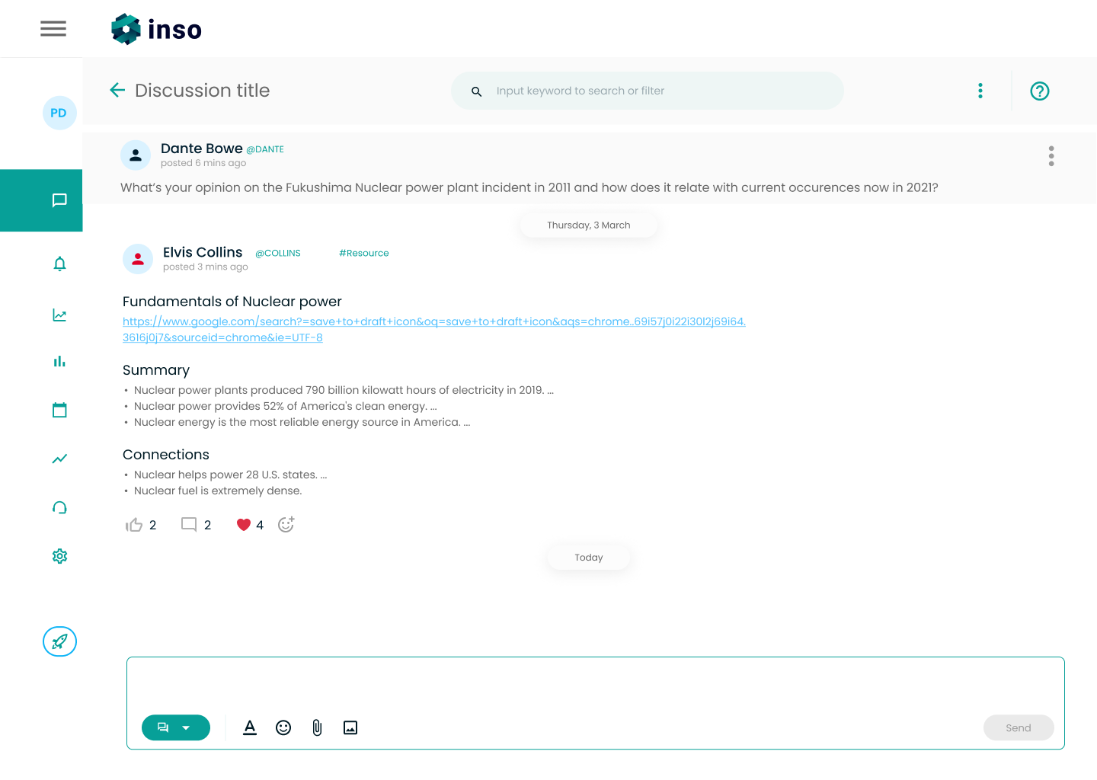


prdempsey@loyola.edu
Patrick Dempsey, EdD, MBA, MDiv, MAPC
Director of Digital Teaching & Learning
Loyola University Maryland
Code
QMS22
Power equitable achievement through developmental discussions about any topic
Notes:
https://forms.monday.com/forms/239a51046d7effc68901e738c8fd369c?r=use1

Slide 72

Speaking and Workshops
Popular Topics
Inclusive teaching practices
Transformative learning
Designing for equity
Changing role of instructors
Creating community online
Feedback strategies
Scaling instructional design services
Improving online discussions
Patrick Dempsey EdD, MBA, MDiv, MAPC
Director of Digital Teaching & Learning
Loyola University Maryland
Rates |  | Rates
Type | Description | Virtual | In-Person
Conversation | Presentation to a team or division | $250-$750 | $1,000+
Conference | Keynote or other major address | $500-$2,500 | $2,000+
Workshop | Half-day to multiday | $750/day | $1,000/day+
Final pricing is flexible and depends on the needs, audience, scope, and other factors. Contact me to discuss.
thepatrickdempsey@gmail.com
631-353-9093

