Slide 1

Indiana University Online
#WelcomeOnlineStudents
Collaborating to Build Flexible Orientation Experiences for Online Learners
INDIANA UNIVERSITY

Slide 2
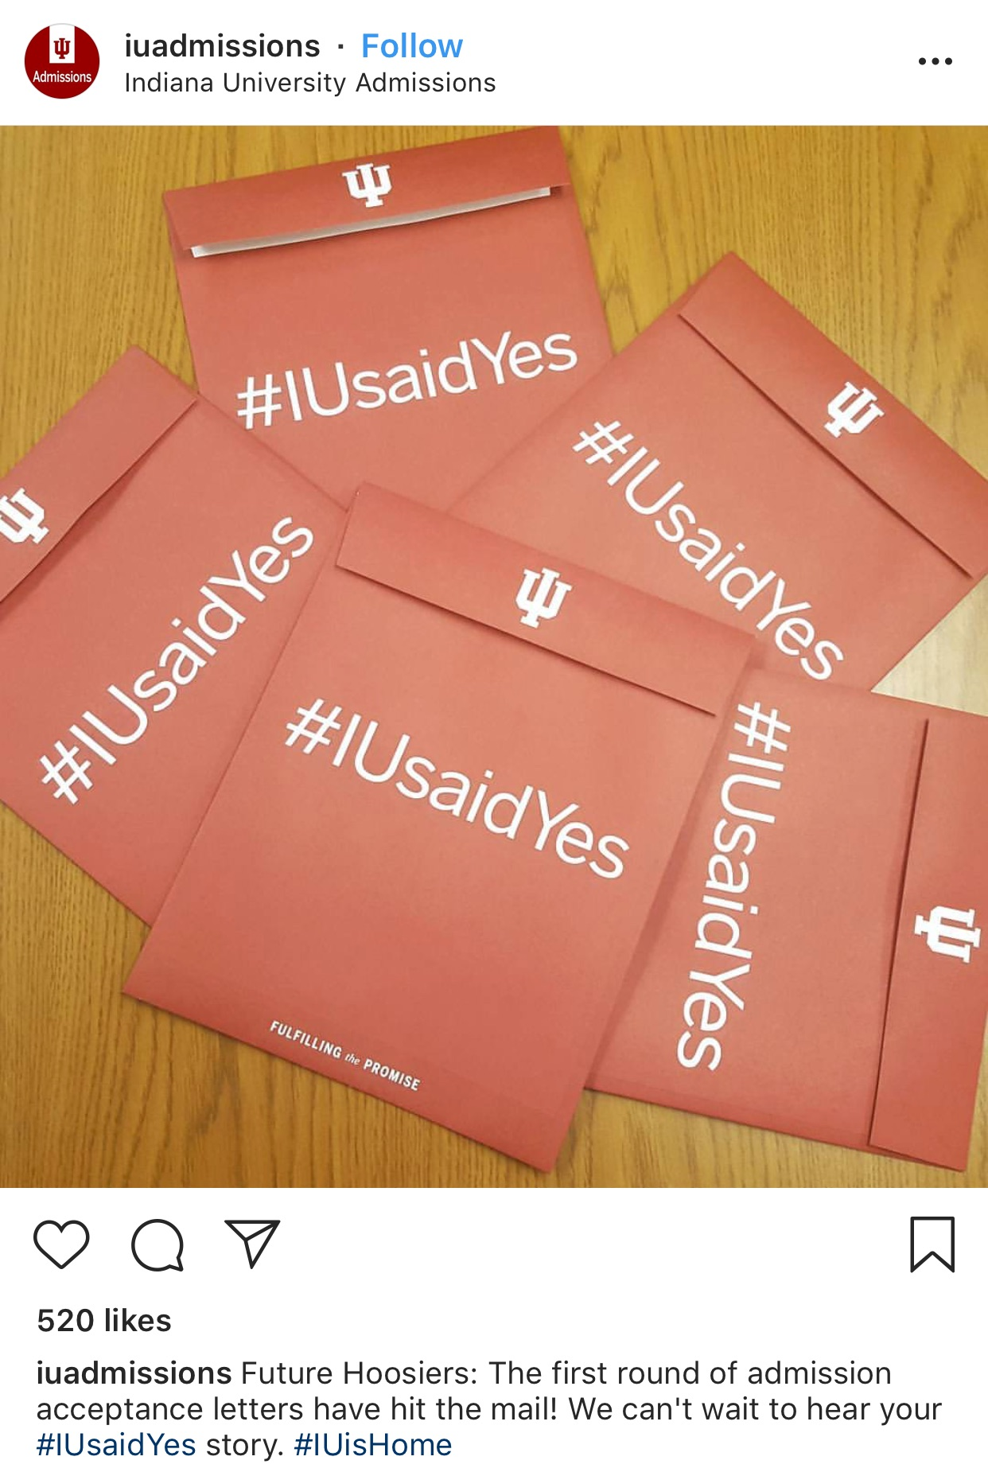

Summer

Slide 3
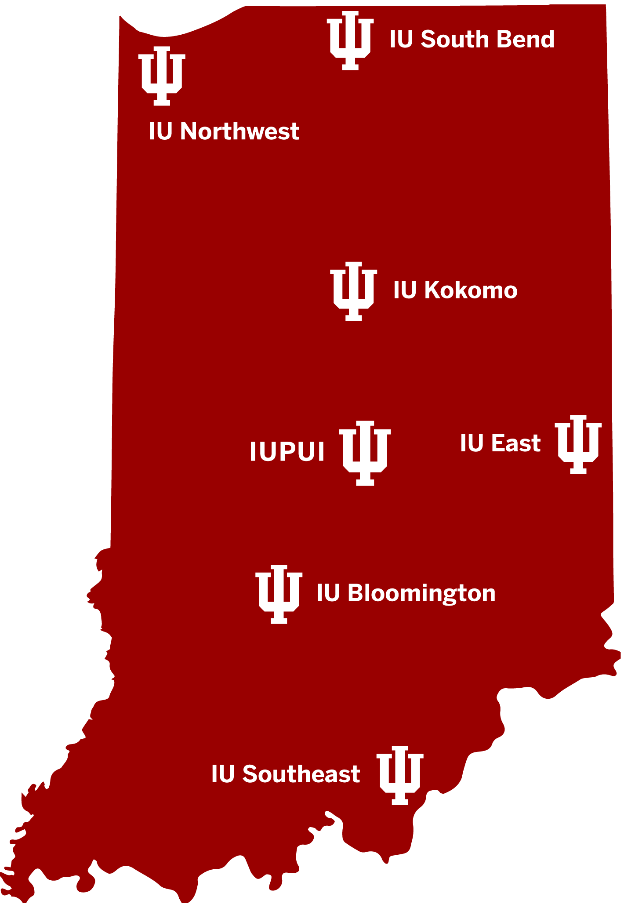
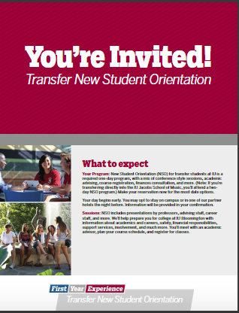
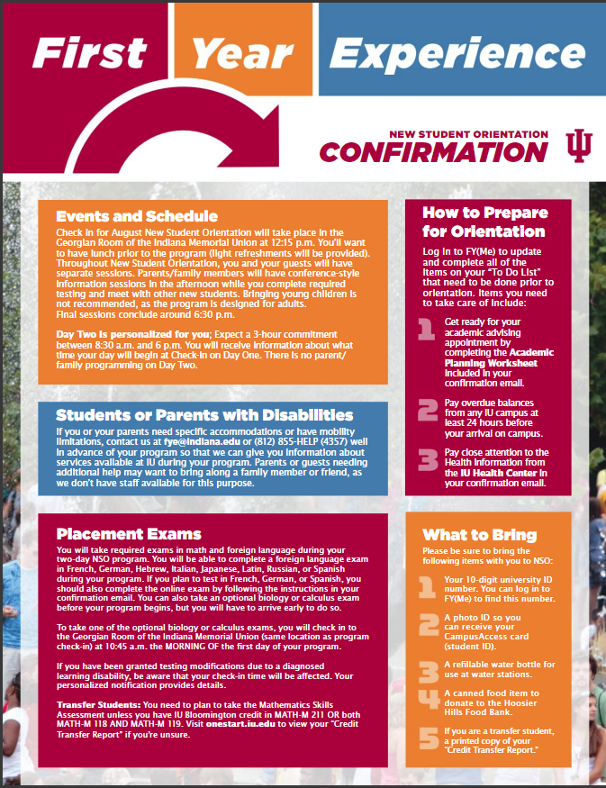
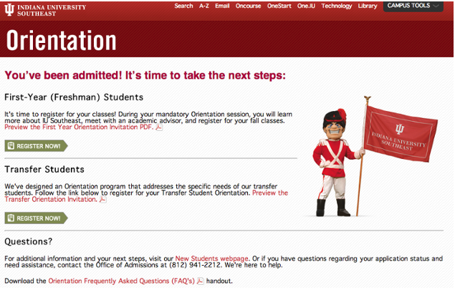

Slide 4
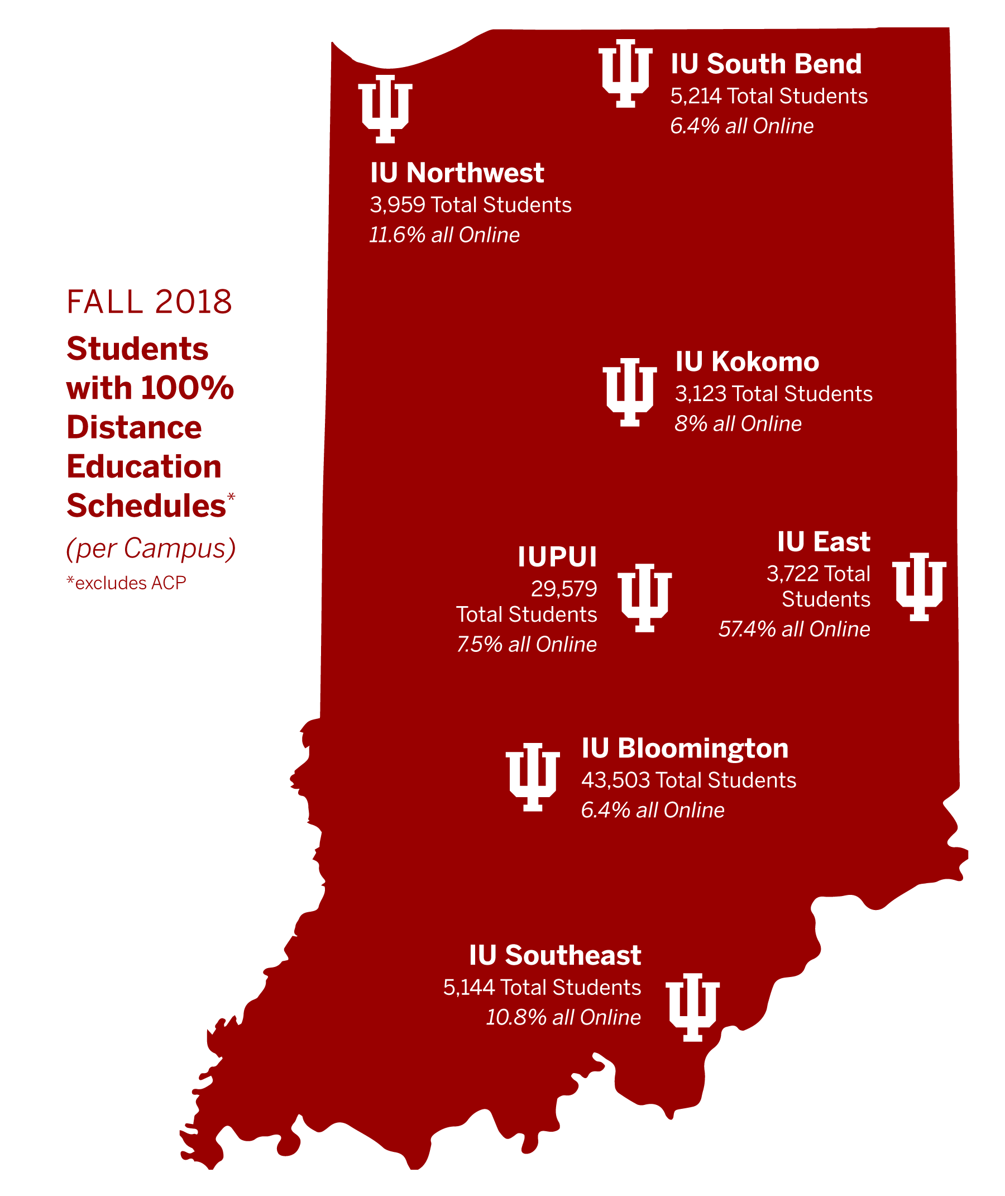
As IU Online expanded….
Collaborative degrees launched
Distance from home campus became factor
Blend of admit types stared to change
Greater interest from certificate and non-degree applicants
F2F students started taking more courses online – often at other campuses
Online enrollments grew across the board

Slide 5
Development Process
Engage instructional design team
Content inventory of existing campus-based orientation programs
Prioritization by “phase” of topics for online students
Determine learning outcomes
Gather and build content in consultation with subject matter experts

Slide 6
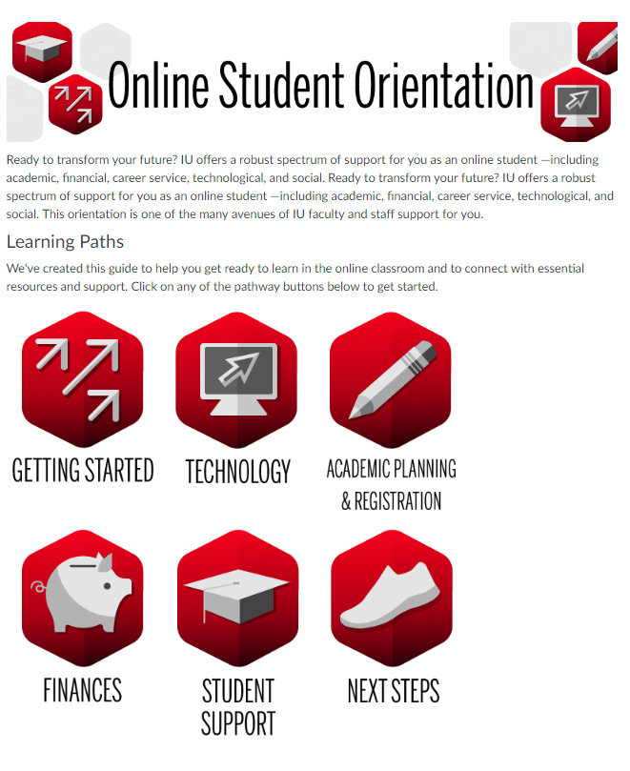
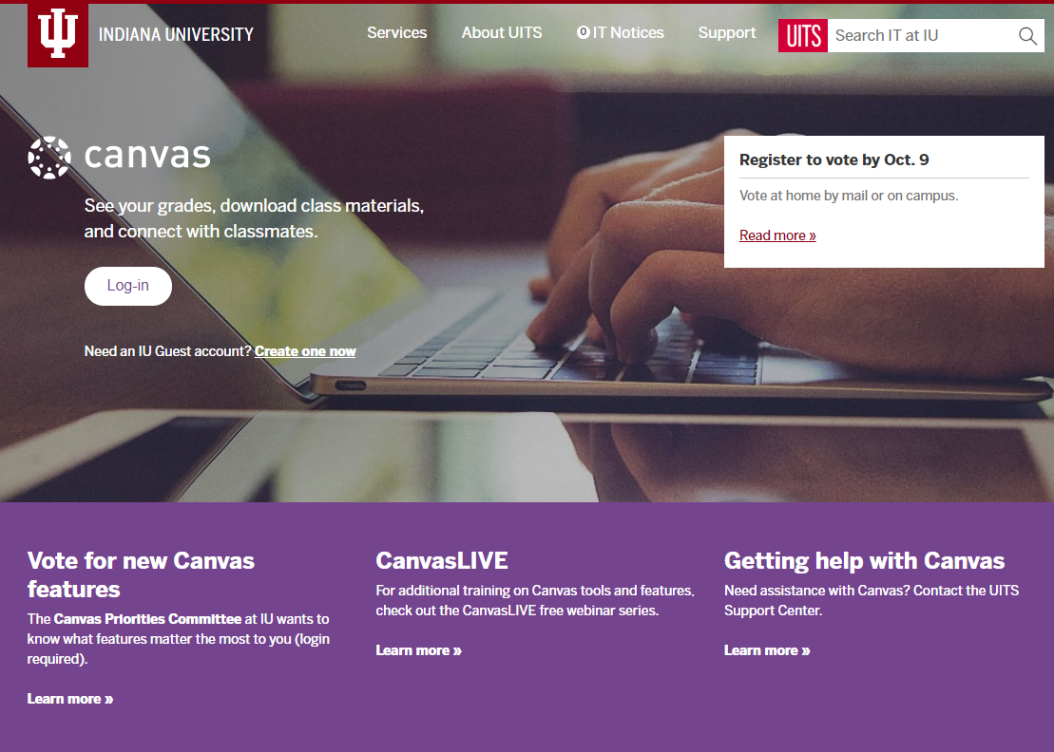
Version 1

Slide 7
How it Evolved into an “Onboarding”
Utilization patterns
  Students used it as just-in-time resource to find relevant information at key moments
Onboarding becomes a flexible experience
  Students can shop for what they need, when they need it.
Allows content to mature and to encourage student success
  Ex: Graduation, Career Services, Next Steps Modules
Requests for new content from other campus stakeholders

Slide 8
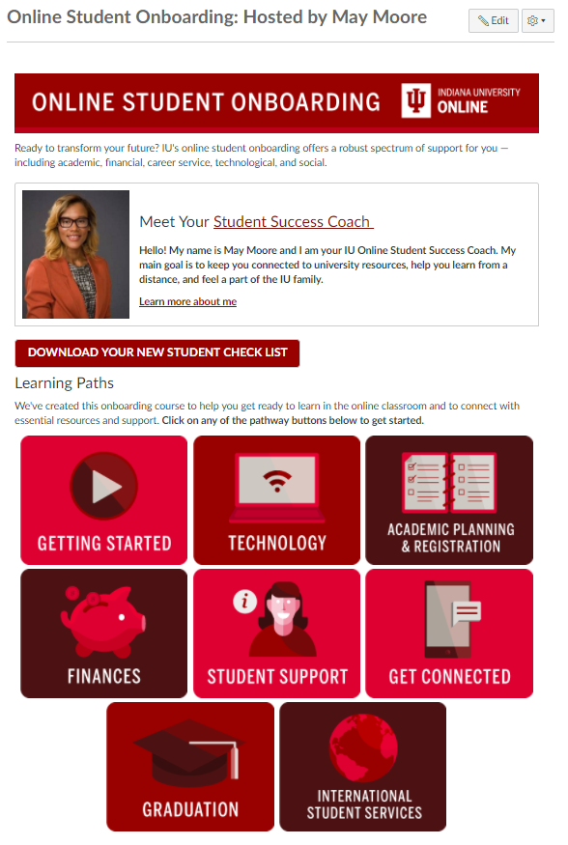
How it Works
Students are assigned a Success Coach based on campus
Success Coach sends email invitation to join onboarding within two weeks of admissions decision
Student accepts invitation in Canvas
Student retains access throughout time at IU Online
Version 2

Slide 9
Coaching
Partnership
Self-assessment
Goal-setting
Accountability
Student
Reflection
Application
Motivation
Learning
System
Resource
Information
Engagement
Learning outcomes

Slide 10
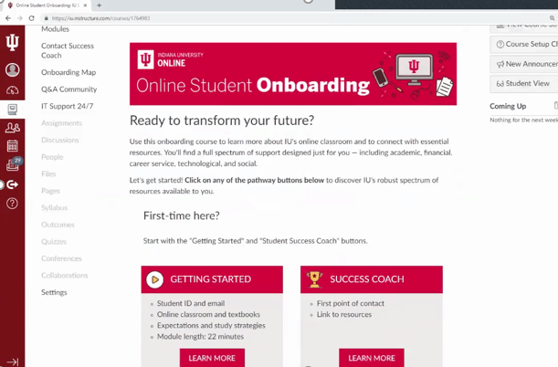
Enhancements over time
More granular modules
Improved navigation
Student-centered videos
Discussion community (Inscribe)
Mapping tool
Data dashboard
Version 3
Notes:
Estimated module completion

Slide 11
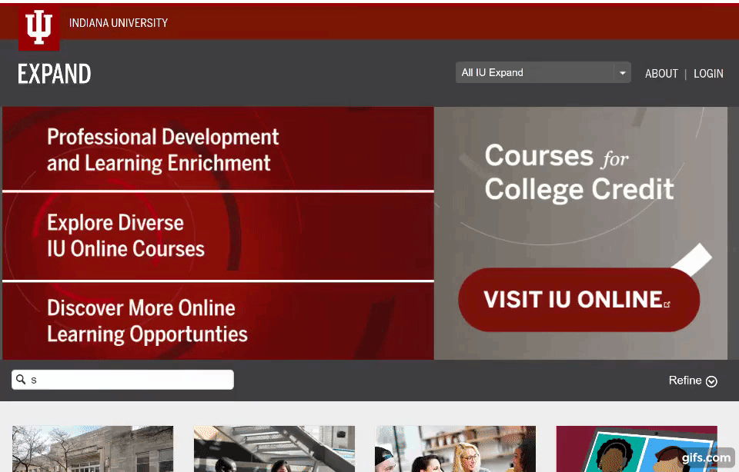
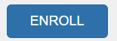

Get access
Navigate to expand.iu.edu
Search “Showoff”
Select the course
Select
If needed, create guest account

Slide 12
Discussion Break
Who has an orientation experience for online students?
  Is it focused on the institution? The program? Studying online?
How does it differ for online and face-to-face students or is it the same?
Is it required? Why or why not?

Slide 13
Flexible Orientation Experiences for Online Learners

Slide 14
Six possible basic starting points
Online learning
Online courses
Program
Department
Campus
Institution

Slide 15
Is Onboarding a Fixed Pathway?
Online Learning
Online Courses
Program
Department
Campus
Institution

Slide 16
Is it a Hierarchy?
Online Courses
Program
Department
Campus
Institution
Online Learning
Online Learning
Online Courses
Program
Department
Campus
Institution

Slide 17
What About a Customizable Equation?
Online Learning
Online Courses
Program
Department
Campus
Institution
Well prepared student?
Online Learning
Online Courses
Program
Department
Campus
Institution
Well prepared student?
Online Learning
Online Courses
Program
Department
Institution
Well prepared student?
Campus

Slide 18
Creating Flexible Blocks
Online Learning
Online Courses
Program
Department
Campus
Institution

Slide 19
For your block
Goals
Content
Collaborators

Slide 20
Creating Flexible Blocks
Online Learning
Online Courses
Program
Department
Campus
Institution
Continue Slides

Slide 21
Online Learning
Goals
Content
Collaborators
Provide a basic overview of learning online
Demonstrate how online learning works at Indiana University
Communicate the value of IU Online coursework
Answer commonly asked questions
Easy grouping or navigation
Intentionally brief and easy to consume
Marketing
Admissions
Success Coaches
Faculty
Advisors
Back

Slide 22
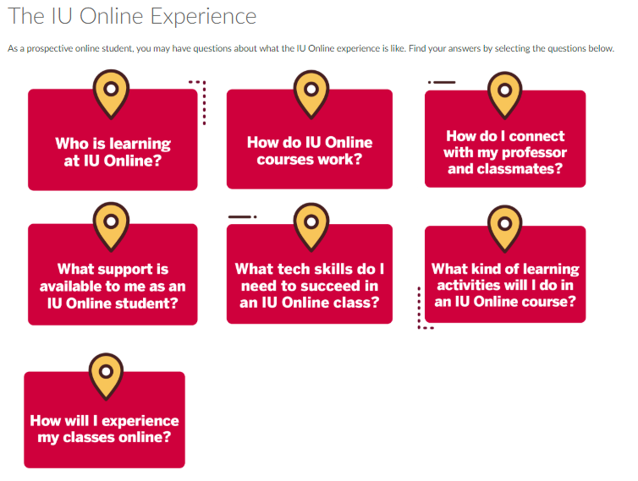


Back

Slide 23
Online Courses
Goals
Content
Collaborators
Expose students to common elements of online courses
Showcase the role of faculty in designing and delivering courses
Demonstrate different learning materials, assessments
Address student concerns/interests
Appeal to broad audiences
Instructional Designers
Faculty
Admissions
Success Coaches
Advisors
Back

Slide 24
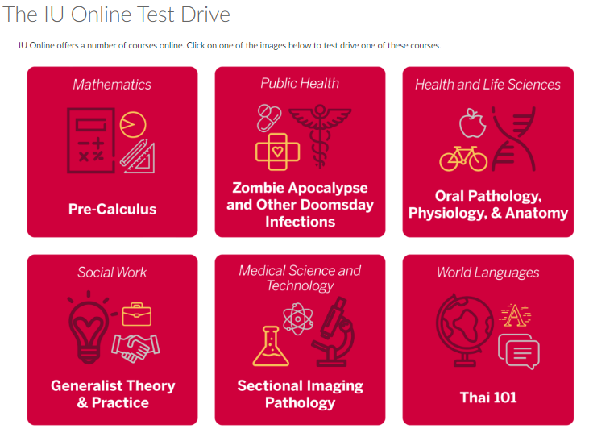
Back

Slide 25
Program
Goals
Content
Collaborators
Provide program specific information
Connect with key advisors, faculty, and staff
Prereqs/Requirements
Special Features
Outcomes
“Personality”
  Foundational courses
  Readiness assessments
  Skill refreshers
Program staff lead
Program chair
Faculty
Admissions
Advisors
Back

Slide 26
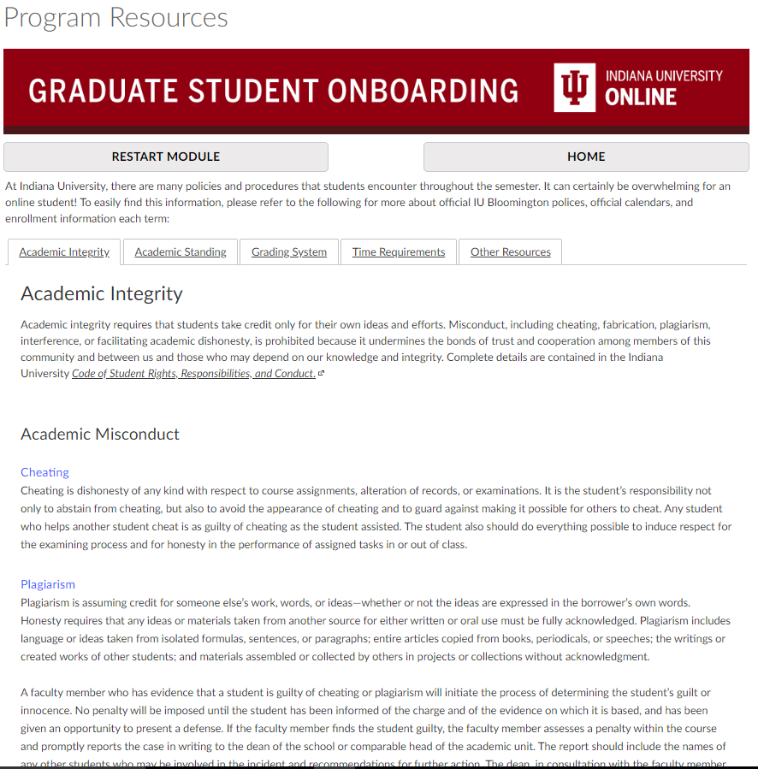
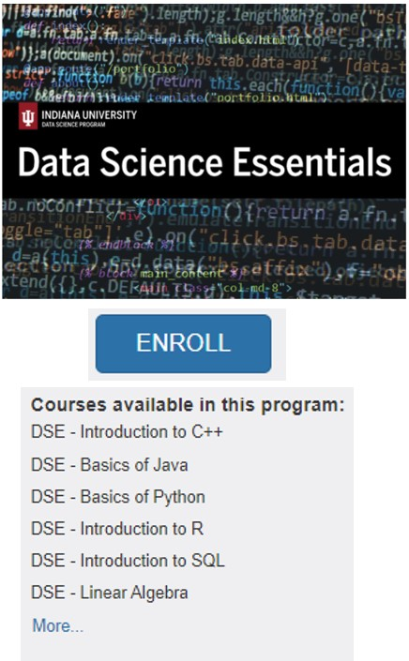
Back

Slide 27
Department
Goals
Content
Collaborators
Provide department specific information
Connect with key advisors, faculty, and staff
Degrees/Programs
Policies and Procedures
Leadership and Staff
Faculty
Student Groups
Career Services
Residency Weeks
Study Abroad
Dean
Department Chair
Departmental staff
Faculty
Back

Slide 28
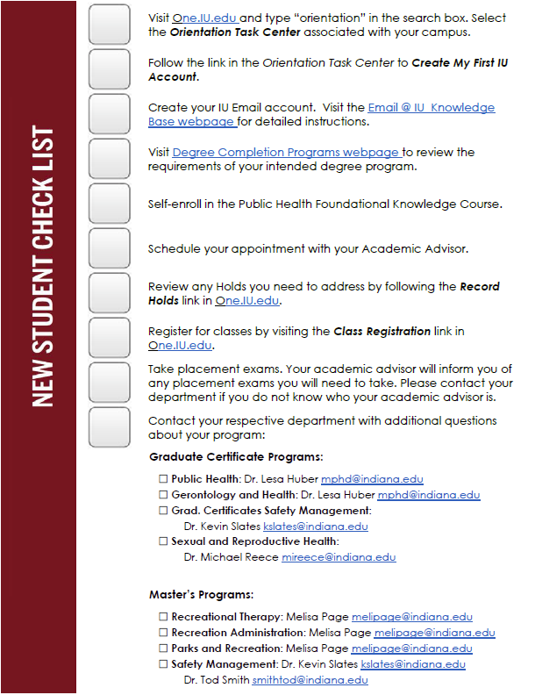
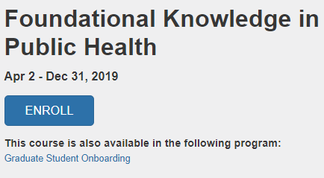
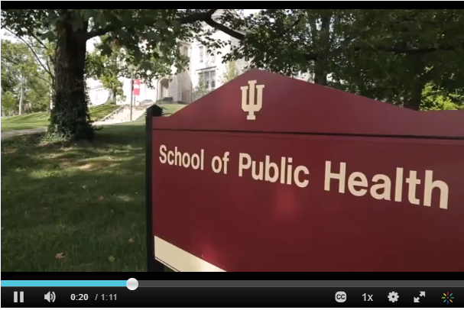

Back

Slide 29
Campus
Goals
Content
Collaborators
Provide consistent but campus specific information
Introduce campus staff and offices
Create virtual space for students
Social Media
Mascots
Bookstore
Libraries
Cohort Map
Discussion Community
Admissions
Advising
Success Coaches
Marketing
Alumni
Back

Slide 30
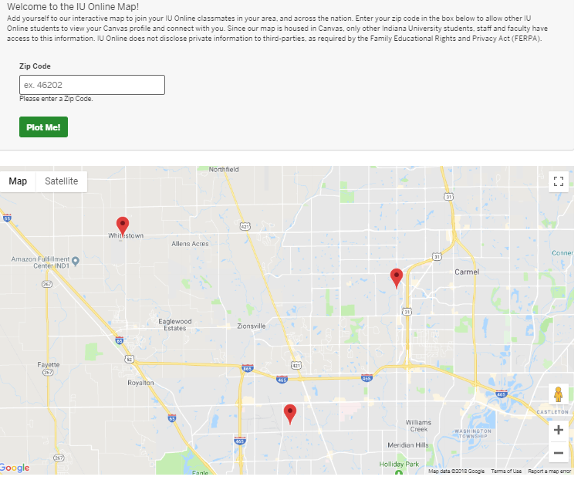

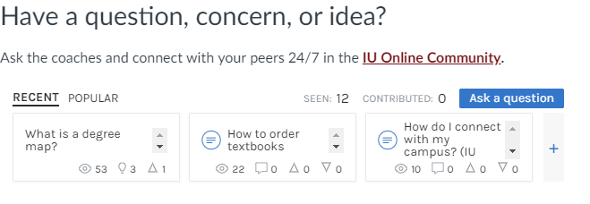
Back

Slide 31
Institution
Goals
Content
Collaborators
Give big picture view
Provide access to key institutional policies
Build connection to “Spirit and Tradition”
Academic Integrity
Student Conduct
Crimson Card
Graduation Checklist
Graduation video
Admissions
Marketing
Alumni Association
Back

Slide 32
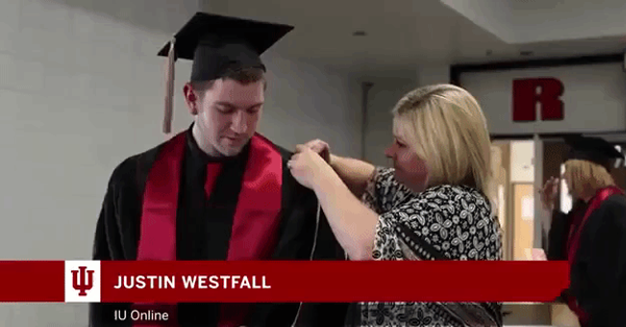
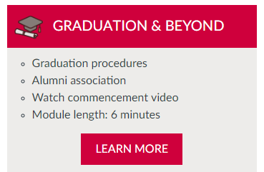
Back

Slide 33
Building with your blocks

Slide 34
Leveraging Flexible Building Blocks
Online Learning
Online Courses
Program
Department
Campus
Institution
Continue Slides

Slide 35
Leveraging Flexible Building Blocks
Online Learning
Online Courses
Program
+
✓
✓
Department
Campus
Institution
Continue Slides

Slide 36
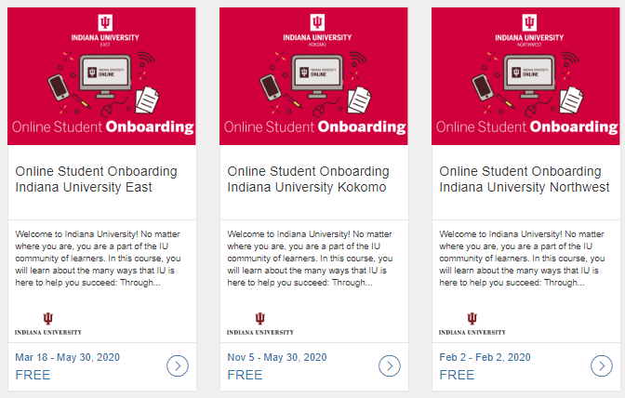
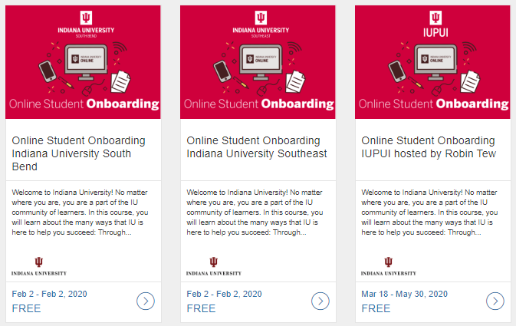
Undergraduate Onboarding

Slide 37
Leveraging Flexible Building Blocks
Online Learning
Online Courses
Program
+
✓
✓
Department
Campus
Institution

Slide 38
Leveraging Flexible Building Blocks
?
Online Learning
Online Courses
Program
+
✓
✓
Department
Campus
Institution

Slide 39
Leveraging Flexible Building Blocks
✓
Online Learning
Online Courses
Program
+
+
✓
✓
Department
Campus
Institution

Slide 40
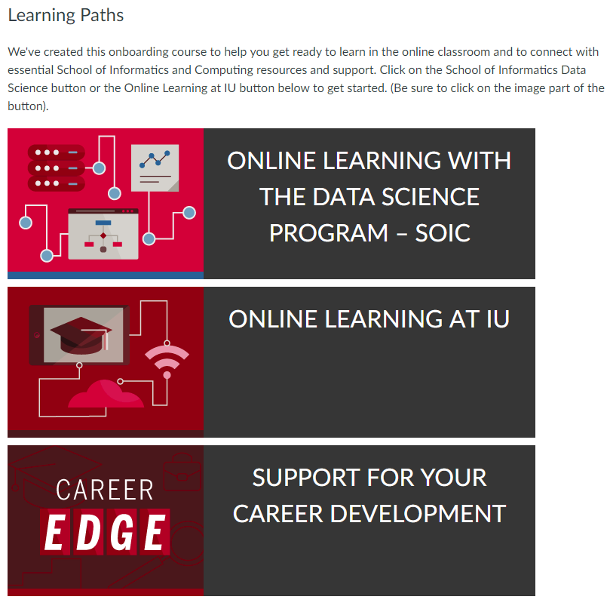
Graduate Onboarding Program Version

Slide 41
Leveraging Flexible Building Blocks
✓
Online Learning
Online Courses
Program
+
+
?
✓
✓
Department
Campus
Institution

Slide 42
Leveraging Flexible Building Blocks
✓
Online Learning
Online Courses
Program
+
+
+
✓
✓
✓
Department
Campus
Institution

Slide 43
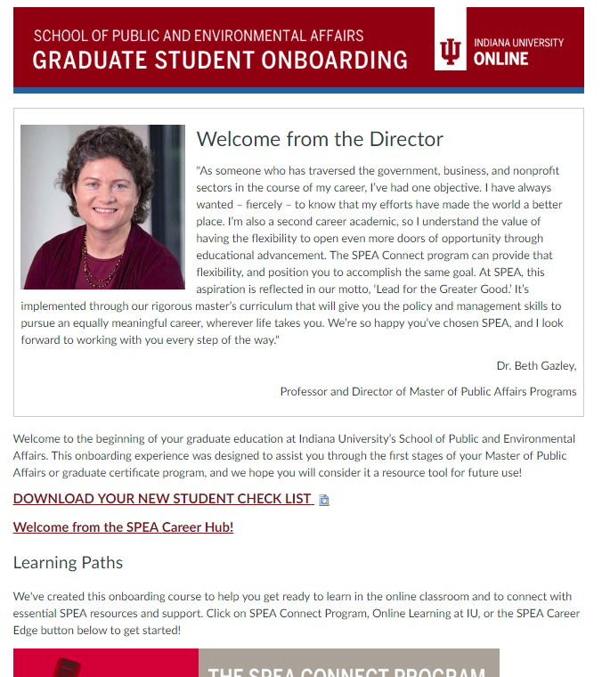
Graduate Onboarding Department Version

Slide 44
Leveraging Flexible Building Blocks
?
?
✓
Online Learning
Online Courses
Program
✓
✓
✓
Department
Campus
Institution

Slide 45
Leveraging Flexible Building Blocks
+
?
?
✓
Online Learning
Online Courses
Program
✓
✓
✓
Department
Campus
Institution

Slide 46
Leveraging Flexible Building Blocks
+
?
?
✓
Online Learning
Online Courses
Program
✓
✓
✓
Department
Campus
Institution

Slide 47

IU Online Course Test Drive

Slide 48
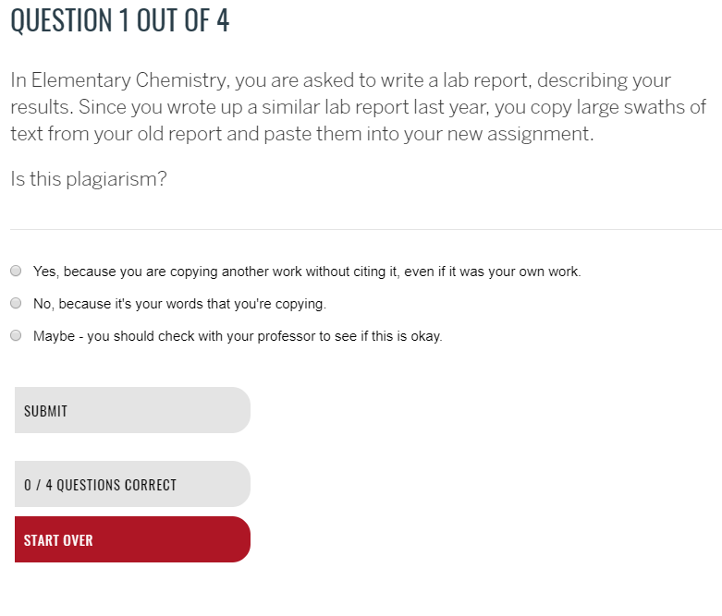
Points for Consideration
When to enroll students?
How to enroll students?
Are the experiences required?
How do you communicate value added?
If “completion” is measured, how is it measured?

Slide 49
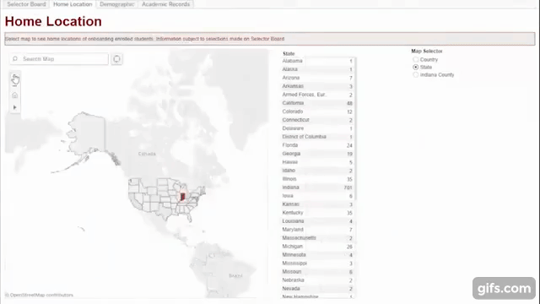
Extracting Useful Data
Phases:
  Basic LMS data
  Integrating SIS Data
  Add detailed behavioral data
Goals:
  Understand how users interact
  Weighting within Retention Model

Slide 50
Chris J. Foley
Associate Vice President
and Director
Office of Online Education
Indiana University
cfoley@ iu.edu
Alison Bell
Project Lead
IU Online Onboarding
Office of Online Education
Indiana University
naabell@iupui.edu
Robert Smith
Project Manager
IU Online Onboarding
Office of Online Education
Indiana University
rs23@iupui.edu
Mitchell Farmer
Assistant Director
Campus Partner Programs
Office of Online Education
Indiana University
mgf@iu.edu
Julia Sanders
Principal Instructional Designer
eLearning Design & ServicesOffice of UITS
Indiana University
juasande@iu.edu

