Slide 1

QM and Accreditation—Sounds Boring but It’s BASIC
Paula Reams PhD, APRN, CNP-F, CNE, LMT
Kettering College
Innovative. Superior graduates. Passion for health and service.

Slide 2
Directions for Using Poll Everywhere
Respond to polling questions by:
  Website:
    PollEv.com/paulareams992
  Text Messaging:
    paulareams992 to 22333
    Then enter the letter for your response
Notes:
Must type in 22333 in the address then paulareams992 in the message.

Slide 3
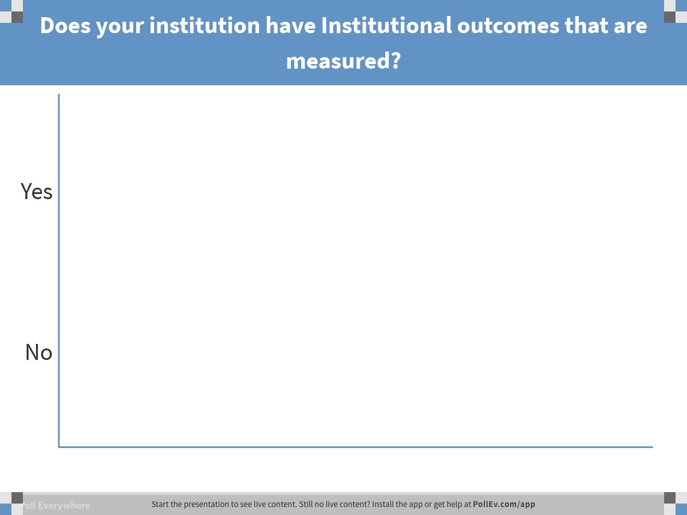
Notes:
Poll Title: Does your institution have Institutional outcomes that are measured?
https://www.polleverywhere.com/multiple_choice_polls/7cVYEcCg6QufWyt

Slide 4
QM Standard 3.1
Standard 3.1 is one of the QM Alignment Standards that assists with learner success through demonstration of proficiency of assignments and meeting outcomes. This QM Standard helps higher education institutions demonstrate accreditation goals by aligning learning outcomes to assignments.
Notes:
This is where working with QM is so important because it helps accreditors see the alignment from institutional, program, course to even modular outcomes come alive. Data that is gathered can not only help with accreditation, it can help make improvements in programs and courses, which is also a QM goal.

Slide 5
HLC Criteria for Accreditation
Criterion 4B. The institution demonstrates a commitment to educational achievement and improvement through ongoing assessment of student learning.
  The institution has clearly stated goals for student learning and effective processes for assessment of student learning and achievement of learning goals.
  The institution assesses achievement of the learning outcomes that it claims for its curricular and co-curricular programs.
  The institution uses the information gained from assessment to improve student learning.
  The institution’s processes and methodologies to assess student learning reflect good practice, including the substantial participation of faculty and other instructional staff members.

Slide 6

BASIC Institutional Outcomes
Broad Integrative Learning
  Demonstrates broad integrative knowledge of disciplines outside the students’ specific field of study.
Applied Learning
  Demonstrates the ability to put knowledge to use in a new practical context, such as classroom settings, clinical/laboratory, or mission experiences.
  Specialized Learning
    Demonstrates appropriate use of, and fluency in, specialized terms, vocabulary, technologies, and methods of the specific field of study.
Intellectual Skills
  Demonstrates continued development in reading comprehension, oral and written communication and quantitative analysis in projects, papers and professional performance.
Civic Engagement
  Engages in serving human need using knowledge and skill from both integrative and specialized curricula in community/global settings.
Notes:
B: What life lessons are you learning?
A: How do you use what you learn?
S: How are you becoming an expert?
I: In what ways are you smarter?
C: How are you engaged in your community?

Slide 7
Program Accreditation Guidelines
CoARC Standard 3.02
  Program goal(s) must form the basis for ongoing program planning, implementation, evaluation, and revision. In addition, optional program goal(s) and outcomes must be reviewed annually by program personnel to ensure compatibility with the mission of the sponsoring educational institution.
Notes:
There are 5 emphases in the program, management, education, respiratory, advanced imaging and sonography.
The Respiratory program is accredited (will be in July we hope!) had visit in January.
By Co ARC

Slide 8
RC Program Learning Outcomes
All graduates will demonstrate the:
Ability to recall, apply, and analyze information required of advanced-level respiratory therapists. (Specialized Learning IO)
Manual dexterity and technical proficiency necessary to perform as competent advanced-level respiratory therapists. (Specialized Learning IO)
Caring and positive attitude necessary for continued employment as advanced-level respiratory therapists. (Applied Learning IO)
Ability to engage in critical thinking, reflection, and problem solving through evidence-based practice in multiple health care settings. (Intellectual Skills IO)
Respect and adaptability for cultural, ethnic, and individual diversity within a changing health care environment. (Broad Integrative Learning IO)
Ability to incorporate current knowledge, theory, and research into health professions practice. (Intellectual Skills IO)
Ability to empower himself or herself and others through an integration of leadership, management, and teaching/learning skills in the health care environment. (Civic Engagement IO)
Professional, ethical, spiritual, and compassionate service within the health care setting. (Civic Engagement IO)

Slide 9
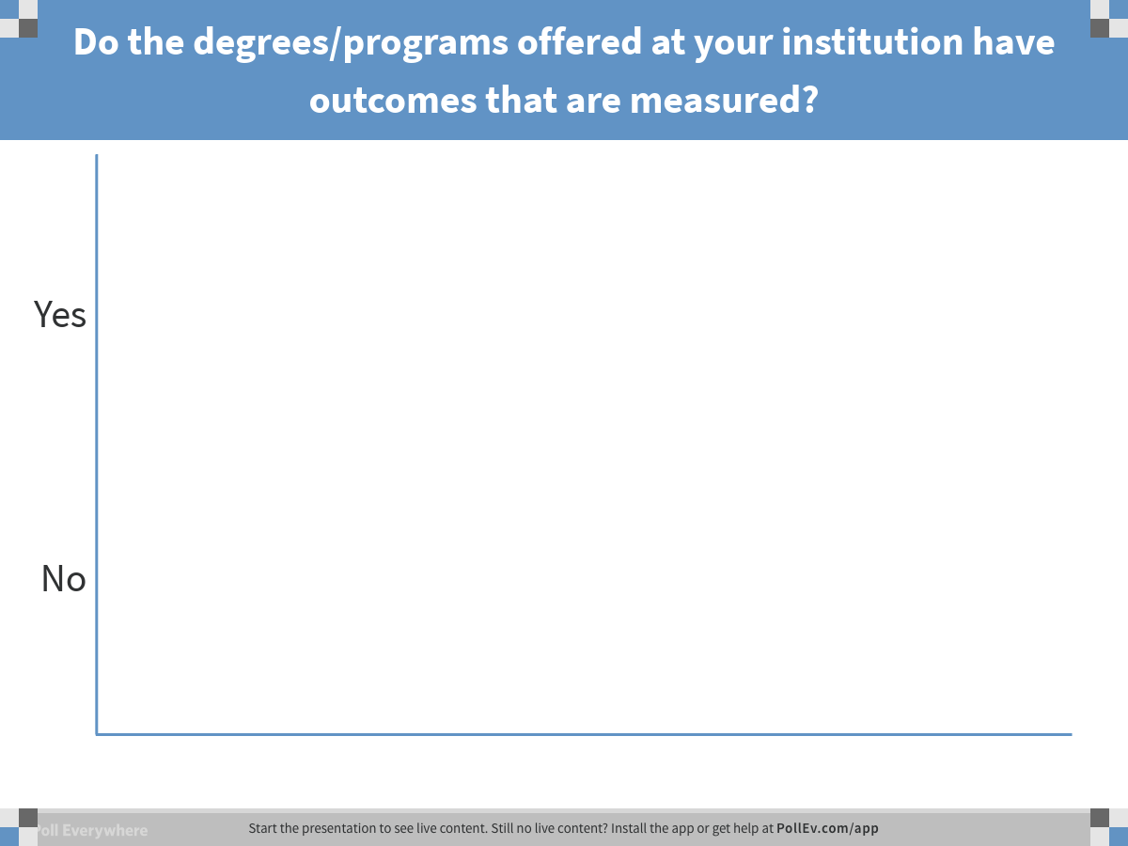
Notes:
Poll Title: Do the degrees/programs offered at your institution have outcomes that are measured?
https://www.polleverywhere.com/multiple_choice_polls/91zao6IVkt5CKR1

Slide 10
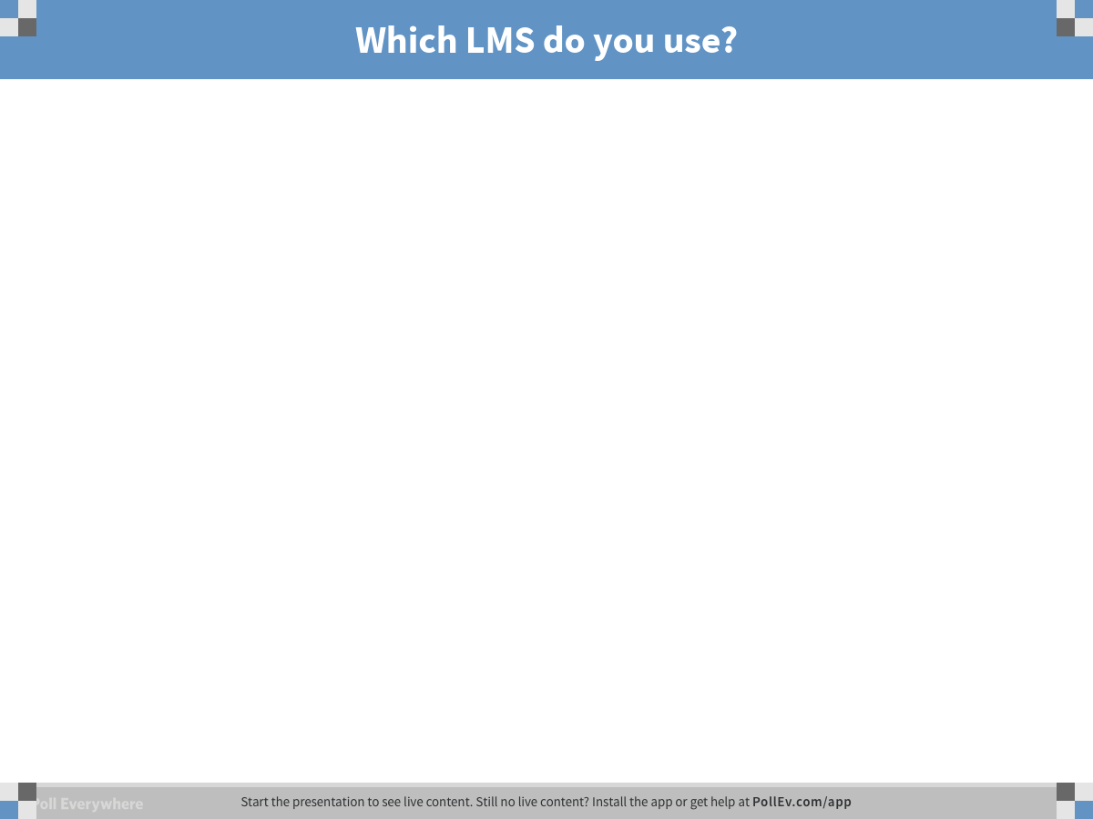
Notes:
Poll Title: Which LMS do you use?
https://www.polleverywhere.com/free_text_polls/IMly2h135U4UkWj

Slide 11
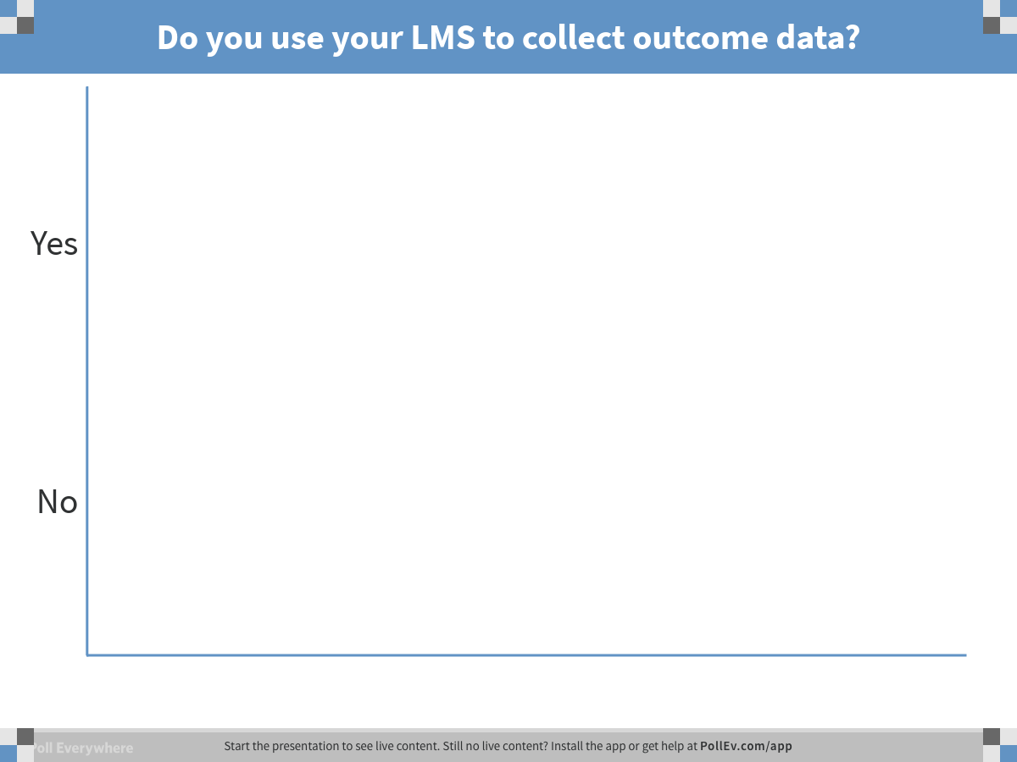
Notes:
Poll Title: Do you use your LMS to collect outcome data?
https://www.polleverywhere.com/multiple_choice_polls/c4cDhTbO4yvkatp

Slide 12
QM Standards
The QM Rubric addresses learning outcomes
  Course learning outcomes
  Unit/Module learning outcomes
If the unit/module and course outcomes align, then it is just a process to align program and institutional outcomes to them.
Notes:
Alignment of 2.1, 2.2 3.1, 4.1, 5.1, 6.1—all are 3 points on the rubric

Slide 13
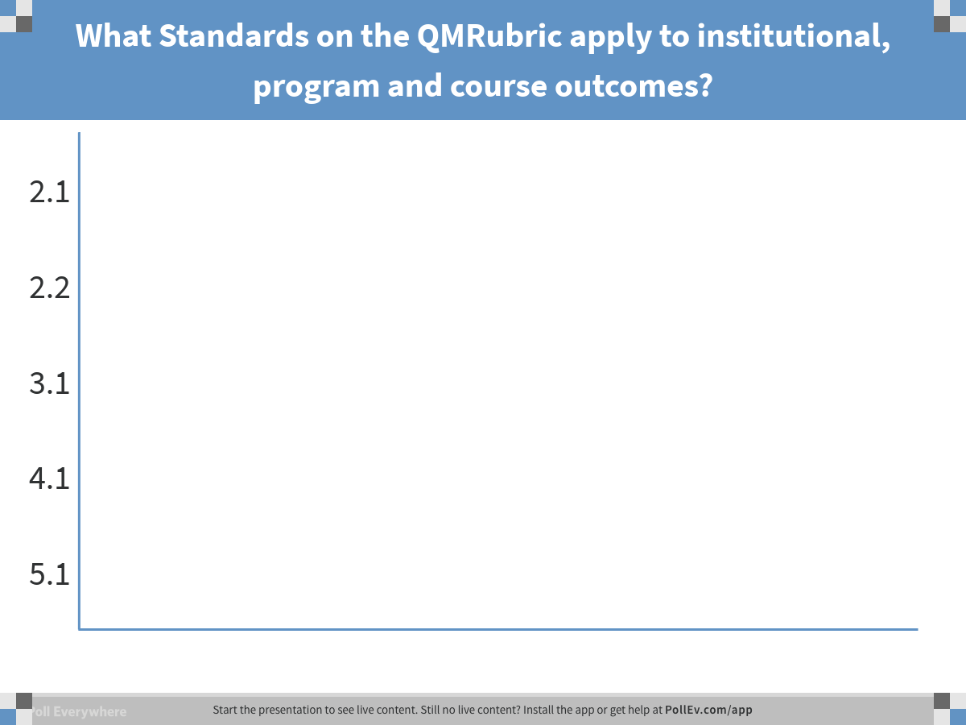
Notes:
Poll Title: What Standards on the QMRubric apply to institutional, program and course outcomes?
https://www.polleverywhere.com/multiple_choice_polls/Q3LwDFExDosQ7QK

Slide 14
QM Alignment Standards
Standard 2.2:
  The module/unit learning objectives or competencies describe outcomes that are measureable and consistent with the course-level objectives or competencies.
Notes:
Show rubric book

Slide 15
Health Sciences
Linking specific assessments to module/course, program and institutional outcomes
It’s in the syllabus!
LMS linking (Canvas)
Notes:
Go to canvas; show rubric link and outcome grade on the rubric—HESC 348, interview paper

Slide 16
Health Sciences
Rubric for measuring the outcomes
  4—exceeds outcomes
  3—meets outcomes
  2—elements of outcomes being met
  1—does not meet outcome
  0 – for students not enrolled in the program

Slide 17
Course Outcomes for HESC 348
Interview paper assignment—course outcomes measured
  Demonstrate understanding of management of physical, fiscal, and human resources within the current practice environments
  Discuss use of professional communication to effectively implement patient safety and quality improvement initiatives within the context of the interprofessional team.
  Apply key concepts of decision making, conflict management, delegation, change theory, ethical and legal issues to health care professional management.
  Evaluate organizations and systems within the context of structure, culture and climate.
  Demonstrate knowledge of political, fiscal, and regulatory process related to health care provider management and leadership in shaping health care.

Slide 18
HESC example of linking outcomes
Program outcome and Institutional outcome (BASIC) measured with Interview paper assignment
Empowers himself or herself and others through an integration of leadership, management and teaching/learning skills in the health care environment. (Specialized Knowledge)—the S in Basic

Slide 19
Data Collection
All courses in the Health Sciences measure course, program and institutional outcomes
Data is downloaded from Canvas into Tableau
Data is reviewed for errors
Snap shot for each semester of
  Meeting/not meeting outcomes for each course
  Meeting/not meeting outcomes for the program and institutional outcomes

Slide 20
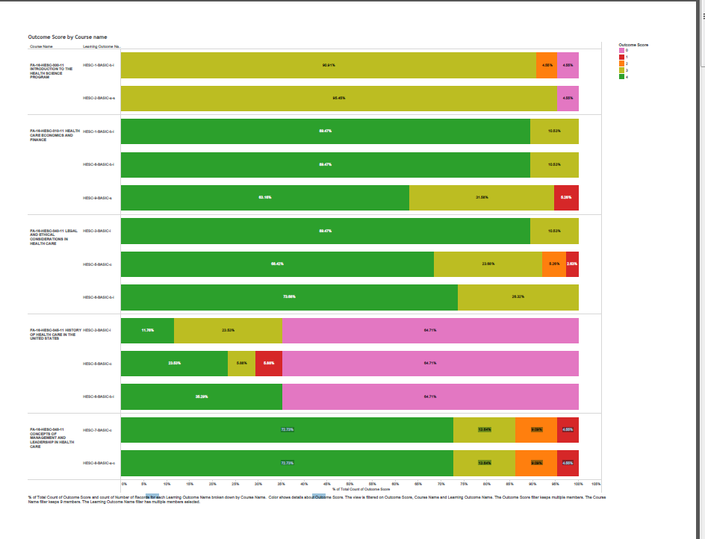
Outcome Data
Notes:
We use tabluo

Slide 21
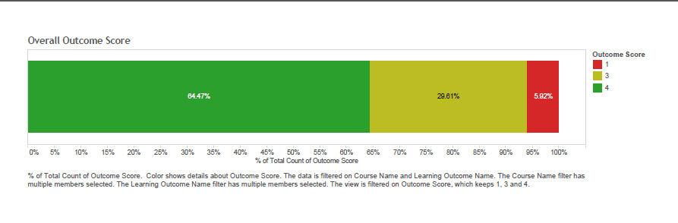
More Data

Slide 22
Evaluation of Data
Over time (year)
Reviewed by Health Sciences Council
Changes made based on aggregated and trended data.
  Made changes based on this data for particular courses
  Continuous monitoring of trends for improvement.

Slide 23


