Slide 1

Scaling Up Quality
A Five-Year-Plan for QM Professional Development at a Large Public University
Belltower at night image credit: Marc Hall

Slide 2

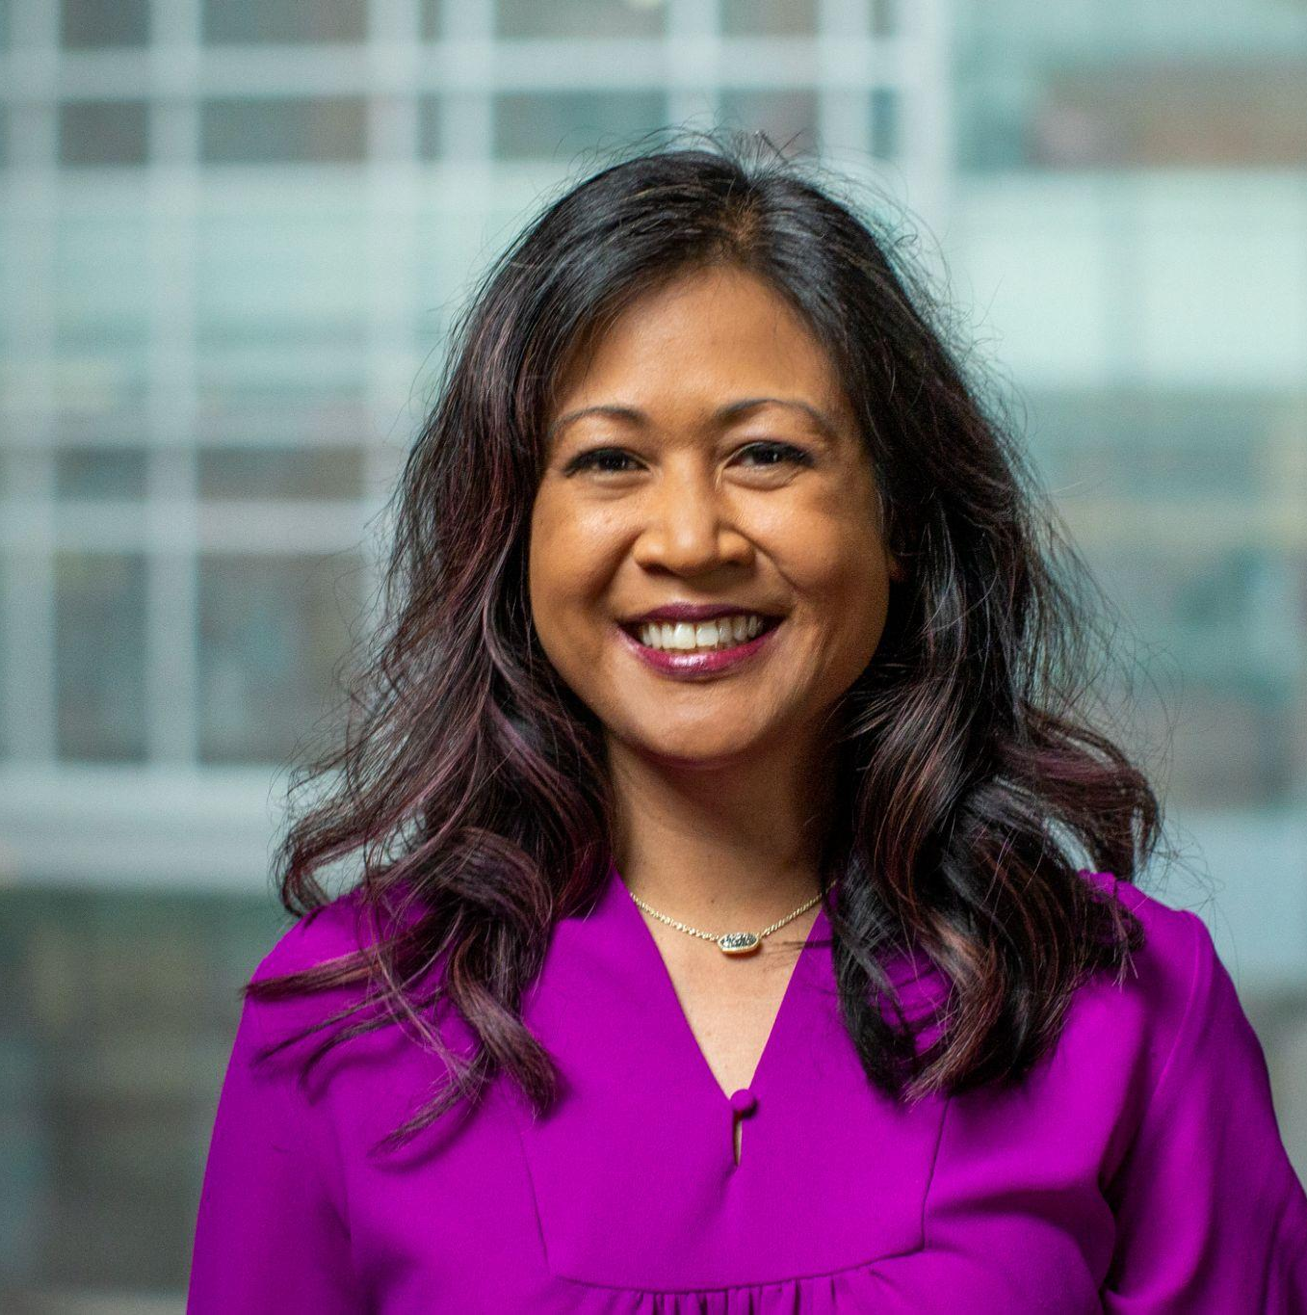
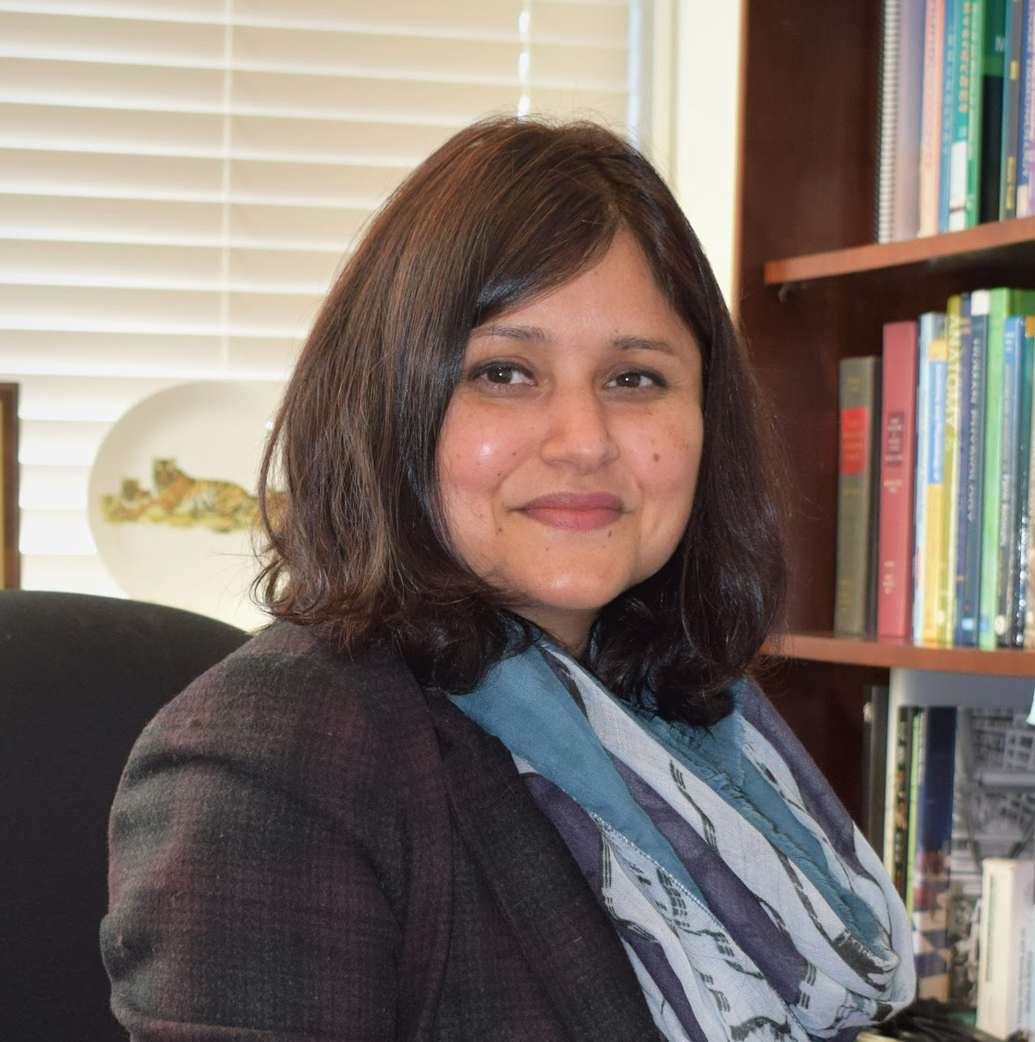
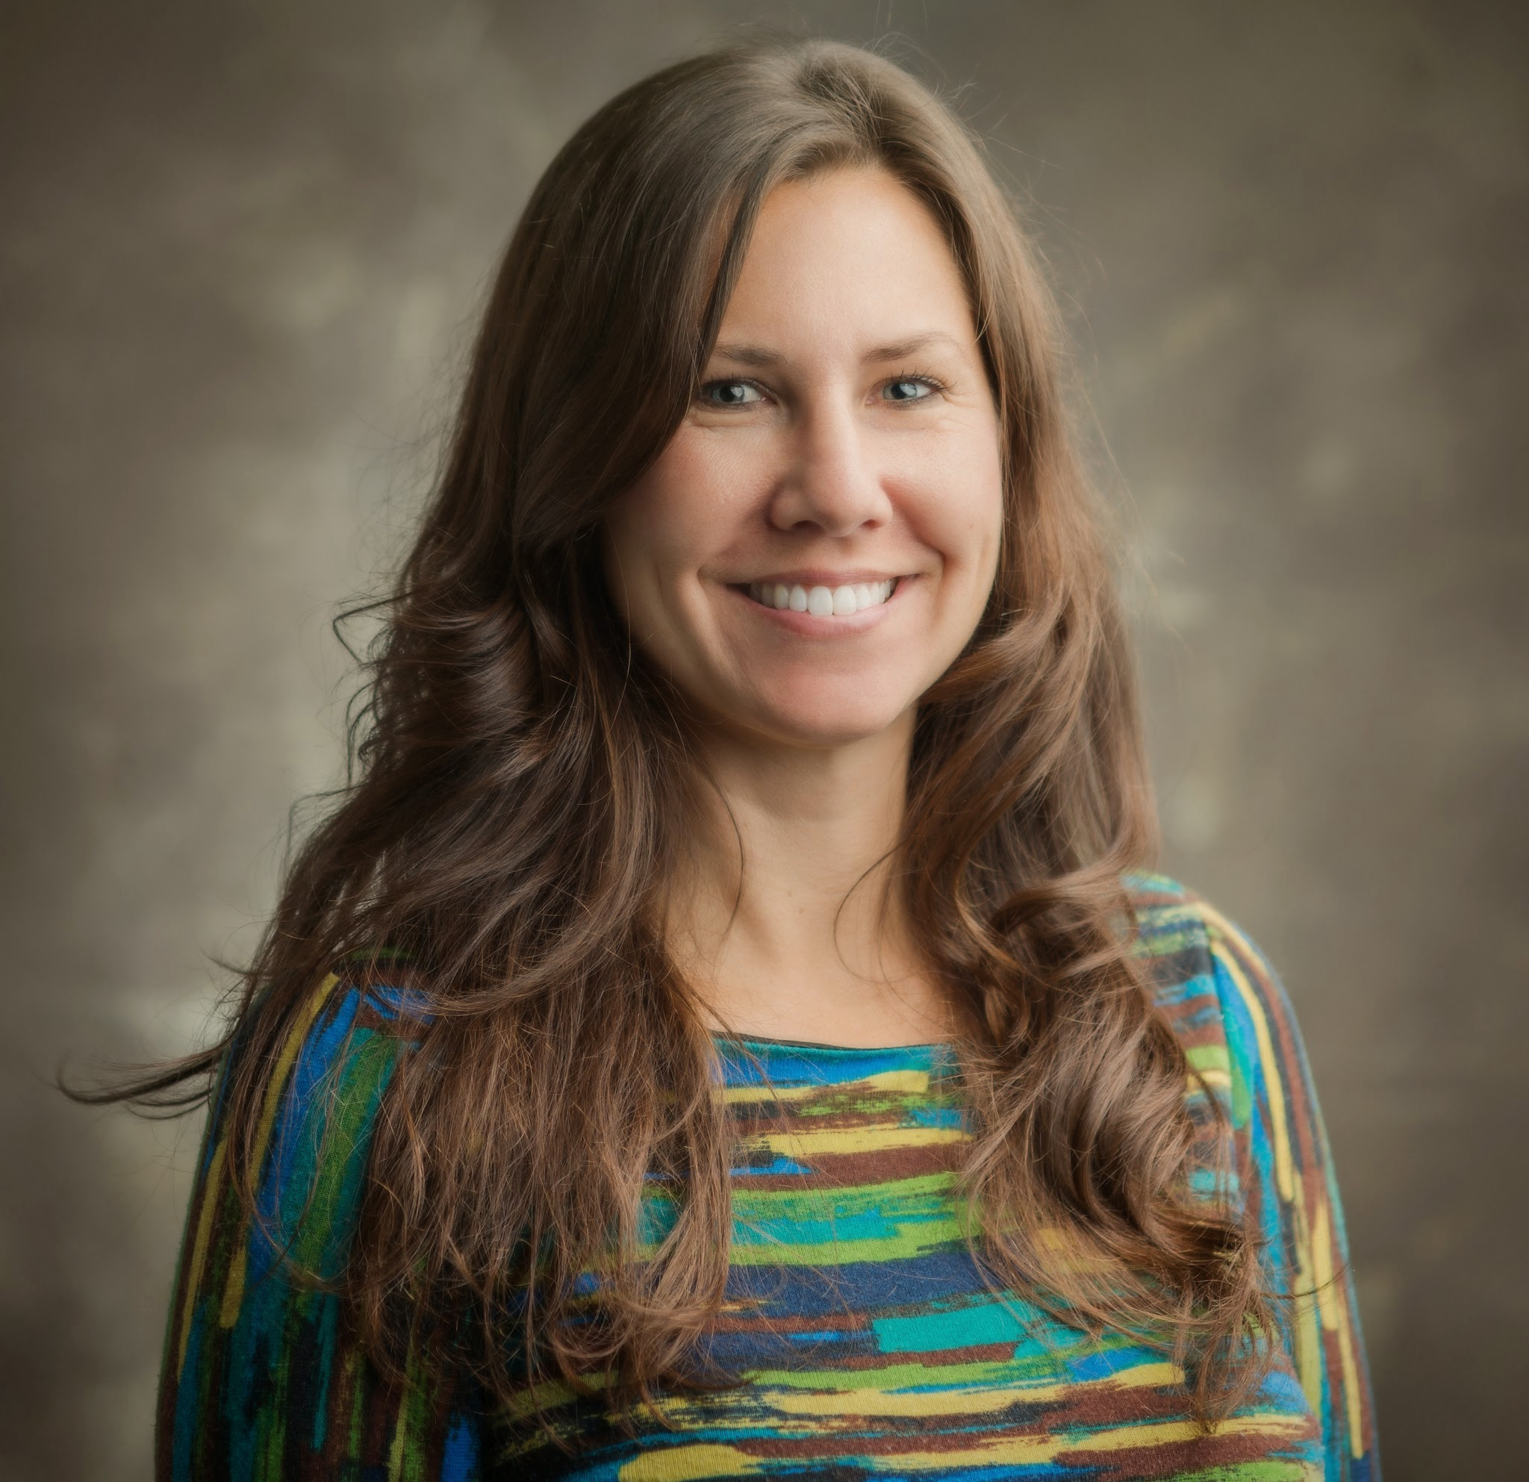
About Us
Arlene Mendoza-Moran
Lead Instructional Technologist
Digital Education and Learning Technology Applications (DELTA)
Dr. Shweta Trivedi
Professor and VetPAC Director
Department of Animal Science
College of Agriculture and Life Sciences
Bethanne Winzeler
Assistant Director of Course Quality
Digital Education and Learning Technology Applications (DELTA)

Slide 3
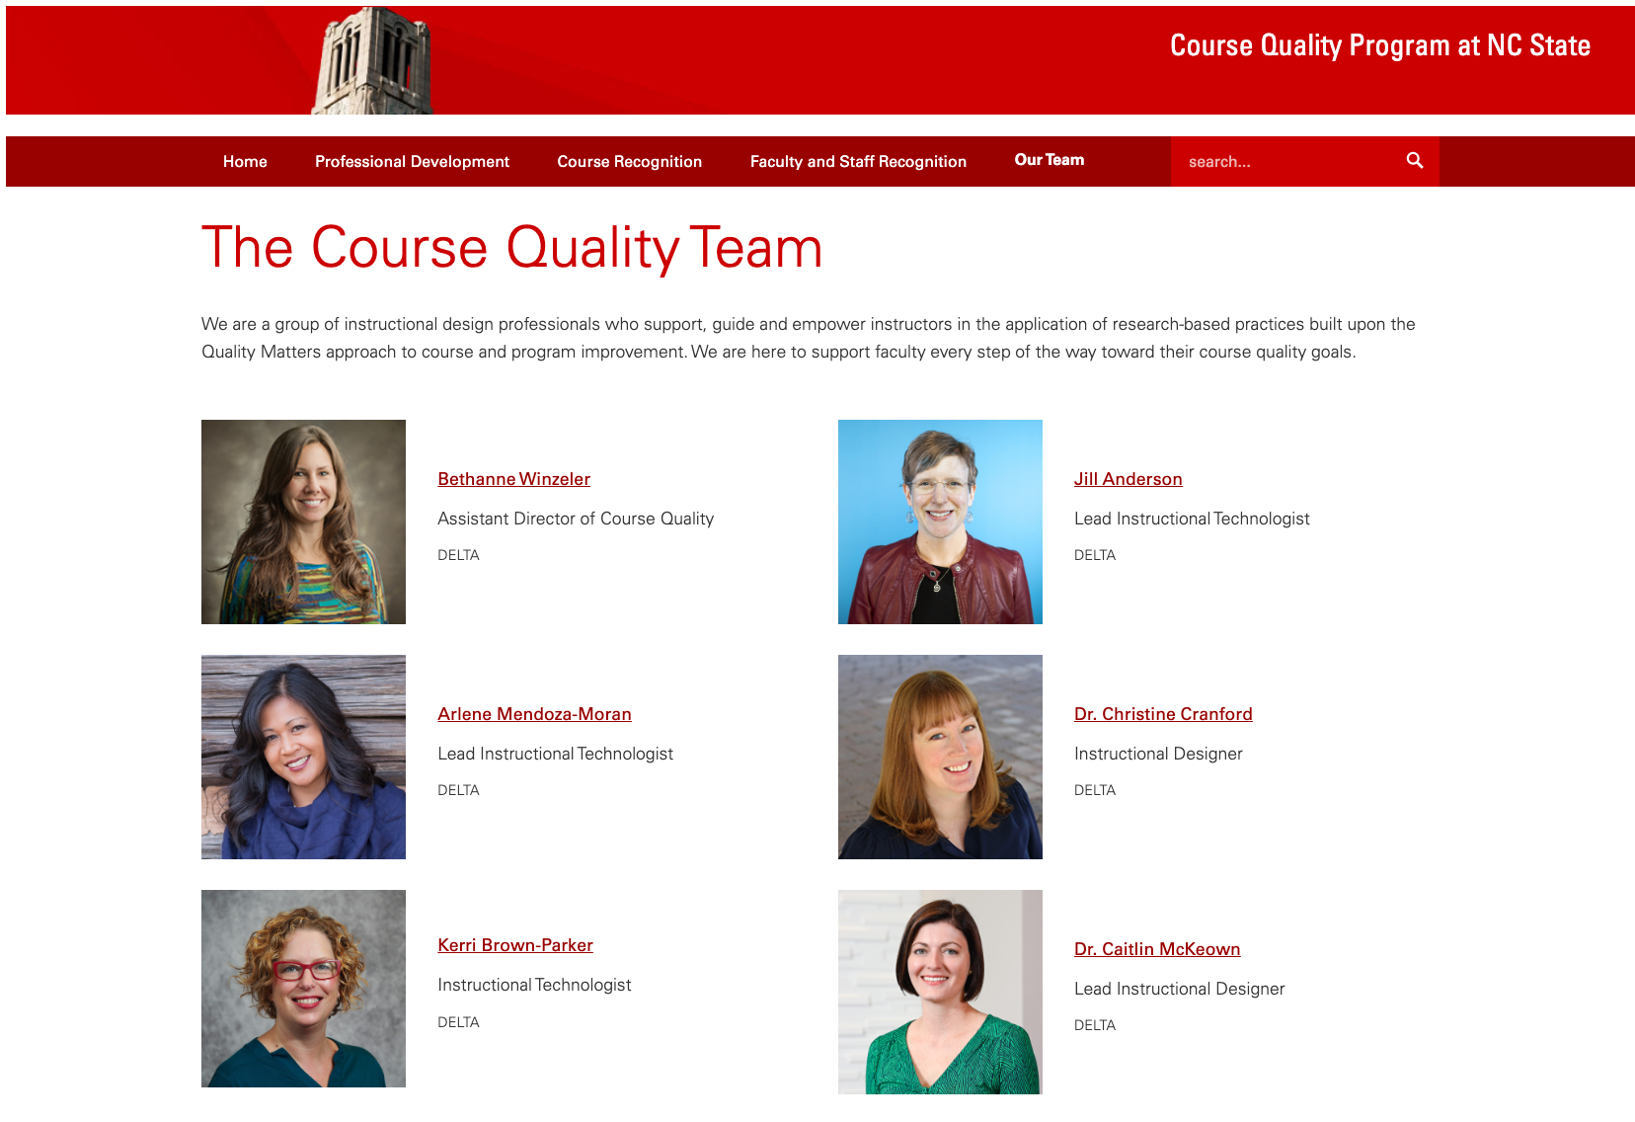
Our Team

Slide 4
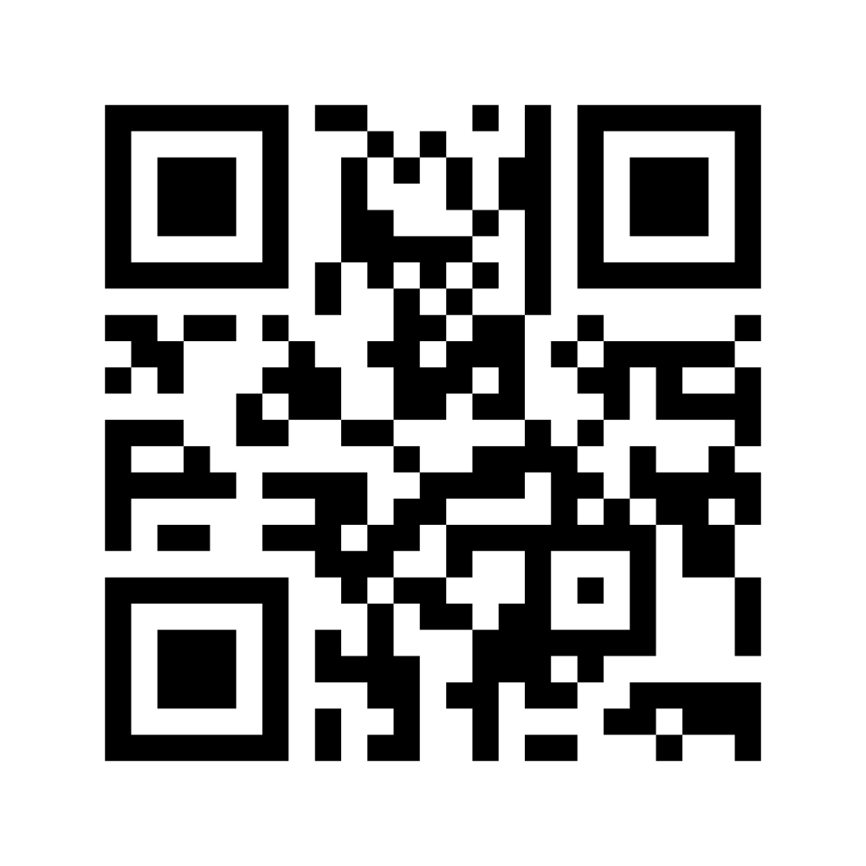
Poll #1:
Who’s in the Room?
Scan the code or go to the URL:
menti.com/c5prxnvurc
Notes:
Mentimeter multiple choice questions:
What is your position or role at your institution? (Select one or more)
Faculty/Instructor
Instructional Support/Design
Administration
Other
What is your level of QM experience? (Select one)
Newbie (0-1 year)
Beginner (2-3 years)
Familiar (4-5 years)
Experienced (6-8 years)
Expert (9+ years)

Slide 5
Learning Objectives
Identify components of a quality assurance plan for increasing QM impact
1
Discuss goals for creating QM-based professional development
2
Develop an action plan for professional development goals
3

Slide 6

What’s in a
Five-Year-Plan
For Course Quality Assurance?
Belltower image credit: Roger W Winstead
Notes:
go.ncsu.edu/cq5yearplan

Slide 7





5-Year-Plan Components
Impact
Milestones
Description
Budget
Resources

Slide 8
Project Description
Justification
Goals
Deliverables
Project success

Slide 9
Projected Impact
Professional development enrollments
QM Certified courses

Slide 10
Resources
Staff and faculty
Tools and resources
Professional development

Slide 11
Budget
QM professional development and materials fees
QM course review fees
Faculty stipends

Slide 12
Milestones
Creation of digital resources
Delivery of professional development
Course preparation and certification
Evaluation of impacts

Slide 13
Outcomes
Years 1-5
Belltower image credit: Roger W Winstead

Slide 14
Year 1
Launch of semester-long course improvement program to help faculty prepare for QM review.
Number | Success measure
9 | QM professional development completions by faculty and staff
1 | Certified course
125 | Students enrolled annually in a QM-certified or recognized course
2017-2018

Slide 15
Year 2
Certification of APPQMR facilitators and Peer Reviewer training for staff.
Number | Success measure
53 | QM professional development completions by faculty and staff
12 | Certified courses
1,212 | Students enrolled annually in a QM-certified or recognized course
2018-2019
2017-2018

Slide 16
Year 3
Launch of second professional development course for QM essentials. Create internal review process.
2019-2020
Number | Success measure
121 | QM professional development completions by faculty and staff
21 | Certified courses
2,886 | Students enrolled annually in a QM-certified or recognized course
2018-2019
2017-2018

Slide 17
Year 4
Creation of more pathways for instructors with limited experience. Begin Teaching Online Certification (TOC) cohort training.
2020-2021
2019-2020
Number | Success measure
238 | QM professional development completions by faculty and staff
38 | Certified courses
5,040 | Students enrolled annually in a QM-certified or recognized course
2018-2019
2017-2018

Slide 18
Year 5
2021-2022
Develop short, asynchronous, just-in-time training modules based on the eight QM General Standards.
2020-2021
2019-2020
Number | Success measure
356 | QM professional development completions by faculty and staff
54 | Certified courses
9,619 | Students enrolled annually in a QM-certified or recognized course
2018-2019
2017-2018

Slide 19
Designing QM-based professional development
Belltower image credit: Roger W Winstead

Slide 20
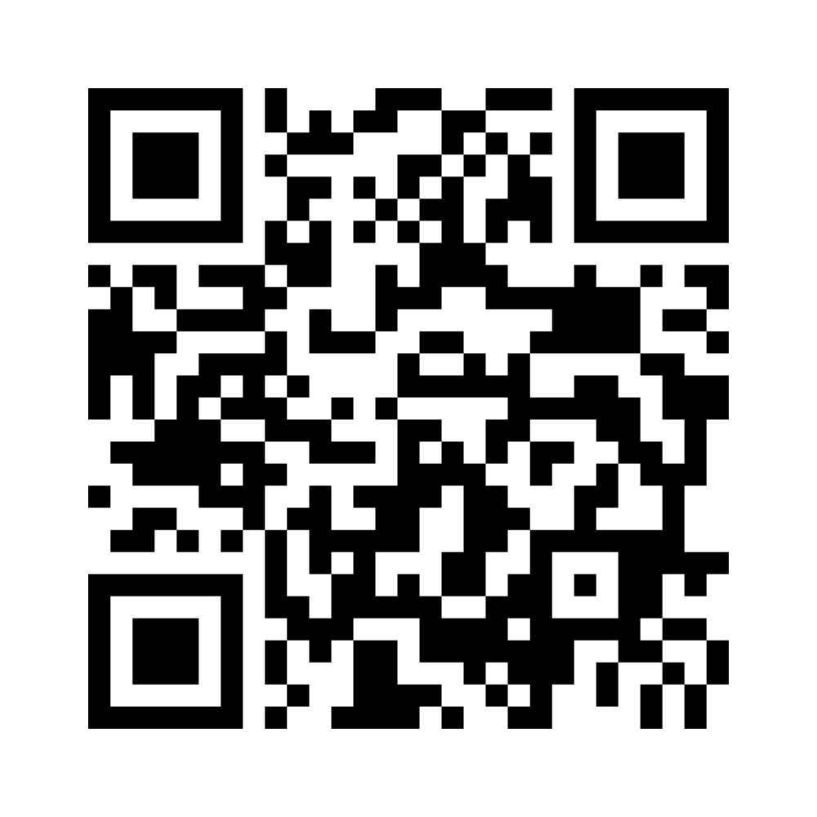
Poll #2:
Course prep methods
Scan the code or go to the URL:
menti.com/albpky21wp1j

Slide 21
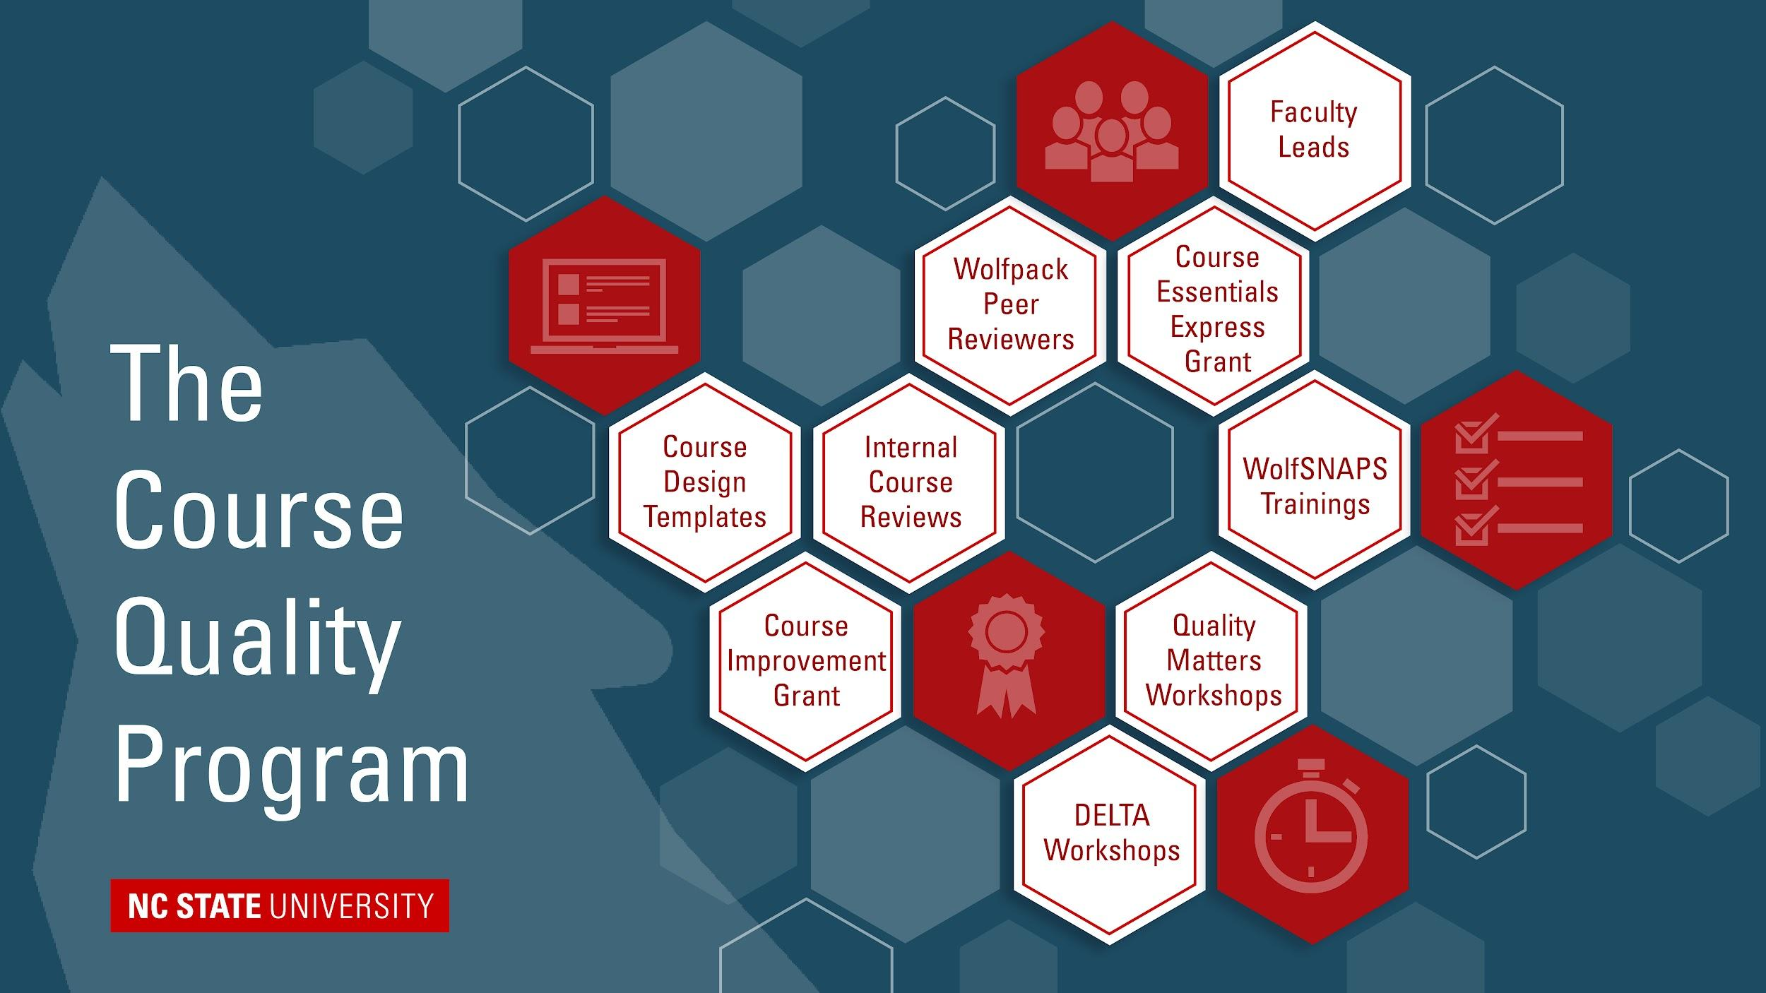
The Course Quality Program at NC State
Professional Development and Resources
Course Design Templates
Course Improvement Grant
Internalt Course Reviews
Wolfpack Peer Reviewers
Course Essentials Express Grant
Faculty Leads
WolfSNAPS Trainings
Quality Matters Workshops
DELTA Workshops

Slide 22


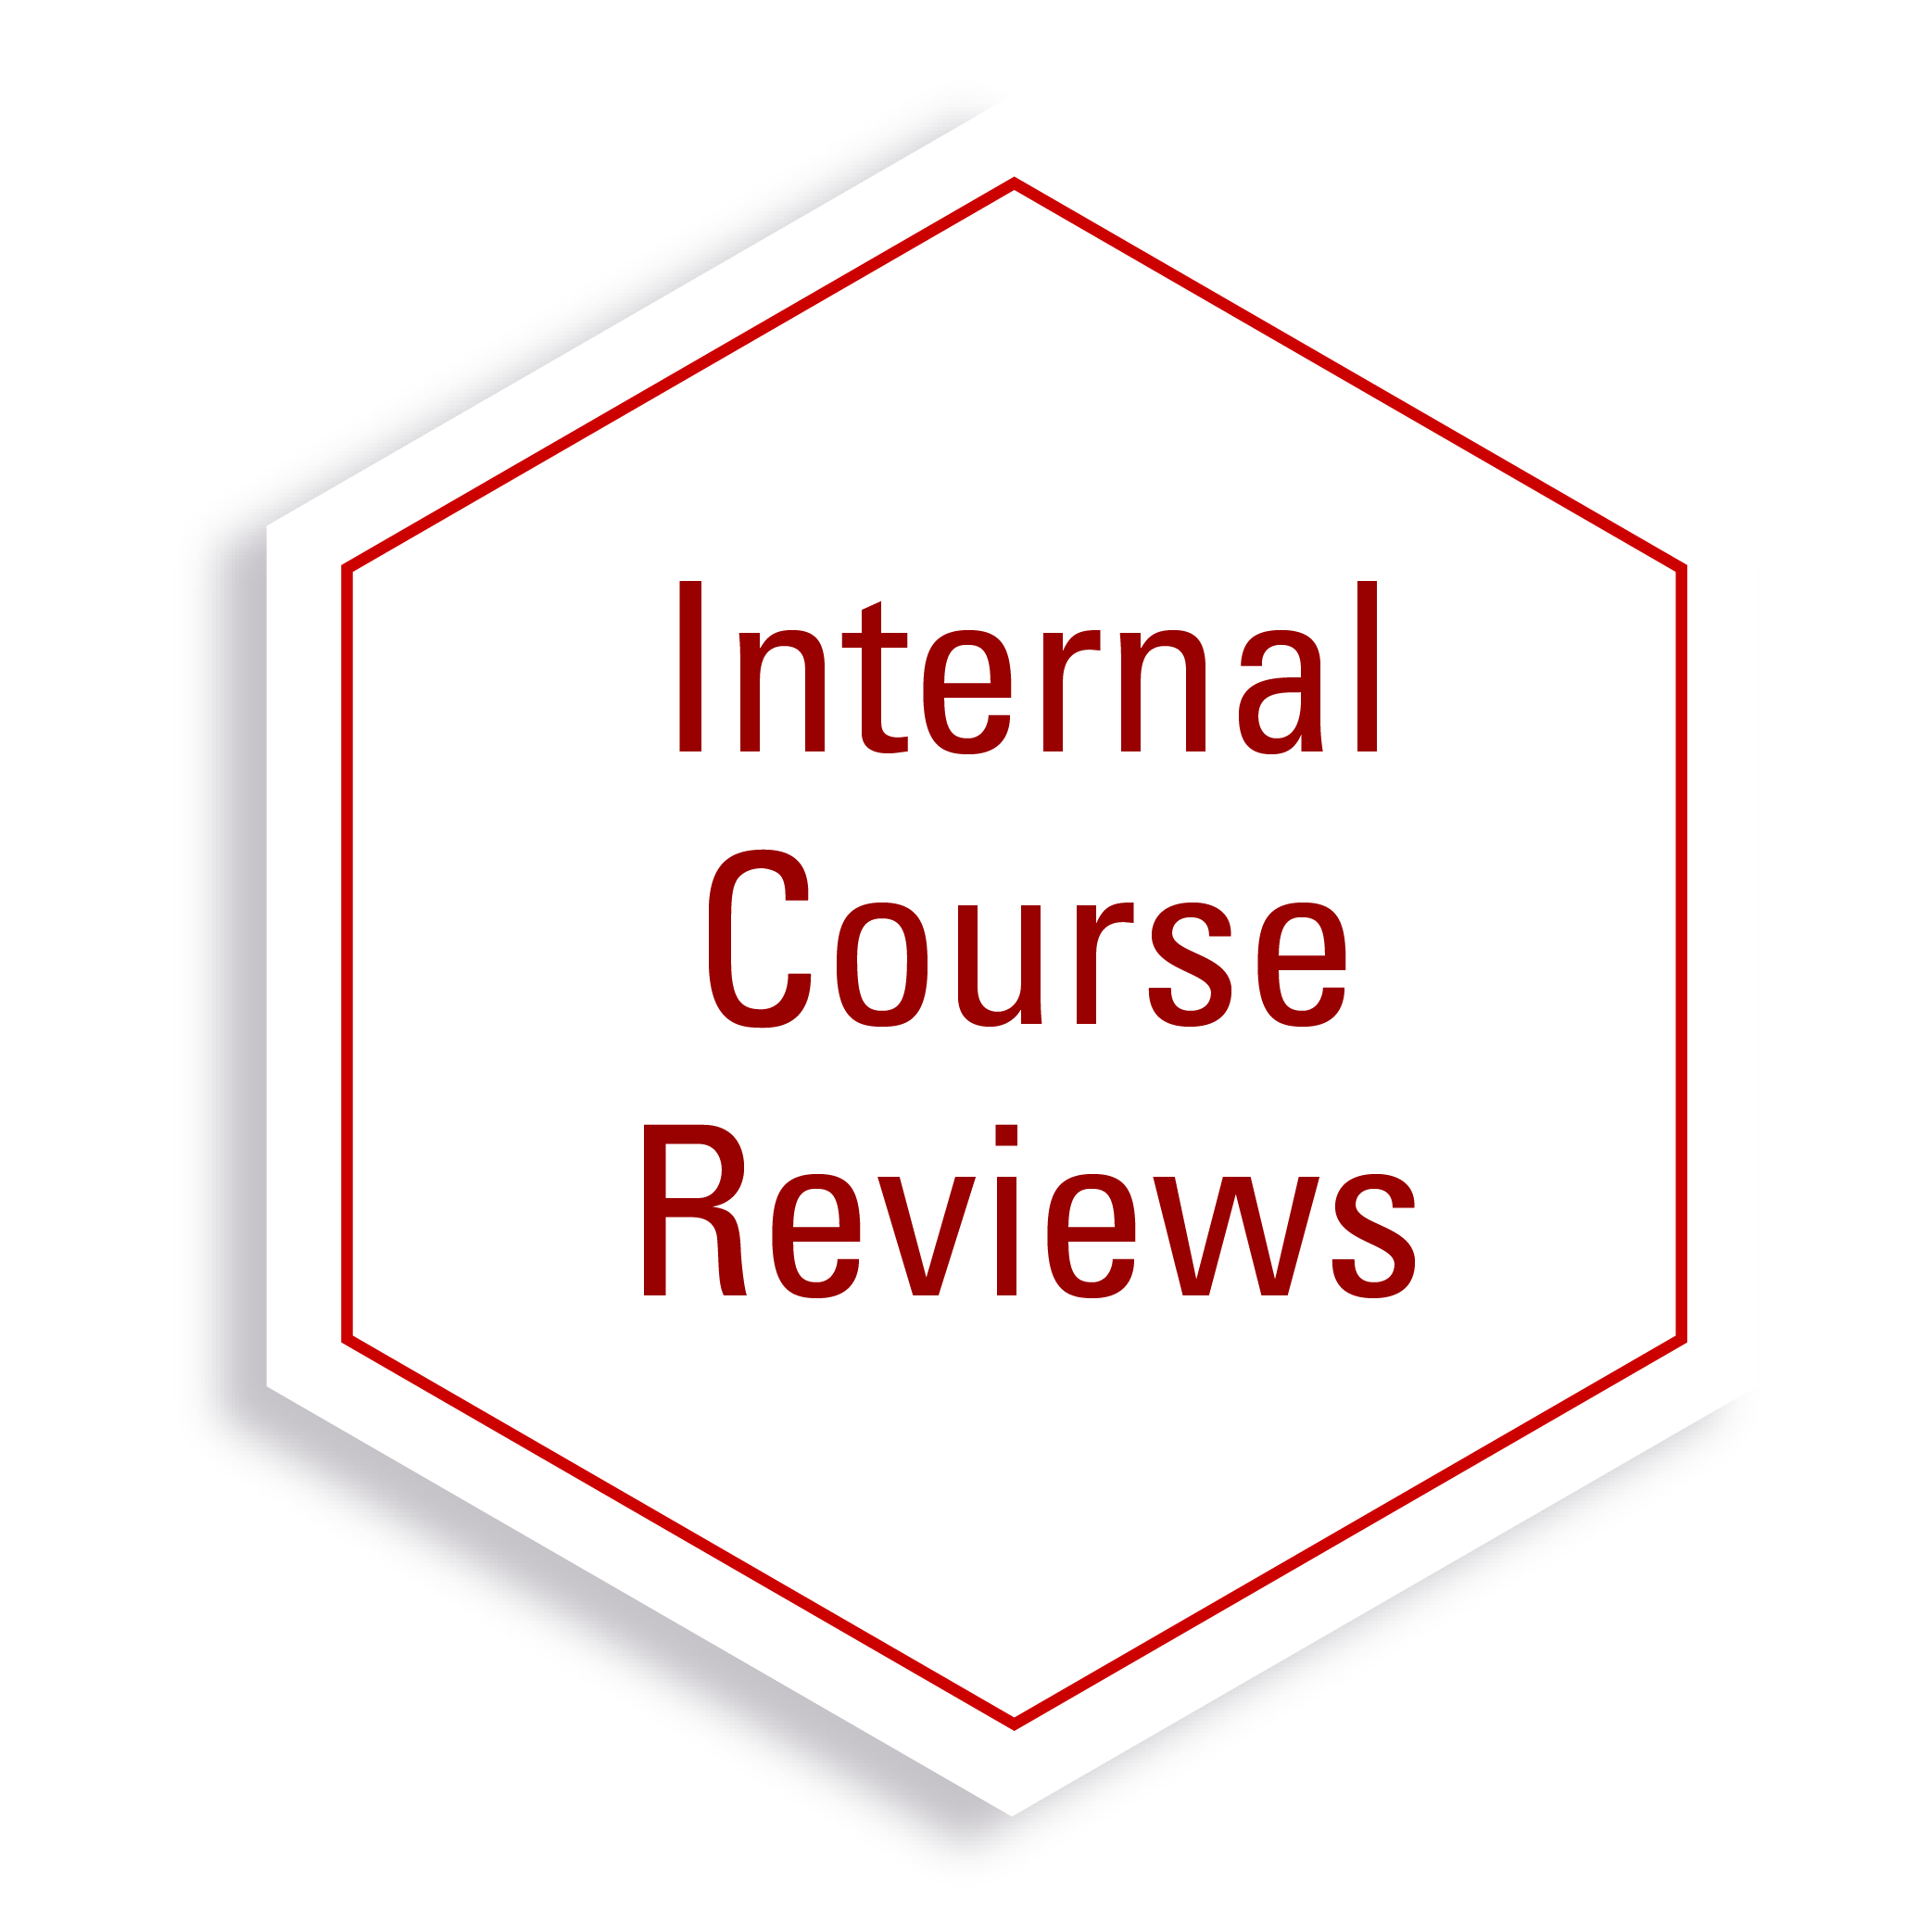
Faculty Participation in Quality Matters
2020
2020
2021

Slide 23

Professional Development through Quality Matters
Wolfpack Peer Reviewer
Manuscript and Abstracts
Course Quality
Research Fellow
2021-2022
2021
2022
2022-23

Slide 24
Considerations for designing QM-based professional development
Course design experience
Very little
A lot
Course improvement goal
Awareness
QM Review
Feedback
Self-
Checks
Self, Peer & Staff
Staff load
Low
High

Slide 25

Course Improvement Grant
Experience
Very little
A lot
Goal
Awareness
QM Review
Feedback
All QM standards
September-April
Cohort model
Blended delivery
Self-check
Self, Peer & Staff
Staff load
Low
High

Slide 26
Course Essentials Express Grant
Experience
Very little
A lot
Goal
Awareness
QM Review
Feedback
Essential standards
January-June
Individual
Asynchronous delivery
Self-check
Self, Peer & Staff
Staff load
Low
High

Slide 27

WolfSNAPS Trainings
Experience
Very little
A lot
Goal
Awareness
QM Review
General QM standards
Eight modules, 30-90 minutes each
Self-paced course delivery
Feedback
Self-check
Self, Peer & Staff
Staff load
Low
High

Slide 28

Planning QM-based Professional Development
On the worksheet, select some parameters for professional development.
Brainstorm ideas for designing training or resources to fit your goals.
Select a spokesperson to share one idea out loud.

Slide 29

Share out
Scan the code or go to the URL:
go.ncsu.edu/scaleup-handout

Slide 30
Questions?
The Course Quality Program
at NC State University
go.ncsu.edu/course-quality
Arlene Mendoza-Moran
ajmendoz [at] ncsu.edu
Shweta
Trivedi
strived [at] ncsu.edu
Bethanne
Winzeler
bwtobey [at] ncsu.edu

